Slide 1
Acute abdomen
Omar alobaid

Slide 2
Acute abdomen
Commonest cause of emergency surgical admission
Challenging disease varieties
Ranging from simple to life threatening diseases

Slide 3
Acute abdomen
The primary symptom is abdominal pain

Slide 4
assesment
A full history is a key
Complete physical exam
Needs different investigations

Slide 5
Types of abdominal pain
Visceral
Parietal
referred

Slide 6
Acute abdominal pain
Two approaches
systems
Abdominal tomography (4 quadrants)

Slide 12
Bowel obstruction
Small bowel VS large bowel obstruction
Adhesions are the commonest cause
In a virgin abdomen: don’t let the sun set on a bowel obstruction!

Slide 26
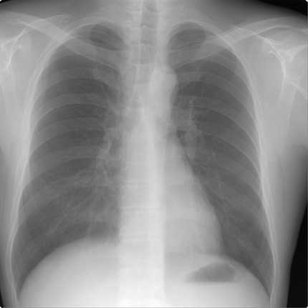

Slide 27
