Slide 1
Shock
Ahmed Alburakan, MD, MSc, FRCSC, FRCPC
Assistant professor & consultant
Trauma surgery & Critical care
King Saud University

Slide 2
Shock
What is Shock?

Slide 3
Shock
Inadequate oxygen delivery to meet metabolic demand.
Results in global tissue hypoperfusion and metabolic acidosis
Shock can occur with a normal blood pressure, and hypotension can occur without shock

Slide 4
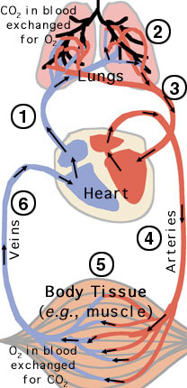
Shock
Oxygen delivery is the function of the circulatory system.
This system is basically:
- Pump (heart)
- Pipes (vessels)
- Solution (blood)
Needs to function at adequate pressure, volume and carrying capacity.

Slide 5
Understanding Shock
Inadequate systemic oxygen delivery activates autonomic responses to maintain systemic oxygen delivery
Sympathetic nervous system
NE, epinephrine, dopamine, and cortisol release
Causes vasoconstriction, increase in HR, and increase of cardiac contractility (cardiac output)
Renin-angiotensin axis
Water and sodium conservation and vasoconstriction
Increase in blood volume and blood pressure

Slide 6
Understanding Shock
Cellular responses to decreased systemic oxygen delivery
ATP depletion → ion pump dysfunction
Cellular edema
Hydrolysis of cellular membranes and cellular death
The body tries to maintain cerebral and cardiac perfusion
Vasoconstriction of splanchnic, musculoskeletal, and renal blood flow
Global cellular reliance on anerobic glycolysis and increased lactate production.
Systemic metabolic lactic acidosis

Slide 7
Multiorgan Dysfunction Syndrome (MODS)
Progression of physiologic effects as shock ensues
Cardiac depression
Respiratory distress
Renal failure
DIC
Result is end organ failure

Slide 8
Types Of Shock
Low Cardiac Output states
Hypovolemic shock (↓↓ solution)
bleeding
Dehydration
Cardiogenic shock (↓↓ pump)
Impaired inflow
Primary pump dysfunction
Impaired outflow
Low peripheral resistance states (↑↑pipes)
Neurogenic shock
Loss of sympathetic tone
Vasogenic Shock
Septic
Anaphylactic

Slide 9
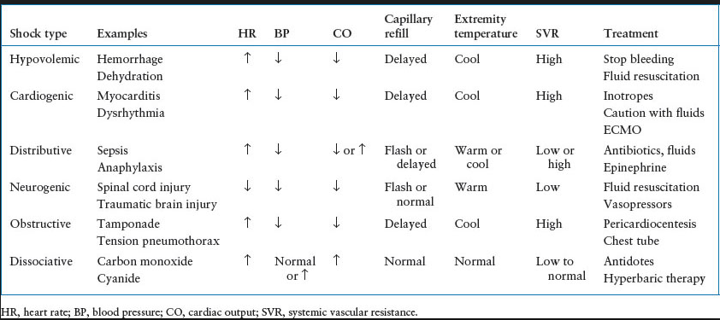
Types Of Shock

Slide 10
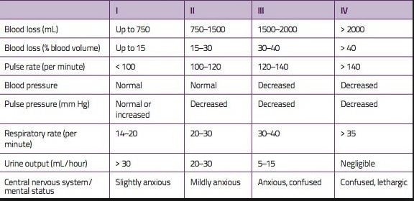
Classes of Hypovolemic Shock

Slide 11
Treatment of Shock
Goal: Restore perfusion
Method: Depends on type of Shock
Reverse the cause.

Slide 12
End Points of Resuscitation in Shock management
Normal vital signs ( can be misleading)
Normal serum lactate levels
Evidence of adequate tissue perfusion!!
- normal mental status.
- normal urine output.
- normal liver function.
etc.

Slide 13
What Type of Shock is This?
68 yo M with hx of HTN and DM presents to the ER with abrupt onset of diffuse abdominal pain with radiation to his low back. The pt is hypotensive, tachycardic, afebrile, with cool but dry skin.

Slide 14
What Type of Shock is This?
68M with hx of HTN and DM presents to the ER with abrupt onset of diffuse abdominal pain with radiation to his low back. The pt is hypotensive, tachycardic, afebrile, with cool but dry skin.
Hypovolemic shock

Slide 15
Hypovolemic Shock Management
ABCs
Establish 2 large bore IVs or a central line
Crystalloids
Normal Saline or Lactate Ringers
PRBCs
O negative or cross matched
Control any bleeding
Arrange definitive treatment

Slide 16
Evaluation of Hypovolemic Shock
CBC
ABG/lactate
Electrolytes
BUN, Creatinine
Coagulation studies
Type and cross-match
As indicated
CXR
Pelvic x-ray
Abd/pelvis CT
Chest CT
GI endoscopy
Bronchoscopy
Vascular radiology

Slide 17
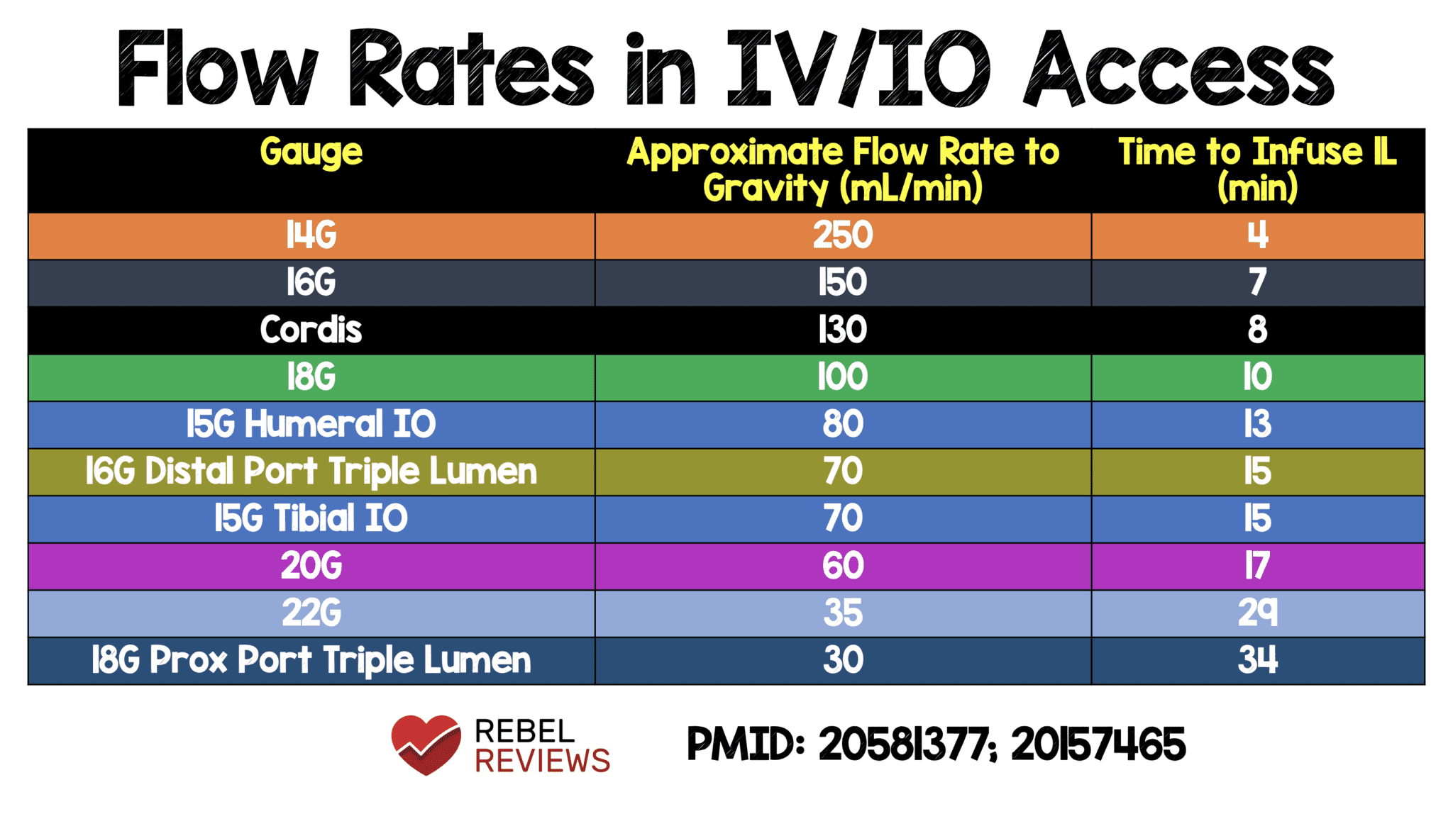
IV Resuscitation

Slide 18
What Type of Shock is This?
A 34F presents to the ER after dining at a restaurant where shortly after eating the first few bites of her meal, became anxious, diaphoretic, began wheezing, noted diffuse pruritic rash, nausea, and a sensation of her “throat closing off”. She is currently hypotensive, tachycardic and ill appearing.

Slide 19
What Type of Shock is This?
A 34F presents to the ER after dining at a restaurant where shortly after eating the first few bites of her meal, became anxious, diaphoretic, began wheezing, noted diffuse pruritic rash, nausea, and a sensation of her “throat closing off”. She is currently hypotensive, tachycardic and ill appearing.
Anaphylactic

Slide 20
Anaphylactic Shock- Diagnosis
Clinical diagnosis
Defined by airway compromise, hypotension, or involvement of cutaneous, respiratory, or GI systems
Look for exposure to drug, food, or insect
Labs have no role

Slide 21
Anaphylactic Shock- Treatment
ABC’s
Angioedema and respiratory compromise require immediate intubation
IV, cardiac monitor, pulse oximetry
IVFs, oxygen
Epinephrine
Second line
Corticosteriods
H1 and H2 blockers
Notes:
Epi – the single most important step in treatment

Slide 22
What Type of Shock is This?
A 73 year old lady with a history of ischemic heard disease, HTN, DM II presents to the ED with altered mental status. She is febrile to 39.4, hypotensive with a widened pulse pressure, tachycardic, with warm extremities and decreased urine output.

Slide 23
Treatment of Septic Shock
2 large bore IVs, fluid resus.
Supplemental oxygen
Broad spectrum IV antibiotics, based on suspected source, as soon as possible.
Goal directed therapy.

Slide 24
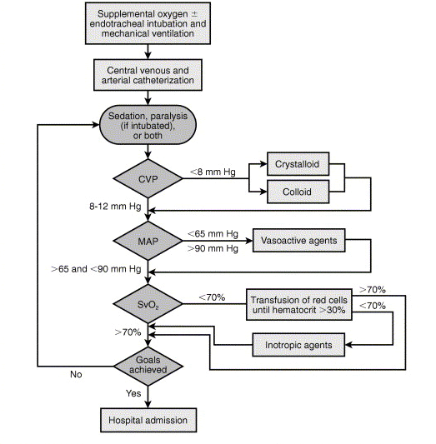
Treatment Algorithm
Rivers E et al. Early goal-directed therapy in the treatment of severe sepsis and septic shock N Engl J Med. 2001:345:1368-1377.

Slide 25
Summary
Shock is inadequate tissue oxygenation.
Can be a result of a variety of conditions.
First step in management is to detect patients in shock.
Management is mainly reversing the cause, while supporting vital functions in the meantime.
If left untreated, will lead to death.

Slide 26
??

