Slide 1
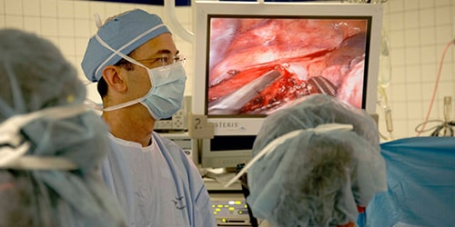
Esophageal Diseases
Dr.Saleh Alnasser MD MSc FRCS(C)
Consultant Thoracic Surgery
King Saud University

Slide 2
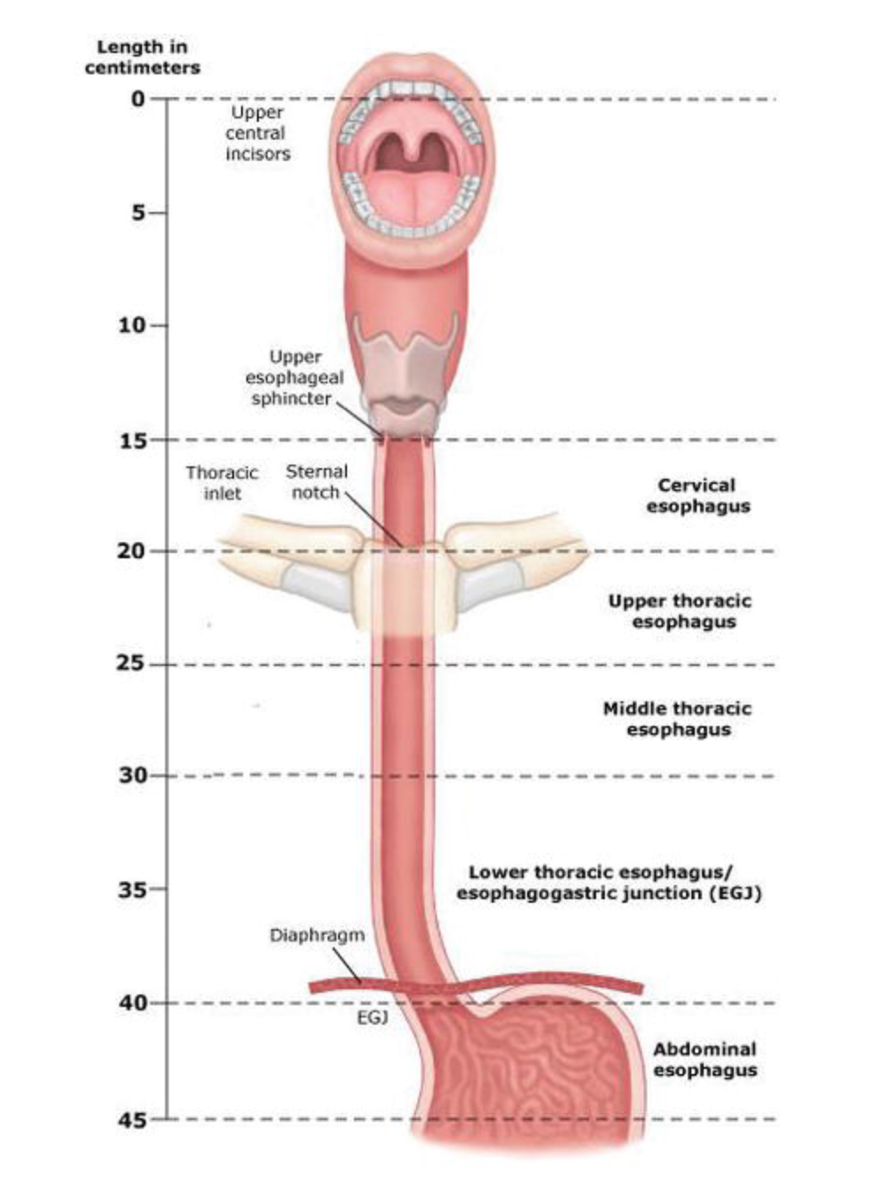
Surgical Anatomy
Fibromuscular tube ( 25cm) long.
Posterior mediastinum.
4cm of esophagus below
the diaphragm.
Lined by squamous
epithelium.

Slide 3
Esophageal Diseases
Benign:
Esophageal motility disorder
Esophageal diverticula
Benign esophageal tumors
GERD and Hiatus Hernia
Esophageal perforation
Caustic Injury
Esophageal cancer
Malignant ➔ Esophageal cancer

Slide 4
GASTROESOPHAGEAL REFLUX DISEASE (GERD)
LES has primary role of preventing reflux of the gastric contents into the esophagus.
When LES has too low pressure to prevent the reflux of gastric contents from entering the esophagus ➔ GERD.

Slide 6
GASTROESOPHAGEAL REFLUX DISEASE
GERD is often associated with a hiatal hernia

Slide 7
GASTROESOPHAGEAL REFLUX DISEASE
Definition :
Symptoms OR mucosal damage produced by the abnormal reflux of gastric contents into the esophagus
Often chronic and relapsing
May see complications of GERD in patients who lack typical symptoms

Slide 8
GASTROESOPHAGEAL REFLUX DISEASE
Epidemiology :
About 44% of the US adult population have heartburn at least once a month
14% of Americans have symptoms weekly
7% have symptoms daily

Slide 9
Clinical Presentations of GERD
Classic GERD
Extra esophageal/Atypical GERD
Complicated GERD

Slide 10
Clinical Presentations of GERD
Classic GERD:
Substernal burning and or regurgitation
Postprandial pain
Aggravated by change of position
Prompt relief by antacid

Slide 11
Extra-esophageal Manifestations of GERD
Pulmonary
Asthma
Aspiration pneumonia
Chronic bronchitis
Pulmonary fibrosis
Other
Chest pain
Dental erosion
ENT
Hoarseness
Laryngitis
Pharyngitis
Chronic cough
Globus sensation
Dysphonia
Sinusitis
Subglottic stenosis
Laryngeal cancer

Slide 12
Diagnostic Tests for GERD
Barium swallow
Endoscopy
Ambulatory pH monitoring
Esophageal manometry

Slide 13
Clinical Presentations of GERD
Symptoms of Complicated GERD :
Dysphagia
Difficulty swallowing: food sticks or hangs up
Odynophagia
Retrosternal pain with swallowing
Bleeding

Slide 14
Treatment
Lifestyle Modifications
Acid Suppression Therapy
Anti-Reflux Surgery
Endoscopic GERD Therapy

Slide 15
Treatment
Lifestyle Modifications
Elevate head of bed 4-6 inches
Avoid eating within 2-3 hours of bedtime
Lose weight if overweight
Stop smoking
Modify diet
Eat more frequent but smaller meals
Avoid fatty/fried food, peppermint, chocolate, alcohol, carbonated beverages, coffee and tea
OTC medications prn

Slide 16
Acid Suppression Therapy for GERD
H₂-Receptor Antagonists
(H₂RAs)
Cimetidine (Tagamet®)
Ranitidine (Zantac®)
Famotidine (Pepcid®)
Nizatidine (Axid®)
Proton Pump Inhibitors
(PPIs)
Omeprazole (Prilosec®)
Lansoprazole (Prevacid®)
Rabeprazole (Aciphex®)
Pantoprazole (Protonix®)
Esomeprazole (Nexium ®)

Slide 17
Indication for Surgery:
Failed medical therapy.
Patient desire.
Complications of GERD (e.g. Barrett's esophagus; grade III or IV esophagitis).
Medical complications attributable to a large hiatal hernia. (e.g. bleeding, dysphagia).
”Atypical" symptoms and reflux documented on 24 hour pH monitoring

Slide 18
Endoscopic GERD Therapy
Stretta procedure radiofrequency heating of GE junction
Endoscopic plication TIF
Enteryx

Slide 19
Surgical treatment
Fundoplication
LINX®
EndoStim

Slide 21
Achalasia
An uncommon disease of esophageal motility disorder.
It is characterized by degeneration of the myenteric neurons that innervate LES and esophageal body
Pathogenesis:
Primary vs. secondary

Slide 22
Primary:
autoimmune ?
Viral ?
Gentics ?
Secondary:
Chagas' disease is a parasitic infection caused by Trypanosoma cruzi which can cause secondary achalasia

Slide 23
Pseudoachalasia
The most concerning secondary etiology is cancer ➔which can present as achalasia through mechanical obstruction of the GEJ.

Slide 25
Clinical features
2 peaks. Age of 20s and 60s
Equal male-to-female distribution.
-Dysphagia:
Most common presenting symptom.
Both liquids and solids

Slide 26
Clinical features
-Regurgitation:
second most common symptom
occurring in 60% of patients.
Nocturnal regurgitation lead to night time cough and aspiration.

Slide 27
Clinical features
- Chest pain : 20% to 60% of patients.
- Heartburn : 30% of Achalasia patients).
may be related to direct irritation of the esophageal lining by retained content , or acidic by-products of bacterial metabolism of retained food.

Slide 28
Diagnosis
CXR may show air-fluid level.
Barium swallow quite dilated, and an air-fluid level.
The classic finding is a gradual tapering at the end of the Esophagus, similar to a bird's beak.

Slide 30
Upper endoscopy:
Role out other causes of dysphagia.
Dilated esophagus with retained food particles.

Slide 32
Esophageal manometry
Aperistalsis of the esophageal body.
Incomplete or absent LES relaxation with swallowing.
Hypertensive LES.

Slide 33
Diagnosis
Manometric variants of achalasia exist
The best known is vigorous achalasia
defined by the presence of normal to high amplitude esophageal body contractions in the presence of a non-relaxing LES
Manometric variants of achalasia exist
vigorous achalasia may represent an early stage of achalasia

Slide 34
Treatment
Goal of treatment is Symptom relief.
Treatment options:
Medical therapy
Botulinum toxin injection
Pneumatic dilation
Surgical myotomy

Slide 35
Pharmacological Therapy
Decrease the LES pressure by causing smooth muscle relaxation.
Inconvenient as they are :
Partially effective.
frequently associated with side effects.
It is reserved for patients who are awaiting or unable to tolerate more invasive treatment modalities

Slide 36
Nitrates were first recognized as an effective treatment of achalasia
their systemic vasodilatory effects and headaches limit their tolerability by patients
Calcium channel blockers have a better side-effect profile when compared with nitrates
30% of patients report adverse side effects including peripheral edema, hypotension, and headache.

Slide 37
Botulinum Toxin

Slide 38
Reserved for use in patients:
- Not candidates for more invasive treatments.
- Refuse surgical intervention.
Efficacy up to 6-12 months

Slide 39
Pneumatic Dilation
A balloon is insufflated at the level of the gastroesophageal junction to rupture the muscle fibre.
Success rate 70-80%.
50% will require more than 1 dilation session.
Complications of pneumatic dilation exist
- Gastroesophageal reflux 25-35%
- Esophageal perforation 3 %

Slide 40
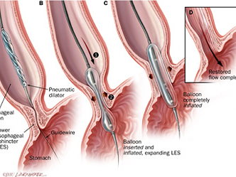

Slide 41
Surgical Therapy
Has success rates in excess of 90%.
Acid exposure is a known complication of surgical intervention for achalasia.

Slide 42
Surgical Therapy
Laparoscopic Heller's myotomy demonstrated excellent results, with 98% of patients reporting symptomatic improvement.

Slide 43
Complications of Achalasia
The primary complications of achalasia are related to the functional obstruction ➔ progressive malnutrition and aspiration.
Uncommon but important secondary complications of achalasia include:
Epiphrenic diverticula.
Esophageal squamous cell carcinoma.

Slide 44
Esophageal Diverticula
The three most common sites of occurrence are:
Pharyngoesophageal (Zenker’s).
Parabronchial (midesophageal).
Epiphrenic.

Slide 45
Esophageal Diverticula
True diverticula involve all layers of the esophageal wall, including mucosa, sub-mucosa, and muscularis.
False diverticulum consists of mucosa and submucosa only.

Slide 46
Esophageal Diverticula
False (Pulsion) diverticula:
Zenker's diverticulum
Epiphrenic diverticulum
True (Traction) diverticula :
external inflammatory mediastinal lymph nodes adhering to the esophagus

Slide 47
Is the most common esophageal diverticulum found today.
Disease of elderly (7th decade of life).
Pharyngoesophageal (Zenker’s)
Diverticulum
Herniation at Killian's triangle between:
Oblique fibers of the thyro-pharyngeus muscle
Horizontal fibers of the crico-pharyngeus muscle.

Slide 49
Symptoms and Diagnosis
Commonly, patients complain of a sticking in the throat.
Nagging cough, excessive salivation, and intermittent dysphagia often are signs of progressive disease.
As the sac increases in size, regurgitation of foul-smelling, undigested material is common

Slide 50
Symptoms and Diagnosis
Halitosis, voice changes, retro-sternal pain, and respiratory infections are especially common in the elderly population
The most serious complication from an untreated Zenker's diverticulum is aspiration pneumonia or lung abscess

Slide 51
Diagnosis
Diagnosis is made by barium esophagram.
Neither esophageal manometry nor endoscopy are needed to make a diagnosis of Zenker's diverticulum.

Slide 52
Treatment
Surgical or endoscopic repair of a is the gold standard of treatment.

Slide 53
Barrett's Esophagus
Squamous epithelium that normally lines the distal esophagus replaced by columnar epithelium.
Chronic gastro-esophageal reflux is the factor that both injures the squamous epithelium and promotes repair through columnar metaplasia

Slide 54
Barrett's Esophagus
Although these metaplastic cells may be more resistant to injury from reflux, they also are more prone to malignancy.
10 % of patients with GERD develop Barrett's esophagus.

Slide 55
Clinical significance
the 40-fold increase in risk for developing esophageal carcinoma in patients with Barrett's esophagus

Slide 56
Barrett's Esophagus
With continued exposure to the reflux disease, metaplastic cells undergo cellular transformation to low- and high-grade dysplasia.

Slide 57
Symptoms and Diagnosis
Many patients harboring intestinal metaplasia in their distal esophagus are asymptomatic.
Most patients present with symptoms of GERD.

Slide 58
Diagnosis
The diagnosis of BE is made by endoscopy and pathology.

Slide 59
Treatment
Yearly surveillance endoscopy is recommended in all patients with a diagnosis of Barrett's esophagus.
Patients undergoing surveillance are placed on acid suppression medication and monitored for changes in their reflux symptoms.

Slide 60
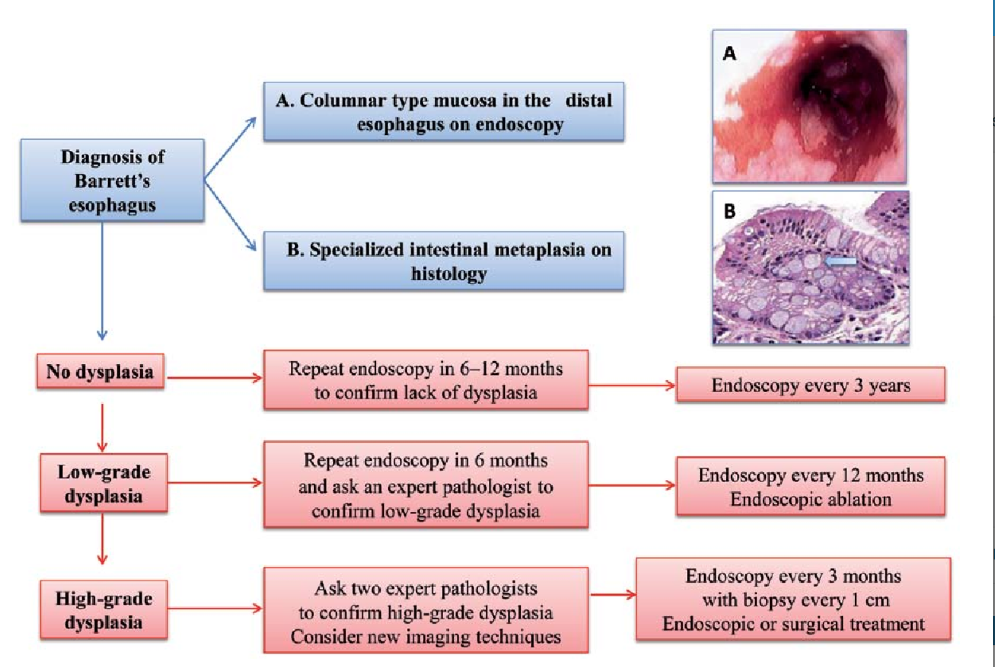

Slide 61
Treatment
The benefits of anti-reflux surgery in patients with Barrett's esophagus.
Surgery renders the LES competent and restores the barrier to reflux
Studies have demonstrated regression of metaplasia to normal mucosa up to 57% of the time in patients who have undergone antireflux surgery

Slide 62
Treatment
Esophageal resection for Barrett's esophagus is recommended only for patients in whom high-grade dysplasia is found
Pathologic data on surgical specimens demonstrate a 40% risk for adenocarcinoma within a focus of high-grade dysplasia

Slide 63
Caustic Injury
Best cure for this condition is prevention.
In children, ingestion of caustic materials is accidental and tends to be in small quantities.
In teenagers and adults, however, ingestion usually is suicide attempts, and much larger quantities of caustic liquids are consumed

Slide 64
Caustic Injury
Alkali ingestion is more common than acid ingestion because of its lack of immediate symptoms
Alkali ingestion are much more devastating and almost always lead to significant destruction of the esophagus

Slide 66
Symptoms and Diagnosis
1st Stage ➔ patients may complain of oral and substernal pain, hyper salivation, odynophagia and dysphagia, hematemesis, and vomiting.
2nd Stage ➔ these symptoms may disappear only to see dysphagia reappear as fibrosis and scarring begin to narrow the esophagus throughout stage three

Slide 67
Symptoms and Diagnosis
Symptoms of respiratory distress, such as hoarseness, stridor, and dyspnea, suggest upper airway edema and are usually worse with acid ingestion.
Pain in the back and chest may indicate a perforation of the mediastinal esophagus, whereas abdominal pain may indicate abdominal visceral perforation

Slide 68
Symptoms and Diagnosis
Diagnosis is initiated with a physical exam specifically evaluating the mouth, airway, chest, and abdomen
Careful inspection of the lips, palate, pharynx, and larynx is done
The abdomen is examined for signs of perforation

Slide 69
Symptoms and Diagnosis
Early endoscopy is recommended 12 to 24 hours after ingestion to identify the grade of the burn.
Serial chest and abdominal radiographs are indicated to follow patients with questionable chest and abdominal exams

Slide 71
Treatment
Management of the acute phase is aimed at limiting and identifying the extent of the injury.
It begins with neutralization of the ingested substance.
Alkalis (including lye) are neutralized with half-strength vinegar or citrus juice.

Slide 72
Treatment
Acids are neutralized with milk, egg whites, or antacids.
Emetics and sodium bicarbonate need to be avoided because they can increase the chance of perforation.

Slide 73
Treatment
First-Degree Burn :
48 hours of observation is indicated
Oral nutrition can be resumed when a patient can painlessly swallow saliva
A repeat endoscopy and barium esophago-gram are done in follow-up at intervals of 1, 2, and 8 months

Slide 74
Treatment
Second- and Third-Degree Burns :
Resuscitation is aggressively pursued
The patient is monitored in the intensive care unit
kept (NPO) with IV fluids. IV antibiotics and a proton pump inhibitor are started
Fiber optic intubation may be needed and must be available

Slide 75
Benign esophageal tumor

Slide 76
Benign Esophageal Tumors and Cysts
Benign tumors are rare (< 1 %)
Classified in two groups
Mucosal
Extramucosal (intramural)
More useful classification:
60% of benign neoplasms are leiomyomas
20% are cysts
5% are polyps
Others (< 2 percent)

Slide 77
Esophageal Cysts
Arise as diverticula of the embryonic foregut
¾ of this cyst present in childhood
60% are located along the right side of the esophagus
60% present in the first year of life with either respiratory or esophageal symptoms
Cyst found in the upper third of the esophagus present in infancy while lower third lesions present later in childhood

Slide 78
Pedunculated Intraluminal Tumors (Polyps)
Rare.
Occur in older men and may cause intermittent dysphagia
Easily missed with barium swallow and esophagoscopy

Slide 79
Leiomyoma
60% of all benign esophageal tumors.
Found in men slightly more than women
Present in the 4th and 5th decades
They are found in the distal two thirds of the esophagus more than 80% of the time

Slide 80
Leiomyoma
They are usually solitary and remain intramural, causing symptoms as they enlarge.
Recently, they have been classified as a gastrointestinal stromal tumor (GIST)
GIST tumors are the most common mesenchymal tumors of the gastrointestinal tract and can be benign or malignant

Slide 81
Leiomyoma
Nearly all GIST tumors occur from mutations of the c-KIT oncogene, which codes for the expression of c-KIT (CD117).
All leiomyomas are benign with malignant transformation being rare

Slide 82
Symptoms and Diagnosis
Many leiomyomas are asymptomatic.
Dysphagia and pain are the most common symptoms and can result from even the smallest tumors
Barium esophagram ➔ a leiomyoma has a characteristic appearance.

Slide 84
Leiomyoma
Endoscopy ➔
Extrinsic compression
Overlying mucosa is intact.
Endoscopic ultrasound (EUS) ➔ hypoechoic mass in the submucosa or muscularis propria

Slide 85
Treatment
Leiomyomas are slow-growing tumors with rare malignant potential that will continue to grow and become progressively symptomatic with time.
Although observation is acceptable in patients with small (<2 cm) asymptomatic tumors or other significant co morbid conditions, in most patients, surgical resection is advocated

Slide 86
Treatment
Surgical enucleation of the tumor remains the standard of care.
Success in relieving dysphagia approaches 100%

Slide 87
Malignant esophageal
tumor
2 common types :
Squamous cell
Adneocarcinoma
Others

Slide 89
Squamous cell cancer
Arise from the squamous mucosa that is native to the esophagus.
Found in the upper and middle third of the esophagus 70% of the time
Smoking and alcohol both increase the risk for f cancers by 5-fold. Combined

Slide 90
Food additives, including nitrosamines found in pickled and smoked foods, long-term ingestion of hot liquids.
Caustic ingestion, achalasia, bulimia, tylosis (an inherited autosomal dominant trait), Plummer-Vinson syndrome, external-beam radiation, and esophageal diverticula all have known associations with squamous cell cancer.

Slide 91
CARCINOMA OF THE ESOPHAGUS
Survival based on the stage of the disease ➔
5 year survival
70% with polypoid lesions.
15% with advanced tumors.

Slide 92
Esophageal adenocarcinoma
There are a number of factors that are responsible for this shift in cell type:
Western diet ➔ obesity
Increasing incidence of GERD
Intake of caffeine, fats, and acidic and spicy foods all lead to decreased tone in the LES and an increase in reflux ➔ increase risk of Barrett’s metaplasia.

Slide 93
Symptoms
Early-stage cancers may be asymptomatic or mimic symptoms of GERD.
Most patients with esophageal cancer present with dysphagia and weight loss.
Because of the distensibility of the esophagus, a mass can obstruct two thirds of the lumen before symptoms of dysphagia are noted

Slide 94
Symptoms
Choking, coughing, and aspiration from a tracheo-esophageal fistula, as well as hoarseness and vocal cord paralysis from direct invasion into the recurrent laryngeal nerve, are ominous signs of advanced disease.
Systemic metastases to liver, bone, and lung can present with jaundice, excessive pain, and respiratory symptoms.

Slide 95
Diagnosis
There are a plethora of modalities available to diagnose and stage esophageal cancer.
Radiologic tests, endoscopic procedures, and minimally invasive surgical techniques all add value to a solid staging workup in a patient with esophageal cancer.

Slide 96
Esophagram
A barium esophagram is recommended for any patient presenting with dysphagia
Differentiate:
Intra-luminal vs. intramural lesions
Intrinsic vs. extrinsic compression

Slide 97
Esophagram
The classic finding of an apple-core lesion in patients with esophageal cancer is recognized easily

Slide 99
Endoscopy
Allow:
Direct visualization
Determine the location of the tumor
Biopsies.

Slide 100
Computed Tomography
CT scan of the chest and abdomen and pelvis :
assess the length of the tumor
thickness of the esophagus and stomach
regional lymph node status
distant disease to the liver and lungs

Slide 101
Positron Emission Tomography
PET scan evaluates:
The primary mass
Regional lymph nodes
Distant metastasis

Slide 102
Endoscopic Ultrasound
EUS is the most critical component of esophageal cancer staging.
Determine:
Invasion depth of the tumor
Lymph nodes involvement.

Slide 103
Treatment
Depend on the clinical stage.
Usually combined multimodality therapy.
Chemothepary + radiotherapy +/- surgery

