Slide 1
Use of antibiotics
Dr.fatimah M.D
1441

Slide 2
Important considerations when prescribing antibiotics:
1) Obtain accurate diagnosis of infection.
2) Empiric and definitive therapy.
3) Identifying opportunities to switch to narrow-spectrum.
4) Cost-effective oral agents for the shortest duration
necessary.

Slide 3
Important considerations when prescribing antibiotics:
5) Understanding drug pharmacodynamics and efficacy at the site of infection..
6) Host characteristics that influence antimicrobial activity
7) Adverse effects of antimicrobial agents on the host.

Slide 4
1) Obtaining an Accurate Infectious Disease Diagnosis
Determining the site of infection,
Defining the host (e.g., immunocompromised)
Establishing, when possible, a microbiological diagnosis.
especially for:
Endocarditis, septic arthritis, meningitis..
Additional investigations to exclude noninfectious diagnoses

Slide 5
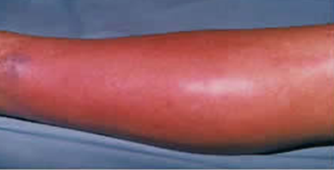
Microbiological diagnosis :
Bacterial or fungal culture or
Serologic testing..
Frequently the “Most likely”
microbiological etiology can be inferred from the clinical
presentation:
Cellulitis (streptococci or staphylococci )…
No need for positive culture.
Cellulitis

Slide 6
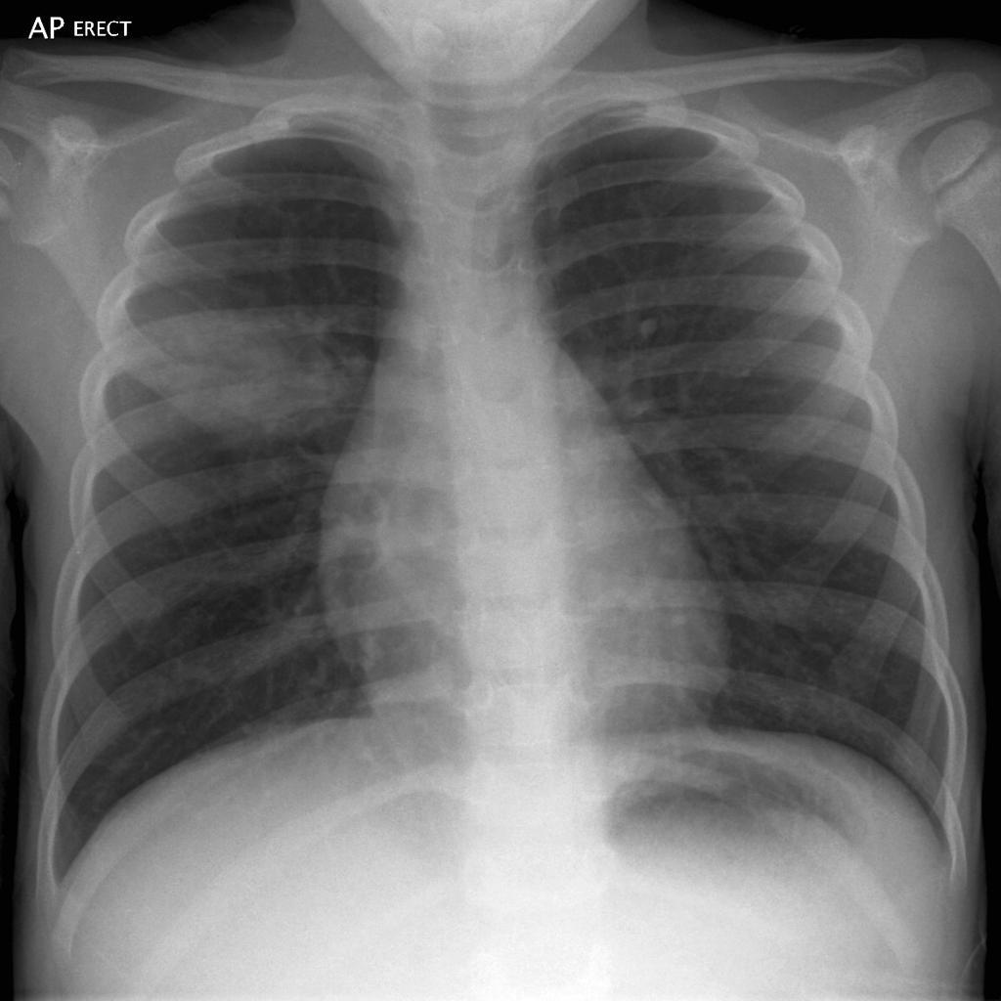
Use of antibiotics
Is An Antibiotic Indicated?
Clinical diagnosis of bacterial infection.
Pneumonia (CAP)
can also be treated empirically—
Macrolide or fluoroquinolone
antibiotic—without performing
specific diagnostic test
Pneumonia

Slide 7
Timing of Initiation of Antimicrobial Therapy
Urgent situation:
1) Acute meningitis
2) Septic shock
3) Febrile neutropenia..
Empiric therapy should be initiated immediately after or concurrently with collection of diagnostic specimens.
None urgent:
1) febrile and stable patient with fever for several days with no clue to diagnosis..

Slide 8
In more stable clinical circumstances..
Hold antibiotics until appropriate specimens have been collected and submitted:
Example:
subacute bacterial endocarditis ………. multiple sets of blood cultures

Slide 9
Urgent vs non urgent
16 year old boy who presented with 3 days H/O high grade fever and severe headache ..examination revealed T: 39 and patient has neck stiffness, otherwise fully conscious and has no neurological deficit :
What is the most appropriate steps of approach:
A) Start combination of antibiotic and arrange for CSF study.
B) Arrange for urgent CT-scan brain ,
C) Perform urgent LP and give the first dose of antibiotics.
D) perform urgent LP and if csf is abnormal ,start RX…
……………………… A OR C …………………………

Slide 10
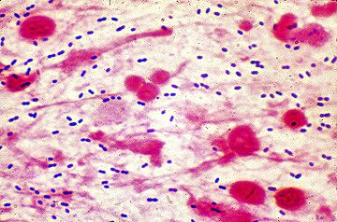
Use of antibiotics
Patient was prescribed a dose of :
cefetriaxone and vanocmycin and urgent LP is done:
Result:
WBC : 1230 cells/mm…90% polymorph..
RBC : NIL ..
Gram stain:
Gram positive intracellular dipplococci..
What you will do?
To continue the same antibiotics? Yes or No.

Slide 11
Premature initiation of antimicrobial therapy…any harm ?
can suppress bacterial growth
Preclude the opportunity to establish a microbiological
diagnosis,
Require several weeks to months of directed antimicrobial therapy to achieve cure.

Slide 12
Empiric vs Definitive Antimicrobial Therapy
Microbiological results do not become available
for 24 to 72 hours
Empiric and guided by the clinical presentation..
Inadequate therapy for infections in critically ill, hospitalized patients is associated with greater morbidity
and mortality
Use broad-spectrum antimicrobial agents as initial empiric
therapy

Slide 13
Use of antibiotics
:What organisms are likely to be responsible
Best Educated Guess?
Based on:
Hx & P.E…. You might have a clue to DX.
Epidemiological data
Hospital-acquired vs. community-acquired
Prior antibiotic use

Slide 14
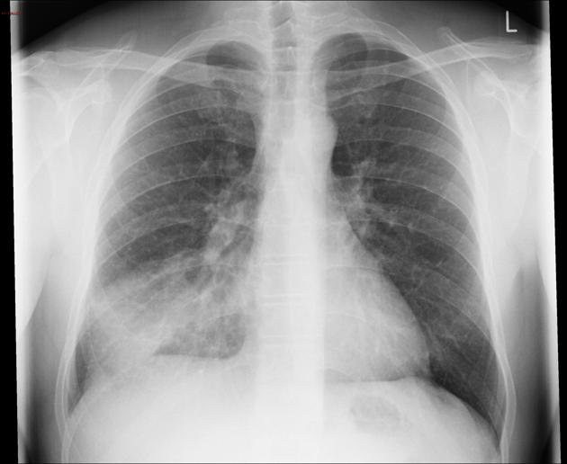
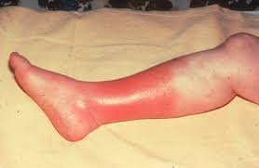
Best Educated Guess?
Patient with dyspnoea and cough …..
Streptococcal pneumonia and atypical organism..
Patient with fever and urinary symptomes :
E.coli ….
Patient with erythema over the right leg associated
with pain and tenderness …
Group A Streptococcus and Staphylococcus

Slide 15
Hospital-acquired infections
Related to the presence of invasive devices and procedures
A] Catherter related bacteremia:,
Coagulase negative staph..
Methicillin-resistant Staphylococcus aureus [MRSA]
B] Catheter related UTI:
Gram negative (eg, Pseudomonas aeruginosa)

Slide 16
Once :
1) Microbiology have identified the etiologic pathogen
and
2) Antimicrobial susceptibility data are available..
Then…
Every attempt should be made to narrow the antibiotic spectrum. :
1) It can reduce cost and toxicity and
2) Prevent the emergence of antimicrobial resistance in the
community

Slide 17
Interpretation of Antimicrobial Susceptibility Testing Results
Antimicrobial susceptibility testing measures the ability of
a specific organism to grow in the presence of a particular
drug in vitro:
susceptible, resistant, or intermediate
Data are reported in the form of minimum inhibitory
concentration (MIC):
The lowest concentration of an antibiotic that inhibits visible
growth of a microorganism..

Slide 18
antimicrobial susceptibility testing (AST).
Susceptible:
indicates that the isolate is likely to be inhibited by the usually achievable concentration of a particular antimicrobial agent when the recommended dosage is used..
Different antibiotics has different MIC.
LIMITATION …

Slide 19
CASE SCENARIO
23 years old man who has surgery at the base of the skull
After trauma . Presented few days later with meningitis
CSF has recealed :
WBC 1200 mainly poly
Culture : staph aureus ..
RX cephazolin..
it does not achieve therapeutic concentrations in the CSF

Slide 20
Bactericidal vs Bacteriostatic Therapy
Bactericidal
Cause death and disruption of the bacterial cell. Drugs act on :
1) The cell wall ……….β-lactams
2) Cell membrane ….. Daptomycin
3) Bacterial DNA ….… Fluoroquinolones
Preferred in the case of serious infections such as
endocarditis & meningitis to achieve rapid cure…

Slide 21
Bacteriostatic
Inhibit bacterial replication without killing the organism.
act by inhibiting protein synthesis: SUCH AS
Sulfonamides.
Tetracyclines.
Macrolides.

Slide 22
Use of Antimicrobial Combinations
Exhibits synergistic activity
is used in the treatment of serious Infections:
A] Rapid killing is essential
Endocarditis caused by Enterococcus species with
a combination of penicillin and gentamicin: bactericidal,
activity…

Slide 23
B] shorten the course:
Endocarditis due to viridans group streptococci,
A combination of penicillin or ceftriaxone with
gentamicin for 2 weeks can be as effective as penicillin or
ceftriaxone alone for 4 weeks).
C] critical ill patient :
Empiric therapy
Septic shock and blood cultures are reported to be growing
gram-negative bacilli, it would be appropriate to provide
initial therapy with 2 agents that have activity against
gram-negative bacilli, particularly P aeruginosa,

Slide 24
D] Polymicrobial Infections:
Antimicrobial
combinations, such as a third-generation cephalosporin
or a fluoroquinolone plus metronidazole,
can be used as a potential treatment option in these cases and
can sometimes be more cost-effective than a comparable single agent (eg, a carbapenem)

Slide 25
Indifference
Synergism
Antagonism
Log of number if viable bacteria/mL
No drug
No drug
No drug
Drug A
Drug A
Drug C
Drug B
Drug B
A + C
A + B
I
II
A + B
III
Drug A
Hours after inoculation

Slide 26
Host Factors to Be Considered in Selection of Antimicrobial Agents
1) Renal and Hepatic Function..
2) Pregnancy and Lactation… Special considerations ..
teratogenicity or otherwise toxic to the fetus.
:
Sulphonamides : A risk to develop kernicterus, especially
preterm
infants..
Tetracycline : Staining of the teeth..
Fluoroquinolone: Cartilage damage to the fetus..
3) History of Allergy or Intolerance.
Pencillin and anaphylaxis

Slide 27
Consider Special Host Factors
Genetic e.g. G6PD
Renal function
Liver function
Pregnancy & Lactation
Drug interaction

Slide 28
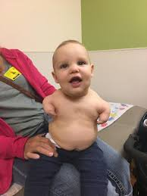
Thalidomide‐induced teratogenesis
Phacomelia..
Thalidomide was released in the late 1950's
It was very effective :
anti‐emetic and used to treat morning sickness
and emesis in pregnant women..
The biggest man‐made medical disaster ever,
Over 10,000 children were born with a range
of severe and debilitating malformations…

Slide 29
Oral vs Intravenous Therapy
Candidates for treatment mild to moderate infections
well-absorbed oral antimicrobial agents :
A] Pyelonephritis
Fluoroquinolones ..
B] Community-acquired pneumonia
Augmentin and macrolides coverage

Slide 30
Bioavailability
The percentage of the oral dose that is available unchanged in the serum).
Examples of antibiotics with excellent bioavailability are:
Trimethoprim-sulfamethoxazole
.

Slide 31
The efficacy of antimicrobial agents depends on their capacity to achieve :
Concentration equal to or greater than the MIC at the site of
infection..
Ocular fluid, CSF, abscess cavity, prostate, and bone) are often
much lower than serum levels
For example:
First- and second- generation cephalosporins
do not cross the blood-brain barrier

Slide 32
Aminoglycosides: are less active in the :
low-oxygen, low-pH, of Abscesses
Fluoroquinolones achieve high concentrations in the prostate
preferred oral agents for the treatment of Prostatitis..
Moxifloxacin does not achieve significant urinary concentrations
therefore not suitable for treatment of UTIs.

Slide 33
Assessment of Response to Treatment
Response to treatment of an infection:
Clinical parameters
improvement of symptoms and signs (eg,
fever, tachycardia, or confusion
laboratory values
decreasing leukocyte count
radiologic decrease in the size of an abscess).,

Slide 34
Antimicrobial Agents as Prophylactic
1) Presurgical Antimicrobial Prophylaxis
is used to reduce the incidence of postoperative surgical site infections..
A single dose of a cephalosporin (such as cefazolin) administered
within 1 hour before the initial incision is appropriate for
most surgical procedures..

Slide 35
Antimicrobial Agents as Prophylactic
2) Prevent Transmission
of Communicable Pathogens to Susceptible Contacts
ciprofloxacin for close contacts of a patient with N.meningitis
3) Antimicrobial Prophylaxis Before Dental Procedures:
Prosthetic valves
Rheumatic heart..
to prevents Endocaridits

Slide 36
NONE INFECTIOUS CAUSES :..PROLONGED USE
Examples :
Adult onset Still disease
Drug-induced fever
fever associated with pulmonary embolism
lymphoma

Slide 37
Treatment of a Positive Clinical Culture in the Absence of Disease:
Colonization without any associated manifestation
of disease occurs frequently in certain populations:
Colonization of :
Old women with indwelling urinary catheter:
Active infection are absent
(asymptomatic bacteriuria)
Endotracheal tubes in mechanically ventilated patients,
chronic wounds..

Slide 38
Conclusion
Appropriate use of antimicrobial agents involves:
Obtaining an accurate diagnosis,
Determining the need for and timing of antimicrobial therapy.
Understanding how dosing affects the antimicrobial activities of different agents,
Tailoring treatment to host characteristics,

Slide 39
Sign for the narrowest spectrum and shortest duration of
therapy, and:
switching to oral agents as soon as possible.
In addition,
Nonantimicrobial interventions, such as abscess drainage,
are equally or more important in some cases and should be
pursued diligently in comprehensive infectious disease
management.

Slide 40
What is the appropriate dose?
The lowest dose that is effective..
Avoid sub-therapeutic doses
Determined by:
Serious vs non-serious infections
Site of infection
Drug PK/PD properties
Other host factors (e.g. renal function … etc)

Slide 41
Any Modification Needed?
Principles:
Narrow vs broad spectrum agents.
Least toxic agent.
Cheaper.

Slide 42
New VS Current Antimicrobial Agent (2)
Know:
approved indications
advantages vs disadvantages
basic pharmacokinetics
serum T ½
activity at various site
common adverse effects

Slide 43
Criteria for Use of New Agent
Antimicrobial activity is superior
Have a therapeutic advantage
Better pharmacokinetics
Site penetration
Longer t ½
Shorter duration
Less toxic
Better tolerance

Slide 44
antibiotics use
Identification of infecting organism
Determining antimicrobial susceptibility
Host factors: allergies, age, pregnancy, renal and hepatic function, site of infection (which is an indication to the most likely type of organism)
Antimicrobial combinations: indications, synergism, antagonism, cost, adverse effects
Dosing: route, regimen, monitoring response/effectiveness

Slide 46
The Four Moments of Antibiotic Decision-Making
1. Does my patient have an infection that requires antibiotics?
2. Have I ordered appropriate cultures before starting antibiotics? What empiric therapy should I initiate?
3. A day or more has passed. Can I stop antibiotics? Can I narrow therapy or change from IV to oral therapy?
4. What duration of antibiotic therapy is needed for my patient's diagnosis?

Slide 47
Thank you

