Slide 1
Endemic Infections in Saudi Arabia
Awadh R. Alanazi M.D

Slide 2
OBJECTIVES
By the end of the lecture the student should be able to know:
Common terminology describing Endemicity.
Common Endemic disease in KSA especially:
Typhoid, salmonella/Brucella.
Gastroenteritis, Viral hemorrhagic fever (Dengue, RVF).
Leishmaniasis, MERS-COV, Malaria.
For each endemic diseases: Epidemiology, Pathogenesis, Clinical features, Complications, Diagnostic workup, Differential diagnosis, Treatment & prevention.

Slide 3
INTRODUCTION
It is of major importance that healthcare workers be aware of how to deal with Endemic disease because of cases of spread in society, being prevented & curable.
Key Outlines:
Commonly used definition & Endemicity.
Major common endemic disease in KSA.
Importance of cost effective workshop, prevention.
Take home message:
Preventing & correctly treating endemic diseases will lead to better health and cost effective use of resources.
Recommended Books:
As recommended by the college and dept. of medicine.

Slide 4
DEFINITIONS
The amount of a particular disease that is usually present in a community is referred to as baseline or endemic level.
Sporadic is a disease that occurs infrequently and irregularly.
Endemic refers to the constant presence and/or usual prevalence of a disease or infectious agent in a population within a geographic area.
Hyperendemic refers to persistent, high levels of disease occurrence.
Epidemic refers to an increase, often sudden, in the number of cases of a disease above what is normally expected in that population in that area.
Outbreak carries the same definition of epidemic, but is often used for a more limited geographic area.
Pandemic refers to an epidemic that has spread over several countries or continents, usually affecting a large number of people.

Slide 5
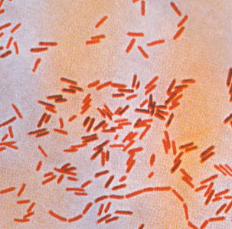
TYPHOID FEVER
It is an acute febrile disease, caused by Salmonella typhi and S. paratyphi A, B,C.
S. typhi and paratyphi lives only in humans.
Persons with typhoid fever carry the bacteria in their bloodstream and intestinal tract.
Carriers recovering from typhoid fever shed S. Typhi in their feces.
It is transmitted through the ingestion of food or drink contaminated by infected people.

Slide 6
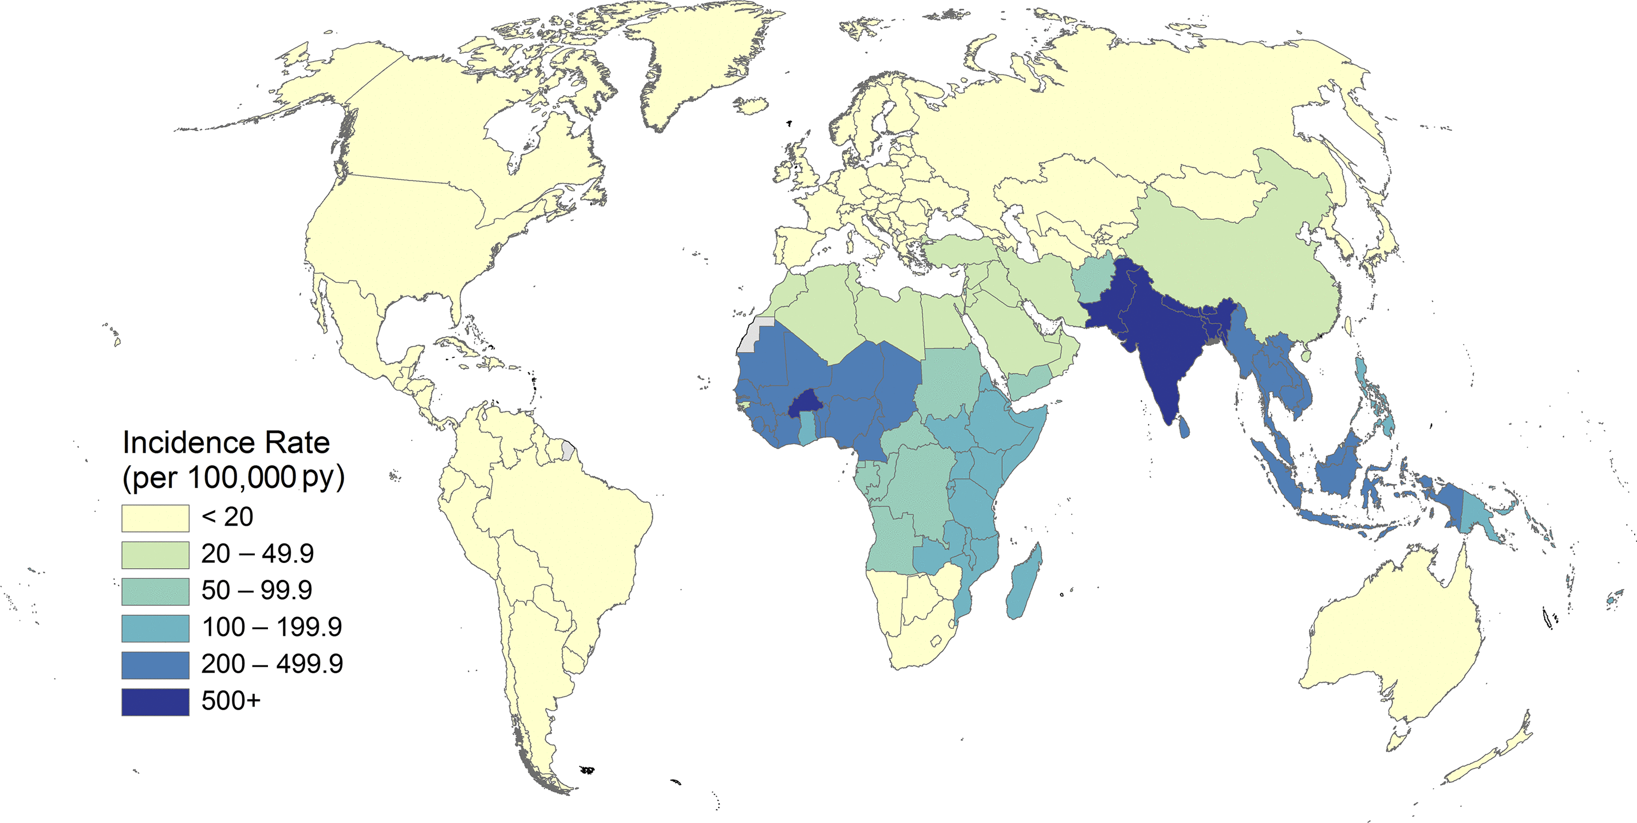
EPIDEMIOLOGY
*Estimated incidence of typhoid and paratyphoid fevers by country per 100,000 population, 2015.

Slide 7
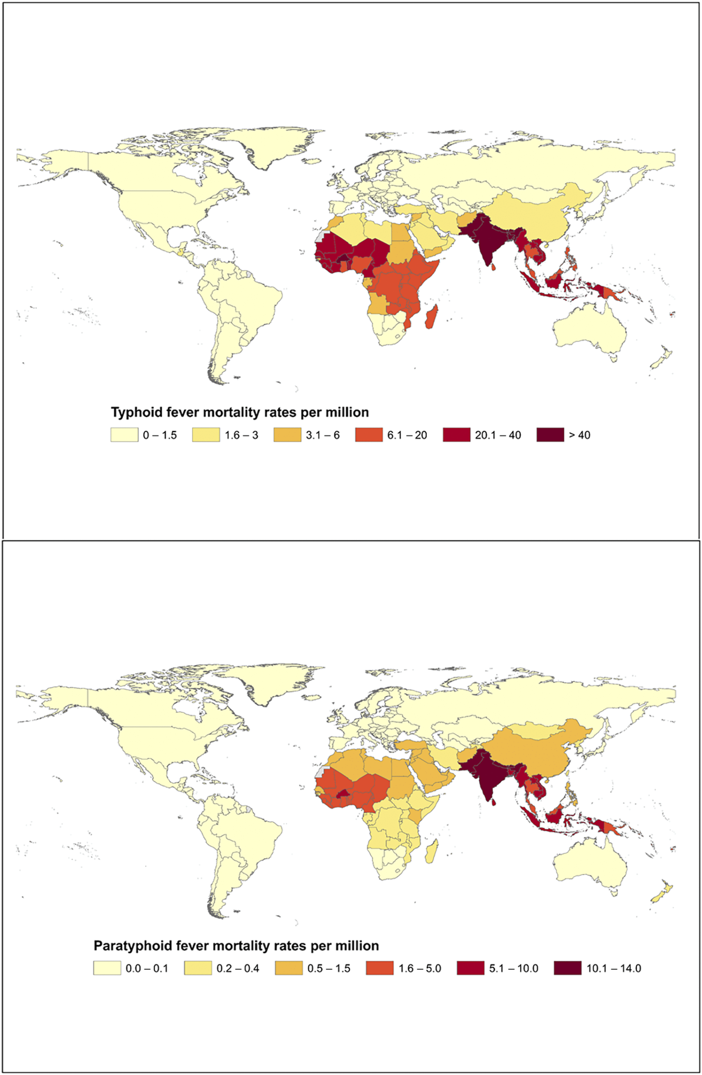
EPIDEMIOLOGY
*Estimated global mortality from typhoid and paratyphoid fever by country per million, 2015.

Slide 8
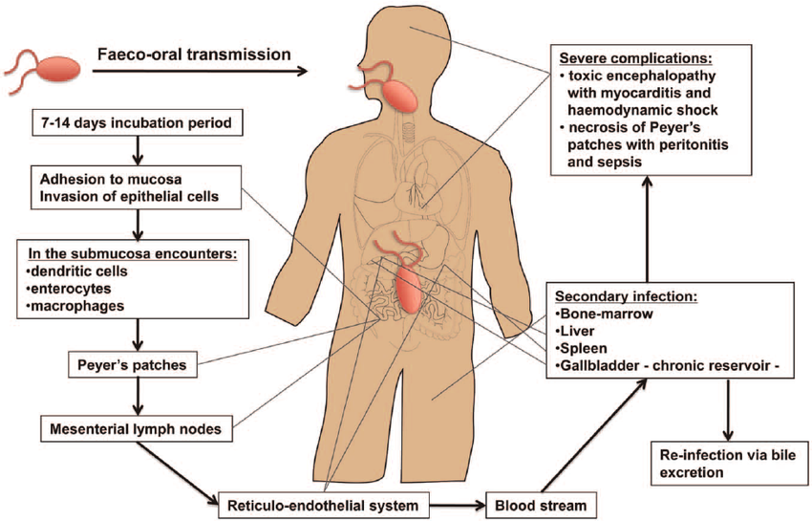
PATHOGENESIS OF ENTERIC FEVER
The organisms penetrate ileal mucosa.
Reach mesenteric lymph nodes - multiply there.
Invade Blood stream.
Infect Liver, Gall Bladder, spleen, Kidney, Bone marrow.
After 7-10 days bacilli pass into blood stream (secondary bactermia ).

Slide 9
CLINICAL FEATURES
Develop 1- 3 weeks after exposure.
May be mild or severe. Gradual onset:
Intermittent fever.
Malaise, headache.
Abdominal pain.
Constipation or diarrhea.
Rose-colored spots on the chest.
Enlarged spleen or liver.
Healthy carrier state may follow acute illness.

Slide 10
RASH IN TYPHOID
Rose spots: 2 -4 mm in diameter raised discrete irregular blanching pink maculae's found in front of chest.
Appear in crops of up to a dozen at a time.
Fade after 3 – 4 days.

Slide 11
COMPLICATIONS
Pneumonia, meningitis, osteomyelitis.
Severe intestinal hemorrhage and intestinal perforation.
If not treated can be fatal.

Slide 12
CARRIERS
5% of the survivors continue to excrete the organism for months = carriers.
In carriers the bacteria remain in the gall bladder and are shed into the intestine.

Slide 13
INVESTIGATIONS
WBC.
ESR .
Blood, bone marrow, or stool cultures.
Widal test (serum agglutination test). It has cross reactions– false positives. Also false negatives. Not a good test.

Slide 14
BLOOD CULTURES IN TYPHOID FEVERS
Bacteremia occurs early in the disease.
Blood Cultures are positive in:
1st week in 90%.
2nd week in 75%.
3rd week in 60%.
4th week and later in 25%.

Slide 15
DIFFERENTIAL DIAGNOSIS
Brucellosis.
Tuberculosis.
Infective endocarditis .
Lymphoma.
Adult Still's disease .
Malaria.

Slide 16
TREATMENT
3rd generation cephalosporins, like Ceftriaxone are effective.
Fluoroquinolones, like ciprofloxacin are the drugs of choice for treatment of typhoid fever.
Fever may continue for several days after starting therapy.
The majority are cured with antibiotics.
10% may relapse.

Slide 17
PREVENTION AND CONTROL (WHO,2018)
Control measures:
Health education.
Access to safe water and adequate sanitation
Antibiotic treatment.
Excluding disease carriers from food handling.
A vaccine is available recommended for travelers to high risk areas. It does not provide full protection.

Slide 18
TYPHOID VACCINE
Two vaccines have been used for many years to protect people from typhoid fever:
an injectable vaccine based on the purified antigen for people aged over 2 years.
a live attenuated oral vaccine in capsule formulation for people aged over 5 years.
These vaccines do not provide long-lasting immunity and are not approved for children younger than 2 years old.
A new typhoid conjugate vaccine, with longer lasting immunity, was prequalified by WHO in December 2017 for use in children from the age of 6 months.

Slide 19
TRAVELING TO TYPHOID ENDEMIC AREAS
The following recommendations will help ensure safety while travelling:
Ensure food is properly cooked and still hot when served.
Avoid raw milk and products made from raw milk. Drink only pasteurized or boiled milk.
Avoid ice unless it is made from safe water.
When the safety of drinking water is questionable, boil it or if this is not possible, disinfect it with a reliable, slow-release disinfectant agent (usually available at pharmacies).
Wash hands thoroughly and frequently using soap, in particular after contact with pets or farm animals, or after having been to the toilet.
Wash fruits and vegetables carefully, particularly if they are eaten raw. If possible, vegetables and fruits should be peeled.

Slide 20
BRUCELLOSIS
Systemic febrile illness.
Zoonosis. It occurs worldwide.
B. melitensis and B. abortus are the most frequent.
The incubation period is 1 – 4 weeks.

Slide 21
EPIDEMIOLOGY

Slide 22
TRANSMISSION
Infection transmitted to humans by:
contact with fluids or meat from infected animals (sheep, cattle, goats, pigs, camels or other animals).
eating food products such as unpasteurized milk and cheese.
The disease is rarely, if ever, transmitted between humans.

Slide 23
PATHOGENESIS
Enters the body.
To lymph nodes.
To blood stream.
Reticulo-endothelial System.
Blood.
Any organ.

Slide 24
CLINICAL MANIFESTATIONS
Often fits one of the three pattern:
- Acute febrile illness resembling typhoid
- Fever & acute mono-arthritis (hip/knee)
- low grade fever, low back pain, hip pain

Slide 25
CLINICAL MANIFESTATIONS
Symptoms :
Fever.
Night sweats.
Fatigue.
Anorexia.
Weight loss.
Arthralgia.
Low back pain.
Depression.
Signs:
Arthritis.
Lymphadenopathy.
Hepatosplenomegaly.

Slide 26
LOCALIZED BRUCELLOSIS
Osteoarticular disease: especially sacroileitis, vertebral spondylitis and large joints arthritis.
Genitourinary disease, especially epididymo-orchitis.
Neurobrucellosis, usually presenting as meningitis, radiculopathy.
Abscess involving the liver, spleen, abdomen.

Slide 27
DIFFERENTIALS
Typhoid fever.
Tuberculosis.
Infective endocarditis.
Collagen vascular disease.
Lymphoma.

Slide 28
INVESTIGATIONS
WBC.
ESR.
Blood cultures
slow growth = 4 weeks.
Serology: SAT positive in recent infection
No diagnostic level...>1:320.

Slide 29
TREATMENT
Treatment for uncomplicated Brucellosis:
Streptomycin (10 days) + Doxycycline for 6 weeks.
Rifampicin + Doxycycline for 6 weeks.
TMP/SMX + Doxycycline for 6 weeks.
RIMFAPICIN(1ST Line RX Of TB),in Brucellosis use RIFAMP. ONLY in: Br Endocarditis, NeuroBrucellosis, Pregnancy & Certain Children populations.
Treatment of complicated Brucellosis
Endocarditis, meningitis.
No uniform agreement.
Usually 3 antibrucella drugs for Not Less than 3 months.

Slide 30
RELAPSE
About 10 percent of patients relapse after therapy.
Most relapses occur within three months following therapy and almost all occur within six months.
Relapse should prompt assessment for a focal lesion, especially hepatosplenic abscess
Most relapses can be treated successfully with a repeat course of a standard regimen.

Slide 31
TREATED BRUCELLOSIS

Slide 32
CASE
A 22 year old student presented with nausea, abdominal pain and diarrhea for 2 days. On examination, he was febrile with mild peri-umbilical tenderness.

Slide 33
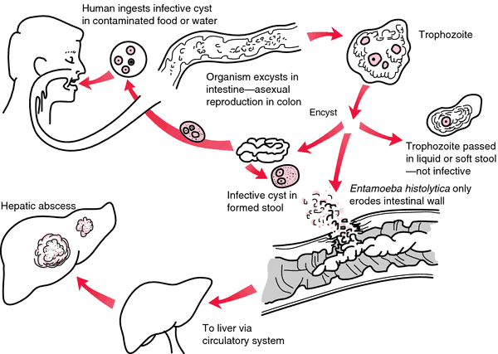
GASTROENTERITIS (Intestinal Amebiasis)
Transmission: by cysts.
Causes invasive colitis.
Presentation:
Asymptomatic.
acute dysentery.
chronic amebiasis.
Complications: liver abscess.
Diagnosis: stool microscopy, serology.
Treatment: metronidazole.

Slide 34
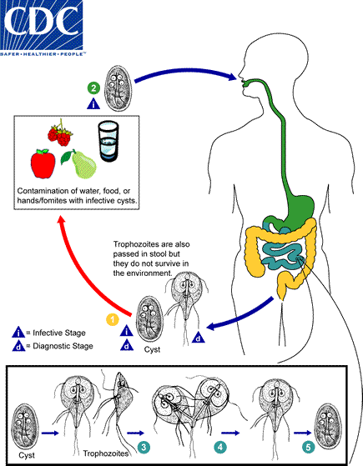
GASTROENTERITI (Giardiasis)
Transmission:
Colonize upper small intestine.
Presentation: asymptomatic – mild to moderate: abd. pain, flatulence.
May become chronic.
Diagnosis: stool microscopy.
Treatment: metronidazole.

Slide 35
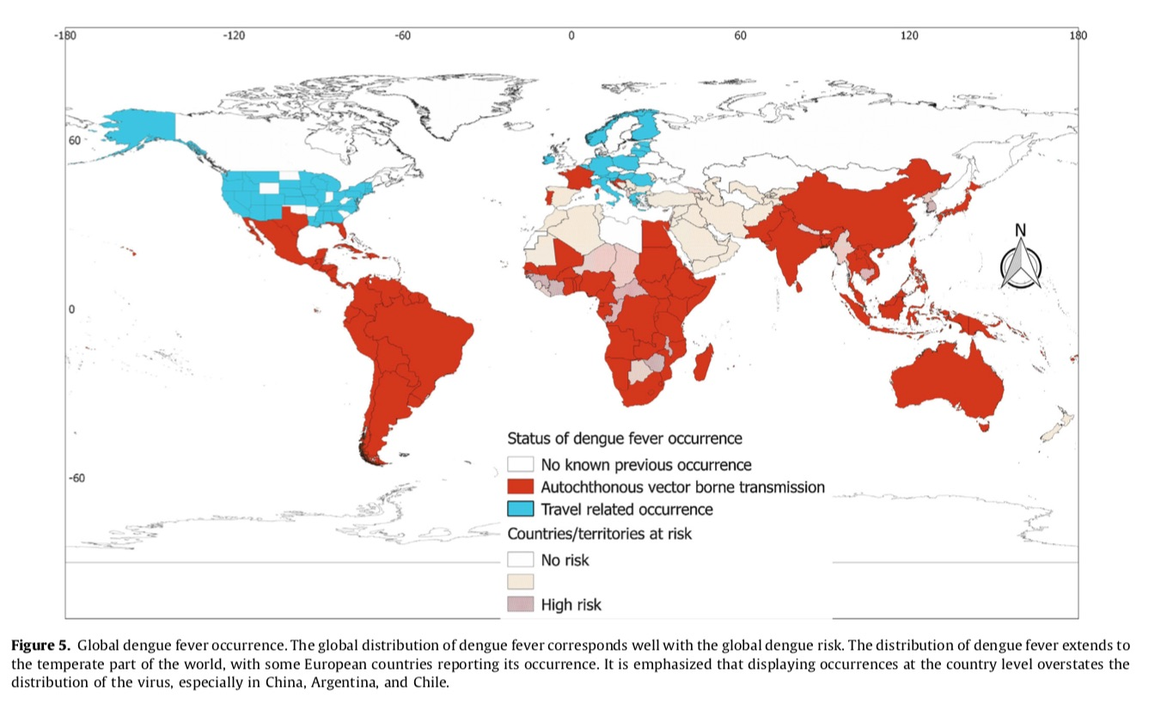
VIRAL HEMORRHAGIC FEVERS: (dengue fever)

Slide 36
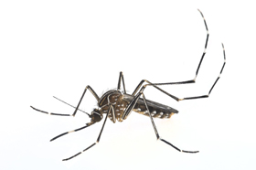
DENGUE VIRUS
Causes dengue and dengue hemorrhagic fever.
Is an arbovirus.
Transmitted by mosquito: Aedes Aegypti.
Composed of single-stranded RNA.
Has 4 serotypes (DEN-1, 2, 3, 4).
Notes:
3

Slide 37
DENGUE CLINICAL SYNDROMES
Undifferentiated fever.
Classic dengue fever.
Dengue hemorrhagic fever.
Dengue shock syndrome.
Notes:
17

Slide 38
CLINICAL CHARACTERISTICS OF DENGUE FEVER
Fever.
Headache.
Muscle and joint pain.
Nausea/vomiting.
Rash.
Hemorrhagic manifestations.
Notes:
18

Slide 39
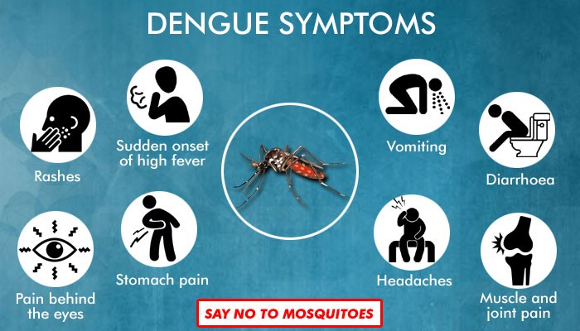
HEMORRHAGIC MANIFESTATIONS OF DENGUE
Skin hemorrhages: petechiae, purpura, ecchymoses.
Gingival bleeding.
Nasal bleeding.
Gastro-intestinal bleeding: hematemesis, melena.
Hematuria.
Increased menstrual flow.
Notes:
20

Slide 40
DANGEROUS SIGNS IN DENGUE HEMORRHAGIC FEVER
Abdominal pain - intense and sustained.
Persistent vomiting.
Abrupt change from fever to hypothermia, with sweating and prostration.
Restlessness or somnolence.
Notes:
24

Slide 41
PREVENTION
Elimination & destruction of mosquitos and larval habitat:
Space Spraying of insecticide is not usually effective.
Spraying residual insecticides in-door.
Larval source reduction : Cover water holding containers.
Personal protection against mosquito biting:
Screening
Protective clothing
Repellents
Centralized, vertically-structured programs with military-type organization, strict supervision, high level of discipline.
Vaccine not yet available, though human trials conducted

Slide 42
TREATMENT
Symptomatic treatment.
Hydration.
Avoid NSAIDS or Aspirin, only acetaminophen for fever, headache or arthralgia.
Platelet transfusion only if platelets <10-20.

Slide 43
RIFT VALLEY FEVER
What is Rift Valley fever?
Rift Valley fever (RVF) is an acute, fever-causing viral disease that affects domestic animals (such as cattle, buffalo, sheep, goats, and camels) and humans. RVF is most commonly associated with mosquito-borne epidemics during years of unusually heavy rainfall.
The disease is caused by the RVF virus, a member of the genus Phlebovirus in the family Bunyaviridae. The disease was first reported among livestock by veterinary officers in Kenya in the early 1900s.

Slide 44
RIFT VALLEY FEVER
On 11 September 2000, the Ministry of Health (MOH) of the Kingdom of Saudi Arabia (Riyadh) received reports of unexplained severe hepatitis in 7 patients from the Jizan region at the southwestern border of Saudi Arabia.
A team from the MOH started investigations within 24 h after notification. Clinical manifestations included low-to-moderate–grade fever, abdominal pain, vomiting, diarrhea, and elevated liver enzyme levels progressing to liver failure, encephalopathy or encephalitis, disseminated intravascular coagulation (DIC), renal failure, and, in 5 of the 7 patients, death.

Slide 45
RIFT VALLEY FEVER
Next outbreak was reported in Yemen.
Now Rift valley fever is considered to be at a low level of endemicity in Saudi Arabia.
Treatment is symptomatic.
Vaccines for veterinary use are available.

Slide 46
LEISHMANIASIS
leishmaniasis is a protozoal disease caused by Leishmania parasite, which is transmitted by the sand fly.
Leishmaniasis is of three types:
cutaneous leishmaniasis.
muco-cutaneous.
visceral (Kala-azar ).

Slide 47
SAUDI ARABIA & LEISHMANIASIS
It is known in the Kingdom since 1950.
Ministry of Health established the Leishmaniasis unit in the 1980s to follow the disease in the country.

Slide 48
VISCERAL LEISHMANIASIS

Slide 49
GEOGRAPHIC DISTRIBUTION OF CUTANEOUS LEISHMANIASIS
Map of the Kingdom of Saudi Arabia showing the distribution of reported cases of CL in 2015 by region.

Slide 50
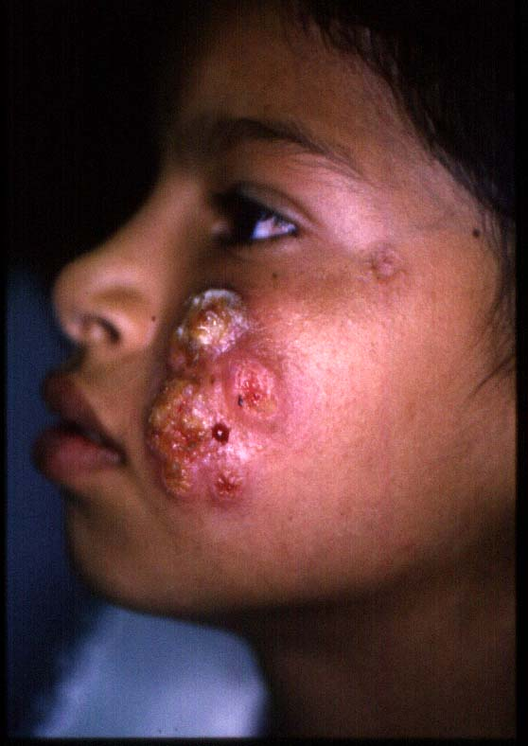
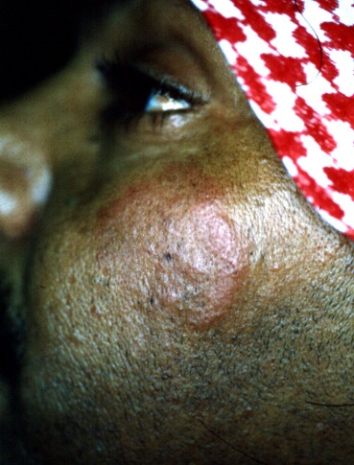
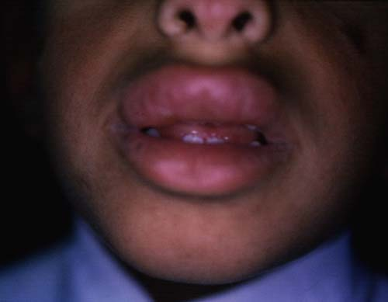
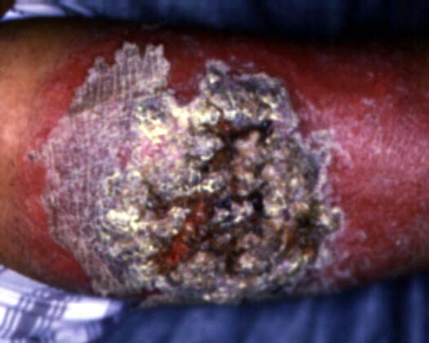
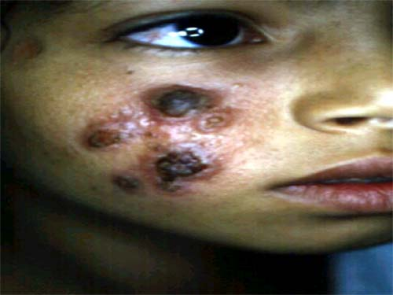
TYPES OF CUTANEOUS LEISHMANIASIS
Hyperkeratotic
Recidivans
Mucosal
Erysipeloid
Plaque

Slide 51
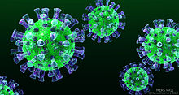
MERS CoV
MIDDLE EAST RESPIRATORY SYNDROME CORONAVIRUS

Slide 52
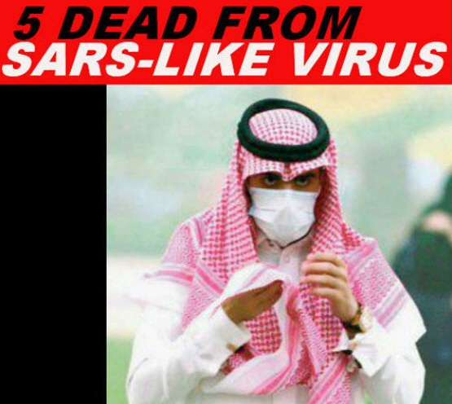

Slide 53
MERS CoV
OUTBREAK :
-2012 emerged in Saudi Arabia
-2014 March -April increased dramatically in Arabian Peninsula → declined sharply in ensuing months. → still detected cases
-2015 May -early July : in South Korea : large outbreak (the index case was an individual who had traveled to the Arabian Peninsula )
-2015: large outbreak began in a hospital in Riyadh, Saudi Arabia
Last data:
https://www.moh.gov.sa/CCC/events/national/Pages/2019.aspx
Notes:
Last data : http://www.who.int/emergencies/mers-cov/en/
To be updated

Slide 54
WHERE DOES THE VIRUS COME FROM?
Partial sequence found in bat in Saudi Arabia near location of human case.
Growing evidence that camels play an important role in transmission across the region.
Virus has been detected in dromedary camels in:
Saudi Arabia, Egypt and Qatar.
Antibodies have been found in camels in: (? Cross reactivity !! )
Jordan, Tunisia, Ethiopia, Nigeria, Egypt, Saudi Arabia, Canary Islands, UAE.
MERS-CoV likely widespread in camels throughout region.
Transmission likely occurring from camel to human.

Slide 55
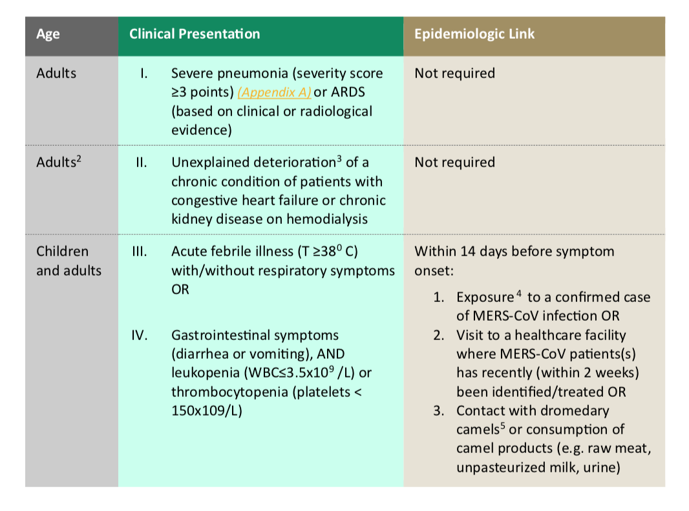
CASE DEFINITION AND SURVEILLANCE GUIDANCE

Slide 56
MERS CoV: DIAGNOSIS AND TREATMENT
DIAGNOSIS:
Real-time reverse-transcriptase polymerase chain reaction (rRT-PCR) for respiratory secretions.
EXPERIMENTAL TREATMENT:
Convalescent plasma.
IVIG.
IFN.
Protease Inhibitors used In HIV infection.
Ribavirin.
Corticosteroids.
Nitazoxanide.
Cyclosporin A.
Combination therapy.
Treatment is mainly SUPPORTIVE
No vaccine available

Slide 57
OTHER ENDEMIC DISEASES OF SAUDI ARABIA
Malaria is endemic in Saudi Arabia.
Tuberculosis is endemic in Saudi Arabia.
These are amongst the most important of the endemic diseases.
Malaria and Tuberculosis have been covered fully in previous lectures.

Slide 58
THANK YOU

