Slide 1
Osteoarthritis
Rizwan Mansoor m.D.
Consultant Rheumatologist

Slide 2
OA - Definition
Heterogeneous group of conditions resulting in common histopathologic and radiologic changes involving
Entire joint organ, including:
the articular cartilage
the subchondral bone and
the synovium.

Slide 3
Epidemiology
Internationally, osteoarthritis is the most common articular disease. Estimates of its frequency vary across different populations.
80-90% of individuals older than 65 years have evidence of radiographic osteoarthritis.
the prevalence of osteoarthritis is higher among women than among men.
Interethnic differences in the prevalence of osteoarthritis have been noted.
Notes:
more prevalent in Native Americans than in the general population.. Symptomatic knee osteoarthritis is extremely common in China. ^{[61]}
osteoarthritis is more common in whites than in blacks. Knee osteoarthritis appears to be more common in black women than in other groups., African American men and women had a slightly higher prevalence of radiographic and symptomatic knee osteoarthritis but a significantly higher prevalence of severe radiographic knee osteoarthritis. ^{[62]}

Slide 4
Involved joints
Weight-bearing joints, including:
the knees
the hips
cervical and lumbosacral spine
feet.
Non weight bearing joints:
the(DIP), the(PIP), and the(CMC) joints.

Slide 5
Synovial Joints
Articular cartilage
Subchondral bone
Synovial membrane
Synovial fluid
Joint capsule

Slide 6
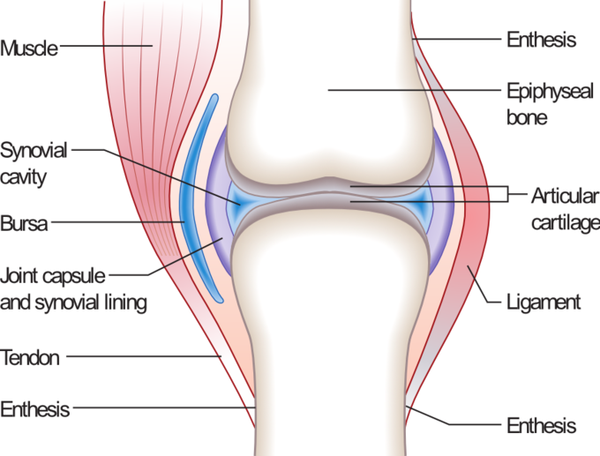
Synovial joint anatomy

Slide 7
The normal articular surface of synovial joints
articular cartilage ( chondrocytes) surrounded by extracellular matrix includes
proteoglycans and collagen. The cartilage facilitates joint function and protects the underlying subchondral bone by
distributing large loads,
maintaining low contact stresses, and
reducing friction at the joint.

Slide 8
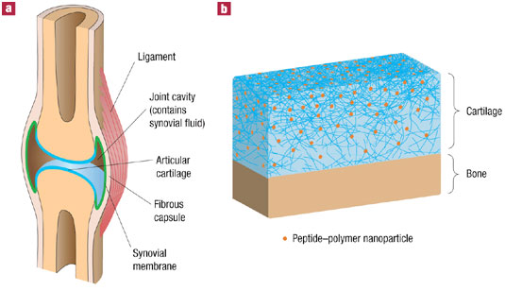
Synovial cartilage

Slide 9
Synovial Fluid
Synovial fluid is formed by (synoviocytes).
Synovial cells also manufacture hyaluronic acid (HA, also known as hyaluronate), a glycosaminoglycan that is the major noncellular component of synovial fluid.
Synovial fluid supplies nutrients to the avascular articular cartilage; it also
provides the viscosity needed to absorb shock from slow movements
provides elasticity required to absorb shock from rapid movements.

Slide 10
Pathogenesis
Swelling of the cartilage usually occurs
the level of proteoglycans eventually drops very low, the cartilage softens and lose elasticity and compromising joint surface integrity.
Flaking and fibrillations (vertical clefts) develop along on the surface of an osteoarthritic joint. Over time, the loss of cartilage results in loss of joint space.
a greater loss of joint space occurs at those areas experiencing the highest loads.
Notes:
, because of the increased synthesis of proteoglycans-an effort by the chondrocytes to repair cartilage damage. This stage may last for years or decades and is characterized by hypertrophic repair of the articular cartilage.

Slide 11
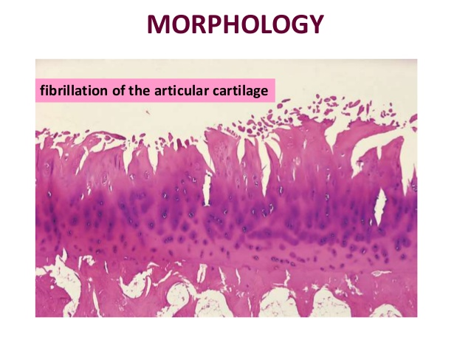
Cartilage changes

Slide 12
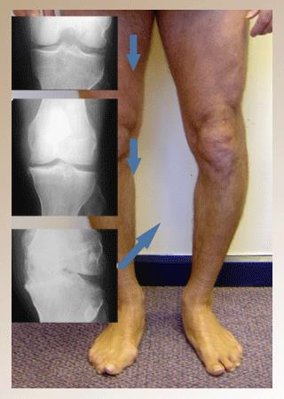
Clinical and Radiological

Slide 13
Bone changes
Bone denuded of its protective cartilage continues to articulate with the opposing surface.
Eventually, the increasing stresses exceed the biomechanical yield strength of the bone.
The subchondral bone responds with vascular invasion and increased cellularity, becoming thickened and dense (a process known as eburnation) at areas of pressure.

Slide 14
Bone changes
subchondral bone undergo cystic degeneration.
Osteoarthritic cysts are also referred to as subchondral cysts, pseudocysts, or geodes and may range from 2 to 20 mm in diameter.
Osteoarthritic cysts in the acetabulum are termed Egger cysts.

Slide 15
Joint changes
vascularization of subchondral marrow,
osseous metaplasia of synovial connective tissue, and
ossifying cartilaginous protrusions lead to irregular outgrowth of new bone (osteophytes).
Fragmentation of these osteophytes or of the articular cartilage itself results in the presence of intra-articular loose bodies (joint mice).

Slide 16
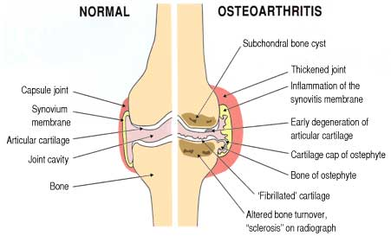
Joint changes

Slide 17
Etiology
Risk factors-
Age, obesity,trauma, genetics, hypogonadism, muscle weakness, repetitive use, Infection, crystal deposition, acromegaly, previous inflammatory arthritis (burnt-out rheumatoid arthritis)
Heritable metabolic causes (alkaptonuria, hemochromatosis, Wilson disease)Hemoglobinopathies (sickle cell disease and thalassemia)Neuropathic disorders leading to a Charcot joint (syringomyelia, tabes dorsalis, and diabetes)Underlying morphologic risk factors (congenital hip dislocation and slipped femoral capital epiphysis)
Disorders of bone (Paget disease and avascular necrosis)Previous surgical procedures (meniscectomy)Diabetes mellitus ^{[44]}

Slide 18
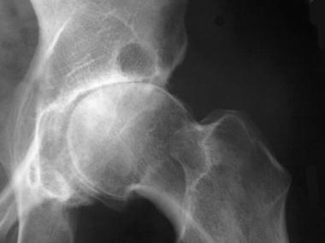
Radiographic changes
Notes:
This radiograph demonstrates osteoarthritis of the right hip, including the finding of sclerosis at the superior aspect of the acetabulum.

Slide 19
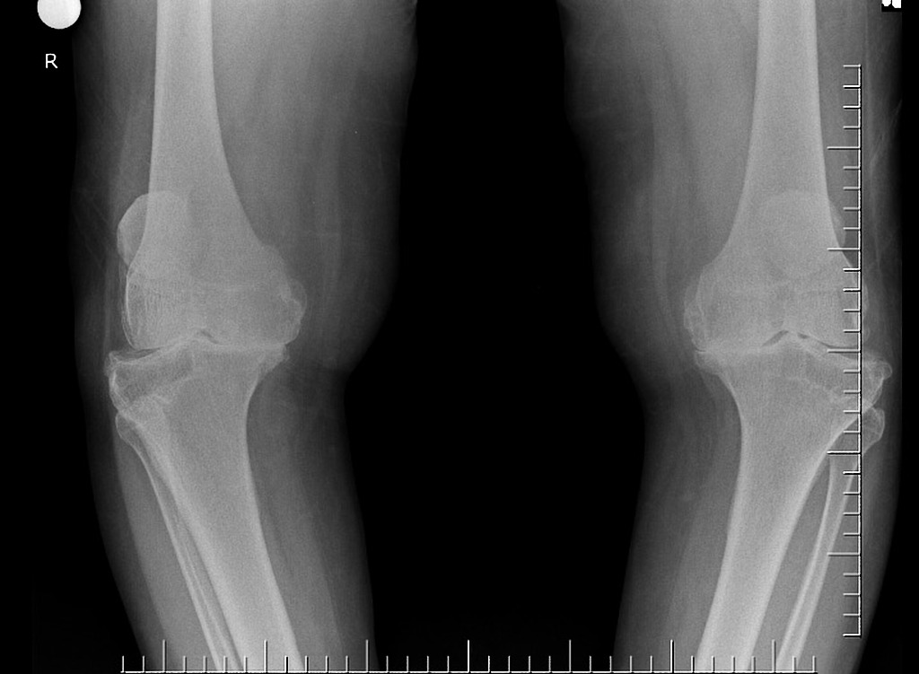
Radiological changes

Slide 20
Osteoarthritis Progression
Stage 1- breakdown of the cartilage matrix occurs.
Stage 2 - involves the fibrillation and erosion of the cartilage surface
Stage 3 - a chronic inflammatory response in the synovium.
Further Progression - the above events alter the joint architecture, compensatory bone overgrowth occurs. joint architecture is changed mechanical and inflammatory stress occurs on the articular surfaces, the disease progresses unchecked.
Notes:
1-Chondrocyte metabolism is affected, leading to an increased production of enzymes, which includes metalloproteinases (eg, collagenase, stromelysin) that destroy the cartilage matrix.
2-release of proteoglycan and collagen fragments into the synovial fluid.
3-Synovial macrophage production of MMP, cytokines ,(IL) 1, (TNF)-alpha, occurs. These can diffuse back into the cartilage and directly destroy tissue or stimulate chondrocytes to produce more MMPs. Other proinflammatory molecules (eg, nitric oxide [NO], an inorganic free radical) may also be a factor in stage 3. proteoglycan and collagen fragments into the synovial fluid.

Slide 21
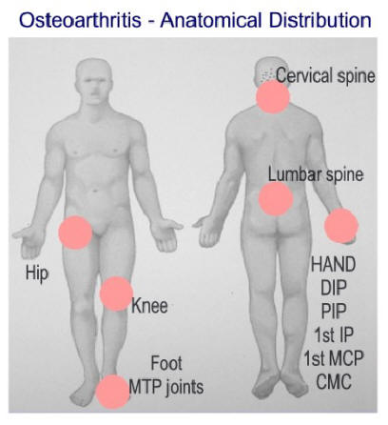
PGOA

Slide 22
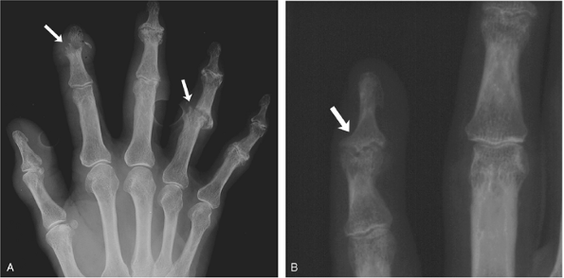
Erosive OA

Slide 23
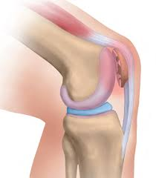
Chonromalcia Patellae

Slide 24
Differential Diagnosis
Crystalline arthropathies (ie, gout and pseudogout)
Inflammatory arthritis (eg, rheumatoid arthritis)
Seronegative spondyloarthropathies (eg, psoriatic arthritis and reactive arthritis)
Septic arthritis or postinfectious arthropathy
Fibromyalgia
Tendonitis

Slide 25
Work Up
Laboratory
Plain Radiography
CT scan, MRI scan, ultrasonography
Bone scintigraphy
Arthrocentesis

Slide 26
Treatment
Non pharmacologic-
Life style modification, physical and rehab therapy
Pharmacotherapy
Arthroscopy
Osteotomy
Arthroplasty
Fusion and joint Lavage
Stem cell therapy

Slide 27
References
1.Hunter, W. Of the structure and diseases of articulating cartilages. Phil. Trans. Royal Soc. 470, 514–521 (1743).
  2.National Collaborating Centre for Chronic Conditions (UK).
  National Clinical Guideline for Care and Management in Adults(Royal College of Physicians of London, 2008).
  3.Felson, D. T. An update on the pathogenesis and epidemiology of osteoarthritis. Radiol. Clin. North Am. 42, 1–9 (2004).
4.WHO. The World Health Report 2002: reducing risks, promoting healthy life (WHO, 2002).
  5.Centers for Disease Control and Prevention (CDC). Prevalence of doctor-diagnosed arthritis and
  arthritis-attributable activity limitation—United States, 2010–2012. MMWR Morb. Mortal. Wkly Rep. 62, 869–873 (2013).

