Slide 1

“CLOSER LOOK AT SpA”
Dr. Mohamed Bedaiwi
Consultant Rheumatologist
Rheumatology Unit - KKUH

Slide 2


Slide 3
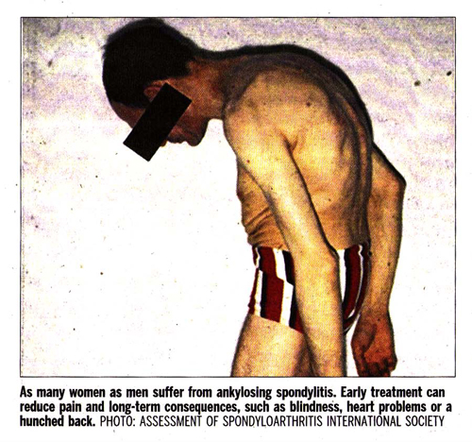

Slide 4
Closer look at SpA
Categories
SIGN & SYMPTOMS
X-RAY
MRI
MANAGMENT

Slide 5
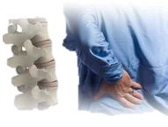

Spondyloarthritis (SpA) diseases:???
What are they?
Ankylosing spondylitis (AS)
Non-radiographic axial spondyloarthritis (nr-axSpA
PsA
IBD related arthritis
ReA
Undifferentiated Peripheral SpA

Slide 6
Spondyloarthritis (SpA) diseases:???
What are they?
Ankylosing spondylitis (AS)
Non-radiographic axial spondyloarthritis (nr-axSpA
PsA
IBD related arthritis
ReA
Undifferentiated Peripheral SpA

Slide 7

Complex
disease
2 Broad Overlapping Categories
Axial
Spondyloarthritis
Peripheral
Spondyloarthritis
PsA
ReA
nr-axSpA
AS
IBD-SpA
Undifferentiated
Periphere SpA

Slide 8
Complex
disease
2 Broad Overlapping Categories
Axial
Spondyloarthritis
Periphere
Spondyloarthritis
PsA
ReA
nr-axSpA
AS
IBD-SpA
Undifferentiated
Periphere SpA

Slide 9
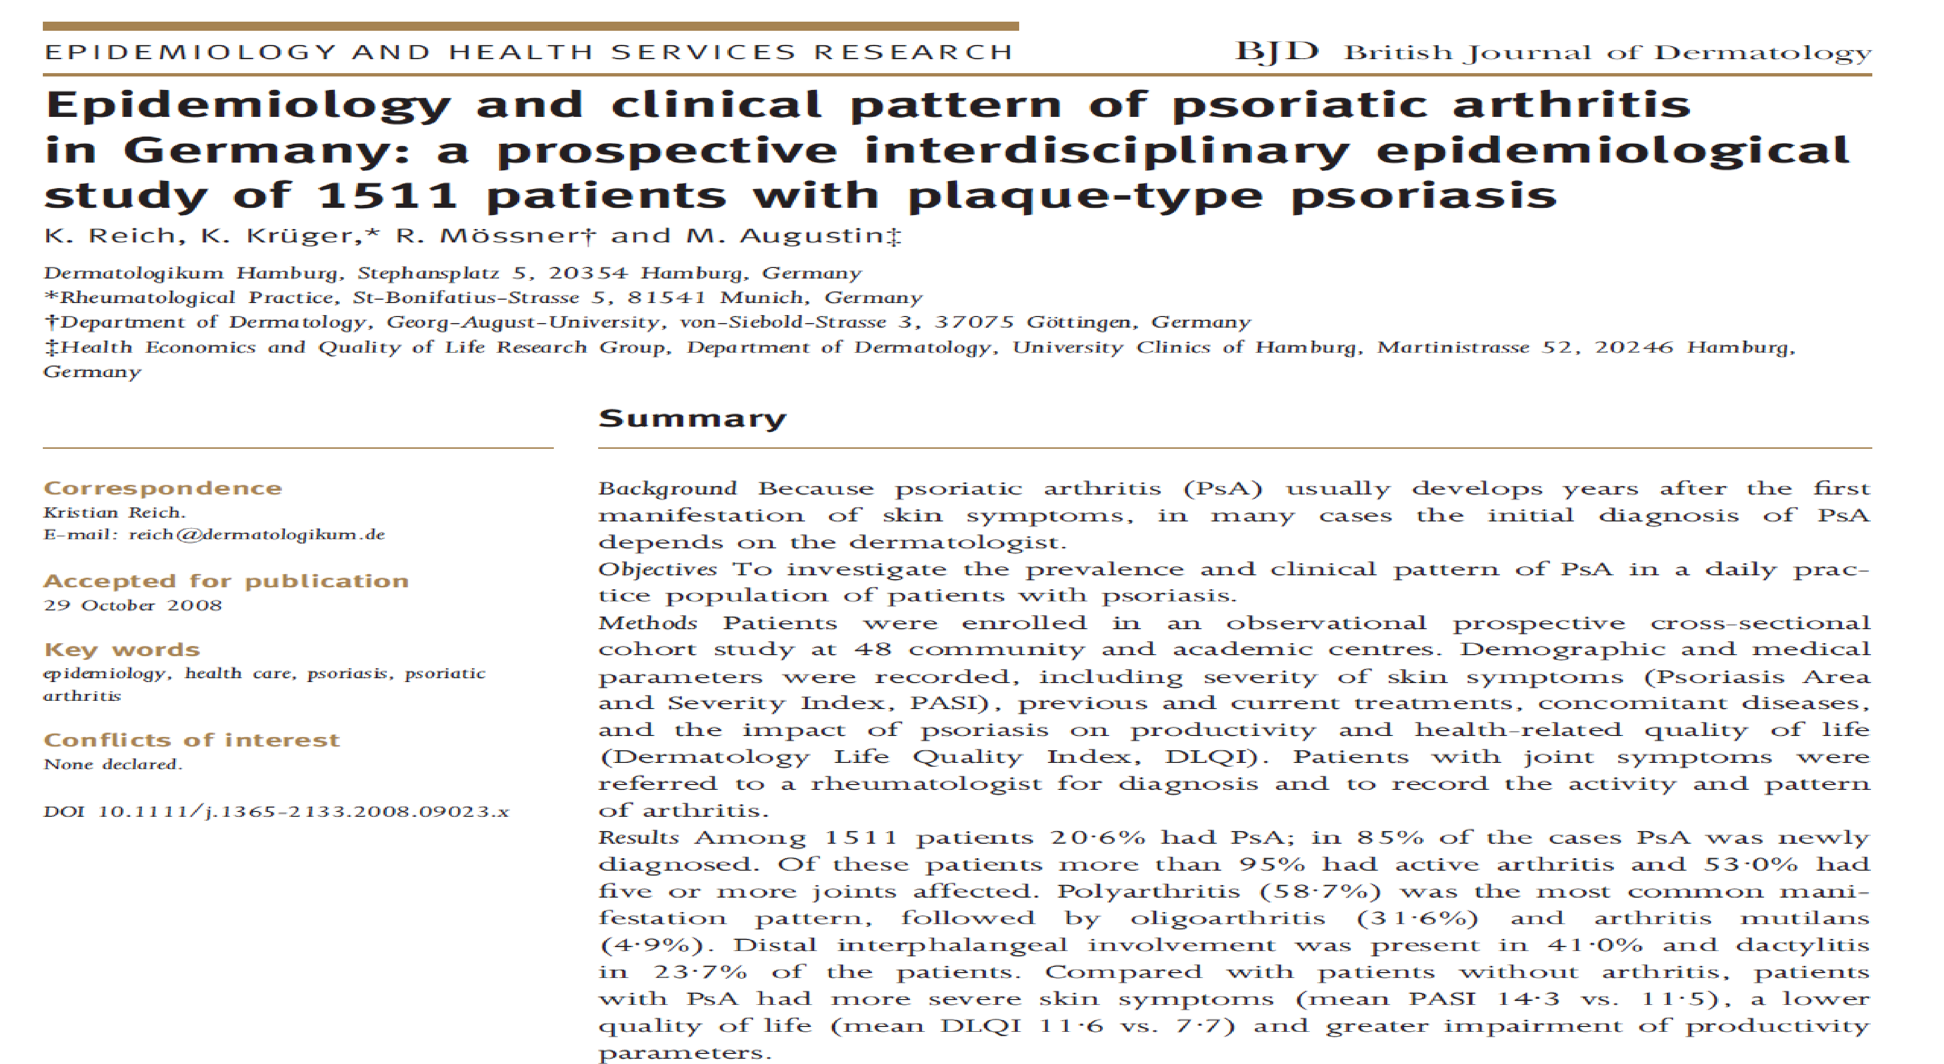
SpA IS MISSED
  Observational prospective cross-sectional cohort study at 48 community and academic centres in Germany
  1511 patients with psoriasis
  Patients with joint symptoms were referred to a rheumatologist
  Among 1511 patients 20.6% had PsA → 85% newly Dx

Slide 10
Ankylosing spondylitis
Family medicine practice
MRI?? → is very valuable

Slide 11
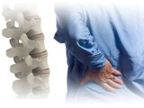


Good response
to NSAIDs
Tips
Symptoms
Patient History
Lab
Genetics
Imaging
Dealing with a Solvable Problem

Slide 12
Back Pain
80% of the population will experience
back pain during their lifetime.
More than 85% cannot attribute it to a specific disease or spinal abnormality.
Up to one third (1/3) of patients report persistent back pain of at least moderate intensity 1 year after an acute episode.

Slide 13
Low Back Pain is caused by a specific disorder:
Compression fracture
Symptomatic herniated disc
Spinal stenosis
Ankylosing spondylitis (3%)
Cancer
Spinal infection
Physician role is to recognize non-mechanical cause

Slide 14
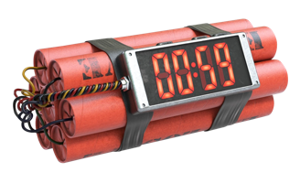

Inflammation is bad
Inflammation is treatable
Inflammation x Time = Damage

Slide 15
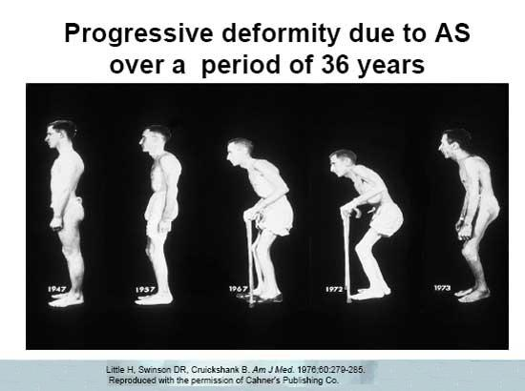
AS is progressive disease

Slide 16
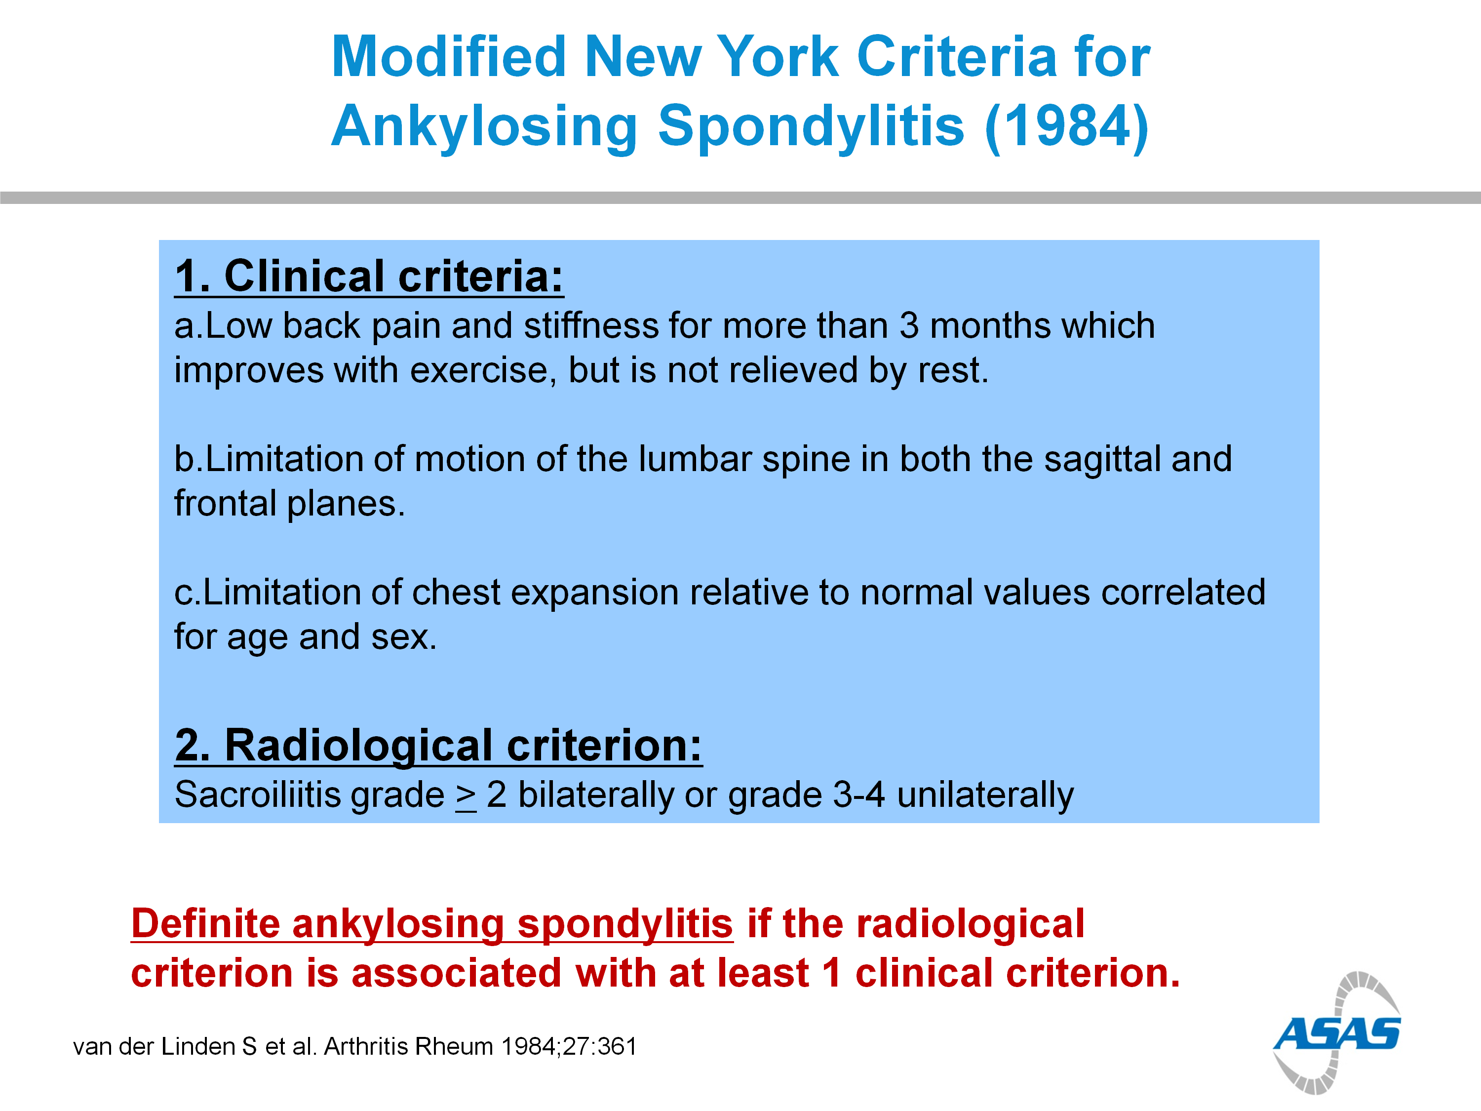

Slide 17
NEW YORK CRITERIA
MRI??
Extra-articular features??
HLA-B27

Slide 18
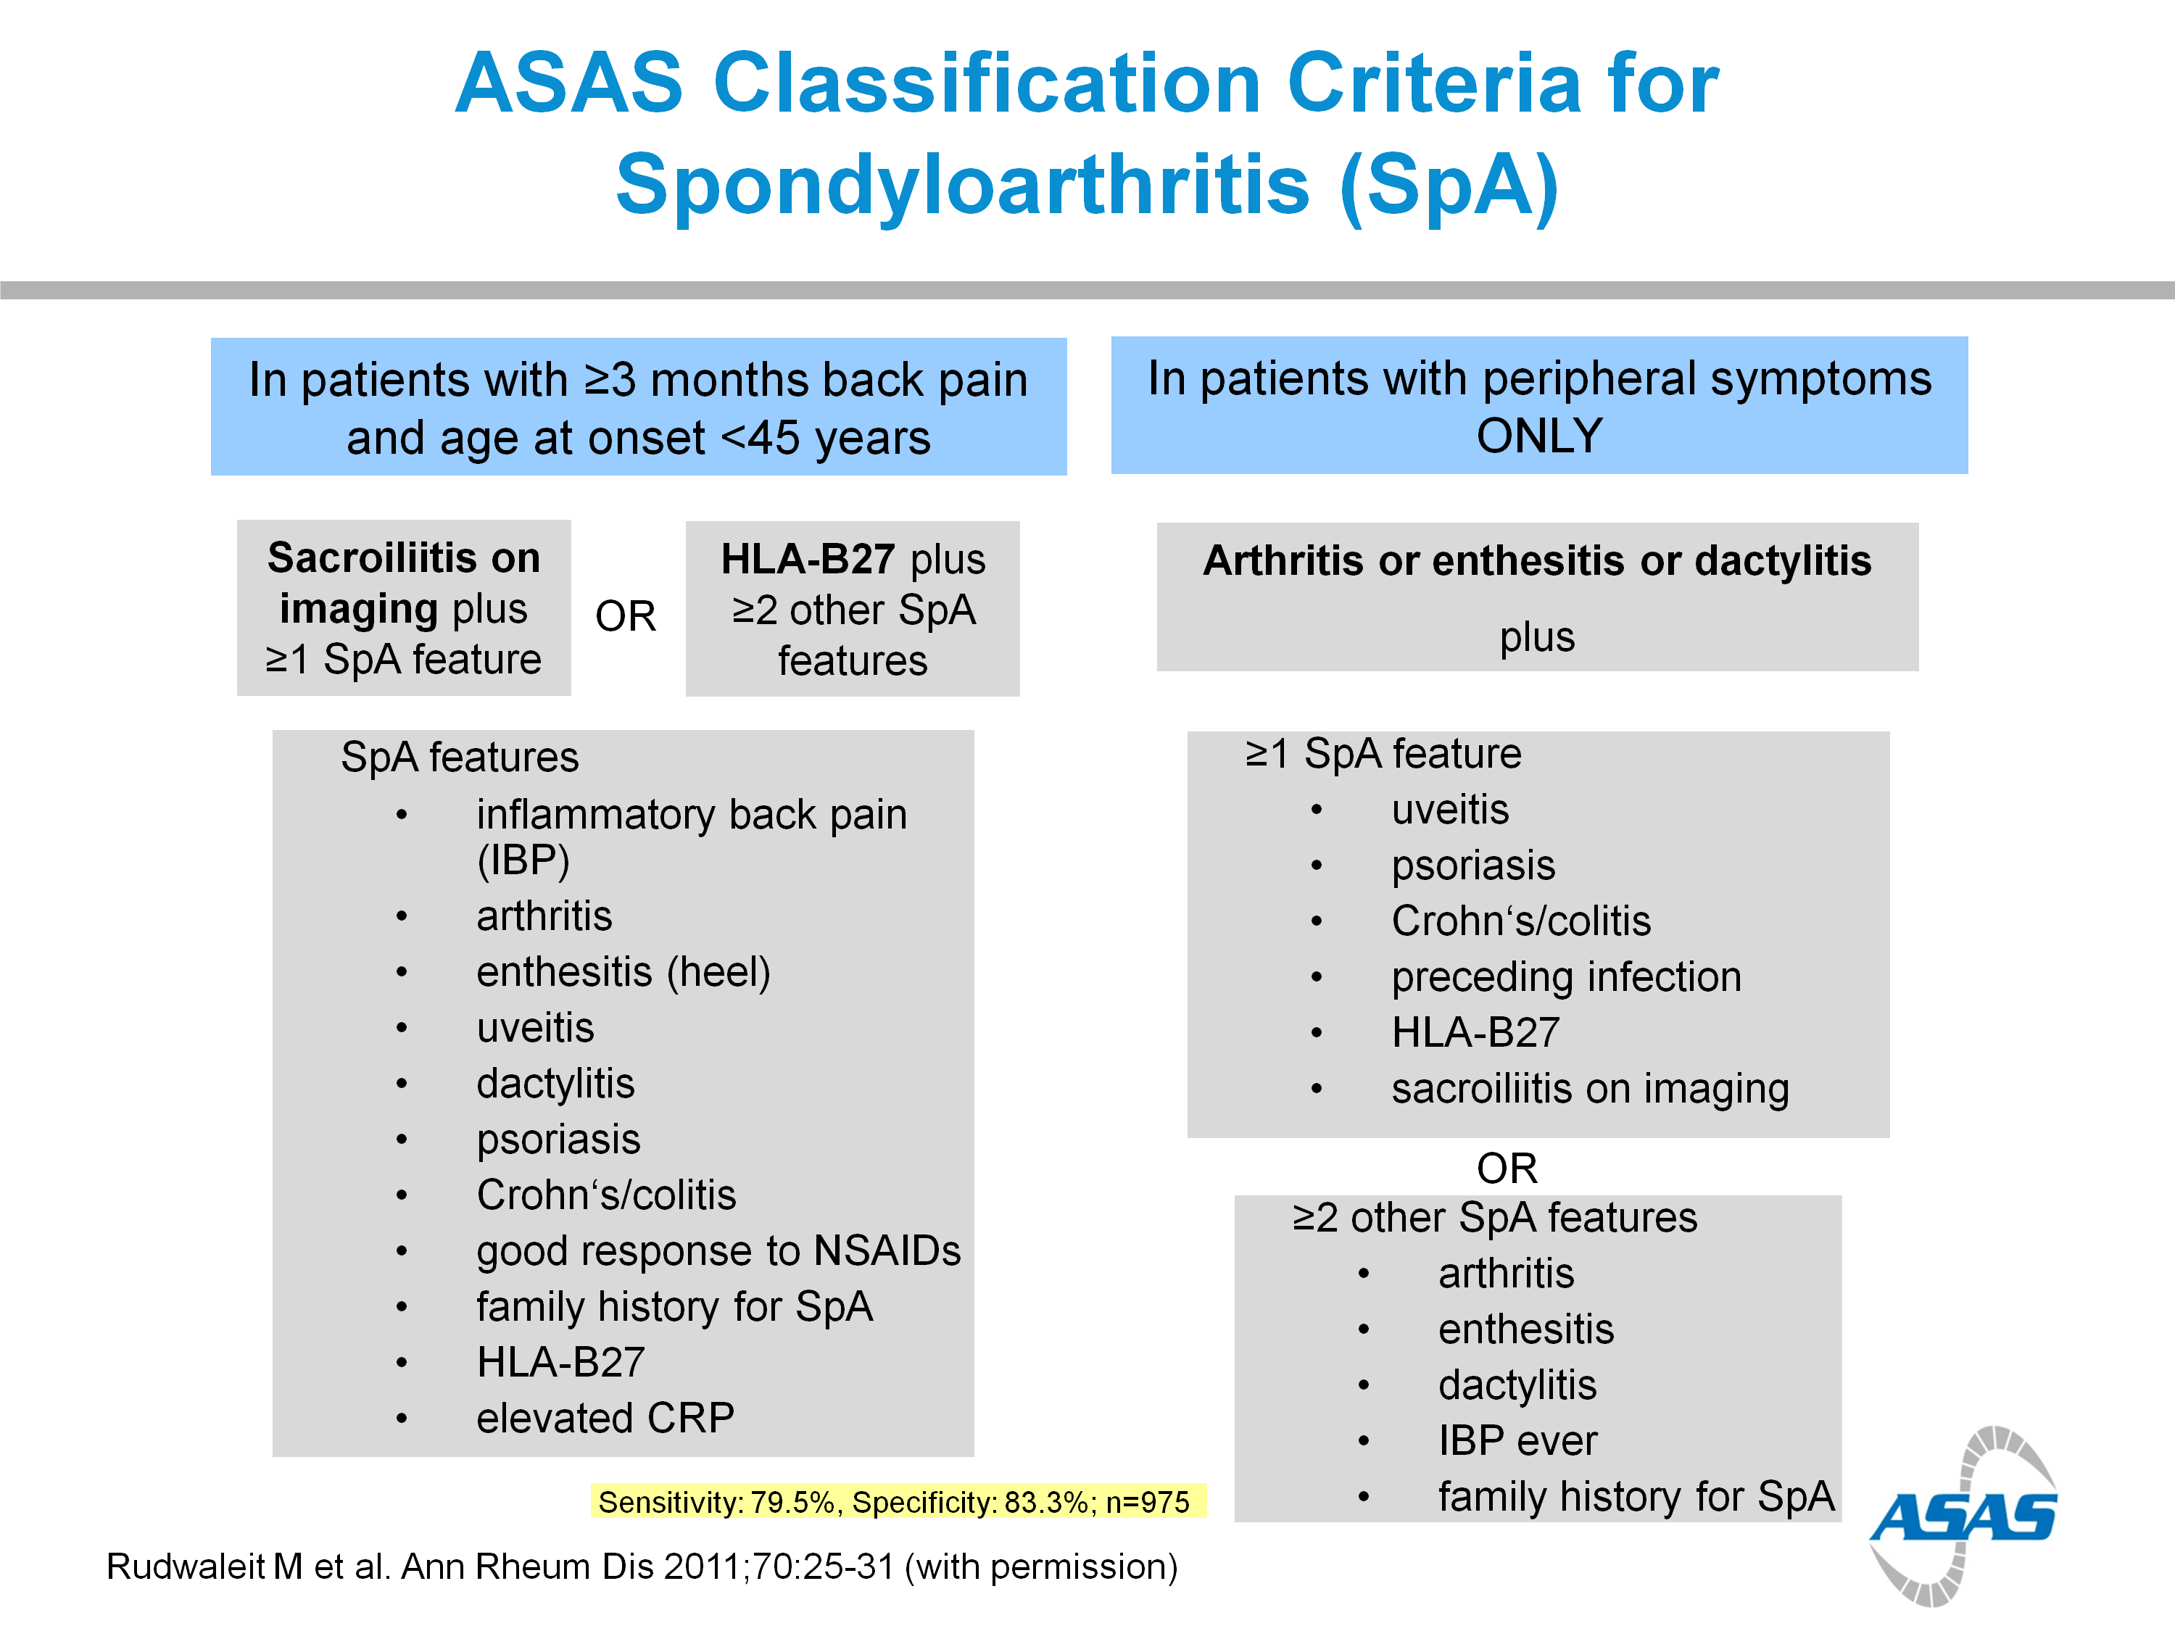

Slide 19
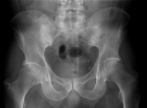
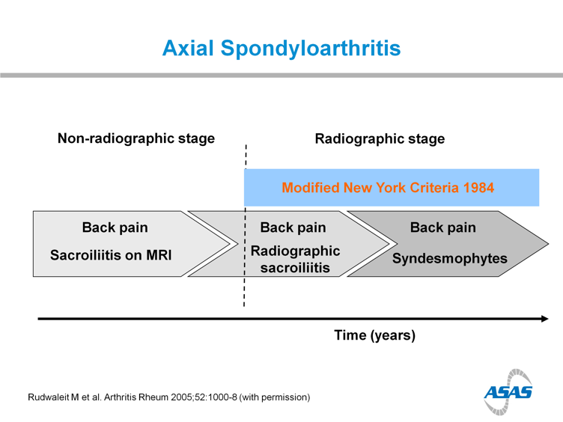
?

Slide 20
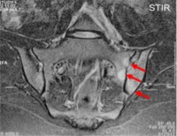
?

Slide 21
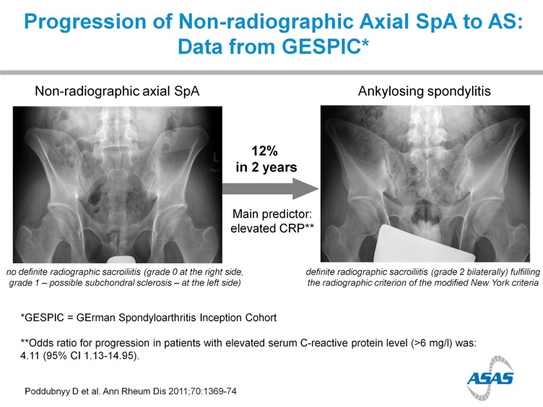

Slide 22
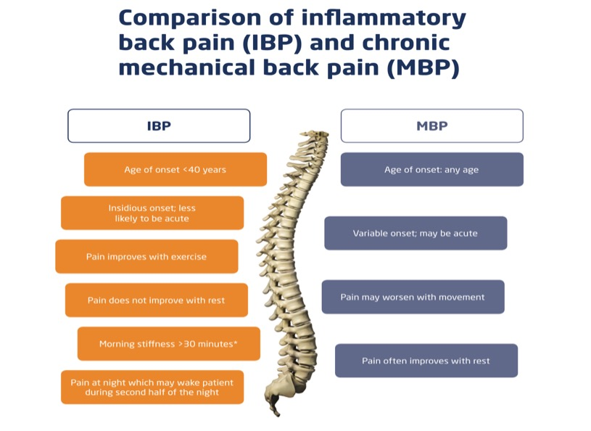
Back Pain
This Back in Focus resource was developed in collaboration with Claire Harris, Susan Gurden, Dr Jane Martindale, Claire Je ries and organized and funded by AbbVie.
Date of Preparation: August 2015 Job Code: AXHUR150732

Slide 23
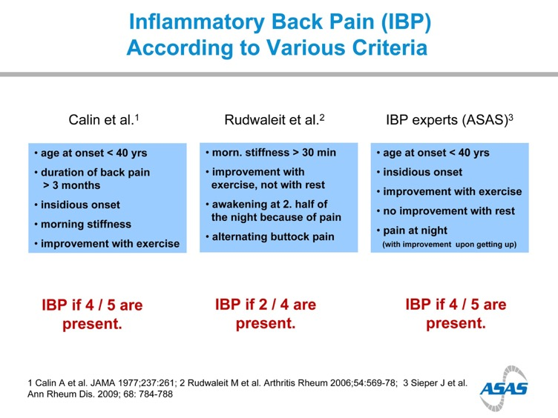

Slide 24
M vs F

Slide 25
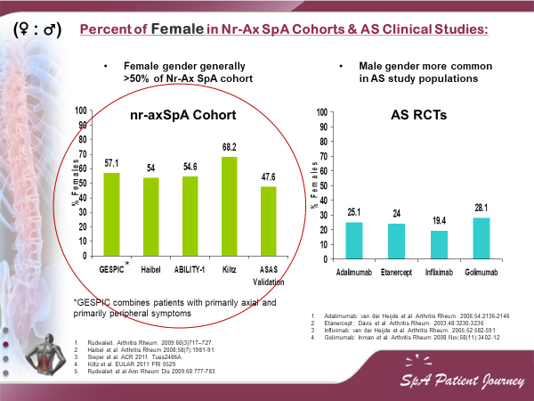

Slide 26
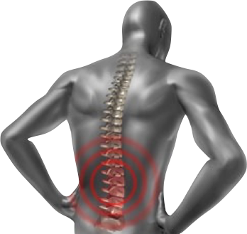

Spondyloarthropathies – SpA
Is it only SPINE?

Slide 27
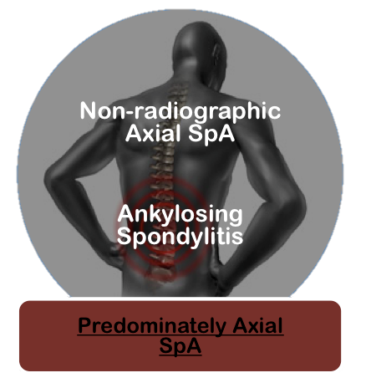

Updated ASAS Concept of Spondyloarthritis (SpA)
Groups Diseases into 2 Broad Overlapping Categories
van den Berg R, et al. Polskie Archiwum Medycyny Wewnętrznej. 2010;120(11):452-457.

Slide 28
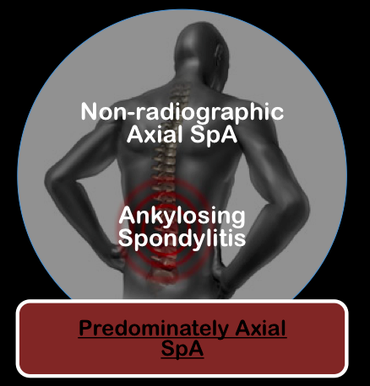

Slide 29





Inflammatory Back Pain
Tips
In patients with chronic back pain (>3 months), IBP criteria are fulfilled if at least 4 out of 5 parameters are present:
Symptoms
I
P
A
I
N
Patient History
Lab
Genetics
Insidious onset
No improvement
with rest
Imaging
Pain at night
Improvement
with exercise
Age at onset <45 years
An insidious disease is any disease that comes on slowly and does not have obvious symptoms at first. The person is not aware of it developing.

Slide 30
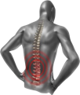
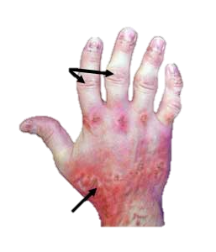








Extra-articular Manifestations
Uveitis
25-40% of patients affected
Uveitis
25% of patients affected
Psoriasis
16% of patients affected
Axial Disease
40% of patients affected
Inflammatory bowel
Disease (IBD)
10% of patients affected
(UC & CD)
Nail Psoriasis
80-90% of patients
affected at some point
Dactylitis
21.5% of patients affected
Synovial joint
involvement
Enthesitis
25-58% of patients affected
Enthesitis
20% of patients affected

Slide 31
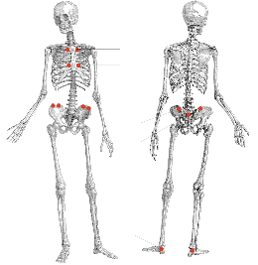
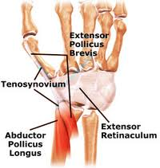
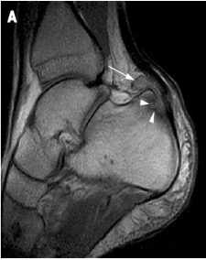
Heel Pain - Enthesitis
Tips
Enthesitis is inflammation of Entheses.
  Entheses are sites where tendons, ligaments, joint capsules, or fascia attach to bone.
Heel Enthesitis is most common.
Symptoms
Patient History
Lab
Tenosynovitis Enthesitis
Achilles heel Enthesitis
Genetics
Imaging
Eshed I, et al. Ann Rheum Dis 2007;66:1553–9

Slide 32
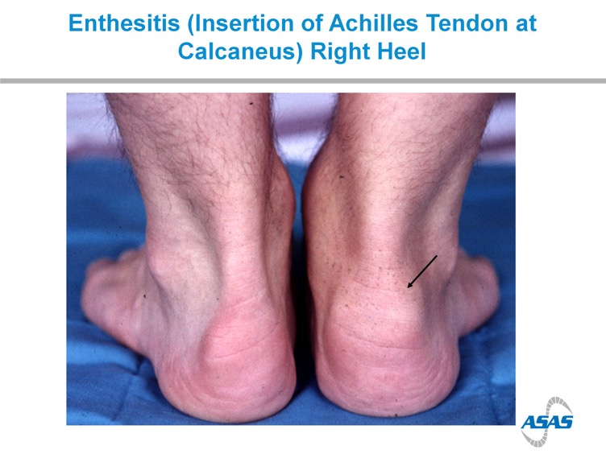
Tips
Symptoms
Patient History
Lab
Genetics
Imaging
25-58% of patients affected

Slide 33
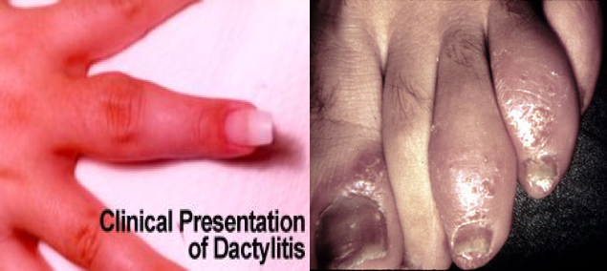
Dactylitis
Tips
Symptoms
Patient History
Lab
Genetics
Imaging
21.5% of patients affected

Slide 34
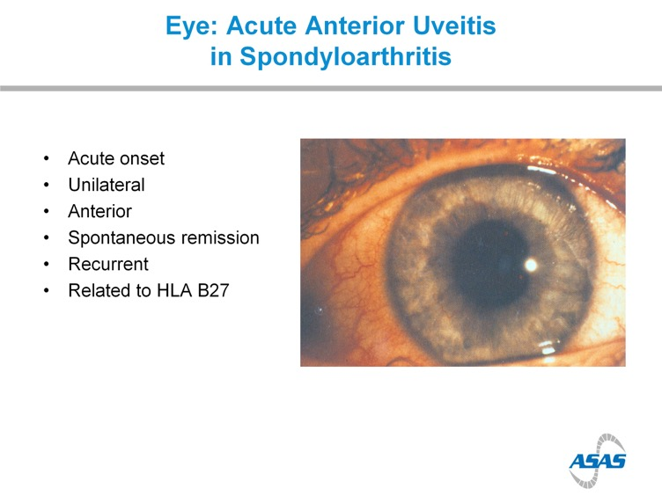
Tips
Symptoms
Patient History
Lab
Genetics
Imaging
25-40% of patients affected

Slide 35
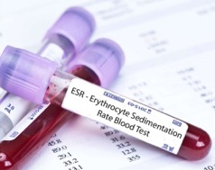
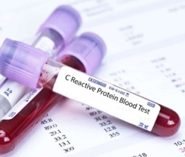

ESR & C-reactive protein
Tips
Symptoms
Levels are increased up to 70% in most As. Patient.
No relation with disease activity.
If ESR or CRP is normal this doesn’t reflect that there is no AS.
Patient History
Lab
Genetics
Imaging

Slide 36
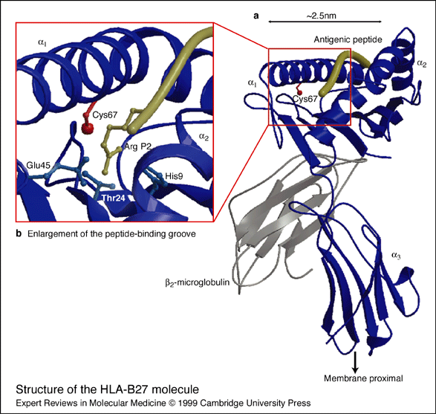
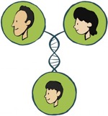
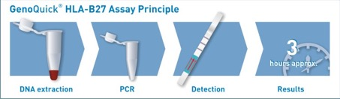
Tips
HLA-B27
Symptoms
Patient History
Lab
90% to 95% of AS patient.
Is neither necessary nor sufficient for the diagnosis of patient that their history and physical examination suggest AS.
If the radiographic finding is not clear the lab, Test may be confirmatory.
Genetics
Imaging

Slide 37
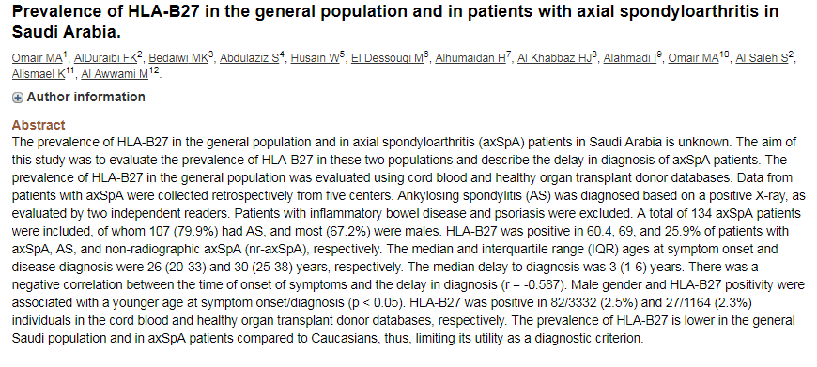
Tips
HLA-B27
Symptoms
Patient History
Lab
Genetics
Imaging

Slide 39
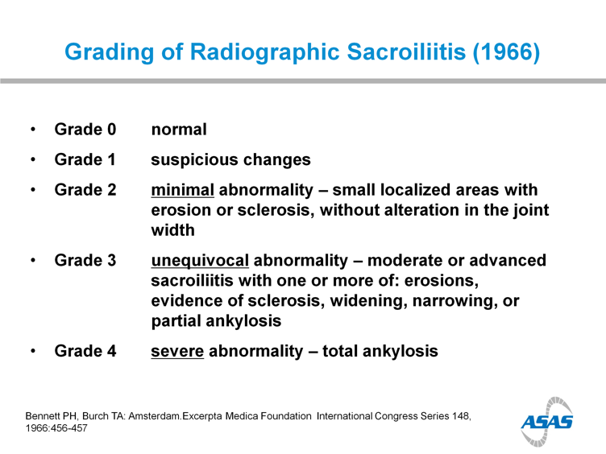
Tips
Symptoms
Patient History
Lab
Genetics
Imaging

Slide 40
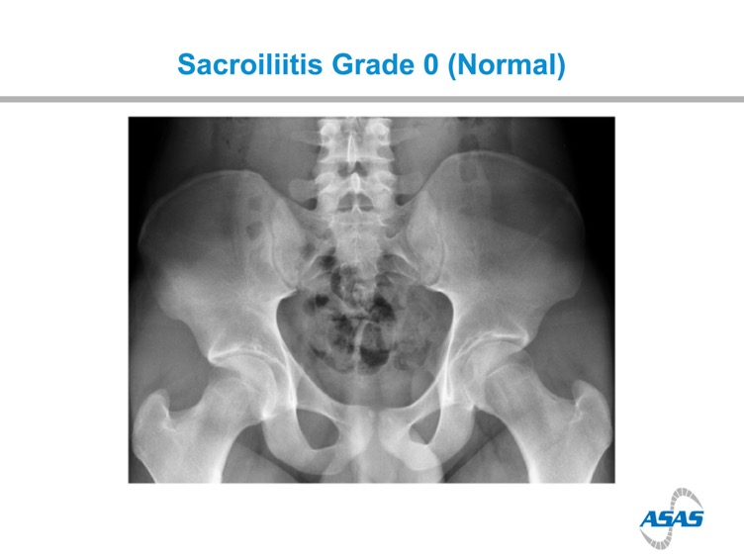
Tips
Symptoms
Patient History
Lab
Genetics
Imaging

Slide 41
Tips
Symptoms
Patient History
Lab
Genetics
Imaging

Slide 42
Q
22 y.o male.
Inflammatory back pain for a year.
Recurrent iritis.
Family Hx of SpA
Good response to NSAIDs
What's the diagnosis
Whats the next step?

Slide 44
Tips
Symptoms
Patient History
Lab
Genetics
Imaging

Slide 45
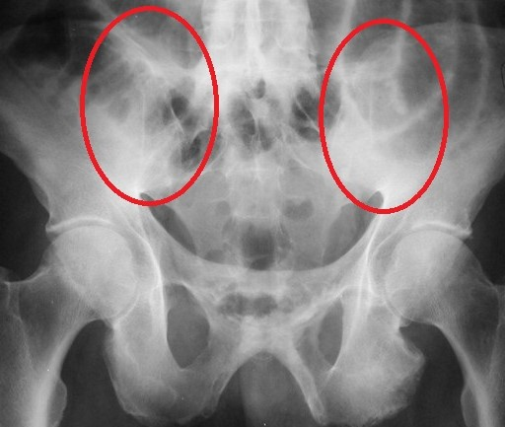
Tips
Symptoms
Patient History
Lab
Genetics
Imaging

Slide 46
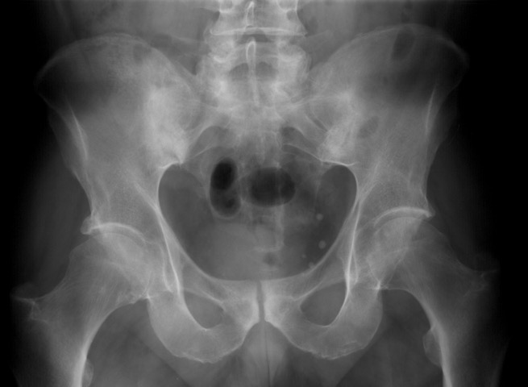
Bilateral Grade 3 Radiographic Sacroiliitis:
Bony Changes
Inflammation is not Visible on Plain X-ray
Tips
Symptoms
Patient History
Arrows point to sacroiliac (SI) joints
*Note loss of the clear SI joint line and “fluffy” white area surrounding both SI joints
Lab
Genetics
Imaging

Slide 47
Bilateral Grade 3 Radiographic Sacroiliitis:
Bony Changes
Inflammation is not Visible on Plain X-ray
Tips
Symptoms
Patient History
Arrows point to sacroiliac (SI) joints
*Note loss of the clear SI joint line and “fluffy” white area surrounding both SI joints
Lab
Genetics
Imaging

Slide 48
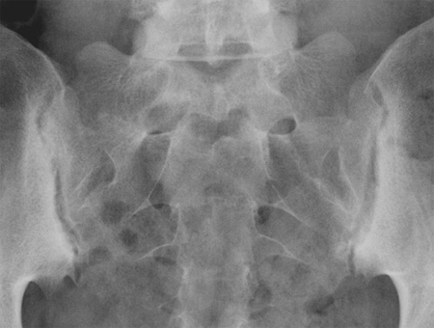
Bilateral Grade Radiographic Sacroiliitis:
Bony Changes
Tips
Symptoms
Patient History
Lab
Genetics
Imaging

Slide 49
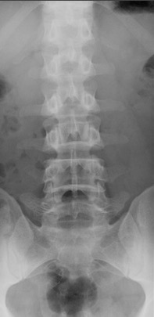
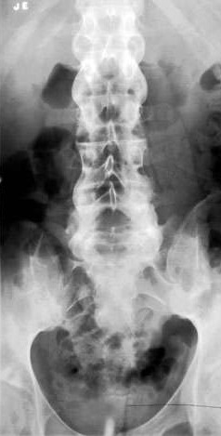
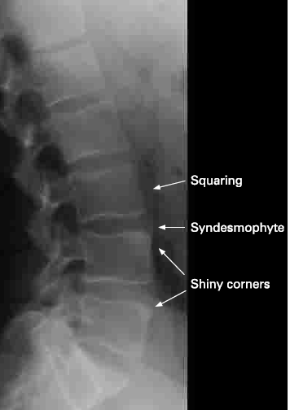
Spondylitis
Tips
Symptoms
Patient History
Lab
Genetics
Imaging
Normal
Ankylosing Spondylitis:
Bamboo Spine, Lumbar Vertebrae
Rheumatology Image Bank 2011 ACR AS Bamboo Spine Image 99-07-0044
Kelley’s Textbook of Rheumatology. 2009:813.: Figure 53-58. Radiopaedia.org

Slide 50
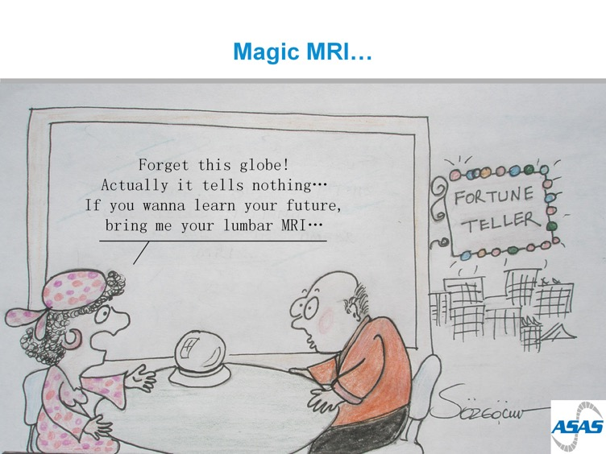
“Ask Your Patients to bring their lumber MRI"

Slide 51
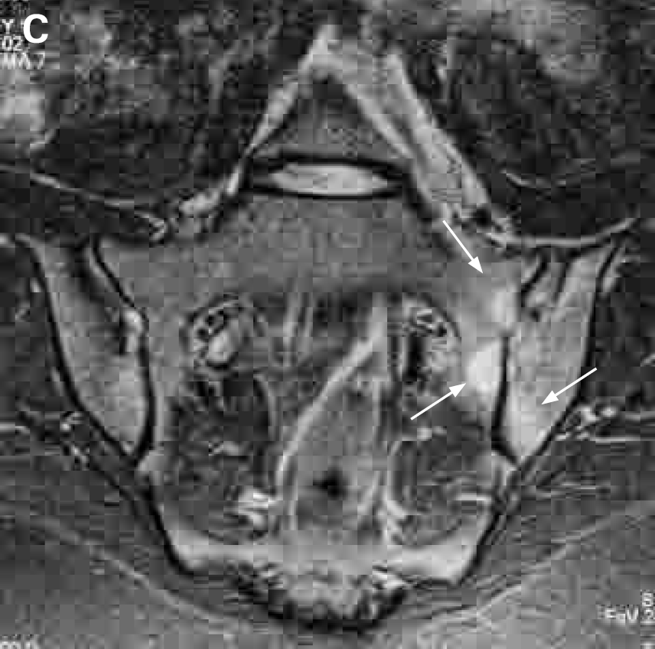
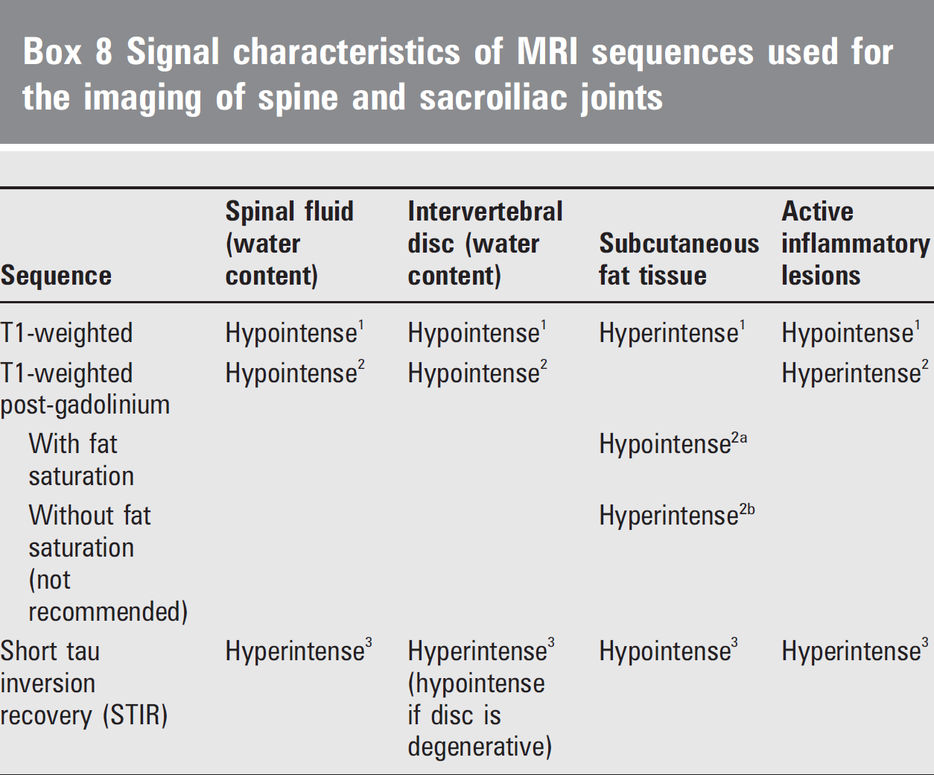

Slide 52
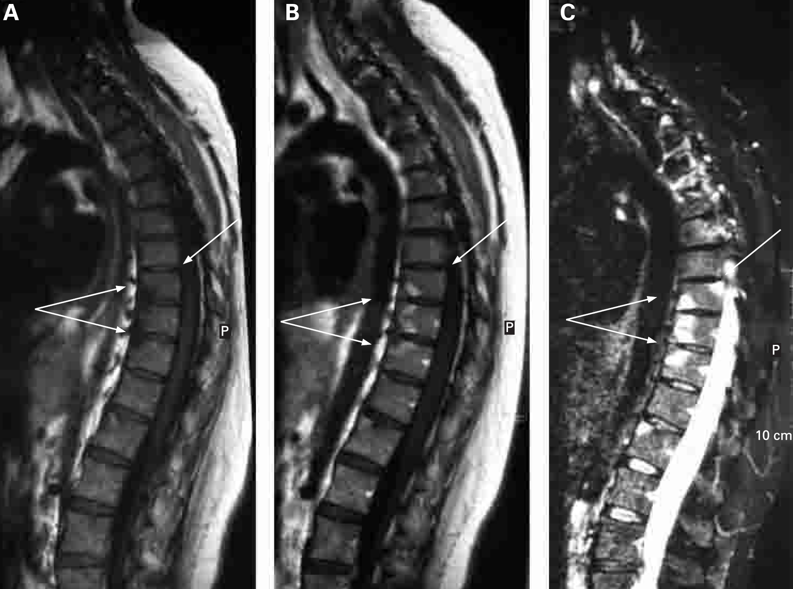
MRI

Slide 53
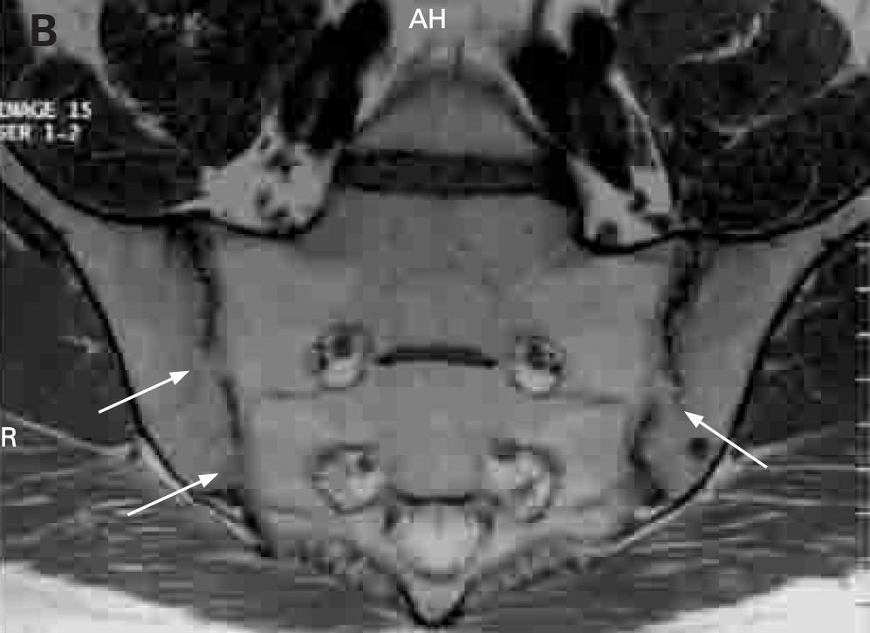
MRI

Slide 54
MRI

Slide 55
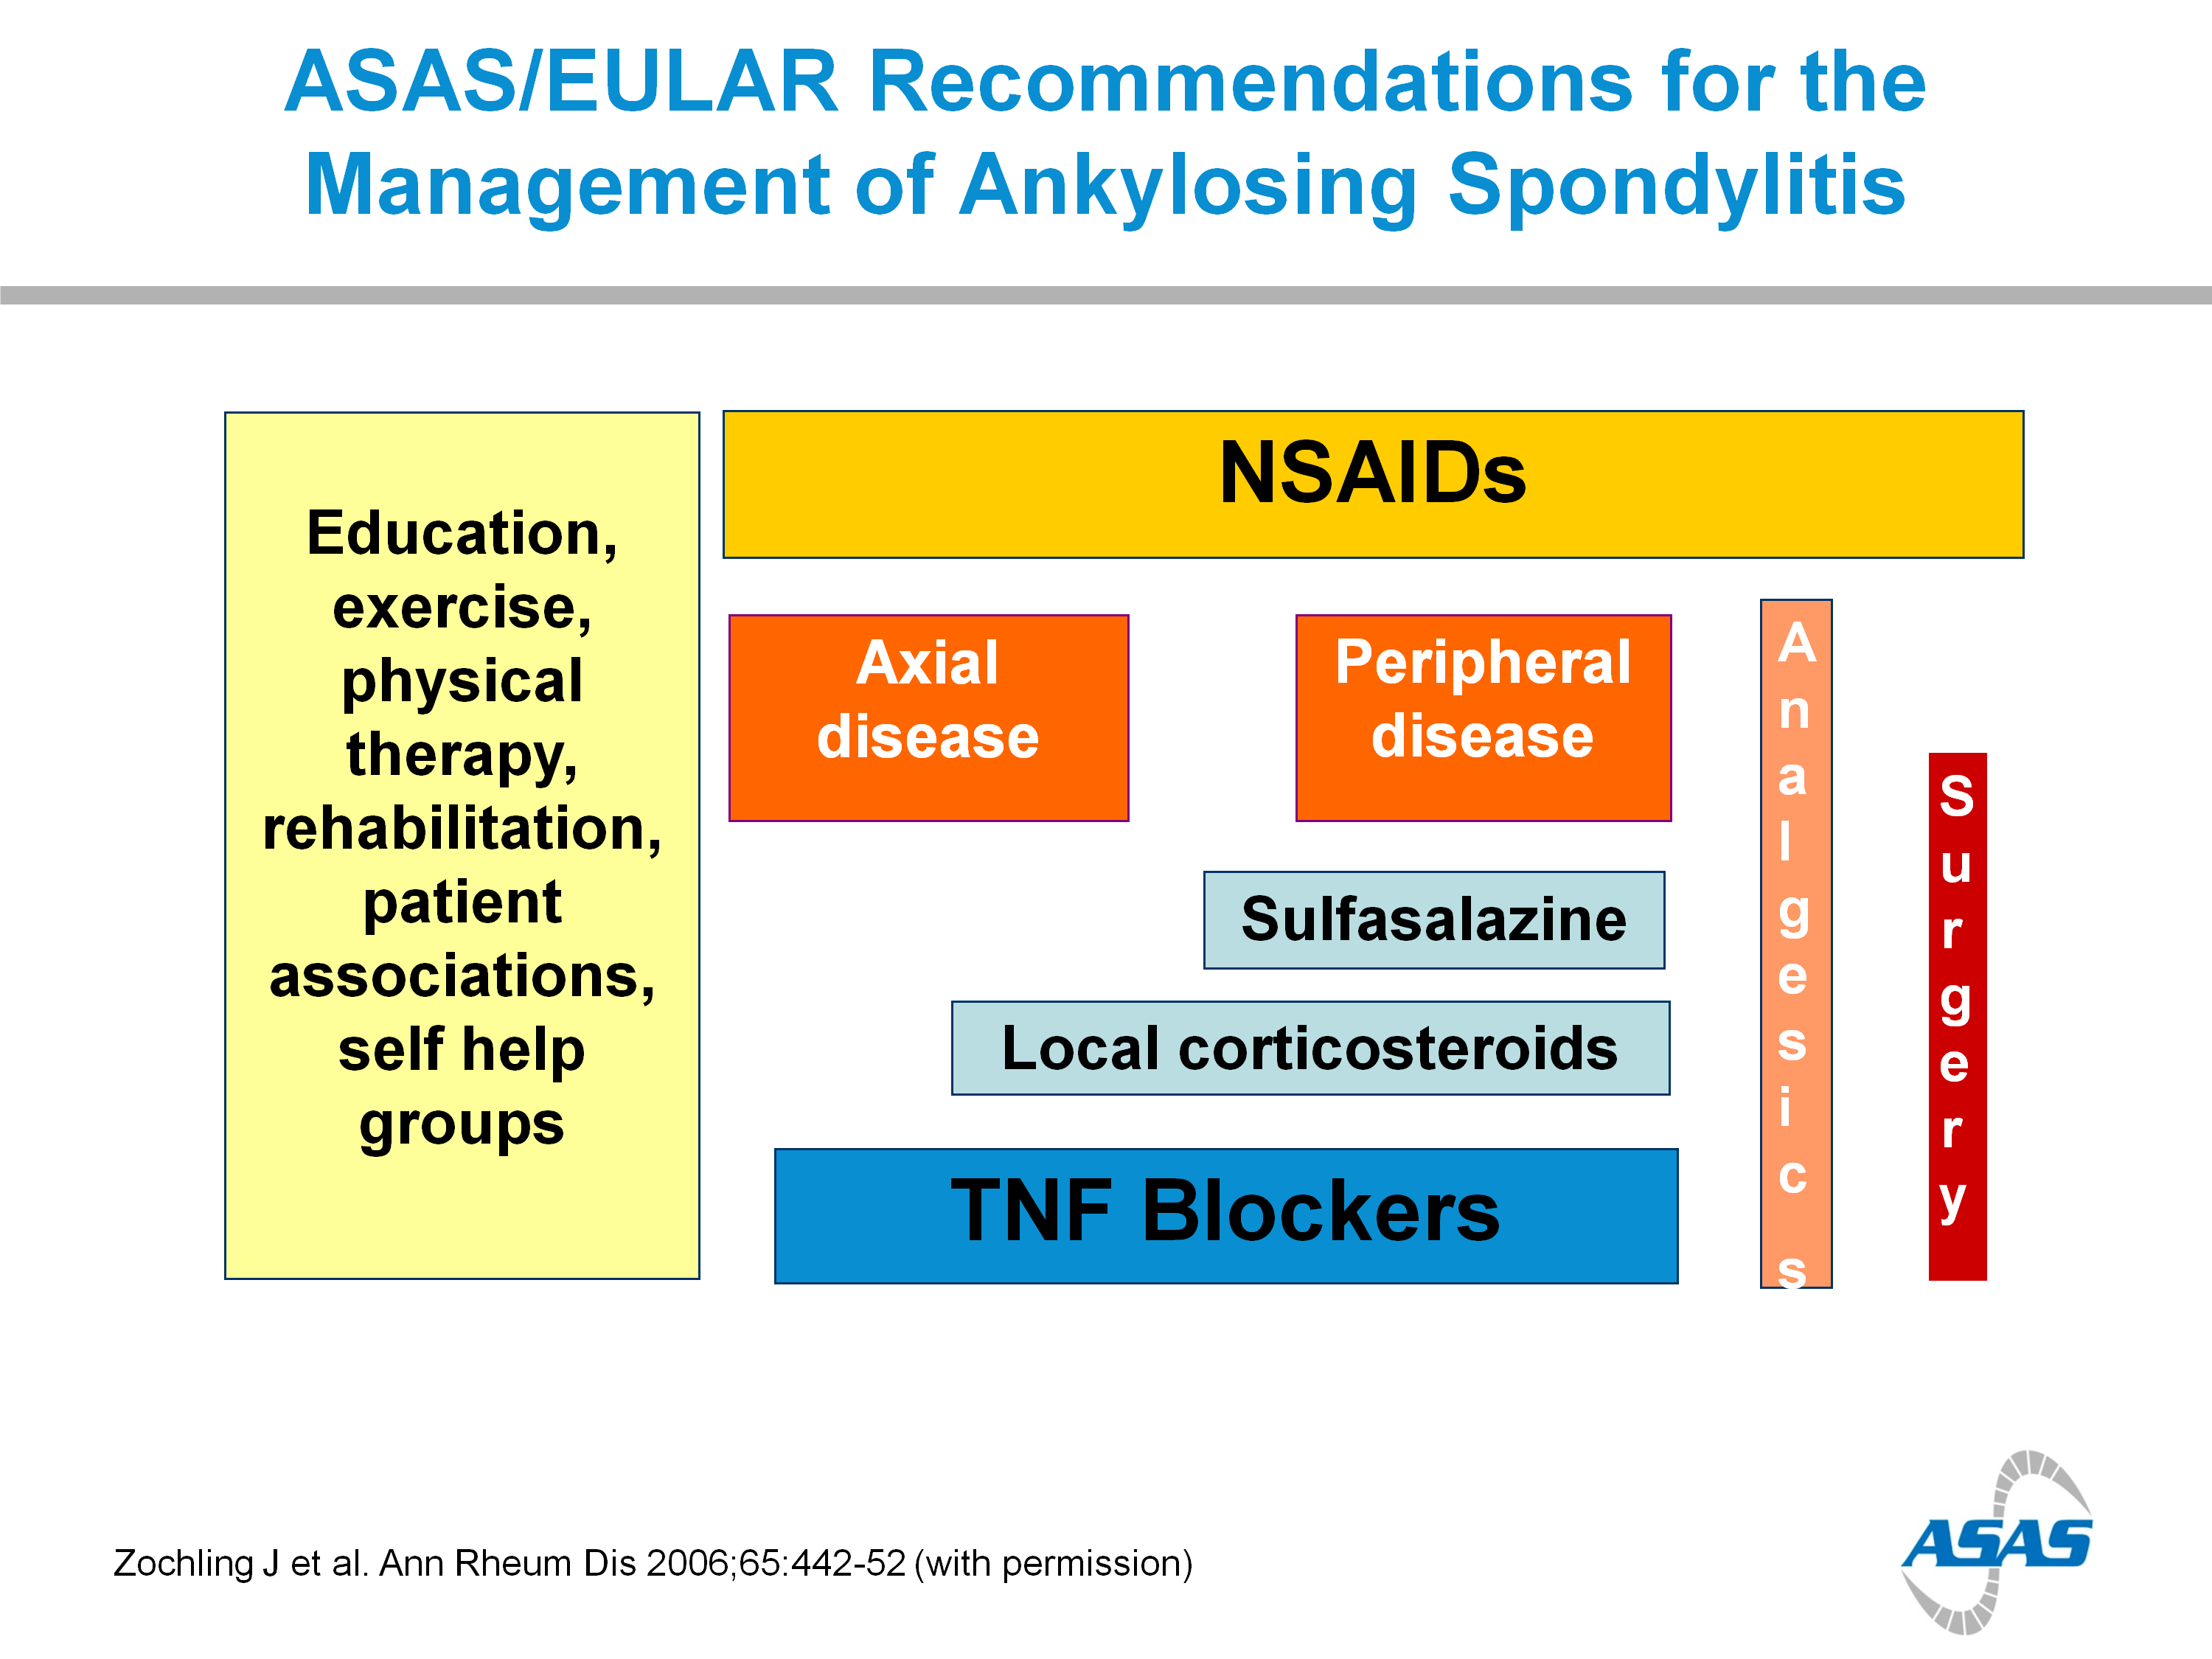

Slide 56
Complex
disease
SpA - Complex Overlapping diseases
Axial
Spondyloarthritis
Periphere
Spondyloarthritis
PsA
ReA
nr-axSpA
AS
IBD-SpA
Undifferentiated
Periphere SpA

Slide 57
Updated ASAS Concept of Spondyloarthritis (SpA)
Groups Diseases into 2 Categories
van den Berg R, et al. Polskie Archiwum Medycyny Wewnętrznej. 2010;120(11):452-457.

Slide 58
Tips
Patterns
Pathogenesis
Morbidity

Slide 59
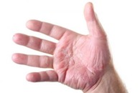
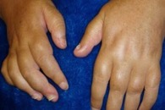
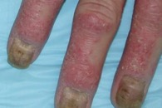
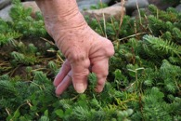

PsA is a chronic progressive disease
Skin changes
Swelling
Affected nails
Mutations
Time/Years
Psoriatic arthritis: Pictures of symptoms and progression
https://www.medicalnewstoday.com/articles/316877.php

Slide 60
PsA
Arthritis associated with psoriasis,
(a scaly rash, most frequently occurring on the elbows, knees, and scalp)
Identifying features
  Psoriasis
  Other manifestations such as:
    peripheral arthritis, spondylitis, tenosynovitis,
    enthesitis, dactylitis.
Tips
Patterns
Pathogenesis
Morbidity
Olivieri I, et al. Imaging of psoriatic arthritis Reumatismo. 2007;59 Suppl 1:73-6
Khan MA. Ann Intern Med. 2002 Update on Spondyloarthropathies Page 900
Kelley’s Textbook of Rheumatology, 8th ed, 2009:685–686

Slide 61
PsA
Psoriatic plaques typically precede development of the arthritic component.
  7–42% of psoriasis (Ps) patients (in patient populations with severe Ps) may develop PsA.
  No correlation between the severity of psoriatic plaques and PsA has been identified.
Equal gender distribution. (♂ : ♀)
Peak years of onset typically between the ages of 20 and 40
Tips
Patterns
Pathogenesis
Morbidity
Kelley’s Textbook of Rheumatology. 2009, Page 1201-1204
Moll JM, et al Semin Arthritis Rheum 1973;3:55–78;
Kelley’s Textbook of Rheumatology, 8th ed, 2009:1201–1206

Slide 62
Patterns in PsA
Pattern | Features | Rate
Asymmetrical | Usually involves small joints, less frequently involves large joints Normally oligoarthritis (≤4 joints) | ~ 47%
Symmetrical | Involves small joints and large joints May be RF positive (clinically similar to RA) Arthritis may develop concurrently with psoriasis | ~ 25%
Spondylitis | SIJ and vertebrae affected asymmetrically More common in men May coexist with peripheral PsA Enthesitis prevalent | ~ 23%
DIP synovitis | Restricted to only DIP joints
Arthritis mutilans | Joint lysis Telescoping movement
Tips
Patterns
Pathogenesis
Morbidity
SIJ: sacroiliac joint
Gottlieb AB. Dermatol Nurs 2003;15:107–10; Harrison’s Principles of Internal Medicine, 15th ed, 2001:2003–5

Slide 63



Patterns in PsA
Some features are common to nearly all patterns of PsA:
Tips
Patterns
Morning stiffness
Nail disease
Joint pain
Pathogenesis
Morbidity
Harrison’s Principles of Internal Medicine, 15th ed, 2001:2003–5

Slide 64

Asymmetric Psoriatic Arthritis
Asymmetric psoriatic arthritis typically involves one to three joints in the body -- large or small -- such as the knee, hip, or one or several fingers.
Asymmetric psoriatic arthritis does not affect matching pairs of joints on opposite sides of the body.
Tips
Patterns
Pathogenesis
Morbidity

Slide 65

Symmetric Psoriatic Arthritis
Symmetric psoriatic arthritis affects the same joints -- usually in multiple matching pairs -- on opposite sides of the body.
Symmetric psoriatic arthritis can be disabling, causing varying degrees of progressive, destructive disease and loss of function in 50% of people with this type of arthritis.
Symmetric psoriatic arthritis resembles rheumatoid arthritis.
Tips
Patterns
Pathogenesis
Morbidity

Slide 66

Distal Interphalangeal Predominant (DIP)
Distal interphalangeal predominant psoriatic arthritis involves primarily the small joints in the fingers and toes closest to the nail.
DIP psoriatic arthritis is sometimes confused with osteoarthritis, a chronic disease that causes the deterioration of joint cartilage and bone at the joints.
Tips
Patterns
Pathogenesis
Morbidity

Slide 67

Arthritis Mutilans
Arthritis mutilans is a severe, deforming, and destructive form of psoriatic arthritis that primarily affects the small joints in the fingers and toes closest to the nail. This leads to loss of function of the involved joints.
Fortunately, this severe type of psoriatic arthritis is rare.
Tips
Patterns
Pathogenesis
Morbidity

Slide 68
Pathogenesis of PsA
Synovial hyperplasia and cellular infiltration.
  Pannus formation
  Cartilage erosion
  Prominent role for cytotoxic (CD8+) T cells
Increased levels of TNFα found in joint.
  Pro-inflammatory effect
  Stimulation of proteases
Associated enthesitis present.
Tips
Patterns
Pathogenesis
Morbidity
Veale DJ, et al. Ann Rheum Dis 2005;64(suppl 2):ii26–9 Gladman DD. Rheum Dis Clin North Am 1998;24:829–44

Slide 69
TNFα Levels in Psoriatic skin blister fluids
  In a clinical trial, TNFα levels in psoriatic skin blister fluids were found to be much greater than in healthy control subjects
Tips
160
145
Control (normal skin blister fluids)
Patterns
140
Pathogenesis
120
Psoriatic involved skin blister fluids
36×
Morbidity
100
Median blister TNFα (pg/ml)
80
N = 30
(P = 0.0001)
60
40
20
Bonifati, 384/2/Table 1
and 384/1/2
4
0
Bonifati C, et al. Clin Exp Dermatol. 1994;19:383-387.

Slide 70
Morbidity Associated With PsA
40–57% of patients have deforming erosive arthropathy*
16% of patients with at least five deformed joints*
11–19% of patients with disability*
Tips
Patterns
Pathogenesis
Morbidity
*Data published in 1987 and 1991. These data may not accurately reflect current morbidity trends following recent medical advances
Torre Alonso JC, et al. Br J Rheumatol 1991;30:245–50 Gladman DD, et al. Q J Med 1987;62:127–41

Slide 71

Diagnosis of
PsA Patients
Subclinical
Clinical
Imaging
Criteria

Slide 72


Arthritis in the presence of psoriasis is the key to clinical diagnosis.
The onset depends on the subtype:
  Delayed after psoriasis onset:
    asymmetrical, spondylitis.
  Concurrent with psoriasis:
    symmetrical.
Diagnosis is clinical and radiographic.
Subclinical
Clinical
Imaging
Criteria
Harrison's Principles of Internal Medicine, 15th ed, 2001:2003–5
Gladman DD, et al. Q J Med 1987;62:127–41

Slide 73
Clinical Features of PsA
Clinical feature | Patients (%)
Actively inflamed joints | 97
Plaque psoriasis | 94
Nail lesions | 83
DIP joint disease | 54
Morning stiffness | 52
Deformities: ≥1 / ≥5 | 43 / 16
Skin and joints flaring simultaneously | 35
Dactylitis | 33
Inflammatory neck pain and stiffness | 23
Inflammatory back pain and stiffness | 19
ACR functional class III/IV | 11
Sacroiliac stress pain | 10
Iritis | 7
Subclinical
Clinical
Imaging
Criteria
ACR: American College of Rheumatology
Gladman DD, et al. Q J Med 1987;62:127–41

Slide 74


Plaque psoriasis
Actively inflamed joints
Subclinical
97% of patients affected
Clinical
Imaging
Criteria
94% of patients affected
scaly rash, most frequently occurring on the scalp, elbows and knees
ACR: American College of Rheumatology
Gladman DD, et al. Q J Med 1987;62:127–41

Slide 75


Nails
Subclinical
Clinical
Imaging
Criteria
83% of patients affected
Fingernail pitting
ACR: American College of Rheumatology
Gladman DD, et al. Q J Med 1987;62:127–41

Slide 76



PIP and DIP synovitis
Subclinical
Clinical
Imaging
Criteria
PIP = proximal interphalangeal.
DIP = distal interphalangeal.
54% of patients affected
Kelley’s Textbook of Rheumatology, 8th ed, 2009:1087–1102
ACR: American College of Rheumatology
Gladman DD, et al. Q J Med 1987;62:127–41

Slide 77



Morning stiffness
Subclinical
52% of patients affected
Clinical
Inflammatory neck pain and stiffness
Imaging
Criteria
23% of patients affected
Inflammatory back pain and stiffness
19% of patients affected
ACR: American College of Rheumatology
Gladman DD, et al. Q J Med 1987;62:127–41

Slide 78

Subclinical
Clinical
Imaging
Criteria
ACR: American College of Rheumatology
Gladman DD, et al. Q J Med 1987;62:127–41

Slide 79
Dactylitis
Subclinical
Clinical
Imaging
Criteria
33% of patients affected
ACR: American College of Rheumatology
Gladman DD, et al. Q J Med 1987;62:127–41

Slide 80
Heel Pain - Enthesitis
Enthesitis is inflammation of Entheses.
  Entheses are sites where tendons, ligaments, joint capsules, or fascia attach to bone.
Heel Enthesitis is most common.
Subclinical
Clinical
Tenosynovitis Enthesitis
Achilles heel Enthesitis
Imaging
Criteria
Eshed I, et al. Ann Rheum Dis 2007;66:1553–9

Slide 81
Subclinical
Clinical
Imaging
Criteria
20% of patients affected

Slide 82
Subclinical
Clinical
Imaging
Criteria
25% of patients affected

Slide 83



PsA Radiologic Features
Subclinical
Characteristic peripheral joint
destruction progresses
to cause a “pencil in cup”
appearance.
In spondylitis subtype, may
also see sacroiliitis and changes in the spine.
Clinical
Imaging
Criteria
Mease, P.J., et al. J Am Acad Dermatol 2005;52:1–19
Kelley’s Textbook of Rheumatology, 8th ed, 2009:1207: Figure 72-5

Slide 84
Symptoms at presentation determine which pathway
Subclinical
Purely peripheral symptoms at time of presentation*
Axial ± peripheral symptoms at time of presentation
Clinical
Imaging
Criteria
Apply ASAS Criteria for Axial SpA¹
Apply ASAS Criteria for Peripheral SpA²
*Past inflammatory back pain allowed
¹Rudwaleit et al. Ann Rheum Dis 2009;68:777-783. ²Rudwaleit et al. Ann Rheum Dis 2011;70:25-31.

Slide 85

Subclinical
Clinical
✅
Imaging
Criteria

Slide 86










PsA Patient
Equal gender distribution
(♂ : ♀)
Age at onset 20-40 years
Neck Pain & Stiffness
Eye inflammation
Inflammatory Back Pain (IBP)
Plaque psoriasis
(a scaly rash, most frequently occurring on the elbows, knees, and scalp)
Crohn’s/ Colitis
DIP joint disease
Joints Arthritis
Nail lesions
or pitting
Tenosynovitis
(inflammation of the synovium that surrounds a tendon, typically leading to joint pain, swelling, and stiffness. It can be either infectious or noninfectious)
Dactylitis
Enthesitis
Morning stiffness
Deformities
Family History of SpA
+ve HLA-B27

Slide 87






Axial-SpA Patient Journey
Derma Clinic
Ophtha Clinic
7–42% of psoriasis (Ps) patients may develop PsA.
  No correlation between the severity of psoriatic plaques and PsA has been identified.
25% of patients may have uveitis
Pain Clinic
Family Medicine
Clinic

Slide 88






Derma Clinic
Ophtha Clinic
Family Medicine
Clinic
Pain Clinic
ESR,CRP,
HLA-B27

Slide 89








Arthritis
Dactylitis
Enthesitis
or
or
Age at onset 20-40 years old
✚
Psoriasis
Uveitis
IBP
Crohn’s/ Colitis
Family History
or
or
or
or
Yes
“Start confirmation”
-Involved joints X-ray
-HLA – B27
Connect to Rheumatologist

Slide 90
EULAR Treatment Algorithm for PsA
Phase I
Adverse prognostic factors
(± major skin involvement)
Clinical diagnosis of active psoriatic arthritis
Major skin involvement
(also in phase II–IV)
Go directly to phase II
Start NSAIDS ± local glucocorticoid injections
Consider consulting
a dermatologist
Failure phase I: go to phase II
No
Achieve target within 3–6 months
Yes
Continue
Recommendation
Phase II
Lack of efficacy and/or toxicity in phase I
(or adverse prognostic factors)
Algorithm
Contraindication for methotrexate
Predominantly axial disease or severe enthesitis
Start leflunomide
or sulfasalazine
(or cyclosporine A)
Start methotrexate
(consider appropriate dosage)
Go directly to phase III
Failure phase II: go to phase III
No
Achieve target within 3–6 months
Yes
Continue
Gossec L et al., Ann Rheum Dis. 2012 Jan;71(1):4-12

Slide 91
EULAR Treatment Algorithm for PsA
Phase III
Arthritis with adverse
prognostic factors
Lack of efficacy and/or toxicity in phase II
Arthritis without adverse
prognostic factors
Predominant axial disease or enthesis
Start a second synthetic
DMARD
Leflunomide,
Sulfasalazine,
MTX, or Cyclosporine A
(or combination therapy)
Start a
TNF-inhibitor
(± DMARD)
No
Achieve target within 3–6 months
Recommendation
Failure phase III: go to phase IV
Achieve target within 3–6 months
No
Yes
Continue
Algorithm
Phase IV
Lack of efficacy and/or toxicity in phase III
Change the
biologic treatment.
Switch to a second
TNF-blocking drug
(± DMARD)
No
Achieve target within 3–6 months
Yes
Continue
Gossec L et al., Ann Rheum Dis. 2012 Jan;71(1):4-12

Slide 92
GRAPPA Treatment Recommendations for PsA (2009)
Establish diagnosis of PsA
Peripheral arthritis
Skin and
nail disease
Axial disease
Dactylitis
Enthesitis
Recommendation
Initiate therapy:
NSAIDs
IA steroids
DMARDs ((MTX, CsA, SSZ, LEF)
Biologics
(anti-TNFs)
Initiate therapy:
Topicals
PUVA/UVB
Systemics (MTX, CsA, etc.)
Biologics
(anti-TNFs)
Initiate therapy:
NSAID
Physiotherapy
Biologics
(anti-TNFs)
Initiate therapy:
NSAID
Injection
Biologics
(anti-TNFs)
Initiate therapy:
NSAID
Injection
Biologics
(anti-TNFs)
Algorithm
Reassess response to therapy and toxicity
Ritchlin C, et al. ARD 2009; 68:1387-1394

