Slide 1
Abdominal Trauma
Thamer Nouh MD, FRCSC, FACS
Associate professor & Consultant
Trauma Surgery & Critical Care Medicine
King Saud University

Slide 2
Introduction
Solid organ injury is a leading cause of significant morbidity and mortality following injury.
Identification of serious solid organ injury may be challenging.
Many injuries, however, manifest during the initial assessment and treatment period. Thus, early identification is essential.

Slide 3
Initial Assessment and Resuscitation
Primary Survey: Identification and treatment of life threatening injuries.
Airway with cervical spine precautions
Breathing
Circulation
Disability
Exposure

Slide 4
Abdominal assessment
Vital signs and physical exam
Investigational Studies
- FAST
- DPA/DPL
- CT Abdomen/Pelvis

Slide 5
Focused Assessment with Sonography in Trauma (FAST)
First used in 1996
Rapid
Sensitivity 86-99%
May be able to detect as little as 100 ml of blood
Cost effective
Views: Pericardiac, perihepatic, perisplenic, and peripelvic spaces.
User dependent with inherent limitations of ultrasound.
Useful in unstable patient

Slide 6
CT Scan
Gold standard.
Hemodynamically normal patients!
Provides excellent imagining of solid organs (liver and spleen).
Determines the source and amount of bleeding (angio phase).
Reveals associated injuries: pancreas, genitourinary.
Poor for hollow viscous injury.

Slide 7
CT scan

Slide 8
CT scan

Slide 9
CT scan

Slide 10
Solid Organ Injuries
Difficult to diagnose on physical exam
May lead to significant blood loss
Grading of solid organs dependent on degree of hematoma, laceration, or avulsion.
Injuries may present late, leading to further difficulty in assessment and management.
The most common solid organs injured spleen and liver.

Slide 11
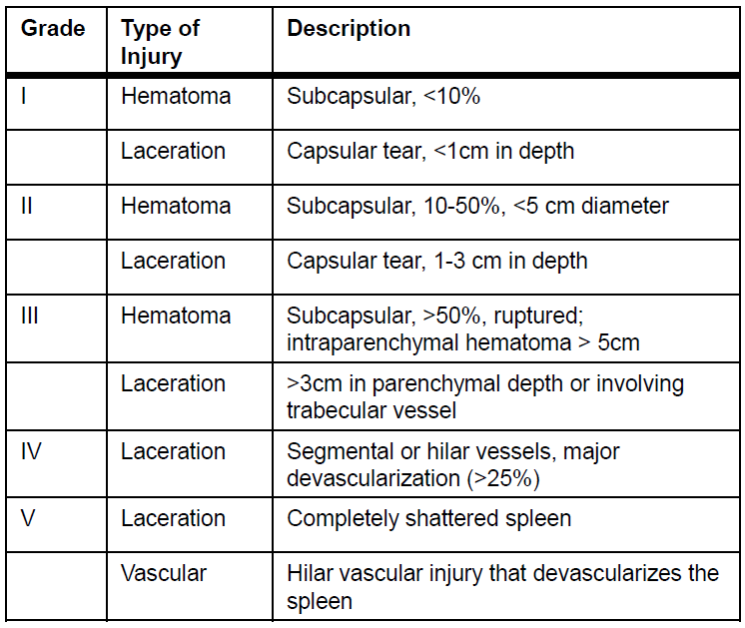
Splenic Injuries

Slide 12
Key Principles
Hemodynamically unstable patients require immediate laparotomy.
- Splenectomy
Non-operative management is an option in the hemodynamically stable patient ONLY.
No patient should die as a consequence of non-operative management.

Slide 13
Non Operative management
Intensive monitoring
Serial clinical exam, Hgb level.
High grade injury patients may require angiography +/- angioembolization to improve success rates.
Patients are told to avoid contact sports for a period of time ( up to 7 weeks).
If the patient becomes hemodynamically unstable, or requires multiple transfusions, then this is considered failure.
Failure of NOM laparotomy and splenectomy.

Slide 14
Complications of NOM
Failure!
Splenic ischemia, infection, abscess.
Chronic pain

Slide 15
Liver injuries
Classification
grade I
haematoma: subcapsular, <10% surface area
laceration: capsular tear, <1 cm parenchymal depth
grade II
haematoma: subcapsular, 10-50% surface area
haematoma: intraparenchymal <10 cm diameter
laceration: capsular tear 1-3 cm parenchymal depth, <10 cm length
grade III
haematoma: subcapsular, >50% surface area of ruptured subcapsular or parenchymal haematoma
haematoma: intraparenchymal >10 cm or expanding
laceration: capsular tear >3 cm parenchymal depth
grade IV
laceration: parenchymal disruption involving 25-75% hepatic lobe or involves 1-3 Couinaud segments
grade V
laceration: parenchymal disruption involving >75% of hepatic lobe or involves >3 Couinaud segments (within one lobe)
vascular: juxtahepatic venous injuries (retrohepatic vena cava / central major hepatic veins)
grade VI
vascular: hepatic avulsion
N.b. advance one grade for multiple injuries up to grade III.

Slide 16
Liver Injuries
Similarly, regardless of grade, a trial of non-operative management is appropriate for stable patients.
Unstable patients → laparotomy
- packing.
- packing + angio.
- deep liver sutures.
- balloon tamponade.
- hemostatic agents.
- hepatic artery ligation.

Slide 17
Liver Injuries
Laparotomy for continued blood loss with hypotension, tachycardia, decrease urine output, and decreasing HCT.
Operative rate:
- 3-11% with multiple injuries
- 0-3% when isolated

Slide 18
Biliary Tree Injury
4% incidence of continued bile leak. Increased 10 fold in Grade IV
and V injuries.
• ERCP with decompression and stenting may be both diagnostic and therapeutic.
May require operative washout for delayed bile leak and peritonitis.

Slide 19
Other Complications
Failure!
Liver ischemia, infection, abscess
Biliary leak, biloma, peritonitis.

Slide 20
Bowel Injury
Blunt
2. Penetrating: Stab, Gunshot
3. Operative

Slide 21
Mechanism
Crushing: Compression
Shearing: Sudden Deceleration
Bursting: ↑ Abdominal Pressure

Slide 22
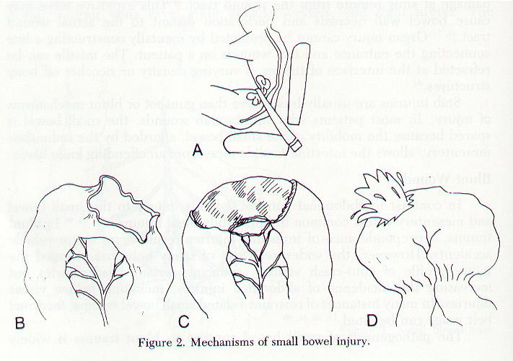

Slide 23
Causes
Motor – Vehicle: 75%
Fall from Heights
Seat Belt
Penetrating

Slide 24
Unrecognized : frequent cause of preventable death

Slide 25
Symptoms and Signs: Unreliable Often Masked:
1. Head Injury
2. Major Fractures
3. Alcohol

Slide 26
Signs
Echymosis & Abrasions
Tender ribs
Peritonitis
Tenderness and Guarding : 75%
Rebound and Rigidity: 28%
DRE
Blood from NG, DRE.

Slide 27
Management
Needs operative management
If <50% and non destructive, primary repair.
If >50% or destructive, resection and anastomosis.

Slide 28
?

