Slide 1
Mechanisms of Injury
Ahmed Alburakan, MD, MSc ,FRCSC , FRCPC
Assistant professor & consultant
King Saud University

Slide 2
Introduction
Trauma is the primary cause of death and disability between ages 1 to 44 years.
Analyzing a trauma scene is a vital skill.
Determining the events that lead to trauma, often predict the injuries encountered.

Slide 3
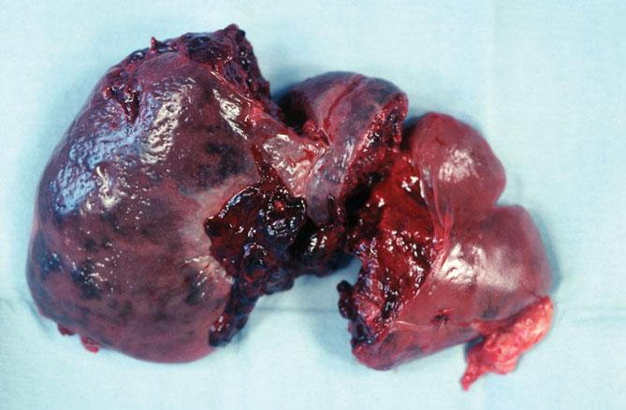
Trauma
Injury occurs when an external source of energy affects the body beyond its ability to sustain and dissipate energy.
© Shout Pictures

Slide 4
Trauma
Different forms of energy produce different kinds of trauma.
Mechanical energy
Chemical energy
Electrical energy
Barometric energy

Slide 5
Factors Affecting Types of Injury
Ability of body to disperse energy delivered
Force and energy
Size of object
Velocity
Acceleration or deceleration
Affected body area
Duration and direction
The larger the area, the more energy will be dissipated.
Position of victim

Slide 6
Factors Affecting Types of Injury
The impact resistance of body parts has a bearing on types of tissue disruption.
Organs that have gas inside are easily compressed.
Liquid-containing organs are less compressible.

Slide 7
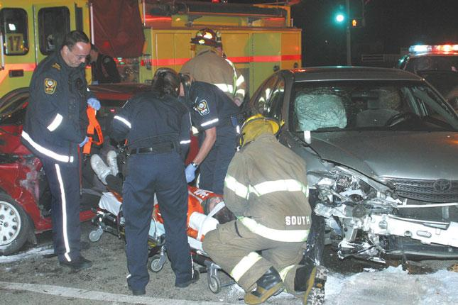
Blunt Trauma
Injuries in which tissues are not penetrated by external object
© Jack Dagley Photography/ShutterStock, Inc.

Slide 8
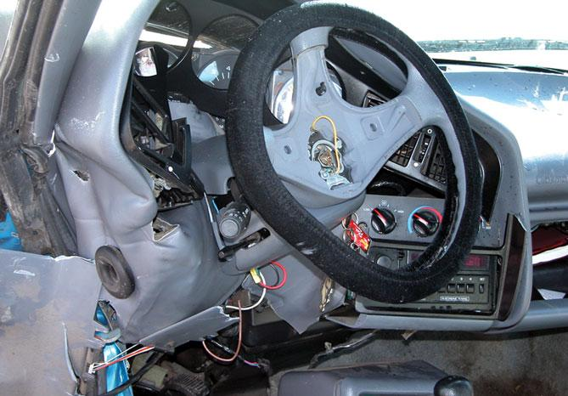
Motor Vehicle Crashes
Five phases of trauma:
Phase 1: Vehicle Deceleration
Phase 2: Occupant deceleration
Courtesy of Captain David Jackson, Saginaw Township Fire Department

Slide 9
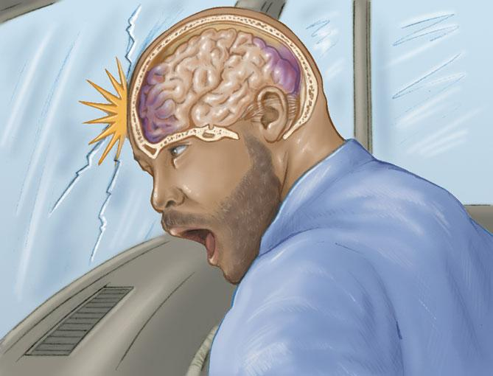
Motor Vehicle Crashes
Five phases of trauma (cont’d):
Phase 3: Deceleration of internal organs
Phase 4: Secondary collisions
Phase 5: Additional impacts received by the vehicle

Slide 10
Impact Patterns
Frontal or head-on impacts
Front end of the car distorts.
Passengers decelerate at same rate as vehicle.
Abrupt deceleration injuries are produced by a sudden stop of a body’s forward motion.

Slide 11
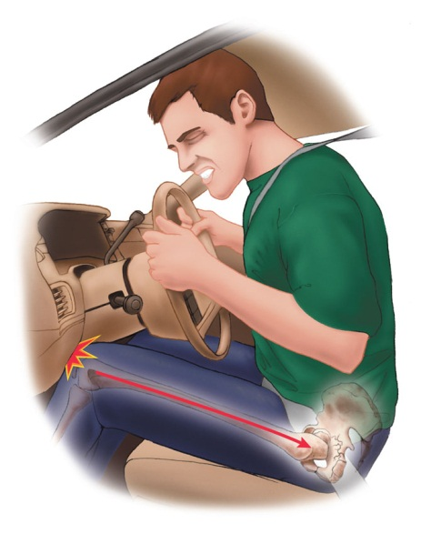
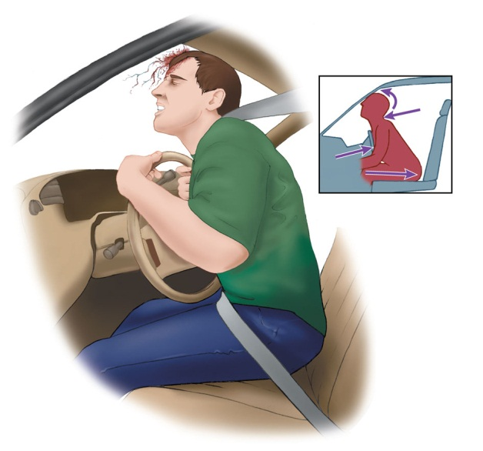
Impact Patterns
Frontal or head-on impacts (cont’d)
Unrestrained occupants usually follow one of two trajectories:
Down-and-under pathway
Up-and-over pathway

Slide 12
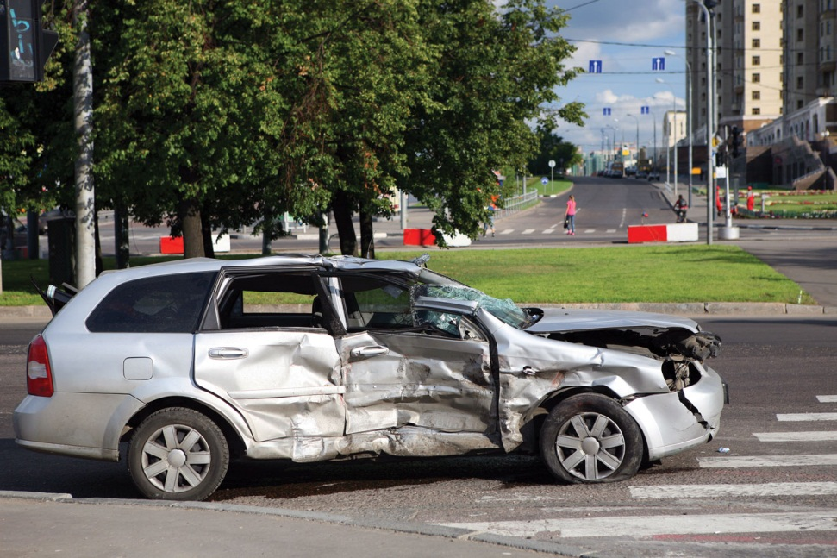
Impact Patterns
Lateral or side impacts
Impart energy to the near-side occupant
Seat belts offer little protection.
The body is pushed in one direction, while the head moves toward the impacting object.
© Alexander Gordeyev/ShutterStock, Inc.

Slide 13
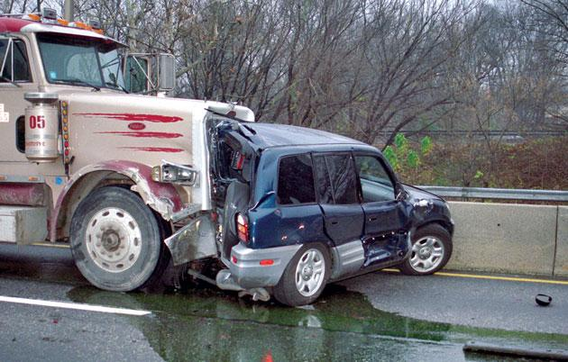
Impact Patterns
Rear impacts
Have the most survivors
Whiplash injury is common.
Energy is imparted to the front vehicle.
© Dennis Wetherhold, Jr

Slide 14
Impact Patterns
Rotational or quarter-panel impacts
Occurs when a lateral crash is off center
The vehicle’s forward motion stops, but the side continues in rotational motion.

Slide 15
Impact Patterns
Rollovers
Patients may be ejected.
Patients may be struck hard against the interior of the vehicle.
© iStockphoto/Thinkstock

Slide 16
Restrained Versus Unrestrained Occupants
Seat belts stop the motion of an occupant traveling at the same speed as the vehicle.
Associated injuries include cervical fractures and neck sprains.

Slide 17
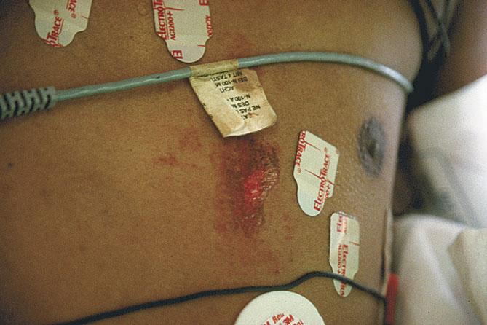
Restrained Versus Unrestrained Occupants
Air bags have reportedly reduced deaths in direct frontal crashes by about 30%.
Can also result in secondary injuries:
Direct contact
Chemicals
Courtesy of AAOS

Slide 18
Pedestrian Injuries
Three predominant MOIs:
First impact:
- Car strikes body with its bumpers.
Second impact:
- Adult is thrown on hood and/or grille of vehicle.
Third impact:
- Body strikes the ground or some other object.

Slide 19
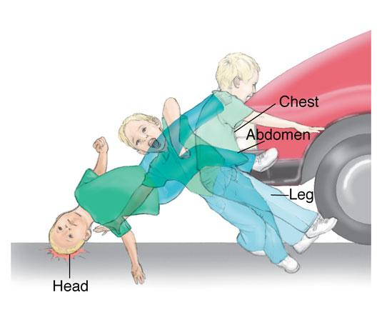
Pedestrian Injuries
Waddell triad: Pattern of injuries in children and people of short stature
Bumper hits pelvis and femur.
Chest and abdomen hit grille.
Head strikes vehicle and ground.

Slide 20
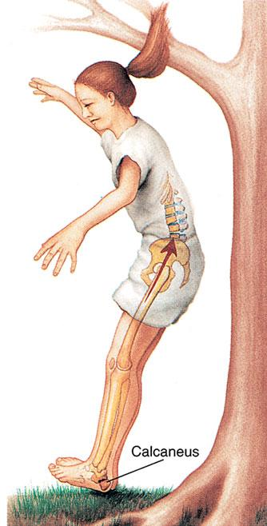
Falls from Heights
Severity of injuries impacted by:
Height
Position
Surface
Physical condition

Slide 21
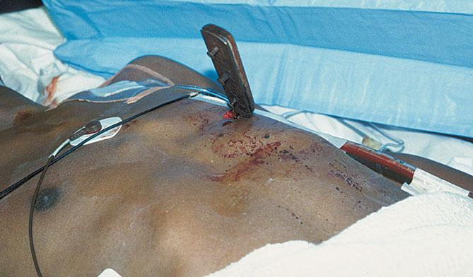
Penetrating Trauma
Involves disruption of skin and tissues in a focused area
Low velocity: Caused by sharp edges
Medium and high velocity: Object might flatten out, tumble, or ricochet.

Slide 22
Stab Wounds
Severity depends on:
Anatomic area involved
Depth of penetration
Blade length
Angle of penetration

Slide 23
Gunshot Wounds
Severity depends on:
Type of firearm
Velocity of projectile
Physical design/size of projectile
Distance of victim from muzzle
Type of tissue struck

Slide 24
Gunshot Wounds
Handgun
Revolver holds 6 to 10 rounds of ammunition
Pistol holds up to 17 rounds of ammunition
Accuracy is limited.
Shotguns
Fire round pellets
Rifles
Fire single projectile at a very high velocity
Impart a spin for accuracy

Slide 25
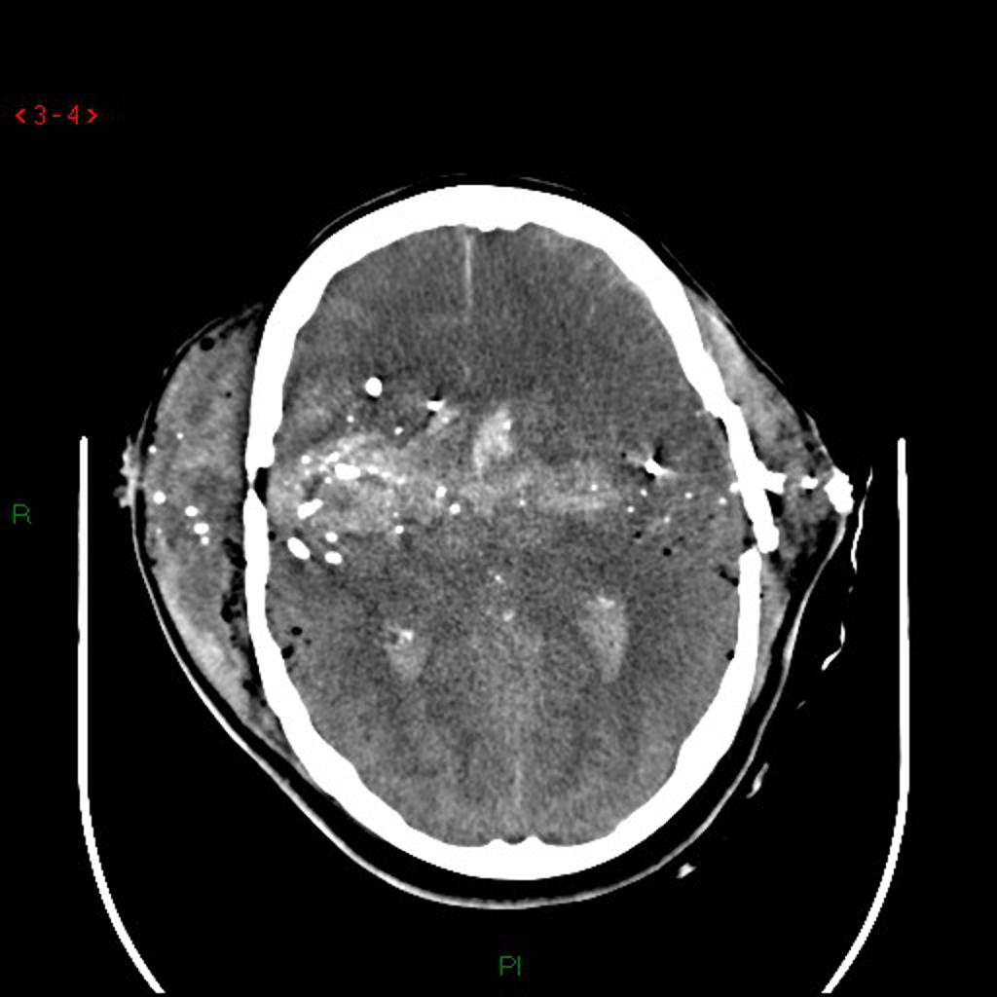
Gunshot Wounds
Projectile creates a permanent cavity.
May be straight line or irregular pathway
Pathway expansion: Tissue displacement that results from low-displacement sonic pressure
Missile fragmentation: Projectile sends off fragments that create paths through tissues.

Slide 26
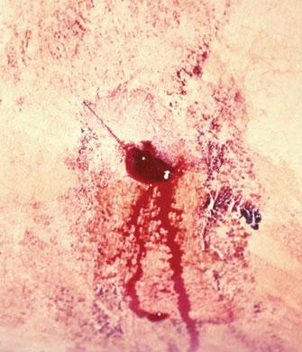
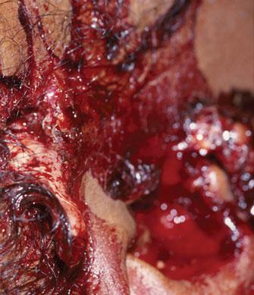
Gunshot Wounds
Exit wounds occur when projectile’s energy is not entirely dissipated.
Size depends on energy dissipated and degree of cavitation.
Entrance wound
Exit wound
© Chuck Stewart, MD
D.Willoughby/Custom Medical Stock Photography

Slide 27
Gunshot Wounds
Wounding potential depends on:
Powder charge
Size and number of pellets
Dispersion of the pellets
Range at which the weapon was fired
Barrel length
Type of choke at the end of the barrel

Slide 28
Gunshot Wounds
Try to obtain the following:
Weapon used
Range fired
Bullet used
Look for:
Powder residue around the wound
Entrance and exit wounds

Slide 29
Trauma Care

Slide 30
Goals/ Principles of Trauma Care
Rapid, accurate, and physiologic assessment
Resuscitate, stabilize, and monitor
by priority
Prepare for transfer to definitive care
Teamwork for optimal, safe patient care

Slide 31
Principles
Treat greatest threat to life first
Definitive diagnosis less important
Physiologic approach
Time is of the essence
Do no further harm
Teamwork required to succeed

Slide 32
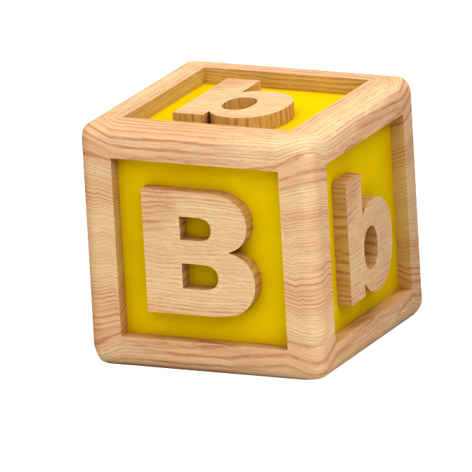
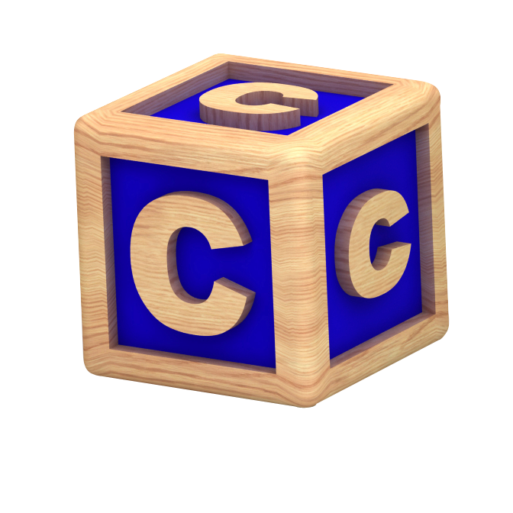
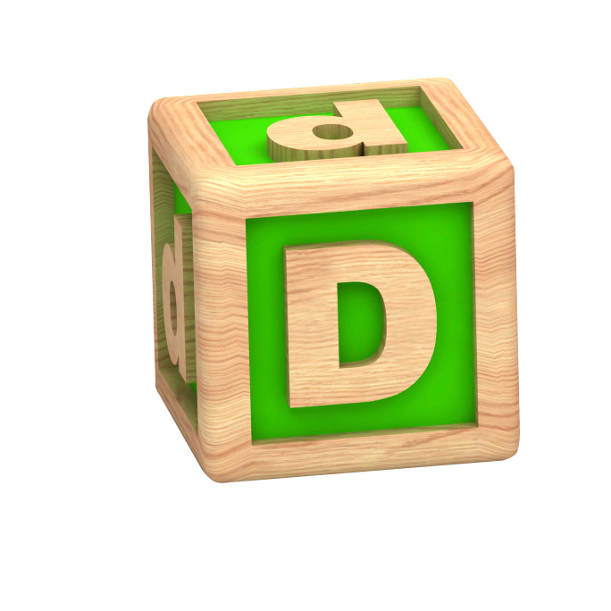
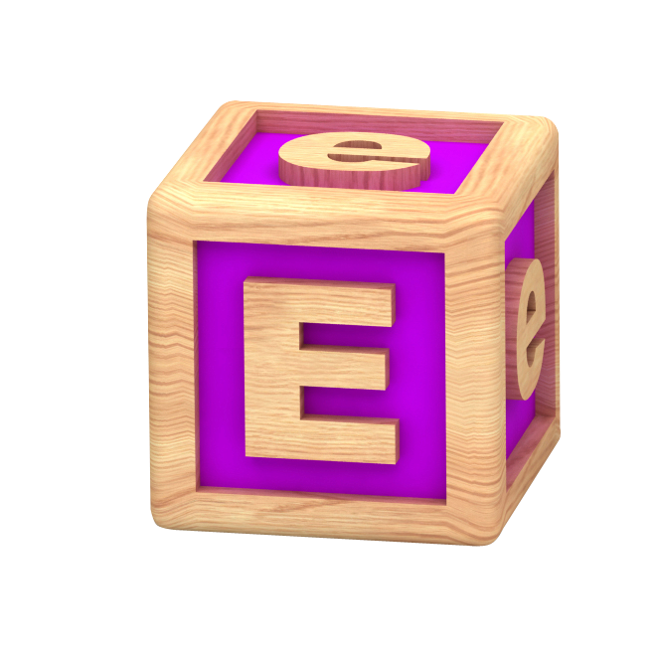
Approach
Airway with c-spine protection
Breathing/ ventilation/ oxygenation
Circulation: Stop the bleeding!
Disability (neuro status)
Expose/ Environment/ body temp

Slide 33
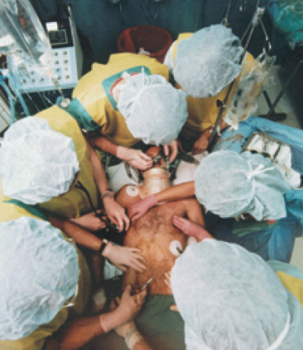
Sequence and Teamwork
Simultaneous primary survey and resuscitation of vital functions
Simultaneous secondary survey and reevaluation of vital functions

Slide 34
In-hospital Preparation
Preplanning essential
Team approach
Trained personnel
Proper equipment
Lab / x-ray capabilities
Standard precautions
Transfer agreements
QI Program

Slide 35
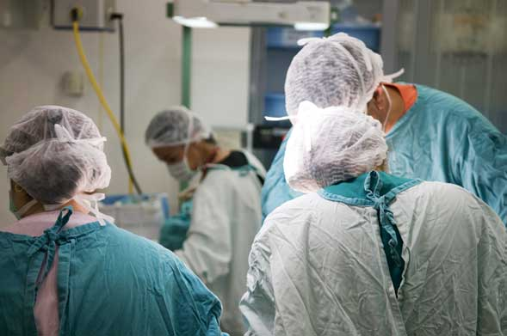
Standard Precautions
Cap
Gown
Gloves
Mask
Shoe covers
Goggles/ face shield

Slide 36
Triage
Sorting of patients according to
- ABCDE’s
- Available resources
- Other factors, e.g., salvageability

Slide 37
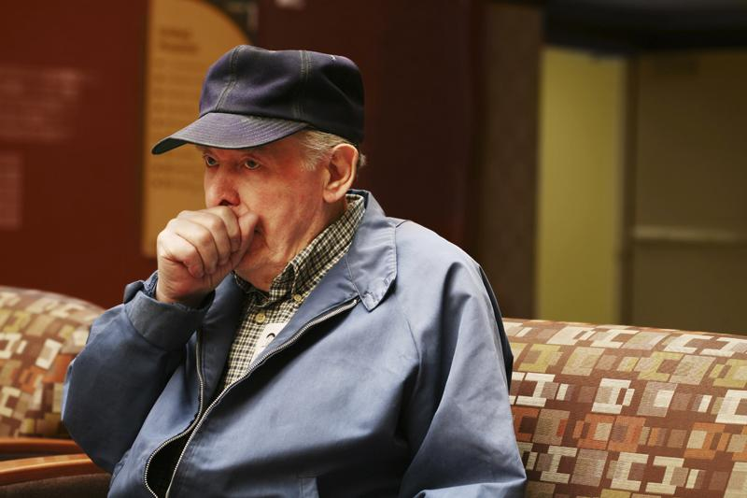
Primary Survey
Priorities are the same for all!

Slide 38
Primary Survey
A Airway / C-spine protection
B Breathing / Life-threatening chest injury
C Circulation / Stop the bleeding
D Disability / Intracranial mass lesion
E Exposure / Environment/ Body temp

Slide 39
Primary Survey: Airway
Assess for airway patency
Snoring
Gurgling
Stridor
Rocking chest wall motions
Maxillofacial trauma/ laryngeal injury
C-Spine Injury

Slide 40
Resuscitation: Patent Airway
Chin lift/ Modified jaw thrust
Look, listen, feel
Remove particulate matter
Definitive airway as necessary
Reassess frequently
C-Spine Injury

Slide 41
Resuscitation: Assess Breathing
Chest rise and symmetry
Air entry
Rate/ Effort
Color/ Sensorium
Tension / open
pneumothorax

Slide 42
Resuscitation: Breathing
Administer supplemental oxygen
Ventilate as needed
Tension pneumothorax: Needle decompression
Open pneumothorax: Occlusive dressing
Reassess frequently

Slide 43
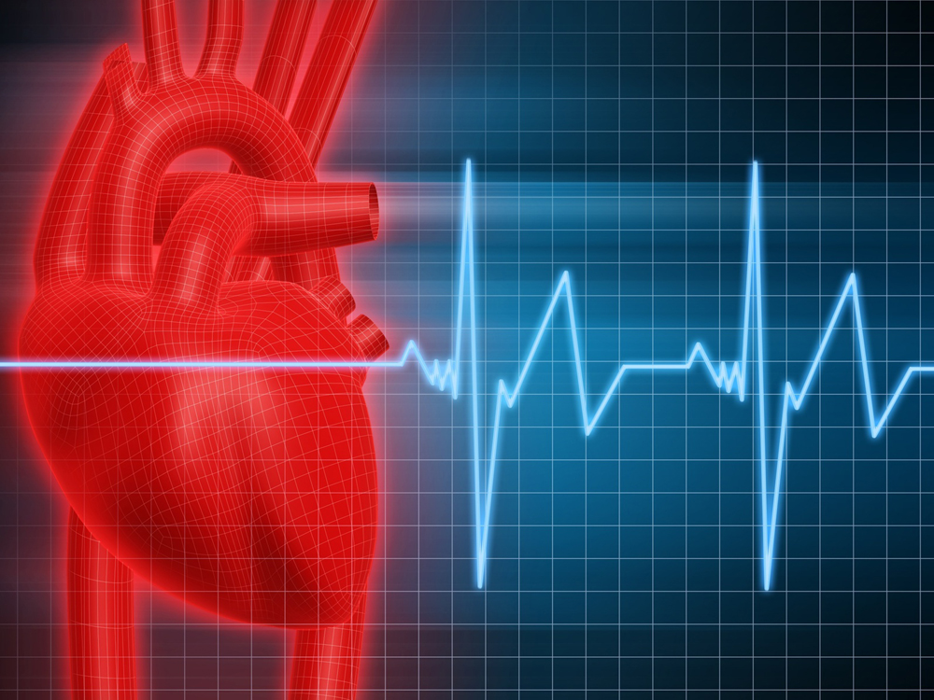
Primary Survey: Circulation
Non hemorrhagic shock
Cardiac tamponade
Tension pneumothorax
Neurogenic
Septic (late)

Slide 44
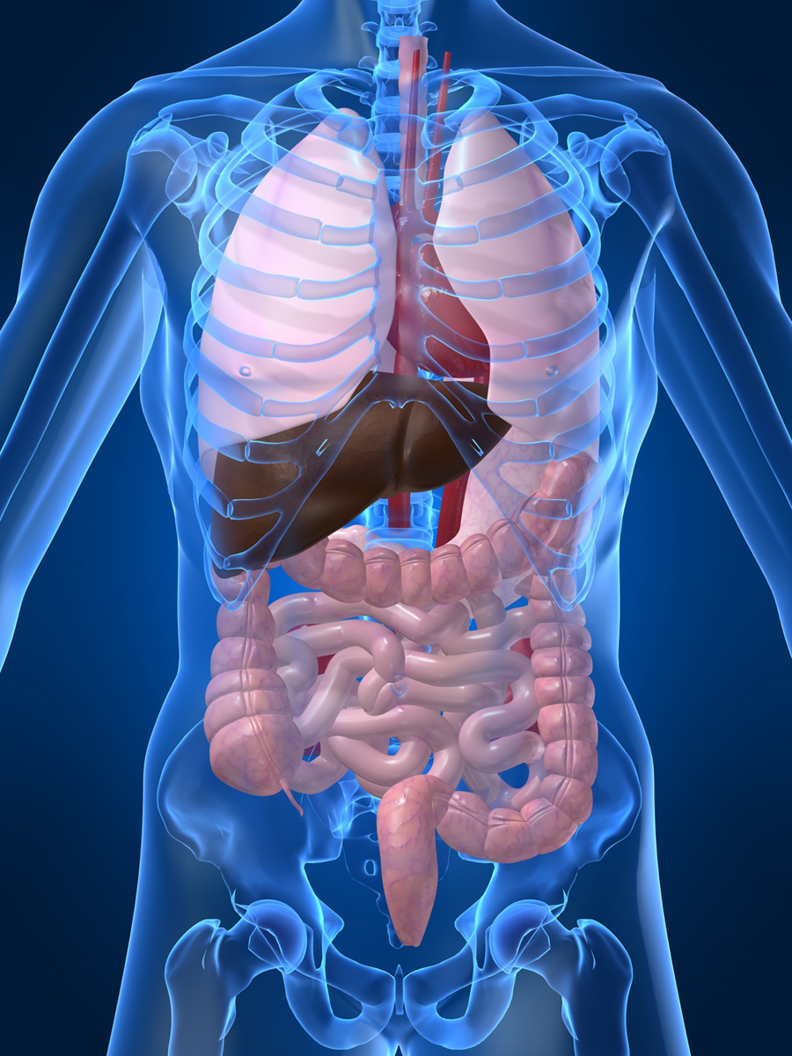
Primary Survey: Circulation
Assess organ perfusion
Level of consciousness
Skin color
Pulse rate and character

Slide 45
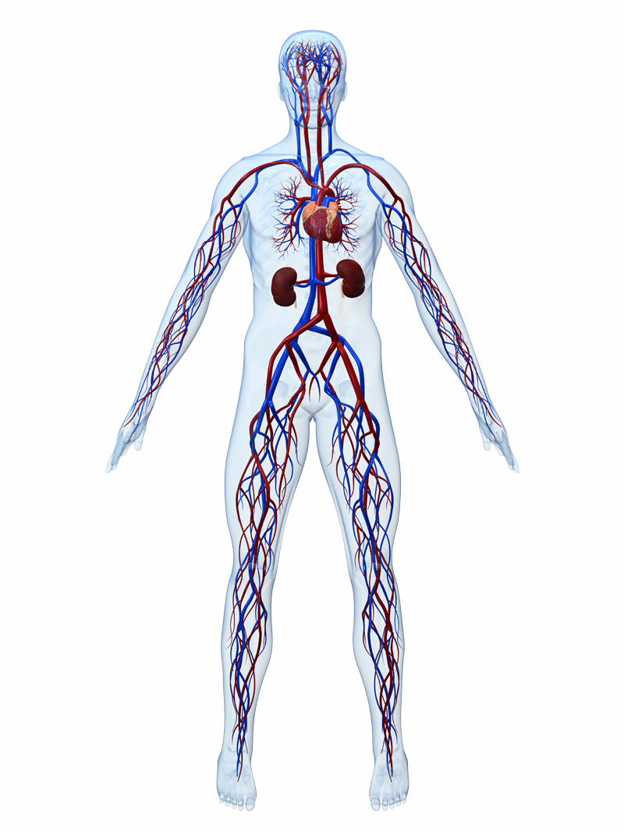
Primary Survey: Circulation
Assess Organ Perfusion
Tachycardia
Vasoconstriction
2. ↓ Cardiac output
2. Narrow pulse pressure
3. ↓ MAP
3. ↓ Blood flow
3
2
2
2
3
1

Slide 46
Resuscitation: Circulation
Bleeding?
Direct pressure
Operation
Avoid blind clamping
Find it!

Slide 47
Resuscitation: Circulation
Obtain venous access
Restore circulating volume
Ringer’s lactate, 1-2 L
PRBCs if transient response or no response
Reassess frequently

Slide 48
Resuscitation: Circulation
Consider
Tension pneumothorax: Needle decompression and tube thoracostomy
Massive hemothorax: Volume resuscitation and tube thoracostomy
Cardiac tamponade: Pericardiocentesis and direct operative repair

Slide 49
Primary Survey: Disability
Baseline neurologic evaluation
Pupillary response
Neurosurgical consult
as indicated
Observe for neurologic
deterioration

Slide 50
Primary Survey: Exposure
Completely undress the patient
Remove helmet if present
Look for visible / palpable injuries
Log roll, protect spine
Prevent
hypothermia
Notes:
50

Slide 51
Resuscitation: Overview
If in doubt, establish definitive airway
Oxygen for all trauma patients
Chest tube may be definitive for
chest injury
Stop the bleeding!
2 large-caliber IVs
Prevent hypothermia

Slide 52
Primary Survey: Adjuncts
Monitoring
Vital signs
ABGs
ECG
Pulse oximetry
End-tidal CO₂
Diagnostic Tools
Chest / pelvis x-ray
C-spine x-rays when appropriate
FAST
DPL
Consider need for transfer

Slide 53
Secondary Survey: Start After
Primary survey completed
Resuscitation in process
ABCDEs reassessed
Vital functions returning to normal

Slide 54
Secondary Survey: Key Parts
AMPLE History
Complete physical exam: Head-to-toe
Complete neurologic exam
Special diagnostic tests
Reevaluation

Slide 55
Secondary Survey: History
A Allergies
M Medications
P Past illnesses / Pregnancy
L Last meal
E Events / Environment

Slide 56
Secondary Survey
Mechanism of Injury
Anatomy
Physiology
Pattern of
Injury
Mechanism
of Injury

Slide 57
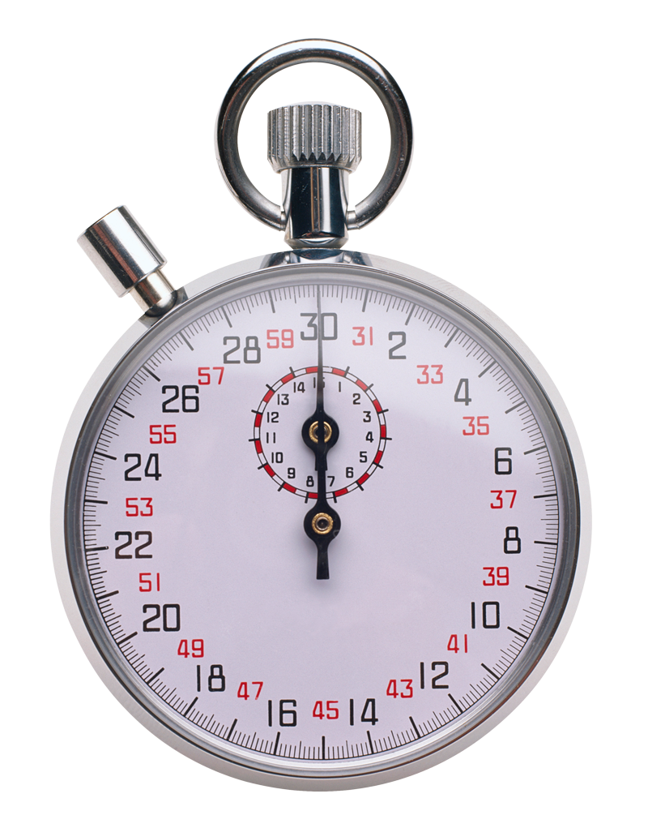
Summary
Definitive care
Primary Survey
Adjuncts
Safe transfer
Resuscitation
Continuous
Reevaluation
Secondary Survey
Adjuncts

Slide 58
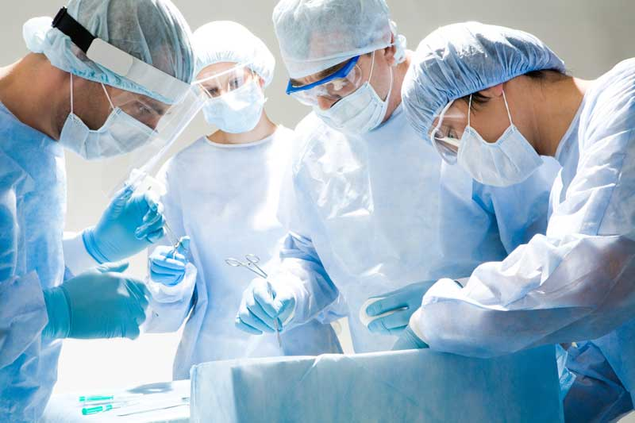
Summary
One, safe way
Do no further harm
Treat greatest
threat to life first
Teamwork

Slide 59
Thank You

