Slide 1
Overview of Noncommunicable Diseases and Related Risk Factors
Dr. Armen Torchyan
Department of Family and Community Medicine

Slide 2
Objectives
Definition of risk factors and metabolic risk factors
Common risk factors for NCDs
More in-depth discussion on 4 leading NCDs, 4 behavioral/lifestyle risk factors, and 4 metabolic risk factors
Definition
Global burden
Health effects
2

Slide 3
Types of NCDs
Cardiovascular disease (e.g., Coronary heart disease, Stroke)
Cancer
Chronic respiratory disease
Diabetes
Chronic neurologic disorders (e.g., Alzheimer’s, dementias)
Arthritis/Musculoskeletal diseases
Unintentional injuries (e.g., from traffic crashes)
http://www.who.int/gho/ncd/mortality_morbidity/en/index.html
3

Slide 4
Risk Factor: Definition
“An aspect of personal behavior or lifestyle, an environmental exposure, or a hereditary characteristic that is associated with an increase in the occurrence of a particular disease, injury, or other health condition.”
Principles of Epidemiology, CDC, 2006
8

Slide 5
Modifiable Risk Factor
A behavioral risk factor that can be reduced or controlled by intervention, thereby reducing the probability of disease.
WHO has prioritized the following four:
Physical inactivity,
Tobacco use,
Alcohol use, and
Unhealthy diets (increased fat and sodium, with low fruit and vegetable intake).
http://www.who.int/nmh/events/2012/discussion_paper3.pdf

Slide 6
Non-Modifiable Risk Factor
A risk factor that cannot be reduced or controlled by intervention; for example:
Age,
Gender,
Race, and
Family history (genetics).

Slide 7
Common Risk Factors

Slide 8
Metabolic Risk Factors
“Metabolic" refers to the biochemical processes involved in the body's normal functioning
Behaviors (modifiable risk factors) can lead to metabolic/physiologic changes.
WHO has prioritized the following four metabolic risk factors:
Raised blood pressure
Raised total cholesterol
Elevated glucose
Overweight and obesity
http://www.who.int/nmh/events/2012/discussion_paper3.pdf

Slide 9
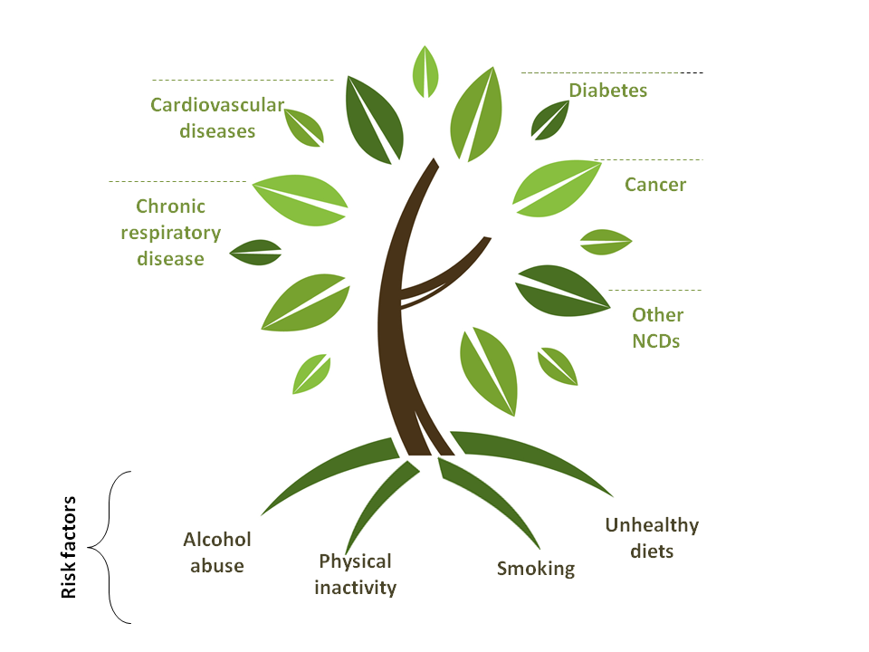
FOUR LEADING NCDs

Slide 10
WHO Website
Global Health Observatory (GHO): http://www.who.int/gho/en/
Provides data and analyses on global health priorities
Noncommunicable diseases
Mortality/morbidity
Risk Factors
Country statistics: health data and statistics for countries
Media centre fact sheets:
http://www.who.int/mediacentre/factsheets/en/
Key facts
Symptoms
Risk factors
Burden of disease

Slide 11
Cardiovascular Disease: Definition
Cardiovascular disease (CVD) is a group of disorders of the heart and blood vessels, and may include:
Coronary heart disease | Disease of the blood vessels supplying the heart muscle
Cerebrovascular disease (Stroke) | Disease of the blood vessels supplying the brain
Peripheral arterial disease | Disease of blood vessels supplying the arms and legs
Congenital heart disease | Malformations of heart structure existing at birth

Slide 12
Cardiovascular Disease: Definition (cont.)

Slide 13
Global Burden of Cardiovascular Disease
CVDs are the #1 cause of death globally.
An estimated 17.9 million people died from CVDs in 2016. (31% of all global deaths)
85% are due to heart attack and sroke
Over 80% CVD deaths occur in low- and middle- income countries.
By 2030, almost 25 million people will die from CVDs.
http://www.who.int/cardiovascular_diseases/en/

Slide 14
Cardiovascular Disease: Risk Factors
Major modifiable risk factors High blood pressure Abnormal blood lipids Tobacco use Physical inactivity Obesity Unhealthy diet (salt) Diabetes | Other modifiable risk factors Low socioeconomic status Mental ill health (depression) Psychosocial stress Heavy alcohol use Use of certain medication Lipoprotein(a)
Non-modifiable risk factors Age Heredity or family history Gender Ethnicity or race | “Novel” risk factors Excess homocysteine in blood Inflammatory markers (C- reactive protein) Abnormal blood coagulation (elevated blood levels of fibrinogen)

Slide 15
Diabetes: Definition
Diabetes is a disorder of metabolism— the way the body uses digested food for growth and energy.
There are 4 types: Type 1, Type 2, Gestational, and Pre-Diabetes (Impaired Glucose Tolerance).
Type 2 is caused by modifiable risk factors and is the most common worldwide.
>90% of all adult diabetes cases are Type 2
http://www.who.int/mediacentre/factsheets/fs312/en/
National institute of Diabetes and Digestive and Kidney Diseases, 2012

Slide 16
Diabetes: Definition
http://www.drugs.com/health-guide/type-1-diabetes-mellitus.html
21

Slide 17
Diabetes: Burden of Disease
422 million people worldwide had diabetes in 2014.
In 2014, an estimated 3.8 million people died from consequences of high blood sugar.
More than 80% of diabetes deaths occur in low- and middle-income countries.
WHO projects that diabetes deaths will increase by two thirds between 2008 and 2030.
Healthy diet, regular physical activity, maintaining a normal body weight and avoiding tobacco use can prevent or delay the onset of type 2 diabetes.
1. http://www.who.int/mediacentre/factsheets/en/ 2.http://www.idf.org/regions

Slide 18
Diabetes: Risk Factors
Major modifiable Risk Factors Unhealthy diets Physical Inactivity Obesity or Overweight High Blood Pressure High Cholesterol | Other Modifiable Risk Factors Low socioeconomic status Heavy alcohol use Psychological stress High consumption of sugar- sweetened beverages Low consumption of fiber
Non-modifiable Risk Factors Increased age Family history/genetics Race Distribution of fat | Other Risk Factors Low birth weight Presence of autoantibodies

Slide 19
Cancer: Definition
Generic term for a large group of diseases that can affect any part of the body.
“Rapid creation of abnormal cells that grow beyond their usual boundaries, and which can then invade adjoining parts of the body and spread to other
organs.”
(WHO, 2012)
Benign tumors
Malignant tumors

Slide 20
Cancer: Definition (cont.)
http://www.cancer.gov/cancertopics/cancerlibrary/what-is-cancer

Slide 21
Global Burden of Cancer
9.6 million people died from cancer in 2018.
70% of all cancer deaths occur in low- and middle- income countries.
About 30% of cancers are attributable to behavior risk factors.
The total annual economic cost of cancer in 2010 was estimated at approximately US$ 1.16 trillion
http://www.who.int/mediacentre/factsheets/fs297/en/index.html

Slide 22
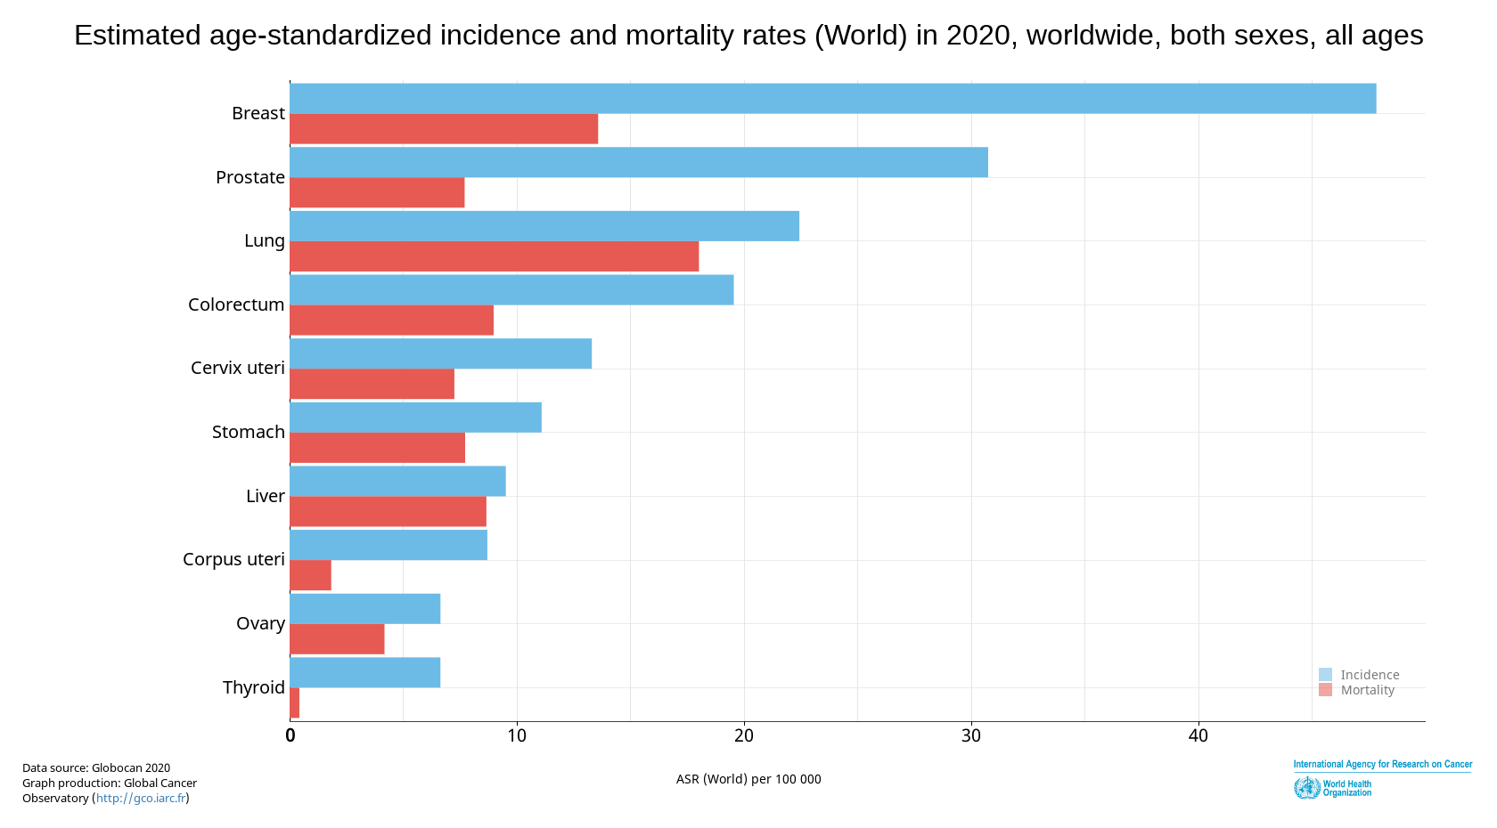

Slide 23
Cervical Cancer: Definition
Cancer of the female reproductive system:
Two cell types present (squamous and glandular)
Tend to occur where the two cell types meet
99% of cases linked to genital infection with human papillomavirus (HPV)
TAP Pharmaceuticals, “Female Reproductive Systems
28

Slide 24
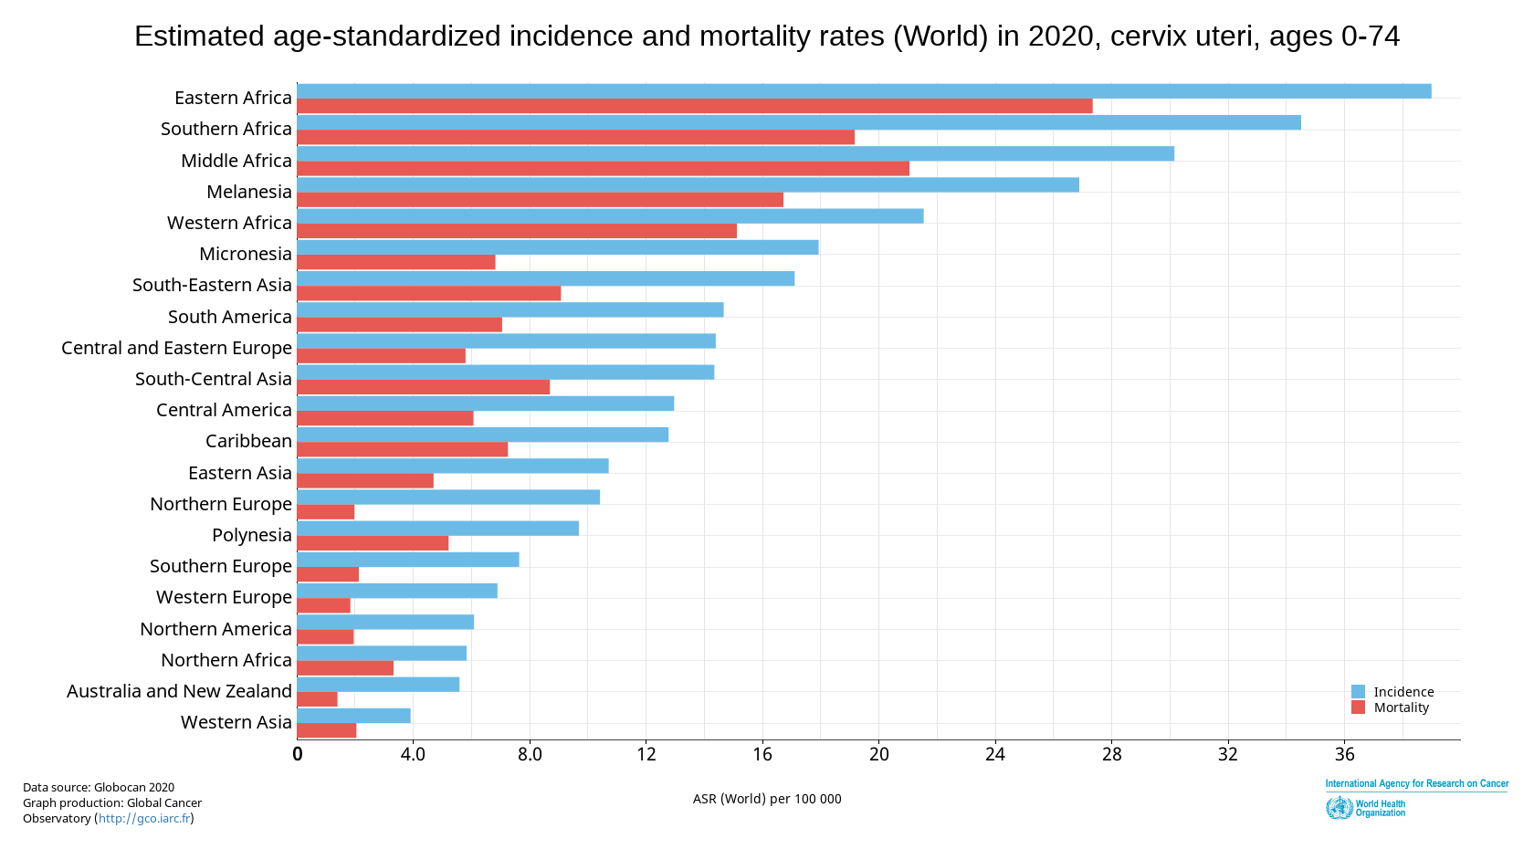
Cervical Cancer

Slide 25
Cervical Cancer: Risk Factors
Human papilloma virus infection (HPV)
Smoking
Immune Deficiencies
Poverty
No access to PAP screening
Family history of cervical cancer

Slide 26
Lung Cancer: Definition
Cancer that forms in tissues of the lung, usually in the cells lining air passages
Leading cause of cancer death globally,1.37 million deaths in 2008
Affects more men than women
Two main types:
Small cell lung cancer
Non-small cell lung cancer

Slide 27
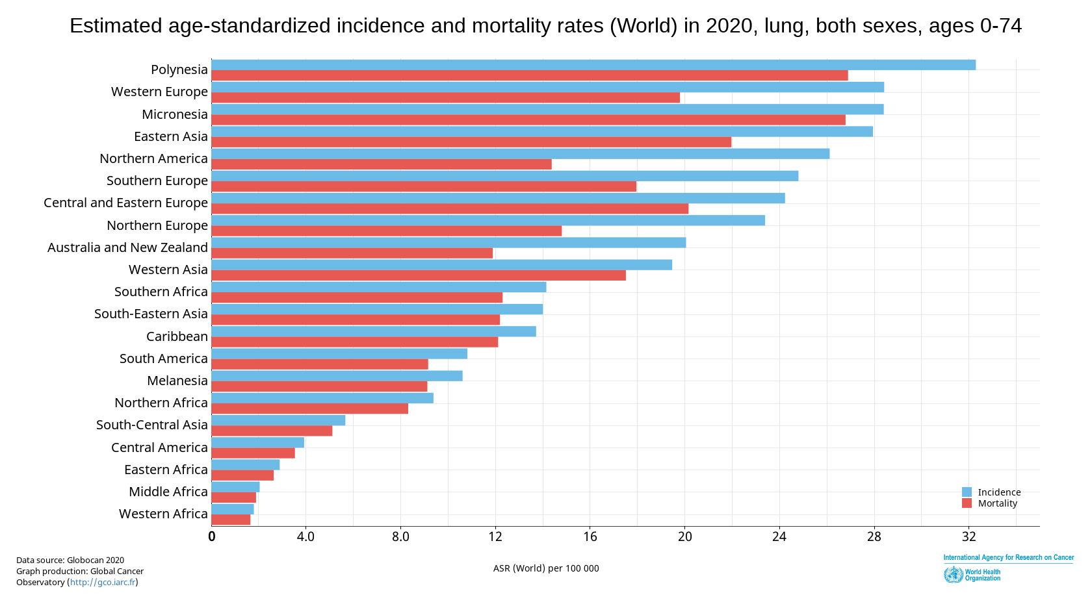
Lung Cancer

Slide 28
Lung Cancer: Risk Factors
Smoking cigarettes, pipes, or cigars - now or in the past
Being exposed to second-hand smoke
Being treated with radiation therapy to the breast or chest
Being exposed to asbestos, radon, chromium, nickel, arsenic, soot, or tar
Living where there is air pollution

Slide 29
Breast Cancer: Definition
Cancer that forms in the tissues of the breast, usually in the ducts or in the lobules
Occurs commonly in women, rarely occurs in men
1 of 8 women will be diagnosed with breast cancer in her lifetime.

Slide 30
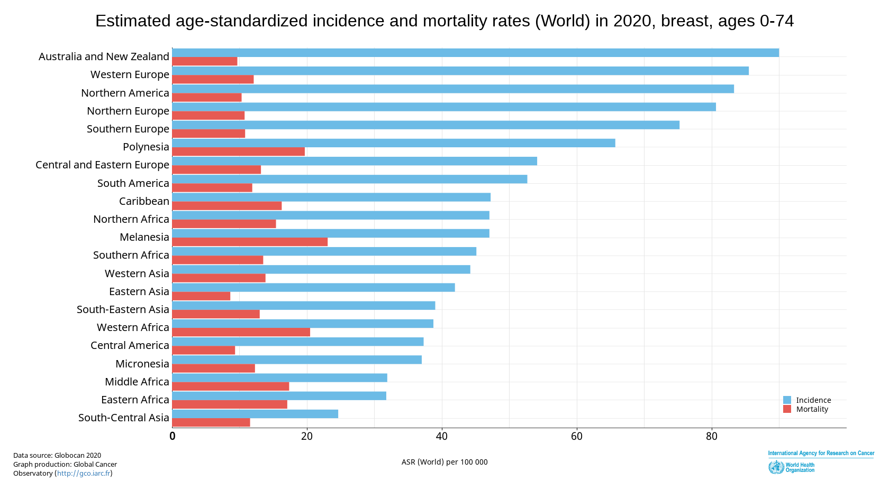
Breast Cancer

Slide 31
Breast Cancer: Risk Factors
Hormone therapies
Weight and physical activity
Race
Genetics or family history
BRCA1 and BRCA2 genes
Age is the most reliable risk factor!
Risk increases with age

Slide 32
Prostate Cancer
2nd most common cancer among men
The cancer develops inside of the prostate gland.
Risk factors: age, race, obesity, weight gain
Mortality Rate
Year
http://globocan.iarc.fr/factsheet.asp

Slide 33
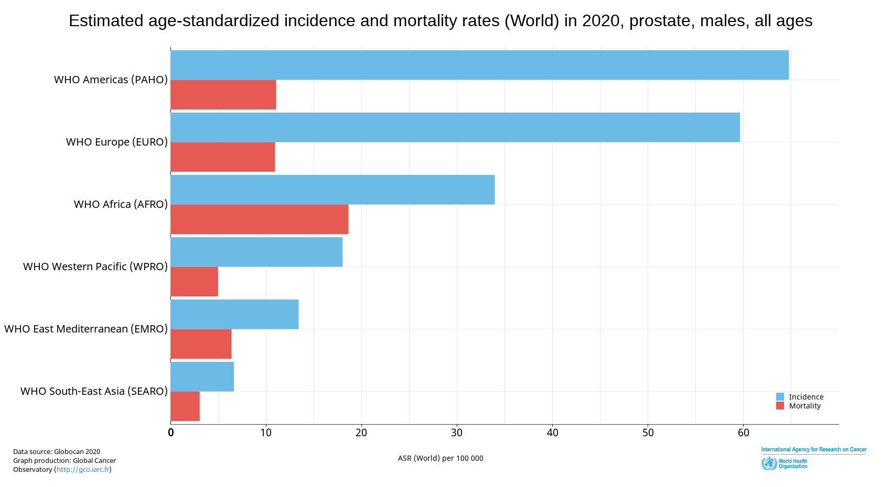
Prostate Cancer

Slide 34
Colorectal Cancer
3rd most common type of cancer
Forms in the lower part of the digestive system (large intestine)
Risk Factors include:
Aging
Black race
Unhealthy diet and low exercise
Diabetes
Family history of colorectal cancer
http://www.mayoclinic.com/health/colon-cancer/DS00035

Slide 35
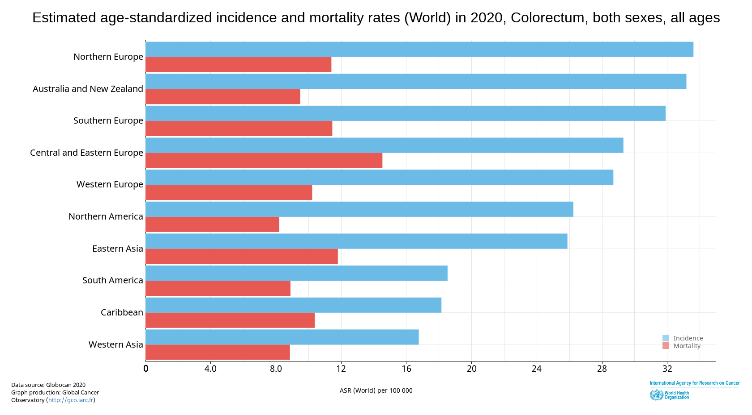
Colorectal Cancer

Slide 36
CHRONIC RESPIRATORY DISEASES

Slide 37
Global Burden of Chronic Respiratory Disease
A leading cause of death
High under-diagnoses rates
90% of deaths occur in low-income countries
http://www.who.int/respiratory/about_topic/en/index.html
42

Slide 38
Chronic Respiratory Diseases: Shared Risk Factors
Genes
Infections
Socio-economic status
Aging Populations
http://www.goldcopd.org/other-resources-gold-teaching-slide-set.html

Slide 39
Why Risk Factors?
Surveillance for non-communicable disease can be difficult because of:
Lag time between exposure and health condition,
More than one exposure for a health condition, and
Exposure linked to more than one health condition.
Interventions that target risk factors are needed to prevent disease.

Slide 40
Risk Factor Surveillance

Slide 41
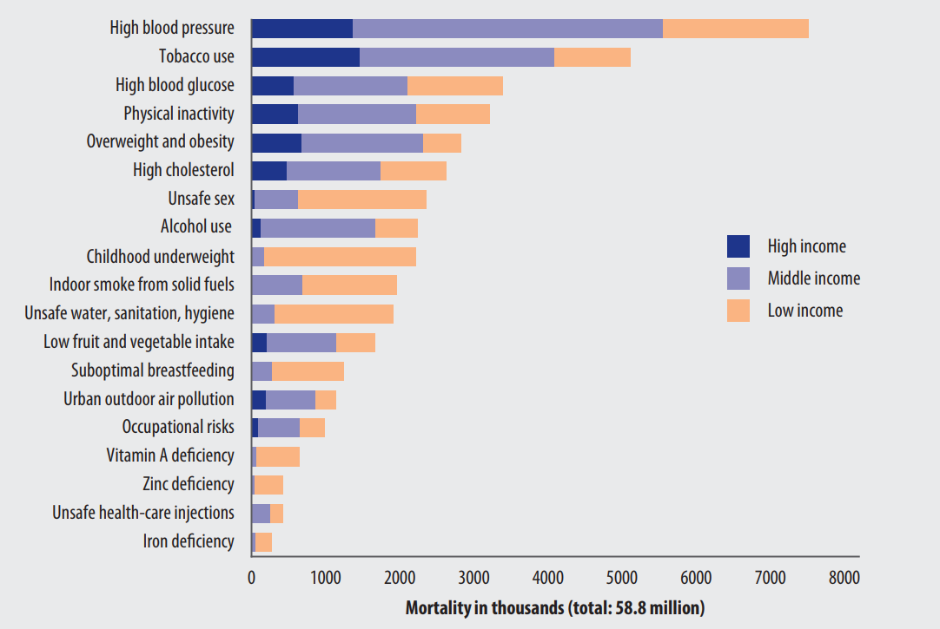
Deaths attributed to 19 leading risk factors, by country income
WHO Global Health risks report

Slide 42
Tobacco Use
Tobacco kills up to half of its users.
Tobacco kills nearly 8 million people each year.
More than 7 million deaths are the result of direct tobacco use
Around 1.2 million are the result of non-smokers being exposed to second-hand smoke.
Nearly 80% of the world’s 1.3 billion smokers live in low- and middle-income countries.
http://www.who.int/mediacentre/factsheets/fs339/en/index.html

Slide 43
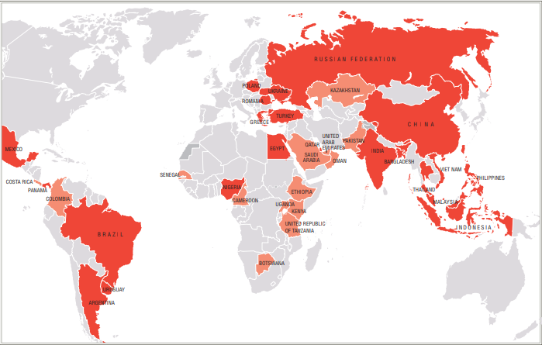
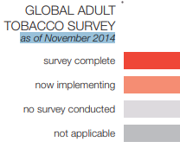
Global Adult Tobacco Survey
http://www.cdc.gov/tobacco/global/gtss/tobacco_atlas/index.htm
54

Slide 44
Tobacco Use: Health Effects
Mathers CD, Loncar D. Projections of global mortality and burden of disease from 2002 to 2030. PLoS Medicine, 2006, 3(11): e442.

Slide 45
Tobacco Use: Health Effects
(cont.)
Among smokers: •
Second-hand smoke causes:
Heart disease, including heart attack
Lung cancer
Cancer
Coronary heart disease
Diseases of the lungs
Peripheral vascular disease
Stroke
Fetal complications and stillbirth

Slide 46
DIET

Slide 47
Global Changes in Diet
Most countries have increased overall daily consumption of:
Daily calories,
Fat and meats, and
Energy dense and nutrient-poor foods such as:
Starches
Refined sugars
Trans-fats
http://www.pitt.edu/~super4/41011-42001/41171.pdf

Slide 48
Unhealthy Diet: Health Effects
Coronary heart disease
Stroke
Cancer
Type 2 diabetes
Hypertension
Diseases of the liver and gallbladder
Obesity

Slide 49
PHYSICAL INACTIVITY

Slide 50
Global Changes in Physical Activity
31% of the world’s population does not get enough physical activity.
Many social and economic changes contribute to this trend:
Aging populations,
Transportation, and
Communication technology.
http://www.cdc.gov/physicalactivity/everyone/guidelines/adults.html
http://www.sciencedirect.com/science/article/pii/S0140673612608988

Slide 51
Global Changes in Physical Activity (cont.)
Lee IM, Shiroma EJ, Lobelo F, Puska P, Blair SN, Katzmarzyk PT; Lancet Physical Activity Series Working Group. Effect of physical inactivity on major non-communicable diseases worldwide: an analysis of burden of disease and life expectancy. Lancet. 2012 Jul 21;380(9838):219-29
62

Slide 52
Physical Activity: Health Effects
Reduces:
High blood pressure
Adverse lipid profile
Arthritis pain
Psychiatric issues
Reduces risk of:
Type 2 diabetes
Certain cancers
Heart attacks
Stroke
Falls
Early death
http://www.health.gov/paguidelines/factsheetprof.aspx

Slide 53
ALCOHOL USE

Slide 54
Global Alcohol Consumption
11.5% of all global drinkers are episodic, heavy users.
2.5 million people die from alcohol consumption per year
The majority of adults consume at low-risk levels.
Estimated worldwide consumption of alcohol has remained relatively stable.
http://www.who.int/substance_abuse/publications/global_alcohol_report/msbgsruprofiles.pdf

Slide 55
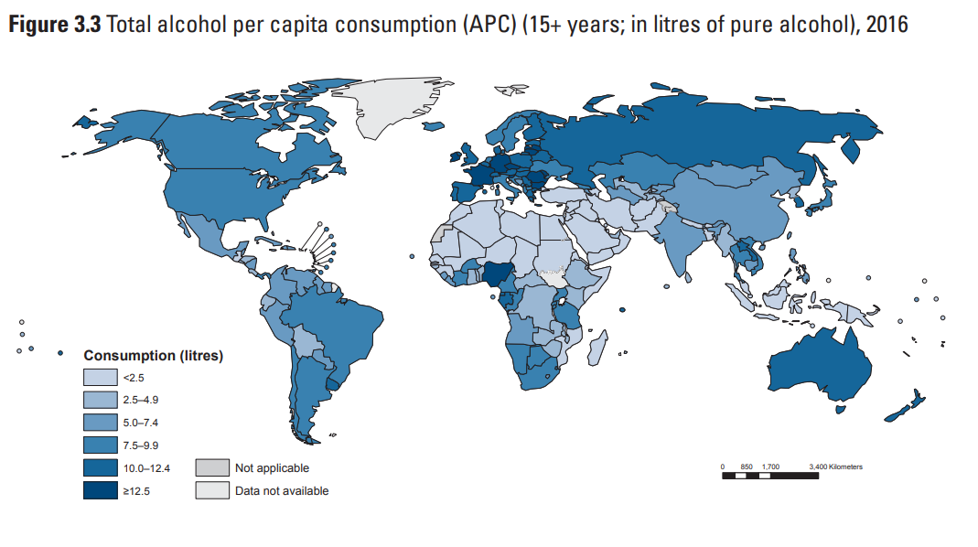
Global Alcohol Consumption
http://www.who.int/substance_abuse/publications/global_alcohol_report/en/index.html

Slide 56
Use of Alcohol: Definitions
Excessive drinking, per day
Heavy drinking – on average
> >
Binge drinking – single occasion
≥
≥

Slide 57
Alcohol Use: Effects
Immediate effects: Long-term effects:
Diminished brain function
Loss of body heat
Fetal damage
Risk for unintentional injuries
Risk for violence
Coma and death
Liver diseases
Cancers
Hypertension
Gastrointestinal disorders
Neurological issues
Psychiatric issues

Slide 58
Metabolic Risk Factors
What are the four metabolic risk factors?
Raised Blood Pressure (Hypertension)
Raised Cholesterol
Raised Blood Glucose
Overweight and Obesity

Slide 59
Raised Blood Pressure
Hypertension
(Systolic)/(Diastolic) in mm of Hg (mercury)
Systolic = amount of force your arteries use when the heart pumps
Diastolic = amount of force your arteries use when the heart relaxes
Measurement | Normal | Pre-Hypertensive | Hypertensive
Systolic mmHg | <120 | 120-139 | 140+
Diastolic mmHg | <80 | 80-89 | 90+

Slide 60
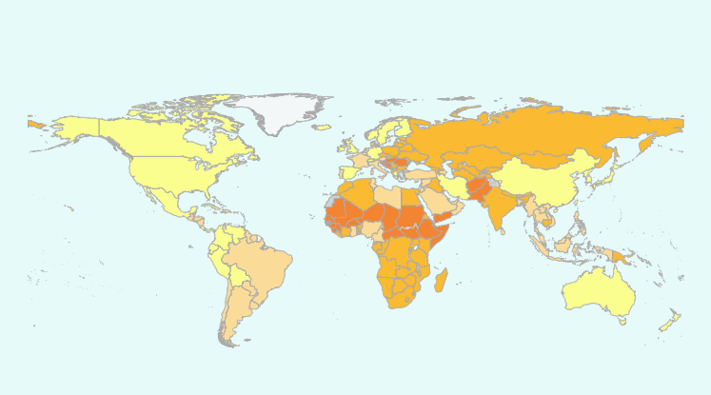
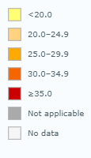
Prevalence or raised blood pressure, 2015
http://gamapserver.who.int/gho/interactive_charts/ncd/risk_factors/blood_pressure_prevalence/atlas.html

Slide 61
Raised Blood Pressure: Health Effects
Leading risk factor for stroke
Major risk factor for coronary heart disease
In some age groups, the risk of CVD doubles for each increment of 20/10 mmHg of blood pressure
Other complications of raised blood pressure:
Heart failure
Peripheral vascular disease
Renal impairment
Retinal hemorrhage
Visual impairment

Slide 62
Hypertension and Excessive Sodium Intake
Sodium, through hypertension, is a major cause of cardiovascular disease deaths and disability.
About 10% of cardiovascular disease is caused by excess sodium intake.
8.5 million deaths could be prevented over 10 years if sodium intake were reduced by 15%.

Slide 63
Sources of Sodium
People are unaware of how much dietary sodium they are eating.
In the U.S. 75% of sodium consumed comes from processed and restaurant foods.
In China and Japan, 75% of sodium consumed comes from cooking with high sodium products.

Slide 64
Recommendations and Actual Intakes WHO/PAHO
Recommendations
A population salt intake of less than 5 grams or approximately 2,000 milligrams of sodium, per person per day is recommended to reach national targets or in their absence. This level was recommended for the prevention of cardiovascular diseases.
Actual Intake
Latest global estimates show that average sodium intake varies from 2,000 to 7,200 milligrams of sodium per person per day.

Slide 65
Raised Total Cholesterol
HDL: High density lipoproteins; often called “good cholesterol”
LDL: Low density lipoproteins; often called “bad cholesterol”
VLDL: Very low density lipoproteins; has highest amount of triglycerides
Triglycerides: Type of fat found in your blood (stored in fat cells)

Slide 66
Global Burden of Raised Total Cholesterol
In 2008, global prevalence of raised total cholesterol among adults (≥ 5.0 mmol/l) was 39% (37% for males and 40% for females).
Estimated to cause 2.6 million deaths.
What is the prevalence of raised total cholesterol in your country?
Search the WHO Global Health Observatory website:
http://www.who.int/gho/ncd/risk_factors/en/index.html

Slide 67
Raised Total Cholesterol: Health Effects
Increases risks of heart disease and stroke
Globally, 1/3 of ischaemic heart disease is attributable to high cholesterol
A 10% reduction in serum cholesterol in men aged 40 has been reported to result in a 50% reduction in heart disease within 5 years
A 10% reduction in serum cholesterol in men aged 70 years can result in an average 20% reduction in heart disease occurrence in the next 5 years
http://www.who.int/gho/ncd/risk_factors/cholesterol_text/en/

Slide 68
Elevated Glucose
Sugar produces fuel and energy for our cells
Insulin helps control the amount of glucose in our bodies

Slide 69
Global Burden of Elevated Glucose
In 2012, it was estimated that elevated glucose resulted in 3.7 million deaths.
Globally, approximately 8.3% of adults aged 18 and over had elevated blood glucose in 2013.

Slide 70
Elevated Glucose: Health Effects
Elevated glucose levels can lead to type 2 diabetes.
Diabetes: leading cause of renal failure
Lower limb amputations are at least 10 times more common in people with diabetes than in non-diabetic people
Raised glucose is a major cause of heart disease and renal disease.

Slide 71
Overweight and Obesity
Overweight and obesity are defined as ''abnormal or excessive fat accumulation that presents a risk to health.” (1)
BMI - the Body Mass Index
BMI = (weight in kg)/(height in meters, squared)
- Between 25 and 29.9 indicates overweight
- 30 or higher indicates obesity
Skinfold Thickness Test
Waist-to-Hip Circumference Ratio
Men > 102 cm are considered high risk
Women > 88 cm are considered high risk
1. http://www.who.int/dietphysicalactivity/childhood_what/en/index.ht

