Slide 1
CANCER
By Dr. Haytham AlSaif
MBBS, MPH, SBFM, ABFM
Notes:
1

Slide 2
OBJECTIVES
Appreciate the Global impact of cancer.
Identify the most prevalent cancers worldwide, in the region and in KSA.
Identify the leading causes of cancer deaths.
Understand the cancer control continuum and explain its implication to public health.
Screening for cancer.
Understand and reflect the Kingdoms efforts to control the rising burden of Cancers in KSA.
Explain important factors and trends affecting cancer control and directions for future research.

Slide 3
BRAIN STORMING QUESTIONS….

Slide 4
True or False?
Large percentage of cancers are preventable
4
Notes:
True

Slide 5
True or False?
Preventing cancer is easier than treating cancer
5
Notes:
True

Slide 6
True or False?
Screening tests are recommended for most cancers
6
Notes:
False
Screening is recommended are available for some cancers, such as colorectal, and breast.
There are many cancers for which we do not have screening tests yet, such as pancreatic, brain, etc.

Slide 7
1-THE GLOBAL IMPACT OF CANCER
2nd leading cause of death globally.
In 2018, 18.1 million new cases and 9.6 million deaths* (26,300 death/days)
One in 5 men and one in 6 women develop cancer during their lifetime.
one in 8 men and one in 11 women die from the cancer.
* 2,552,226 died from the COVID-19 pandemic as per 2-March-2021.
https://www.who.int/cancer/en/

Slide 8
1-THE GLOBAL IMPACT OF CANCER
In 2010 total annual economic cost of cancer was approximately 1.16 trillion US$.
Late-stage presentation and inaccessible diagnosis and treatment are common.
In 2017, only 26% of low-income countries reported having pathology services generally available in the public sector.
More than 90% of high-income countries reported treatment services are available compared to less than 30% of low-income countries.
https://www.who.int/en/news-room/fact-sheets/detail/cancer

Slide 9
2-IDENTIFY THE MOST PREVALENT CANCERS WORLDWIDE, IN THE REGION AND IN KSA. 3-IDENTIFY THE LEADING CAUSES OF CANCER DEATHS.
World cancer report 2014

Slide 10
2-IDENTIFY THE MOST PREVALENT CANCERS WORLDWIDE, IN THE REGION AND IN KSA.
Region |  | World |  |  |  | Middle East and North Africa |  |  |  | Saudi Arabia
Cause |  | Men |  | Women |  | Men |  | Women |  | Men |  | Women
 | Incidence |  | Mortality | Incidence | Mortality | Incidence | Mortality | Incidence | Mortality | Incidence | Mortality | Incidence | Mortality
1st | Lung |  |  | Breast |  | Lung |  | Breast |  | Colorectal |  | Breast
2nd | Prostate |  | Liver | Colorectal | lung | Prostate | Liver | Colorectal |  | Lymphomas, multiple myeloma |  | Colorectal
3rd | Colorectal |  | Stomach | lung | Colorectal | Bladder | Prostate | Thyroid | Lung | Prostate | Lung | Thyroid | Lymphomas, multiple myeloma
4th | Stomach |  | Colorectal | Cervical |  | Colorectal |  | Non-Hodgkins | Stomach | Lung | Liver | Lymphomas, multiple myeloma | Leukemia
5th | Liver |  | Prostate | Stomach |  | Liver | Bladder | Ovarian | Liver | Leukemia |  | Uterine | Liver
World cancer report 2014

Slide 11
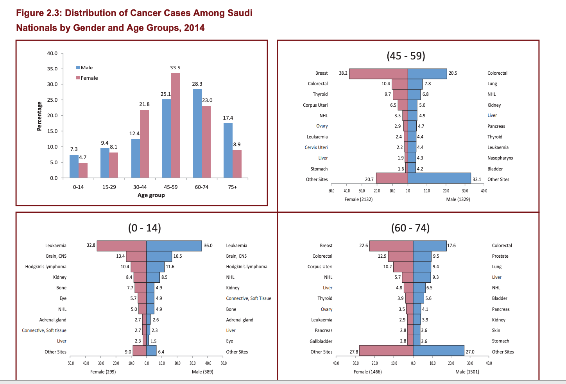
Ref: Cancer incidence report Saudi Arabia 2014

Slide 12
CANCER CAUSES
Cancer is the result of the interaction between a person's factors and 3 categories of external agents, including:
Personal factors:
1-Genetic (Family hx & genetic testing).
2-Age:
A-cellular repair mechanisms become less effective as a person grows older.
B-accumulation of external risk factors.
External factors:
physical carcinogens, such as ultraviolet and ionizing radiation;
chemical carcinogens, such as asbestos, components of tobacco smoke, aflatoxin (a food contaminant), and arsenic (a drinking water contaminant).
biological carcinogens, such as infections from certain viruses, bacteria, or parasites.
https://www.who.int/en/news-room/fact-sheets/detail/cancer

Slide 13
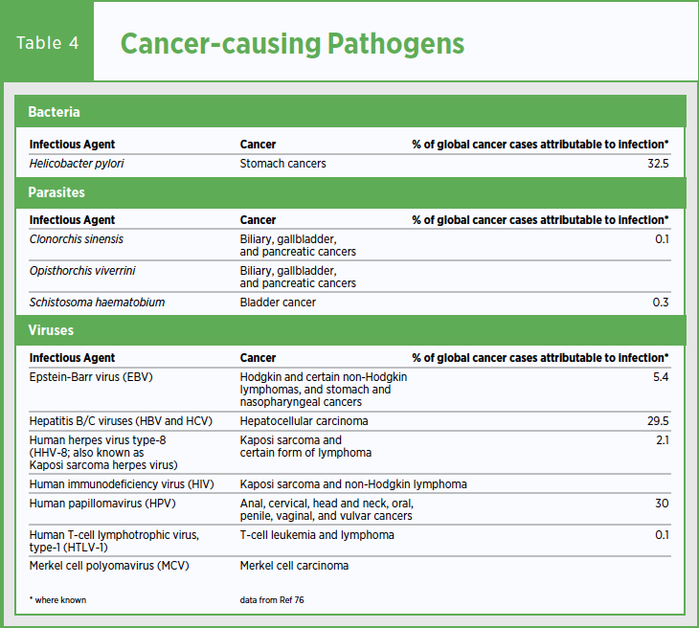
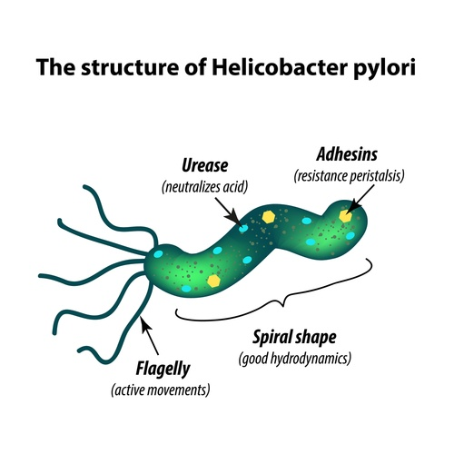
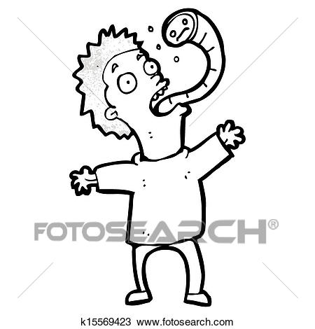

Slide 14
4-UNDERSTAND THE CANCER CONTROL CONTINUUM AND EXPLAIN ITS IMPLICATION TO PUBLIC HEALTH.
The cancer control continuum describes the various stages from cancer etiology, prevention, early detection, diagnosis, treatment, survivorship, and end of life.
The cancer control continuum is a useful framework to view plans, progress, and priorities.
It helps us identify research gaps, where we must collaborate with others to have an impact, and where more resources may be needed.

Slide 15
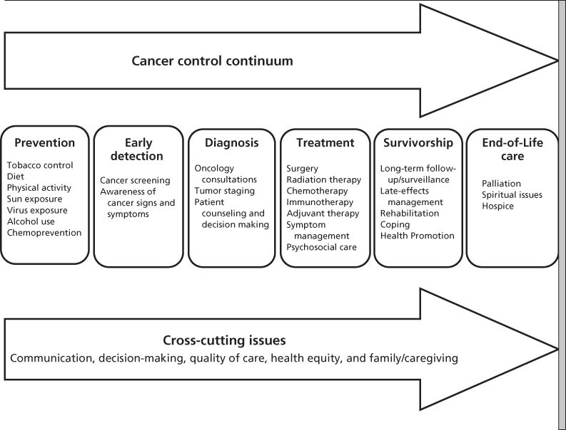

Slide 16
5-SCREENING FOR CANCER.

Slide 17
THE WILSON-JUNGNER CRITERIA FOR SCREENING PROGRAM
The condition should be an important health problem.
The natural history should be well understood.
There should be a detectable early stage.
Treatment at an early stage should be of more benefit.
A suitable test should be devised for the early stage.
The test should be acceptable.
Intervals for repeating the test should be determined.
Adequate health service provision should be made for the extra clinical workload resulting from screening.
The risks, both physical and psychological, should be less than the benefits.
The costs should be balanced against the benefits.
World Health Organization 1968

Slide 18
USPSTF Recommendation grades
Grade | Recommend / against | Evidence from literature | Benefit to patients
A | Recommend | high | substantial
B | Recommend | high | moderate
 |  | moderate | Moderate to substantial
C | Recommend selectively based on professional judgment + patient preferences. | moderate | small
D | against | Moderate to high | No benefit or harm>benefit
I | Unknown | Lacking, or poor quality, or conflicting | Benefit? Harm?

Slide 19
BREAST CANCER SCREENING
Population | Recommendations | Grade
40 to 49 years | The decision to start screening mammography in women prior to age 50 years should be an individual one. Women with a parent, sibling, or child with breast cancer are at higher risk for breast cancer and thus may benefit more than average-risk women from beginning screening in their 40s. | C
50 to 74 years | Biennial screening mammography for women aged 50 to 74 years. | B
75 years or older | Current evidence is insufficient to assess the balance of benefits and harms of screening mammography in women aged 75 years or older. | I
https://www.uspreventiveservicestaskforce.org/Page/Document/RecommendationStatementFinal/breast-cancer-screening1

Slide 20
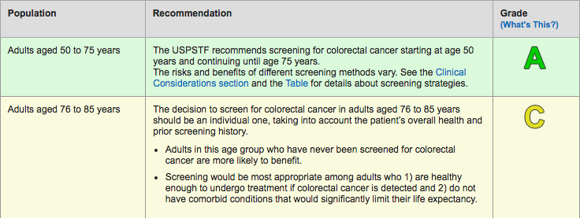
COLORECTAL CANCER SCREENING
https://www.uspreventiveservicestaskforce.org/Page/Document/UpdateSummaryFinal/colorectal-cancer-screening2

Slide 21
COLORECTAL CANCER MODALITIES AND FREQUENCY
Test | Frequency (years)
Guaiac-based Fecal Occult Blood Test (gFOBT) looks for heme | 1
Fecal immunochemical test (FIT) looks for globin, more sensitive than gFOBT | 1
FIT-DNA* | 1-3
Colonoscopy** | 10
CT-colonography | 5
Flexible sigmoidoscopy** | 5
Flexible sigmoidoscopy +FIT | 10
*Can detect altered DNA in the stool.
**Common side effects of colonoscopy/sigmoidoscopy: perforation, bleeding, and infection.
https://www.uspreventiveservicestaskforce.org/Page/Document/UpdateSummaryFinal/colorectal-cancer-screening2

Slide 22
INCIDENCE OF CERVICAL CANCER IN KSA
http://www.hpvcentre.net/statistics/reports/SAU.pdf

Slide 23
CERVICAL CANCER SCREENING
Age group | Pap smear (cytology) | HPV testing | Grade
<21 years | Against screening |  | D
21-30 years |  | Against | D
 | Recommended every 3 years |  | A
30-65 years | Recommended every 3 years |  | A
 | Or recommend pap + hpv every 5 years
>65 years | against screening if have had adequate prior screening and are not otherwise at high risk for cervical cancer. |  | A
Had Hysterectomy + removal of cervix + no prior high-grade precancerous lesion (CIN grade 2 or 3) or cervical cancer.: Against |  |  | D
https://www.uspreventiveservicestaskforce.org/Page/Document/UpdateSummaryFinal/cervical-cancer-screening2

Slide 24
DEFINE “ADEQUATE” CERVICAL CANCER SCREENING?
3 consecutive negative cytology (Pap smear) results.
or 2 consecutive negative HPV results within 10 years before cessation of screening, with the most recent test occurring within 5 years.
Screening may be clinically indicated in > 65 years for whom the adequacy of prior screening cannot be accurately assessed or documented.

Slide 25
SCREENING FOR HEMATOLOGIC MALIGNANCIES (LYMPHOMA, LEUKEMIA…ETC)?
There are no routine screening tests for hematologic malignancies.
It is typical for a patient to seek medical treatment when symptoms appear.
Can be discovered incidentally when a blood test is ordered for another reason.

Slide 26
SCREENING FOR LUNG CANCER
Screening patients for smoking:
Ask all your patients systematically if they smoke or not. Make it part of their vital signs.
If a smoker is identified, implement smoking cessation guidelines.
Saudi lung cancer prevention and screening guidelines

Slide 27
SCREENING FOR LUNG CANCER
Age 55-75 years
Smoking history ≥30 Pack Years.
And are active smoker or quit smoking less than 15 years ago.
Did not have chest CT scan in the last year.
Screening modality:
Low dose chest CT scan.*
*Conventional chest CT radiation dose (7-8 mSv), low dose chest CT (1.4 mSv).
Saudi lung cancer prevention and screening guidelines

Slide 28
SCREENING FOR PROSTATE CANCER
Population | Recommendation | Grade
Men aged 55 to 69 years | The decision to undergo periodic prostate-specific antigen (PSA)-based screening for prostate cancer should be an individual one. | C
Men 70 years and older | The USPSTF recommends against PSA-based screening for prostate cancer in men 70 years and older. | D
https://www.uspreventiveservicestaskforce.org/Page/Document/UpdateSummaryFinal/prostate-cancer-screening1

Slide 29
Prostate Cancer
Men should have an opportunity to discuss the potential benefits and harms of screening with their clinician.
Screening offers a small potential benefit of reducing the chance of death from prostate cancer in some men.
Many men will experience potential harms of screening, including false-positive results that require additional testing and possible prostate biopsy; overdiagnosis and overtreatment; and treatment complications, such as incontinence and erectile dysfunction.

Slide 30
SCREENING FOR THYROID CANCER
Population | Recommendation | Grade
Adults | The USPSTF recommends against screening for thyroid cancer in asymptomatic adults. | D
https://www.uspreventiveservicestaskforce.org/Page/Document/UpdateSummaryFinal/thyroid-cancer-screening1

Slide 31
SCREENING FOR LIVER CANCER
-Patients with cirrhosis of any etiology, but especially cirrhosis caused by hepatitis B or C, are at high risk for the development of HCC and these patients should be the targets for a screening program.
-The best screening modality is ultrasound of the liver.
http://www.annsaudimed.net/index.php/vol32/vol32iss2/42.html

Slide 32
SCREENING FOR UTERINE CANCER
-No evidence that screening reduces mortality from uterine (endometrial) cancer.
-Most cases of endometrial cancer (85%) are diagnosed at an early stage because of symptoms, and survival rates are high.
https://www.ncbi.nlm.nih.gov/books/NBK65786/

Slide 33
SCREENING FOR OVARIAN CANCER
Population | Recommendation | Grade
Asymptomatic women | The USPSTF recommends against screening for ovarian cancer in asymptomatic women. This recommendation applies to asymptomatic women who are not known to have a high-risk hereditary cancer syndrome. | D
Example of a high-risk hereditary cancer syndrome, women with BRCA1 or BRCA2 genetic mutations associated with hereditary breast and ovarian cancer.
https://www.uspreventiveservicestaskforce.org/Page/Document/UpdateSummaryFinal/ovarian-cancer-screening1

Slide 34
6-UNDERSTAND AND REFLECT THE KINGDOMS EFFORTS TO CONTROL THE RISING BURDEN OF CANCERS IN KSA.
Cancer Control Program Ministry of Health
Saudi Cancer society.
http://saudicancer.org/index.php
National program for early detection of breast cancer.
http://www.bc-moh.com/
King Fahad National Centre for Children's Cancer
https://www.kfshrc.edu.sa/en/home/hospitals/riyadh/kfnccc
Sanad Children’s Cancer Support Association
http://www.sanad.org.sa/

Slide 35
In Saudi Arabia there is no countrywide policy for colorectal screening despite the increasing incidence of the disease.
Policy of screening for colorectal cancer in Saudi Arabia: A prospective analysis

Slide 36
7-EXPLAIN IMPORTANT FACTORS AND TRENDS AFFECTING CANCER CONTROL AND DIRECTIONS FOR FUTURE RESEARCH.

Slide 37
TOBACCO
Raise tobacco taxes to at least prevent tobacco products from becoming affordable.
Tax all tobacco products to prevent consumers switching from highly taxed products to less taxed ones.
Require by law and enforce 100% smoke-free environments in all indoor workplaces and public places.
Cancer control , Knowledge into action.WHO guide for effective programs.
https://apps.who.int/iris/bitstream/handle/10665/43575/9241547111_eng.pdf?sequence=1

Slide 38
TOBACCO
Put health warnings on all tobacco packaging.
Establish a national pilot cessation program in health-care facilities .
https://www.moh.gov.sa/Ministry/Projects/TCP/Pages/default.aspx
call 937
Build media awareness of both the addictive nature of tobacco use and treatment options.
Cancer control , Knowledge into action.WHO guide for effective programs.
https://apps.who.int/iris/bitstream/handle/10665/43575/9241547111_eng.pdf?sequence=1

Slide 39
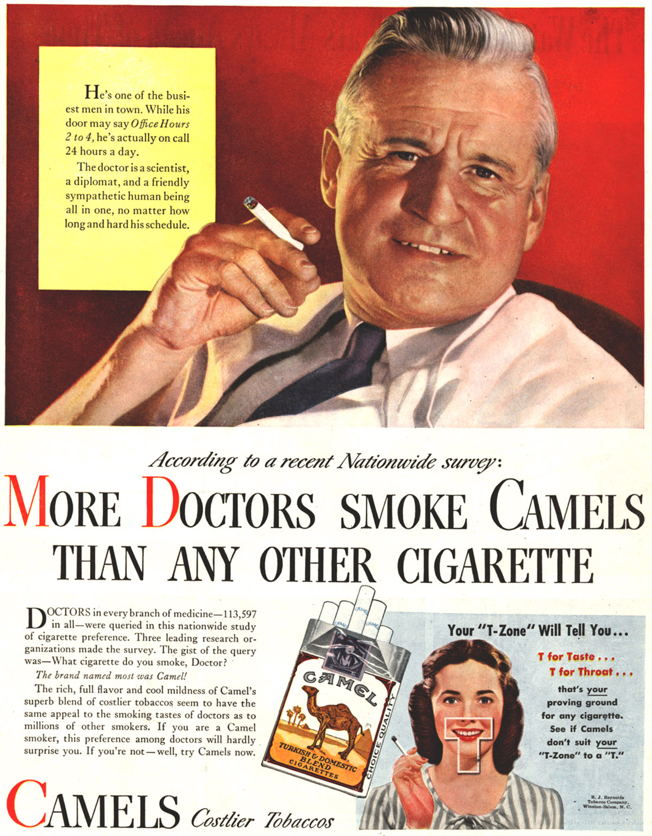

Slide 40
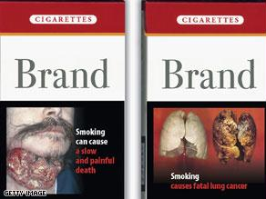

Slide 41
UNHEALTHY DIET, PHYSICAL INACTIVITY, OVERWEIGHT AND OBESITY
Develop and implement national dietary guidelines and nutrition policies.
For eg restaurants should put calories.
Promote educational and information campaigns about reducing salt, sugar and fat consumption.
Develop and implement national guidelines on physical activity.
Implement community-wide campaigns to promote the benefits of physical activity.
Promote physical activity in workplaces.
Cancer control , Knowledge into action.WHO guide for effective programs.
https://apps.who.int/iris/bitstream/handle/10665/43575/9241547111_eng.pdf?sequence=1

Slide 43
ALCOHOL
Raise public awareness, especially among young people, about alcohol-related health risks, including cancer.
Cancer control , Knowledge into action.WHO guide for effective programs.
https://apps.who.int/iris/bitstream/handle/10665/43575/9241547111_eng.pdf?sequence=1

Slide 44
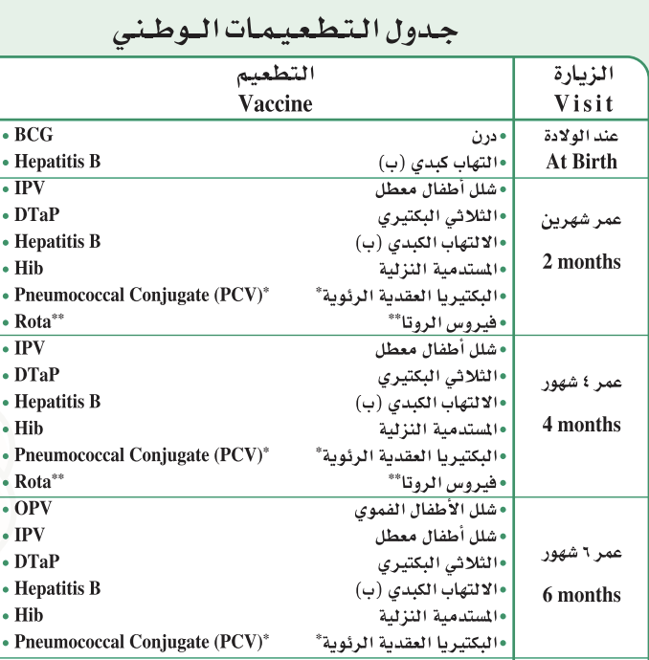
HEPATITIS B VIRUS (HBV)
Implement universal infant immunization using one of the recommended immunization schedules.
Cancer control , Knowledge into action.WHO guide for effective programs.
https://apps.who.int/iris/bitstream/handle/10665/43575/9241547111_eng.pdf?sequence=1

Slide 45
ENVIRONMENTAL EXPOSURE TO CARCINOGENS
Stop using all forms of asbestos.
Provide safe drinking water.
Reduce the use of biomass and coal for heating and cooking at home, and promote use of clean burning and efficient stoves.
Implement food safety systems (i.e. legislation and monitoring) focusing on key contaminants. For eg. SFDA.
Cancer control , Knowledge into action.WHO guide for effective programs.
https://apps.who.int/iris/bitstream/handle/10665/43575/9241547111_eng.pdf?sequence=1

Slide 46
OCCUPATIONAL EXPOSURE TO CARCINOGENS
Develop regulatory standards and enforce control of the use of known carcinogens in the workplace.
Include occupational cancer in the national list of occupational diseases.
Identify workers, workplaces and worksites with exposure to carcinogens.
Cancer control , Knowledge into action.WHO guide for effective programs.
https://apps.who.int/iris/bitstream/handle/10665/43575/9241547111_eng.pdf?sequence=1

Slide 47
RADIATION
Provide information about sources and effects of all types of radiation.
Establish national radiation protection standards (using internationally available guidelines).
Ensure regular safety training of radiation workers.
Promote UV risk awareness and UV protection action.
For example Dose limits for Ionizing radiation are:
for the public, 1 mSv/year.
for occupationally exposed persons, 20 mSv/year.
Cancer control , Knowledge into action.WHO guide for effective programs.
https://apps.who.int/iris/bitstream/handle/10665/43575/9241547111_eng.pdf?sequence=1

Slide 48
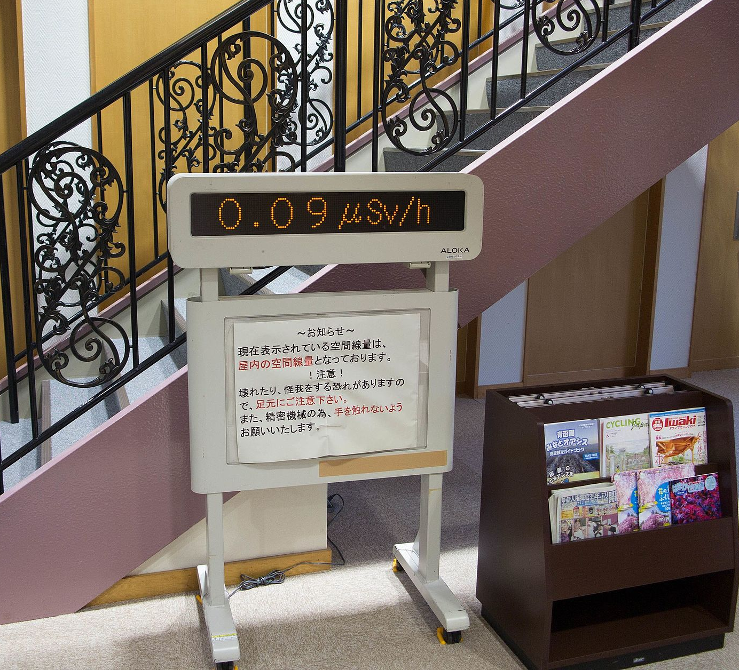
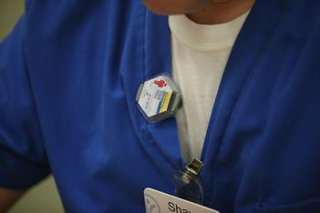
Display of background radiation in a hotel at Naraha, Japan, showing dose rate in microsieverts per hour, five years after the Fukushima disaster.
Personal radiation badge

Slide 49
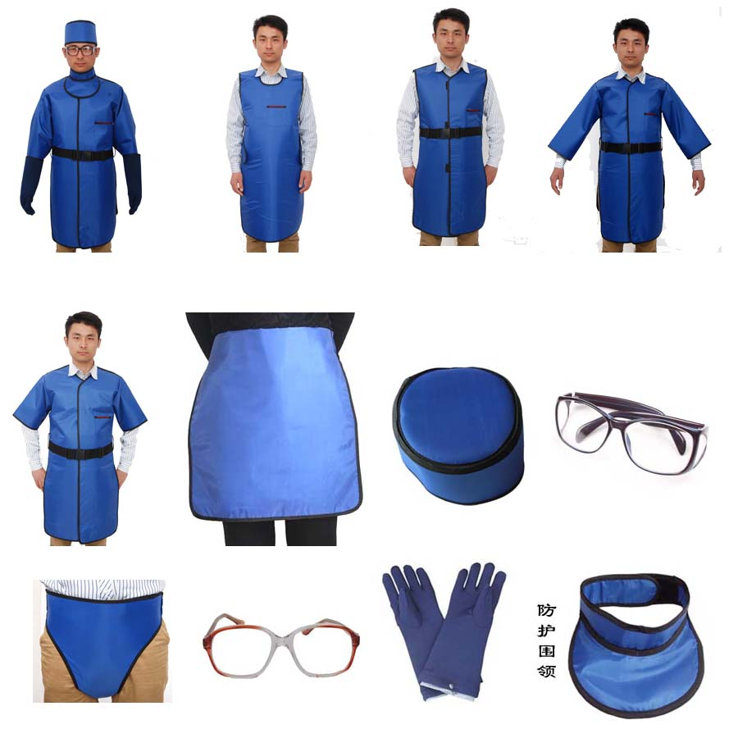
Radiation protection clothes

Slide 50
HOW ARE PEOPLE EXPOSED TO UV RADIATION?
Sunlight: the main source of UV radiation.
Sunlamps and sunbeds (tanning beds and booths).
Phototherapy (UV therapy):
UVA (320 to 400 nm) OR UVB, UVB is divided into:
Broadband (280 to 320 nm)
Narrowband (311-313 nm)
the carcinogenic potential of narrow band UVB is less established.
Other (Black-light lamps, Mercury-vapor lamps, High-pressure xenon and xenon-mercury arc lamps, plasma torches, and welding arcs).
https://www.cancer.org/cancer/cancer-causes/radiation-exposure/uv-radiation/uv-radiation-how-are-people-exposed-to-uv.html

Slide 51
THANK YOU

Slide 52
APPENDIX
How to use home fecal occult blood screening test:
https://youtu.be/WI8zaZiQXDg
How to use home Fecal immunochemical (FITs) screening test:
https://youtu.be/UWr7IJpm9do
How to do pap smear and hpv test
https://www.youtube.com/watch?v=7AWbs-OUV6Y

