Slide 1

COMM 311
Determinants of Health
Nurah Alamro, MD. MPH. DrPH.
Assistant Professor and Consultant of Public Health
Community Medicine Unit, Family & Community Medicine Department
nmalamro@ksu.edu.sa

Slide 2
Objectives
By the end of this lecture, students should be able to:
Discuss the spectrum of health in relation to health and sickness
Define: health, disease, illness, sickness and wellbeing
Define “Determinants of Health”
List different types of determinants of health (biological, behavioral, socio and cultural, environmental, socioeconomic, health services, aging, and gender)
Discuss the concepts of “right to health “ and “health for all”

Slide 3
1
Spectrum of Health

Slide 4
Health and disease lie along a continuum, and there is no single cut-off point
The lowest point on the health-disease spectrum is death and the highest point corresponds to the WHO definition of positive health
The health of an individual is not static; it is a dynamic phenomenon and a process of continuous change
There are degrees or "levels of health" as there are degrees or severity of illness. As long as we are alive there is some degree of health in us.

Slide 5
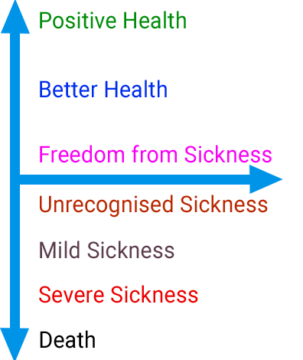
Spectrum of Health
Notes:
The state of positive health implies the notion of “perfect functioning” of the body and mind”. It conceptualizes health biologically, as a state in which every cell and every organ is functioning at optimum capacity and in perfect harmony with the rest of the body; psychologically, as a state in which the individual feels a sense of perfect well- being and of mastery over his environment and socially, as a state in which the individual’s capacities for participation in the social system are optimal.

Slide 6
2
Definitions: Health, Disease, Illness, Sickness, Wellbeing

Slide 7
Health is a relative concept!

Slide 8
It is relative to
  Where on the spectrum of health the person is.
  The health dimensions (physical, mental, social, spiritual, emotional, vocational dimensions)
  Local conditions and health standards.

Slide 9
Definitions: Health
  The oldest definition is that health is the "absence of disease".
  World Health Organization (1948):
  "Health is a state of complete physical, mental and social well-being and not merely an absence of disease or infirmity"
  In recent years, this statement has been amplified to include the ability to lead a "socially and economically productive life"

Slide 10
Definitions: The trilogy of Disease, Illness, Sickness
Disease | Illness | Sickness
a condition that is diagnosed by a physician or other medical expert. (Physician) | ill health that the person identifies themselves with, often based on self reported mental or physical symptoms. It can be Acute or Chronic (Patient) | social & cultural conception of a person’s condition. (Society)
Example: Flu diagnosed by a physician | Example: Flu reported by the patient | Example: Missed class or work due to Flu

Slide 11
There is no satisfactory definition of the term well-being!

Slide 12

Wellbeing
Objective Components
Standard of Living
Level of Living
Subjective Components
Quality of Life
PQLI
HDI

Slide 13
 | Physical Quality of Life Index (PQLI) | Human Development Index (HDI)
Indicators used in calculating this index | Infant mortality Life expectancy at age one literacy | Life expectancy at birth (longevity) Mean years of schooling (knowledge) Expected years of schooling (knowledge) GNI, gross national income, per capita (income/ decent standard of living)
Scale | From 0-100 0 is worst performance and 100 is best performance | Values from 0 to 1
It measures | The results of social, economic, and political policies. Does NOT measure economic growth | It reflects achievements in the most basic human capabilities
Both allow for National and International Comparison
Notes:
???

Slide 14
3 & 4
Determinants of Health:
Definition, Types, and Levels

Slide 15
“Many factors combine together to affect the health of individuals and communities.”

Slide 16
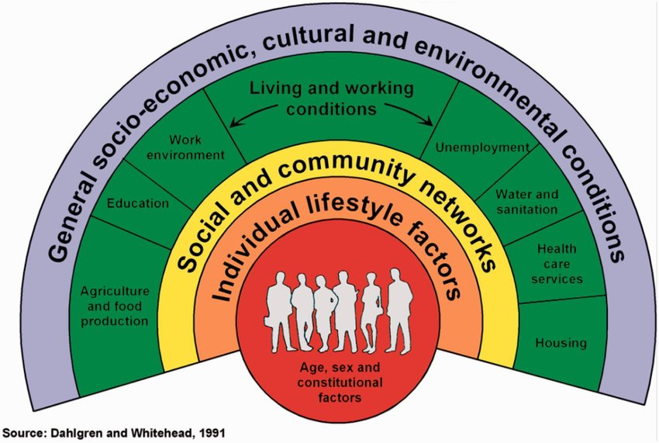

Slide 17
1) Biological:
2) Behavioral and socio-cultural:
3) Environment:
Genetic predisposition
Cultural and behavior patterns, life long habits developed from socialization (eg: smoking, staying up late!)
Internal – internal medicine! / external (macro-environment: things you’re exposed to after conception)
4) Socio-economic:
Economic status: Education, Employment, Housing

Slide 18
5) Health services:
6) Aging population:
7) Gender:
Services for treatment of disease, prevention, and promotion of health.
Increased burden of chronic diseases
Women's health covering nutrition, reproductive health, the health consequences of violence, ageing, lifestyle related conditions and the occupational environment.
8) Other:
Information technology, health related systems like agriculture and food

Slide 19
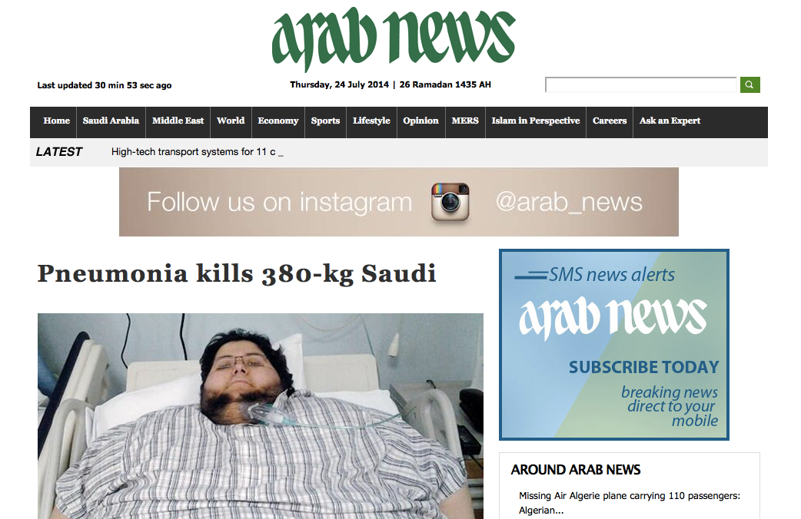

Slide 20
Type of Determinant | Analysis
1) Biological: | Genetic predisposition / Obese parents
2) Behavioral and socio-cultural: | High TV, computer, electronic entertainment use Sedentary lifestyle Car-only mode of transportation
3) Environment: | Internal: Hypothyroidism, Syndromic / External: High consumption of fatty takeaway foods / Low consumption of fruits, vegetables and fiber rich foods / Poor walkable environment / Easy access to convenience stores / Extensive unhealthy food marketing
4) Socio-economic: | Unemployment / Low disposable income / Rural area
5) Health services: | Limited preventive services / Delayed access to treatment
6) Gender | Male obesity is more prevalent than females in Saudi Arabia
7) Others | Weak food policy & pricing High Cost of organized physical activity programs/sport

Slide 21
5
“Right to Health”
“Health for All”

Slide 22
Right to Health
Historically, the right to health was one of the last to be proclaimed in the Constitutions of most countries.
Universal Declaration of Human Rights (1948): "Everyone has the right to a standard of living adequate for the health and well-being of himself and his family ..... ".
WHO Constitution introduction affirms that it is one of the fundamental rights of every human being to enjoy "the highest attainable standard of health".

Slide 23
Health for all
Decided by the 30th World Health Assembly in year 1977.
They decided that the main social target of governments and WHO in the coming decades should be "the attainment by all citizens of the world by the year 2000 of a level of health that will permit them to lead a socially and economically productive life"

Slide 24
THANK YOU

Slide 25

Thank you!
Office Hours (by appointment via email):
Mondays & Wednesdays
11 AM – 1 PM
Via Zoom
nmalamro@ksu.edu.sa

Slide 26
References:
Park, K. "Text Book of Preventive and Social Medicine; 23rd." M/s Banarsidas Bhanot Publishers: Pages 11, 13 – 21. [Accessed 14th Sept. 2020] URL: https://www.medgag.com/book/park-textbook-preventive-social-medicine-pdf-book/
World Health Organization. The Determinants of Health [webpage]. [Accessed 14st sept. 2020] URL: http://www.who.int/hia/evidence/doh/en/
Wikman, Anders, Staffan Marklund, and Kristina Alexanderson. "Illness, disease, and sickness absence: an empirical test of differences between concepts of ill health." Journal of Epidemiology & Community Health 59.6 (2005): 450-454.
Vision 2030. Quality of Life Program 2020. [Accessed 14st Sept 2020] URL: https://vision2030.gov.sa/en/programs/QoL
Google images. https://images.google.com

