Slide 1
COMM 311
Global Health Programs and Policies
Nurah Alamro, MD. MPH. DrPH.
Assistant Professor and Consultant of Public Health
Community Medicine Unit, Family & Community Medicine Department
nmalamro@ksu.edu.sa

Slide 2
Objectives
By the end of this lecture, students should be able to:
Define “Policy”, “Health Policy”, “Global Health”, “Global Health Governance”
Identify the goals of health policy
Describe the policy process
Differentiate between health policies (Macro- vs. Micro-policy)
Discuss Global Health major players and challenges
Discuss Sustainable Development Goals (SDGs)

Slide 3
1
Definitions

Slide 4
Definition: Policy
Policy is a law, regulation, procedure, administrative action, incentive, or voluntary practice of governments and other institutions.
Policy decisions are frequently reflected in resource allocations. Health can be influenced by policies in many different sectors.
For example, transportation policies can encourage physical activity (pedestrian- and bicycle-friendly community design); policies in schools can improve nutritional content of school meals.

Slide 5
Definition: Health Policy
Health policy refers to decisions, plans, and actions that are undertaken to achieve specific health care goals within a society.

Slide 6
Definition: Global Health
An area of study, research and practice that places a priority on improving health and achieving equity in health for all people worldwide
Emphasizes trans-national health issues, determinants and solutions
Inter- and multi-disciplinary collaboration within and beyond health sciences
A synthesis of population-based prevention and individual-level clinical care

Slide 7
Definition: Global Health Governance (GHG)
The formal and informal institutions, norms and processes which govern or directly influence global health policy and outcomes

Slide 8
2
Goals of Health Policy

Slide 9
Why health policies are needed
A health policy can achieve several things:
It defines a vision for the future which in turn helps to establish targets and points of reference for the short and medium term.
It outlines priorities and the expected roles of different groups; and
It builds consensus and informs people.

Slide 10
3
The Policy Process

Slide 11
The key steps include:
Step 1: Identify the Problem or Issue
Step 2: Policy Analysis
2.1 Identify and Describe Policy Options
2.2 Assess Policy Options
2.3 Prioritize Policy Options
Step 3: Develop a Strategy for Furthering Adoption of the Policy Solution
Step 4: Policy Enactment
Step 5: Policy Implementation
Overarching activities: Stakeholder engagement & education AND Evaluation

Slide 12
Factors that affect health policy decision making
Economic factors
Cultural/religious factors
Behavioral factors
Physical environment
Availability of medical services
Technology advances
Epidemiological structure (disease distribution and disease prevention priorities)
Public health evidence
Political situation

Slide 13
4
Macro- vs. Micro- Health Policy

Slide 14
Macro Health Policy
Broad and expansive health policies that are developed at the national level
Affect a large portion of the population (region or country)
Define the country’s vision priorities, budgetary decisions, course of action to sustain health
Developed based on population-health needs
For example, MOH policies; Vision 2030 health transformation initiatives

Slide 15
Micro Health Policy
More specific to level of organization or individuals, examples:
Hospital administrative policy and procedures
Departmental/Internal policy and procedures
Clinical practice guidelines
Based on the operational needs of the facility; differ by organization (from hospital to another)
Policies that apply to:
Employees
Operations
Ethics
Safety
Research

Slide 16
Inter-relationship between micro- and macro- policies
Micro-policies at organizations are developed in line with macro-policies put in place by the MOH
The development and implementation of such policies require a multi-disciplinary approach
For example:
Many ministries work together on development of some macro-policies; MOH + MOMRA + MOE etc (HiAP)
Different departments of the hospital collaborate for putting in place micro-policies

Slide 17
5
Global Health Players and Challenges

Slide 18
Global Health Major Players
International organizations (e.g. WHO, UNICEF, World Bank)
Multilateral entities (e.g. G8, G20)
Multilateral initiatives (e.g. GAVI)
Bilateral initiatives (e.g. PEPFAR)
Philanthropies (e.g. Gates Foundation)
Global public-private partnerships
Private sector-industry
Civil society

Slide 19
The World Health Organization (WHO) is a specialized non-political health agency of the United Nations with headquarters in Geneva.
WHO is unique among the specialized UN agencies as it:
has its own constitution: came into force on April 7th, 1948 which is celebrated every year as “World Health Day” with a different theme each year to focus attention on a specific public health issue.
own governing bodies
own membership
own budget
Two major policy developments influenced WHO:
The Alma-Ata Declaration of 1978 that identified primary health care as the key to the attainment of the goal of Health for All.
Global strategy for Health for all by 2000, followed by MDGs, and recently SDGs 2030.

Slide 20
WHO Scope of Work:
Prevention and control of disease
Development of comprehensive health services
Family Health
Environmental Health
Health Statistics
Health Research
Health Literature and Information
Coordination with other agencies
World Health Assembly
Executive Board
Secretariat
Regions
EMRO
SERO
AFRO
PAHO
EURO
WPRO

Slide 21
Global Health Challenges
Impact of financial crisis & globalization
Multiple, diverse, emerging health threats
Failures in delivery & access to both existing and needed interventions
Disparities and inequities continue
Fragile health systems unable to achieve SDGs targets

Slide 22
6
Sustainable Development Goals (SDGs)

Slide 23
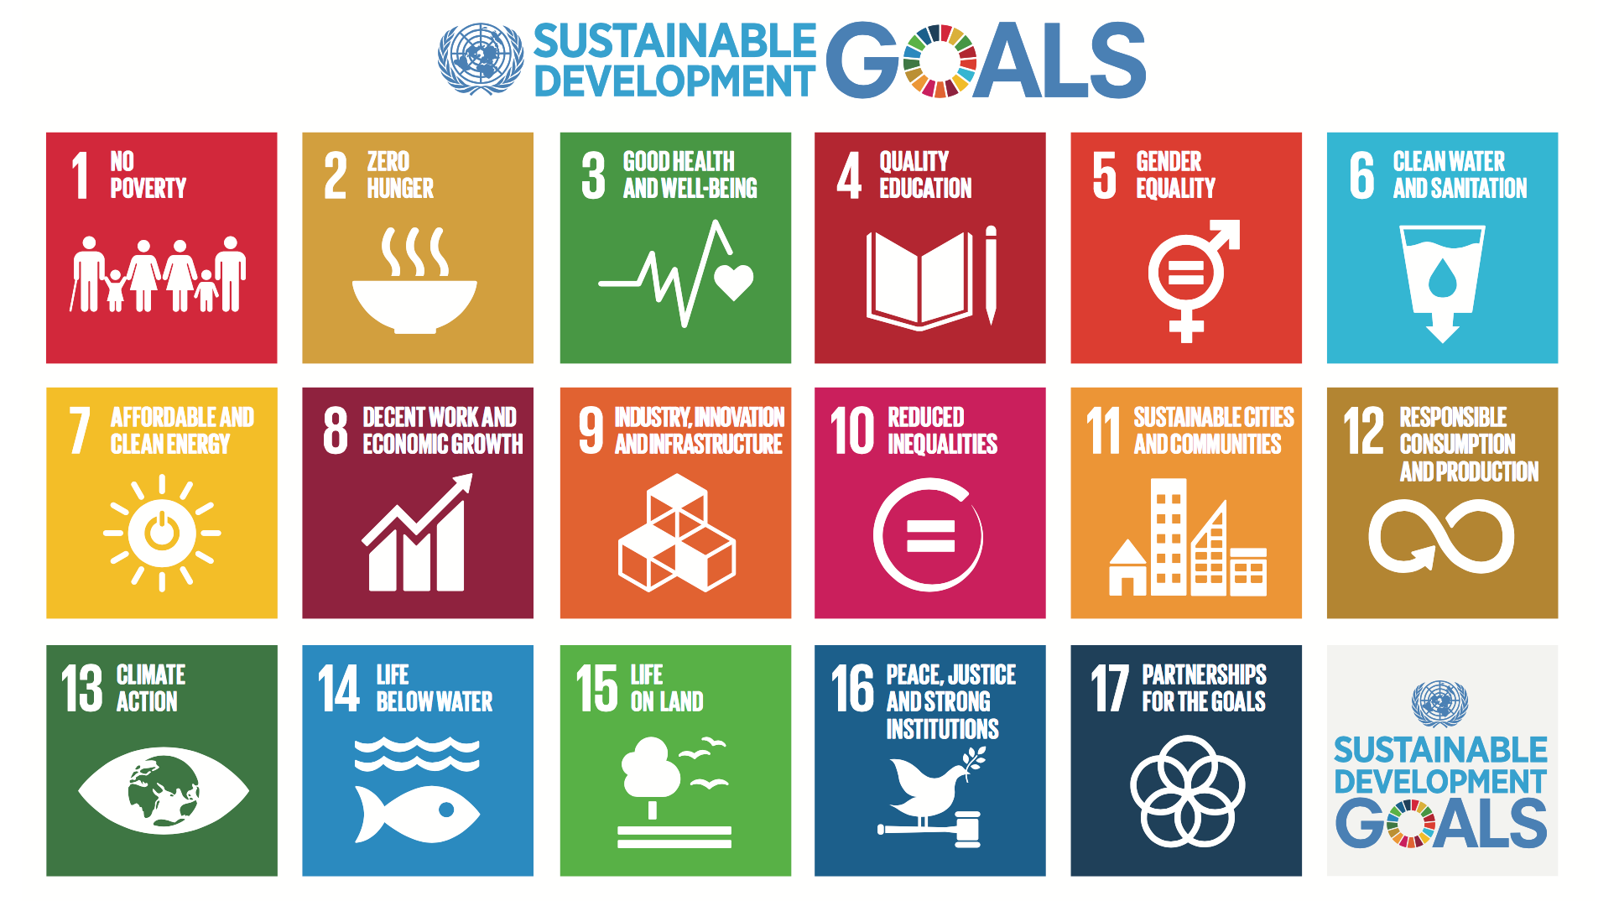

Slide 24
What is sustainable development?
Sustainable development has been defined as development that meets the needs of the present without compromising the ability of future generations to meet their own needs.

Slide 25
What are the Sustainable Development Goals?
The 193 Member States of the United Nations reached consensus on the outcome document of a new sustainable development agenda entitled, "Transforming Our World: The 2030 Agenda for Sustainable Development”.
This agenda contains 17 goals and 169 targets
This agenda builds on the achievements of the Millennium Development Goals (MDGs), which were adopted in 2000 and guided development action for the last 15 years. The MDGs have proven that global goals can lift millions out of poverty.
UN summit for the adoption of SDGs with its 17 goals was held from 25 to 27 September 2015, in New York and convened as a high–level meeting of the General Assembly.

Slide 26
How are the SDGs different from the MDGs?
The 17 Sustainable Development Goals with 169 targets are broader in scope and will go further than the MDGs by addressing the root causes of poverty and the universal need for development that works for all people. These goals will cover the three dimensions of sustainable development: economic growth, social Inclusion and environmental protection.
The SDGs are universal and apply to all countries, whereas the MDGs were intended for action in developing countries only.
A core feature of the SDGs has been the means of implementation - the mobilization of financial resources, as well as capacity building and the transfer of environmentally sound technologies.

Slide 27
How will progress of the SDGs be measured?
The 17 goals and 169 targets will be monitored and reviewed using a set of global indicators. These will be complemented by indicators at the regional and national levels, which will be developed by Member States.
When are the SDGs expected to start and end?
The SDGs started on 1 January 2016 and to be achieved by 31 December 2030.

Slide 28
3.1 By 2030, reduce the global maternal mortality ratio to less than 70 per 100,000 live births.
3.2 By 2030, end preventable deaths of newborns and children under 5 years of age, with all countries aiming to reduce neonatal mortality to at least as low as 12 per 1,000 live births and under-5 mortality to at least as low as 25 per 1,000 live births.
3.3 By 2030, end the epidemics of AIDS, tuberculosis, malaria and neglected tropical diseases and combat hepatitis, water-borne diseases and other communicable diseases.
3.4 By 2030, reduce by one third premature mortality from non-communicable diseases through prevention and treatment and promote mental health and well-being.
3.5 Strengthen the prevention and treatment of substance abuse, including narcotic drug abuse and harmful use of alcohol.
3.6 By 2020, halve the number of global deaths and injuries from road traffic accidents.
3.7 By 2030, ensure universal access to sexual and reproductive health-care services, including for family planning, information and education, and the integration of reproductive health into national strategies and programmes.
3.8 Achieve universal health coverage, including financial risk protection, access to quality essential health-care services and access to safe, effective, quality and affordable essential medicines and vaccines for all.
3.9 By 2030, substantially reduce the number of deaths and illnesses from hazardous chemicals and air, water and soil pollution and contamination.

Slide 29
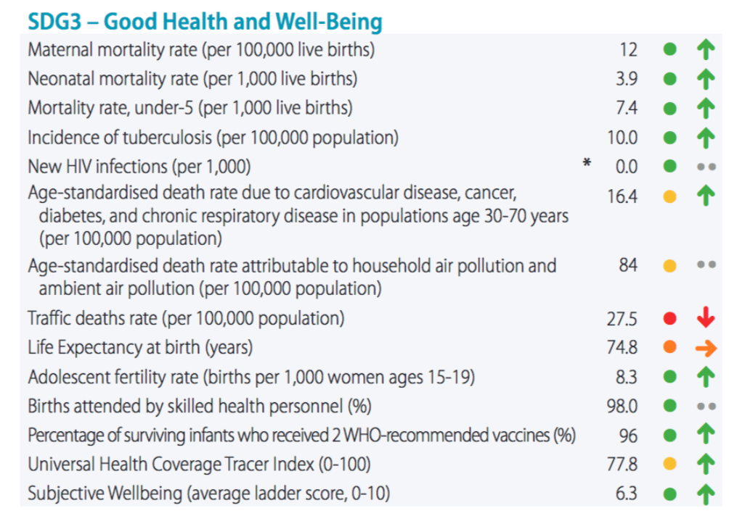

Slide 30
Thank you!
Office Hours (by appointment via email):
Mondays & Wednesdays
11 AM – 1 PM
Via Zoom
nmalamro@ksu.edu.sa

Slide 31
References
CDC. Health Policy Analysis and Evidence. Accessed October 10th, 2020: https://www.cdc.gov/policy/analysis/index.html
WHO. Health Policy. Accessed October 10th, 2020: https://www.who.int/topics/health_policy/en/
Park, K. Text Book of Preventive and Social Medicine; 23rd. M/s Banarsidas Bhanot Publishers, 1167. Pages: 918 - 922
Tikki Pang. Global Health Governance – A Search for Meaning. (2009). Accessed October 10th, 2020: https://ses.library.usyd.edu.au/bitstream/2123/11524/1/pang160709.pdf
Alkhamis AA. Framing health policy in the context of Saudi Arabia. J Infect Public Health 2016; 9: 3-6.
UN General Assembly, Transforming our world : the 2030 Agenda for Sustainable Development, 21 October 2015, A/RES/70/1, available at: https://www.refworld.org/docid/57b6e3e44.html [accessed 10 October 2020]
United Nations. About the Sustainable Development Goals. Accessed October 10th, 2020: https://www.un.org/sustainabledevelopment/sustainable-development-goals/
Sachs, J., Schmidt-Traub, G., Kroll, C., Lafortune, G., Fuller, G. (2019): Sustainable Development Report 2019. New York: Bertelsmann Stiftung and Sustainable Development Solutions Network (SDSN). Accessed October 10th, 2020: https://github.com/sdsna/2019GlobalIndex/blob/master/country_profiles/Saudi%20Arabia_SDR_2019.pdf

