Slide 1



Maternal and Child Health
Focus on breast feeding positioning, counseling, growth chart
Dr. Nada A. Alyousefi
Associate Professor, Postgraduate Trainer and Consultant of Family Medicine
International Board Certified Lactation Consultant
Department Of Family And Community Medicine
College Of Medicine, King Saud University (KSU)
December 2020

Slide 2
Objectives
Demonstrate counselling skills for promotion of breast feeding (focused on benefits of breast feeding for the mother and child, and correct way of breast feeding, advise on prevention on breast engorgement and breast abscesses)
Demonstrate skills to plot growth charts of children

Slide 3
We will discuss..
Global target for breastfeeding ‘The Baby -Friendly Hospital Initiative As Part of The Global Strategy’
Antenatal Infant Feeding Check list
Perceived insufficient milk issue.
History taking for assessment of breastfeeding.
How to assess a breastfeed (attachment, positioning, signs of effective suckling).
Demonstrate skills to plot growth charts of children to aid in breastfeeding counseling.

Slide 4
Aim
Student will be confidently support mothers with early and exclusive breastfeeding.
Student can help in movement towards achieving Baby-friendly hospitals and communities.

Slide 5

Notes:
Poor infant feeding
What are the effects on:
Families?
Communities?
Health services?

Slide 6

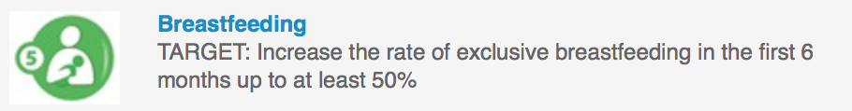
Global targets 2025
To improve maternal, infant and young child nutrition

Slide 7

The Baby -Friendly Hospital Initiative
A Part Of The Global Strategy
Notes:
YOU HAVE TO CONTRIBUTE IN THIS MISSION

Slide 8

The WHO International Code of Marketing of Breastmilk Substitutes
The Local Implementation
Notes:
The WHO International Code of Marketing of Breastmilk Substitutes (usually abbreviated to the WHO Code) was adopted in 1981 by the World Health Assembly (WHA) to promote safe and adequate nutrition for infants, by the protection and promotion of breastfeeding and by ensuring the proper use of breast-milk substitutes
(individual countries) implement the Code, but they may implement it in the way that they think is best for their countries
they can make their Code a law

Slide 9
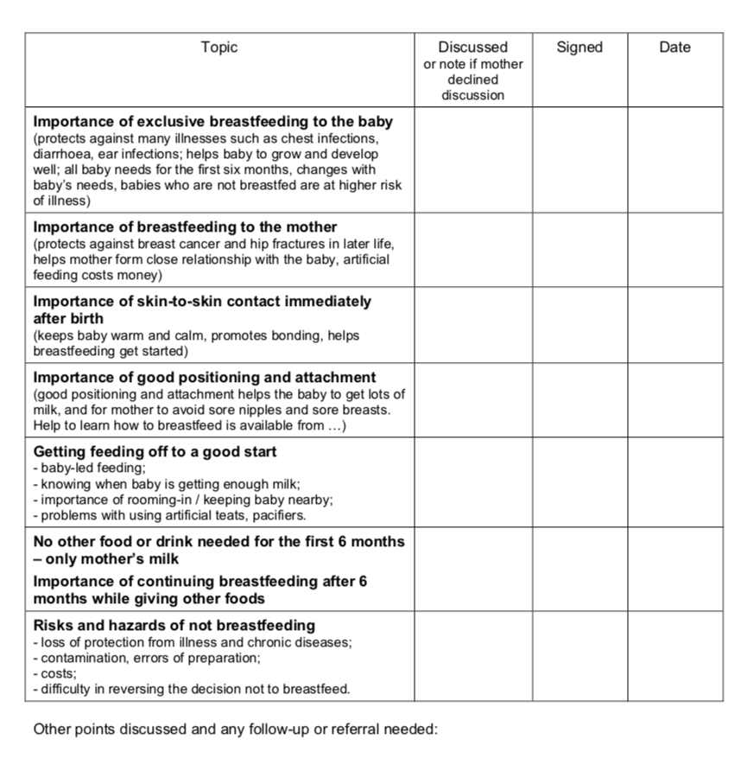
Antenatal Infant Feeding Check list

Slide 10
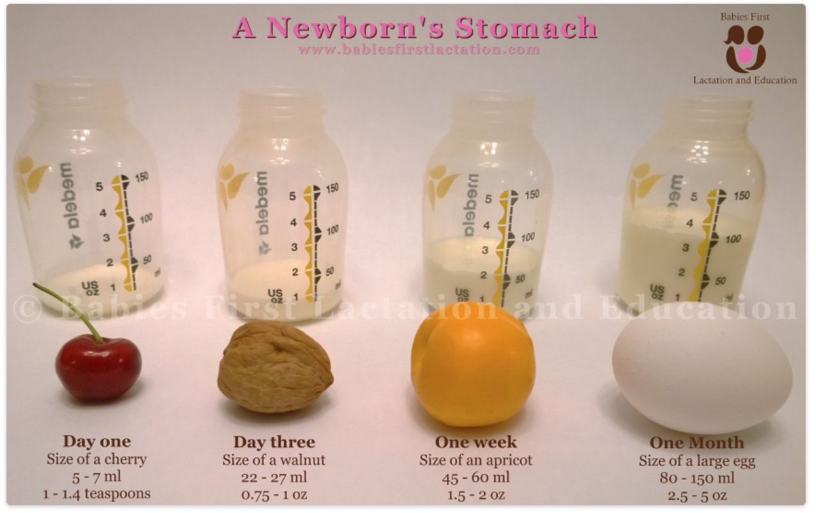

Slide 11
Perceived insufficient milk
The issue of perceived insufficient milk supply is a frequently occurring problem and is reported globally.
Perceived insufficient milk is often reported as the most common problem that women experience with breastfeeding.
The occurrence of perceived insufficient milk frequently leads to early weaning or decreased exclusivity.

Slide 12
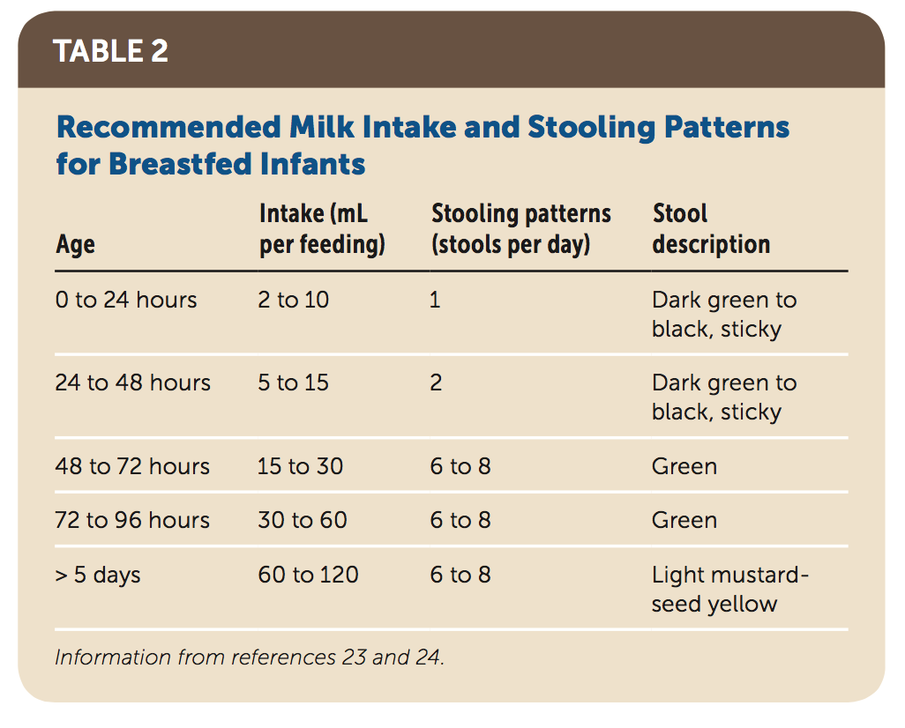
Breastfeeding: Common Questions and Answers. Am Fam Physician. 2018 Sep 15;98(6):368-376.

Slide 13
HOW TO ASSESS A BREASTFEED
Look
Look at the mother herself
Look
Look at how the mother holds her baby
Look
Look at the baby’s condition
Observe
Observe how the baby responds to the breast
Observe
Observe how the mother holds her breast for the baby
Observe
Observe the baby’s attachment and suckling
Notice
Notice how the breastfeed finishes
Observe
Observe the condition of the mother's breasts

Slide 14
How the mother holds her baby
? mother supports the baby’s whole body
? calm and relaxed ? Nervous
the four signs of good positioning of the baby are:
  the baby should be straight, facing the breast, close to the mother, and supported.
Notes:
How the mother holds her baby
It is easier for the baby to attach to the breast if the mother supports the baby’s whole body.
Supporting only the baby’s head and shoulders makes it more difficult. However, supporting
the whole body is less important after the first few months, when the baby has more control.
If the mother is calm and relaxed, this helps milk flow. If she is nervous, and for example, she shakes or pokes her baby, this can interfere with suckling and breast milk flow.
Key point: the four signs of good positioning of the baby are:
the baby should be straight, facing the breast, close to the mother, and supported.
See also Session 10 ‘Positioning a baby at the breast’.

Slide 15
Baby’s Position
Remember 4 key points :
IN LINE – ear, shoulder, hip in a straight line; neck not twisted/bent forward or backward
FACING – the breast with baby’s nose to nipple
CLOSE to mum’s body – baby to breast
SUPPORTED – at head, shoulders; newborn – support whole body

Slide 16
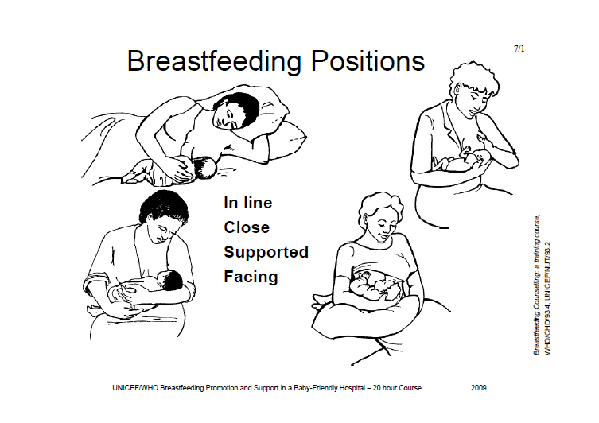

Slide 17
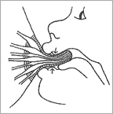
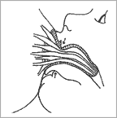
Observe the baby’s attachment and suckling
2
1

Slide 18
Which one is good attachment?
A
B

Slide 19
How a baby latch
The baby’s mouth is wide open.
The lower lip is turned out.
The chin is touching the breast (or nearly so).
More areola is visible above the baby’s mouth than below
Good attachment
Poor attachment
The mouth is not wide open.
The lower lip is pointing forward (it may also be turned in).
The chin is away from the breast.
More areola is below the baby’s mouth (you might see equal amounts of areola above and below the mouth)

Slide 20
Signs of effective suckling
The baby takes slow deep sucks.
Then he pauses and waits for the ducts to fill up again.
Then he takes a few quick sucks to start the milk flow.
As the milk flows, his sucks become deeper and slower again.
You may see or hear swallowing.
The babies cheeks are round.
Notes:
To demonstrate effective suckling:
Suck on your fist, with your mouth open wide, your tongue forward, and your lower lip curled back. Give slow deep sucks, about 1 per second.
To demonstrate ineffective suckling:
Suck on your thumb, with your mouth almost closed, your lips pointing forwards, and letting your cheeks pull in. Give quick, small sucks.

Slide 21
Signs of ineffective suckling
The baby taking quick shallow sucks all the time.
The baby may make smacking sounds as he sucks.
The baby’s cheeks may be tense or pulled in as he sucks.
that mean the baby is not getting much breast milk.

Slide 22
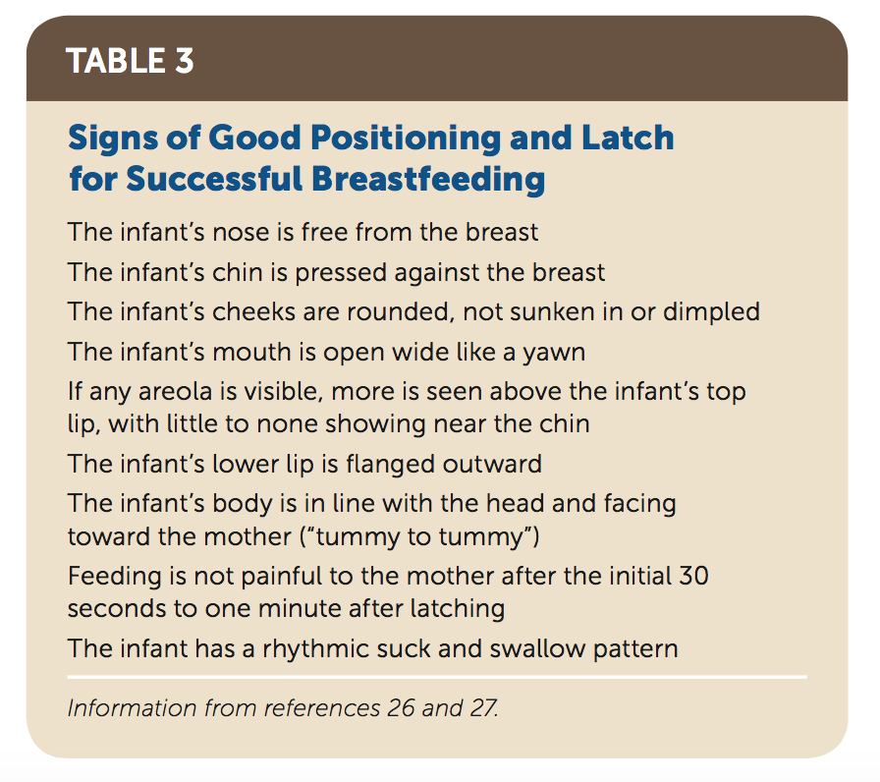
What Are Ways to Ensure an Adequate Latch?
Breastfeeding: Common Questions and Answers. Am Fam Physician. 2018 Sep 15;98(6):368-376.

Slide 23
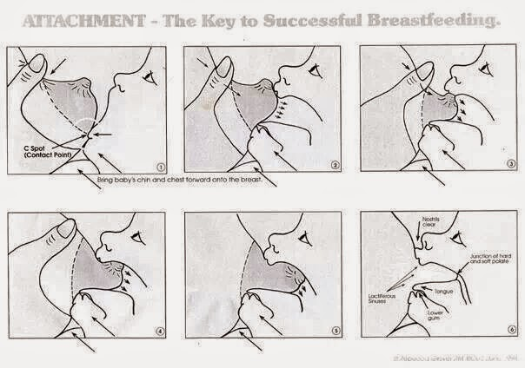

Slide 24
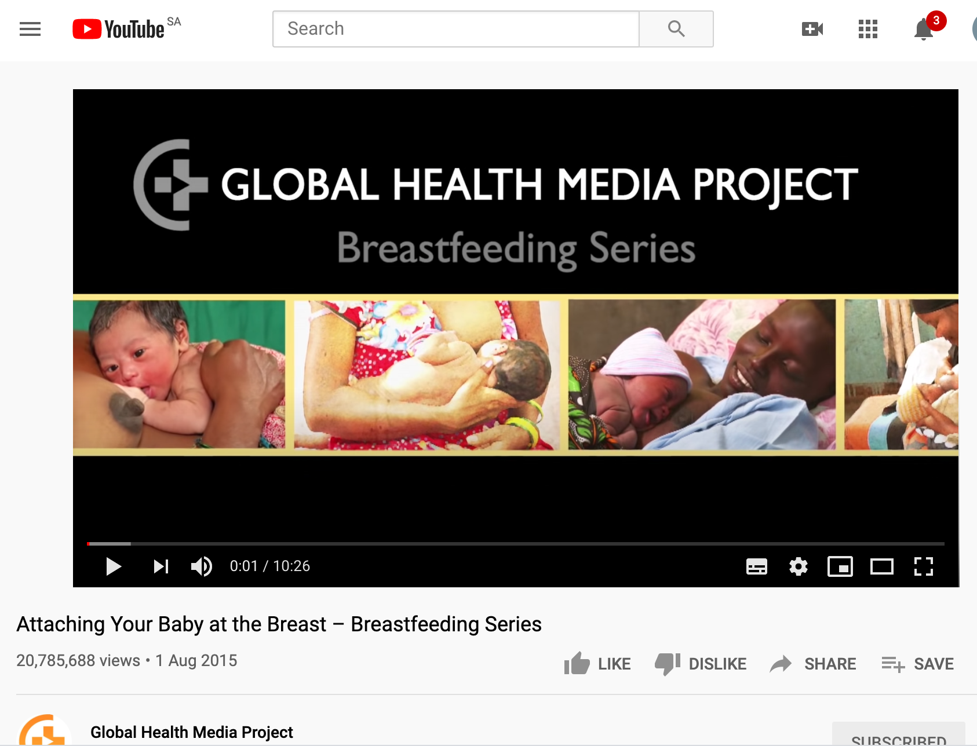
https://www.youtube.com/watch?v=wjt-Ashodw8

Slide 25
Materials to be used in Maternal & Child Health
CASES
Focus on breast feeding positioning, counseling, growth chart.

Slide 26
Antenatal Infant Feeding Check list

Slide 27
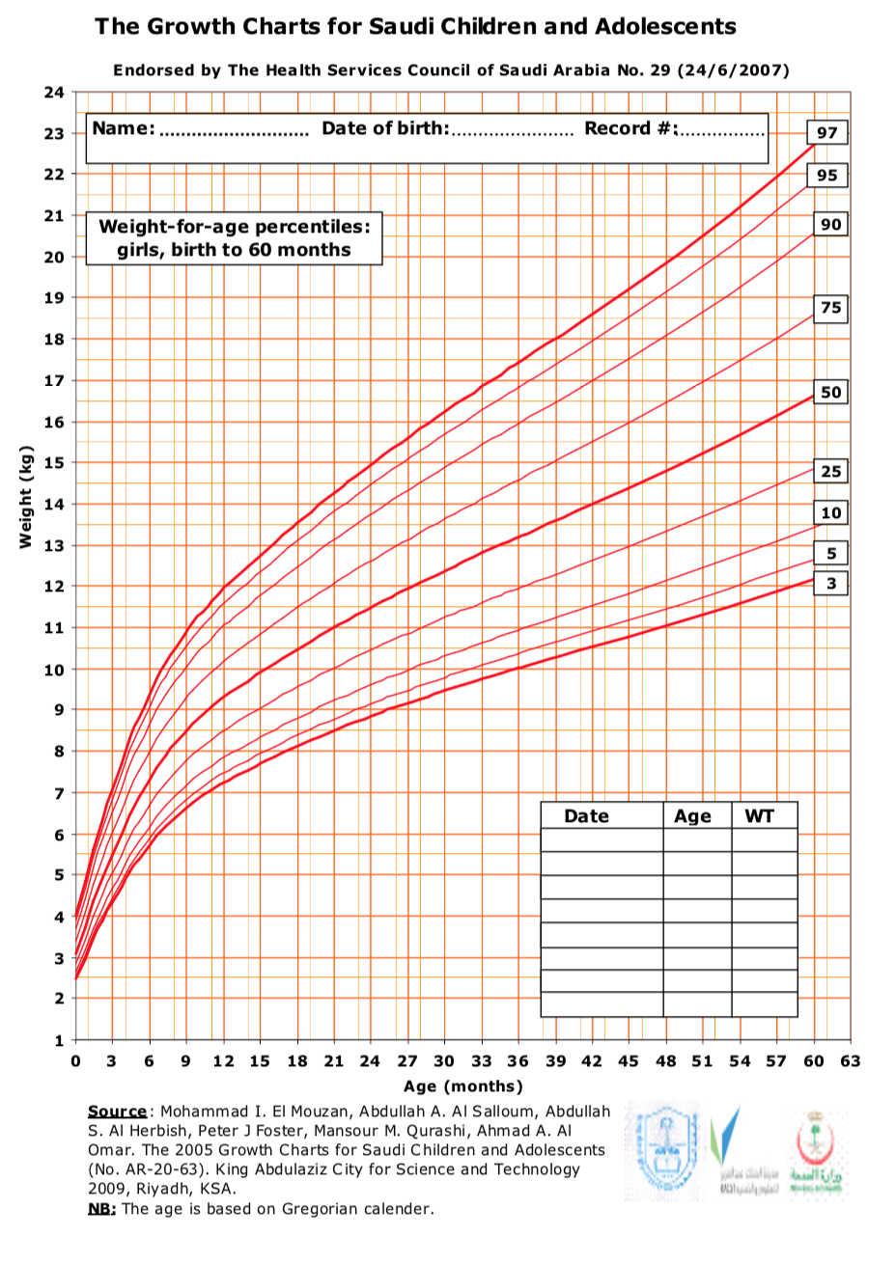
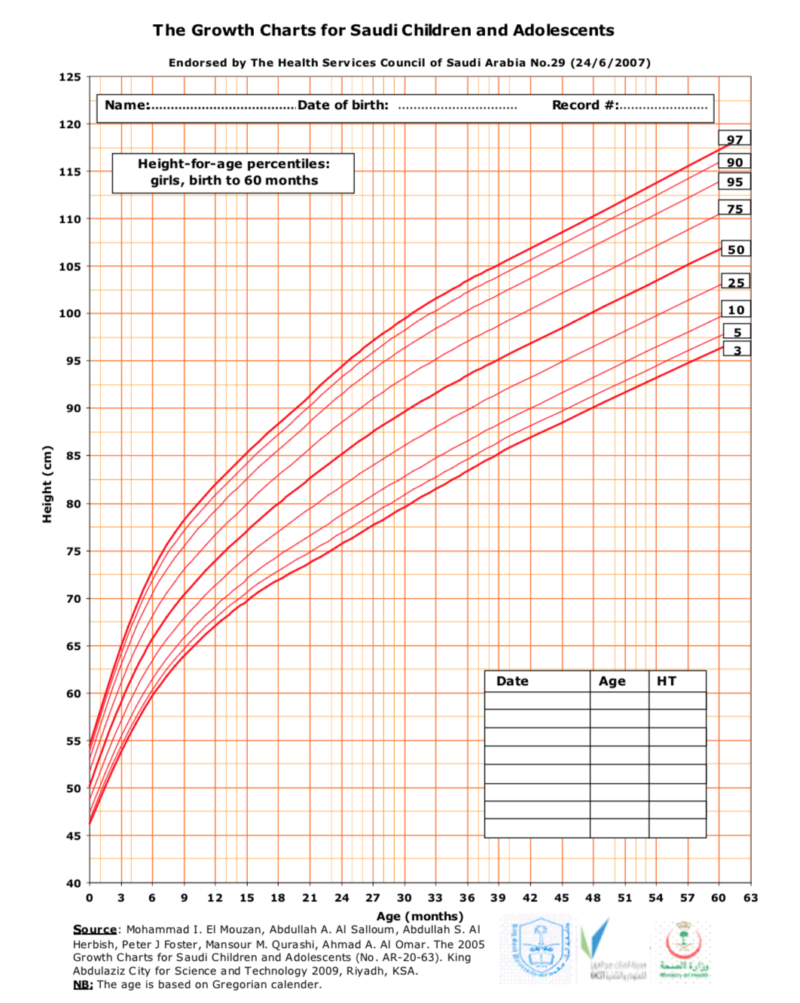

Slide 28
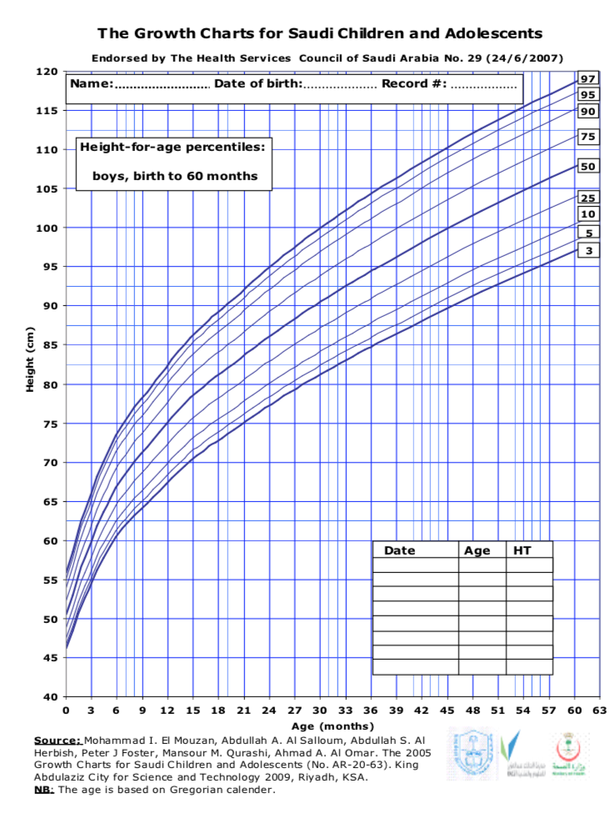
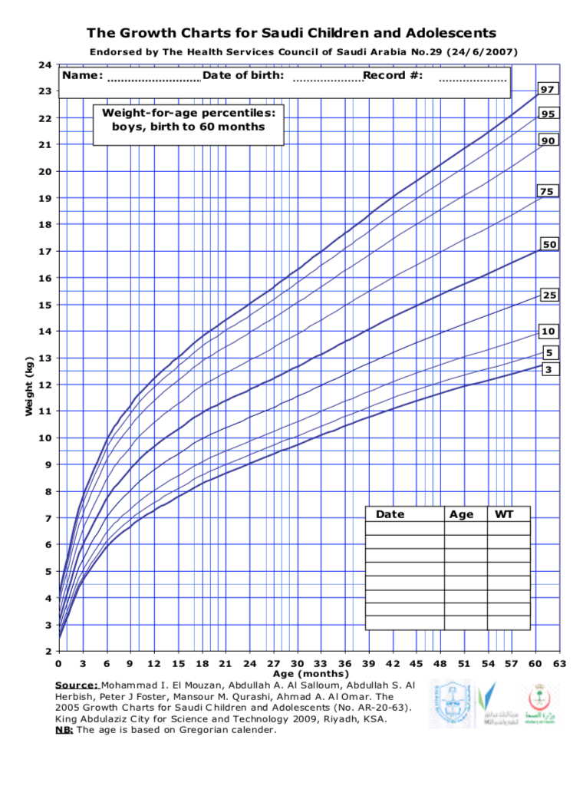

Slide 29
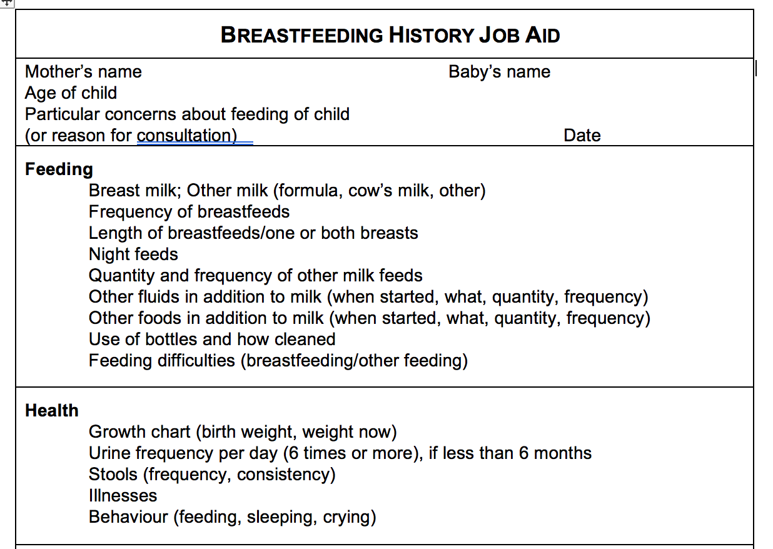

Slide 30
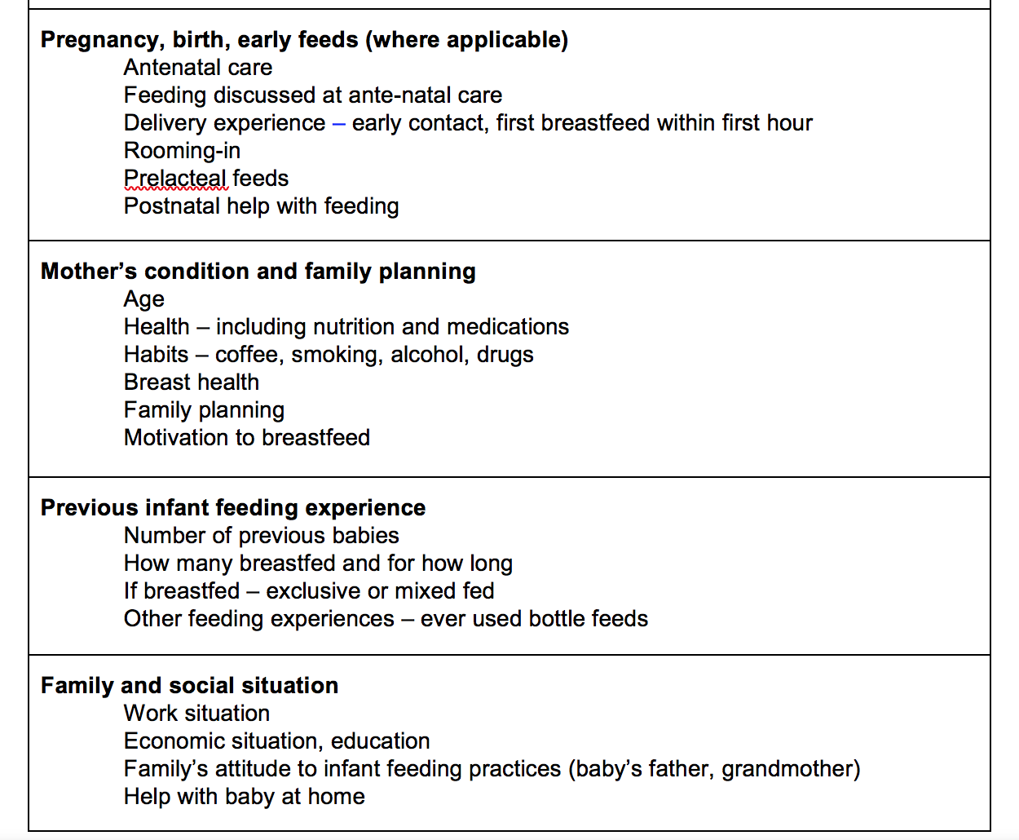

Slide 31
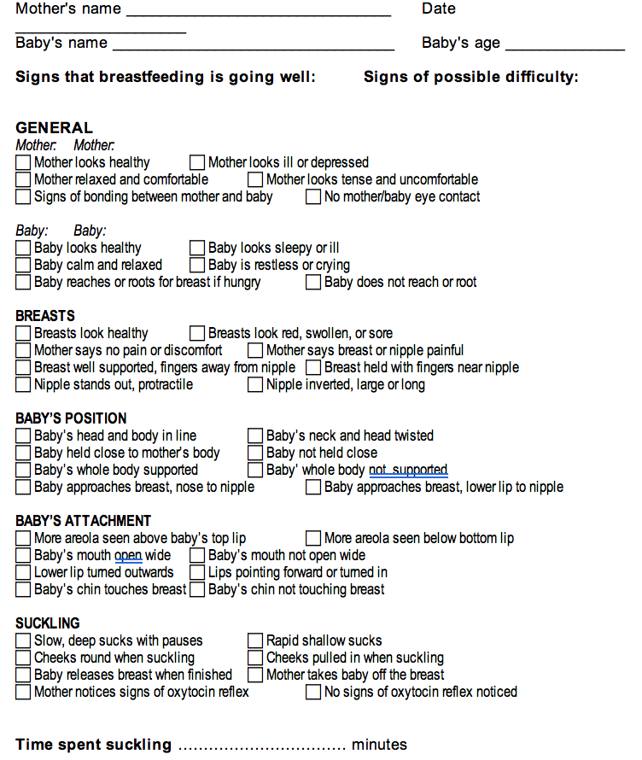
BREASTFEED OBSERVATION JOB AID
Notes:
It summarizes the key points for assessing a breastfeed.
You will use this form to practise observing breastfeeds with mothers and babies.
The signs are in 6 groups: General signs of the mother, and of the baby; Condition of the breasts; the baby’s position; the baby’s attachment; and suckling. There are 3 signs each for mother and baby, and four signs in each of the other groups.
Notice that the signs on the left all show that breastfeeding is going well. The signs on the right indicate a possible difficulty.
Beside each sign is a box ◻ to mark with a tick ✓ if you have seen the sign in the mother and baby that you are observing.
As you observe a breastfeed, mark a ✓ in the box for each sign that you observe. If you do not observe a sign, do not make a mark.
If all ✓s are on the left hand side of the form, breastfeeding is probably going well.
If there are some ✓s on the right hand side, then breastfeeding may not be going well. This mother may have a difficulty, and she may need your help.
The negative signs, such as "no signs of milk ejection", and "cannot see tongue", do not necessarily mean that there is a difficulty. However, the opposite positive signs are always helpful.
▪ If a mother says that breastfeeding is going well, but you see signs that indicate a possible difficulty, you must decide what to do.
- In the days soon after delivery, while the mother is still learning, offer to help her. Even if she is not aware of any difficulty now, you may prevent one occurring later.
- If breastfeeding seems to be well established, you probably do not want to intervene immediately. It is usually more helpful to see her again soon, and follow the baby's growth, to make sure that breastfeeding continues to go well. Intervene only if a difficulty arises.

Slide 32
Maternal & Child Health
CASES
Focus on breast feeding positioning, counseling, growth chart.

Slide 33
Case 1
Fatima goes in to see her pregnancy care provider. He or she does not know if Fatima heard the group talk on breastfeeding and if she has any questions.
How can the pregnancy care provider find out if a pregnant woman knows about the importance of breastfeeding or has questions?

Slide 35
Case 2
Mariam gave her previous baby regular supplements from birth. Now she is hearing that supplements are not good for babies and wants to know why because she want to give her daughter. Her baby now is 3 months ht 58 cm wt 6 kg
What can you say to Mariam?

Slide 37
Case 3
Nora gave birth to a healthy boy in the hospital two weeks ago. Today she, the baby, and her mother-in-law are returning to the hospital because the baby is "sleeping all the time" and has passed only three stools this week. When the outpatient clinic nurse weighs the baby, she finds him 12% under birth weight.
Nora feels that her baby is refusing her breasts. Yesterday, the mother-in-law began offering tea with honey in a bottle twice a day.
Upon observing the breastfeed; the baby is held loosely and that he must bend his neck to reach the breast. The baby has very little of the breast in his mouth and falls off the breast easily. When he falls off the breast, he gets upset, moves his head around, crying and has difficulty getting attached again.
How you can approach this case?

Slide 40
BREASTFEED OBSERVATION JOB AID

Slide 41

Additional Resources for practice Breastfeeding Counselling

Slide 42
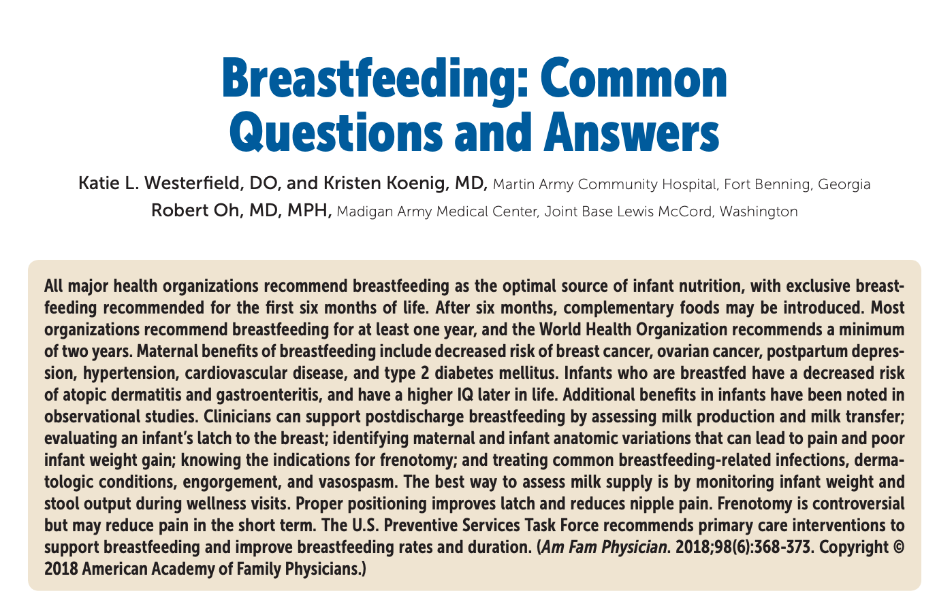
Management of Common Problems that can Affect Breastfeeding
For additional reading
Breastfeeding: Common Questions and Answers. Am Fam Physician. 2018 Sep 15;98(6):368-376.

Slide 43
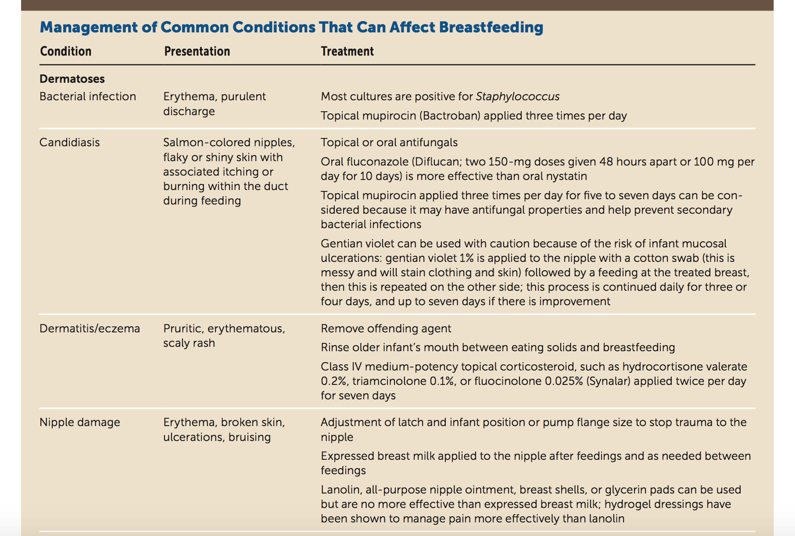
Breastfeeding: Common Questions and Answers. Am Fam Physician. 2018 Sep 15;98(6):368-376.

Slide 44
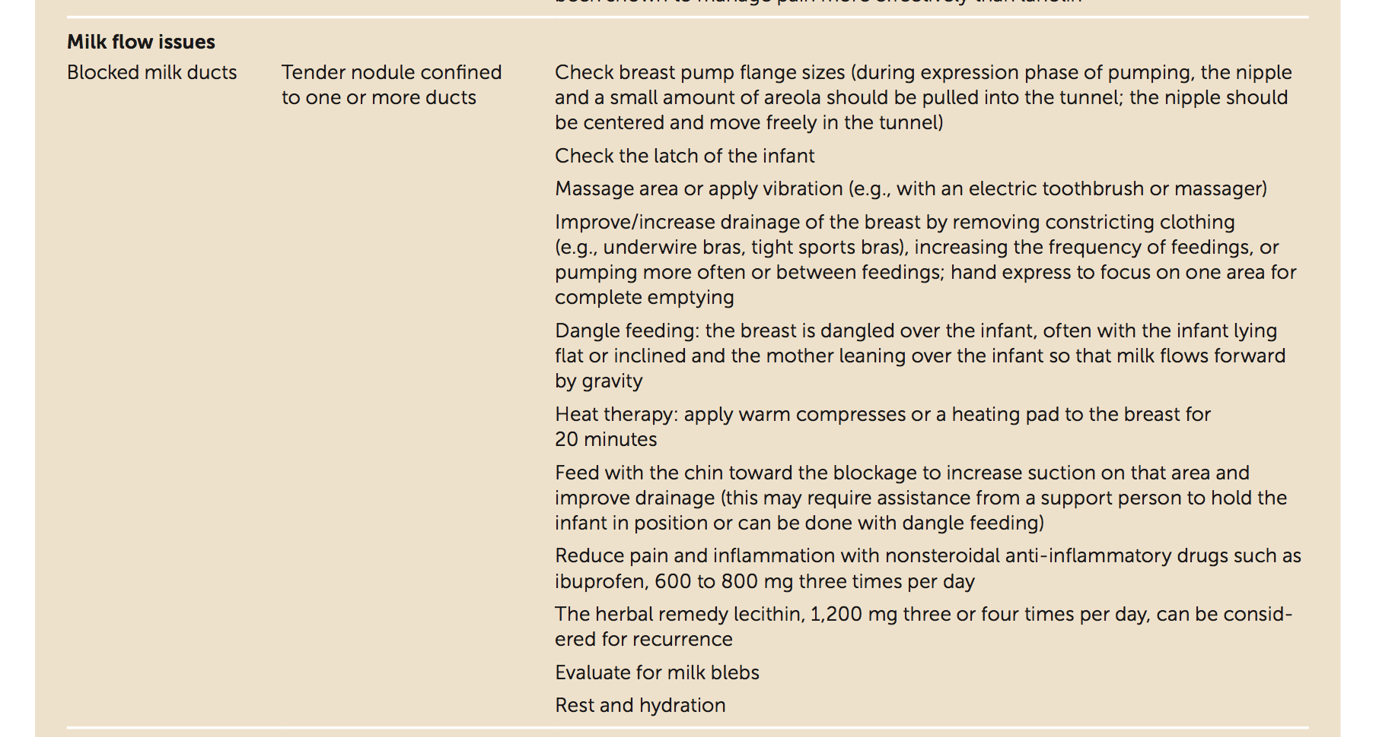
Breastfeeding: Common Questions and Answers. Am Fam Physician. 2018 Sep 15;98(6):368-376.

Slide 45
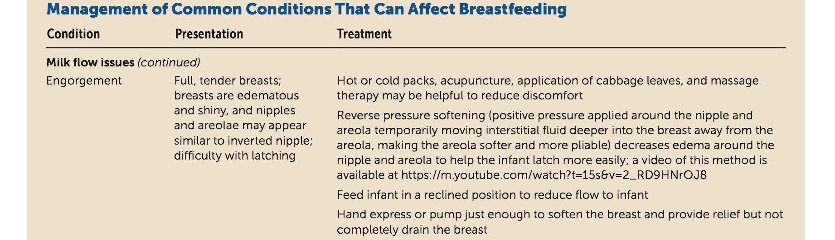
Breastfeeding: Common Questions and Answers. Am Fam Physician. 2018 Sep 15;98(6):368-376.

Slide 46
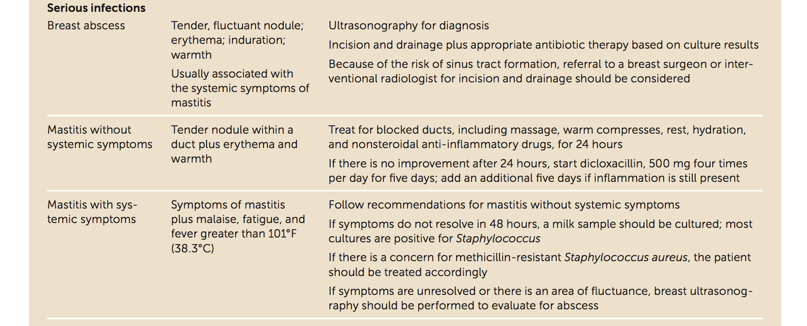
Breastfeeding: Common Questions and Answers. Am Fam Physician. 2018 Sep 15;98(6):368-376.

Slide 47
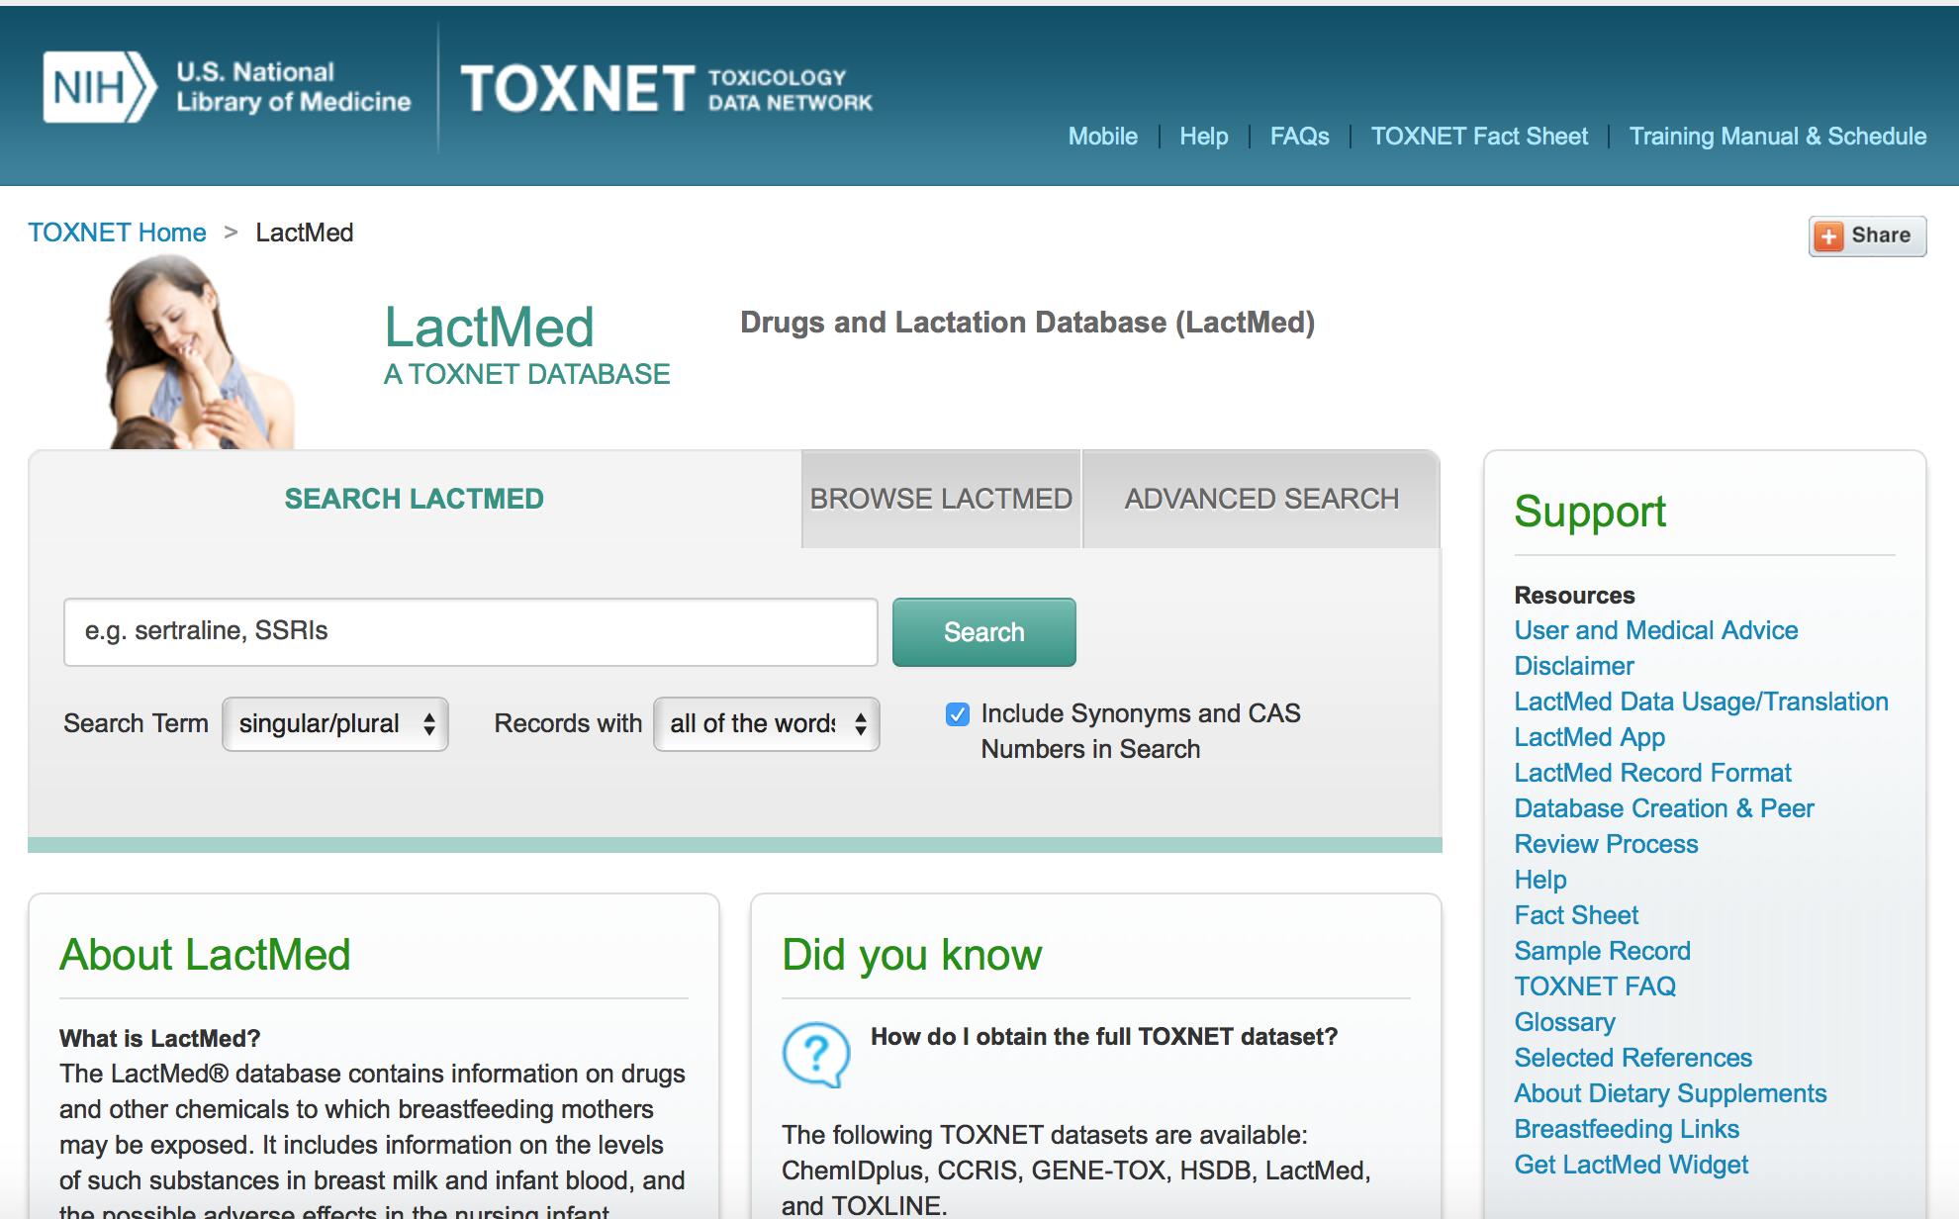
https://toxnet.nlm.nih.gov/newtoxnet/lactmed.htm

Slide 48
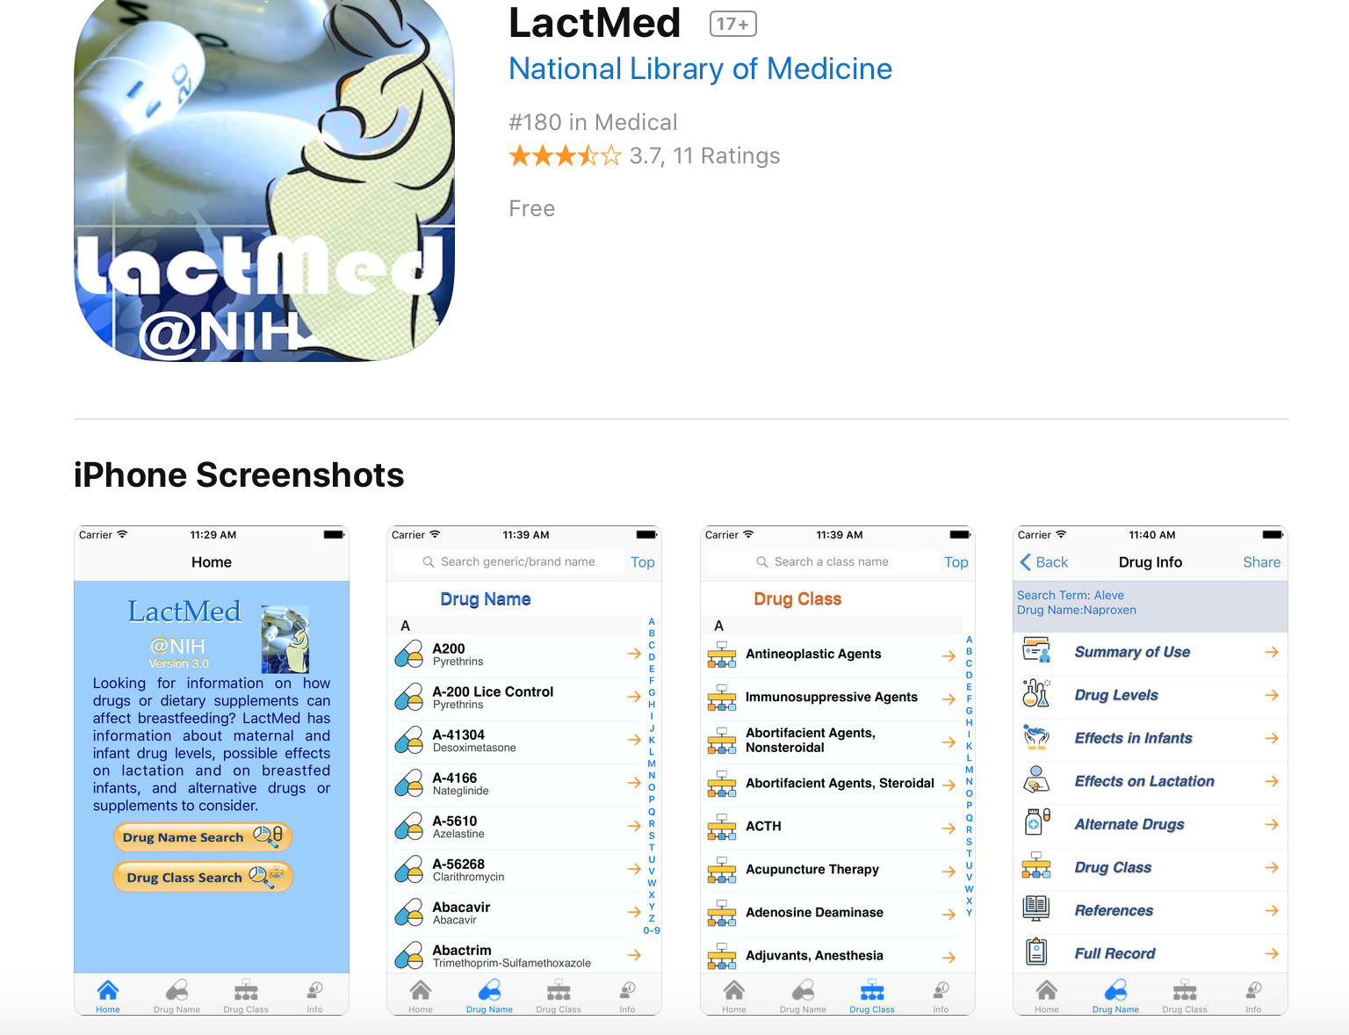

Slide 49


