Slide 1
Final Summary
Deema AlMaziad
Lama AlAssiri
Leen AlMazroa
Muneera AlKhorayef
Nouf Alhussaini
Reema AlMutawa
Renad Alhaqbani
Wejdan AlNufaie
Color Index
Main text
Males slides
Females slides
Doctor notes
Important
Textbook
Golden notes
Extra
Editing File

Slide 2
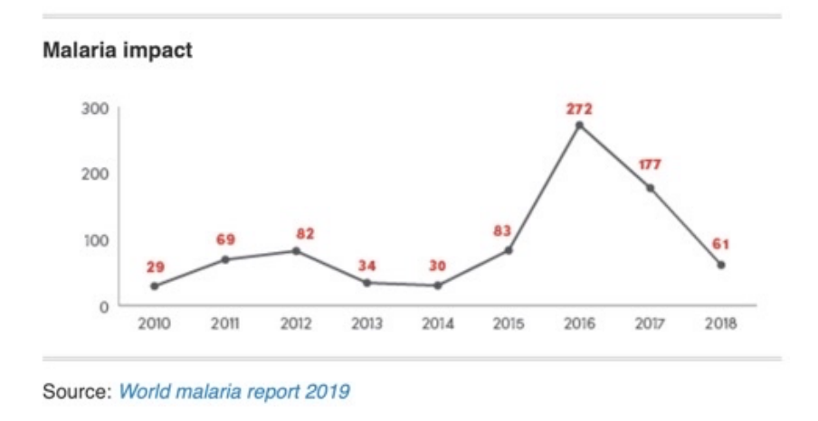
L16- Malaria
a life threatening febrile illness caused by infection with the protozoan parasite Plasmodium.
It is transmitted to humans by the bite of the female Anopheles mosquito
Epidemiology
predominantly affecting :
young children (Especially those who are less than 5 years)
pregnant women.
In 2019, there were 229 million cases and, 409,000 deaths caused by malaria worldwide (WHO 2020)
67% of deaths were in children aged less than five years.
94% of cases and deaths occurred in Africa.
Multidrug resistance is prevalent in many areas around the world, particularly in South East Asia (Cambodia, Thailand, Brunei, Burma (Myanmar), Timor-Leste, Indonesia, Laos, Malaysia, Philippines, Singapore and Vietnam.)
Cases are increasing
Usually due to political reasons (like wars) more than health reasons. Poverty, war, etc can increase the chance of disease incidence and this will also cause the death percentages to increase
Epidemiology in Saudi Arabia
Dominant species in indigenous cases: P. Falciparum (93%), mainly transmitted by Anopheles Arabiensis (MOH 2019; WHO 2019)
In 2018, number of confirmed cases was 2711, of which:
2650 (97.7%) were either imported or introduced.
only 61 cases were indigenous.
Zero indigenous deaths from 2010 to 2018.
High-risk populations in KSA
Southern and South-
Western populations
Immigrants
Pilgrims
Jazan and Aseer
ue to seasonal anomalies (i.e., unusual high annual rainfall)
from Yemen and its neighbouring countries
from endemic countries.

Slide 3
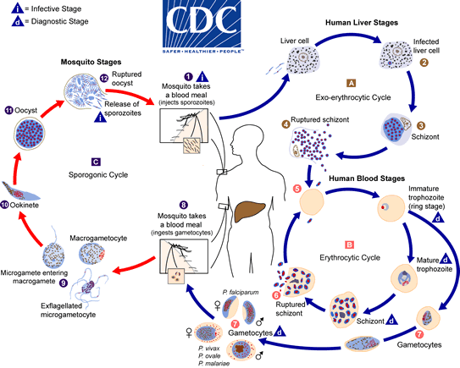
L16- Malaria
Mode of transmission and lifecycle:
MAINLY Vector (female Anopheles mosquitoes)
Blood (injection/transfusion of contaminated blood)
Congenital (rare)
Recall from Microbiology
Explanation for the picture:
1. Malaria is mainly carried by female anopheles mosquito.
2. The infected mosquito will bite and inject sporozoites from it salivary gland into the bloodstream of human
3. Which then will travel through blood until it reaches the liver and enter the hepatocytes where it will multiply
asexually to form merozoites inside the schizont (Exoerythrocytic schizont).
4. When the hepatic schizont rupture (clinical symptoms appear) the merozoites will be released into blood, then it will enter the erythrocytes forming immature trophozoites (ring stage) which will have 2 pathways:
a. First pathway: It goes through the erythrocytic cycle starting from ring stage then into Mature trophozoites,
then the merozoites will multiply inside the RBCs forming schizont (Erythrocytic schizont), which will rupture (hemolysis) and release the merozoites into the bloodstream (Clinical attack of malaria is due to this stage) and the cycle will repeat over and over again.
b. Second pathway: Some immature trophozoites will become gametocytes (male and female) those gametocytes will be ingested by another mosquito; in the mosquito:
i. There are Micro(Male) and Macro(Female) gametocytes, the microgametocytes will enter into the macrogametocytes in which they will form Ookinete then it will develop into Oocyst which will rupture releasing sporozoites in mosquito, then the cycle will go over and over again.
Symptoms “not specific”
Common | Less common
- Paroxysms of: Chills/rigors followed by fever, sweats | Anorexia
- A pattern might develop (i.e., fever occur every 2-3 days) | Nausea, vomiting
 | Diarrhoea
- Headache, weakness, muscle and joint pain. | Abdominal pain

Slide 4
L16- Malaria
History and Risk Factors
Travel history
key in patients presenting in non-endemic countries.
If positive, history of prophylaxis must be obtained. because some patients may be asymptomatic
Settled migrants.
Low host immunity.
Pregnancy.
Children aged less than five years.
Elderly.
Physical examination
Hepatosplenomegaly
due to 1- liver stage + Human blood stage 2-Hemolysis-> anemia -> pale
Signs of Anaemia (e.g., pallor)
he complications of severe malaria (treatment differs in severe cases)
Confusion/altered level of consciousness
Seizures
Hypotension
Oliguria/anuria
Jaundice
Respiratory distress
Laboratory
Other baseline tests
1
Rapid diagnostic test (RDT)
Full blood count (FBC) for anemia or hemolysis
Clotting profile
Serum electrolytes
Urea and creatinine (U&E)
Liver function tests (LFTs)
Blood glucose
Hypoglycemia due to chloroquine- resistance
Urinalysis
Arterial blood gas (ABG) (possible Lactic acidosis)
2
Light Microscopy:
Giemsa-stained blood smear; Thin film, thick film.
3
Polymerase Chain Reaction (PCR)
Only in large hospitals
3
Loop-mediated Isothermal Amplification (LAMP)
An emerging test
Community diagnosis
Pre-elimination
Eliminated
Areas with advanced malaria control
- Universal access to diagnostic tests/ capabilities.
- Surveillance/mapping.
- Focused screening
(e.g., those who present with danger signs)
and treatment (e.g., active case strategy in Oman).
Areas where malaria has been eliminated
- Prevent re-introduction.
- Considerable resources are still needed.
- Different strategies
(e.g., border control, active case management).
- Maintain high-quality diagnosis
Which of the following preventive measures is included in the malaria control program ? Case Management

Slide 5
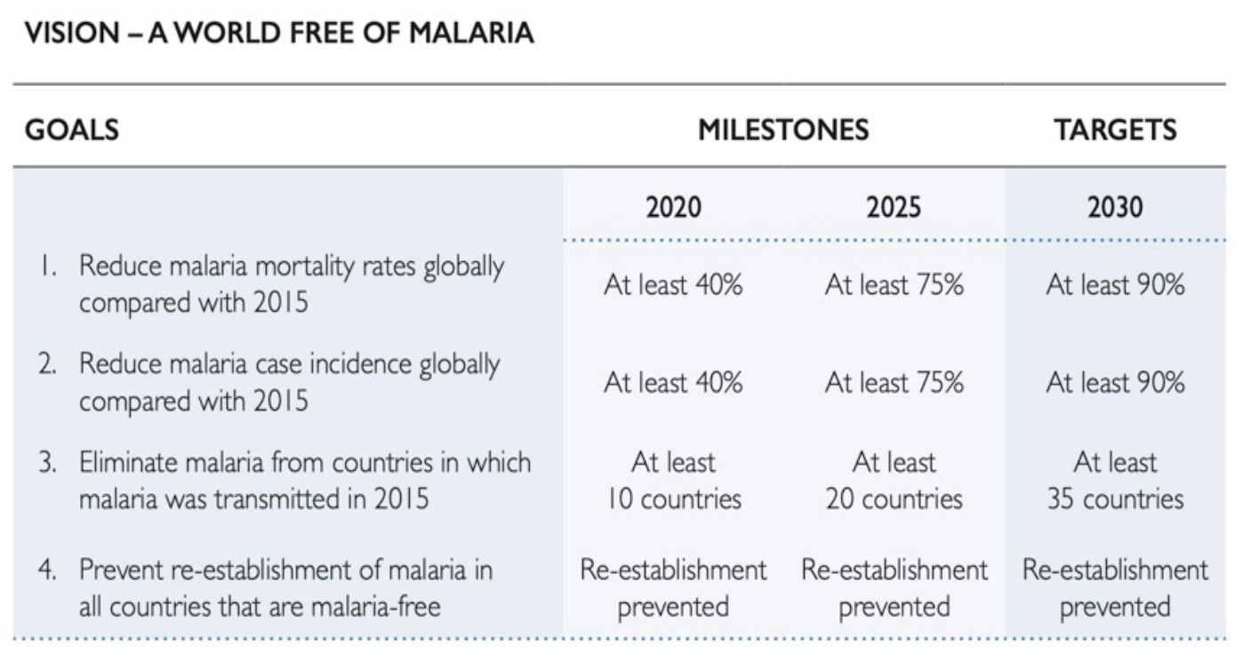
L16- Malaria
Treatment algorithm:
Acute P. falciparum
Severe
Uncomplicated
Pregnant
Non-pregnant
Chloroquine-resistant region an non pregnant
Chloroquine- sensitive region and non-pregnant
Pregnant
1st line: Artesunate and Sulfadoxine- Pyrimethamine (ACT)
2nd line: Artemether and Lumefantrine
Chloroquine phosphate/hydroxychloroquine
1st line: quinine sulphate and clindamycin
Primaquine is contraindicated in:
PLUS Primaquine
G6PG deficiency
Infants <6m
Pregnancy
Hypersensitivity
lactating mothers for babies <6m
Resistance
Three species known for resistance: P. falciparum, vivax and malariae.
Resistance to one drug confers resistance to others (cross-resistance) which leads to multidrug resistance
gene mutations:
Complete:
Survival / multiplication of malaria despite adequate treatment.
Partial:
Delayed clearance or incomplete recovery.
WHO efforts in malaria control (vision 2030)

Slide 6
L16- Malaria
Global technical strategy “GTS” (2016-2030)
Pilar 1: Ensure universal access to malaria prevention, diagnosis and treatment
1- Vector control
Maintain adequate entomological surveillance and monitoring
2- Chemo-prevention subtherapeutic doses of malaria treatment for prophylaxis
Example: Someone plans on traveling to an endemic chloroquine- resistant country? Doxycycline (before/during/after travel)
3- Diagnostic testing and treatment
- All suspected cases must be confirmed first before given treatment. If treatment failure is > 10% , first line therapy is reviewed (every 2 years, countries review their malaria health policies) - Use multiple drugs (combination) to avoid resistance
Pillar 2: accelerate efforts towards elimination and attainment of malaria-free status
Enact legislation Implement transmission-blocking chemotherapy in high transmission/resistance cases Detect all infections to attain elimination and prevent reestablishment Use of medicines to reduce the parasite pool Devise P. vivax-specific strategies the problem is that it can live in multi environments so it’s very resistant Use surveillance as an intervention in elimination programs
Pillar 3: transform malaria surveillance into a core intervention
Surveillance in areas of high (focus on no. of deaths and cases) and low (focus on high risk groups) transmission. Invest in routine information systems Ensure the surveillance system is monitored
Supporting element 1: harnessing innovation and expanding research | Supporting element 2: strengthening the enabling environment
Vector control Diagnostic testing and treatment Malaria vaccines Surveillance Elimination | Increase international and domestic financing Ensure robust health sector response Strengthen health workforce and malaria expert base Ensure the sustainability of malaria responses Improve government stewardship Strengthen multisectoral collaboration Encourage private sector participation Empower communities and engage with non-governmental organisation

Slide 7
L17- Emerging Respiratory infectious diseases
Influenza Virus
Antigen type | Who does it infect? | What does it cause?
A | Human | Seasonal epidemic,pandemic
B | Human | Seasonal Epidemic
C | Human | Mild respiratory illness
D | Cattle | ---
Antigenic drift
Happens continually over time.
Results from point mutation of the gene -> changes in surface proteins¹.
Why do some people get the flu more than 1 time, although they are vaccinated? This is due to antigenic drift.
Antigenic Shift
Complete sudden change
Results from genetic recombination of human virus with animal or avian virus Responsible for pandemic strains.
Three different methods for antigenic shift:
1- virus from human and avian reassort in the swine.
2- virus jumps from avian to human.
3- virus jumps from avian to swine to human without Reassortment
Influenza A subtypes infective to humans:
Currently circulating viruses type A are:
H1N1 responsible for pandemics (this is the doctor’s note and a golden note)
H3N2
Date of Pandemic | Influenza subtype | Death Toll
1918-1919 | Spanish influenza H1N1 | 50 million
1957-1958 | Asian influenza H2N2 | 2 million
1968-1969 | Hong kong influenza H3N2 | 1 million
2009-2010 | H1N1 (swine flu) - novel subtype | 18.2 thousand +
Signs of an outbreak :
01
02
03
04
05
06
Starts with few cases
Sudden outburst of disease
Increased febrile illness in children followed by adults
Increased hospitalization due to illness
Attack rates are high: 5-10% in adults; 20-30% children
Epidemic peaks within 3-4 weeks then declines

Slide 8
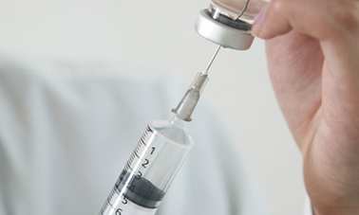
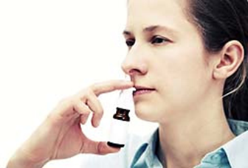
L17- Emerging Respiratory infectious diseases
Influenza Virus
Vaccine
takes two weeks to produce immunity
Immunity against type A (H1N1; H3N2) , and B (trivalent)
Flu vaccines available in KSA:
Injection vaccine:
Inactivated virus
Ages 6 months and above
Safe for pregnant women
Targets H antigen
Nasal spray vaccine:
Live weakened virus
Ages 2y to 49 y
NOT safe for pregnant women
Targets both H and A antigens
Contraindications (the Doctor might ask a question)
Those who have severe egg allergy Previous history of severe allergy to influenza vaccine Yes there are vaccine modifications where egg allergies aren’t contradicted but we don’t know of KSA has them so we make sure they don’t have egg allergies
History of Guillain Barre Syndrome after taking the vaccine
Children under 6 months
People suffering from very high or moderate temperature
wow, such empty

Slide 9
 | Influenza | MERS-CoV | SARS-CoV
Reservoir | Animals (swine, horses, dogs, cats) Birds (poultry, wild birds) human | Animals in the Arabian peninsula Dromedary camels May have been in bats and transmitted to camels sometime in the past | Horseshoe bats
Mode of transmission | Secretions of respiratory tract | Person-to-person(patient- to-HCW) Camels-to-humans | Direct: Indirect: Contacting surface contaminated with droplets May be airborne ? Aerosol-generating procedures Virus shed in stool – not clear feco-oral transmission
Incubation period | 18 – 72 hrs Period of infectivity: 1-2 days prior to symptoms, and 5-7 days after. | 2-14 days high case fatality rate in relation to COVID-19 | 2 – 7 days
Risk factors | Season: Winter or rainy Age: severe in elderly and < 18 m Overcrowding Contact with infected individual Immunity Chronic diseases; DM; CHD; CLD. Pregnancy | close contact with a confirmed case Healthcare personnel who do not use recommended infection-control precautions contact with camels Consumption of raw animal products Elderly, immunocompromised, chronic disease
Prevention & control | Cough etiquette Wash hands Vaccine | secondary prevention : Same as influenza + Avoid touching eyes, nose and mouth Avoid personal contact, or sharing items Clean and disinfect frequently touched surfaces Healthcare workers practice infection control precautions | Same as previous + early identification and efficient reporting of cases Isolation of patients Exit screening for international travelers

Slide 10
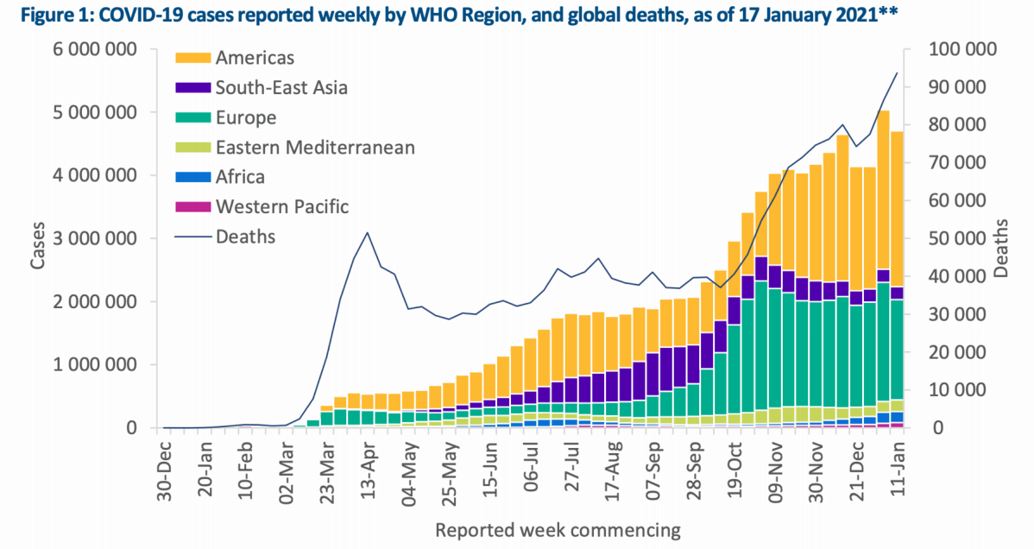
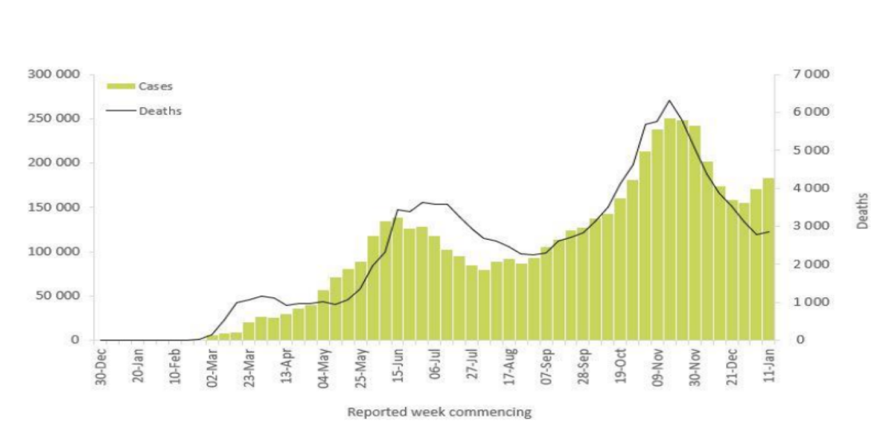
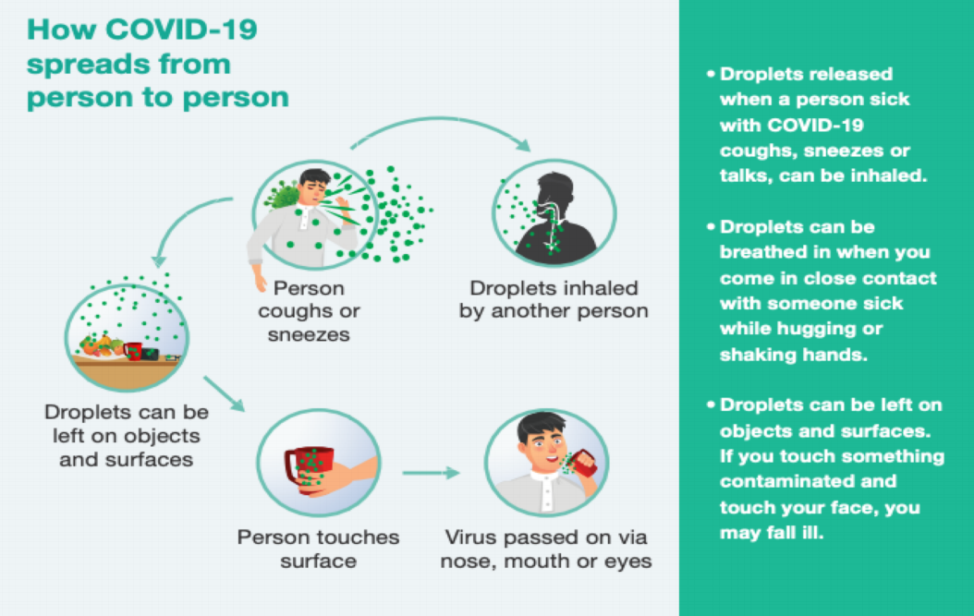
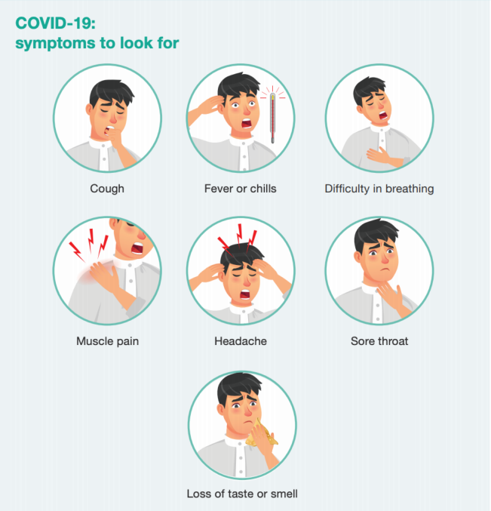
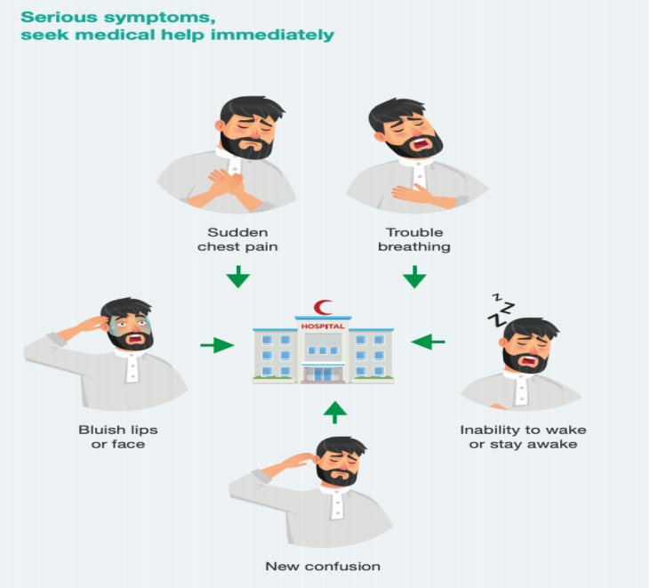
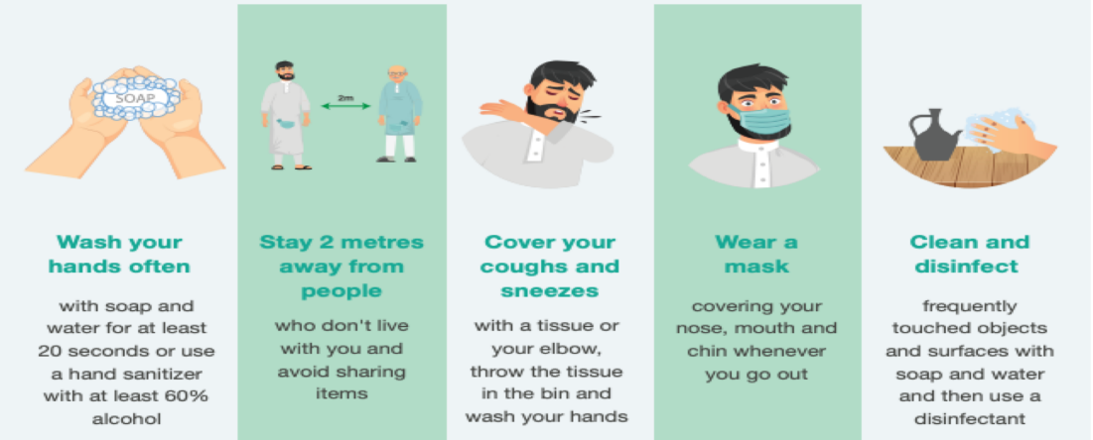
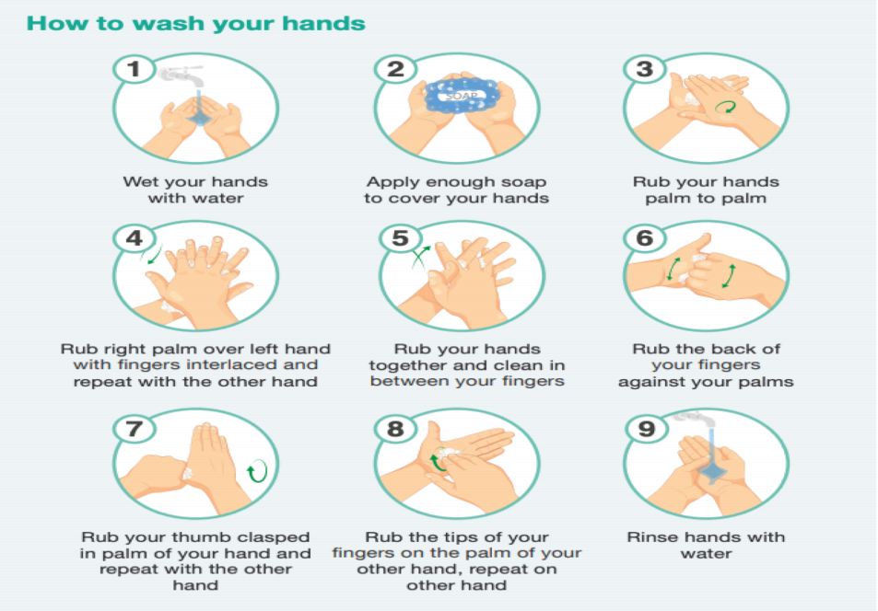
L18- COVID-19 Pandemic
It entered a global level on March, 2020. The graph shows two major peaks (Mar & Nov) with smaller peaks in between.
Eastern Mediterenean regions
There are two peaks.
First was in May-June and the other peak was in November.
The graph also predicts
Americas region is where most of the cases are.
that there might be a rise in the cases if necessary precautions weren’t implemented.
Mode of Transmission:
COVID-19 is mainly transmitted through droplet infection.
Whenever an infected person speaks or coughs, droplets are released and can be inhaled by a different person within 2 m
Moreover, droplets can be left on surfaces ¹ for sometime before getting inactivated
Signs and Symptoms:
Common symptoms | Serious/Severe Symptoms
The symptoms differ from the flu in their intensity. Loss of taste or smell is particularly pathognomic and should rise high index of suspicion. | Any patient with any of the symptoms above should immediately seek healthcare and MUST be admitted to the hospital.
How to protect yourself and others? ^{2,3}
Video is very important!!
2 meters = 2 arm's length
Handwashing should be for 2 minutes
Recent research evaluated the survival of the COVID-19 virus on different surfaces and reported that the virus can remain viable for up to 72 hours on plastic and stainless steel, up to four hours on copper, and up to 24 hours on cardboard.
Does a person, who had the infection, required to wear a mask? YES, all people should wear masks even if they got the infection since they’re still susceptible for reinfection.
Medical masks (surgical) should be worn by healthcare workers, COVID-19 infected people, people who takes care of infected people, people above the age of 60 and people with underlying conditions. Other than that, a fabric mask is enough.

Slide 11
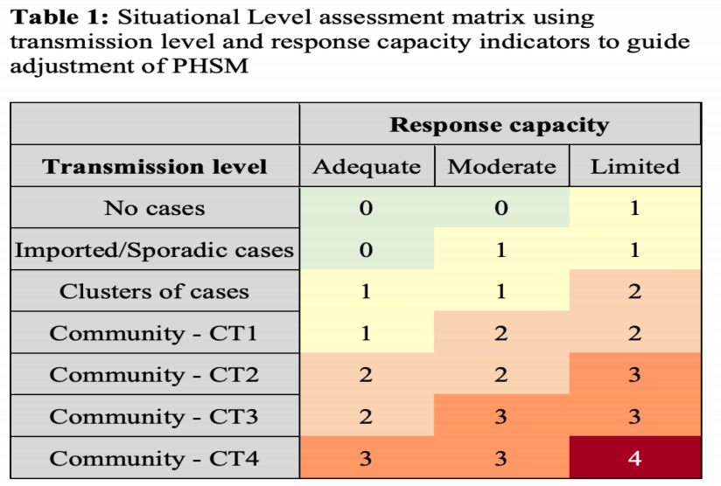
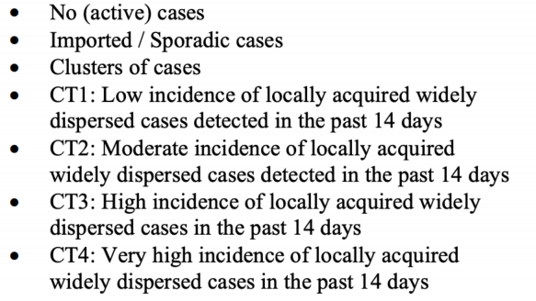
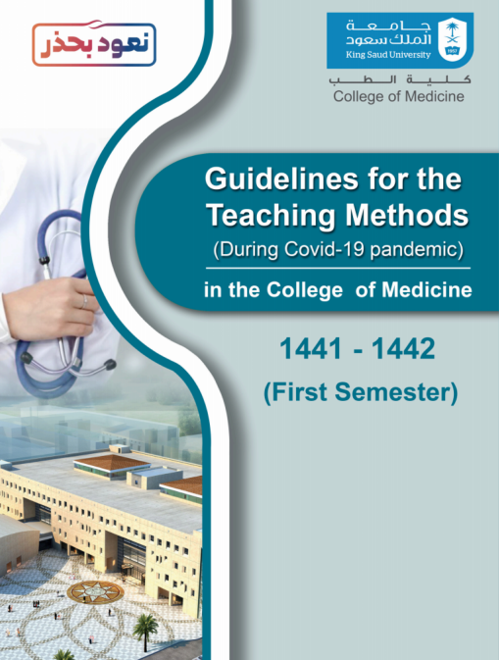
What Should I do if I Feel Sick?
REPORT IMMEDIATELY!
Flu-like symptoms:
Report to the flu clinic
Opens 24 hrs
Come in Close Contact:
Report to the occupational health clinics
Fill in the link for contact tracing
Who & Where
Public Health and Social Measurements
Community Transmission
1
Public health and social measures (PHSM) have proven critical to limiting transmission of COVID19 and reducing deaths.
3
Indicators and suggested thresholds are provided to gauge both the intensity of transmission and the capacity of the health system to respond; taken together, these provide a basis for guiding the adjustment of PHSM. Measures are indicative and need to be tailored to local contexts.
2
The decision to introduce, adapt or lift PHSM should be based primarily on a situational assessment of the intensity of transmission and the capacity of the health system to respond, but must also be considered in light of the effects these measures may have on the general welfare of society and individuals
4
PHSM must be continuously adjusted to the intensity of transmission and capacity of the health system in a country and at sub-national levels . When PHSM are adjusted, communities should be fully consulted and engaged before changes are made
COVID-19 in University Settings
Risk transmission can be categorized as the following:
Lowest risk: virtual learning, activities, and events.
More risk: small in-person classes, activities, and events. (eg. hybrid virtual and in-person class structures or staggered / rotated scheduling to accommodate smaller class sizes)
Individuals are spaced at least 1.5-2 m apart and DO NOT share objects
Highest risk: Full-sized in-person classes, activities, and events.
Individuals are not spaced apart and they share objects, materials and supplies
How do you protect yourself in the hospital?
REMEMBER: PPE, surgical masks, face shield & gloves
Always follow the guidelines in the OR, ICU, ER
Always report any signs of illness, any one is deviating from the policies laid down
Reduce congestion in the health clinic
Distance inside clinics has to be 1.5 meters
Compensate the clinical training by enforcing CBD, or online courses

Slide 12
L19- Hajj and Health
The Hajj pilgrimage is one of the greatest mass gatherings in the world, and presents unique public health challenges.
Mass gatherings can present important public health challenges related to the health of attendees and of the host country population and health services.
Diseases and Health risks associated with mass gathering (Hajj)
Transmission of communicable diseases, including antibiotic-resistant bacterial infections.
Non communicable diseases.
Communicable diseases
Unhygienic practices and close contacts between pilgrims in overcrowded situations during the Hajj rituals, as well as international travel, increase the risks of outbreaks and the spread of infectious diseases among pilgrims.
Meningococcal disease
Meningitis most commonly caused by Neisseria meningitidis because of its potential to cause epidemics.
Epidemiology
Crowded conditions are a risk factor for the carriage and transmission
Hajj has been associated with outbreaks of invasive meningococcal disease. Most cause of epidemics
Outbreaks have high fatality rates.
Associated with medical costs.
During the 2000 and 2001 Hajj pilgrimages, Saudi Arabia experienced 2 large outbreaks of invasive meningococcal disease that led to global spread of N. meningitidis serogroup W-135 This happened during hajj before that this strain wasn’t known.
Neisseria meningitidis
Pathogenic meningococci are enveloped by a polysaccharide capsule the capsule identifies the valurince
Humans are the only reservoir.
Nasopharynx is the natural habitat and reservoir, in most cases colonization of Nasopharynx is asymptomatic.
Even with adequate chemotherapy, meningococcal meningitis has a fatality rate of about 10% and about 15% of the survivors have residual (CNS) damage hearing loss, vision loss, and preeminent damage

Slide 13
Meningococcal disease
Host
Maternal antibodies offer protection against invasive disease till the age of six months.
Susceptibility peaks at age 6 - 12 months and decreases again after colonization of closely related non-pathogenic bacteria.
Invasive disease occurs if no protective bactericidal antibodies are mounted against the infecting strain.
Environment
Crowded living conditions also facilitate disease spread, since individuals from different areas have different strains of meningococci.
The risk of invasive disease is higher in the first few days after exposure to a new strain.
Smokers
Mode of Transmission
Direct contact.
Respiratory droplets
The average incubation period is 3 - 4 days with a range of 2 to 10 days, this is also the period of communicability.
Diagnosis
by the clinical presentation and a lumbar puncture showing a purulent spinal fluid.
Typical CSF abnormalities in meningitis include:
Increased pressure (>180 mm water)
WBC counts between 10 and 10,000 cells/μL, (predominantly neutrophils)
Decreased glucose concentration (<45 mg/dL)
Increased protein concentration (>45 mg/dL)
Clinical Features
Most Common symptoms
In infants and young children
- Acute onset of intense headache
- High fever can reach to 40
- Sensitivity to light (photophobia)
- Stiff neck.
- Meningococcal septicaemia: which is characterized by a haemorrhagic rash which usually indicates disease progression and rapid circulatory collapse
- Subacute infection that progresses over several days.
- Irritability and projectile vomiting may be the presenting features in this age group.
- Seizures occur in 40% of children with meningitis.
- Neck stiffness can be absent in children so a high fever in children meningitis unless proven otherwise

Slide 14
Meningococcal disease
Management
fatal and should always be viewed as medical emergency.
requires early recognition, prompt initial parenteral antibiotic therapy and close monitoring.
Preventive measures for Meningococcal diseases
Chemoprophylaxis
Use of vaccination
Health awareness and educational campaigns
Efficient disease surveillance and response systems
1- Chemoprophylaxis:
Is the preferred means of prevention of disease among close contacts of sporadic
2- Meningococcal Vaccines:
More than 90% of meningococcal disease, vaccines are available for group A, C, Y and W - 135
At present two types of meningococcal vaccines are licensed;
Meningococcal polysaccharide vaccines:
Bivalent → protection against serogroups A and C.
Quadrivalent → protection against serogroups A, C, Y and W - 135 commonly used
Meningococcal conjugated polysaccharide vaccine.
Recommendations for use of meningococcal vaccine:
Vaccination with a single dose of polysaccharide vaccine is recommended for travelers above 18 months of age going to an area experiencing an epidemic of meningococcal disease or to areas with a high rate of endemic meningococcal disease.
Diarrhoeal diseases
Cholera (especially from Yemen) and traveller’s diarrhoea are common during the Hajj.

Slide 15
Respiratory tract infections
Upper respiratory tract infections (URTIs), including pharyngitis, viral URTI, and tonsillitis are the most common cause of outpatient department visits during the Hajj
Pneumonia
Tuberculosis
-One of the leading causes of hospitalization of pilgrims in Mecca, especially
among elderly people
- The leading cause of severe sepsis and septic shock among pilgrims admitted to the ICU.
- The annual risk is 3 times higher in Mecca than the national average in Saudi Arabia.
Pathogens
Candida albicans 28%
Pseudomonas aeruginosa 21.8%
Legionella pneumophila 14.9%
Klebsiella pneumoniae
KSA’s Efforts for a Healthy Hajj
KSA’s Healthcare System during Hajj
The Saudi government provides free healthcare services for all pilgrims.
The healthcare system, which is operated by 26 421 domestic employees in addition to international visiting healthcare practitioners, provides curative and preventive services.
Travel immunisation recommendations
They are classified as:
Mandatory (required)
Voluntary (recommended) before performing Hajj
The three mandatory vaccines are:
quadrivalent meningococcal vaccine for all pilgrims
Yellow fever
Polio vaccines for pilgrims coming from countries with active polio transmission.
Recommended vaccines include:
influenza vaccine
pneumococcal vaccine

Slide 16
L20- Reporting & Surveillance
The Centres for Disease Control and Prevention (CDC) defined Public Health Surveillance as: “Ongoing systematic collection, analysis, interpretation and dissemination of data regarding a health related event for use in public health action to reduce morbidity and mortality and to improve health”.
In other words, it means “information for action”.
It is the eyes and ears of public health.
It a very important tool for public health
It is a network of people and activities to keep this process.
Functions at local to international levels and is available in regular reports routinely.
Objectives of Public Health Surveillance
Main aim:
Disease control and prevention
1
To study the trends of disease
6
To develop epidemiologic research questions
2
Early warning of epidemics
7
To test epidemiologic hypothesis
3
To provide quantitative estimates of magnitude of health problem
8
Evaluation of control and preventive measures Breast cancer screening
4
To study the natural history of disease
9
Monitoring of change in infectious agent like changes in malaria species
5
Demonstrating the spread of a disease in time and Place
10
Detecting changes in health practices
Types of Surveillance
Types | Item | Description
Passive | Definition | Regular reporting of disease data by all institutions that see patients (or test specimens) and are part of a reporting network. There is no active search for cases. Relies on the cooperation of health-care providers — laboratories, hospitals, health facilities and private practitioners. This is the most common type of surveillance. Example: Reported cases of COVID-19 by hospitals.
 | Uses | In this type of surveillance criteria are established for reporting diseases, risk factors or health-related events then health practitioners are notified of the requirements and they report events as they come to their attention. The data recipient has to wait for the data providers to report. In most countries with a passive surveillance system, every health facility is required to send a monthly (sometimes weekly/daily) report of all cases on a standard form.
 | Advantage | Simple to conduct Inexpensive Covers wide areas (whole countries or provinces)
 | Disadvantage | It can be difficult to ensure completeness and timeliness of data. Because it relies on an extensive network of health workers. Usually underestimate the true illness burden.

Slide 17
Types | Item | Description
Active | Definition | In active surveillance the organization conducting the surveillance actively seeks the relevant information (healthcare providers are contacted and asked to provide details of any cases they have seen). Data must be obtained by searching for cases, and also by periodically contacting those who may know of cases. Example: Health workers go into the community, search for cases of fever and take their blood slide for malarial parasite Screening for people arriving from a certain country. Actively visiting and screening individuals in high risk areas.
 | Uses ¹ | Active surveillance is used when there is an indication that something unusual is occurring: Rare disease Disease on way to eradication e.g. polio During outbreaks (very good indication) Regular outreach to potential reporters, to stimulate the reporting of specific diseases or injuries.
 | Advantage | Produce complete data of a good quality
 | Disadvantage | Expensive high use of resources For this reason, when it is used, it is for a limited time period.
Sentinel ² | Definition | Reporting of cases of specific diseases ³ or risk factors that may indicate that a particular preventive or therapeutic activity is not working as planned. Example: a measles outbreak in kids who were supposedly vaccinated.
 | Uses | It is used when high-quality data are needed about a particular disease that cannot be obtained through a passive system. It involves only a limited network of carefully selected reporting sites Data is obtained from selected hospitals who agree to report all cases of the disease. Data collected in a well-designed sentinel system can be used to: Signal trends. Identify outbreaks. Monitor the burden of disease in a community.
 | Advantage | Rapid Economical alternative to other surveillance methods. Because it is conducted only in selected locations.
 | Disadvantage | May not be as effective for detecting rare diseases or diseases that occur outside the catchment areas.
This type of surveillance is not effective in all types of diseases.
Similar to passive but more detailed and is not considered a main type of surveillance.
E.g. Myocardial Infarction

Slide 18
Steps in Establishing a Surveillance System
Step 1
Step 2
Step 3
Is it Justifiable to Establish a Surveillance System?
Spell out the objectives of surveillance system
Specify the organization and structure of the surveillance?
Step 4
Clearly define the disease(s) being considered for surveillance?
Case Definition:
A set of uniform criteria used to define a disease for public health surveillance (possible, probable, confirmed).
Low specificity
Suspected
Probable
Confirmed
High specificity
Example | Item | Description
Beginning of COVID-19 (2019-nCoV) | Suspected case | A person with acute respiratory illness (fever with cough and/or shortness of breath) AND and of the following: 1. A history of travel to China in the 14 days prior to the symptom onset. 2. A close physical contact in the past 14 days with a confirmed case of COVID
 | Confirmed case | Suspected case with laboratory confirmation of 2019-nCoV infection
Smallpox | Probable case | A case that meets the clinical case definition that is not laboratory confirmed but has an epidemiological link to another confirmed or probable case.
 | Confirmed case | case of smallpox that is laboratory confirmed.
Step 5
Step 6
Step 7
Specify the Details of Collection of Information
The Organization and procedures of data analysis
Making Scientific interpretations out of the results
Step 8
Step 9
Ensure proper feedback to all concerned
Periodically evaluate / review the surveillance system
Examples of National Surveillance Systems
HESN
ISSA
Health Electronic Surveillance Network (HESN) is used to control and manage infectious diseases and epidemics online.
Influenza Surveillance In Saudi Arabia (ISSA)
1
2

Slide 19
L21-Introduction to Non-Communicable Diseases
Definition of NCDs
● Non-communicable diseases are all impairments or deviations from the normal, which have one or more of the following characteristics;
Are permanent
Caused by non-reversible pathological alterations
Leave residual disability
Require special training of the patient for rehabilitation
May be expected to require a long term supervision
Non-Communicable Diseases
5
Mental disorders: Schizophrenia, anxiety and depression
Hypertensive Heart Diseases
Chronic Obstructive diseases
Coronary Heart Diseases
4
Mental Retardation
1
2
3
Diabetes
Cancer
Stroke
Peptic Ulcer
Blindness
8
9
Arthritis
11
6
7
10
4
Causes of non-communicable diseases
1
Underlying socioeconomic, cultural, political and environmental determinants:
● Globalization ● Urbanization ● Population ageing
2
Common modifiable risk factors:
● Unhealthy diet ● Physical inactivity ● Tobacco use
3
Non-modifiable risk factors:
● Age ● Heredity ● Gender
4
Intermediate risk factors:
● Raised blood pressure ● Raised blood glucose ● Abnormal blood lipids ● Overweight/obesity
5
Main Chronic Diseases:
● Heart Disease ● Stroke ● Cancer ● Chronic Respiratory Disease ● Diabetes
Modifiable risk factors
VS
Non Modifiable risk factors
Cigarette smoking
High Blood pressure
Elevated serum Cholesterol
Diabetes
Lifestyle changes (dietary patterns,physical activity)
Stress factors
Alcohol abuse
Age
Sex
Family Hx
Genetic factors
Personality
Race

Slide 20
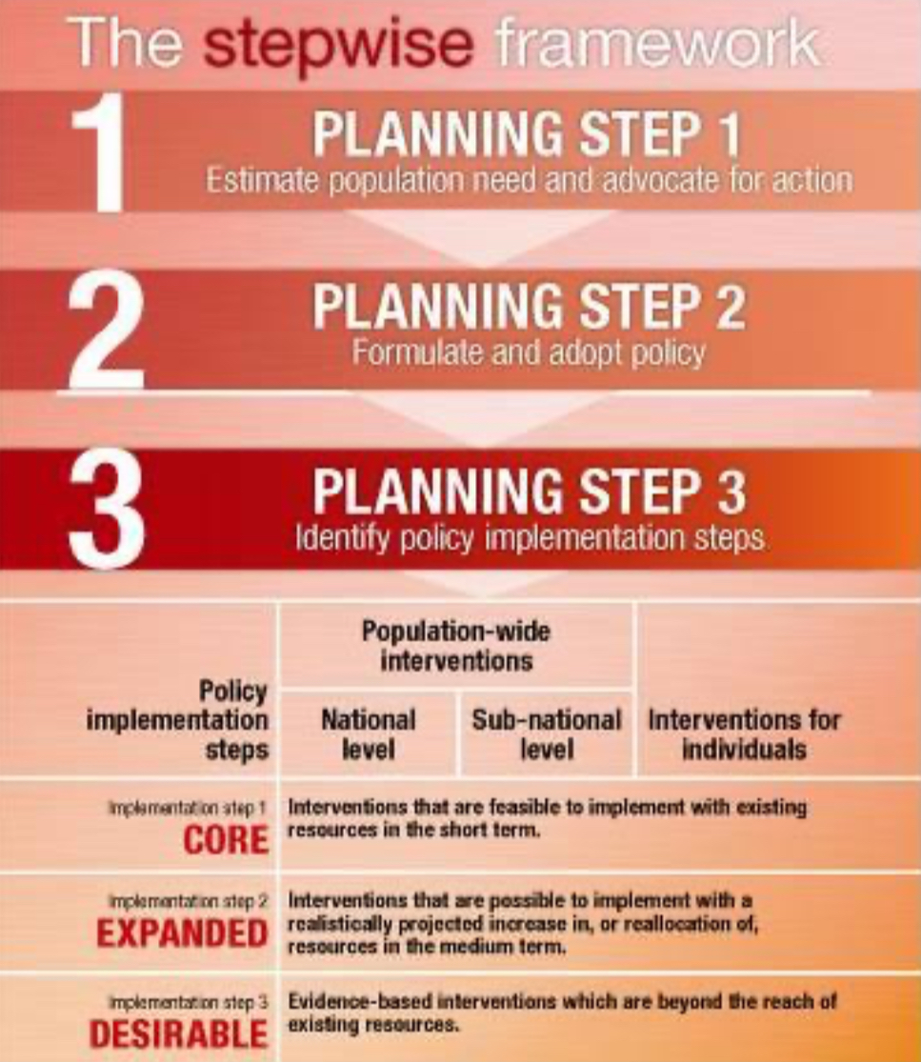
Framework for NCD prevention
2
Secondary prevention
Primary prevention
Population Strategy
High Risk strategy
Prevention
01
Tertiary prevention
Population Strategy
High risk approach
Secondary approach
Dietary Changes
Blood pressure control
Physical activity
(weight reduction)- specially children
Behavioral change reduction of stress & Smoking cessation
Self care
Health education
Identify Risk: Identify high risk people and families eg those who smoke, and have high serum cholesterol.
Specific Advice: helping them to stop smoking and exercise and diet control ect
Continuation of primary care.
Early case detection
and treatment.
Eg: CHD
Cessation of smoking
Reduction of serum cholesterol level
Compliance
4
The stepwise framework
Step 1→Data, data will give us how many male and female diabetics we have, how many people died of stroke and how many people need secondary or tertiary prevention due to stroke.
Step 2→Policy, for ex. adaptation of tobacco free areas and taxation of tobacco products.
Step 3→Implementation:
A.National level: not selling tobacco products to anyone under 18.
B.Sub-national level: labeling zones and neighborhoods that are smoke free.
C.Individuals level: fines/penalties for anyone who smokes in a smoke free area.

Slide 21
L22-Introduction to Non-Communicable Diseases
Cardiovascular Disease
Definition:
CVDs are the #1 cause of death globally.
Cardiovascular disease (CVD) is a group of disorders of the heart and blood vessels,and may include:
Coronary heart disease
Cerebro- vascular disease
Peripheral arterial disease
Congenital heart disease
Disease of the blood vessels supplying the heart muscle.
Disease of the blood vessels supplying the brain.
(Stroke)
Disease of blood vessels supplying the arms and legs.
Malformations of heart structure existing at birth
not of main focus.
Diabetes
Definition:
4
Diabetes is a disorder of metabolism — the way the body uses digested food for growth and energy.
There are 4 types:
1- Type 1 an autoimmune attack against insulin secreting cells in the pancreas
2- Type 2 insulin resistance combined with decreased insulin secretion
3- Gestational diabetes first diagnosed during pregnancy that usually resolves after labor.
4- Prediabetes elevated blood sugar but doesn’t meet the clinical definition of diabetes.
Type 2 is mainly caused by modifiable risk factors and is the most
common world wide.
>90% of all adult diabetes cases are type 2.
Healthy diet, regular physical activity, normal body weight and avoiding tobacco use can prevent or delay the onset of type 2 diabetes.
Risk Factors:
Major Modifiable | Other Modifiable
Unhealthy diets Physical Inactivity Obesity or Overweight High Blood Pressure High Cholesterol | Low socioeconomic status Heavy alcohol use Psychological stress High consumption of sugar sweetened beverages Low consumption of fiber
Non-Modifiable | Other
Increased age Family history/genetics Race Distribution of fat | Low birth weight Presence of autoantibodies

Slide 22
Cancer
Definition:
Generic term for a large group of diseases that can affect any part of the body.
“Rapid creation of abnormal cells that grow beyond their usual boundaries, and which can then invade adjoining parts of the body and spread to other organs.” (WHO, 2012)
About 30% of cancers are attributable to behavior risk factors.
1
Cervical Cancer
Risk Factors:
1. Human Papillomavirus (HPV) ⁴
2. Smoking
3. Immunodeficiency Disorders (e.g. HIV)
4. Poverty
5. No access to PAP screening
6. Family history of cervical cancer
2
Breast Cancer
4
Risk Factors:
1. Hormonal therapy
2. Weight and physical activity¹
3. Race
4. Age is the most reliable risk factor
Screening should start after 45.²
5. Genetics (e.g. BRCA1, BRCA2)
3
Lung Cancer ³
Risk Factors:
Smoking cigarettes, pipes, or cigars now or in the past.
Being exposed to secondhand smoke
Being exposed to asbestos, radon, chromium, nickel, arsenic, soot, or tar.
4. Being treated with radiation therapy
To the breast or chest
5. Living where there is air pollution.
4
Prostate Cancer
(2nd most common cancer among men)
Risk Factors:
Age
Weight gain
Obesity
Race
Estrogen is formed in the ovaries and in adipose tissue. Obesity can increase the aromatization of androgens and increase the levels of estrogen leading to an increased risk for breast cancer
Women with positive family history should start screening prior to this age
Two main types: 1- small cell cancer ‘more aggressive’ 2- non-small cell cancer. It is important to differentiate between the 2 types because the two have different management options; SCC can not be treated by surgery.
There’s a vaccine for this virus that decreased the incidence of cervical cancer

Slide 23
5
Colorectal Cancer
3rd most common type of cancer (most common in men in KSA)
Forms in the lower part of the digestive system (large intestine)
Most preventable cancer among men in KSA
Most common death cause of cancer among men in KSA
Risk Factors:
1. Age
2. Unhealthy diet and low exercise
3. Black Race
4. Diabetes
5. Family history of colorectal cancer
Chronic Respiratory Disease
Risk Factors
1. Cigarette smoke
2. Occupational dust and chemicals
3. Environmental Tobacco Smoke (ETS)
4. Indoor and outdoor air pollution
5. Genes
6. Infections (frequent respiratory infections)
7. Socio-economic status
8. Aging populations
4
Why Risk Factors?
Surveillance for non-communicable disease can be difficult because of:
Lag time between exposure and health condition (e.g. smoking and COPD)
More than one exposure for a health condition
Exposure linked to more than one health condition
Interventions that target risk factors are needed to prevent disease.
Metabolic Risk Factors
1
Raised Blood Pressure:
Health Effects:
Leading risk factor for stroke and coronary heart disease (CHD).
In some age groups, the risk of CVD doubles for each increment of 20/10 mmHg of blood pressure.
In the U.S. 75% of sodium consumed comes from processed and restaurant foods.
In China and Japan, 75% of sodium consumed comes from cooking with high sodium products.
Recommendations and Actual Intakes WHO/PAHO:
A population salt intake of less than 5 grams or approximately 2,000 milligrams of sodium, per person per day is recommended to reach national targets or in their absence. This level was recommended for the prevention of cardiovascular diseases.
Actual intake: Latest global estimates show that average sodium intake varies from 2,000 to 7,200 milligrams of sodium per person per day

Slide 24
2
Raised Blood Cholesterol:
Health Effects
Increases risks of heart disease and stroke
Globally, ⅓ of ischaemic heart disease is attributable to high cholesterol.
A 10% reduction in serum cholesterol in men aged 40 has been reported to result in a 50% reduction in heart disease within 5 years.
A 10% reduction in serum cholesterol in men aged 70 years can result in an average 20% reduction in heart disease occurrence in the next 5 years
3
Raised Blood Glucose:
Health Effects
Elevated glucose levels can lead to type 2 diabetes.
Diabetes is the leading cause of renal failure.
Lower limb amputations are at least 10 times more common in people with diabetes
Raised glucose is a major cause of heart disease and renal disease.
Retinal damage
4
4
Overweight and Obesity:
Overweight and obesity are defined as
''abnormal or excessive fat accumulation that presents a risk to health.”
Body Mass Index
BMI (Body Mass Index) = Weight (kg) / Height² (m)
Underweight | <18.5
Normal | 18.5-24.9
Overweight | 25-29.9
Obese | >30
Skinfold Thickness Test
Waist-to-Hip Circumference Ratio
Men | > 102 cm are considered high risk
Women | > 88 cm are considered high risk

Slide 25
L23- Diabetes
Type 1 diabetes:
due to autoimmune β-cell destruction, usually leading to absolute insulin deficiency
Gestational diabetes mellitus (GDM): diabetes diagnosed in the second or third trimester of pregnancy that was not present prior to gestation
Classification of diabetes
Type 2 diabetes¹:
due to a progressive loss of β-cell insulin secretion frequently on the background of insulin resistance²
Specific types of diabetes due to other causes, e.g. maturity-onset diabetes of the young [MODY], and drug induced diabetes (such as with glucocorticoid use,)
Criteria for the diagnosis
No reference values will be given during the OSCE
FPG: 126 mg/dL (7.0 mmol/L)³. Fasting for at least 8 h.
OR 2-h PP: 200 mg/dL (11.1 mmol/L).
OR A1C: 6.5%.
OR In a patient with classic symptoms of hyperglycemia and a random plasma glucose 200 mg/dL (11.1 mmol/L)⁴.
In the absence of unequivocal hyperglycemia, diagnosis requires two abnormal test results from the same sample or in two separate test samples. (2 FPG / 2 A1C / FPG and A1C/ FPG and 2hpp)
Normal Fasting Plasma Glucose: 5.5 mmol/L (99 mg/dL)
Normal 2-h PP: < 140 mg/dl (7.8 mmol/L)
Prediabetes; Fasting Plasma Glucose: 5.6 – 6.9 mmol/L (100 - 125 mg/dL)
Prediabetes 2-h PP: 140- 199 mg/dl (7.8-11 mmol/L)
Prediabetes; A1C: 5.7 – 6.4%
The person is at risk to develop diabetes mellitus
Prediabetes
Diabetes
More common in the clinic
Especially among obese patient
To get in mmol/L divide by 18 and vice versa.
In symptomatic patients one random plasma glucose reading is sufficient to diagnose diabetes.

Slide 26
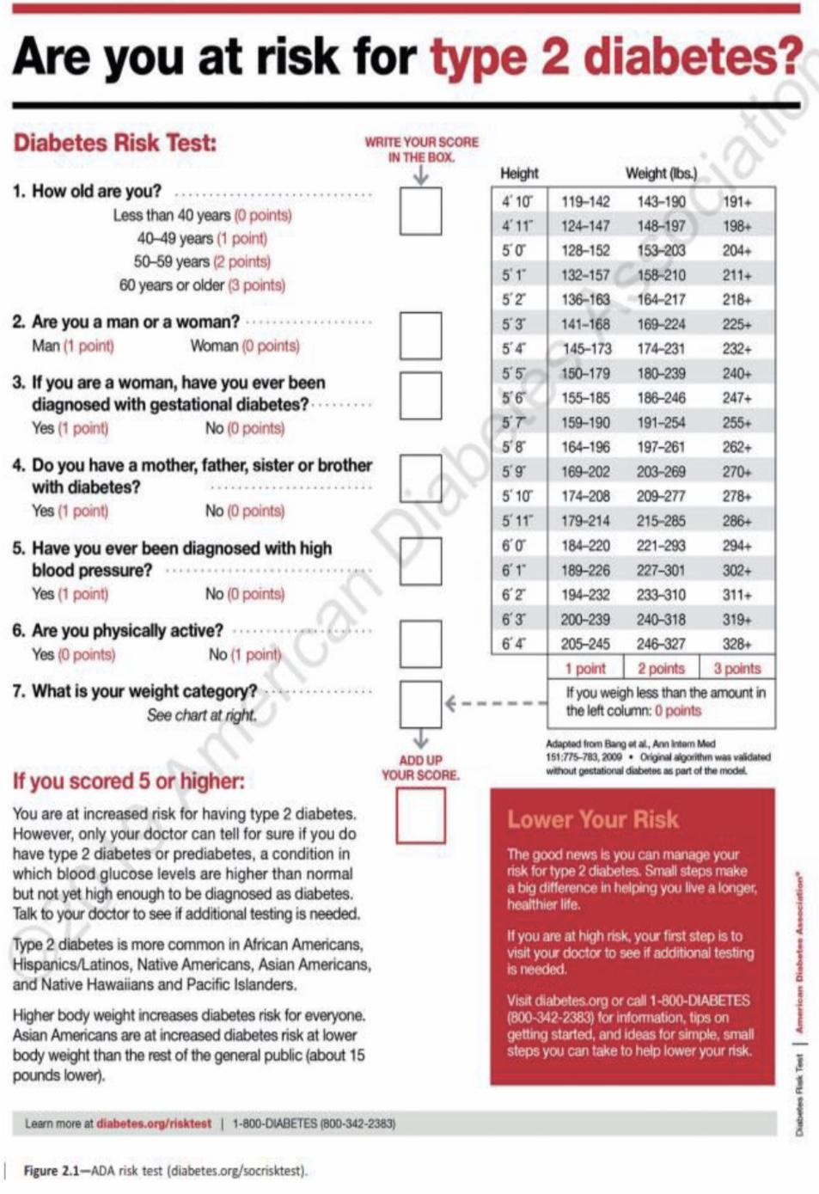
Criteria for testing for diabetes in asymptomatic adults
Testing should be considered in overweight or obese adults who have one or more of the following risk factors:
a. First-degree relative with diabetes
b. History of CVD or Hypertension
c. Women with polycystic ovary syndrome
d. Physical inactivity
e. Conditions associated with insulin resistance (e.g., severe obesity, acanthosis nigricans)
1
Patients with prediabetes should be tested yearly.
2
Women who were diagnosed with GDM even after delivery.
3
For all other patients, testing should begin at age 45 years.
4
If results are normal, testing should be repeated at a minimum of 3-year intervals
Can be distributed on the world’s diabetes day for awareness and educational purposes.
5
Prevention or delay development of diabetes
The strongest evidence for diabetes prevention comes from the Diabetes Prevention Program (DPP) .
DPP demonstrated that an intensive lifestyle intervention could reduce the incidence of type 2 diabetes by 58% over 3 year
LIFESTYLE INTERVENTIONS
Refer patients with prediabetes to an intensive behavioral lifestyle intervention program.
Based on the Diabetes Prevention Program (DPP) to achieve PREVENTION OR DELAY OF TYPE 2 DIABETES and maintain 7 - 10% loss of initial body weight and increase moderate-intensity physical activity (such as brisk walking) to at least 150 min/week (i.e. at least 30 min, 5 day a week).
Healthy nutrition
Physical activity and tobacco cessation
Pharmacologic Interventions
Encourage:
Whole grains, legumes, nuts, fruits, vegetables, and meat with no fat
Minimize; refined and processed foods, like rice, white bread, sugary drinks,
use of nonnutritive sweeteners.
A referral to dietitian (even when you give them diet advice)
Just as 150 min/week of moderate intensity physical activity, such as brisk walking, showed beneficial effects in those with prediabetes.
Moderate intensity physical activity has been shown to improve insulin sensitivity and reduce abdominal fat.
Tobacco Smoking may increase the risk of type 2 diabetes; therefore, evaluation for tobacco use and referral for tobacco cessation.
Metformin therapy for prevention of type 2 diabetes should be considered in those with prediabetes, especially for those who are obese and hypertensive.
Metformin and intensive lifestyle modification led to an equivalent 50% reduction in diabetes risk.

Slide 27
Complications of DM
Cardiovascular Disease (CVD) | After 10 years of observational follow-up of the UKPDS, those originally randomized to intensive glycemic control had significant long-term reductions in MI (15% with sulfonylurea or insulin as initial pharmacotherapy, 33% with metformin as initial pharmacotherapy) and in all-cause mortality (13% and 27%,respectively). DM increase risk of CVD
Chronic kidney disease (CKD) | Optimize glucose control to reduce the risk or slow the progression of chronic kidney disease. A Optimize blood pressure control to reduce the risk or slow the progression of chronic kidney disease. A Screening by: Albumin/Creatinine Ratio to detect Microalbuminuria beside Renal function tests. Normal levels → once a year Abnormal levels → more than once a year, depending on the patient status.
Diabetic Retinopathy | Optimize glycemic control to reduce the risk or slow the progression of diabetic retinopathy. A Optimize blood pressure and serum lipid control to reduce the risk or slow the progression of diabetic retinopathy. A Screening by referring them to the ophthalmology clinic: Adults with type 1 diabetes should be referred to an ophthalmologist within 5 years¹ after the onset of diabetes. B Patients with type 2 diabetes should be referred to an ophthalmologist at the time² of the diabetes diagnosis. B
Neuropathy | Screening by the GP no need for referral to neurology: All patients should be assessed for diabetic peripheral neuropathy starting at diagnosis of type 2 diabetes and 5 years after the diagnosis of type 1 diabetes and at least annually thereafter. B
Foot care & Diabetic foot | Perform a comprehensive foot evaluation at least annually³ to identify risk factors for ulcers and amputations. B The examination should include inspection of the skin,assessment of foot deformities, neurological assessment (monofilament testing with pinprick, temperature, vibration), and vascular assessment including pulses in the legs and feet. B
Because the symptoms presents shortly after the onset of insulin deficiency
Because the pathological process (hyperglycemia) started years ago
However, in each visit ask about the feet and maybe do a general inspection.

Slide 28
L24- Cancer
TRUE OR FALSE?
True or False: Large percentage of cancers are preventable.
True or False: Preventing cancer is easier than treating cancer.
True or False: Screening tests are recommended for most cancers.
2nd leading cause of death globally
In Saudi Arabia there is no countrywide policy for colorectal screening despite the increasing incidence of the disease.
Screening for Cancer
Wilson-Jungner Criteria for Screening program:
1
The condition being screened for should be an important health problem.
6
The test should be acceptable.
2
The natural history of the condition should be well understood.
7
Intervals for repeating the test should be determined.
3
There should be a detectable early stage.
8
Adequate health service provision should be made for the extra clinical workload resulting from screening.
4
Treatment at an early stage should be of more benefit than at a later stage.
9
The risks, both physical and psychological, should be less than the benefits. ³
5
A suitable test ² should be devised for the early stage.
10
The costs should be balanced against the benefits
Screening for Liver Malignancy
Patients with cirrhosis of any etiology, but especially cirrhosis caused by hepatitis B or C, are at high risk for the development of HCC and these patients should be the targets for a screening program.
The best screening modality is ultrasound of the liver. Every 6 months
Screening for Uterine Malignancy
No evidence that screening reduces mortality from uterine (endometrial) cancer.
Most cases of endometrial cancer (85%) are diagnosed at an early stage because of symptoms ¹, and survival rates are high.
Screening for Ovarian Cancer
Example of a high-risk hereditary cancer syndrome, women with BRCA1 or BRCA2 genetic mutations associated with hereditary breast and ovarian cancer.
Symptoms:
Menopause
Vaginal bleeding after menopause
1-Symptoms include: unusual vaginal bleeding, spotting, or discharge. For premenopausal women, this includes menorrhagia, which is an abnormally heavy or prolonged bleeding, and/or abnormal uterine bleeding.
2- An example of suitable test is measurement of PSA levels. An example of an unsuitable test is bone marrow biopsy.
3- For example, mammogram can be painful the women; however, when comparing it to the danger of breast cancer and the benefit of early screening we’ll notice that the benefits outweigh the risks

Slide 29
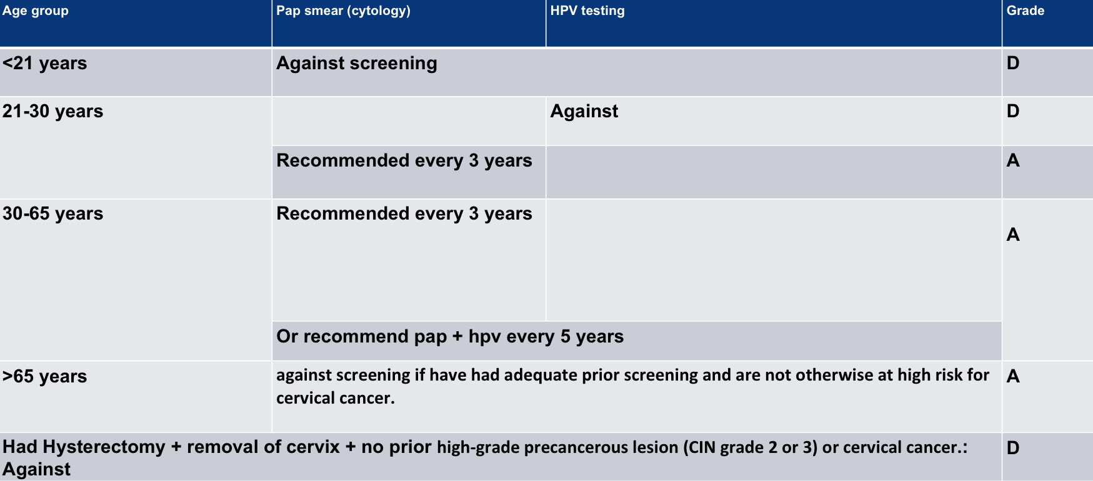
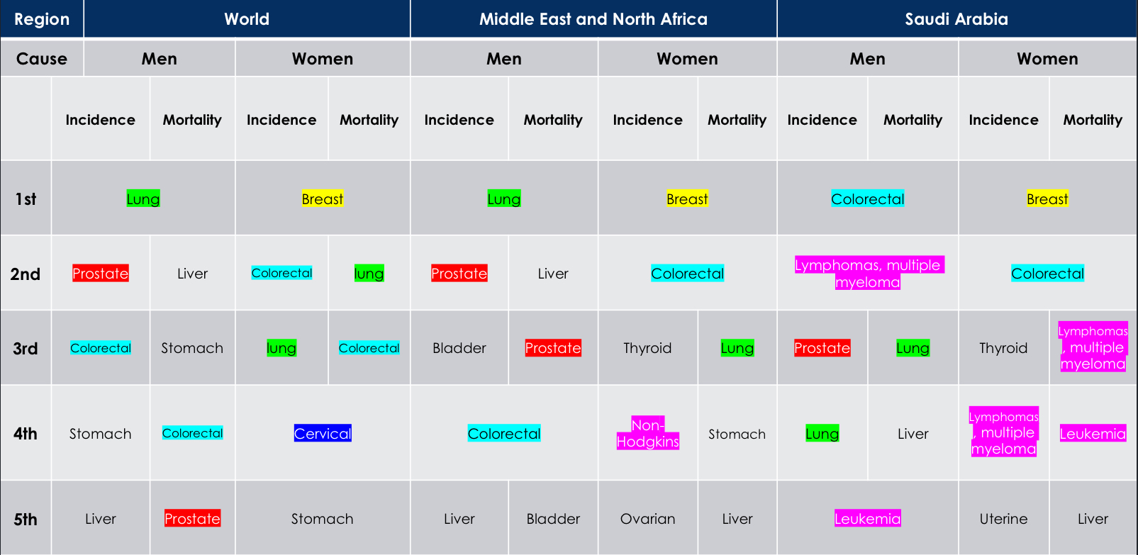
Define "Adequate" cervical cancer screening?
Very Important!!
3 consecutive negative cytology (Pap smear) results.
2 consecutive negative HPV results within 10 years before cessation of screening, with the most recent test occurring within 5 years.
Screening may be clinically indicated in > 65 years for whom the adequacy of prior screening cannot be accurately assessed or documented.
Secondary prevention of cervical cancer → pap smear every 3 years (the main type of prevention nowadays and usually starts at 21 years old)
Primary prevention of cervical cancer → improve personal hygiene and birth control. Gardasil 9 is an HPV vaccine approved by the U.S. Food and Drug Administration and can be used for both girls and boys. This vaccine can prevent most cases of cervical cancer if given before a girl or woman is exposed to the virus.STD prevention, HPV vaccine hasn't been added in our guidelines yet
Screening for Hematological Malignancy
There are no routine screening tests for hematologic malignancies (Lymphoma, Leukemia, .. etc)
It is typical for a patient to seek medical treatment when symptoms appear.
Can be discovered incidentally when a blood test (leukocytosis) is ordered for another reason
Screening for Lung Malignancy Most common malignancy in men worldwide
Screening patients for smoking:
Ask all your patients systematically if they smoke or not. Make it part of their vital signs.
If a smoker is identified, implement smoking cessation guidelines. (which is the 5A’s)
Screening for Lung Cancer:
Age 55–77 years.
Smoking history ≥ 30 Pack Years.
And Active smoker or quit smoking less than 15 years ago.
Did not have chest CT scan the last year.
Screening modality: Low dose chest CT scan.
→ Conventional chest CT radiation dose (7-8 mSv), low dose chest CT (1.4 mSv).
Screening for Prostate Cancer
Men should have an opportunity to discuss the potential benefits and harms of screening with their clinician. (Individualized choice)
Screening offers a small potential benefit of reducing the chance of death from prostate cancer in some men.
Many men will experience potential harms of screening, including false-positive results that require additional testing and possible prostate biopsy; overdiagnosis and overtreatment; and treatment complications, such as incontinence and erectile dysfunction.
Screening for Thyroid Cancer patient tend to be asymptomatic What we mean by screening is screening for asymptomatic people as a mean of secondary prevention. If the patient is symptomatic (has a goiter or hyperthyroidism) then we need to perform diagnostic tests for him.

Slide 30
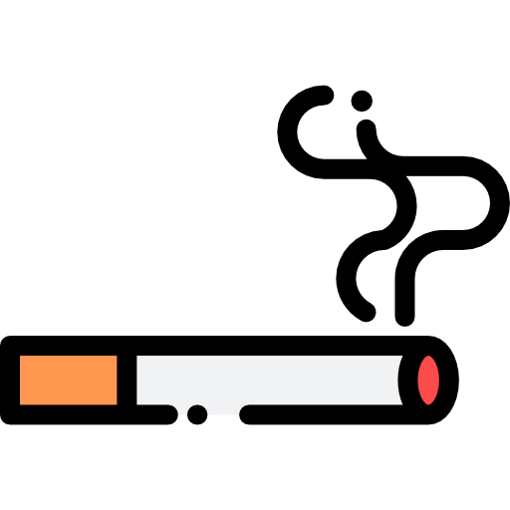
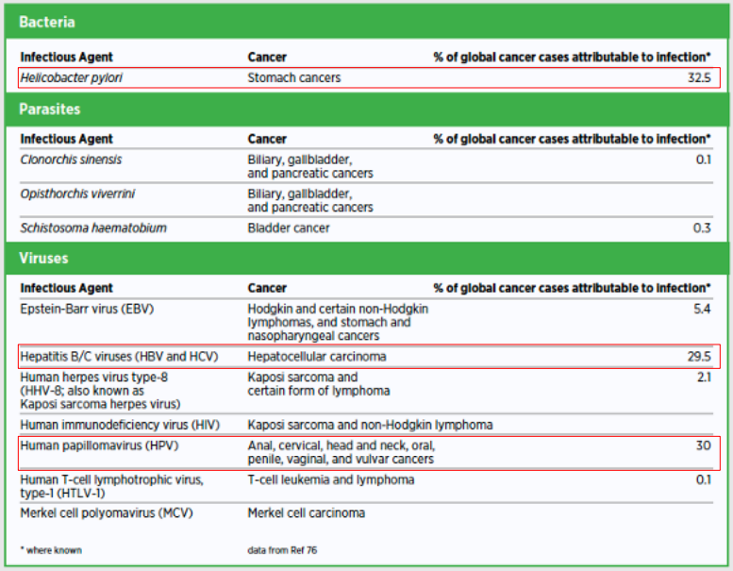
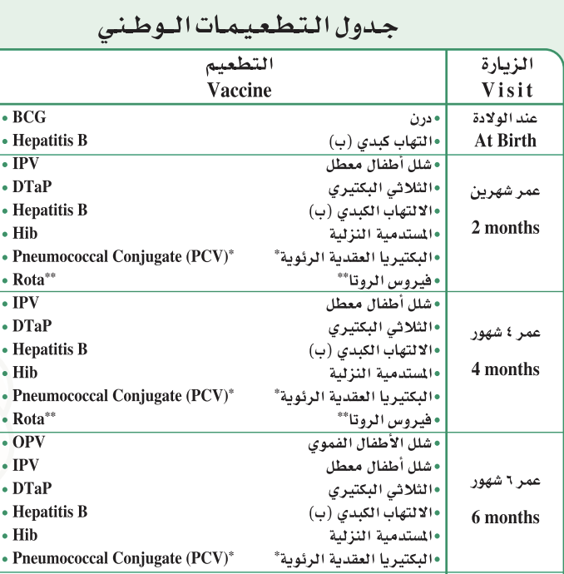
Causes of Cancer
Causes of Cancer
Cancer is the result of the interaction between a person's factors and 3 categories of external agents
Personal Factors
Genetic ¹ | Example: Family Hx and oncogenic genes
Age | Through two main mechanisms: A- Cellular repair mechanisms become less effective as a person grows older. B- Accumulation of external risk factors. ²
External Factors
Physical Carcinogens | Example: Ultraviolet and ionizing radiation.
Chemical Carcinogens ³ | Example: Asbestos, components of tobacco smoke, aflatoxin (a food contaminant), and arsenic (a drinking water contaminant). (also in rice so wash carefully) Diethylstilbestrol (DES) hormone is associated with vaginal adenocarcinoma
Biological Carcinogens | Example: Bacteria → H. pylori causing stomach cancer Parasites → S. haematobium causing bladder cancer → C. sinensis causing biliary, gallbladder and pancreatic cancer → O. viverrini causing biliary, gallbladder and pancreatic cancer Viruses → EBV causing hodgkin and non-Hodgkin lymphoma, stomach and nasopharyngeal cancer → Hep B/C causing hepatocellular carcinoma → HHV-8 causing kaposi sarcoma and certain form of lymphoma → HIV causing Kaposi sarcoma and non-Hodgkin lymphoma → HPV causing anal, cervical, head, neck, oral, vaginal and vulvar Cancers → HTLV-1 causing T-cell leukemia and lymphoma → MCV causing Merkel cell carcinoma
Genetic testing has become crucial in some family related cancers such us BRCA1 and BRCA2 gene testing for breast and ovarian cancers
As the person grows he accumulates more risk factors such as exposure to chemical carcinogens , UV radiation ...etc
Asbestos can lead to mesothelioma and aflatoxin can increase the risk for liver cancer

Slide 31
Factors Affecting Cancer Control and Future Research
Factors Affecting Cancer Control
The following are important factors and trends affecting cancer control and the directions of future research
1- Tobacco Use
Raise tobacco taxes to at least prevent tobacco products from becoming affordable. Tax all tobacco products to prevent consumers switching from highly taxed products to less taxed ones. Require by law and Enforce 100% smoke-free environments in all indoor workplaces and public places. Put health warnings on all tobacco packaging. Establish a national pilot cessation program in health-care facilities https://www.moh.gov.sa/Ministry/Projects/TCP/Pages/default.aspx / CALL 937 Build media awareness of both the addictive nature of tobacco use and treatment options.
2- Unhealthy Diet, Physical Inactivity, Overweight and Obesity
Develop and implement national dietary guidelines and nutrition policies. Example: Restaurants should put calories. Promote educational and information campaigns about reducing salt, sugar and fat consumption. Develop and implement national guidelines on physical activity. Implement community-wide campaigns to promote the benefits of physical activity. Promote physical activity in workplaces. (give discount for gym subscriptions)
3- Alcohol
Raise public awareness, especially among young people, about alcohol-related health risks, including cancer.
4- Hepatitis B Virus
Implement universal infant immunization using one of the recommended immunization schedules.
5- Environmental Exposures to Carcinogens
Stop using all forms of asbestos. Provide safe drinking water. Reduce the use of biomass and coal for heating and cooking at home, and promote use of clean burning and efficient stoves. Implement food safety systems (legislation and monitoring) focusing on key contaminants eg. SFDA.
6- Occupational Exposures to Carcinogens
Develop regulatory standards and enforce control of the use of known carcinogens in the workplace. Include occupational cancer in the national list of occupational diseases. Identify workers, workplaces and worksites with exposure to carcinogens.

Slide 32
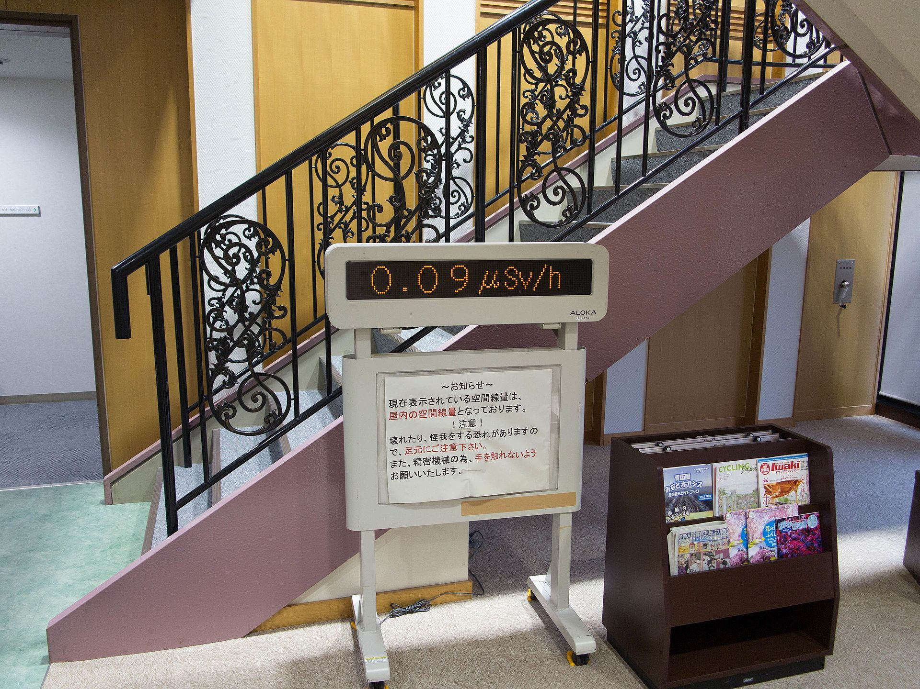
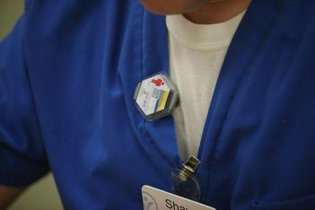
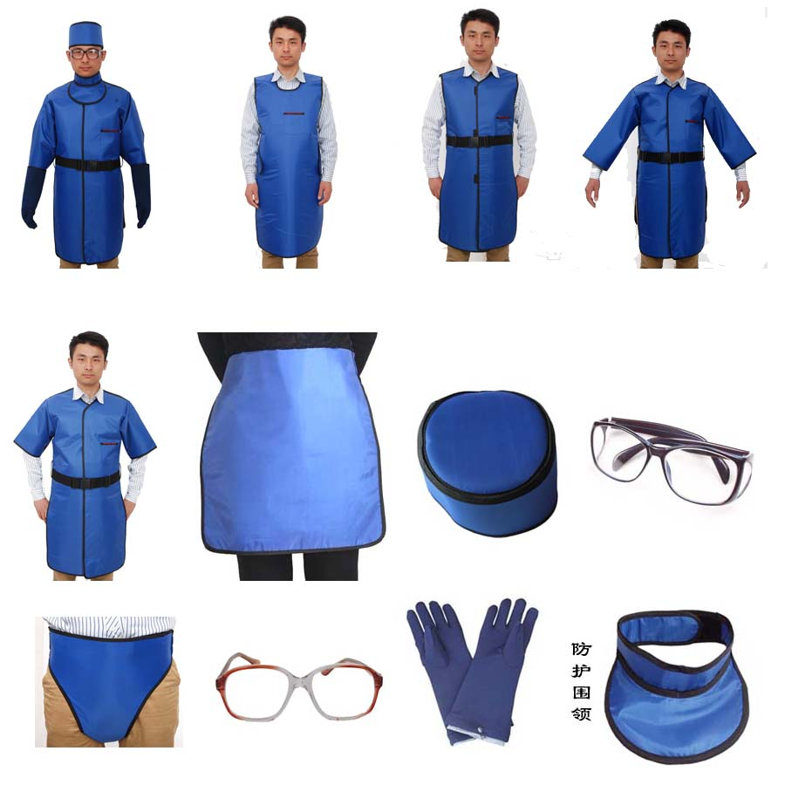
Factors Affecting Cancer Control and Future Research
Factors Affecting Cancer Control
The following are important factors and trends affecting cancer control and the directions of future research
7- Radiation
Provide information about sources and effects of all types of radiation. Establish national radiation protection standards (using internationally available guidelines). Ensure regular safety training of radiation workers. Promote UV risk awareness and UV protection action. For example Dose limits for Ionizing radiation are: for the public, 1 mSv/year. for occupationally exposed persons, 20 mSv/year.
How are people exposed to UV radiation?
Sunlight: the main source of UV radiation. Sunlamps and sunbeds (tanning beds and booths). Phototherapy (UV therapy): UVA (320 to 400 nm) OR UVB, UVB is divided into: → Broadband (280 to 320 nm) more carcinogenic → Narrowband (311-313 nm) The carcinogenic potential of narrow band UVB is less established. Other: (Black-light lamps, Mercury-vapor lamps, High-pressure xenon and xenon-mercury arc lamps, plasma torches, and welding arcs).
Display of background radiation in a hotel at Naraha, Japan, showing dose rate in microsieverts per hour, five years after the Fukushima disaster.
Personal radiation badge
Radiation protection clothes

Slide 33
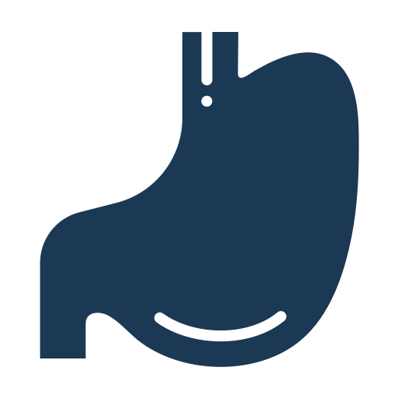
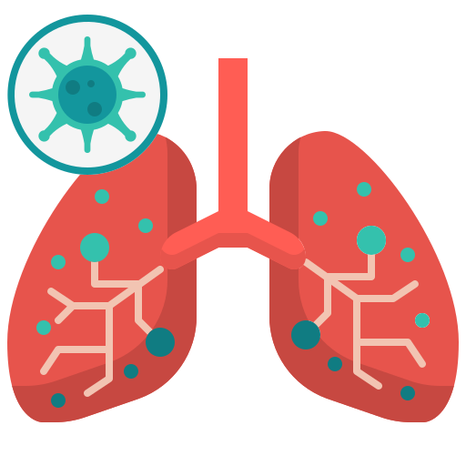
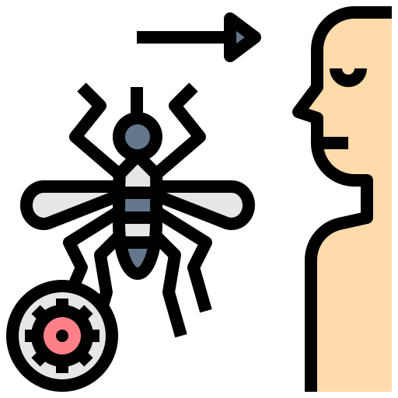
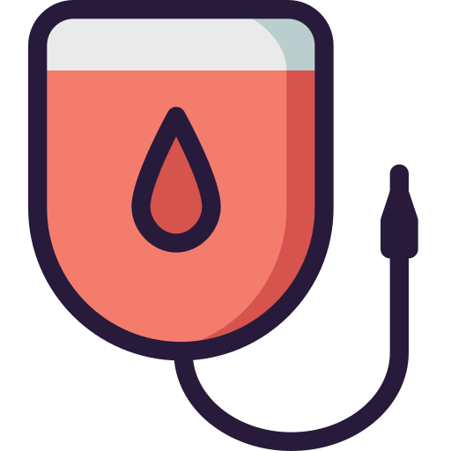
L25- Travel Medicine
What is travel medicine?¹
An interdisciplinary specialty concerned with prevention, early detection, and research of health problems associated with travel.
What does travel medicine do?
Seeks to prevent illnesses and injuries occurring to travelers going abroad.
Manages problems arising in travelers coming back or coming from abroad.
Impact of tourism on health and to improve health and safety services to tourists
Refugee and migrant health
1
2
Common diseases associated with international travel:
4
3
Traveler’s diarrhea
Typhoid fever
Hepatitis A
Cholera
Poliomyelitis
Influenza
Meningitis
MERS-Cov
COVID19
Tuberculosis
Yellow fever
Malaria
Dengue fever
Leishmaniasis
Japanese encephalitis
Gastrointestinal
Pulmonary Disease
Vector borne diseases
Sexually transmitted diseases
Rabies
Hepatitis B
Tetanus
Behavior related
Zoonotic diseases
Blood borne
Soil borne
1: Because the numbers of travellers are usually increasing every year, keep in mind that it got affected by the pandemic so the numbers are gonna decrease with the latest updates

Slide 34
Preventive Measures for International Travelers
Immunization:
Routine:
Childhood immunizations.
Recommended:
According to risk of infection.
Required:
yellow fever vaccine
meningococcal vaccine
COVID-19 vaccine?
Routine immunizations:
Hepatitis A
Hepatitis B
BCG
DPT
MMR
Polio
Pneumococcal
Meningococcal
Rota virus
Varicella
Hemophilus influenzae
Human papilloma virus
Tick borne encephalitis
Influenza
Others in other countries
In KSA
Required immunizations
Yellow fever (international health regulation)
Meningococcal meningitis: by Saudi Arabia for Hajj and Umrah and seasonal workers.
Polio

Slide 35
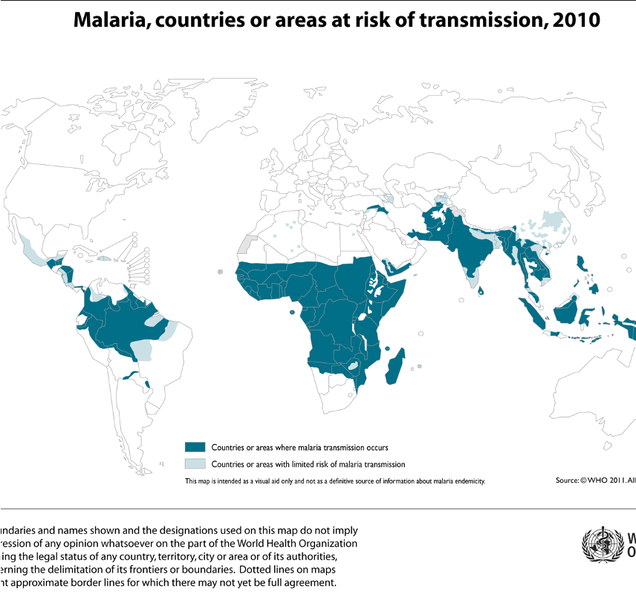
Preventive Measures for International Travelers
Chemoprophylaxis
Malaria
Transmission: Mosquito bite Malaria
Prevention:
Awareness
Bite avoidance
Chemoprophylaxis before and after traveling
Diagnosis of febrile illness
Fever in returned traveler is a medical emergency considered malaria until proven otherwise
Drug | Area | Instructions of use
Proguanil | all areas | 1 – 2 days before departure, daily during the journey and 7 days after return
Doxycycline 100 mg | all areas | 1 – 2 days before departure, daily during the journey and 4 weeks after return
Chloroquine 300 mg | chloroquine sensitive areas | 1 – 2 weeks before departure, weekly during the journey and 4 weeks after return
Primaquine 30mg | predominant vivax areas & ovale | 1 – 2 days before departure, daily during the journey and 7 days after return
Mefloquine 228mg | mefloquine sensitive areas | 2 weeks before departure, weekly during the journey and 4 weeks after return
Responsibilities of Travelers to Prevent Ill-health
Check status of destination:
Warning level 3
Warning level 1
Warning level 2
Avoid non-essential travel
- Presence of outbreak (Ebola, COVID-19) and adverse security situation if returned from and infectious diseased country then the person should quarantine
Practice usual precautions Presence of usual risk for infectious diseases as diarrheal diseases and malaria
Practice enhanced precautions
Presence of MERS-CoV in Arabian Peninsula

Slide 36
Disease | Info | Recommended | Vaccination | Not recommended
Hepatitis A | Endemic in many developing countries & High mortality in elderly & pregnant women Prevention: Food, water, personal hygiene & immunization | -Travelers to the developing countries -2 years and older | Inactivated vaccines Dose (2 doses) (HAVRIX® or VAQTA®) (can combine immunoglobulins with the vaccine if needed) -Protection: 14 – 20 years in children 25 years among adults
Hepatitis B | Transmission: Blood- borne, sexual contact Prevention: Avoid risk factors & immunization | travelers to endemic areas and travelers with special risk | -Type: Recombinant vaccine, IM injection -Monovalent or combined with hepatitis A (for those ≥ 18 years)
Cholera | Transmission: Contaminated food or water Prevention: Food, water & personal hygiene Vaccination (oral) |  | Type: Oral vaccine (Live attenuated)
Yellow fever | vector borne disease associated with international travel and addressed by the international health regulation (IHR) Required for travelers to a country under the International health regulations. | travelers to endemic area. Ex: Brazil | Type: Live attenuated virus vaccine Dose: Single subcutaneous injection Immunity: starts after 10 days Protection: Valid for 10 years | Infants < 9 months Immunocompromised patients Pregnant women Egg allergies HIV-positive individuals

Slide 37
Disease | Info | Recommended | Vaccination | Not recommended
Meningococcal meningitis | Required: by Saudi government for Hajj or Umrah. | or travelers to endemic area. Risk: Sub-Saharan Africa (seasonal) Saudi Arabia (Hajj Crowded student dormitory situations | Dose: Single dose (injection) Protection: for 3–5 years in adults and older children Not effective: for children below 2 years
Disease | Transmission | Prevention |  | cause/risk
Typhoid | contaminated food and water | Food, water, personal hygiene & vaccination
Polio | contaminated food and water. | Food, water, personal hygiene Vaccination: (injectable, oral)
Japanese encephalitis | By mosquito bite same as malaria | vector control & vaccination |  | increases in travelers to rural Asia or long stay travelers
Rabies | Animal bite or scratch | immunization (Preexposure • Post exposure • Immunoglobulin) |  | occupational , travel to rabies risk countries
Tick-borne encephalitis | 1. Ixodes sp. Ticks. 2. Ingestion of unpasteurized dairy products. | Tick prevention. Avoidance of unpasteurized dairy products. Vaccination. Self check and removal ASAP (tweezers). |  | Rural forested areas of east and Central Europe, Russia and part of Asia.
Zika virus | mosquito bite | preventing mosquito bite |  | pregnant women —> microcephaly and other brain abnormalities.
Traveler’s diarrhea One of the most common traveler’s incidence. |  | Wash It, Peel It, Cook It, or Forget It Only Drink Bottled Water Wash hands frequently |  | Bacterial (60-80%) Viral (10-20%) Parasitic (5-10%)

Slide 38
L26- Introduction to Occupational Health
Occupational Health
Industrial Hygiene
It is the promotion and maintenance of the highest degree of physical, mental, and social Well-being of workers in all occupations by preventing departures from health, controlling risks and the adaptation of work, and people to their jobs.
Activities directed to identifying, assessing, preventing, and managing hazards to the worker. In the working environment, falls in the domain of Occupational Safety and Health (OSH).¹
These activities should be systematic and scientific.
Ergonomics
Stress evaluation occurring in a work environment and the ability of people to cope with these stresses. ²
Designing suitability, the facilities, furniture, equipment, tools, and job demands to make them compatible with the work-force capabilities and limitations.
Example: having a rest support under the wrist can prevent carpal tunnel syndrome
Occupational Diseases
Occupational diseases are adverse health conditions in the human being, the occurrence or severity of which is related to exposure to factors on the job or in the work environment.
Physical
Chemical
Heat, noise, radiation
Solvents, pesticide, heavy metals and dust
Biological ¹
Types of Hazards
Ergonomics
TB, HBV and HIV
improperly designed tools or work areas, repetitive motions
Psychosocial
Mechanical
lack of control over work, inadequate personal support
these mainly cause work accidents and injuries rather than occupational diseases.
Aims of Occupational Health and Safety:
Characteristics of Occupational Diseases:
1
1
Ensure the highest degree of Physical, mental, and social well-being of workers in their occupations
The clinical and pathological presentation are identical to that of non-occupational diseases; Example: asthma
2
Preventing adverse effects on health due to workplace hazards
2
Occupational disease may occur after the termination of exposure. Example: asbestos-related mesothelioma (a cancer affecting the lung and abdomen) which can occur 30 or 40 years after the exposure.
3
Preventing and controlling hazards of occupations
Matching health and safety needs with suitable occupational environment
3
4
The clinical manifestations of occupational disease are related to the dose and timing of exposure ² Example: at very high airborne concentrations, elemental mercury is acutely toxic to the lungs and can cause pulmonary failure, while at lower levels of exposure, elemental mercury has no pathologic effect on the lungs but can have chronic adverse effects on the central and peripheral nervous systems.
5
Continued adaptation of workers to work and vise-versa
4
Occupational factors can act in combination with non-occupational factors to produce disease Example: exposure to asbestos (five-fold increase in lung cancer ); and the long-term smoking of cigarettes (increases the risk by 50 and 70 fold.

Slide 39
Types of Hazards
Physical Agents
Factor | Description
Heat ¹ | Heat hyperpyrexia, exhaustion, syncope, cramps, burns
Cold | Trench foot, frostbite
Light | Occupational cataracts, miner’s nystagmus
Pressure | Caisson disease ², air embolism, blast (explosion)
Noise | Occupational deafness
Radiation | Cancers, leukemias, aplastic anemia, pancytopenia
Mechanical Factors | Injuries, accidents
Electricity | Burns
Chemical Agents
Gases | CO2, CO, HCN, N2,NH3,HCL
Dusts (pneumoconiosis) | Coal dust (anthracosis), silica (silicosis), asbestos (asbestosis, Ca lung), iron (siderosis) Cane fiber (bagassosis), cotton dust (byssinosis), tobacco (tobacossosis), hay or grain dust (farmer's lung)
Metals and their compounds | Toxicity from Lead, mercury, cadmium, mercury, arsenic
Chemicals | Acids, alkalis, pesticides
Other Agents
Biological agents | Brucellosis, leptospirosis, anthrax, tetanus, encephalitis, fungal infections
Occupational cancers | Skin, lung, bladder
Occupational dermatosis | Dermatitis and eczema
Psychological origin | Industrial neurosis, hypertension, peptic ulcer
Pulmonary Dust Disease
Pneumoconiosis
Pneumoconiosis is a disabling pulmonary fibrosis that results from the inhalation of various types of inorganic dust, such as silica, asbestos, coal, talc and china clay.
Example: silicosis and asbestosis (the two most important causes of pneumoconiosis)

Slide 40
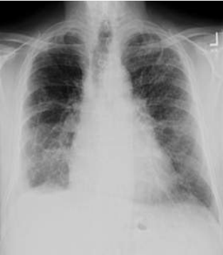
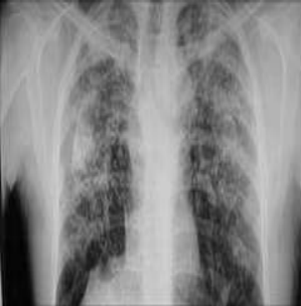
Types of Pneumoconiosis:
Asbestosis
1
Description | Inhalation of asbestos fibres
Occupations | Mining and extraction Exposure to asbestos (insulation) making of asbestos cloth (soldiers clothes) manufacture of asbestos cement pipes and other products, Such as vinyl floor tiles, in brake and cloth lining
Presentation | Interstitial fibrosis of the lungs, pleural thickening, calcification. Bronchogenic carcinoma, pleural and peritoneal mesothelioma Progressive dyspnoea on exertion frequently out of proportion to the clinical signs in the lungs, cough, expectoration, chest pain, cyanosis and clubbing of the fingers
Diagnosis | Asbestos bodies in sputum (asbestos fibres coated with fibrin) X-ray shows ground-glass appearance in the lower 2/3 of the lung →
Progression | Progressive disease
Prevention | Prevention and periodic examinations
Long time ago, insulators were made of asbestos. Asbestos is an important risk factor for mesothelioma which can present with chest pain (pleuritic) and SOB with unexplained weight loss.
Silicosis
2
Description | Absorption of high amount of crystalline silica (SiO₂)
Occupations | Mining , Coal, mica, gold, silver, lead, zinc Stone cutting and shaping, sandblasting , Building and construction areas Glass manufacture Iron and steel industry Ceramic workers and manufacturers
Time | 7–10 years, sometimes less. Prolonged exposure to higher concentrations of dust
Presentation | Dyspnoea on exertion, irritant cough and chest pain Pulmonary tuberculosis (silicosis can activate latent TB) Cardiac or respiratory failure Impaired TLC (total lung capacity) in advanced disease
Diagnosis | X-ray shows snow storm appearance (Scattered micro-opacities and might also present with cavitation in upper lobe of the lung because of TB activation)
Progression | Progressive (irreversible) disease and converts to TB "silico-tuberculosis”
Prevention | Prevention and regular physical examinations Education about the importance of protection
Lead Poisoning (Plumbism)
Modes of absorption:
Defined as lead level of 70 µg/ 100 ml with clinical signs and symptoms
Occupational usage (Industrial): Storage batteries, glass, ship building, printing and potteries, rubber
Non-occupational : Gasoline, drinking water via lead pipes, paints (shine in paints), toys
Inhalation of fumes and dust
Ingestion through food or drink
Skin absorption “tetraethyl lead”

Slide 41
Clinical features:
Lab diagnosis:
Organic Lead
Insomnia, headache, mental confusion and delirium
Coproporphyrin in urine (screening test)
Amino levulinic acid in urine
Lead levels in blood and urine
Basophilic stipling of RBCs (very sensitive)
Inorganic Lead
Plumbism (lead poisoning), abdominal colic, obstinate constipation (very severe), loss of appetite, blue lines on the gum, anemia and wrist and foot drop
Methods of prevention:
Occupational Cancers
Substitution (with other materials)
Carcinogenic agent | Organ affected
Arsenic | Skin and lung
Chromium compounds, hexavalents | Lung
Nickel | Lung and nasal sinus
Polycyclic aromatic hydrocarbons | Skin
Coal tars | Skin, scrotum, lung and bladder
Benzol | Blood (leukaemia)
B-naphthylamine | Bladder
Ionizing radiation | Skin, bone, lung and blood (leukaemia)
Asbestos | Lung, pleura, peritoneum
1
2
Isolation
(segregate procedures with risk)
3
Local exhaust ventilation
4
Personal protection
(should be disposed of after finishing)
5
Periodic examinations
(through coproporphyrin in urine)
6
Health education and personal hygiene
(handwashing)
Occupational Dermatitis
Causes:
Prevention:
Heat, cold and moisture
Friction and pressure
X-rays
Acids, alkalis, solvents, grease, tar and pitch
Bacteria and fungi
Leaves, vegetables and fruits
1
Pre-selection
(pre-employment check)
3
Personal hygiene
2
Protection
(protective equipment)
4
Periodic assessment
(usually every 6 months)
Classification
Primary Irritants and Sensitizing Substances
Radiation Hazards
Industrial Exposures:
Effects of Radiation:
Manufacture of radioactive paints
Painting of luminous dials for watches
Mining of radioactive ores and sand workers
X-rays rooms
Acute
Acute burns, dermatitis and blood dyscrasias
Chronic
Malignancies (carcinogenic effect) and genetic effects
Prevention:
1
Shielding in x-ray areas, monitoring 6 monthly, for their film badge or pocket electronic device, adequate workplace ventilation, replacement and periodic exams. (badges are available)
2
Pregnant ladies should not be allowed to work in the area.

Slide 42
Prevention of Occupational Disease
Prevention of occupational diseases should be addressed by different measures including: medical measures, engineering measures and legislations.
Field | Measurements
Medical | Pre-placement exams Periodic examinations Medical and health care services Notifications, employees should notify the employer with all diseases he has Supervision of working environment Maintenance and analysis of records Health education and counseling
Engineering | Designing of the buildings build good exhaust systems Good housekeeping General ventilation ACs, windows, ...etc. Substitution any harmful substance used should be replaced Dusts Enclose Isolate Local exhausts ventilations Protective devices based on the occupation Environmental monitoring Research
Legislations | Policies and regulations for factories, work places, health of the workers Example: insurance, sickness policies and disability benefits
Dr. Hafsa recommended reading about the measurements from the book. Link here

Slide 43
L27- Introduction to Environmental Health & Hazards
Environmental Health
Environmental health is the science and practice of preventing human injury and illness and promoting well- being.
Air pollution is the introduction of chemicals, particulate matter, or biological materials that cause harm or discomfort to humans or other living organisms, or cause damage to the natural environment or built environment, into the atmosphere.
Types of pollutants:
Primary (directly emitted)
- Sulphur oxide, Nitrogen oxides, carbon monoxide (CO), CO 2, volatile organic compounds, particulate matter, persistent free radicals, chlorofluorocarbons, ammonia, odors, radioactive material.
Secondary (form in air when primary pollutants interact with a third agent)
- Ozone, smog, peroxyacetyl nitrate, Acid rain is formed in the presence of water, with sulfur dioxide or nitrogen oxide.
What are the biological consequences of ozone depletion? Increased skin cancer, cortical cataracts, reduction of plankton populations
Water pollution:
Water appears naturally with impurities (not hazardous)
Pollution of water due to industrialization (hazardous)
Water related diseases:
Chemical causes:
Cyanides, dyes, heavy metals, bleaching agents and ammonia
Directly cause disease or indirectly (fish life)
Biomedical causes:
Viral, bacterial, protozoal, helminthic, snail and cyclopes
Water purification:
Depends on source:
Wells and springs -> only disinfection Surface water -> needs more treatment
1- Filtration.
2- Storage:
● To preserve water from further contamination and pollution
● Provides a small amount of purification
Number of bacteria die out
Suspended impurities fall by gravity
Chemical composition changes (↓free ammonia, ↑nitrates)
● Must be stored within a certain period
Prolonged periods cause vegetable growth (algae)
3- Disinfection:
Methods for disinfection:
1. Heat¹ (boiling for 10-20 min kills most organisms and sterilizes water)
2. Chlorination² (kills bacteria but not spores and viruses)
3. Ozonation³
4. Bleaching powder (chlorinated lime)
5. Bromination
Challenges with disinfection:
● Sterilization is impractical at a large scale
(only feasible at homes)
● Chlorination⁴ is the most widely method used
● Organisms resistant to chlorination (E coli, salmonella, polio, HAV)
● Decision for disinfection method depends on:
○ Costs; availability of technology and method Like in developing countries
○ Target organism to get rid of
○ Ability to produce residual to provide post-treatment disinfection
1- the most common method and the cheapest (the most used in developing countries)
2- common method
3- Ozonation: is a chemical water treatment technique based on the infusion of ozone into water.The treatment of water with ozone has a wide range of applications, as it is efficient for disinfection BUT IT’S EXPENSIVE AND RARELY USED
4- used in larger scales

Slide 44
The five stages of environmental hazard risk assessment¹:
Issue Identification
1
➢ What is the problem in question?
➢ Can the problem be addressed by the proposed risk assessment?
➢ Do we have the technology and capabilities to apply the assessment process?
➢ Are there any factors that contribute to persistence of that risk?
➢ Did the risk come about as a breach in public health measures?
Hazard Identification
2
➢ How severe are the health effects? And are they reversible?
➢ Is there interaction between this hazard and other agents in the environment?
➢ Is the onset of the effect immediate or delayed after exposure to hazard?
➢ Is there a critical window for exposure?
Dose-response Relationship²
3
➢ Does the exposure to the hazard exhibit a dose response relationship for the effect to appear?
➢ Is there a critical threshold for exposure? (cut-off point over which the effects will take place)
Exposure Assessment
4
➢ What is the nature of exposure?
➢ Is there a specific frequency of exposure?
➢ Is there a latency period for exposure?
➢ Can the critical time of exposure be determined?
(In order to be targeted for prevention and control measures)
➢ Has the route for exposure been identified? Is there more than one route?
➢ Is exposure one time, continuous or intermittent?
Risk Characterization
5
➢ Is there genetic variability in exposure to the hazard?
➢ Do personal characteristics play a role in exposure to hazard?
➢ Or do they play a role in the development of the health outcome following exposure to hazard?
➢ Should we consider any population characteristics or dynamics?
Prevention and control
Monitoring water
Biological surveillance of water:
● Sanitary surveys
● Inspection of manufacturing of water bottles and ice
● inspection of reservoirs and wells Establishing policies and procedures for extracting water from wells, and maintaining water safety and storing water
Monitoring air pollution
By monitoring the concentration of:
● Sulphur dioxide
● Smoke
● Suspended particles
1: Example: a. Dusty weather and asthmatic/COPD patients b. How severe are the exacerbations c.Dose= duration of exposure (For how long) the more the dust the more the exacerbations d. Exposure can be confined to a location for example riyadh more than jeddah thus more cases in riyadh e. Can staying home or wearing masks minimize the risk?
2: for example: the cut-off point for Na+ in the water that if exceeded would lead to intoxication, the more the dose the more the risk

Slide 45
Risk Assessment
Issue identification
Identification of key issues amenable of risk assessment
Hazard assessment
Collection and analysis of relevant data
1- Hazard identification
Identify chemicals of potential concern (COPC)
2- Dose - response assessment
Identify relevant toxicity data
Uncertainty analysis for both hazard identification and dose-response assessment
Exposure assessment
Conceptual site model
Analysis of hazard locations
Identification of exposed populations
Identification of potential exposure pathways
Estimation of exposure concentration and intakes of each pathway
Uncertainty analysis for exposure assessment step
Review and reality check
Risk characterization
Characterize potential for adverse health effects to occur
Evaluate uncertainty
Summarize risk information
Review and reality check
Risk Management
Define the options and evaluate the environmental health, economic, social, and political aspects of the options
Make informed decisions
Take actions to implement the directions
Monitor and evaluate the effectiveness of the action taken

Slide 46
L28- Mass-Gathering & Related Hazards
Definitions
Mass gatherings (MGs)
Are events attended by large numbers of individuals, concentrated in a specific area for a specific purpose andover a limited period of time ¹
Are events attended by a sufficient number of people to strain the planning and response resources of the host community, state/province/, nation, or region where it is being held.
The World Health Organization (WHO) definition also takes a broader view of mass gatherings to include the public health dimensions and defines mass gatherings as events attended by a sufficient number of people to potentially strain the public health resources of the community, city, or nation hosting the event.
Number of participants: >1000 persons, although most literature suggests >25000 persons
Mass gatherings medicine
is an area of medicine that deals with health aspects during mass gatherings including the health effects and risks of mass gatherings and strategies for effective health services delivery during these events.
The formal discipline of mass gatherings medicine was launched at the World Health Assembly of Ministers of Health in Geneva in May 2014.
Examples of mass gatherings
Hajj ²
The London Olympics 2012
10,250 Olympic athletes \4,000 Paralympic athletes\ 20,000 press and media \ 180,000 spectators/day
17,000 people living in the Olympic Village
Estimates of 4.5 million visitors to London
26 Olympic sports in 30 venues
20 Paralympic sports in 21 venues
Types of Mass-gathering
Fairs, exhibitions (World Expo Shanghai)
Concerts, festivals (Riyadh season, Glastonbury, UK)
Sports (Olympics)
Religious (Hajj)
Political (G20)
In other words, mass gathering is a lot of people in a confined space
During Hajj, the country hosts millions of people. This confined area creates a risk for hazards that threatens public health to spread and injure those people. Such mass gatherings require huge planning and preparation and identifying potential risks and figuring ways to overcome them.

Slide 47
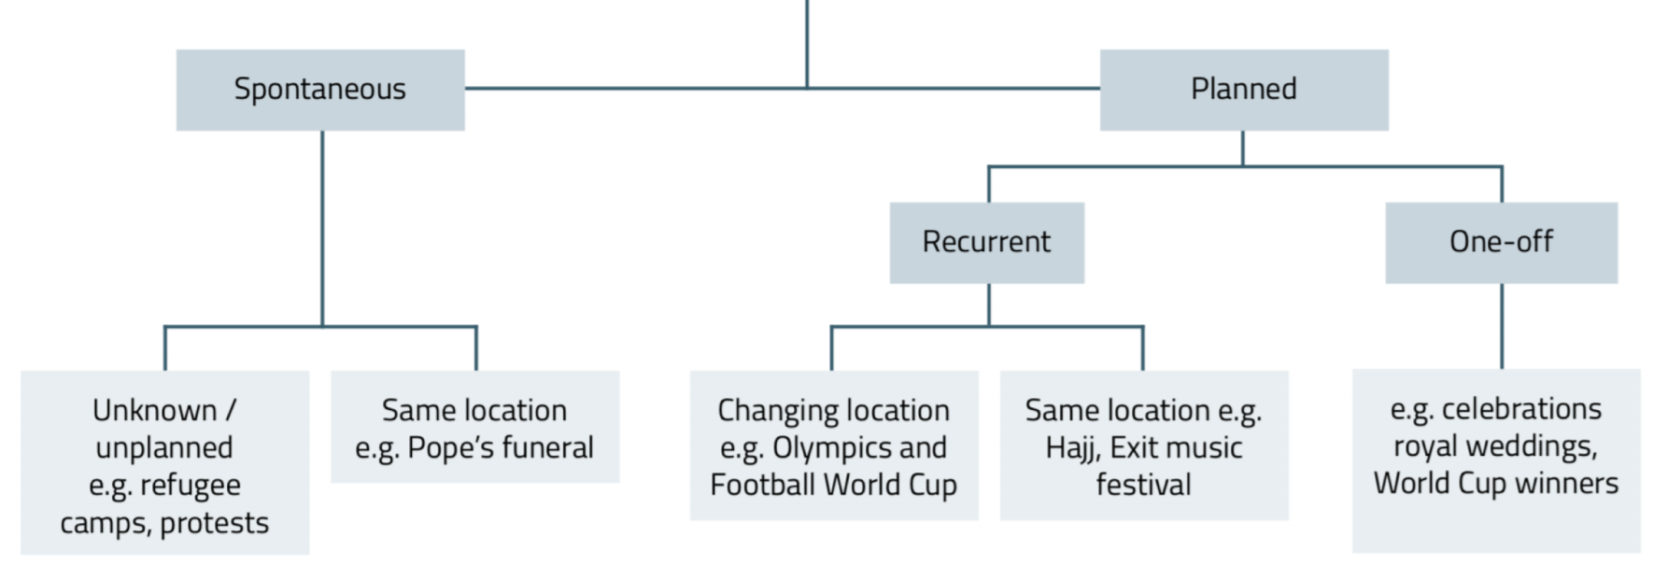
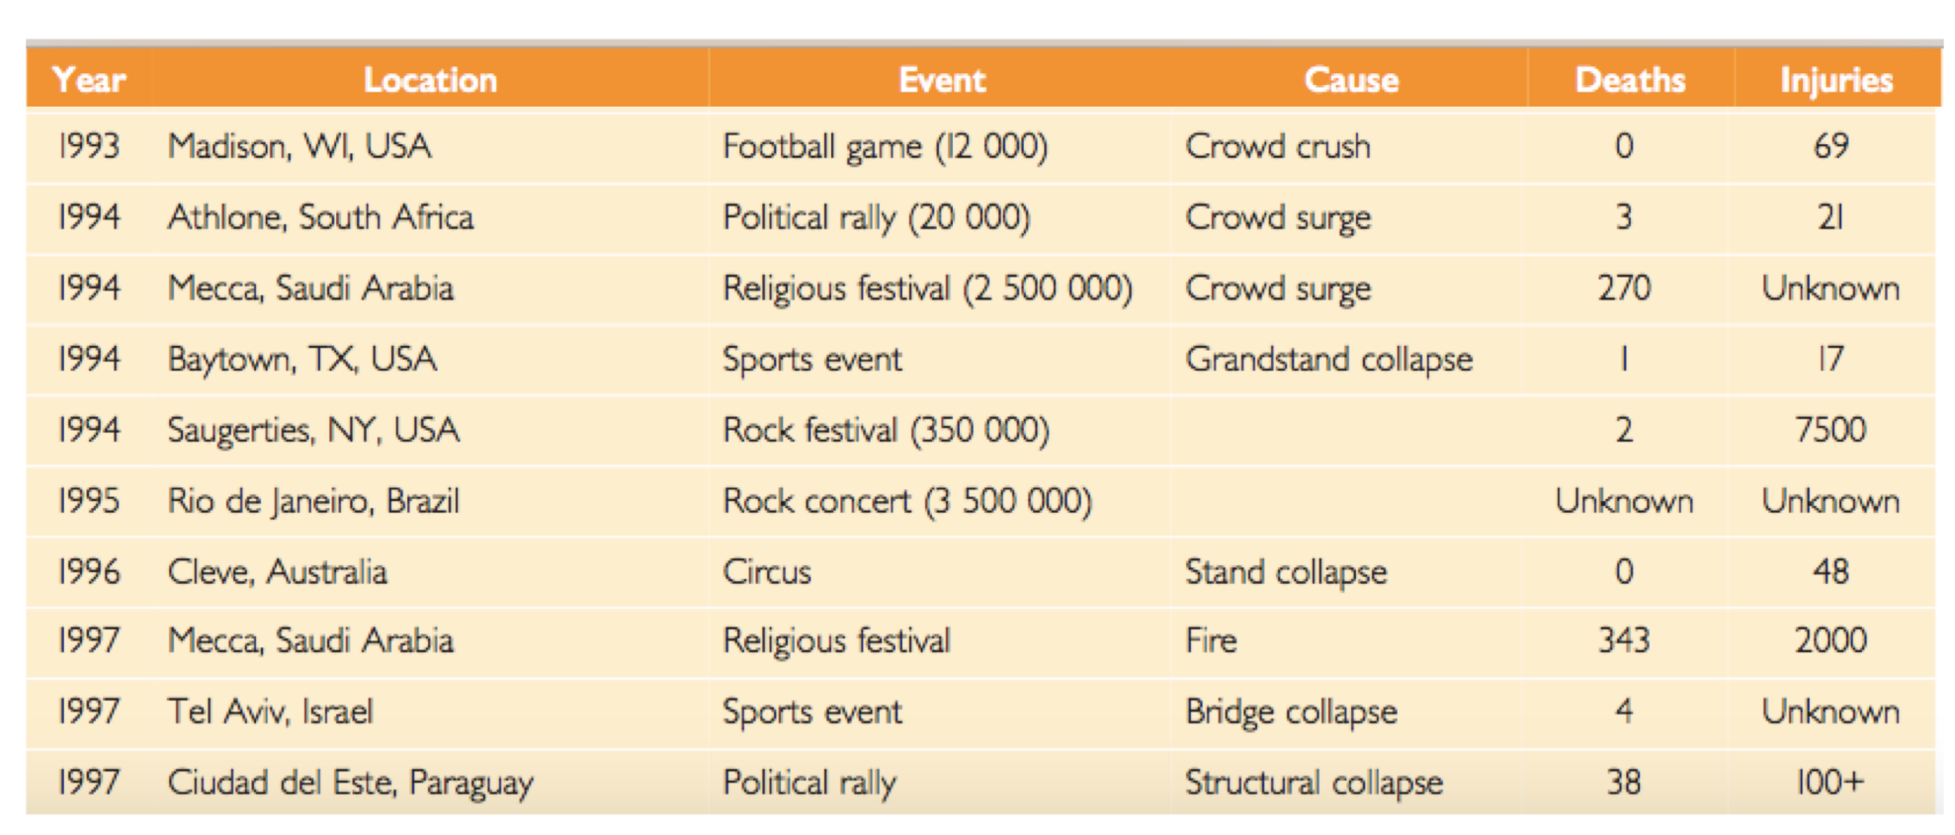
Categories of Mass-gathering
Where is the risk in MG?
Mass gatherings can pose several significant public health challenges to the health and security authorities both within the host country and abroad.
They place additional pressures on health systems, which must operate for the duration of the mass gatherings stretched to surge capacity. ¹
Require intersectoral approaches to risk mitigation and coordination and
cooperation across multiple disciplines, agencies, sectors, and ministries
MG characteristics that represent public
health risk
Higher population concentration Diversity of population characteristics ² Different communities/ parts of the world/ regions Imported diseases Epidemic prone diseases Different health-related behavior | Pressure on infrastructure Hotels Food sales Healthcare system aviors
Environmental conditions Heat/ cold Vectors of diseases | Political attention Terrorism/ bioterrorism
Risk of Outbreak
The importation of infectious diseases during a mass gathering may result in outbreaks.
Mass gatherings health deals with the diverse health risks associated with mass gatherings including transmission of infectious disease, non-communicable disease, trauma and injuries (occupational or otherwise), environmental effects (such as, heat-related illnesses, dehydration, hypothermia), illnesses related to the use of drugs and alcohol and deliberate acts, such as terrorist attacks
Examples of outbreaks
For example Iran facing the coronavirus their healthcare system collapsed
Age, gender, disabilities, comorbidities...etc

Slide 48
Risk assessment ¹
Risk identification
The aim of risk assessment is to:
1
(depending on event assessment)
(impact, likelihood)
(surveillance and response)
Risk characterization
Know the risk by risk assessment, identification
Know when it happens by surveillance
Know what to do when it happens to prepare a response
2
Risk management
3
Risk assessment
Risk identification
1
Host country context assessment
Systems: need for enhancement in surveillance, testing, reporting, response and command, control and communication
Training: responsibilities
Population factors: immunity (hosts, visitors)
Baseline status for CD
After we finished assessing the event we need to identify the risks based on event assessment
Event assessment
Risk identification
Type: Religious event
Older population with NCD, in-site medical care
Season: summer
Risk of dehydration, heat stroke
International
Imported diseases
Venue: indoor
Poor air circulation
Venue: temporary
Poor infrastructure
Catering: informal
Risk of food-born illnesses
Hygiene: hand washing stations
Decreased risk of infections
Risk characterization
2
After identifying the risk we need to characterize its impact on the mass gathering and public health (minimal-severe).
In other words, what is the risk likelihood?
 | Potential impact on the mg | Potential impact on public health
Minimal | Little or no consequence or disruption to the MG | Little or no consequences
Minor | Small impact on MG can be managed with little impact on the event | Few illness or injuries which public health and medical services can manage
Moderate | Some controlled impact on the Games and reputation for host | Death and or injuries or illness occur. Public and medical services are strained
Major | Event is disruptive to MG and reputation of host | Many deaths, injuries or illness. Disrupts public health and medical services
Severe | Event causes cancellation of some or all of MG. Significant adverse impact on MGs and host reputation. | Substantial loss of life and serious injuries or illness. Widespread disruption of local services and infrastructure
Why risk characterization?
If the risk estimate that a particular event will occur is highly uncertain, risk management decisions might be more conservative than in the case of an event deemed to be highly likely ²
Then what?
Once the risks have been mapped on the risk matrix, the objective of public health planning for the MG will be to reduce the likelihood of a threat occurring and to reduce the consequences of each threat: risk management
Risk assessment starts with risk identification through assessing the type of event. For example, if the event was religious (ex. Hajj) you need to expect elderly and people with comorbidities to gather. After identifying the risk we need to characterize it whether it’s major or minor risk. Depending on the risk characterization, a plan must be developed to manage it.
We always need to prioritize the risks we identified after we assessed the mass gathering. Because we can never deal with all risks.

Slide 49
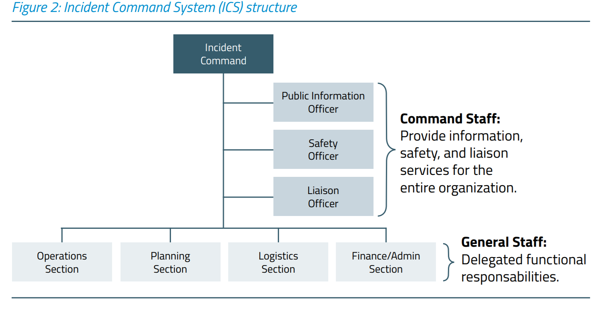
Risk management
3
What mitigation measures can be put into place to manage the risk and reduce either the probability or impact?
Management can include:
Initiating new surveillance programmes
Implementing a range of special prevention (risk of food-borne, waterborne, airborne and person-to-person spread of diseases)
Developing plans for immediate acquisition of additional human and material resources should a crisis occur
Surveillance in MG
When planning surveillance for the MG, the questions that public health authorities are likely to ask are:
Preparing a surveillance plan
What diseases or syndromes should surveillance be conducted for and what is the risk of these?
What is the best type of public health surveillance system(s) to use? (timeliness and sensitivity)
What are the special considerations for outbreak or public health response?
Identify monitoring resources at all levels
Define conditions to look for
Establish priorities
Set threshold / alert levels
Identify mechanism for prompt investigation and feedback
Link notification and response plan
Diseases with the following characteristics should be considered for surveillance:
Surveillance Problems posed by MGs
Have an outbreak potential (modes of transmission enhanced in the MG e.g. respiratory spread)
Are known to be of particular potential use as bioterrorism agents
May cause severe illness and require investigation and / or the application of control measures even for a single case
Imported diseases not usually seen in the host country (especially drug-resistant organisms and unusual serotypes)
Endemic diseases for which event attendees may have no immunity.
Highly infectious diseases (e.g., norovirus or measles).
Diseases or events that need to be reported under the IHR (2005).
Short time – problem for collecting information – systems sensitive and responsive
Large, diffuse and highly varied population Include diseases not normally surveyed?
People arrive from/return to many locations
Multiple opportunities for exposure: air travel – food – water – physical contact
Varying health surveillance capabilities of – host nation– originating nation(s)
Tracking (time/location) and notification – not just in location, but after returning
MG Planning
Response
A safe and healthy MG requires
Early multi-sectoral preparation involving:
event organizers
health emergency managers
public health authority representatives
local hospital emergency departments
first-aid personnel
other sectoral partners (e.g. police, emergency services, security services)
Depends on risk assessment and risk identification
Medical care needs to be offered at the mass gathering but local care needs to be maintained as usual
Establish a major incident response system
Well rehearsed multi-agency and cross government response systems.
Effective liaison across health sector.
Public health engagement with: – Police & other emergency services (threat assessment, incident response) – Central government (threat assessment, preparedness, response) – Intelligence services (threat assessment).
Legacy and Evaluation
The wealth of knowledge and expertise generated from mass gatherings can drive best health promotion, education, and risk mitigation strategies and optimize the planning and delivery of effective health services during future mass gathering events.

Slide 50
WHO’s role in mass gatherings
WHO provides advice and technical support to host governments preparing for mass gathering events.
How does WHO provide support to Member States for mass gatherings?
To provide advice and technical support to Member States that are hosting mass gatherings, WHO draws on 5 WHO Collaborating Centres for Mass Gatherings and a Virtual Interdisciplinary Advisory Group (VIAG). VIAG is an informal network of mass gathering experts. Their role is to share expertise on public health requirements and best practices with any organization considering hosting a mass gathering event.
Activities to support host governments of mass gatherings often include:
Prior to the event: all-hazard risk assessment, travel medicine and activities to encourage increased physical activity, cessation of tobacco use and avoidance of excess alcohol.
During the event: international monitoring of potential disease spread and risk assessment, emergency medical services and hospitals and plans to manage fan zones.
After the event: capture lessons learnt and share expertise with future mass gathering hosts
What governs WHO’s work on mass gatherings?
The decision states that the WHO "Director-General should, where appropriate, work closely with Member States that are planning and conducting mass gatherings to support cooperation and communication between the concerned health authorities in each country, and help Member States strengthen capacities to better utilize the International Health Regulations (2005)".
Does WHO have the power to cancel or move mass gatherings?
WHO may provide advice and technical guidance to host countries on public health risks, but has no decision power to uphold, cancel or postpone mass gatherings hosted by Member States.
Q- A planned combination of educational, political, regulatory, and organizational supports for actions and conditions of living conducive to the health of individuals, groups, or communities is the definition of ?
Health promotion .

