Slide 1
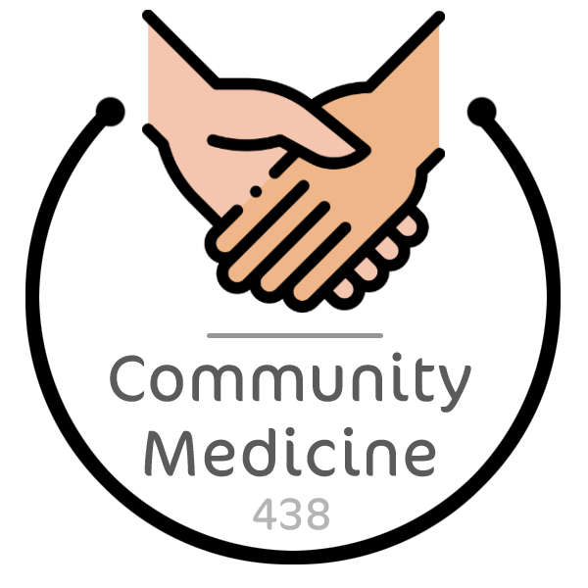
Introduction To
Community Medicine
Objectives
Understand terms; Community medicine, Public health, Preventive medicine.
Understand their relevance in global health delivery.
Define and understand concepts of basic terminologies used in the field of Community medicine/Preventive medicine, and Public health.
Color Index
Main text
Males slides
Females slides
Doctor notes
Important
Golden notes
Extra
Editing File

Slide 2
Community Medicine
Regarded as a specialized field of medical practice focusing on health of a defined population in order to promote and maintain health and wellbeing, prevent disease, disability, and premature death
OR, Specialty which deals with populations and comprises those doctors who try to measure the needs of the population, both sick and well, who plan and administer services to meet those needs, and those who are engaged in research and teaching in the field (Faculty of Community Medicine of the Royal College of Physicians)
Preventive Medicine
Refers to measures taken to prevent diseases ¹, rather than curing them (within all areas of clinical medicine)
Specialists in preventive medicine are uniquely trained in both clinical medicine and public health
They have the skills needed to understand and reduce the risks of disease, disability and death in individuals and in population groups
Three-tiered Preventive intervention classification
1
Universal prevention: addresses the entire population (national, local community, school, district) and aim to prevent or delay the abuse of alcohol, tobacco ², and other drugs.
All individuals without screening are provided with information and skills necessary to prevent the problem.
2
Selective prevention: Focuses on groups whose risks of developing problems are above others. (such in family history of breast cancer)
eg. drug campaigns in recreational settings.
3
Indicated Prevention: involves a screening process eg. aims to identify individuals who exhibit early signs of substance abuse and other problem behaviors.
Identifiers may include falling grades of students, known problem consumption or conduct disorders, alienation from parents, school and positive peer groups
4
Environmental prevention ³: Which ranges from ultimate restrictions like prohibition of alcohol advertisement and ban on smoking in public health places to drug testing and legislative measures.
Community medicine is used interchangeably with preventive medicine.
All these share common ground, i.e. prevention of disease and promotion of health.
Community medicine provides comprehensive health services ranging from preventive, promotive, curative, to rehabilitative services.
1: Why do we need to prevent diseases? To decrease the burden on the health care system (in terms of cost).
2: There are large scale programs that are aimed to decrease tobacco consumption and promoting healthy lifestyle. Therefore decreasing tobacco related cancers, comorbidities and premature death.
3: An example of an environmental hazard is cancer (skin, colon or lung cancer), as they can be attributed to the changing environment.

Slide 3
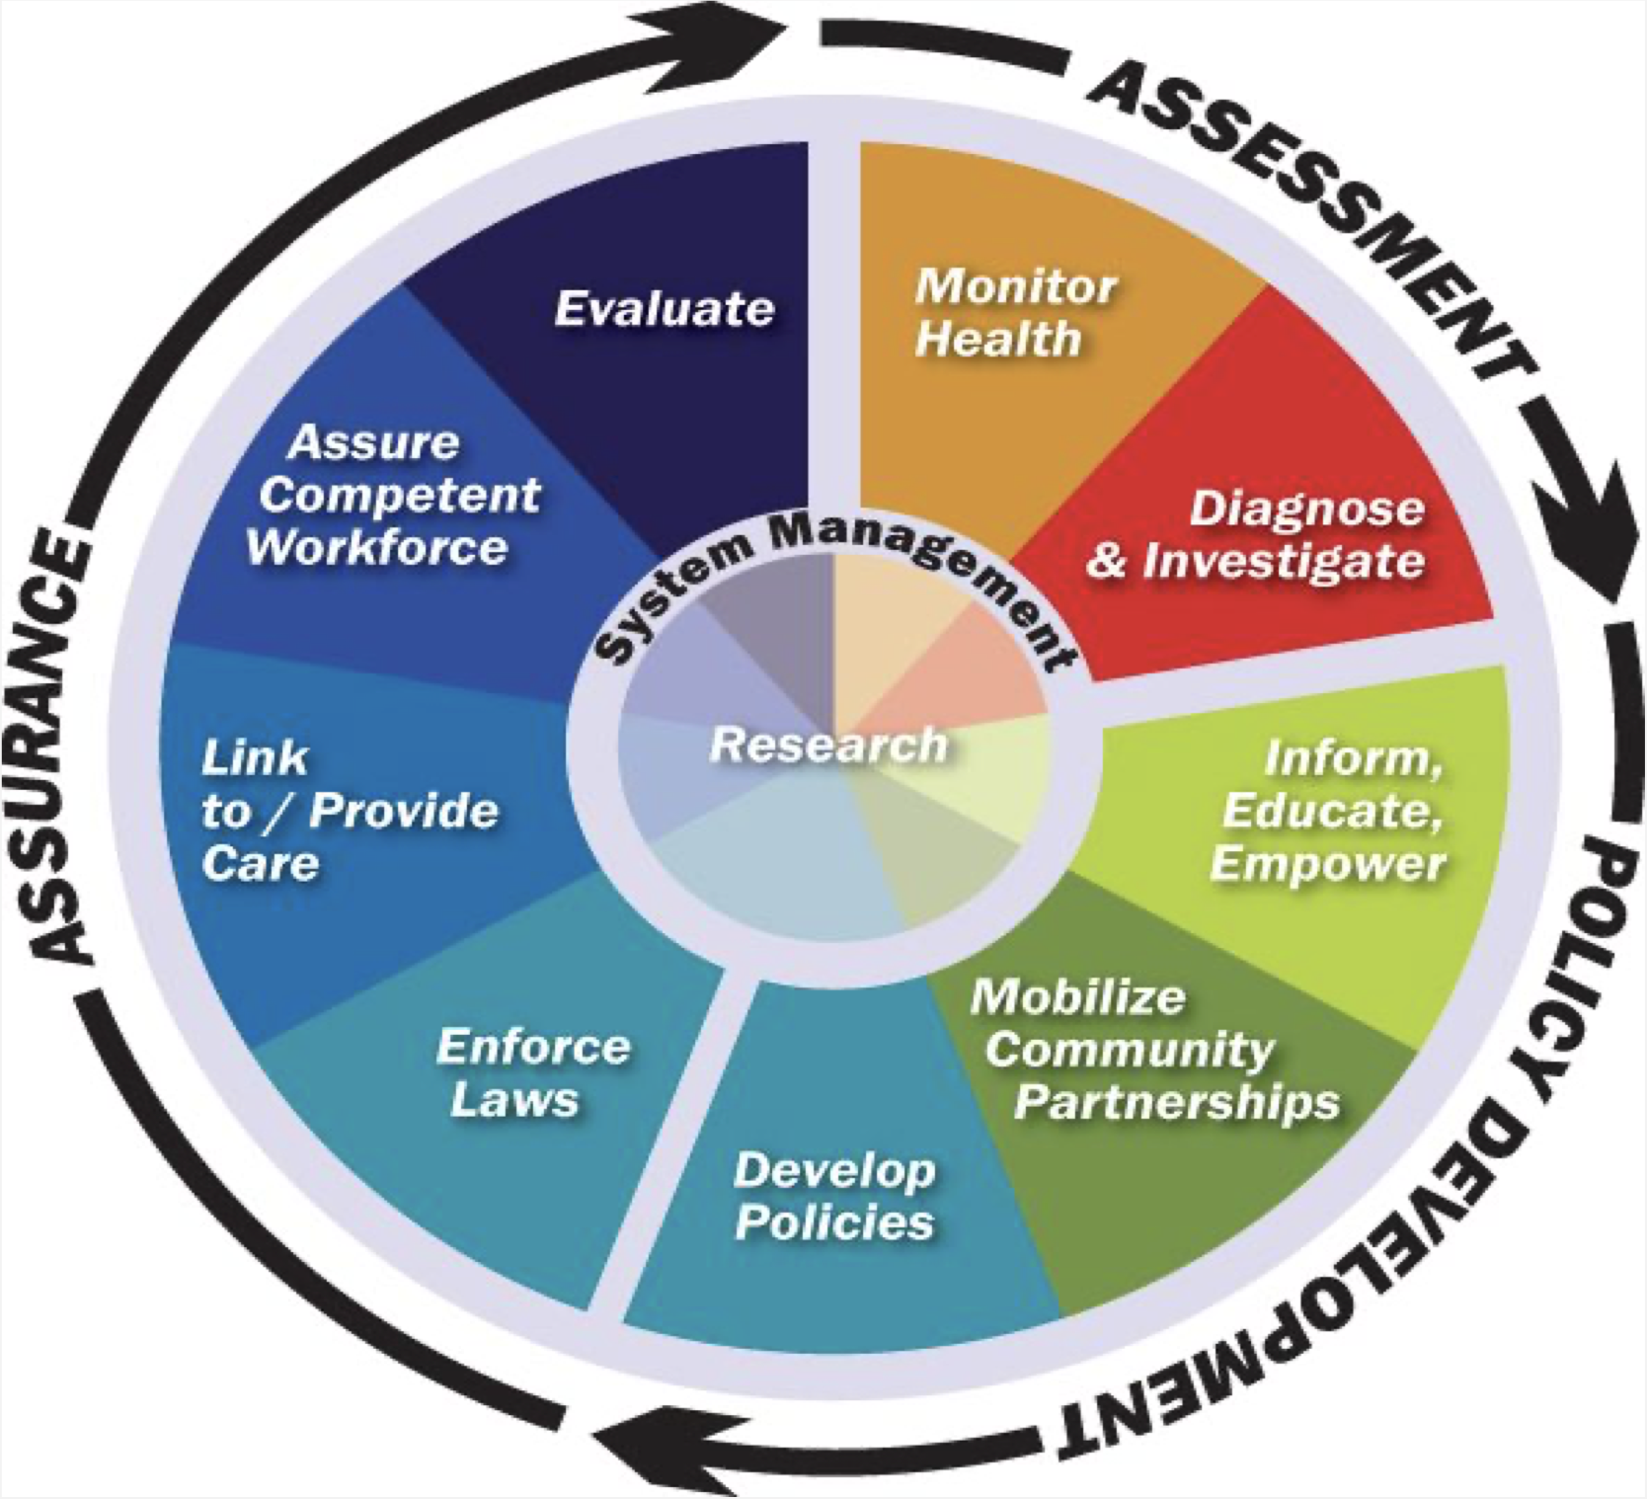
Public Health
Organized measures (whether public or private) to prevent disease, promote health, and prolong life among the population as a whole, through organised community efforts for the sanitation of the environment, the control of communicable infections, the education of the individual in personal hygiene, the organization of medical and nursing services for the early diagnosis and preventive treatment of disease.
It is a combination of:
Scientific discipline (e.g., epidemiology, biostatistics, laboratory science, social science, demography)
Skills and strategies (e.g., epidemiological investigations, planning and management, intervention, evaluation) that are directed to the maintenance and improvement of the health of people
Three Core Public Health Functions
1- Assessment
Assessment & monitoring of the health of communities and populations
2- Policy Development
Development of policies to solve local and national health problems
3- Assurance
To assure access to appropriate and cost-effective care
The 10 Essential Public Health Services
Monitor health status to identify community health problems
Enforce laws and regulations that protect health and ensure safety
Diagnose and investigate health problems and health hazards in the community
Link people to needed personal health services and assure the provision of health care when otherwise unavailable
Inform, educate, and empower people about health issues.
Assure a competent public health and personal health care workforce
Mobilize community partnerships to identify and solve health problems
Evaluate effectiveness, accessibility, and quality of personal and population-based health services
Develop policies and plans that support individual and community health efforts
Research for new insights and innovative solutions to health problems

Slide 4
Public Health Medicine
It’s the sub-speciality of Community Medicine which aims to advance the health of population. Epidemiological principles and methods are applied to describe and define public health problems, as well as to formulate and evaluate health programs and policies to prevent and control health problems and to promote the health of the population.
Specialities of Public Health
Epidemiology
Biostatistics
Demography
Communicable disease epidemiology
Non communicable disease epidemiology
Health education and health promotion
Mental health
School health
Community nutrition
Environmental health
Occupational health
Adolescents’ health
Reproductive health
Maternal and Child Health (MCH)
Health programs and policies
Health systems and services
International health
Travel health
Health of people with special needs
Geriatric Health
Who is responsible for conducting Community health services ¹?
1
Community medicine specialist
2
Community Medicine university departments & Ministry of Health
3
Other governmental and non-governmental agencies ²
4
Community personal (leaders & residents)
Summary
Definitions:
Community Medicine: Specialized field of medical practice focusing on health of a defined population in order to promote and maintain health and wellbeing, prevent disease, disability, and premature death.
Preventive Medicine: Measures taken to prevent diseases, rather than curing them.
Public Health Medicine: It’s the sub-speciality of Community Medicine which aims to advance the health of population.
Three Core Public Health Functions:
Assessment
Policy Development
Assurance
Preventive intervention classification:
Universal prevention: addresses the entire population
Selective prevention: Focuses on groups whose on risk
Indicated Prevention:
screening
Environmental prevention: ranges from ultimate restrictions to drug testing and legislative measures
1: It’s a combination.
2: Non-governmental agencies help the government in carrying out essential services in the community (since the government can’t reach and cover every neighborhood). Examples of non-governmental agencies: diabetic association, heart association.

Slide 5
Quiz
MCQ
1-Delaying the abuse of Alcohol and Tobacco is considered as?
A- Selective Prevention. B- Universal Prevention. C- Indicated Prevention. D- Environmental Prevention
2- Providing appropriate and cost-effective care falls under which of these functions of public health ?
A- Assessment. B- Policy Development. C- Assurance.
3- Preventive Medicine focuses on preventing the disease rather than?
A- Promoting public health. B- Maintaining the public wellbeing. C- Treating the disease of an individual.
4- An example of Environmental Prevention is:
A- Drug testing and legislative measures. B- Delay the abuse of drugs
C- Mammogram for female with a positive family history of breast cancer
D- Drug campaigns in recreational settings
5- Specialized field of Medical practice focusing on health of a defined population in order to promote and maintain health and wellbeing, prevent disease, disability, and premature death:
A-Family Medicine. B- Palliative Medicine. C- Community Medicine.
Answers
Q1 | Q2 | Q3 | Q4 | Q5
B | C | C | A | C

Slide 6
Thank You and
Good Luck
Team Leaders:
Lama AlAssiri | Mohammed AlHuqbani | Ibrahim AlDakhil
Team Members:
Lama AlZamil
Leen AlMazroa
May Babaeer
Muneera AlKhaorayef
Norah AlMazrou
Nouf Alhussaini
Rema AlMutawa
Sara AlAbdulkareem
Sedra Elsirawani
Wejdan Alnufaie
Abdulrahman Alhawas
Abdulrahman Shadid
Abdullah Aldawood
Abdullah Shadid
Alwaleed Alsaleh
Bader Alshehri
Bassam Alkhuwaiter
Faisal Alqifari
Hameed M. Humaid
Khalid Alkhani
Meshari Alzeer
Mohannad Makkawi
Nayef Alsaber
Omar Aldosari
Omar Alghadir
Zyad Aldosari

