Slide 1
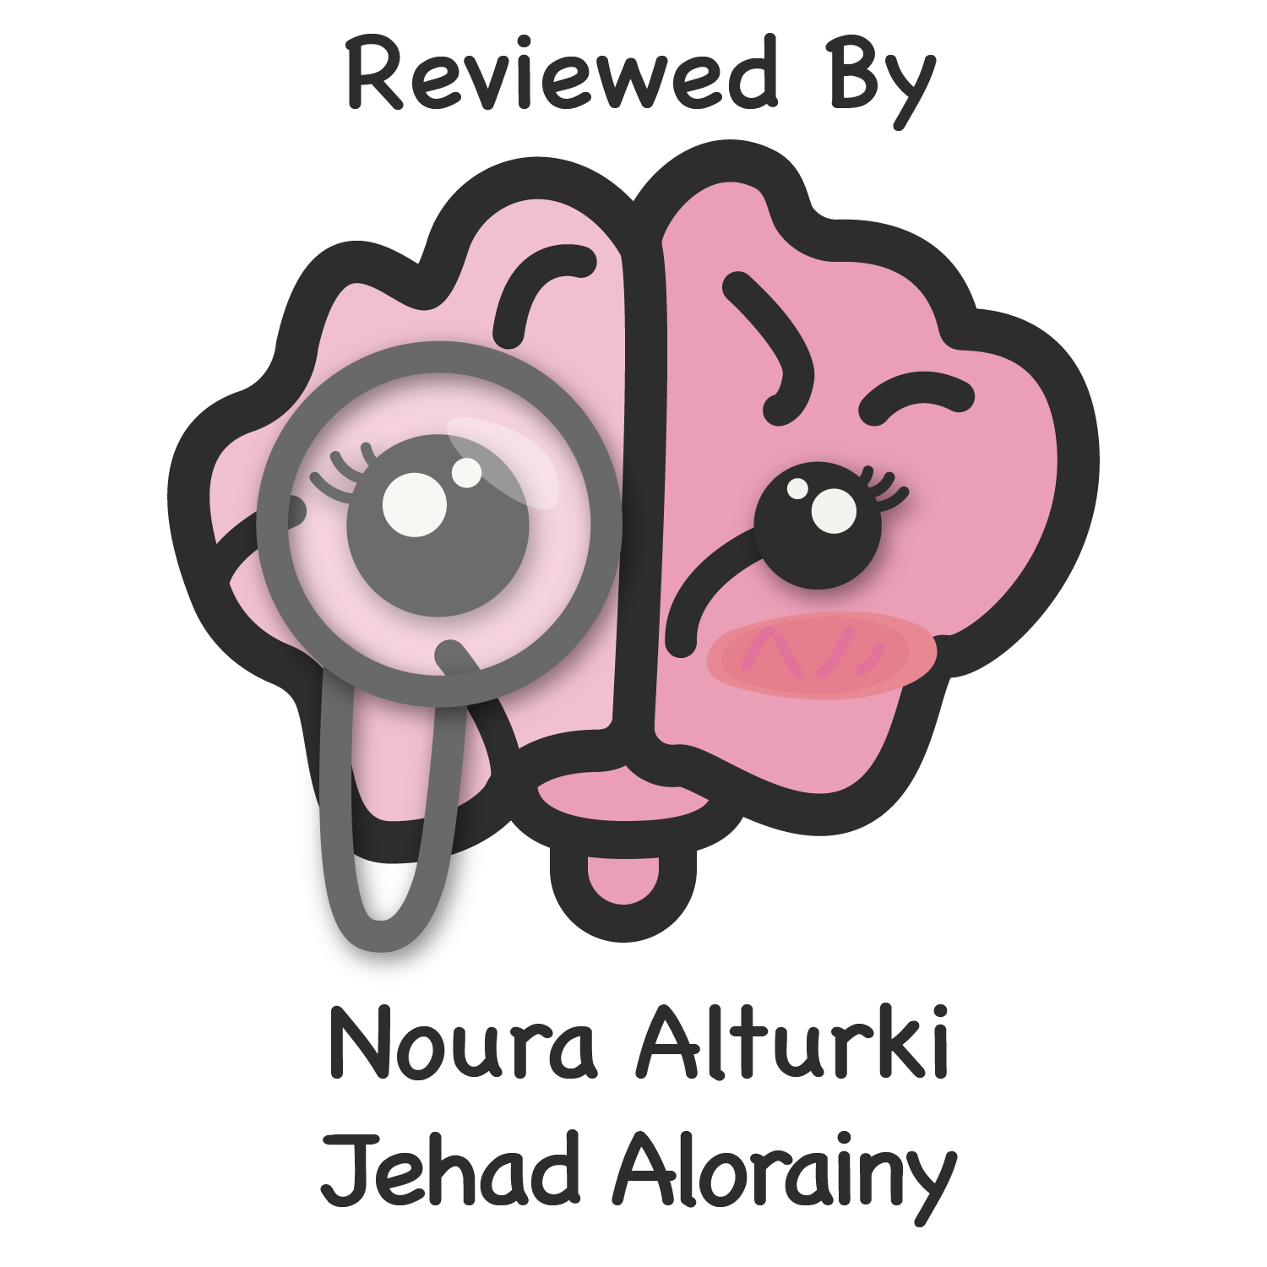
Natural History of Disease & Concept of Prevention & Control
Objectives
To describe theories postulated for the development of diseases.
Explain the concepts of iceberg phenomenon of diseases.
Understand the relationship between host, environment and agent in disease causation.
Define the term prevention.
Identify the level of prevention in relation to stage of disease development.
Identify the measures applied at each level of prevention.
Color Index
Main text
Males slides
Females slides
Doctor notes
Important
Golden notes
Extra
Editing File

Slide 2
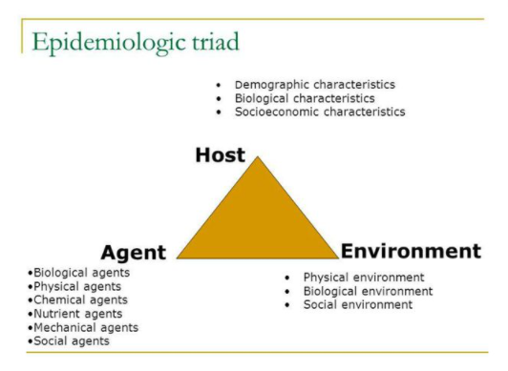
What is Health?
Theories of Disease Causation
“Health is a state of complete physical, mental and social well-being and not merely the absence of disease or infirmity”
Diseases can be caused by multiple factors and agents and there can’t be one theory the represents the causation of all diseases.
1- Germ Theory:
After the discovery of bacterial culture by Louis Pasteur
Robert Koch designed his postulates and came with the germ theory in the second half of the 19th century
Germ theory states that:
Every human disease is caused by a microbe or germ, which is specific for that disease and one must be able to isolate the microbe from the diseased human being.
Germ theory showed a one to one relationship between causal agent and disease
Disease
agent
Man
Disease
2- Epidemiological Triad:
The germ theory didn’t cover the causation of all diseases.
One exception is TB (Tuberculosis)
Not everyone exposed to tubercle bacteria develops tuberculosis but the same exposure in an undernourished or immunocompromised person may result in clinical disease and exposure occurs more in overcrowding.
The second theory for disease causation is the epidemiological triad.
Unlike the germ theory which takes the agent as a sole factor, the epidemiological triad considers the host and environmental factors
It explains why some exposed people get symptoms while others don’t

Slide 3
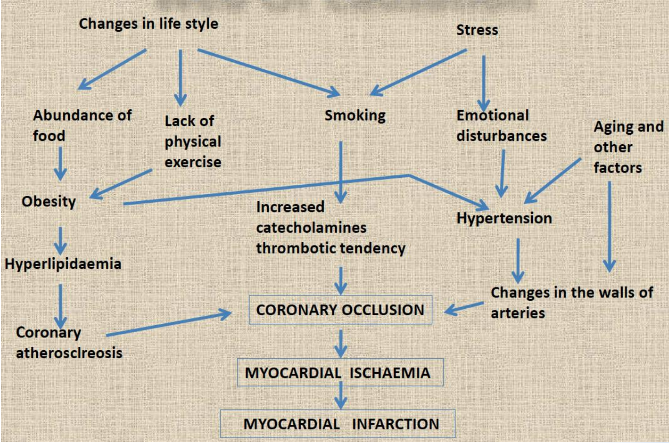
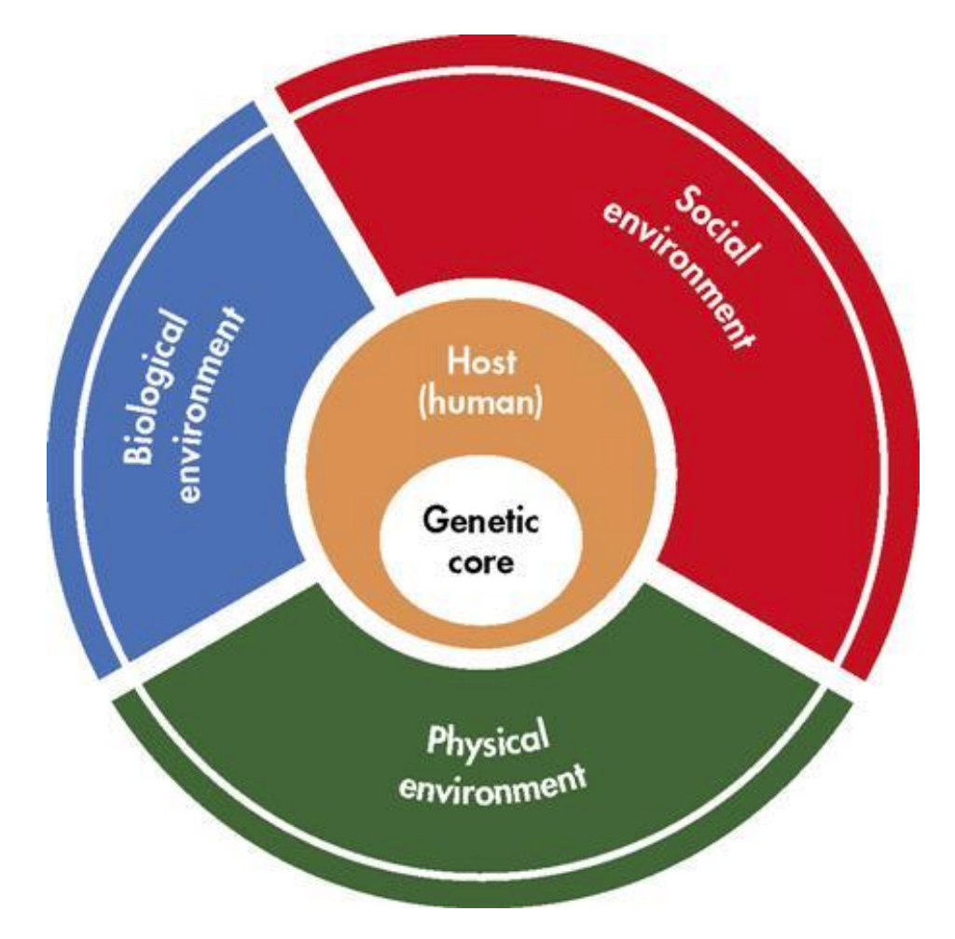
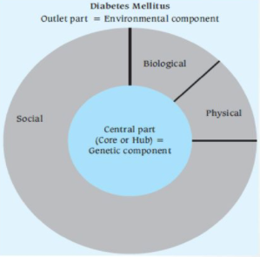
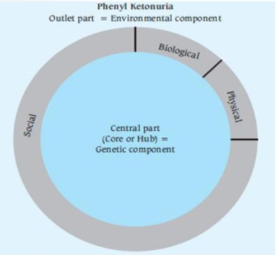
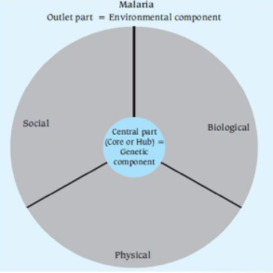
Theories of Disease Causation
3- “Web of Causation”
The web of causation was suggested by McMohan and Pugh
The various factors are like an interacting web of spider.
It considers all predisposing factors of any type and their complex interrelationship with each other.
Each factor has its own relative importance in causing the final departure from the state of health, as well as interacts with others, modifying the effect of each other.
ideally suite chronic diseases (no agent is there) and disease is the outcome of interaction of multiple factors
One example is AMI (Acute Myocardial Infarction)
4- Wheel Theory
As medical knowledge advanced, an additional aspect of interest that came to play is the comparative role between genetics (host) and the environmental (i.e. extrinsic factors outside the host) factors in causation of disease
Both the triad and web theory don’t cover this aspect thoroughly
To explain such a relative contribution of genetic and environmental factors, the “wheel theory” has been postulated
The core of the wheel represents the genetic component
The outer part represents the environment divided into physical, social and biological
Notice that the genetic core and the environment are equal.
Main environment component is social (lifestyle and behavioral habits)
Notice that the genetic core is larger (more important) than environmental factors
Notice that the environmental factors are more important than the genetic component

Slide 4
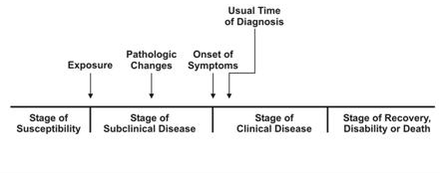
Natural History of Disease:
Definition:
Natural history of disease refers to the progress of a disease process in an individual over time, in the absence of intervention.
The process begins with exposure to or accumulation of factors capable of causing disease.
Results: with no medical intervention
Recovery
Disability (ex. Diabetic foot resulting in amputation)
Death
Stages:
Pre-disease stage
Latent (asymptomatic) stage
Symptomatic stage
Pre-disease Stage
Before a disease process begins in an individual.
The individual can be seen as possessing various factors that promote or resist disease.
Te
Social environment
Immunological capability
Nutritional history
Genetics
makeup
Environment exposure
Demographic
characteristics
(age)
Behavioral
patterns
Latent Stage (asymptomatic)
If the disease-producing process is underway, but no symptoms of disease have become apparent
Patient was exposed and the disease-producing process is underway (no symptoms)
Screening may be feasible
Symptomatic Stage
When the disease is advanced enough to produce clinical manifestations
The earlier the condition is diagnosed and treated, the more likely the treatment will delay death or serious complications, or at least provide the opportunity for effective rehabilitation.

Slide 5
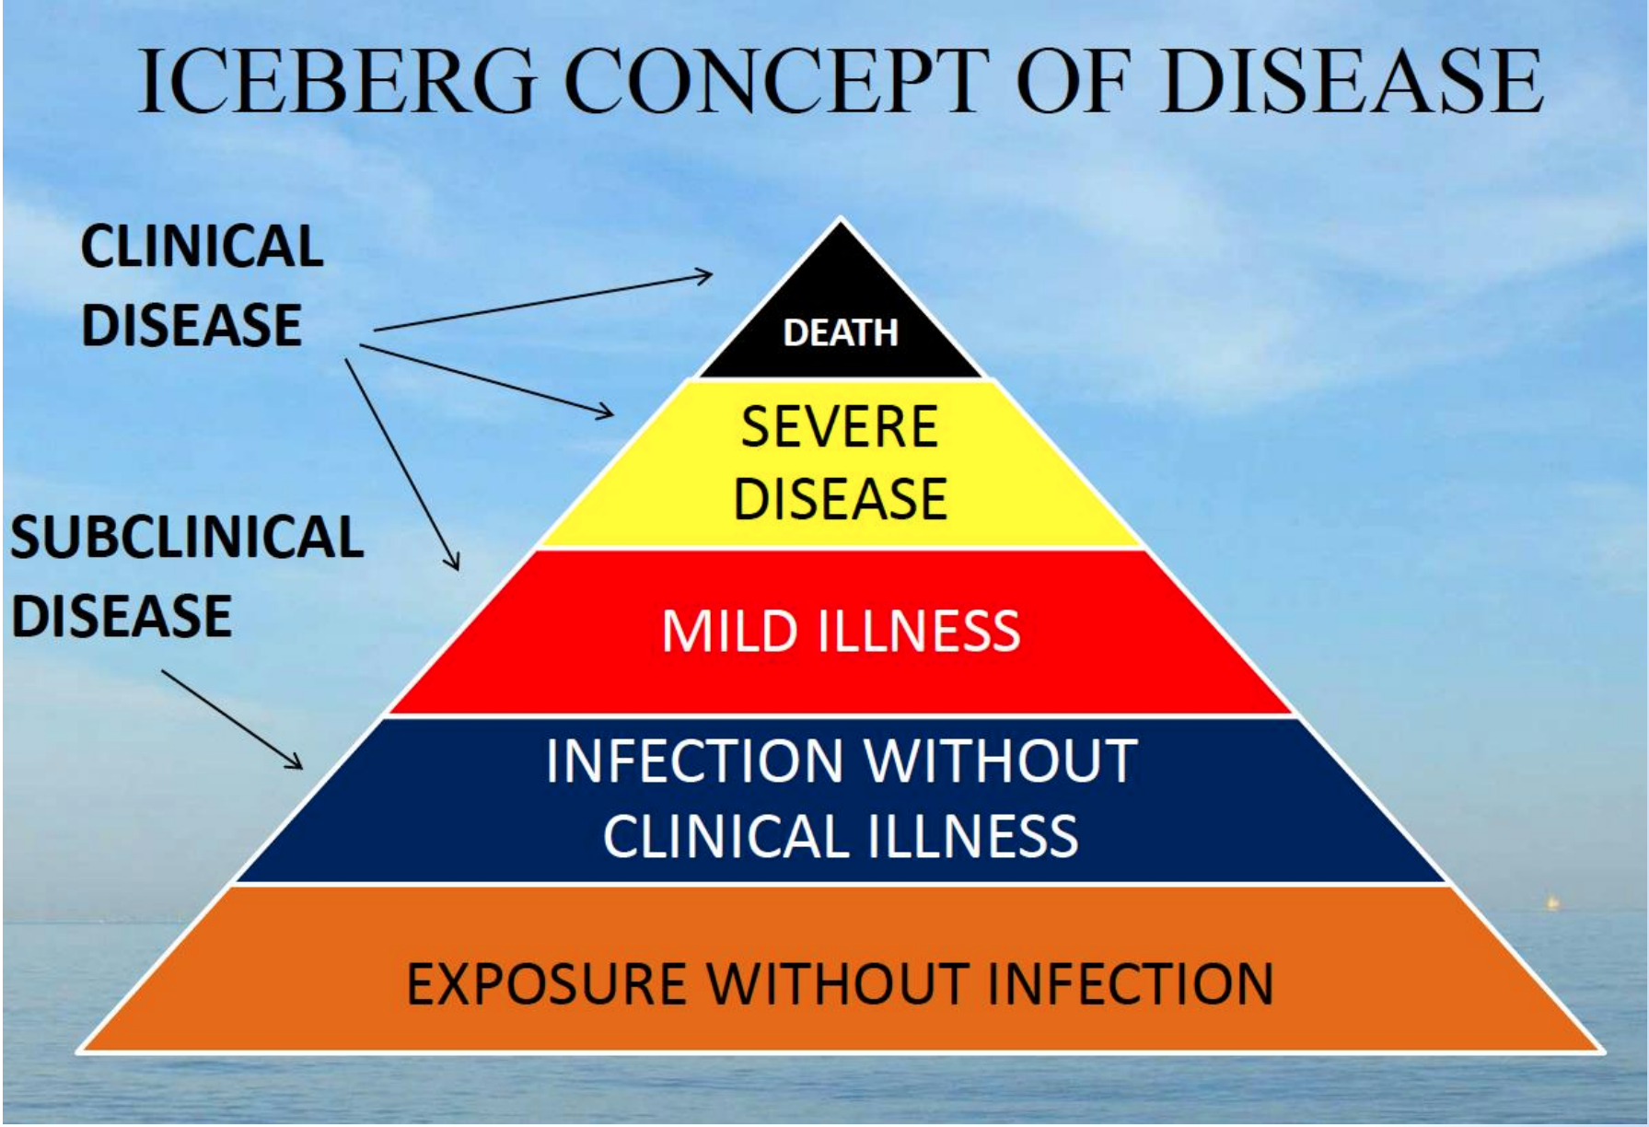
Natural History of T2D
Iceberg Phenomenon
Predisease Stage: obesity, genetic susceptibility and other environmental factors
Latent Stage: ongoing hyperglycemia and insulin resistance
Symptomatic Stage: atherosclerosis, retinopathy, neuropathy, nephropathy...etc.
If disease persisted it’ll lead to potential disabilities and death
The iceberg phenomenon represents the biological spectrum of diseases
Ranging from subclinical disease (asymptomatic) to clinical disease (symptomatic)
The floating tip of the iceberg represents the clinical disease while the submerged part represents the subclinical disease
Different manifestations of the disease is based on the host’s immunity and receptivity

Slide 6
Disease Prevention
Levels of Prevention
Prevention is the process of intercepting or opposing the “cause” of a disease and thereby the disease process.
Successful prevention depends on:
1
Knowledge of causation
2
Dynamics of transmission
3
Identification of risk factors and risk groups
4
Availability of prophylactic
or early detection and
treatment measures
5
Organization to apply these measures
6
Continuous evaluation
Primary Prevention
Secondary Prevention
Tertiary Prevention
1
2
3
Leavell’s Levels of Prevention
Stage of Disease and Care |  | Level of Prevention | Response
Predisease Stage | No known risk factors | Primary Prevention | Health promotion (lifestyle, nutrition & environment)
 | Disease Susceptibility |  | Specific Protection (immunization, safety measures)
Latent Disease | Hidden Stage (Asymptomatic) | Secondary Prevention | Screening (for population) & case finding (for individual)
Symptomatic Disease | Initial Care | Tertiary Prevention | Disability limitation
 | Subsequent Care |  | Rehabilitation

Slide 7
Levels of Protection
1
Primary Prevention:
It can be defined as “action taken prior to the onset of disease, which removes the possibility that a disease will ever occur.
Keeps the disease from being established by eliminating the cause of the disease (clean water to kill cholera) or by increasing resistance to disease (vaccination)
It signifies intervention in the pre-symptomatic phase of a disease.
Two types of strategies:
Health promotion (in positive health people with no known risk factors)
High risk strategy (specific protection for high risk groups)
Health Promotion:
Health-promoting activities usually contribute to the primary prevention of a variety of diseases and enhance a positive feeling of health
Activities consist of non-medical efforts such as changes in lifestyle, nutrition and environment.
Health promotion in infectious disease
reduces the frequency and seriousness of infectious diseases and it includes:
Clean water
Appropriate waste disposal
Manage crowding
Control the animal vectors of disease
Adequate housing and working environment
Example of Primary Prevention
For example primary prevention of cardiovascular disease we need to address modifiable risk factors, they include:
Smoking
Unhealthy diet
Physical Activity
Dyslipidemia
Hypertension
Diabetes Mellitus
Obesity
You cannot control non-modifiable risk factors, so you cannot change them.

Slide 8
Levels of Protection
2
Secondary Prevention:
It can be defined as “action which stops the progress of a disease at its initial stage”
Interrupts the disease process before it becomes symptomatic.
It is applied in the latent stage of disease (asymptomatic)
The specific interventions used is early diagnosis and treatment (screening), for example:
Mammography to screen for breast cancer
Pap smear to screen for cervical cancer
Tertiary Prevention:
Limits the physical and social consequences of symptomatic disease
These include all measures undertaken when the disease has become clinically manifest or advanced with a view to:
Prevent or delay death
Reduce or limit the impairments and disabilities
Minimize suffering
Promote the subject’s adjustment to incurable conditions
3
Approaches to Tertiary Prevention
 | Disability Limitation | Rehabilitation
Stage of Care | Initial care | Subsequent care
Description | Measures to prevent the occurrence of further complication, impairments, disabilities and handicaps or even death | Identify and teach methods to reduce physical and social disability
Example | Complete rest, morphine, oxygen and streptokinase is given to patient of Acute MI to prevent death or complications like arrhythmias / CHF Application of plaster cast to a patient who suffered Colles’ fracture is done to to prevent complications and further disability like mal-union or non-union. | Helping a car accident victim regain the use of his legs

Slide 9
Quiz
MCQ
1- At which stage of a disease’s natural history do we apply screening as a method of prevention?
A- Pre-disease Stage B- Susceptible Stage C- Latent Stage D- Symptomatic Stage
2- Which of the following theories of disease causation best describes the transmission of COVID-19?
A- Germ Theory B- Epidemiological Triad C- Web of Causation D- Wheel Theory.
3- The floating tip in the iceberg phenomenon represents which of the following?
A- Clinical Stage B- Exposure C- Subclinical Stage D- Healthy population
4- Administration of Alteplase (fibrinolytic) for the treatment of STEMI is considered a preventive method to fatal ventricular arrhythmia. Which of the following approaches describes this method?
A- Disability Limitation B- High risk strategy C- Screening D- Rehabilitation
5- A friend of yours came to you at the clinic for a regular check up. Family history showed that his father was diagnosed with T2D recently. After a general examination you found out that your friend is healthy and has a normal blood glucose level. Which stage of T2D natural history is your friend’s currently at?
A- Pre Disease Stage B- Latent Stage C- Symptomatic Stage D- Positive Health
6- Which of the following best describes the “Wheel Theory”?
A- The outlet represents social factors only
B- The Core represents biological factors
C- Physical Factors include lifestyle and activities
D- The inner part resembles the genetic core
Answers
Q1 | Q2 | Q3 | Q4 | Q5 | Q6
C | B | A | A | A | D

Slide 10
Thank You and
Good Luck
Team Leaders:
Lama AlAssiri | Mohammed AlHuqbani | Ibrahim AlDakhil
Team Members:
Lama AlZamil
Leen AlMazroa
May Babaeer
Muneera AlKhaorayef
Norah AlMazrou
Nouf Alhussaini
Rema AlMutawa
Sara AlAbdulkareem
Sedra Elsirawani
Wejdan Alnufaie
Abdulrahman Alhawas
Abdulrahman Shadid
Abdullah Aldawood
Abdullah Shadid
Alwaleed Alsaleh
Bader Alshehri
Bassam Alkhuwaiter
Faisal Alqifari
Hameed M. Humaid
Khalid Alkhani
Meshari Alzeer
Mohannad Makkawi
Nayef Alsaber
Omar Aldosari
Omar Alghadir
Zyad Aldosari

