Slide 1
International Health
Regulation
Objectives
ي
What are International health regulations? Why are they needed?
What strategies are globally adopted to control public health related diseases?
What are the challenges faced by different countries while implementing IHR?
IHR in Saudi context
اللهمّ أبدل مي داراً خيراً من دارها، وأهلاً خيراً من أهلها، وأدخلها الجنّة، وأعذها من عذاب القبر، ومن عذاب النّار اللهمّ إن كانت محسنةً فزد من حسناتها، وإن كانت مسيئةً فتجاوزعن سيّئاتها اللهم عوض شبابها بجنتك واسكنها الفردوس الاعلى بلا حساب ولا عقاب uاللهم وسع قبرها وبشرها بمقعدها بالجنة يارب العالمين
Color Index
Main text
Males slides
Females slides
Doctor notes
Important
Golden notes
Extra
Editing File

Slide 2
1851
1951
1969
1995
2005
First International Sanitary Conference, Paris¹
First International Sanitary Regulations (ISR) adopted by WHO member states²
ISR replaced and renamed the International Health Regulations (IHR)³
Call for Revision of IHR⁴
IHR (2005) adopted by the World Health Assembly.
2006
15 June 2007
2007-2009
2012
World Health Assembly vote that IHR (2005) will enter into force in June 2007
IHR entered into force and are binding on 194 States Parties
Member States assessed and improved their national core capacities for surveillance and reporting
the core capacities were in place and functioning
What’s New?
What’s New?
What is IHR?
A legally-binding agreement.
It significantly contributes to global public health security.
Providing a new framework for the coordination of the management of events that may constitute a public health emergency of international concern.
improves the capacity of all countries to detect, assess, notify and respond to public health threats.
Brief History
1851
1951
1969
1995
2005
First International Sanitary Conference, Paris Cholera’s outbreak
First International Sanitary Regulations (ISR) adopted by WHO member states
ISR replaced and renamed the International Health Regulations (IHR)¹
Call for Revision of IHR²
IHR (2005) adopted by the World Health Assembly.
1851
1951
1969
1995
2005
First International Sanitary Conference, Paris
First International Sanitary Regulations (ISR) adopted by WHO member states
ISR replaced and renamed the International Health Regulations (IHR)
Call for Revision of IHR
IHR (2005) adopted by the World Health Assembly.
2006
15 June 2007
2007-2009
2012
World Health Assembly vote that IHR (2005) will enter into force in June 2007
IHR entered into force and are binding on 194 States Parties
Member States assessed and improved their national core capacities for surveillance and reporting
the core capacities were in place and functioning
2006
15 June 2007
2007-2009
2012
Why were the IHR revised?
World Health Assembly vote that IHR (2005) will enter into force in June 2007
IHR entered into force and are binding on 194 States Parties
Member States assessed and improved their national core capacities for surveillance and reporting
the core capacities were in place and functioning
Cross border travel and trade have increased
The challenge of emerging and reemerging infectious diseases
Only 3 diseases (cholera, plague and yellow fever) narrow scope
Dependence on affected country to notify and lack of mechanism for collaboration between WHO and affected countries
Lack of a formal internationally coordinated mechanism to contain international disease spread
IHR 2005
Purpose and Scope
Differences between IHR 1969 and 2005
To prevent, protect against, control and provide a public health response to the international spread of diseases.
From three diseases to all public health events not diseases
In a way commensurate with and restricted to public health risks.
From passive to pro-active using real time surveillance/ evidence
Which avoid unnecessary interference with international traffic and trade. Should be notified
From control of borders to detection and containment at source
Notifiable diseases under IHR 2005
1
Any case of the following 4 diseases³:
2
Any event of potential international public health concern, including⁴:
Smallpox, Poliomyelitis, SARS and Cases of
human influenza caused by a new subtype.
Those of unknown causes or sources
Even if not listed in points 1
1: Difficult and wasn’t aiming towards the objectives
1: Concerned about 3 diseases but there were others at that time like Ebola and it couldn’t be dealt with because it wasn’t written how nor did they have enough information
2: some diseases were not mentioned
3: Who finds them? Hospitals + Community centers
4: A public emergency should be notified to the MOH even if it wasn’t from the 4 diseases

Slide 3
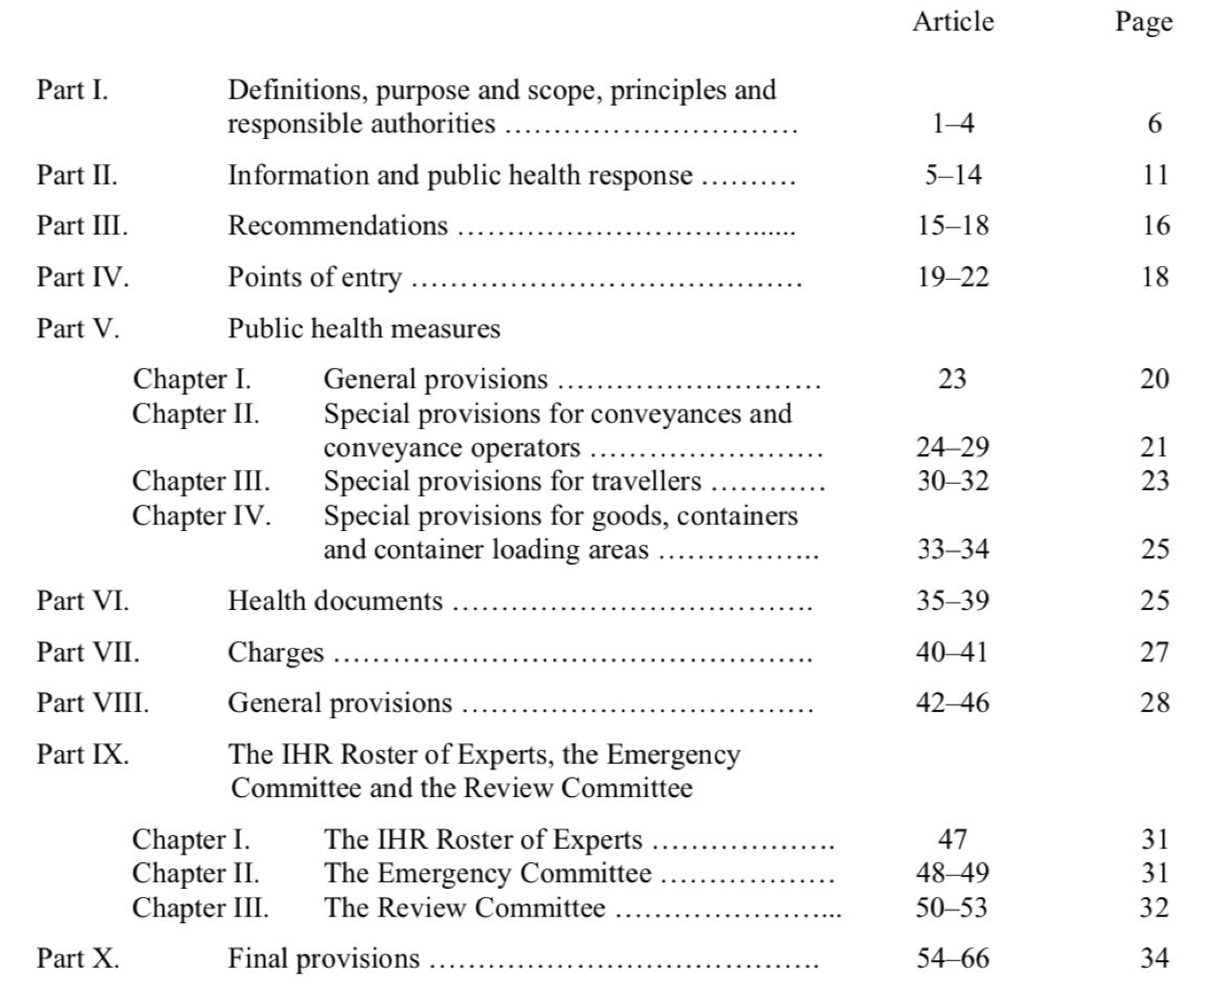
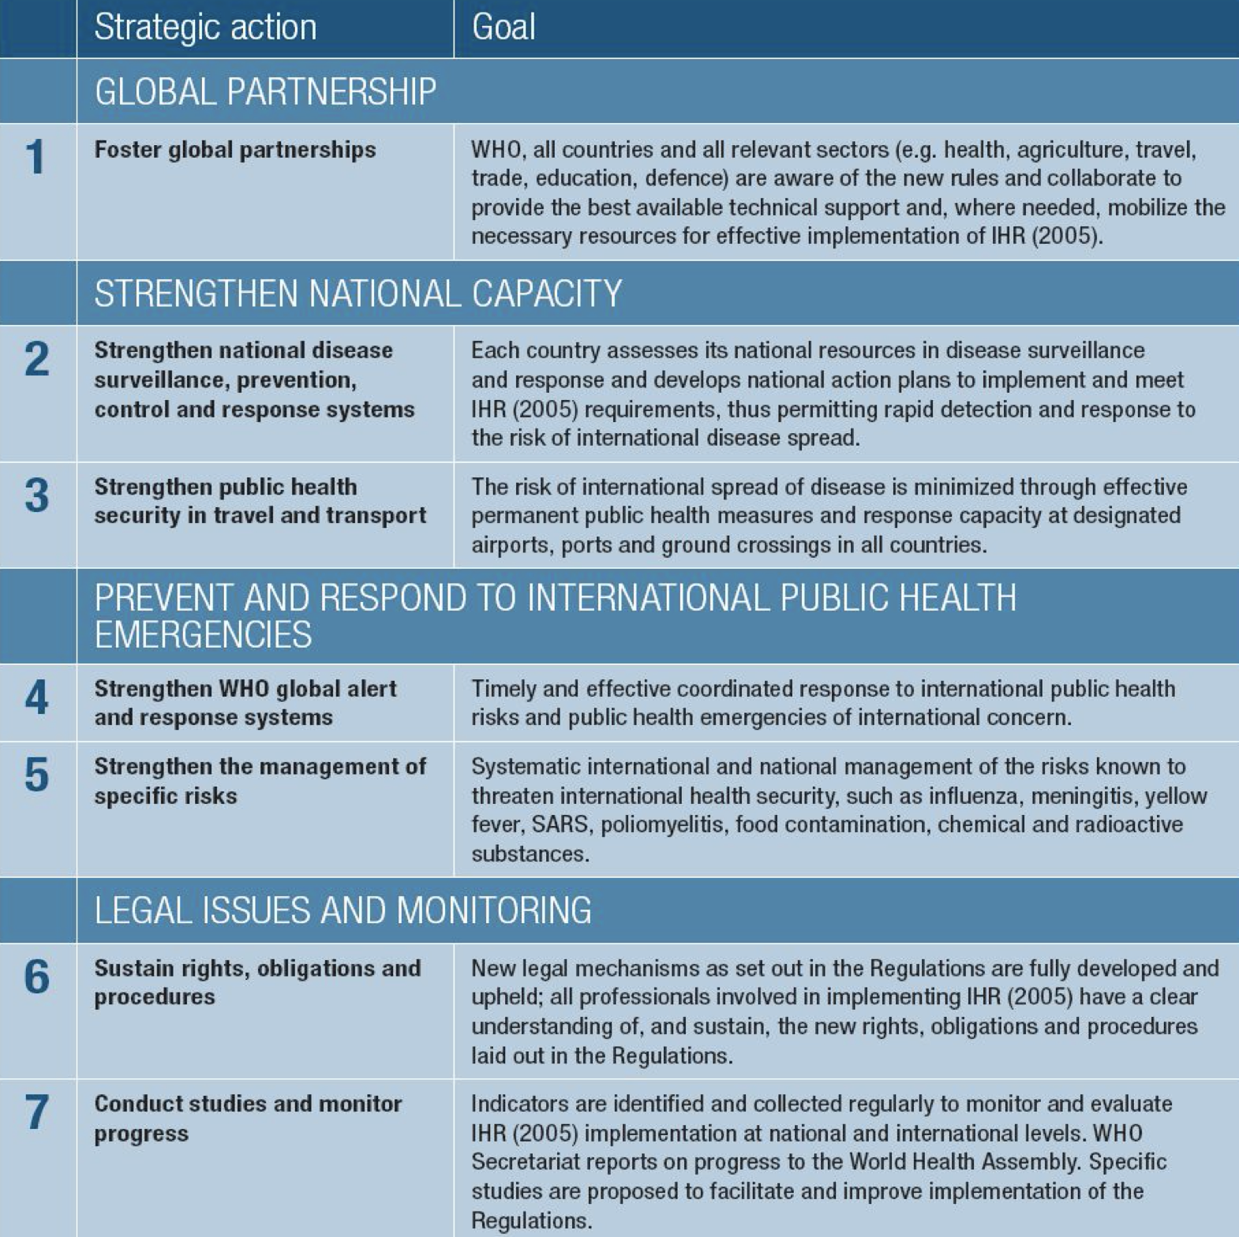
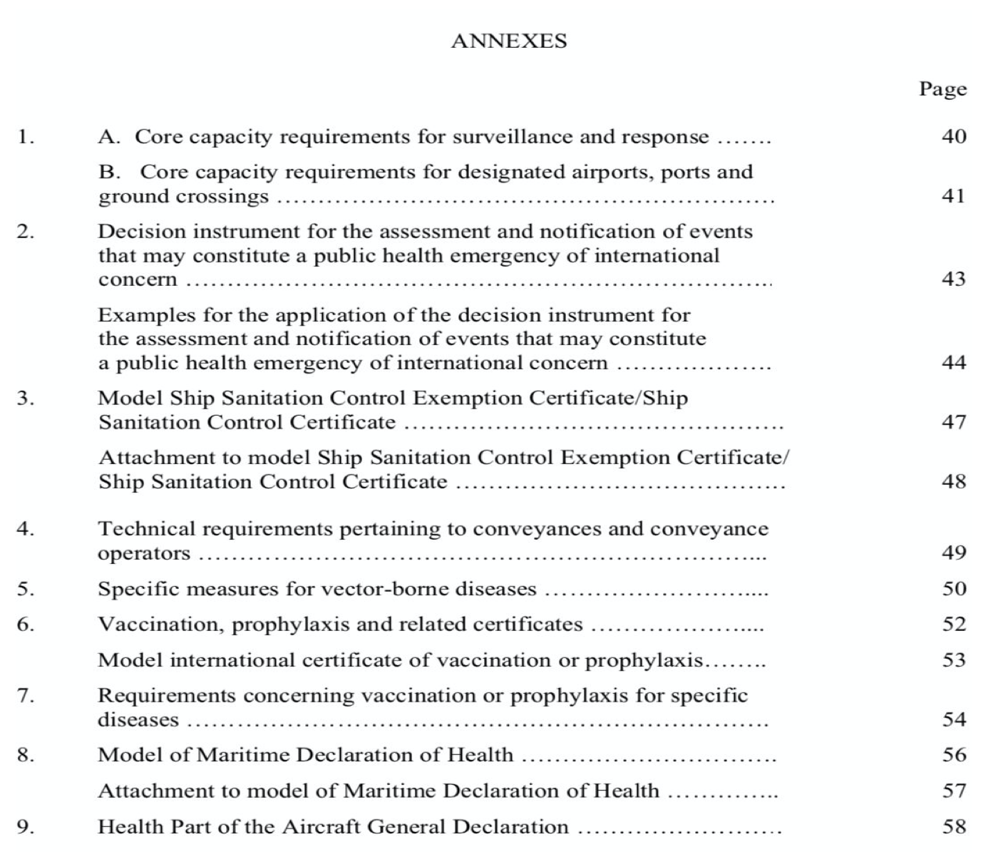
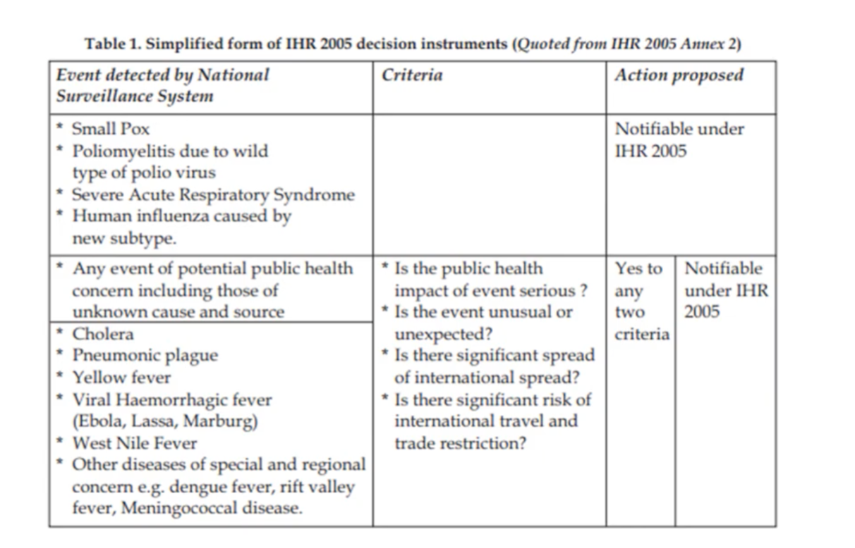
Public Health Emergency of International Concern (PHIEC)¹
An extraordinary public health event which constitute a public health risk to other countries through international spread of disease and potentially requires a coordinated international response.
They include those caused by infectious diseases, chemical agents, radioactive materials and contaminated food.
Any event irrespective of origin and source even if it was an unknown source meeting 2 or more of the following criteria is considered as PHEIC and should be notified to WHO according to IHR (2005):
Unusual or unexpected event
Resulting in serious public health impact
With significant risk of international spread
Significant risk of international travel or trade restriction
IHR (2005) Document
Globally adopted strategies to control public health related diseases²
66 articles organized
in 10 parts
Awareness
3
Technical area
9 Annexes
Legal and monitoring framework
Major Obligations
Designation of a National Focal Point
Core capacity to detect, report and respond
Comply with routine provision
Assess events and notify potential PHEIC
Legal and administrative framework
More details in the next few slides:)
1: The final decision on whether to consider it a public concern is for the WHO nevertheless it has to be notified
2:to be able to implement it
3: Must be aware of what’s in the IHR from all aspects in order to know what to take notice of and what not

Slide 4
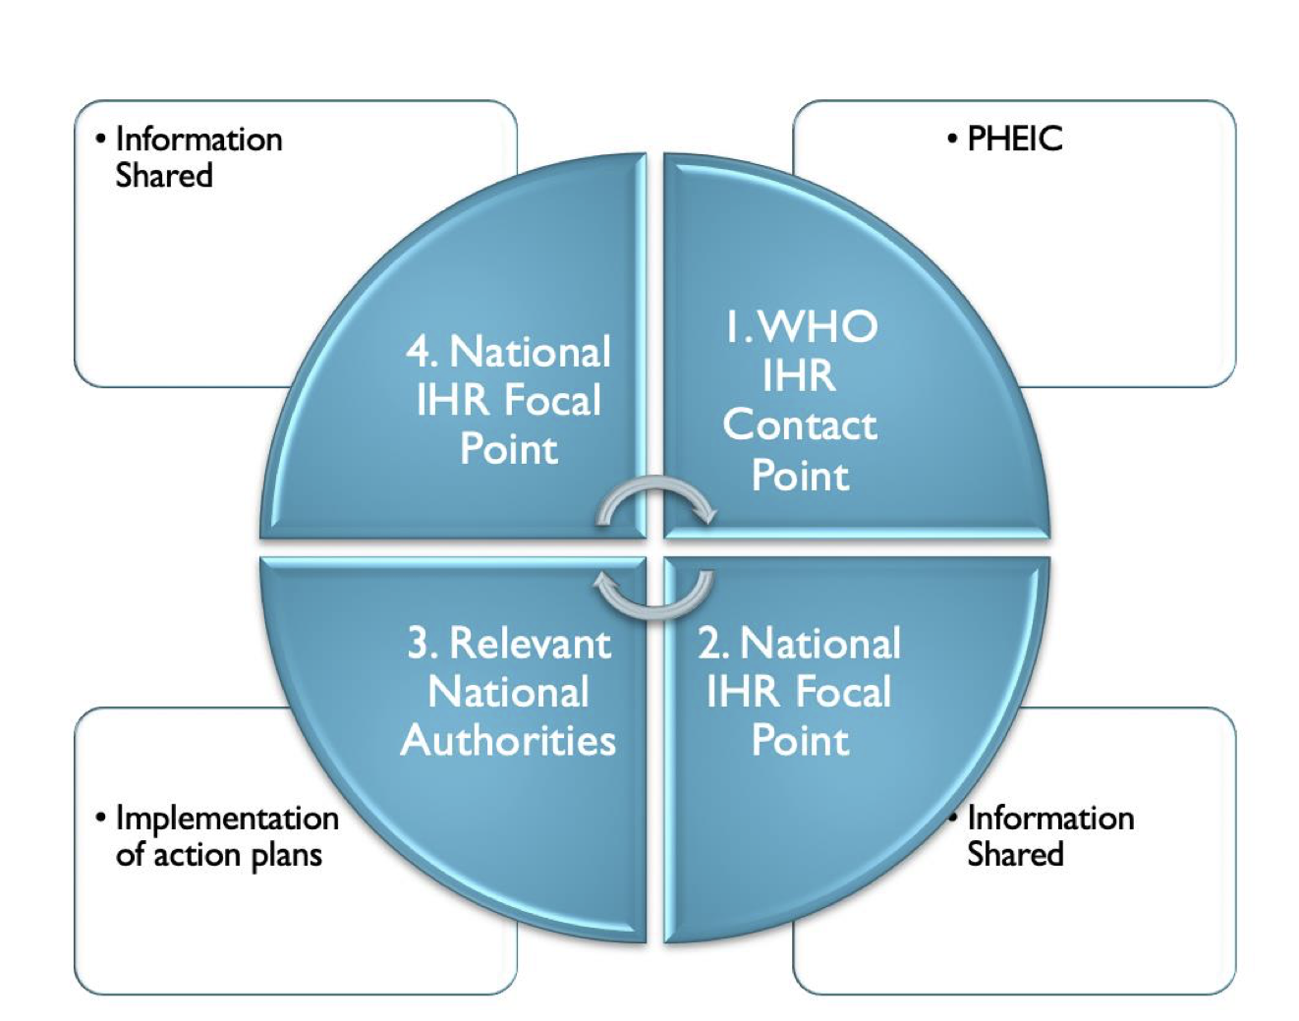
Major Obligations Cont...
1
Designation of a National Focal Point
1
Circle of Communications:
Core capacity to detect, report and respond
“The national center, designated by each State Party which shall be accessible at all times for communication with WHO Contact Points”.
WHO shall designate IHR Contact Points, which shall be accessible at all times for communications with National IHR Focal Points.
Responsible for notification to WHO but not necessarily responsible for carrying out the assessment.
Strengthen national capacity at 3 levels:
community, intermediate and national.
النظام الصحي بشكل عام Health system
وحدات الوبائیات Epidemiology
المختبرات Laboratory
الجاھزیة في جمیع القطاعات Preparedness
توفر الخدمات العلاجیة Case management
مكافحة العدوى Infection control
إدارة الأزمات Disaster management
التواصل السریع Communication
الموانئ Ports
المطارات Airports
المنافذ البریة Ground crossings
Intersectoral collaboration:
الطیران المدني Aviation sector
ھیئة الموانئ Shipping
ھیئة السكة الحدید Railways
الجمارك والجوازات والأمن Customs & Immigration security
"Event-based" surveillance and response at global level¹
البحث والتقصي Intelligence
التحقق من وجود خطر صحيVerification
تقییم الخطر Risk assessment
الاستجابة Response (GORAN)
الدعم اللوجستي Logistics
Collaboration with International organizations:
Influenza, Polio, SARS, Smallpox, Chemical Safety and EPI
Cholera→ GAVI
Global Alliance for Vaccines and Immunization
Cholera, Meningitis and Yellow fever → ICG International Coordinating Group on Vaccine Provision
Food Safety → INFOSAN
International Food Safety Authorities Network
Radionuclear Safety →IAEA
International Atomic Energy Agency
TB, Malaria, HIV\AIDS →GFATM
Global Fund to Fight AIDS, Tuberculosis and Malaria
HIV\AIDS →UNAIDS
Joint United Nations Programme on HIV/AIDS
1-countries have to be prepared, aware, alert to detect it
1: Every Country must have regulations that align with the IHR regulations

Slide 5
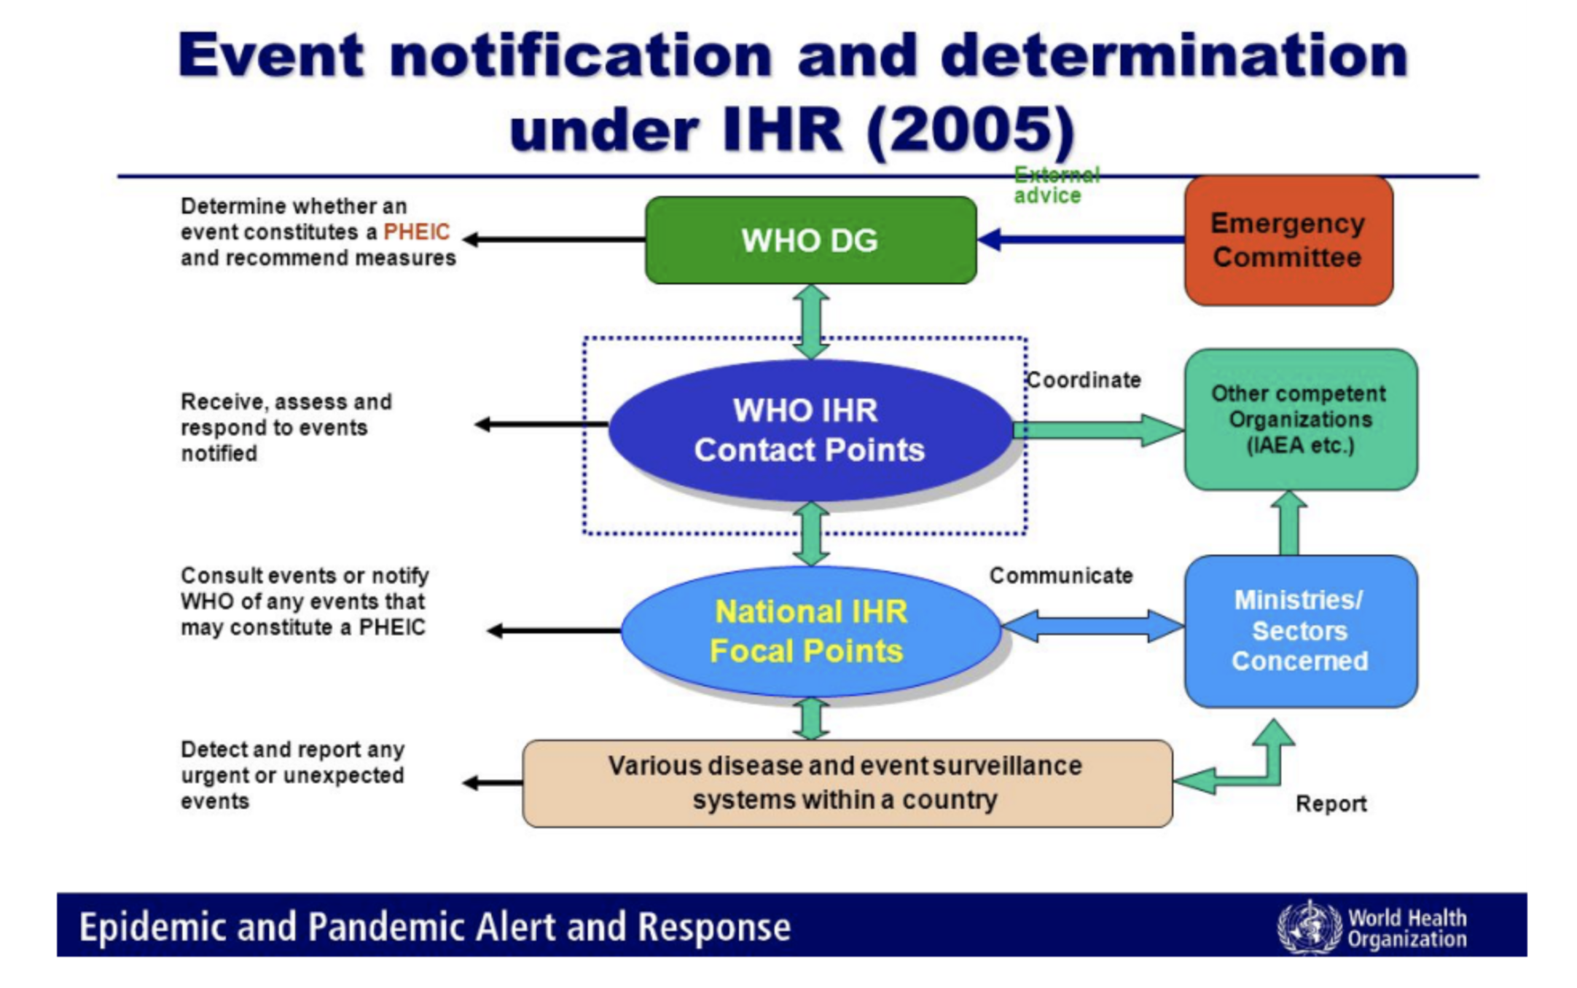
Major Obligations Cont...
2
Comply with routine provision
National Legislation should allow Compliance with IHR
تحدید نقاط الاتصال ومھامھا NFP Designation and Operations
Detection, reporting, verification and control of أعمال الترصد الوبائي والمكافحةevents
Implementation of IHR Documents استعمال وثائق اللوائح الصحية
Definition of implementing structures, organization,roles and responsibility تعريف الجهات المسؤولة وتحديد أدوارها
At 3 levels: Community/Peripheral, Intermediate and
National
تقییم القدرات الأساسیة في كل القطاعات المعنیة بتنفیذ اللوائح
8 Core capacities:
التشریعات Legislation and Policy
التنسیق بین القطاعات المعنیة Coordination
الترصد الوبائي Surveillance
الاستجابة Response
الجاھزیة Preparedness
إدارة المخاطر Risk Communications
الموارد البشریة Human Resources
المختبرات Laboratory
3
Designation of a National Focal Point
Challenges faced by different countries while implementing IHR
Event notification and determination¹
Circle of Communications:
“The national center, designated by each State Party which shall be accessible at all times for communication with WHO Contact Points”.
WHO shall designate IHR Contact Points, which shall be accessible at all times for communications with National IHR Focal Points.
Responsible for notification to WHO but not necessarily responsible for carrying out the assessment.
Mobilize resources and developing national action plans
Strengthen national capacities in alert and response.
strengthen capacity at ports, airports, and ground crossings
Maintaining strong threat-specific readiness for known diseases/risks.
Challenges faced by different countries while implementing IHR
Rapidly notify WHO of acute public health risks
Sustain international and intersectoral collaboration
Mobilize resources and develop national action plans
Strengthen national capacities in alert and response
Strengthen capacity at ports, airports, and ground crossings
Maintaining strong threat-specific readiness for known diseases/risks
Rapidly notify WHO of acute public health risks
Sustain international and intersectoral collaboration
Monitor progress of IHR implementation
Monitor progress of IHR implementation
1-anything happens goes to the ministry of health and then to the national focal point which is assigned by each nation to the WHO contact point which eventually notified by the WHO
1: National IHR focal point —> تعينهم الدوله
WHO IHR Contact points —> تعينهم المنظمه نفسها

Slide 6
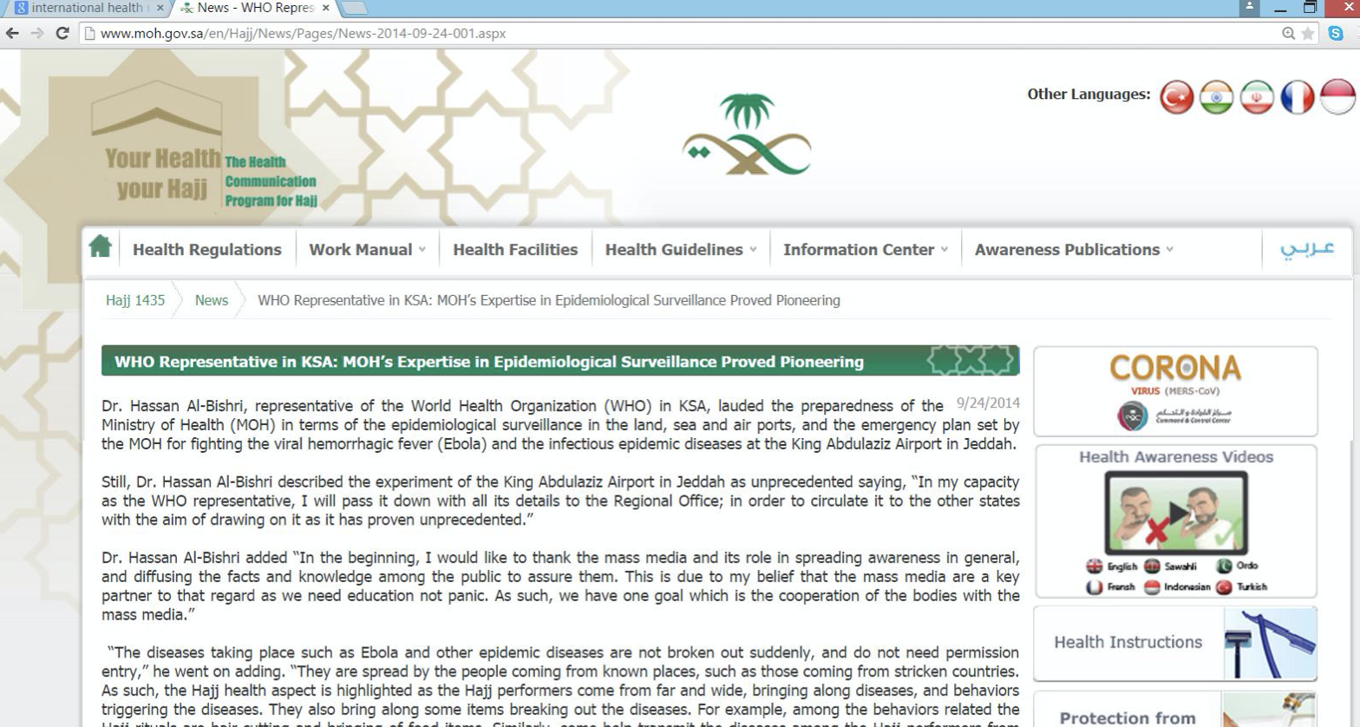
IHR in Saudi Arabia: Case Study
During Hajj Season of 2014, the country was subjected to the risk of Ebola Virus Disease outbreak during the Hajj season.
What was the action plan conducted under the IHR?
Firstly: the disease was announced to be endemic in west African countries: Guinea, Liberia and Sierra Leone in West Africa. Additionally, a localised spread of the virus was announced in certain areas of Nigeria.1
This announcement indicated a Public Health Emergency of International Concern (PHEIC).
Saudi Arabia, as a member state was informed about this PHEIC through the National IHR Focal Point.
The National IHR Focal Point in Saudi Arabia was a representative of the Saudi Ministry of Health.
How does The National IHR Focal Point in Saudi Arabia receive
information from the WHO?
Through the WHO IHR Contact Points.
i.e. (EMRO IHR contact point)
The Information components:
Surveillance, notification, consultation, verification, and information sharing at the endemic countries with ED
Announcement of the PHEIC with state parties
Sharing of relevant public health knowledge about ED with state parties
Action plan at endemic countries:
Application of prevention and control measures in endemic countries.
Application of exit screening measures at Points of Entry
Information sharing with state parties
Action plan at Saudi Arabia:
Restriction of entry of citizens of affected countries
Application of entry screening measures
Information sharing with relevant local authorities
Assessment of the established capacity:
Transportation system adherence to the IHR guidelines
Maintenance of core capacities at designated Points of Entry in Saudi Arabia: Jeddah airport, Madinah Airport, and Islamic seaports in Jeddah
Development of Public health Emergency Contingency Plans at Points of Entry
Plan trials, monitoring and evaluation
1-Saudi arabia during the outbreak didn’t allow entry from these countries and no in or out from the the countries with the endemic, Saudi arabia was prepared for any case with isolation rooms and physicians since they have allowed visitors from slightly affected countries like nigeria

Slide 7
Quiz
MCQ
1-which of the following criteria is consider as PHIEC?
A- unusual or unexpected event B-with no significant international spread
C- not resulting in serious public health impact D- none of the above
2- how does The National IHR Focal Point in Saudi Arabia receive information from the WHO?
A- National IHR focal point. B- relevant national authority.
C- Through the WHO contact point . D- none of the above.
3-Which of the following challenging WHO face when implanting IHR?
A- comply with routine provision. B-legal and administrative framework.
C-core capacity to detect report and response D-sustain international and intersectoral collaboration.
4- How many carteria should be present to consider as PHIEC?
A- zero B-Only one. C-one or more. D-two or more.
5- Which one of the following is responsible for the implantation of action plan according to IHR guidelines?
A. IHR focal point B. WHO contact point C-National IHR Focal point . D-Relevant National Authorities
Answers
Q1 | Q2 | Q3 | Q4 | Q5
A | C | D | D | D

Slide 8
Thank You and
Good Luck
Team Leaders:
Lama AlAssiri | Mohammed AlHuqbani | Ibrahim AlDakhil
Team Members:
Lama AlZamil
Leen AlMazroa
May Babaeer
Muneera AlKhorayef
Norah AlMazrou
Nouf Alhussaini
Rema AlMutawa
Sara AlAbdulkareem
Sedra Elsirawani
Wejdan Alnufaie
Abdulrahman Alhawas
Abdulrahman Shadid
Abdullah Aldawood
Abdullah Shadid
Alwaleed Alsaleh
Bader Alshehri
Bassam Alkhuwaiter
Faisal Alqifari
Hameed M. Humaid
Khalid Alkhani
Meshari Alzeer
Mohannad Makkawi
Nayef Alsaber
Omar Aldosari
Omar Alghadir
Zyad Aldosari

