Slide 1
Global Maternal
Health
Objectives
Understand the maternal health issues globally.
Understand the causes of maternal deaths and mortality.
Understand the interventions done globally to decrease maternal deaths and morbidly
Antenatal care
Promotion of breast feeding practices.....BFHI
Discuss and understand what preventive services for maternal health are delivered in KSA.
The Doctor said to refer to the references at the end of the lecture
Color Index
Main text
Males slides
Females slides
Doctor notes
Important
Golden notes
Extra
Editing File

Slide 2
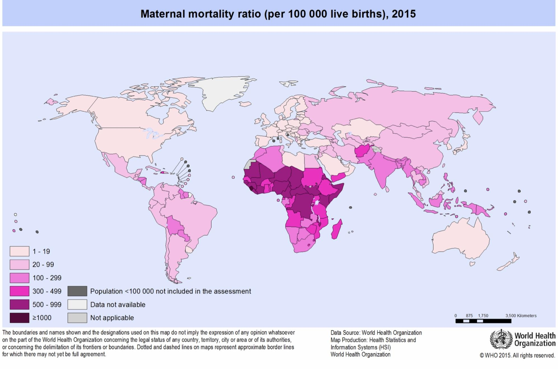
Maternal Health
Definition:
Maternal health refers to the health of women during pregnancy, childbirth and the postpartum period.While motherhood is often a positive and fulfilling experience, for too many women it is associated with suffering, ill-health and even death.
Fast Facts about Maternal Health...WHO Fact sheet sept, 2019
Every day in 2017, approximately 810 women died from preventable causes related to pregnancy and childbirth.
Between 2000 and 2017, the maternal mortality ratio (MMR, number of maternal deaths per 100,000 live births) dropped by about 38% worldwide.
94% of all maternal deaths occur in low and lower middle-income countries.
Young adolescents (ages 10-14)¹ face a higher risk of complications and death as a result of pregnancy than other women.
Skilled care before, during and after childbirth can save the lives of women and new-borns.
1
2
3
4
5
Maternal death:
The death of a women while pregnant, (or within 42 days of termination of pregnancy).
Direct² obstetric deaths
Indirect³ obstetric deaths
Accidental or incidental causes of death⁴ are not classified as maternal deaths.
Not Maternal
Death
Irrespective of the duration and site of the pregnancy
4 week
pregnant
Maternal
Death
1: Vulnerable age group, physically and mentally immature.
2: Directly related to pregnancy or within 42 days of termination.
3: Factors that were aggravated by pregnancy.
4: Gun shots, violence, suicide, homicide.

Slide 3
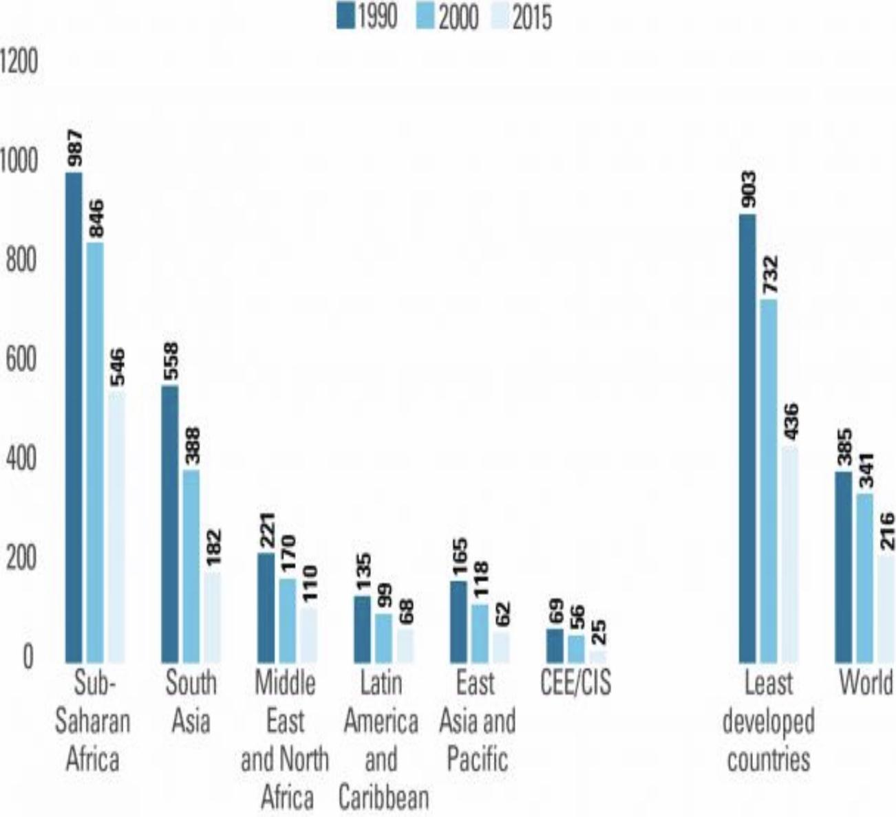
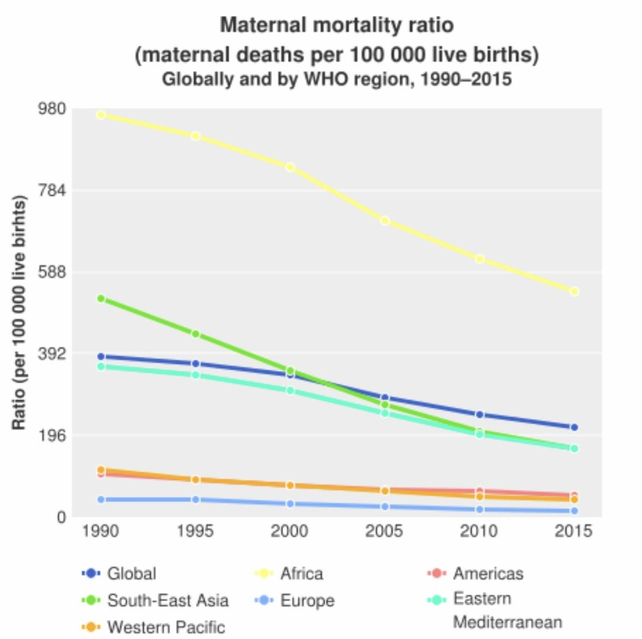
Global Causes of Maternal Mortality
Why women are dying?
Women die as a result of complications during and following pregnancy and childbirth.
The major complications that account for nearly 75% of all maternal deaths are:
Hypertension 14%
Sepsis 11%
Indirect 28%
Haemorrhage 27%
Other
direct 10%
Embolism
3%
Abortion
8%
severe bleeding (mostly after childbirth).¹
infections² (usually after childbirth).
high blood pressure during pregnancy (pre-eclampsia and eclampsia).
complications from delivery³. And unsafe abortion.
associated with diseases such as malaria, and AIDS during pregnancy.
Why do women not get the care they need? (Why do these women die?)
1
Delay in reaching care
Delay in decision to seek care
3 Delays
Model
Mountains, islands, rivers — poor organization
-Lack of understanding of complications
-Acceptance of maternal death
-Low status of women
-Socio-cultural barriers to seeking care
2
3
01
Delay in receiving care
-Supplies, personnel
-Poorly trained personnel with punitive attitude
- Finances
Trends in maternal mortality 1990 - 2015
Maternal mortality fell by almost half between 1990 and 2015
Maternal mortality ratio (maternal deaths per 100,000 live births in women aged 15 to 49), by region, 1990, 2010 and 2015
1: postpartum hemorrhage
2: Tetanus so a vaccination is recommended for pregnant women
3: Malsuturing, instrumental or forceps delivery.

Slide 4
Where do Maternal Mortality data come from?
1
Vital registration data - MM Rate and MM Ratio
3
Health service data - maternity registers
-MM Ratio
2
4
Special studies:
Surveys & censuses:
Hospital studies – tracing deaths, interviews
Research, longitudinal studies, verbal autopsy¹
Direct estimation - Rate and Ratio
Sisterhood method² (indirect) – Rate and Ratio
Maternal Mortality Indicators³
Maternal mortality ratio
1
The number of maternal deaths per live births =
Maternal deaths
Live births
Life-time risk of maternal morality
Maternal mortality rate
2
4
= (N of maternal deaths over the reproductive life span) / (women entering the reproductive period)
The number of maternal deaths in a given period per population of women who are of reproductive age =
Maternal deaths
Women of reproductive age
3
Proportion maternal
proportion of all female deaths due to maternal causes = (N of maternal deaths in a period / Number of all female deaths in Same period *100
Why has the maternal mortality declined?
Global response
Sustainable Development Goal 3
-3.1 By 2030, reduce the global maternal mortality ratio to less than 70 per 100 000 live
Successful Interventions for Maternal Care
Antenatal care:
❏ Nutrition support (anemia, adequate caloric intake).
❏ Personal hygiene, dental care, rest (2 hrs) and sleep. (8 hrs), regular bowel
habits..enough fiber and fruit intake...avoid constipation.
❏ Immunization (mother and the newborn).
❏ Drugs; thalidomide (deformed hands), corticosteroids (impair fetal growth).
streptomycin (8th nerve damage).
❏ Education on delivery and care of the newborn.
❏ Identifying high risk pregnancies, smoking and exposure to passive smoking.
❏ Emphasizing on ANC visits and maintenance of AN card.
❏ Importance and management of lactation (importance/benefits of breastfeeding, exclusive
breast feeding, problems arising from breastfeeding).
❏ Advise on birth spacing.
1: Interviewing individuals who are familiar with the deceased (family, medical workers) to determine the cause of death.
2: Interviewing the sisters of the deceased.
3: Remember to multiply by 100 or 1000 to avoid small numbers with decimals. This is a common mistake students tend to make in the exam

Slide 5
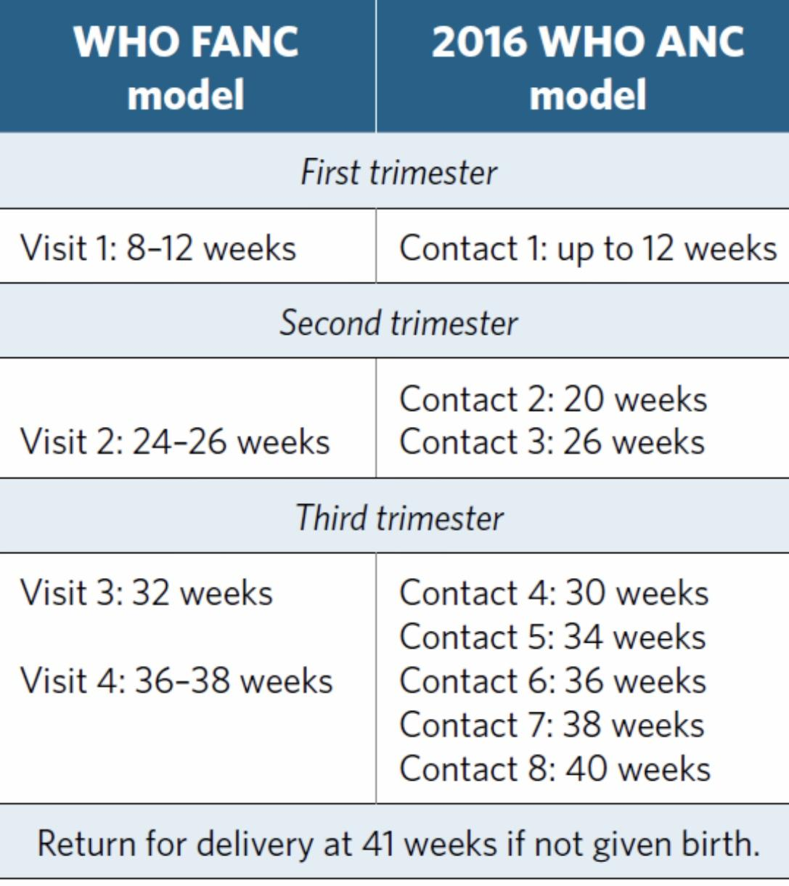
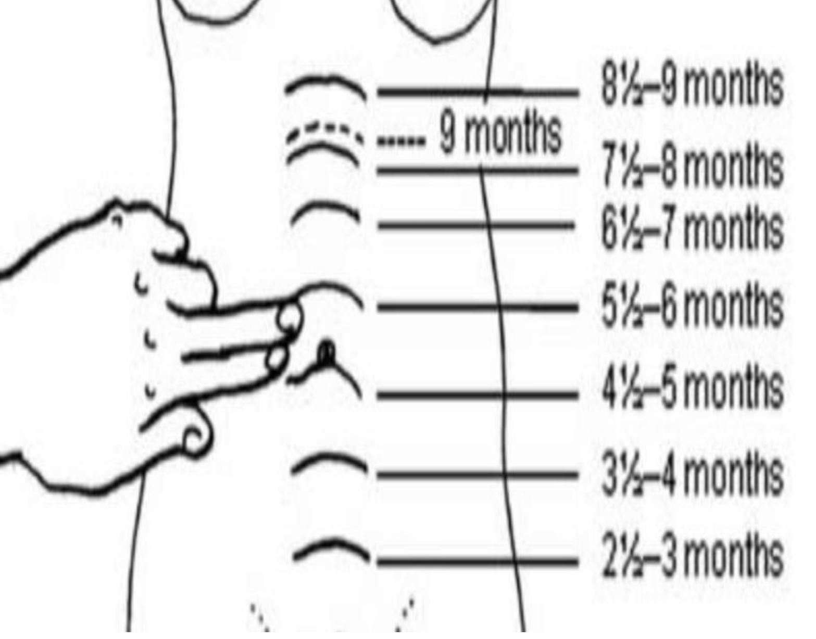
Antenatal care
2016 WHO ANC model
Why is ANC critical?
Through timely and appropriate evidence-based actions related
to health promotion, disease prevention, screening, and treatment.
Reduces complications from pregnancy and childbirth
Reduces stillbirths and perinatal deaths
Integrated care delivery throughout pregnancy
1
2
3
1
History taking (1st visit )
Confirm the pregnancy.
Any previous complications (abortions, stillbirths).
Calculate LMP (add 9 months and 7 days to the first day of menstruation).
Record symptoms; fever, vomiting, (abnormal vaginal bleeding, palpitation, easy fatigability, breathlessness, generalized swelling,)¹ burning micturition, decreased or absent fetal movements.
Any concurrent illness; asthma, heart disease, jaundice, HTN, DM, TB², HIV², STIs, thalassemia, bleeding disorders.
Family history of twins, congenital malformations.
History of drug allergies, or drugs.
2
Physical exam
General physical; pallor, pulse (N 60 – 90 mins), respiratory rate (N 18-20 breaths/min), edema (slight edema is normal, if co-existent with any diseases eg: HTN, referral).
BP (every visit)
High BP; >= 2 readings 140/90 Urine +2 albumin High BP + albuminuria = preeclampsia ---refer
Weight ; 9-11 kg during pregnancy. Approx. 2 kg /month.
Breast exam³.
3
Abdominal exam
At about three months (13-14 weeks), the top of the uterus is usually just above the mother’s pubic bone (where her pubic hair begins).
At about five months (20-22 weeks), the top of the uterus is usually right at the mother's bellybutton (umbilicus or navel).
At about eight to nine months (36-40 weeks), the top of the uterus is almost up to the bottom of the mother's ribs.
Babies may drop lower in the weeks just before birth. You can look back at Figure 7.1 in Study Session 7 to see a diagram of fundal height at various weeks of gestation.
1: All are signs of anemia
2: If the pregnant woman is HIV or TB +ve, be prepared to provide drug therapy for the newborn.
3: Checking for any abnormalities, lumps, retracted nipples.

Slide 6
4
Assessment of gestational age
Routine US + LMP (history).
Lab investigations:
Pregnancy test, Hb estimation, Urine for albumin and sugar, blood grouping, Rh factor, VDRL, HIV testing, Blood sugar, HBsAg for Hep B.
5
Ultrasound
Fetal assessment
One ultrasound scan before 24 weeks of gestation (early ultrasound) is recommended for pregnant women to estimate gestational age.
Advantages; improve detection of fetal anomalies and multiple pregnancies, reduce induction of labour for post-term pregnancy, and improve a woman’s pregnancy experience.
6
Antenatal care counseling
Nutritional recommendations:
Counselling about healthy eating and keeping physically active during pregnancy is recommended for pregnant women to stay healthy and to prevent excessive weight gain during pregnancy
Daily oral iron and folic acid supplementation with 30 mg to 60 mg of elemental iron and 400 µg (0.4 mg) of folic acid is recommended for all acid is recommended for pregnant women to prevent maternal anaemia, puerperal sepsis, low birth weight, and pregnant women with preterm birth.
Foods rich in iron; dates, green leafy vegetables, red beans, guavas, red meats
A pregnant women should avoid smoked meat to protect herself against toxoplasmosis
7
Antenatal care
Maternal assessment
Hyperglycaemia first detected at any time during pregnancy should be classified as either gestational diabetes mellitus (GDM) or diabetes mellitus in pregnancy.
Health-care providers should ask all pregnant women about their tobacco use (past and present) and exposure to second-hand smoke as early as possible in the pregnancy and at every antenatal care visit.
At every visit, history of TB, HIV, and alcohol intake should also be accessed….in high prevalence areas.

Slide 7
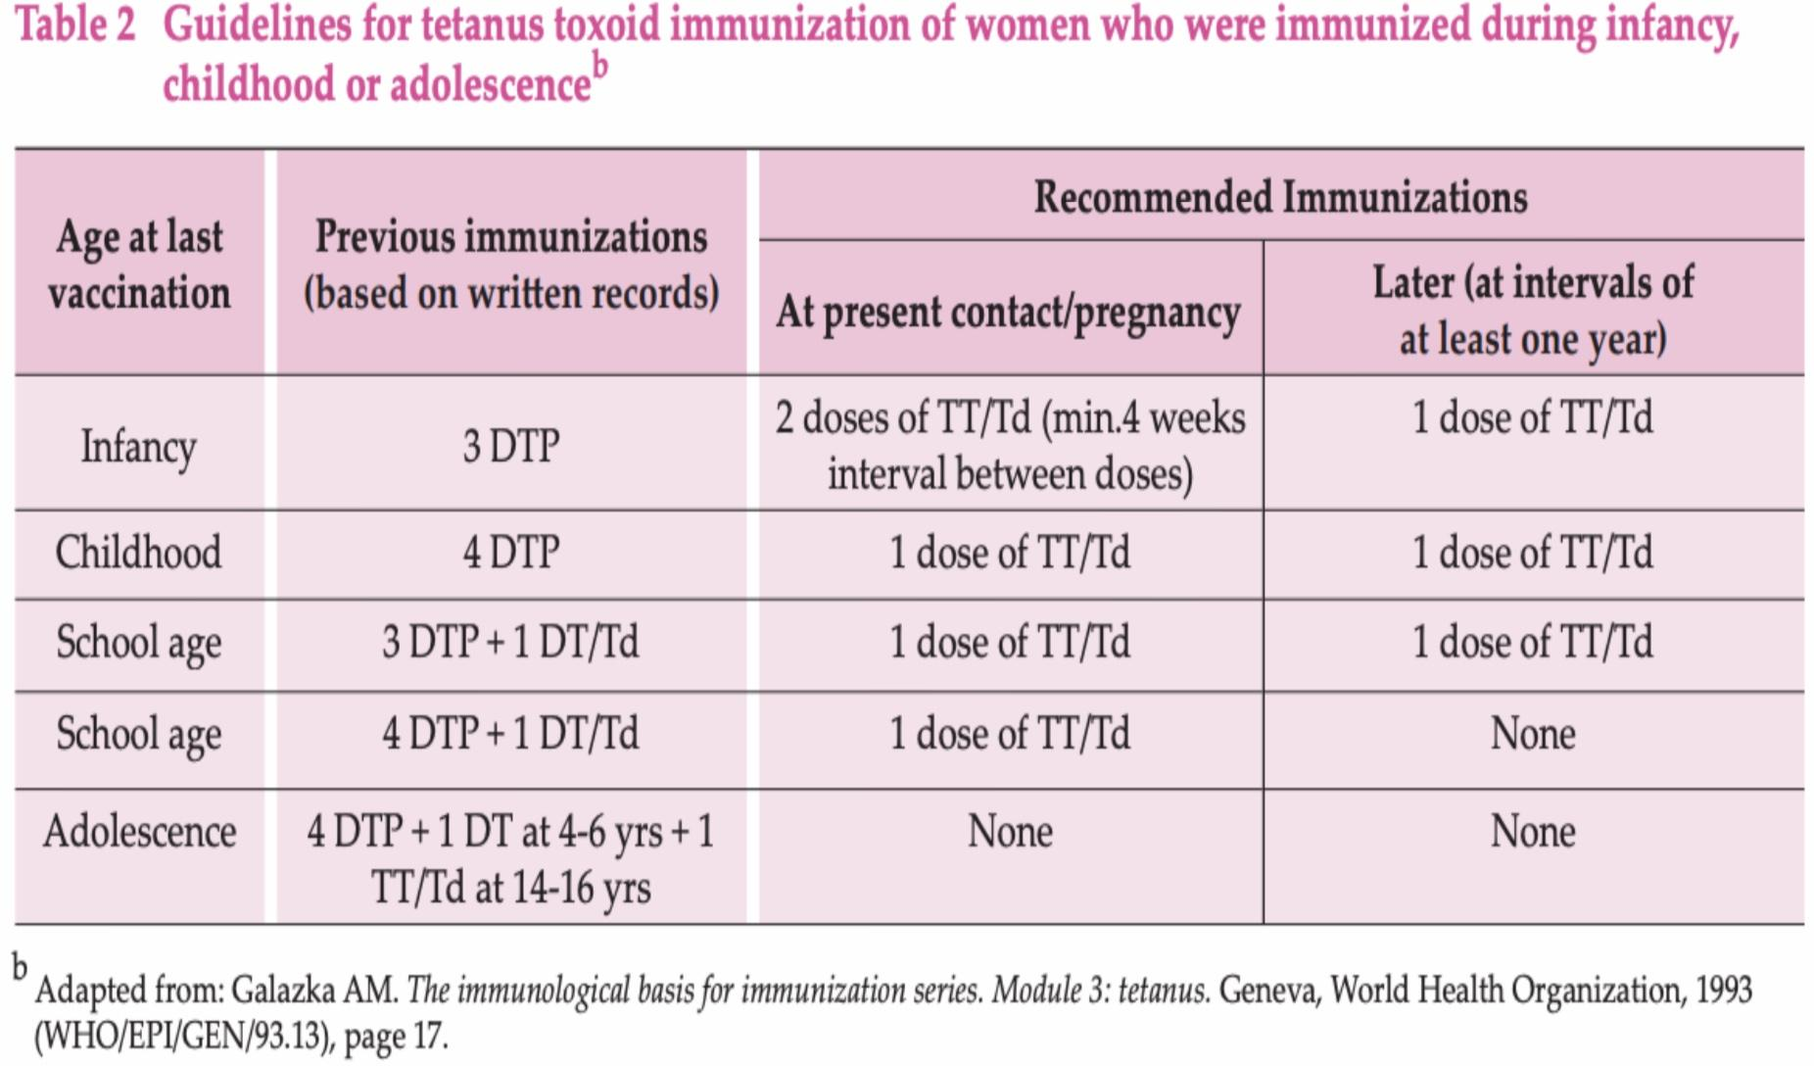
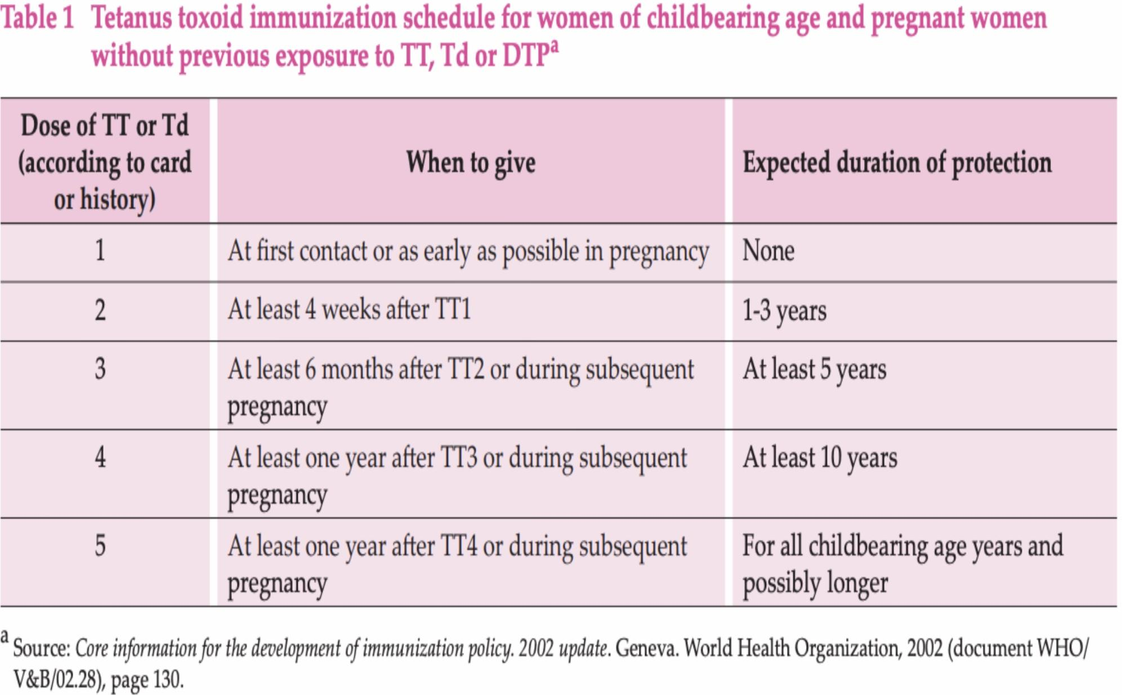
Preventive services
A seven-day antibiotic regimen is recommended for all pregnant women with asymptomatic bacteriuria (ASB) to prevent persistent bacteriuria, preterm birth and low birth weight
Tetanus toxoid vaccination is recommended for all pregnant women, depending on previous tetanus vaccination exposure, to prevent neonatal mortality from tetanus.
Tetanus vaccination
Ginger, chamomile, vitamin B6 and/or acupuncture are recommended for the relief of nausea in early pregnancy, based on a woman’s preferences and available options.
Advice on diet and lifestyle is recommended to prevent and relieve heartburn in pregnancy. Antacid preparations can be offered to women with troublesome symptoms that are not relieved by lifestyle modification.
Non-pharmacological options, such as compression stockings, leg elevation and water immersion, can be used for the management of varicose veins and oedema in pregnancy, based on a woman’s preferences and available options.
Common physiological symptoms
Magnesium, calcium or non-pharmacological treatment options can be used for the relief of leg cramps in pregnancy, based on a woman’s preferences and available options.
Wheat bran or other fibre supplements can be used to relieve constipation in pregnancy if the condition fails to respond to dietary modification, based on a woman’s preferences and available options.
Regular exercise throughout pregnancy is recommended to prevent low back and pelvic pain. There are a number of different treatment options that can be used, such as physiotherapy, support belts and acupuncture, based on a woman’s preferences and available options.

Slide 8
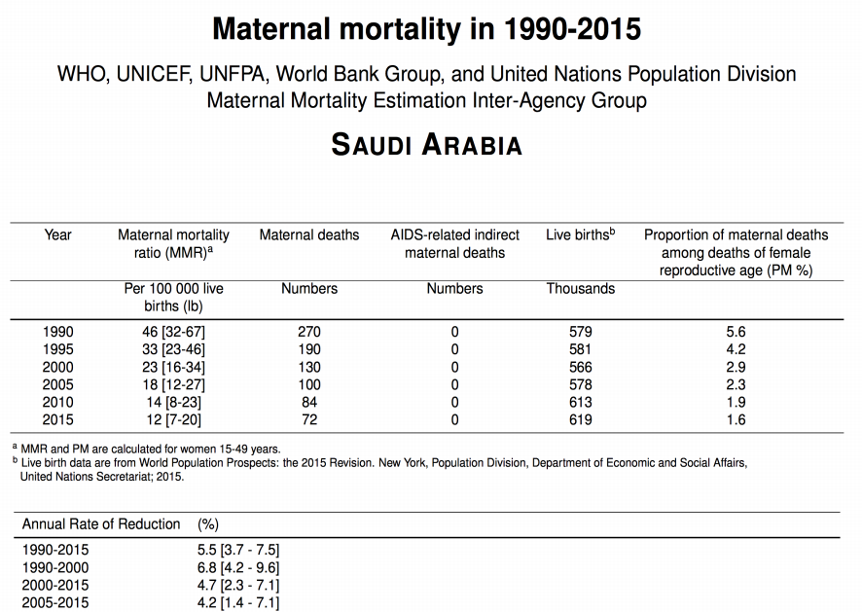
Baby friendly hospital initiative ( BFHI)
The Baby-friendly Hospital Initiative (BFHI) was launched by WHO and UNICEF in 1991.
The initiative is a global effort to implement practices that protect, promote and support breastfeeding.
Maternal mortality in KSA
MCH Indicators in KSA
Under-5 mortality rank | 141
Under-5 mortality rate (2012) | 9
Infant Mortality rate per 1000 live births (under 1), (2012) | 16.2
Annual rate of reduction (%) under-5 mortality rate, (1990-2012) | 7.7
Maternal mortality ratio (2010, adjusted) | 24
Antenatal care coverage (%) at least 1 visit, 2008 | 97
MOH- Mother and Child Health Passport Project
Launched : 14 March 2011
Provide necessary follow-up care for both mother and child by monitoring the mother's health condition during pregnancy and the child's subsequent health progress until the age of six.
Reduce both maternal and infant mortality rates.

Slide 9
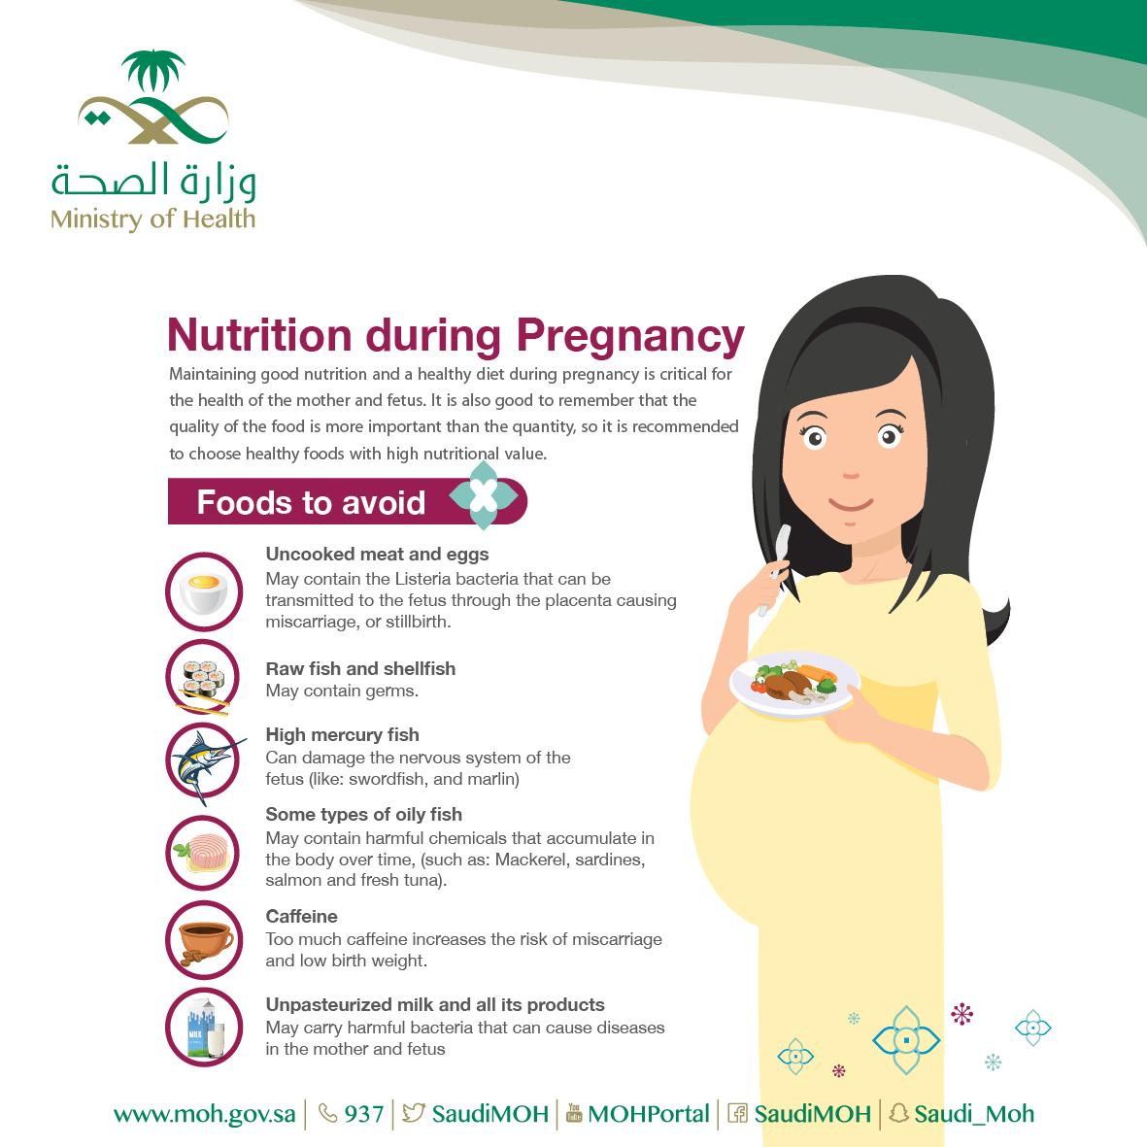
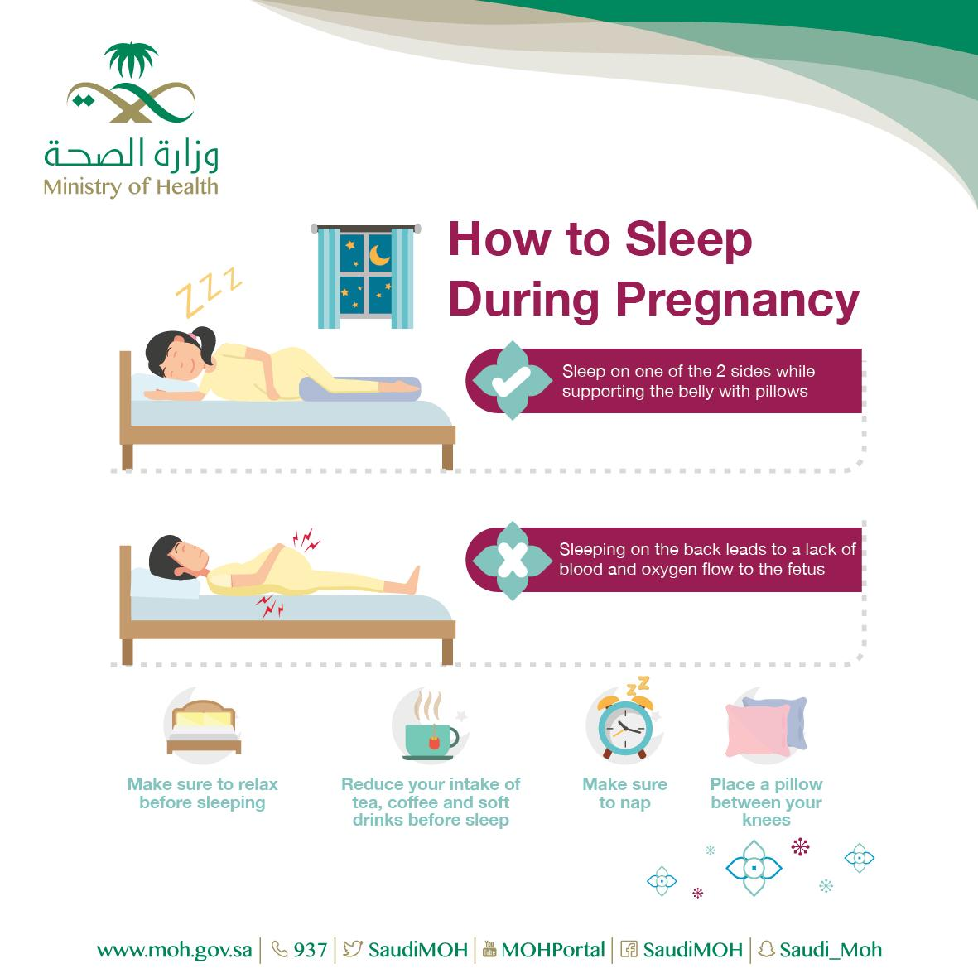
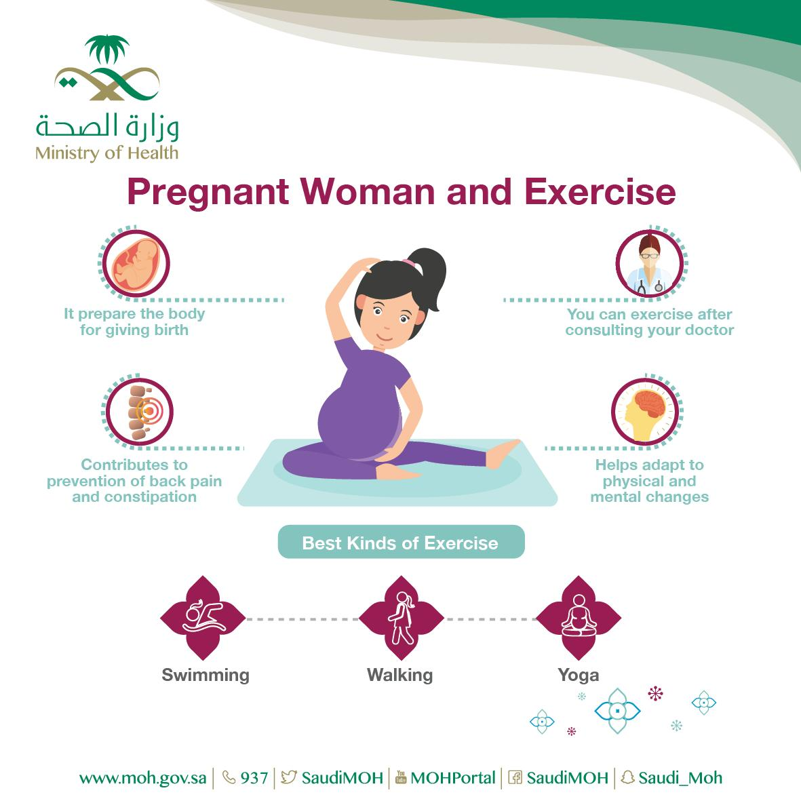
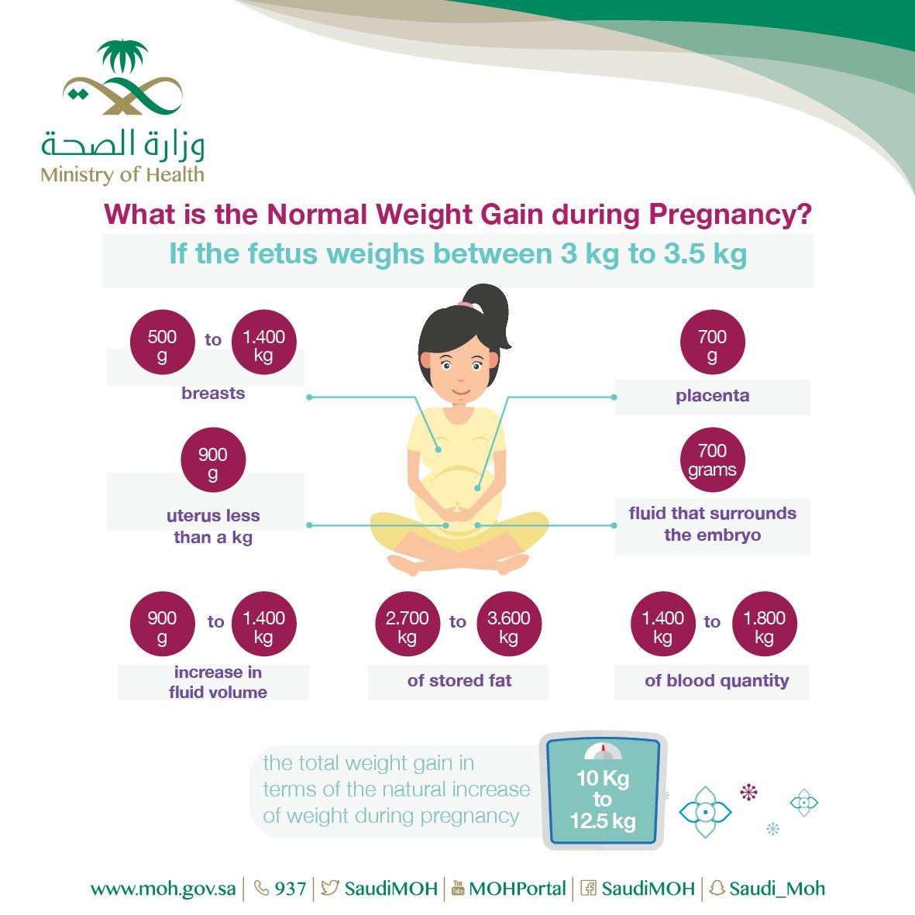
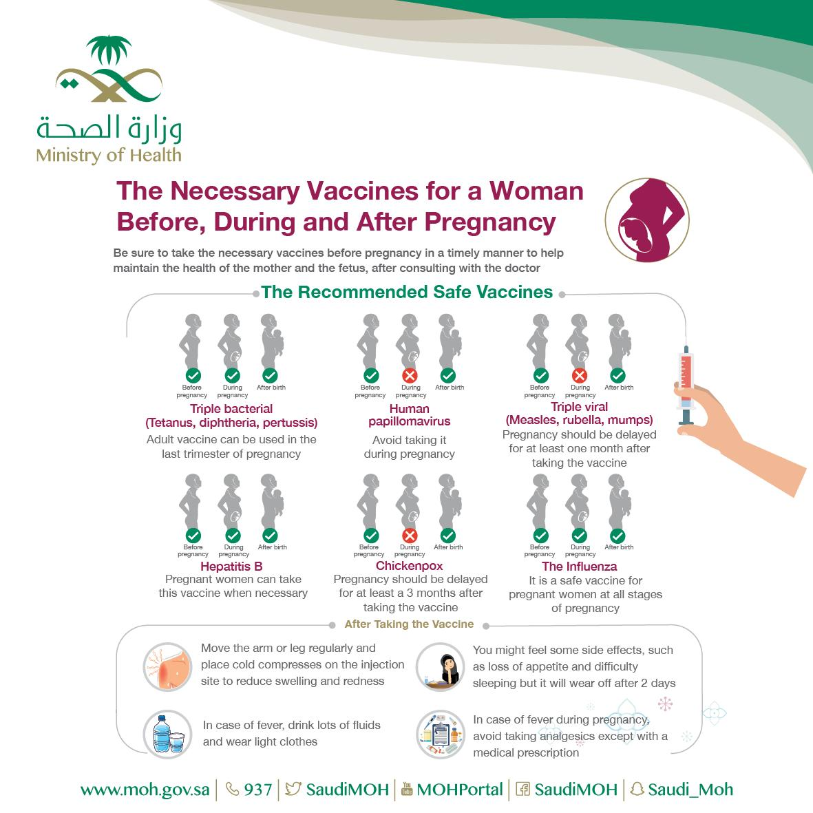
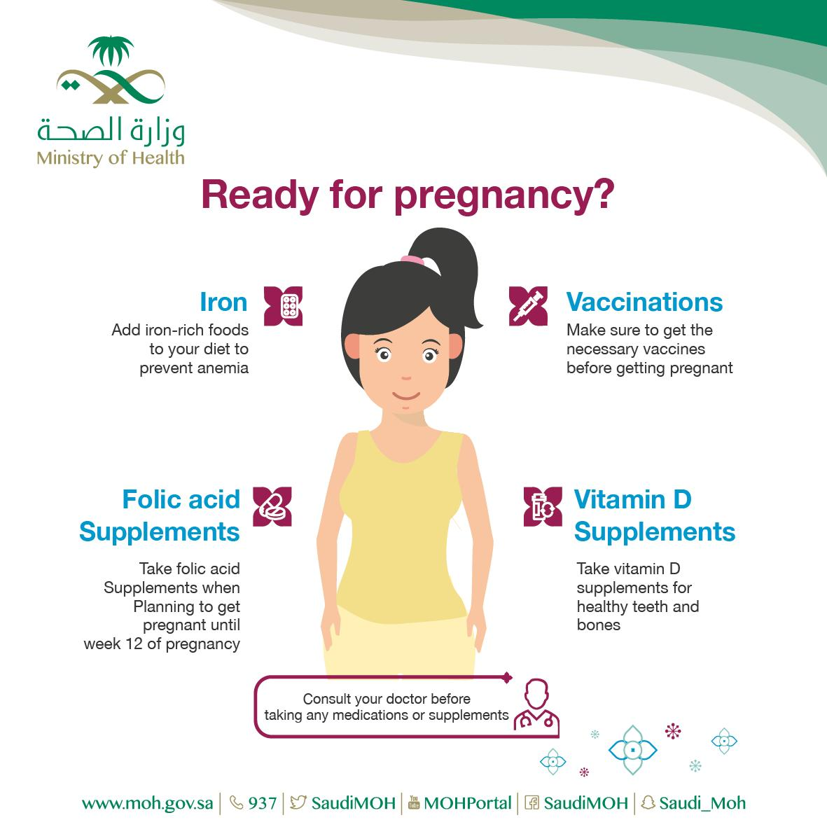
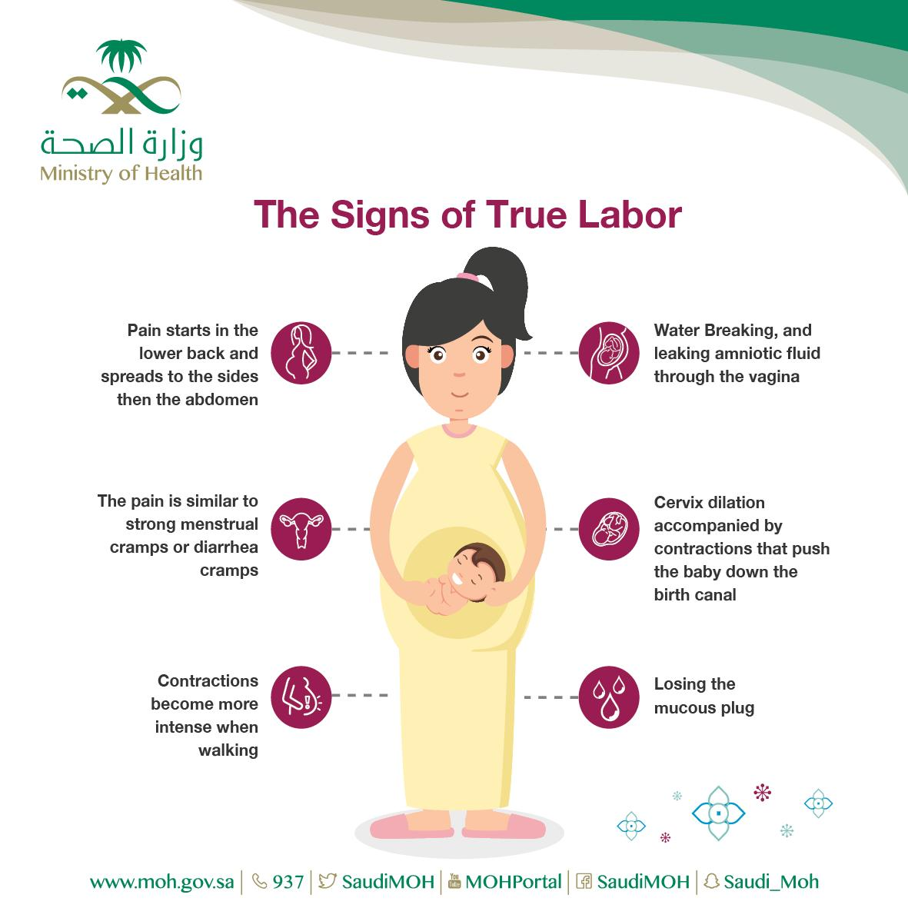
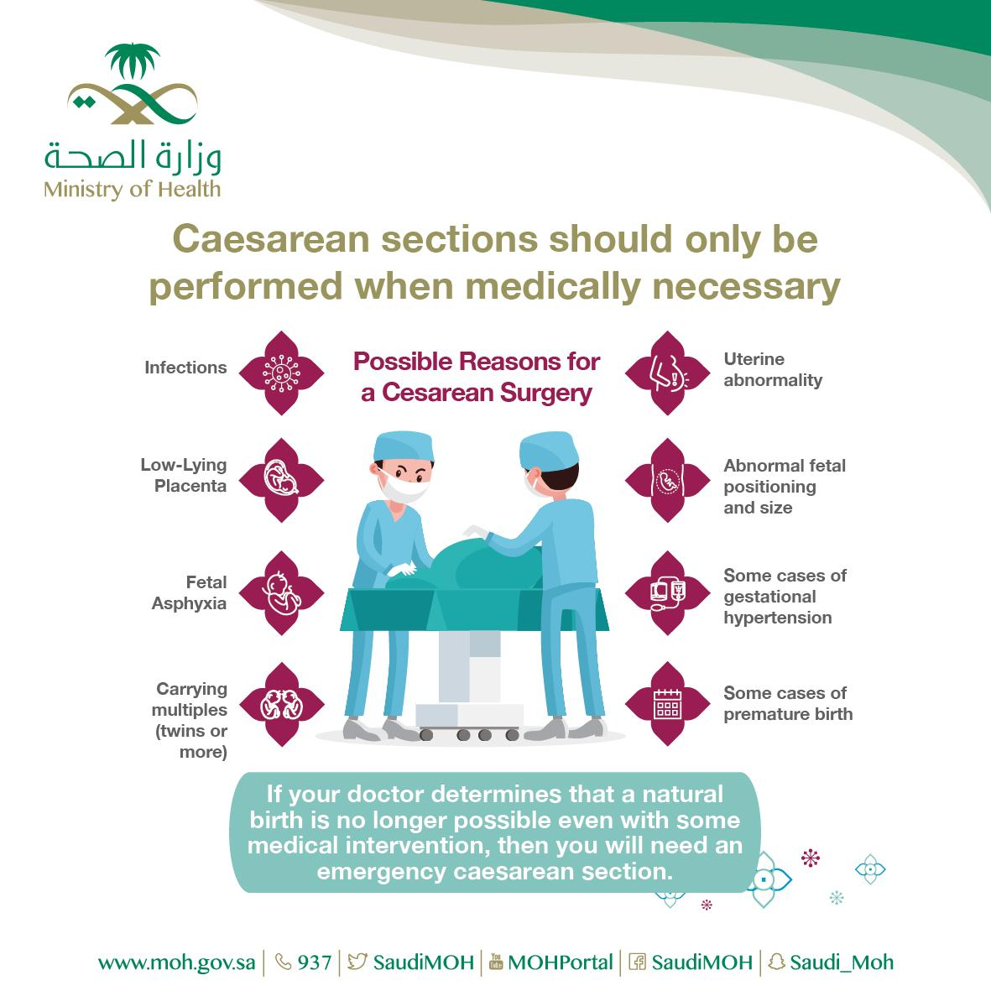
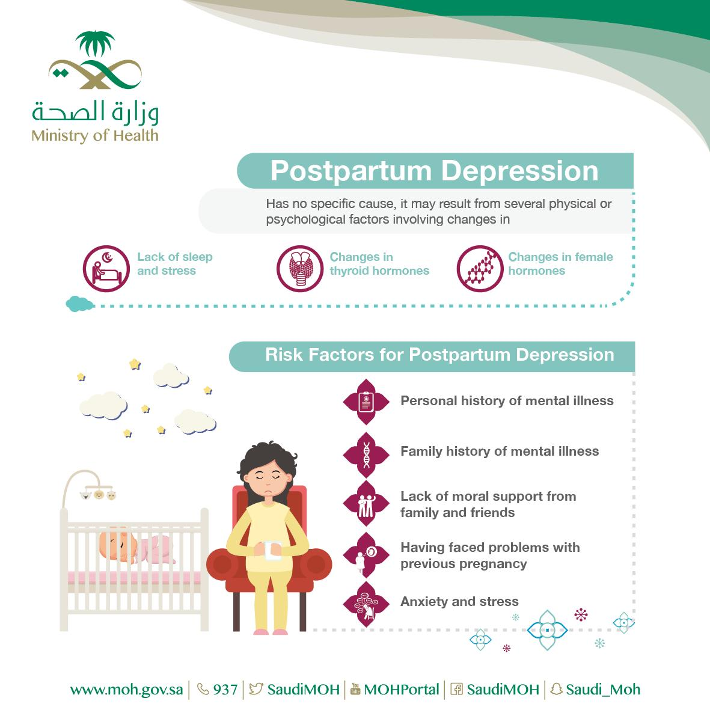
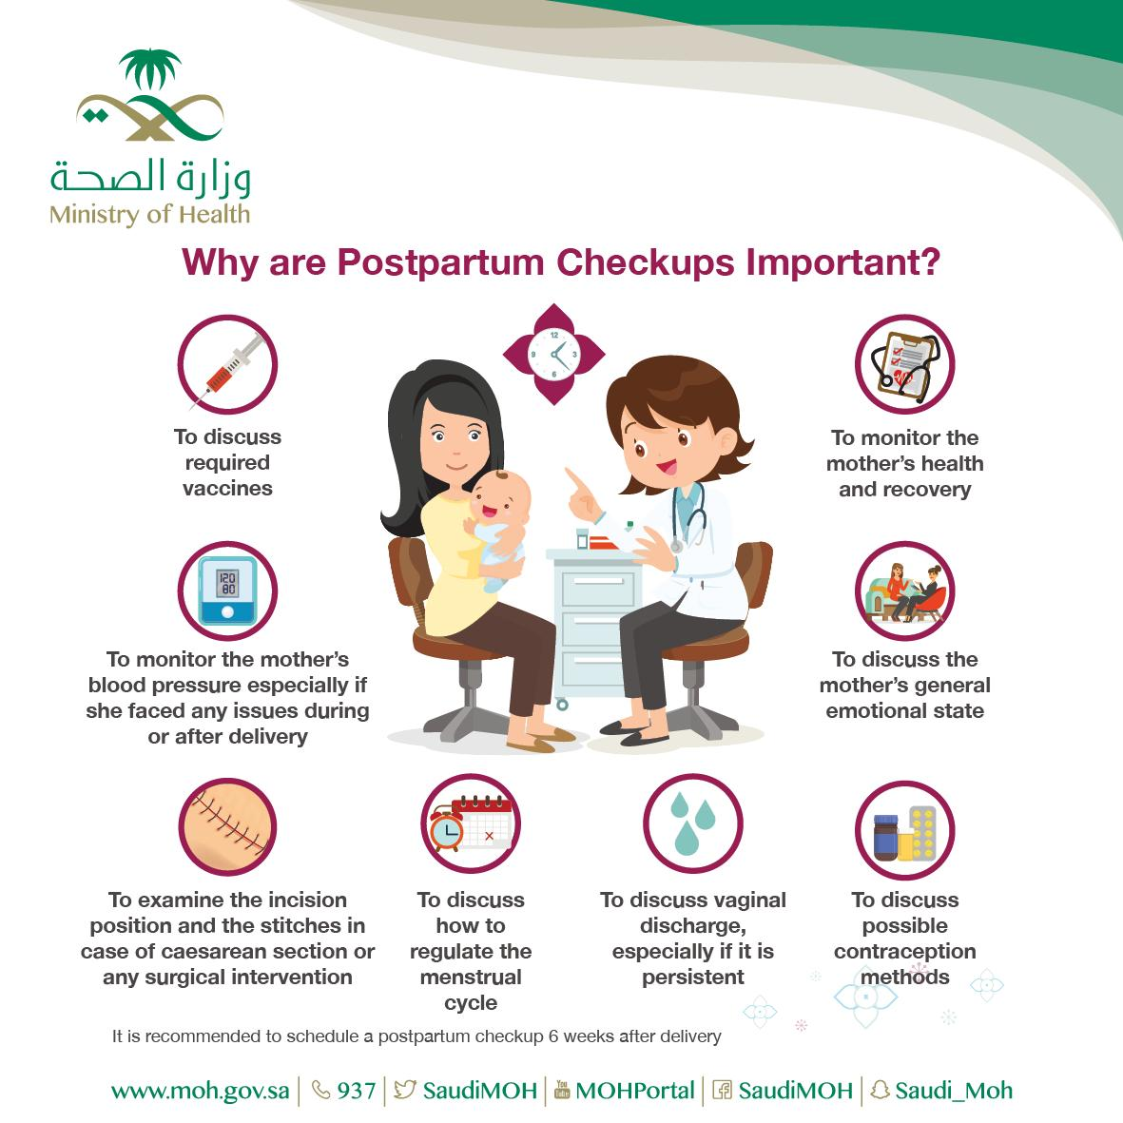
Women’s Health (Ministry of Health) Important to know
Click here to go to the MOH’s Website

Slide 10
Quiz
MCQ
1- What is the number 1 cause of maternal death?
A-unsafe abortion B. Infections C. Bleeding D. high blood pressure during pregnancy
2- Antenatal care is the best time to?
A. Advice on birth spacing B. Advice on taking thalidomide
C. Immunization to the mother only D. Advice to decrease fibers intake
3- which of the following is the definition of maternal mortality ratio?
A-number of maternal death in a given period per population of women in reproductive age
B. Number of maternal deaths per population of women at reproductive age
C. Number of maternal deaths per number of females entering their reproductive age
D. Number of maternal deaths per live births
4- What is the recommended vaccine for pregnant women?
A. Syphilis. B. Malaria. C. Tetanus. D. Rubella
5- Why is antenatal care critical?
A. Reduces complications from pregnancy and childbirth
B. Reduces stillbirths and perinatal deaths
C. Integrated care delivery throughout pregnancy
D. All of the above.
Answers
Q1 | Q2 | Q3 | Q4 | Q5
C | A | D | C | D

Slide 11
Thank You and
Good Luck
Team Leaders:
Lama AlAssiri | Mohammed AlHuqbani | Ibrahim AlDakhil
Team Members:
Lama AlZamil
Leen AlMazroa
May Babaeer
Muneera AlKhorayef
Norah AlMazrou
Nouf Alhussaini
Rema AlMutawa
Sara AlAbdulkareem
Sedra Elsirawani
Wejdan Alnufaie
Abdulrahman Alhawas
Abdulrahman Shadid
Abdullah Aldawood
Abdullah Shadid
Alwaleed Alsaleh
Bader Alshehri
Bassam Alkhuwaiter
Faisal Alqifari
Hameed M. Humaid
Khalid Alkhani
Meshari Alzeer
Mohannad Makkawi
Nayef Alsaber
Omar Aldosari
Omar Alghadir
Zyad Aldosari

