Slide 1
Principles of Immunization
Objectives
Understand the types of acquired immunity
Differentiate between the different types of vaccines used in preventing illness
Understand the type of vaccine, its mode of delivery, and schedule for important immunizable diseases; TB, Pertussis, Rubella, Diphtheria, Measles, Tetanus, Hepatitis, Meningitis, Rabies, Polio
Define and understand the cold chain and its importance
List the vaccines in the current National compulsory vaccination schedule For each disease, briefly describe epidemiology and mode of transmission To identify the type of vaccine (live vs. inactivated), and route of administration
Notes
The 3rd objective was not covered in the lecture, but it is required from us according to the doctor
This is a very important lecture
Color Index
Main text
Males slides
Females slides
Doctor notes
Important
Golden notes
Extra
Editing File

Slide 2
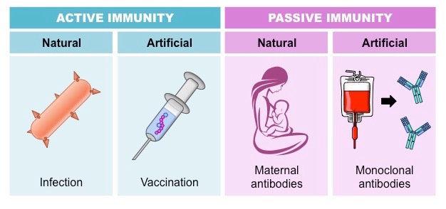
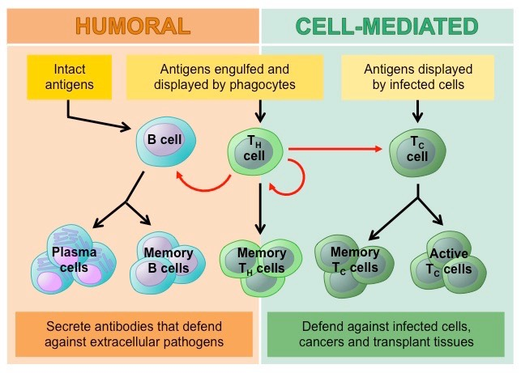
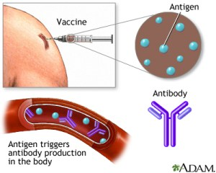
Immunity
Types of Immunity ¹
Types of Active Immunity ²
Advantages of active immunity compared to passive immunity ³:
Herd immunity (Community immunity)
Long-lasting protection
Higher protective efficacy
1
3
Severe reactions are rare
Less expensive
2
4
When vaccination ⁴ of a portion of population (or herd) provides protection to unprotected individuals. How?
Because it’ll lessen the disease prevalence, which decreases the likelihood of getting infected
Higher number of immune individuals, the lower likelihood that a susceptible person will come in contact with an infectious agent.
Provides an immunological barrier to the spread of disease in the human herd.
On-going immunization programme will keep the herd immunity at a very high level. E.g. during hajj
1- In active immunity, we introduce the antigen whether naturally (by getting infected) or artificially (by vaccination) to allow our immunity to identify the pathogen and build up memory cells for future infections.
2- Humoral immunity depends on identifying a pathogenic antigen and forming antibodies against it. For cell mediated immunity, it depends on the activation of phagocytes and other cytotoxic cells through T cells.
3- Passive immunity is the process of giving ready made antibodies whether naturally (mother to child through the placenta and breast milk) or artificially.
4- Herd immunity doesn’t only include getting vaccinated. It can also include getting infected and developing natural active immunity.

Slide 3
Vaccines and their Types
Live, attenuated vaccines
Inactivated vaccines (killed) less potency that live
Vaccine is an immuno-biological substance designed to produce specific protection against a given disease. It stimulates the production of protective antibody and other immune mechanisms. Vaccines may be prepared from live modified organisms, inactivated or killed organisms, extracted cellular fractions, toxoids or combination of these. The following are types of some vaccines:
1
Contain a version of the living ¹ virus or bacteria that has been weakened
It does not cause serious disease ² in people with healthy immune systems.
Contraindication:
immunocompromised persons (leukaemia, lymphoma or cancer)
Persons with immune deficiency disease.
Pregnancy
Example:
Viral |  | Bacterial
Measles, mumps, rubella Zoster Varicella Yellow fever | Rotavirus Influenza Oral polio (I.M. polio is killed) | Bacille Calmette-Guérin (BCG) Oral typhoid vaccine.
2
Produced by growing the bacterium or virus in culture media, then inactivating ³ it with heat and/ or chemicals (usually formalin).
Not alive and cannot replicate ⁴.
Cannot cause disease from infection, even in an immunodeficient person.
Always require multiple doses.
In general, the first dose “primes” the immune system. (also called primary response)
A protective immune response develops after the second or third dose (boosters)
Contraindication:
Severe local or general reaction to a previous dose.
Example:
Polio (injectable NOT oral), Hepatitis A, Rabies
Pertussis, Typhoid, Cholera, Plague
1- It is weakened by chemicals.
2- Produces signs and symptoms of the disease that are minimal and not dangerous. It also produces high potency of immune response against the disease.
3- This causes changes in the structure of the organism that kills it, but the pathogenic antigens are still there and an immune response can still occur.
4- Inactivated vaccines are safe for immunocompromised patients.

Slide 4
Types of Used Vaccines
Polysaccharide Vaccines (based on the preparation method)
Recombinant Vaccines
Combinations Vaccines
3
Type of inactivated subunit vaccine composed of long chains of sugar molecules
Pure polysaccharide
The immune response to a pure polysaccharide vaccine is typically T-cell independent, which means that these vaccines are able to stimulate B cells without the assistance of T-helper cells.
Example: available for three diseases: pneumococcal disease, meningococcal disease, and Salmonella Typhi. (all of them are protected by a polysaccharide capsule)
Conjugated polysaccharide
Which are polysaccharides chemically combined with a protein molecule.
Example: Haemophilus influenzae type b (Hib)
4
Vaccine antigens may also be produced by genetic engineering technology.
Four genetically engineered vaccines are currently available:
Hepatitis B
human papillomavirus (HPV)
Live typhoid vaccine (Ty21a)
Live attenuated influenza
If more than one kind of immunizing agent is included in the vaccine it is called a mixed or combined vaccine
The Aims of combined vaccines are to:
Simplify administration
Reduce costs
Minimize the number of contacts of the patient with the health system
Reducing the storage cost
Usually does not increase the risk ¹ of adverse reactions
Example:
DPT (Diphtheria-pertussis-tetanus)
MMR (Measles, mumps and rubella)
DPTP (DPT plus inactivated polio)
DPT-Hep B-Hib ² (Diphtheria, pertussis, tetanus, hepatitis B & haemophilus influenza type B)
1- You can assure the patient that combined vaccines don’t increase the risk for adverse reactions neither do they carry a decrease in efficacy nor potency
2- Pentavalent vaccine

Slide 5
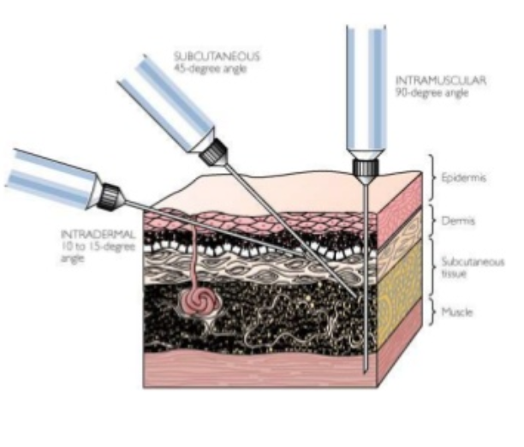
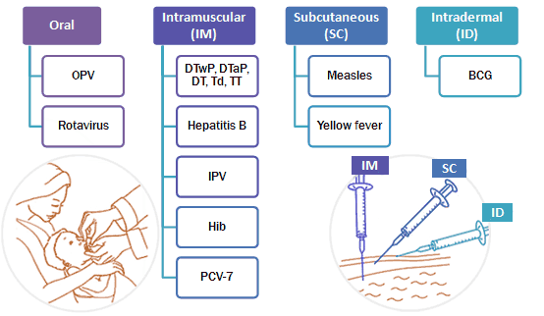
Routes of Vaccines Administration
The route of administration ¹ is the path by which a vaccine is brought into contact with the body.
This is a critical factor for success of the immunization
Routes:
Intramuscular route
Subcutaneous route
Intradermal route ²
Oral route ³
Subcutaneous
45 degrees angle
Intramuscular
90 degrees angle
Intradermal
10 -15 degrees angle
Epidermis
Dermis
Subcutaneous tissue
Muscle
Route of Administration
Oral administration | Intradermal injection | Subcutaneous injection | Intramuscular injection ⁴
• Oral administration of vaccine makes immunization easier by eliminating the need for a needle and syringe. | • Administers the vaccine in the topmost layer of the skin. • BCG is the only vaccine with this route of administration. • Intradermal injection of BCG vaccine reduces the risk of neurovascular injury | • Administers the vaccine into the subcutaneous layer above the muscle and below the skin | • Administers the vaccine into the muscle mass. • Vaccines containing adjuvants ⁵ should be injected IM to reduce adverse local effects.
1- We never give vaccines IV
2- Only BCG, because it can injure the nerves
3- Mainly polio and rotavirus
4- It is the most common route of administration. In adults, shots are usually given through the deltoid muscle while in children it’s more common to be given in the thigh
5- Sometimes a substance is added to a vaccine to enhance the immune response by degree and/or duration, making it possible to reduce the amount of immunogen per dose or the total number of doses needed to achieve immunity. The commonly used adjuvant are aluminium salts

Slide 6
Types of Vaccines Vials
Immunization Schedules
National Immunization Schedule ³
Single-Dose Vials ¹ | A single-dose vial (SDV) contains one dose and should be used one time for one patient. SDVs do not contain preservatives to help prevent microorganism growth.
Multidose Vials ² | A multidose vial (MDV) contains more than one dose of vaccine. MDVs typically contain a preservative to help prevent the growth of microorganisms, they can be entered or punctured more than once. Only the number of doses indicated in the manufacturer’s package insert should be withdrawn from the vial. After the maximum number of doses have been withdrawn, the vial should be discarded, even if there is residual vaccine or the expiration date has not been
Manufacturer-Filled Syringes | A manufacturer-filled syringe (MFS) is prepared and sealed under sterile conditions by the manufacturer. Activate an MFS (i.e., remove the syringe cap or attach the needle) only when ready to use. An MFS does not contain a preservative to help prevent the growth of microorganisms. Once the sterile seal has been broken, the vaccine should be used or discarded by the end of the workday.
Each country determines its own immunization schedule and chooses vaccine presentations.
Health workers should always refer to their national schedules and vaccine handling instructions when providing immunization services.
1- Whenever we open it we need to discard it by the end of the day
2- Can be used for multiple people
3- It is very important to memorize every vaccine and when should it be given for both MCQs and OSCEs. This immunization schedule was updated this year. Changes include postponing BCG vaccine till the 6th month to avoid serious rxns in immunodeficient infants. They also added new vaccines from the age of 11 and onward.

Slide 7
Vaccines
Disease | Vaccine | Dose/Route of administration | Timing | Side effects
Tuberculosis | Bacille Calmette-Guérin (BCG) | 0.05 ml Intradermal | At 6 months | Severe: generalized disease or infections such as osteomyelitis (bone infection); abscess; regional lymphadenitis (lymph node inflammation) Mild: injection site reactions & fever
Hepatitis B | Monovalent (HepB) Pentavalent: with Diphtheria, tetanus, pertussis, and Haemophilus influenzae type b Quadrivalent: DTP+HepB | 0.5 ml Intramuscularly | At birth 2, 4, 6 months | Severe: rare anaphylaxis Mild: injection site reactions (pain, redness, swelling); headache; fever
Diphtheria | (DT/ dT) with tetanus (DTP) with tetanus and pertussis Pentavalent: with tetanus, pertussis, hepatitis B and Haemophilus influenzae type b | 0.5 ml Intramuscularly | 2, 4, 6, 18 months and 4- 6 years | Severe adverse events due to diphtheria toxoid alone have not been reported Mild: injection site reactions, fever
Pertussis | Trivalent (DTP) with tetanus and diphtheria Pentavalent: with tetanus, diphtheria, hepatitis B and Haemophilus influenzae type b | 0.5 ml Intramuscularly | 2, 4, 6, 18 months and 4- 6 years | Severe: rare anaphylaxis, hypotonic– hyporesponsive episodes (loss of muscle tone & responsiveness/ consciousness); febrile seizures; prolonged crying. Mild: injection site reactions (pain, redness, swelling); fever and agitation
Tetanus Recommended during pregnancy | Monovalent (TT) Divalent (DT/ dT) with diphtheria Trivalent (DTP) Pentavalent: with diphtheria, pertussis, hepatitis B and Haemophilus influenzae type b | 0.5 ml Intramuscularly | 2, 4, 6, 18 months and 4- 6 years | Severe: rare anaphylaxis, brachial neuritis Mild: injection site reactions and fever
Haemophilus influenzae type b (Hib) | Monovalent Hib Pentavalent: with diphtheria, tetanus, pertussis and hepatitis B | 0.5 ml Intramuscularly | 2, 4, 6, 18 months | Severe: none reported to date Mild: injection site reactions, fever
Measles | Monovalent Measles only (M) Divalent with rubella (MR) Trivalent with mumps/ rubella (MM, MMR) Quadrivalent with varicella (MMRV) | 0.5 ml Subcutaneous | 9, 12, 18 months and 4-6 years | Severe: thrombocytopenia, anaphylaxis, encephalitis Mild: fever, rash 5–12 days following administration
Mumps Contradicted during pregnancy | (MMR) | 0.5 ml Subcutaneous | 12, 18 months and 4-6 years | Serious: aseptic meningitis (with some strains); orchitis (inflammation of the testicles); sensorineural deafness; acute myositis Mild: injection site reactions; parotid swelling

Slide 8
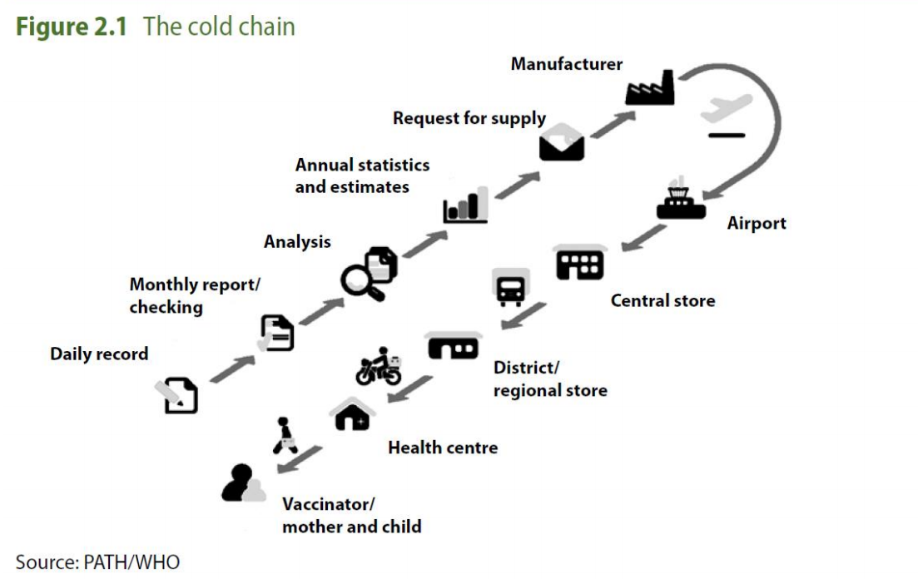
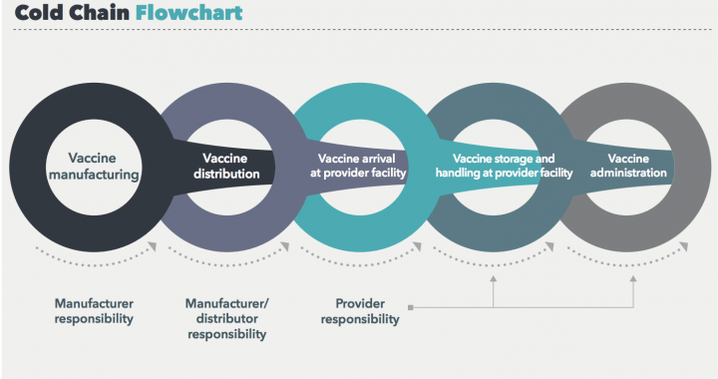
Vaccines Safety and Efficacy
Why proper vaccine storage and handling are important? ¹
Disease | Vaccine | Dose/Route of administration | Timing | Side effects
Rubella | (MR)→with Measles (MMR) →with mumps/measles | 0.5 ml Subcutaneous | 12, 18 months and 4-6 years | Mild: injection site reactions
Meningococcal disease | Quadrivalent Meningococcal conjugate (A,C,W135,Y-D) | 0.5 ml Subcutaneous | 9 and 12 Months | Severe: rare anaphylaxis Mild: injection site reaction, fever
Pneumococcal disease | PCVs | 0.5 ml Intramuscular | 2, 4, 6 and 12 months | Severe: none known Mild: injection site reactions and fever
Poliomyelitis | OPV/ IPV | OPV→2 drops orally IPV→ 0.5 ml intramuscularly | 2, 4, 6, 12,18 months and 4-6 years | OPV – Rare vaccine associated paralytic polio (VAPP) IPV – No known serious reactions; mild injection site reactions do occur
Rotavirus gastroenteritis | RV→Monovalent RV,Rotarix | 1.5 ml of liquid Oral | 2 and 4 months | Severe: intussusception Mild: irritability, runny nose, ear infection, diarrhoea, vomiting
AS an immunization provider, you play a key role in helping to ensure the safety and efficacy of vaccines through proper:
Vaccine storage and handling
Vaccine administration (considered a medical error)
Timing and spacing of vaccine
Observation of precautions and contraindications (needs to be reported)
Management of suspected side effects (life support equipments must be there)
Reporting of suspected side effects (need to be reported)
Communication about vaccine benefits and risks
Proper storage and handling begin with an effective vaccine cold chain ²
Stored in refrigerator
Ex: Middle east distributor
1- In general all vaccines must be stored under the conditions recommended by the manufacturer in the literature accompanying the vaccine, otherwise they may become denatured and totally ineffective. Vaccines must be protected from sunlight and prevented from contact with antiseptics.
2- The "cold chain" is a system of storage and transport of vaccines at low temperature from the manufacturer to the actual vaccination site. The cold chain system is necessary because vaccine failure may occur due to failure to store and transport under strict temperature controls. This is of concern in view of the fairly frequent reports of vaccine preventable disease occurrence in populations thought to have been well immunized. In other words - the success of national immunization programme is highly dependant on supply chain system for delivery of vaccines and equipment, with a functional system.

Slide 9
Cold Chain
Purpose of the vaccine “cold chain”
Vaccine Storage
A temperature-controlled supply chain that includes all vaccine- related equipment and procedures.
It begins with the cold storage unit at the manufacturing plant, extends to the transport and delivery of the vaccine and correct storage at the provider facility (clinic), and ends with administration of the vaccine to the patient.
Vaccines are sensitive biological products. Some vaccines are sensitive to freezing, some to heat and others to light. If not maintained, vaccine potency may be lost, resulting in a useless vaccine supply.
Potency is reduced every time a vaccine is exposed to an improper condition. (This includes overexposure to heat ¹, cold, or light at any step in the cold chain). Once lost, potency cannot be restored.
Vaccines that are as sensitive to light as they are to heat include BCG, measles, measles-rubella, measles-mumps-rubella and rubella.
These vaccines are often supplied in dark glass vials that give them some protection from light damage; but they should be kept in their secondary packaging for as long as possible to protect them during storage and transportation
To maintain product quality from the time of manufacture until the point of administration by ensuring that vaccines are stored and transported within WHO-recommended temperatures ranges.
Carefully select and use the proper vaccine storage units to store vaccines.
Rotate vaccine stock so the oldest vaccines are used first.
Store vaccines in their original packaging with lids closed until ready for administration.
Have a properly calibrated thermometer or temperature recording device inside each storage compartment.
Check and record storage unit minimum and maximum temperatures at the start of each workday.
1- Among the vaccines, polio is the most sensitive to heat, requiring storage at minus 20 degree C. Vaccines which must be stored in the freezer compartment are : polio and measles.

Slide 10
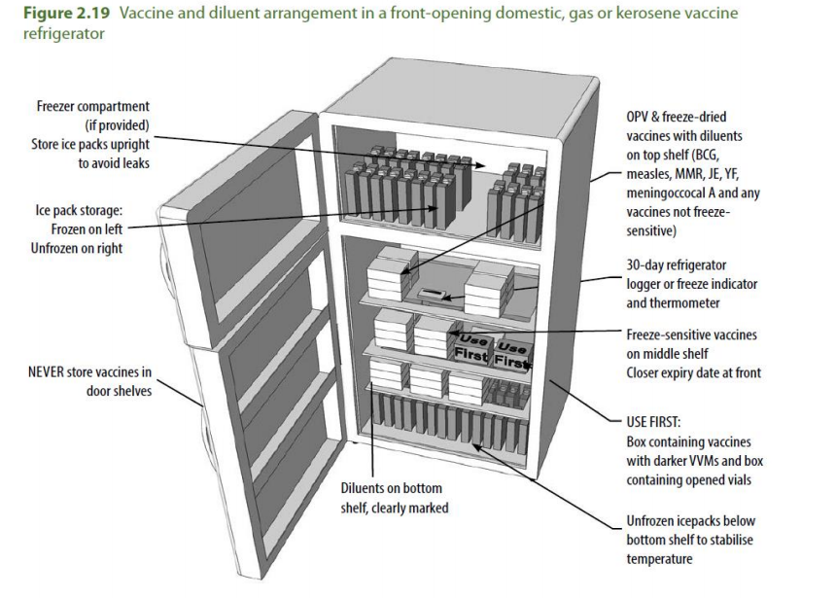
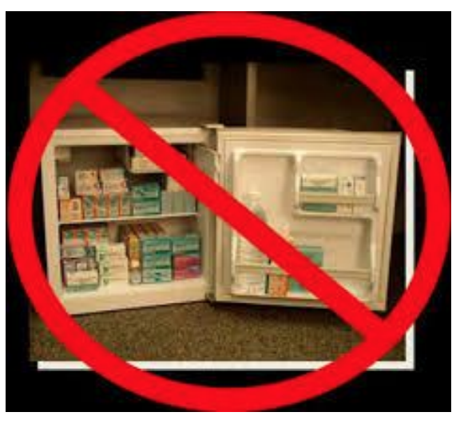
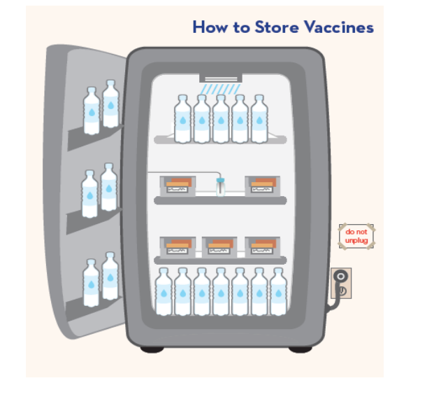
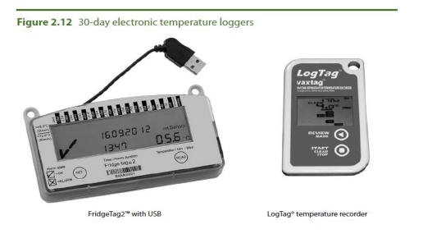
Refrigerator and Freezer Recommendations
Temperature Monitoring Devices (TMD)
Vaccine Organizing and Storing
There are several types of vaccine storage units available. ¹
Purpose-built units are specifically designed to store vaccines. It’s ok to store other things but they have to be in the lower shelf
Place water bottles or ice packs on the top shelf and floor and in the door racks.
Putting water bottles in the unit can help maintain stable temperatures caused by frequently opening and closing unit doors or a power failure.
This is not acceptable because there is a freezer on the top, making the temperature not well controlled
Every vaccine storage unit must have a Temperature monitoring devices (TMD).
An accurate temperature history that reflects actual vaccine temperatures is critical for protecting your vaccines.
There are several types of (TMD).
To confirm vaccines are stored correctly and to minimize the risk of administration errors, implement the following practices:
Store each type of vaccine or diluent in its original packaging and in a separate container.
Position vaccines and diluents two to three inches from the unit walls, ceiling, floor, and door.
Whenever possible, store diluent with the corresponding refrigerated vaccine. Never store diluent in a freezer.
Avoid placing or storing any items other than vaccines, diluents, and water bottles inside storage units.
If other medications and biological products must be stored in the same unit as vaccines, they must be clearly marked and stored in separate containers or bins from vaccines.
Potentially contaminated items (e.g., blood, urine, stool) should be properly contained and stored below vaccines due to risk of contamination from drips or leaks.
Arrange vaccines and diluents in rows and allow space between them to promote air circulation.
1- Is it ok to use conventional refrigerator if a medical one is not available? yes

Slide 11
Extra
This was part of the objectives
Disease | Mode of Transmission | Vaccine
Tuberculosis | Tuberculosis is transmitted mainly by droplet infection and droplet nuclei generated by sputum-positive patients with pulmonary tuberculosis. | Live Attenuated Vaccine (LAV)
Pertussis (Whooping cough) | Whooping cough is spread mainly by droplet infection and direct contact. | Inactivated Vaccine
Rubella | The virus is transmitted directly from person to person by droplets from nose and throat, and droplet nuclei (aerosols) | Live Attenuated Vaccine (LAV)
Diphtheria | The disease is spread mainly by droplet infection. It can also be transmitted directly to susceptible persons from infected cutaneous lesions. | Inactivated Vaccine
Measles | Transmission occurs directly from person to person mainly by droplet infection and droplet nuclei | Live Attenuated Vaccine (LAV)
Tetanus | Infection is acquired by contamination of wounds with tetanus spores. | Tetanus Toxoid (TT)
Hepatitis | Hepatitis A can be transmitted through fecal oral route, parenteral route and sexual transmission. Hepatitis B can be transmitted through parenteral route, perinatal route and sexual transmission. | Hepatitis A - Inactivated Vaccine Hepatitis B - Recombinant Vaccine
Meningitis (Meningococcal) | The disease spreads mainly by droplet infection. The portal of entry is the nasopharynx. | Polysaccharide vaccine
Rabies | People are infected following a deep bite or scratch by an infected animal. Dogs are the main host and transmitter of rabies. | purified· cell-culture vaccine (CCV) embryonated egg-based vaccine (EEV)
Polio | Fecal oral route through contamination and poor hygiene. It can also be transmitted through droplets in its acute phase | OPV (oral) - Live Attenuated Vaccine (LAV) IPV (IM) - Inactivated vaccine

Slide 12
Quiz
MCQ
1. A 2-year-old child presents to the pediatrician’s office for a rash. Her mother is against vaccines, so the child had not received any childhood vaccines. Her father, however, is worried about her lack of vaccination. On physical exam, she has a high fever as well as a confluent maculopapular rash. She also has blue-white spots on her buccal mucosa. An initial diagnosis of “Measles” was made. The family is instructed to take isolation precautions and to bring in the child’s siblings who are also unvaccinated. What type of vaccines does Measles has?
Inactivated Vaccine
Polysaccharide Vaccine
Live Attenuated Vaccine
Recombinant Vaccine
2. Which of the following is an example of “Live attenuated vaccines”?
Injectable Polio
Hepatitis A
Rabies
BCG
3. Which of the following vaccines is expected to be given to a 6 months old girl?
BCG Vaccine
Hepatitis A Vaccine
MMR Vaccine
HPV Vaccine
4. Which of the following vaccine is the only vaccine administered intradermally?
BCG
Hepatitis A
Rabies
MMR
5. A 40-year-old man presents to the primary care physician after 3 weeks of a dry cough. He reports that he occasionally vomits after an episode of coughing and he hears “whoops” during some episodes. His childhood immunization history is incomplete, and the patient states not having had any immunizations in the past 20 years. A special nasopharyngeal swab is sent for analysis and antibiotics are given. Which of the following vaccines is most likely missed?
DPT Vaccine
MMR Vaccine
Pfizer Covid-19 Vaccine
OPV
Answers
Q1 | Q2 | Q3 | Q4 | Q5
C | D | A | A | A

Slide 13
Thank You and
Good Luck
Team Leaders:
Lama AlAssiri | Mohammed AlHuqbani | Ibrahim AlDakhil
Team Members:
Lama AlZamil
Leen AlMazroa
May Babaeer
Muneera AlKhorayef
Norah AlMazrou
Nouf Alhussaini
Rema AlMutawa
Sara AlAbdulkareem
Sedra Elsirawani
Wejdan Alnufaie
Abdulrahman Alhawas
Abdulrahman Shadid
Abdullah Aldawood
Abdullah Shadid
Alwaleed Alsaleh
Bader Alshehri
Bassam Alkhuwaiter
Faisal Alqifari
Hameed M. Humaid
Khalid Alkhani
Meshari Alzeer
Mohannad Makkawi
Nayef Alsaber
Omar Aldosari
Omar Alghadir
Zyad Aldosari

