Slide 1
Global Adolescent &
Child Health
Objectives
Understand the adolescent and child health issues globally and the burden of diseases in this age group
Discuss major global interventions that are to address mortality and morbidity in adolescent and children.
Discuss and understand what preventive services for adolescent, and child health are delivered in KSA
Color Index
Main text
Males slides
Females slides
Doctor notes
Important
Golden notes
Extra
Editing File

Slide 2
What do we mean by the term ‘adolescents’?
The second decade: No longer children, not yet adults!
The definition vary from country to country and from law to law
WHO has three definitions. The first is adolescence from 10 - 19, 'Youth' from 15-24 , and 'Young People' covers the age range 10-24 years.
CDC immunization schedule: 7th till 19th birthday
Society of adolescent medicine: 10-25
Saudi Arabia, Middle East? unfortunately by law there is no segregation of this age group in saudi arabia nor in the middle east, so we rely on international classification
Lost population? They need more care because they feel lost
No one wants to care for them?
Healthy ?
Developmentally challenging?
Difficult to deal with?
Physiology of puberty
Adolescents are a diverse population group
Different needs
Changing needs
Why do we emphasize on this age group? because this age group is going in to a rapid change; physiological, psychological, mental and emotional changes.
We also have to appreciate that they need are different and keep change because there is a transition from childhood to adolescence and then from adolescence to adulthood
What is special about adolescence?
(What makes it different from childhood & adulthood?)
A time of rapid physical and psychological (cognitive and emotional) growth and development.
A time in which new capacities are developed.
A time of changing social relationships, expectations, roles and responsibilities.
This age group experience new challenges, develop new capacities and new habits they are semi exposed to the word and therefore it is very very critical the environment that is provided to this population is control environment otherwise they can end up developing risky behavior

Slide 3
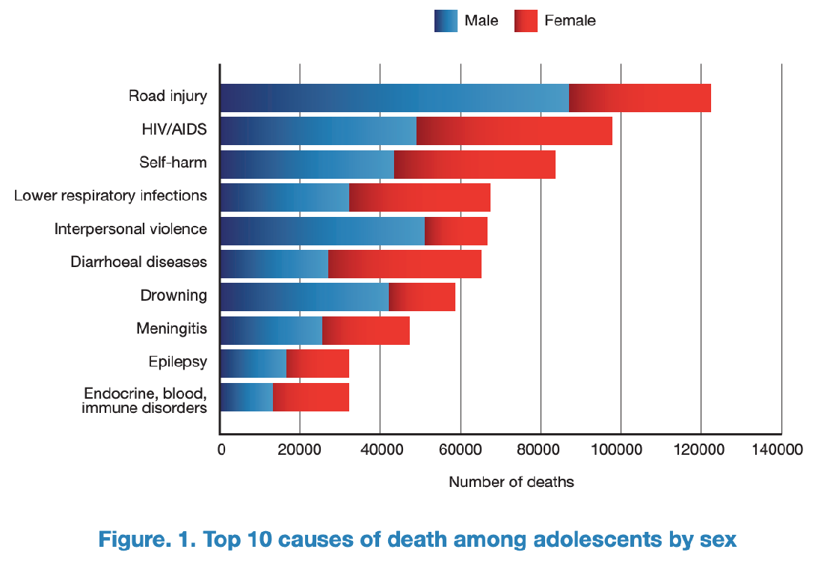
Main health problems of adolescents ?
Studies suggests that depression and anxiety are one of the main problems in this age group
Technology use and sedentary lifestyles increase the risk for obesity
The most common cause of death is “Road Injury”
Third is self harm, self harm by poisoning, sharp instruments, medication overdose. This can be grouped with other causes into mental health issues leading to suicide.
Top causes of illness and disability:
Depression
6
Back and neck pain
1
Road traffic injuries
7
Diarrhoea
2
Anaemia
8
Anxiety disorders
3
HIV/AIDS
9
Asthma
4
Self-harm
10
Lower respiratory infections
5
Key health problems in adolescence:
Sexual & Reproductive Health
pic
Other issues
Too early pregnancy
risks to mother
risks to baby
Health problems during pregnancy & childbirth (including unsafe abortion)
Sexually Transmitted Infections including HIV
Harmful traditional practices e.g. female genital mutilation
Sexual coercion
Injuries from accidents & intentional violence
Mental health problems
Substance use problems
Endemic diseases: malaria, schistosomiasis, tuberculosis
Under/over-nutrition
If a girl got pregnant at an early age her body may not be physically mature enough to tolerate the 9 months period of pregnancy, which might predispose the mother to various health issues including malnutrition which is linked to high infant mortality rate
Moreover unsafe deliveries and abortion done in facilities that aren’t qualified enough may cause the mother to get infected with tetanus, which can also kill the baby.

Slide 4
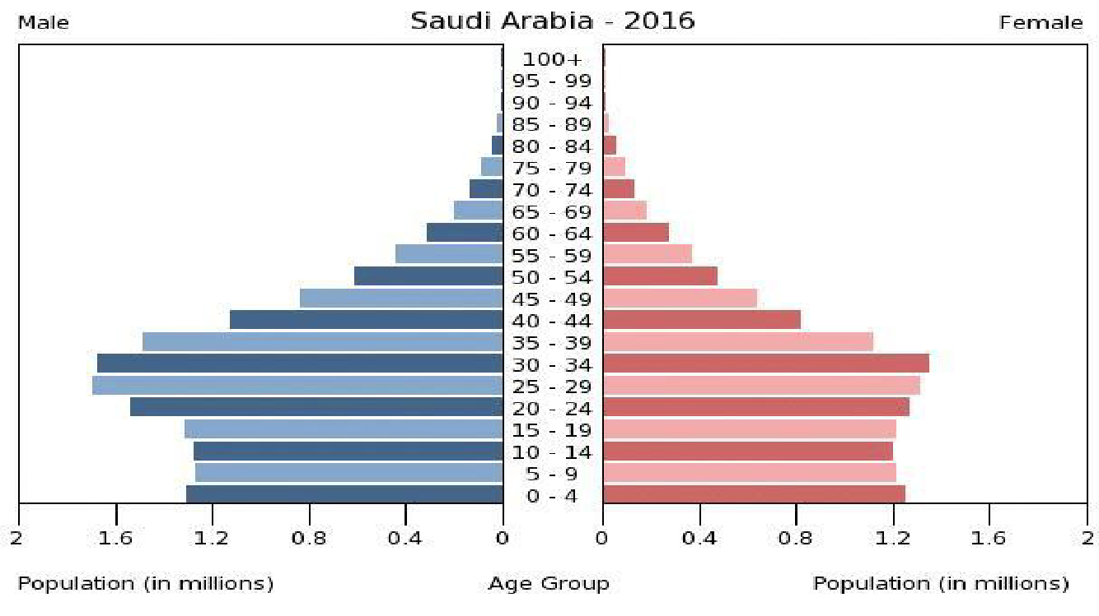
Health Problems of Adolescents in Saudi Arabia
Population Pyramid:
In this population pyramid we can see a big bulk of the population between 25-35.
Also the period between 10-25 makes a huge portion of the population driving us to investigate more on it.
Health problems of adolescents in Saudi Arabia:
There are many studies investigating health problems in the youth of Saudi Arabia ¹.
It is well documented in the literature that young adults from the upper socioeconomic class undergo unlawful sex.
Sex education among females was found to be extremely deficit.
Many studies also documented the increasing use of energy drinks among the kingdom’s youths.
A study also documented that about 30% of this population smokes cigarettes.
“Jeeluna” Study:
Time for an Adolescent Health Surveillance System in Saudi Arabia: Findings From “Jeeluna”
A study done on 12000 adolescent,
1. Some studies links :
Sexual practices of young educated men: implications for further research and health education in Kingdom of Saudi Arabia (KSA)
Knowledge, attitudes, and resources of sex education among female adolescents in public and private schools in Central Saudi Arabia
Knowledge, Attitudes and Practices toward Energy Drinks among Adolescents in Saudi Arabia
Prevalence of Cigarette Smoking Usage among Adolescent Students in Northern Saudi Arabia
Poor diet quality and food habits are related to impaired nutritional status in 13- to 18-year-old adolescents in Jeddah

Slide 5
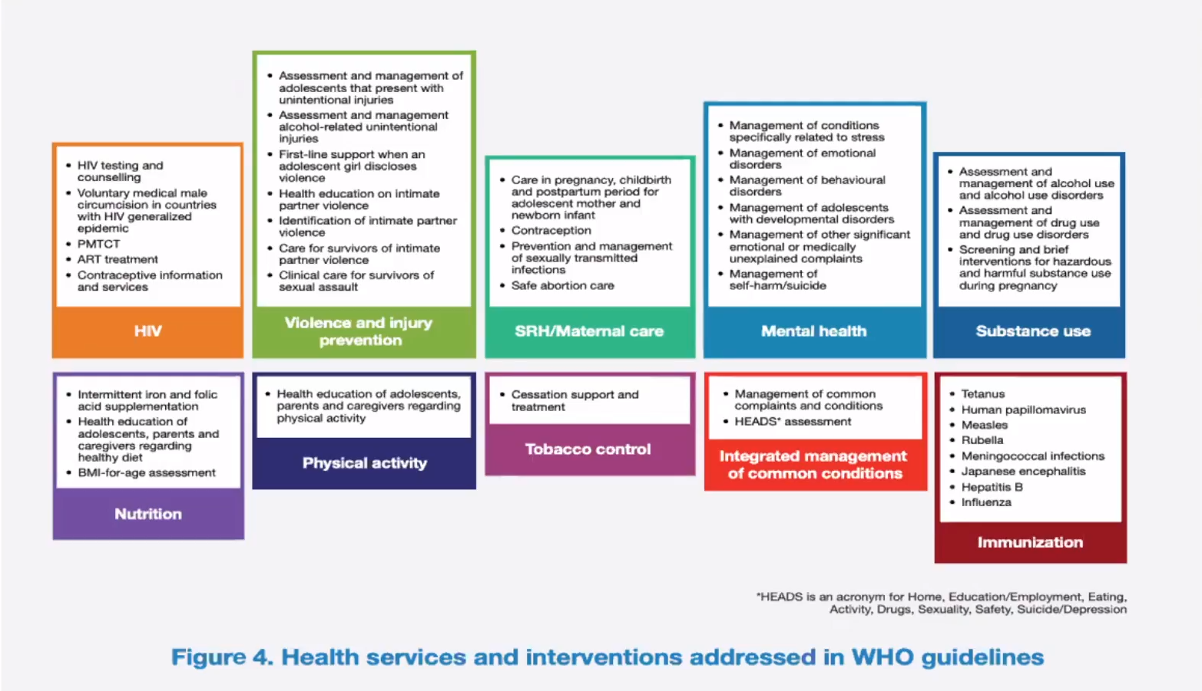
Health Problems of Adolescents in Saudi Arabia
Why invest in the health and development of adolescents?
Investment in their health should focus on:
We should also focus on child marriage and try to prevent it at the government level.
1
Healthy diet
2
No Tobacco and Alcohol use
3
Physical activities
What adolescents need & why and are we providing them?
Information & skills (they are still developing)
Safe & supportive environment (they live in an adult world)
Health & counselling services (they need a safety net)
Health services and interventions addressed in WHO guidelines
Saudi Arabia has a plan on adolescence services that was documented in papers in 2009. However, we don’t know really how it is implemented.
if we want to plan some adolescent health services in our country, there are many guidelines this is from WHO for example.

Slide 6
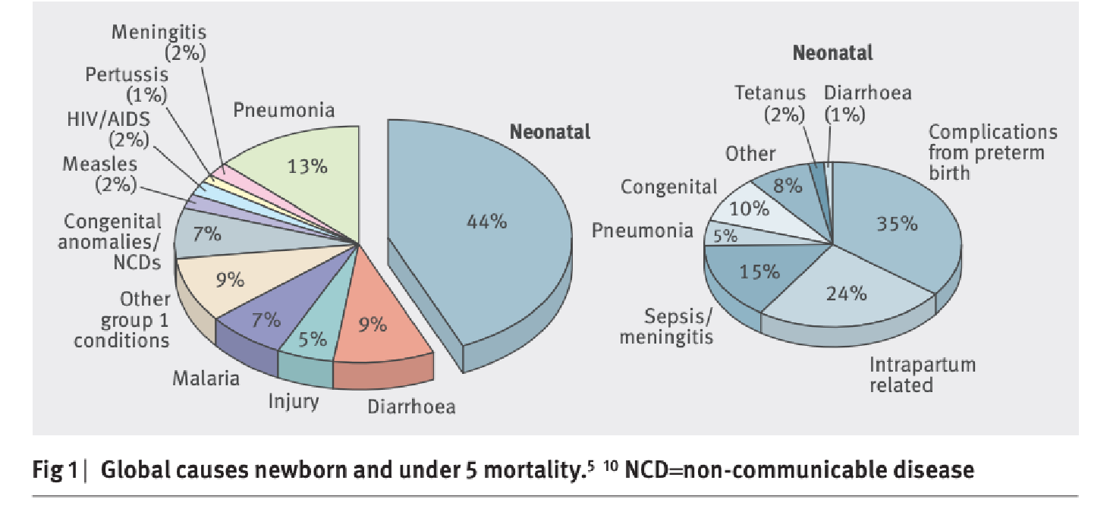
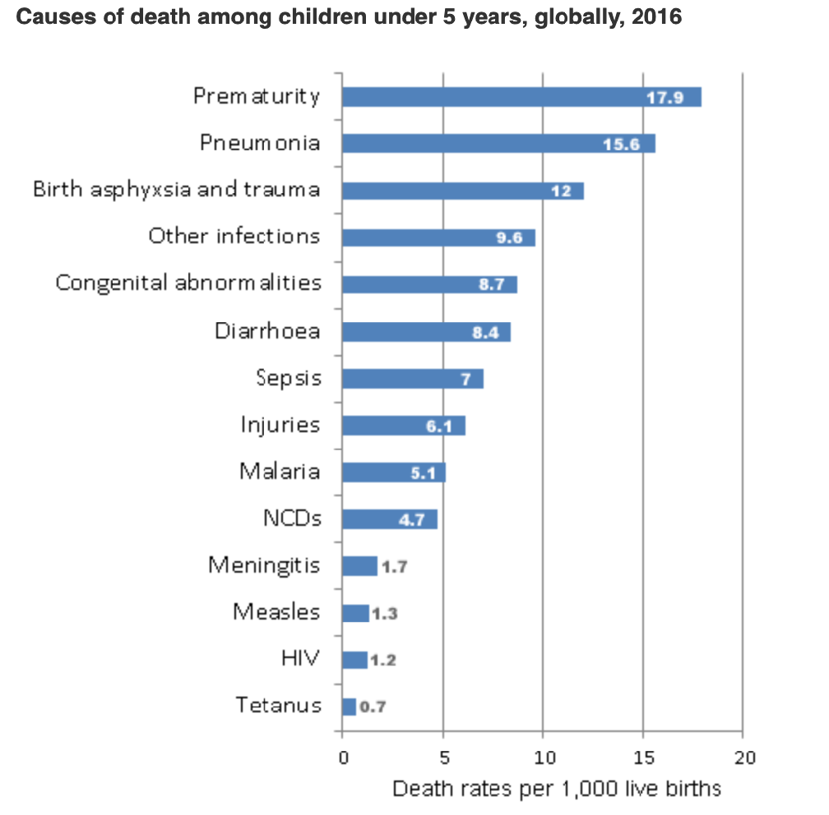
Child Health
This figure shows the global newborn and under 5 mortality causes.
Neonatal death means something went wrong during pregnancy, conception or immediately after birth and it constitutes 44% of the overall mortality.
When we look at the other 56% the number one cause is pneumonia, 2nd is diarrhea, 4th is malaria. We also have meningitis, pertussis and measles,
Most of these infections share a common ground in which most of them can be prevented by vaccination.
The most important message here is that 56% of death are preventable.
Emerging Issues in Child Health:
Congenital Anomalies
Mostly are related to toxins, radiations or medications.
Injuries
Such as foreign object ingestion, drowning, & caustic injuries. The most frequent ER visit in child under 5 is foreign object ingestion
Non-communicable Diseases
Such as chronic respiratory diseases, acquired heart diseases, childhood cancers, diabetes, and obesity)
Global response:
Sustainable Development Goal (SDGs) 3.2 is the goal that reduce the neonatal death and under 5 mortality
By 2030, end preventable deaths of newborns and children under 5 years of age, with all countries aiming to reduce neonatal mortality to at least as low as 12 per 1000 live births and under-5 mortality to at least as low as 25 per 1000 live births

Slide 7
Indicators of Child Health
Prenatal mortality rate
Neonatal mortality rate
1
Infant mortality rate
2
Under 5 mortality rate
3
Prenatal deaths include both stillbirth and early neonatal deaths
REMEMBER stillbirth means they are born dead, if a neonate died immediately after delivery it’s not considered stillbirth.
We can divide neonatal deaths into early and late deaths.
ALWAYS multiply by 100,000
It is very important to know the
interval of each definition.
4
Global interventions:
1
Breastfeeding promotion
2
Growth monitoring
3
Immunization

Slide 8
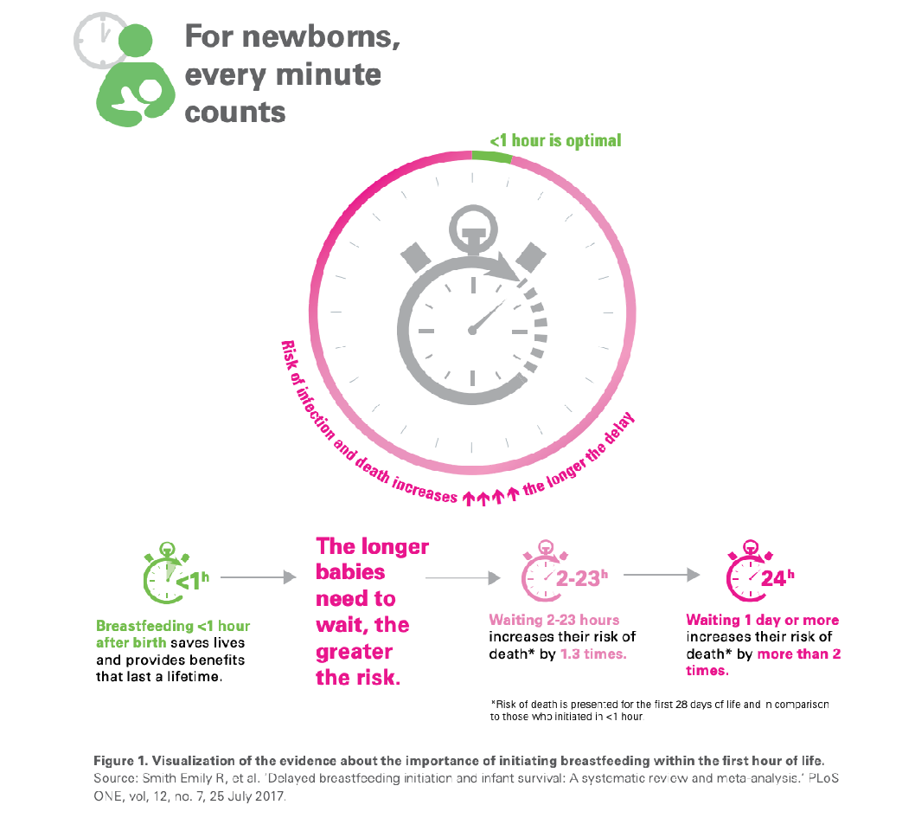
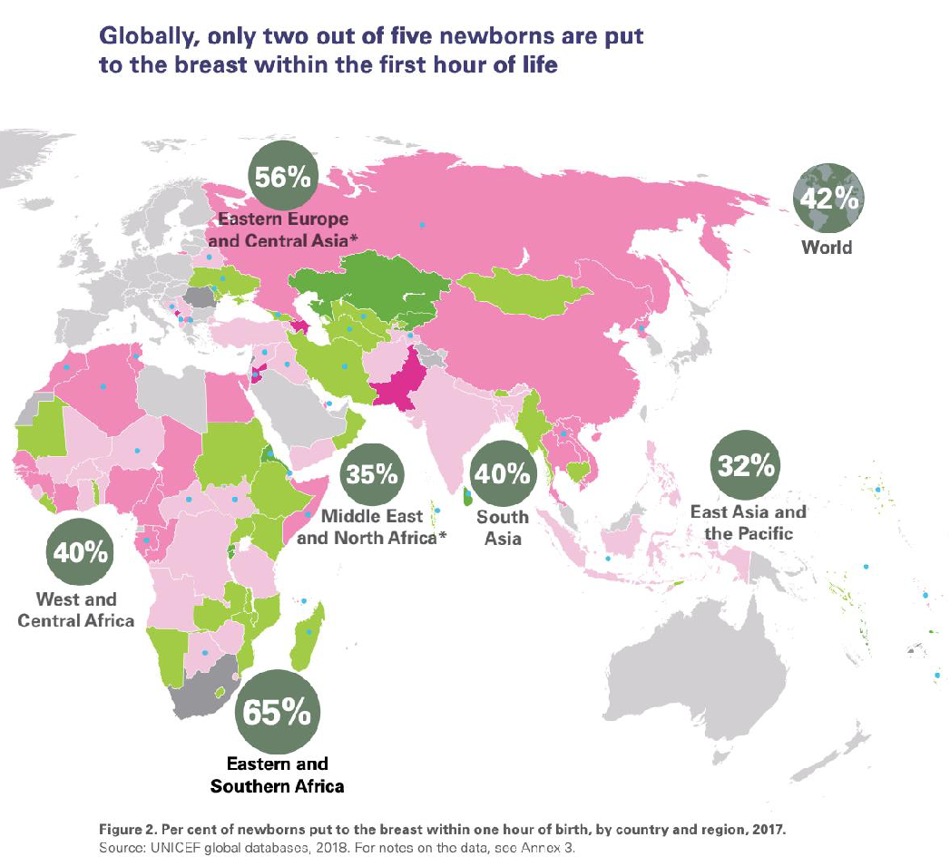
Breastfeeding
WHO Recommendations:
Early initiation of breastfeeding within 1 hour of birth and skin to skin contact
Exclusive breastfeeding for the first 6 months of life
Introduction of nutritionally-adequate and safe complementary (solid) foods at 6 months together with continued breastfeeding up to 2 years of age or beyond
Breastfeeding benefits:
Benefits to the infant
Benefits to the mother
bacteremia
diarrhea
respiratory tract infection
necrotizing enterocolitis
otitis media
urinary tract infection
late-onset sepsis in preterm infants
type 1 and type 2 diabetes
lymphoma, leukemia, and Hodgkin's disease
childhood overweight and obesity
decreased postpartum bleeding and more rapid uterine involution
decreased menstrual blood loss and increased child spacing (lactational amenorrhea)
earlier return to pre-pregnancy weight
decreased risk of breast and ovarian cancers
Growth monitoring
Very essential part in the physical and mental health of a child
The baby’s height and weight should increase during early childhood. If the child’s health remained the same (plateaued) it should rise some worry to the doctor and requires further investigations
“More details in breastfeeding tutorial”
Case: If you see that baby is not growing at normal rate what do you do?
first take history from mother: how often is she breastfeeding, for how long, and if the baby is suckling well. Also Ask about the vaccination & socioeconomic status. Also you should support and encourage mother if she is doing well.

Slide 9
Quiz
MCQ
1. Which of the following is the leading cause of death in adolescence?
Injury, HIV, Self harm
Injury, HIV, Depression
Injury, Epilepsy, Drowning
Epilepsy, HIV, STD
2. Which of the following is the MOST common leading cause of illness during adolescence?
Road traffic injury
Anxiety
Depression
HIV
3. Which of the following is TRUE about the leading cause of death in neonates and under 5s?
Most of the deaths are immediately after birth
Most of the deaths are due to congenital causes
Most of the deaths are preventable
Most of the neonatal deaths are caused by RTIs
4. A baby girl past away on the 12th day of life, At which stage she died?
early neonatal
Late neonatal
stillbirth
postnatal
5. A baby boy past away immediately after birth , At which stage he died?
early neonatal
Late neonatal
stillbirth
postnatal
6. When is it recommended to the mother to start breastfeeding the baby?
After six mouth
Immediately after birth
After 24 hour
After one week
Answers
Q1 | Q2 | Q3 | Q4 | Q5 | Q6
A | C | C | B | A | B

Slide 10
Thank You and
Good Luck
Team Leaders:
Lama AlAssiri | Mohammed AlHuqbani | Ibrahim AlDakhil
Team Members:
Lama AlZamil
Leen AlMazroa
May Babaeer
Muneera AlKhorayef
Norah AlMazrou
Nouf Alhussaini
Rema AlMutawa
Sara AlAbdulkareem
Sedra Elsirawani
Wejdan Alnufaie
Abdulrahman Alhawas
Abdulrahman Shadid
Abdullah Aldawood
Abdullah Shadid
Alwaleed Alsaleh
Bader Alshehri
Bassam Alkhuwaiter
Faisal Alqifari
Hameed M. Humaid
Khalid Alkhani
Meshari Alzeer
Mohannad Makkawi
Nayef Alsaber
Omar Aldosari
Omar Alghadir
Zyad Aldosari

