Slide 1
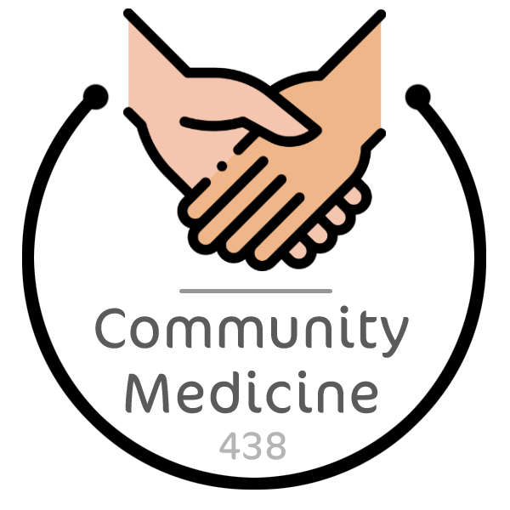
Introduction to Communicable Disease
Objectives
Define communicable disease, control, elimination and eradication
Draw the cycle of infection
Give examples of different types of infectious agents associated with diseases in humans
List types of reservoir of infection
Classify carriers and explain their public health importance in disease transmission
Illustrate with examples the different modes of transmission of communicable diseases
Define incubation period
Classify and differentiate types of immunity
Outline the measures for prevention and control of communicable diseases
Color Index
Main text
Males slides
Females slides
Doctor notes
Important
Golden notes
Extra
Editing File

Slide 2
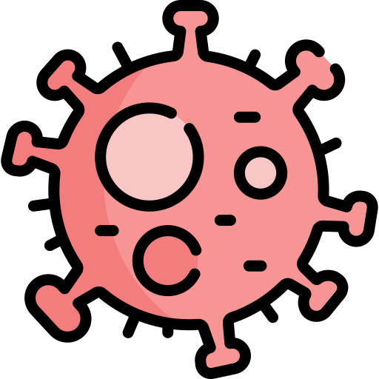
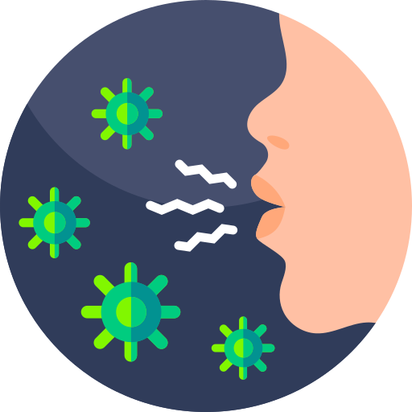
Chain of Infection ⁴
For a disease to be communicable it must meet all the criterias mentioned in red.
Conceptually speaking, these three terms all refer to the process of controlling the spread of an infectious agent. The difference being that control is concerned with lowering the incidence but not to zero, only for it not be a public health problem. Meanwhile “elimination” and “eradication” refers to lowering the incidence to zero, either locally with the former or globally with the latter. An example of an eradicated agent is smallpox.
An example for an eliminated pathogen is measles in many countries.
Microbes are self-replicating organisms that seek their own survival in different reservoirs, microbes maximize their survival chances by choosing a susceptible reservoir. A reservoir (defined in the next page) must have a portal of entry an exit.
You might note the absence of the other major class of prokaryotic organisms, the archaea, interestingly even though they constitute a portion of the normal human microbiome they have never been shown to as causative agents for infectious diseases. There are interesting hypotheses that point to their involvement in IBS and IBD.
What is Communicable Disease?
An illness caused by an infectious agent or its toxic product which can be transmitted directly or indirectly or through vector from the reservoir to a susceptible host.¹
Relevant Terms
Control
Refers to the activities conducted to bring a disease or a health problem to a very low level till it becomes no longer a public health problem.²
Elimination
Termination of all modes of transmission to a reduction of the incidence of the disease to the zero in a confined or specific geographic locality as a result of deliberate efforts yet, continued intervention methods are required. ^{2, 3}
Eradication
Termination of all modes of transmission of infection by extermination of the infectious agent. ²
The concept of eradication is a global one. (complete removal).
Smallpox is the only disease that has been eradicated to date is smallpox.
Susceptible Host
Portals of entry include (same as exit):
(1) Skin and mucous membranes,
(2) Respiratory tract,
(3) Genitourinary tract,
(4) Gastrointestinal tract
Infectious Agent⁵
Agents include:
(1) Bacteria,
(2) Viruses,
(3) Fungi, (4) Parasites, (5) Protozoa ⁴
Reservoir
Reservoirs include:
(1) Humans (cases or carriers)
(2) Animals,
(3) Inanimate (e.g., soil)
Transmission
Transmission include:
(1) Contact
- Direct - Indirect - Droplets contact
(2) Common vehicle
(3) Vector transmission
(4) Airborn
- Droplet nuclei - Dust
Portal of Exit
Portals of exit include (same as entry):
(1) Skin and mucous membranes,
(2) Respiratory tract,
(3) Genitourinary tract,
(4) Gastrointestinal tract

Slide 3
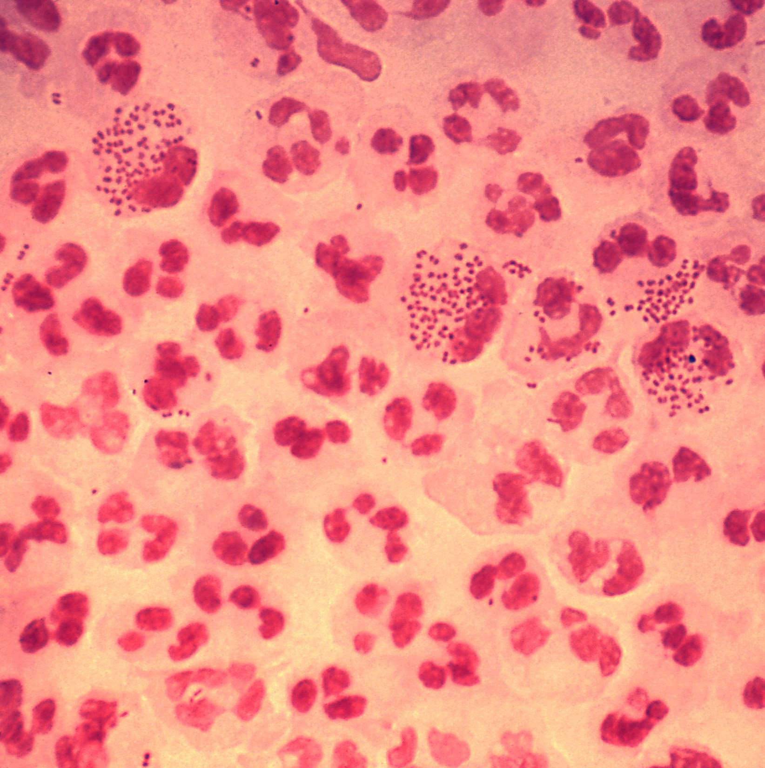
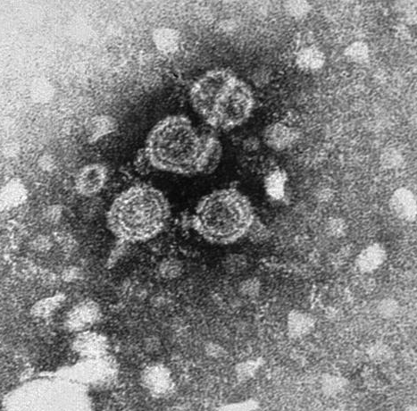
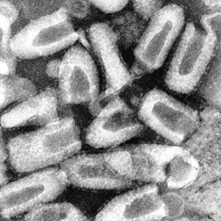
Different microbes have different routes of transmission, for example bacteria exclusively involved in STDs tend to have an unstable chemical structure that soon disintegrates outside the body, this justifies the limitability of their transmissibility to mainly intimate sexual contact.
According to the WHO, dogs account for 99% of the cases. However almost any mammal, including humans, can get infected with rabies and transmit it to another mammal. Rabies is often referred to as a ‘zombifying’ virus due to the propensity of this virus to alter a mammal’s behavior. After being bitten by a mammal, saliva enter the wound and the viral particles travel through the nerves to reach the brain and at times to the salivary glands, thereby permitting its transmissibility. This pathway is most pronounced in dogs for unclear reasons.
Chain of Infection
The reservoir of an infectious agent is the habitat in which the agent normally lives, grows, and multiplies.
Reservoirs include humans, animals, and the environment.
Portal of exit is the path by which a pathogen leaves its host.
For example, influenza viruses and Mycobacterium tuberculosis exit the respiratory tract, cholera vibrios in feces, and schistosomes through urine and feces.¹
An infectious agent may be transmitted from its natural reservoir to a susceptible host in different ways.
The portal of entry refers to the manner in which a pathogen enters a susceptible host
The final link in the chain of infection is a susceptible host.
Susceptibility of a host depends on genetic or constitutional factors, specific immunity, and nonspecific factors that affect an individual’s ability to resist infection or to limit pathogenicity.
Some of the Infectious Agents that are Associated with Diseases in Humans ²
Neisseria gonorrhoeae:
Source: Humans
Reservoir: Humans
Salmonella typhi:
Source: Food & water
Reservoir: Humans
Hepatitis C Virus:
Source: Transfusion and blood products
Reservoir: Humans
Rabies Virus ²
Source: Saliva of dogs
Reservoir: Dogs
(And other animals)

Slide 4
Six Prerequisites for the Transmission of Communicable Diseases ¹
1
2
The presence of a microbial agent.
The presence of a reservoir of infection.
3
4
Portal of exit through which the microbiological agent leaves the reservoir.
Mode of transmission.
5
6
Portal of entry or an inlet through which the microbiological enters the host.
The presence of a susceptible host ².
Types of Reservoir
Human Reservoir
Animal Reservoir
Non-Living Reservoir
1
Human to Human
Most viral and bacterial respiratory tract infections.
Most infections caused by Staphylococci and Streptococci species.
Sexually transmitted diseases (STDs).
Human reservoir can be either:
Case: possesses the infection and shows symptoms.
Carrier ³: possesses the infection but doesn't show symptoms.
Public Health Importance!
These are very common here.
Carriers are hosts without obvious illness
They can continue to spread the pathogen even though they have recovered from illness.
Unless the family and other close contacts of the sick person or even the whole population can be treated, carriers will remain a threat to the health of those surrounding them.
If any one of these prerequisites are missing the cycle will be broken
Immunosuppressed individuals are more susceptible to infections, depending on the type of the susceptibility. Person A and Person B might become colonized with the same viral load with only one of them developing clinical manifestations of the disease.
Usually no one knows that they harbor the pathogen.

Slide 5
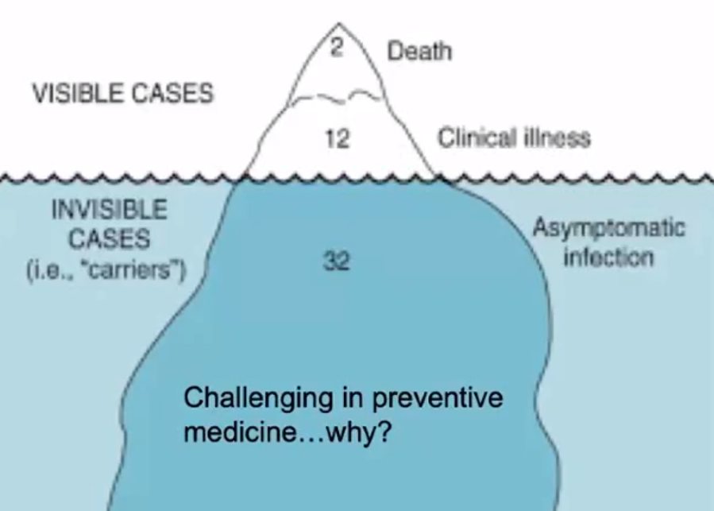
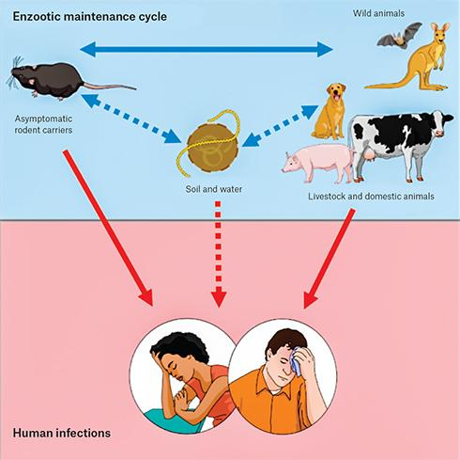
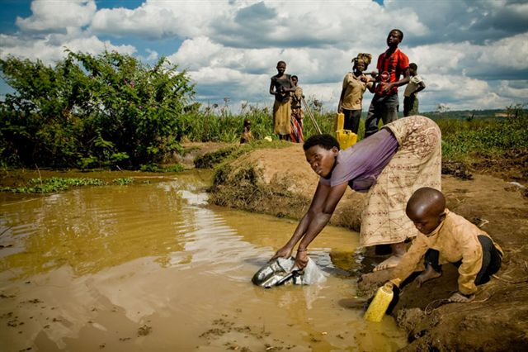
Importance of Carriers
Number: Carriers may outnumber cases.
Difficulty: Carriers don’t know that they are infected.
Mobility: Carriers are mobile, cases are restricted.
Chronicity: Carriers re-introduce infection and contribute to endemicity.
Effect of Carriers on Disease Transmission:
Iceberg effect in temperate zone:
These are the fact that carriers constitute a hidden reservoir of infection and that they may outnumber actual cases.
2
Animal to Human
Zoonosis
Animal
Animal
Human
Examples:
The Plague caused by the bacterium Yersinia pestis was transmitted from rodents to fleas and eventually to humans.
Other examples: Toxoplasmosis from cat feces, leptospirosis (rat urine), rabies.
3
Non-living Reservoir ¹
From places like soil and water.
Examples:
- Tetanus
- botulism,
- fungi (ringworm and hookworm)
Walking barefoot puts such people at risk of contracting the infectious agent from nonliving reservoirs.

Slide 6
Agents Factors Related to Development of a Disease
1
Pathogenicity ¹
Ability of the organism to produce disease or damage to the host or a specific clinical picture
2
Virulence ²
Ability to produce severe pathological reaction. Measured by the ratio of clinical to subclinical disease and case fatality rate.
3
Dose of Infection (Inoculum)
The higher the dose of infection the higher probability of severe disease.
4
Spore Formation ³
Maintain viability for a long period in unfavorable environmental conditions.
5
Antigenic Power of the Organism ⁴
Ability to stimulate the immune system to produce antibodies or antitoxin with subsequent immunity. Measured by the second attack frequency
6
Viability of Organism (resistance)
Ability of the organism to live outside the body.
STD organisms tend to survive poorly outside the body.
7
Ease of Communicability
Is measured by the secondary attack rate, which is the number of secondary cases, occurring within the range of incubation period following exposure to a primary case expressed as a percentage of susceptible.
8
Period of Communicability
Is the length of time, from acquiring the infection, during which the infection can be transmitted to another uninfected organism.
Incubation Period
It is the period between the entry of the organism and the appearance of the first symptom of the disease.
Important for:
Surveillance and quarantine in some diseases
Application of preventive measures to abort or modify the attack.
Identification of the source of infection
The ability of an organism to produce symptoms in an infected individual (either symptoms are present or not), some organisms inevitably make themselves manifest whenever they are in a host and are rarely asymptomatic, examples include (graded in order of pathogenicity): Rabbit fever (Francisella tularensis), The plague (Yersinia pestis), Pseudomonas aeruginosa, Clostridium difficile.
Virulence is a way to quantify pathogenicity, if the symptoms are present, how severe are they?
This should not be confused with fungal spores (these are mainly for reproductive purposes), the concern here is bacterial spores which are produced by organisms like C. difficile and bacillus as a defensive mechanism in response to unfavorable conditions. This process is automatically triggered when the cell’s metabolic yield of ATP is low, which triggers a cellular stress-like response that maintains viability and utilizes minimal amounts of energy.
Some organisms have carbohydrate antigens (stimulate B-cells rather than T-cells which require digested peptides through APCs). A reinfection suggests that the immune system is either lacking in its response or that the organism is variable in its pathogenicity.

Slide 7
Modes of Transmission
Touching
Sexual Intercoure
Direct Routes
Biting
Direct Projection of Droplets
Transplacental
Vehicle-borne
Indirect Routes
Vector-borne
Airborne
Direct Transmission ¹
Refers to the transfer of an infectious agent from an infected host to a new host, without the need for intermediates such as air, food, water or other animals.
Direct modes of transmission can occur in two main ways:
Person to person:
Through touching, biting, kissing, sexual intercourse or direct projection of respiratory droplets ² into another person’s nose or mouth during coughing, sneezing or talking.
Example: A familiar example is the transmission of HIV from an infected person to others through sexual intercourse.
Transplacental transmission:
This refers to the transmission of an infectious agent from a pregnant woman to her fetus through the placenta.
Example: is Mother to Child Transmission (MTCT) of HIV, TORCH infections (Toxoplasmosis, Others [Syphilis, Parvovirus, VZV], Rubella, CMV and hepatitis C and B.
The lack of an intermediate medium to transmit the infection signifies direct from indirect transmission.
Humans produce droplets in various ways (e.g. sneezing, coughing, singing) and these droplets vary in size. Large droplets (> 5 µm) comprise most of the volume of expelled respiratory droplets and they tend to fall rapidly to the ground (only transmitted directly such as COVID-19). Droplets smaller than 5 µm are referred to as droplet nuclei and may remain suspended in the air for significant periods of time and move with air currents (transmitted indirectly as an airborne infection).

Slide 8
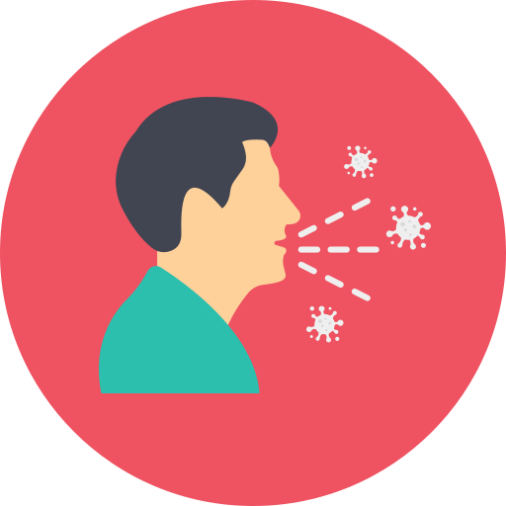
Indirect Transmission
Indirect transmission is when infectious agents are transmitted to new hosts through intermediates such as air, food, water, objects or substances in the environment, or other animals.
1
Airborne Transmission:
The infectious agent may be transmitted in dried secretions from the respiratory tract, which can remain suspended in the air for some time. For example, the infectious agent causing tuberculosis can enter a new host through airborne transmission.
Examples of air-borne:
Droplet infection (direct spread): Whooping cough
Droplet nuclei (indirect air-borne): TB¹, histoplasmosis
Dust particles (indirect air-borne): Fungal spores
2
Vehicle-borne Transmission:
A vehicle is any non-living substance or object that can be contaminated by an infectious agent, which then transmits it to a new host.
Contamination refers to the presence of an infectious agent in or on the vehicle.
Examples: Food and drink borne infections
Food and drink borne illnesses are caused by the consumption of drinks that are contaminated with organism causing disease.
The most commonly recognized are: campylobacter ², Salmonella ² and E. coli bacteria.
Human hands or/and flies
3
Vector-borne Transmission ³:
A vector is an organism, usually an arthropod, which transmits an infectious agent to a new host. Arthropods which act as vectors include houseflies, mosquitoes, lice and ticks.
Arthropod-borne is a group of infectious agents that are transmitted by bloodsucking arthropods from one vertebrate host to another.
Pathogen | Reservoir | Vector | Disease
Chikungunya | Monkeys | Mosquito | Chikungunya fever
Dengue | Monkeys, Humans | Mosquito | Dengue hemorrhagic fever
Japanese B Encephalitis | Wild birds, Pigs | Mosquito | Encephalitis
Kyasanur Forest Disease | Forest birds, animals | Tick | Hemorrhagic fever
Sindbis | Birds | Mosquito | Sindbis fever
Non-viral: Plasmodium | Mainly humans | Mosquito | Malaria
With tuberculosis, a person may cough and leave the room yet their respiratory droplets persist and infect other people who enter the room afterwards. TB droplets can remain suspended in air for several hours.
Campylobacter is associated with eating raw chicken, flies might carry Salmonella to different places.
Vectors are different from your typical house flies, house flies usually take organisms and carry them around to different surfaces without puncturing the skin and injecting the organism.

Slide 9
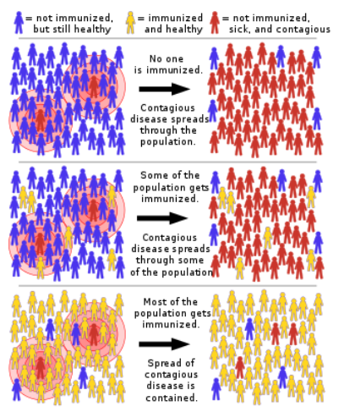
Susceptible Host & Immunity
A person or other living animal, that afford subsistence or lodgment to an infectious agent under natural condition.
Susceptibility to infection is universal but susceptibility to disease depends immunity and resistance.
Immunity ¹
Definition
Immunity is a natural resistance of the body offered by skin, gastric acidity, etc.
Types
Acquired immunity: results when the body is exposed to the disease or organism.
Active:
post infection immunity (natural) or following vaccination (artificial).Exposure to the disease organism that triggers the immune system to produce antibodies to that disease, which can occur through infection with the actual disease (resulting in natural immunity) or through the introduction of a killed/weakened organism by the means of vaccination (resulting in vaccine-induced immunity). Either way the immune system will generate antibodies needed to fight the organism.
Passive:
Acquired through transferred antibodies from mother to infant (natural) or by administration of immunoglobulin or antisera (artificial). ² Passive immunity is advantageous over active immunity in that the immunity provided is immediate; however, it is considerably shorter unlike active immunity which is long-lasting. Natural passive immunity is transmitted through the placenta while artificial passive immunity is given through antibody containing blood products such as immune globulin.
Natural immunity: resistance of the body offered by skin, mucous membranes, gastric acidity, respiratory cilia
Herd Immunity
Also known as community immunity, refers to the protection offered to everyone in a community by high vaccination rates.
With enough people immunized against a given disease, it’s difficult for the disease to gain a foothold in the community. This offers some protection to those who are unable to receive vaccinations.
People who depend on herd immunity: Some people in the community rely on herd immunity to protect them. These groups are particularly vulnerable to disease, but often cannot safely receive vaccines:
1
People without a fully-working immune system, including those without a working spleen and those with HIV.
2
Very ill in hospital
3
Newborn babies who are too young to be vaccinated
4
Elderly people
5
People on chemotherapy treatment whose immune system is weakened
6
People with HIV

Slide 10
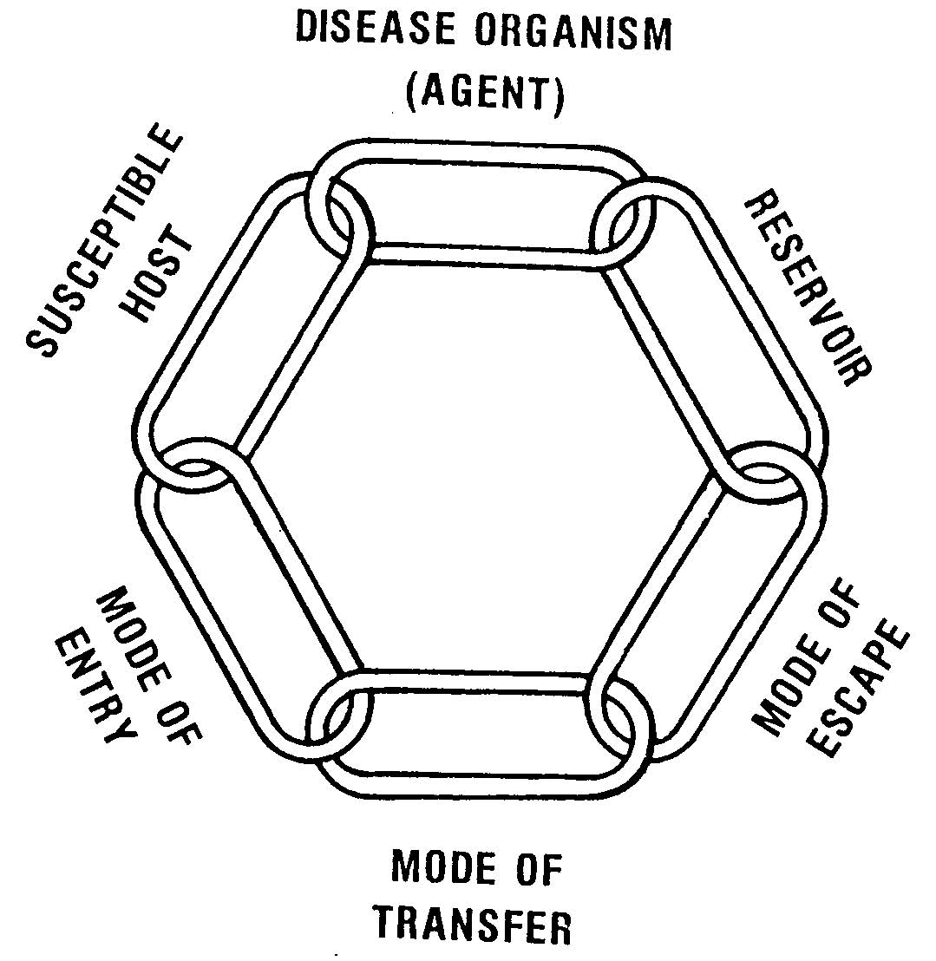
Prevention and control of communicable diseases
GOAL
Our goal in preventing communicable diseases is to break the cycle of infection at its weakest point!!
ENVIRONMENT
1
Measures applied to disease agents
Sterilization and disinfection
2
Measures applied to contact
Enlistment, surveillance for the longest incubation period of the disease, isolation (if indicated) as well as increase resistance by immunization or chemoprophylaxis.
3
Measures applied to the environment
Sanitation (water/food/sewage)
4
Measures applied to the host
Health education, adequate personal hygiene, sound nutrition, immunization and chemoprophylaxis
5
Measures applied to the reservoir
Cases:
Case finding, reporting to the local health authority in order to apply the appropriate control measures for contact and the environment, isolation (strict isolation or discharge/body fluid isolation) for the whole period of communicability and treatment.
Carriers:
Identification of carriers in the community, treatment and exclusion from work till the organism is eliminated especially if food handlers or working with children. Its cost effectiveness depends on the proportion of carrier in the community as well as the sensitivity of their occupation.
Animal reservoir:
Adequate animal husbandry, immunization (if vaccine is available), treatment of infected animals and killing if treatment is not feasible.

Slide 11
Quiz
MCQ
1. Which of the following organisms are characterized by forming endospores that are relatively resistant to unfavorable environmental conditions:
C. difficile
E. coli
B. fragilis
S. aureus
2. Khalid is an 8-year-old boy who was brought to a healthcare facility by his mother due to severe intense spasm that are most pronounced in the jaw and abdominal regions accompanied by fever. Upon physical examination a contaminated wound was found on Khalid’s foot, unbeknownst to the mother Khalid has been playing barefoot in the previous months in different locations with his newly acquired friends. Which of the following was probably missed as part of Khalid’s vaccination schedule?
DTP
HBV
Malaria
Influenza
3. Eradication is defined as “Termination of all modes of transmission of infection by extermination of the infectious agent. “. Which of the following organisms exemplifies the concept of eradication?
Smallpox
Chickenpox
Hepatitis A
Measles
4. Which of the following is a prerequisite for the transmission of an infectious agent?
The presence of immune cells to carry the infectious agent
The presence of lipid membranes to protect the infectious agent enough for transmission to occur
A mode of transmission
A weakened immune system
5. Rabies is frequently transmitted among mammals through bites of infected animals. Which of the following mammals is the most common reservoir for rabies?
Humans
Dogs
Monkeys
Cats
6. Which of the following can get suspended in air for several hours to cause airborne infections?
TB
S. aureus
Rabies
Syphilis
Answers
Q1 | Q2 | Q3 | Q4 | Q5 | Q6
A | A | A | C | B | A

Slide 12
Thank You and
Good Luck
Team Leaders:
Lama AlAssiri | Mohammed AlHuqbani | Ibrahim AlDakhil
Team Members:
Lama AlZamil
Leen AlMazroa
May Babaeer
Muneera AlKhorayef
Norah AlMazrou
Nouf Alhussaini
Rema AlMutawa
Sara AlAbdulkareem
Sedra Elsirawani
Wejdan Alnufaie
Abdulrahman Alhawas
Abdulrahman Shadid
Abdullah Aldawood
Abdullah Shadid
Alwaleed Alsaleh
Bader Alshehri
Bassam Alkhuwaiter
Faisal Alqifari
Hameed M. Humaid
Khalid Alkhani
Meshari Alzeer
Mohannad Makkawi
Nayef Alsaber
Omar Aldosari
Omar Alghadir
Zyad Aldosari

