Slide 1
Tuberculosis
Objectives
Understand the epidemiology and global burden of TB
List the sign and symptoms and risk factors of different types of TB, with particular emphasis on pulmonary TB
Describe trends and state reasons for resurgence of pulmonary TB
List population subgroups at risk for pulmonary TB
Draw the cycle of infection of pulmonary TB
Outline procedures for community diagnosis of pulmonary TB with emphasis on the limitation of each procedure
Describe measures for prevention and control for pulmonary TB
Describe the role of WHO to address the global burden of TB, particularly directly observed therapy short course (DOTS) for pulmonary TB
Color Index
Main text
Males slides
Females slides
Doctor notes
Important
Golden notes
Extra
Editing File

Slide 2
Epidemiology and Global burden of TB
South Africa and Southeast Asia have the highest incidence of TB, although no country is spared.

Slide 3
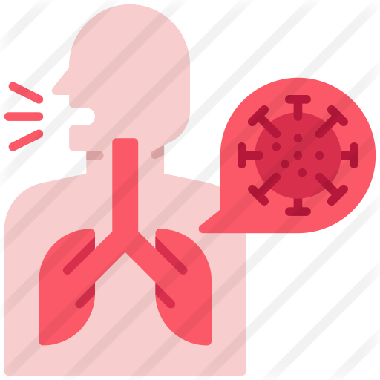
Transmission of M. Tuberculosis
Spread by droplet nuclei¹.
Expelled when person with infectious TB coughs,sneezes, speaks, or sings.
Close contacts at highest risk of becoming infected and prolonged exposure usually needed to establish infection.
Transmission occurs from person with infectious TB disease (not latent TB infection).
Risk of transmission outdoors is reduced because of dilution and bacilli are killed by ultraviolet light.
Probability TB Will Be Transmitted
Infectiousness of person with TB.
Environment in which exposure occurred.
1
2
Duration of exposure
Virulence of the organism².
3
4
CYCLE OF INFECTION OF PULMONARY TUBERCULOSIS
Agent: Mycobacterium tuberculosis
Reservoir:
man in a form of case
Portal of exit:
Respiratory tract.
Source of infection: sputum and contaminated articles, dust.
Transmission:
1- contact :
direct,indirect and
droplet.
2- Airborne: droplet
nuclei and dust
transmission
Portal of entry (inlet):
Respiratory tract.
Susceptible host:
Low standard of living, malnutrition, alcoholism, HIV/AIDS.
Incubation period:
4-12 weeks
1: M. Tuberculosis is transmitted in airborne particles called droplet nuclei, it can stay in the air for a long time.
2: Highly virulent organisms will almost always lead to a disease. Factors that regulate the virulence are: the genetic makeup of the organism and the genetic makeup of the susceptible host.

Slide 4
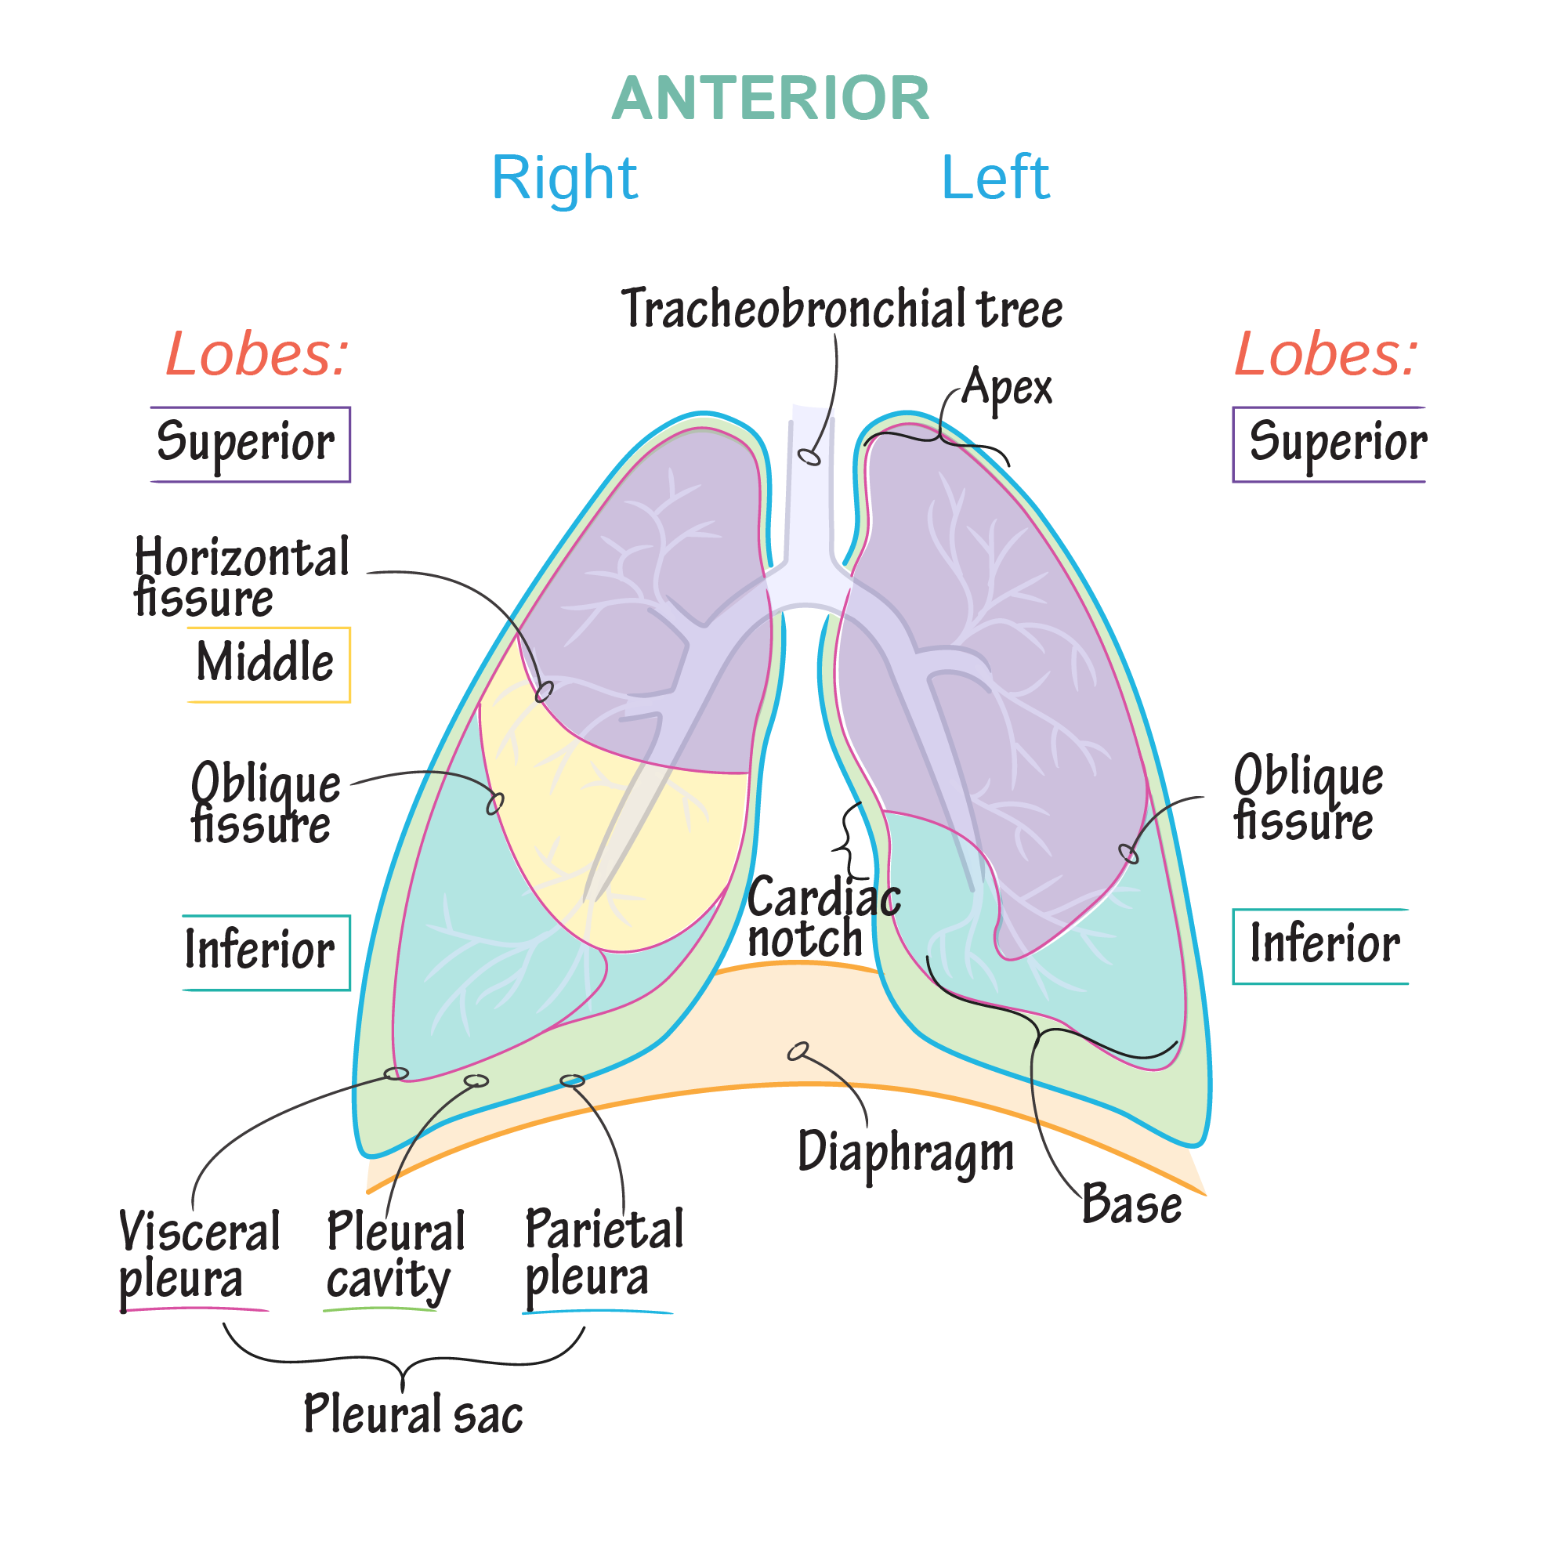
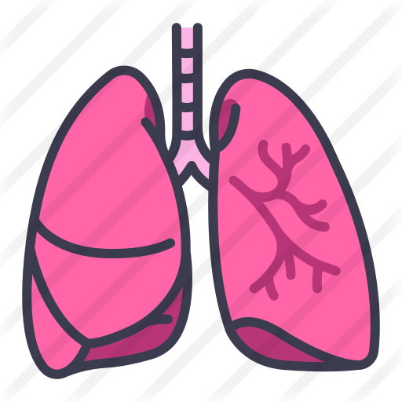
Conditions That Increase the Risk of Progression to TB Disease
HIV infection
Diabetes mellitus
Substance abuse
Silicosis
Recent infection
Prolonged corticosteroid therapy
Chest radiograph finding suggestive of previous TB
Other immunosuppressive therapy
Persons at Higher Risk for Exposure to or Infection with TB
Close contacts of persons known or suspected to have TB
Residents and employees of high-risk congregate settings
Health care workers (HCWs) who serve high-risk Clients
Medically underserved, low-income populations
Persons with malnutrition
Children exposed to adults in high-risk categories
Persons who inject illicit drugs
Common Sites of TB Disease
Pleura
Lungs
Central nervous system
Disseminated (miliary TB)
Lymphatic system
Bones and joints
Genitourinary systems

Slide 5
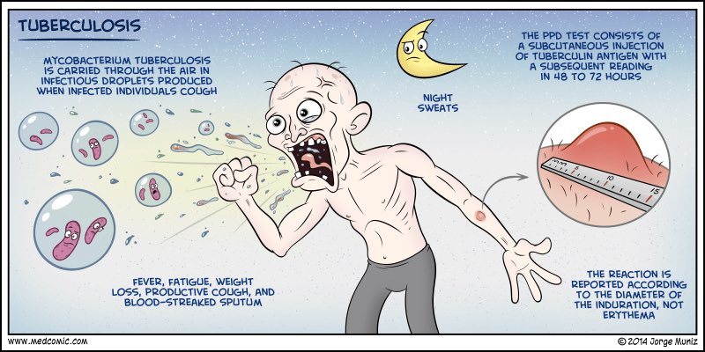
Latent Tuberculosis Infection (LTBI)
1
defined as a state of persistent immune response to stimulation by Mycobacterium tuberculosis antigens with no evidence of clinically manifest active TB.
2
There is an increased chance of developing active TB disease from the infection.
3
Treatment: Isoniazid (has been the standard treatment )
Diagnosis of TB
Medical history
Mantoux tuberculin skin test
Evaluation for TB:
Physical examination
Chest radiograph
Bacteriologic or histologic exam
Symptoms & medical history
Symptoms of pulmonary TB
Symptoms of disease
Productive, prolonged cough
(duration of >3 weeks)
Chest pain
Hemoptysis
1
2.History of TB exposure, infection, or disease¹
3. Past TB treatment²
2. Systemic symptoms
Medical history
Fever
Chills
Night sweats
Appetite loss
Weight loss
Easy fatigability
2&3
4
Demographic risk factors for TB³
5
Medical conditions that increase risk for TB disease⁴
1: Ask about HIV, drug abuse, smoking history and pregnancy.
2: Or steroids therapy (as they are known to reduce the immune system).
3: Travel history, living in a high prevelant area.
4: Sarcoidosis, silicosis, prolonged COPD, chest infections, smokers, etc..

Slide 6
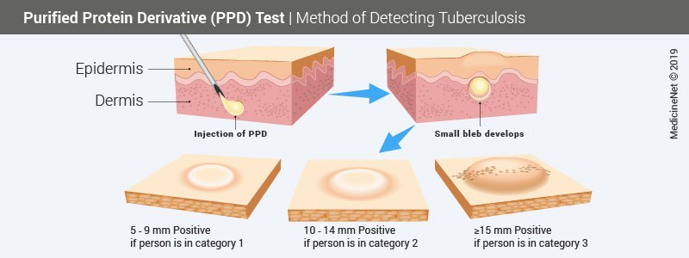
Testing for TB Disease and Infection
All testing activities should be accompanied by a plan for follow-up care
Tuberculin skin test (Universal test)
Administration
Reading
Inject intradermally 0.1 ml of 5 TU PPD tuberculin
Produce wheal 6 mm to 10 mm in diameter
Do not recap, bend, or break needles, or remove needles from syringes
Follow universal precautions for infection control
Read reaction 48-72 hours after injection
Measure only induration not the redness
Record reaction in millimeters
A tuberculin skin test reaction is considered positive if the transverse diameter of the indurated area reaches the size required for the specific group.¹
Induration size | Group
≥5mm | HIV-positive persons. Patients with organ transplants and other immunosuppressed patients.
≥10mm | Recent immigrants from countries with a high prevalence of TB. HIV-negative injection drug users. Laboratory personnel. Health care workers². Persons with increased risk of TB e.g. DM, silicosis, …
≥15mm | Persons with no risk factors for tuberculosis
Factors that May Affect the Skin Test Reaction
Type of reaction:
False-positive
False-negative
Possible causes:
Possible causes:
Non-tuberculous mycobacteria
BCG vaccination
Recent TB infection
Very young age (< 6 months old)
Live-virus vaccination
Overwhelming TB disease
HIV positive people
1:If a person was in contact with TB we should do a skin test: if it’s negative (no reaction, 0mm) then we should repeat the test; if negative again we give the vaccine but if positive we give chemoprophylaxis.
2: Due to their repeated exposure.

Slide 7
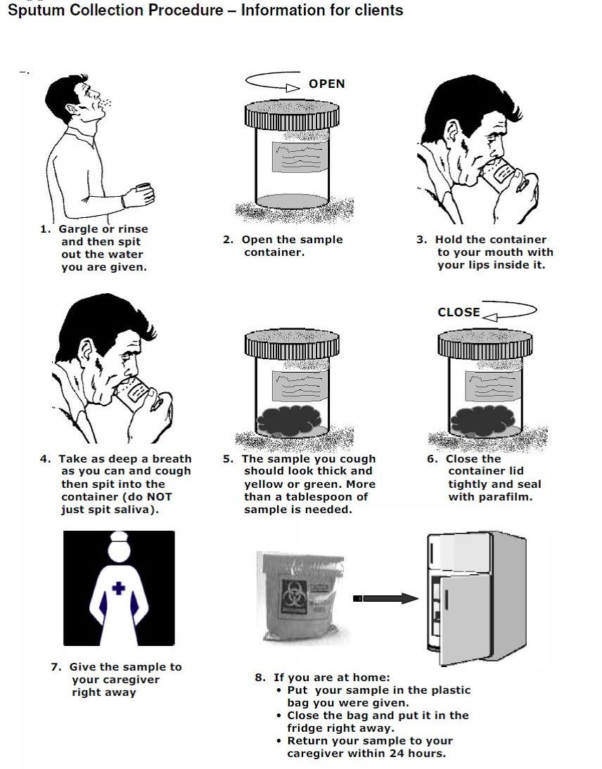
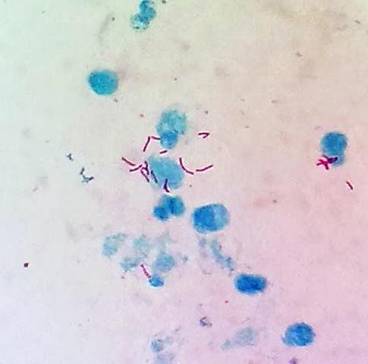
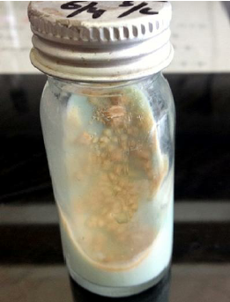
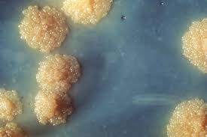
Testing for TB Disease and Infection
Chest Radiograph¹
1
Abnormalities often seen in apical or posterior segments of upper lobe or superior segments of lower lobe.
2
May have unusual appearance in HIV-positive persons.
3
Cannot confirm diagnosis of TB
Arrow points to cavity in patient's right upper lobe
Sputum Specimen Collection
1
2
3
Obtain 3 sputum specimens for smear examination and culture.
Persons unable to cough up sputum, induce sputum, bronchoscopy or gastric aspiration
Follow infection control precautions during specimen collection
Smear Examination
Culture
1
Strongly consider TB in patients with smears containing alcohol acid-fast bacilli (AAFB).
Use to confirm diagnosis of TB.
Culture all specimens, even if smear negative.
Results in 4 to 14 days when liquid medium systems used.
03
Results should be available within 24 hours of specimen collection.
2
3
01
01
Presumptive diagnosis of TB.
Blood Tests for TB Infection
Interferon Gamma Release Assays (IGRA)
Quantiferon
Definition | is a simple-blood test, a modern alternative to the tuberculin skin test that can aid in diagnosing M. tuberculosis infection. highly specific and sensitive
Advantages | Requires a single patient visit to conduct the test. Results can be available within 24 hours. Prior BCG (Bacille Calmette-Guérin) vaccination does not cause a false-positive Quantiferon result². A positive test result suggests that M. tuberculosis infection is likely; a negative result suggests that infection is unlikely³. Used to detect persons with Latent TB infection.
Disadvantage | They do not help differentiate latent tuberculosis infection (LTBI) from tuberculosis disease.
1: It’s important to look at a number of TB x-rays, as you may find them in the exam.
2: Whereas in tuberculin test, prior BCG vaccination did cause a false-positive result.
3: Due to it’s high sensitivity and specificity.

Slide 8
Treatment of TB Infection
DIRECTLY OBSERVED TREATMENT, SHORT COURSE (DOTS)CHEMOTHERAPY
Health care worker watches patient swallow each dose of medication.
Consider DOT for all patients.
DOT can lead to reductions in relapse and acquired drug resistance.
Use DOT with other measures to promote adherence.
The five elements of DOTS:
Political commitment with increased and sustained financing
Case detection through quality-assured bacteriology
Standardized treatment, with supervision and patient support
An effective drug supply and management system
Monitoring and evaluation system, and impact measurement
Include four drugs of initial regimen:
Isoniazid (INH)
Rifampicin (RIF)
Pyrazinamide (PZA)
Ethambutol (EMB) or Streptomycin
Adjust regimen when drug susceptibility result are known
TB for HIV-Negative persons
Extra-pulmonary TB
(Bone and Joint TB, Miliary TB,or TB Meningitis in Children)
In most cases, treat with same regimens used for pulmonary TB
Treat for a minimum of 12 months
Multidrug-Resistant TB (MDR TB)
Presents difficult treatment problems
Treatment must be individualized
Clinicians unfamiliar with treatment of MDR TB should seek expert consultation
Always use DOT to ensure adherence
Click here to go to the WHO website
Treatment with the DOTS strategy is the current WHO recommended tuberculosis control strategy

Slide 9
Screening
WHO EFFORTS

Slide 10
Preventing and Controlling TB
Three priority strategies:
1
Identify and treat all persons with TB disease
2
Identify contacts to persons with infectious TB; evaluate and offer therapy
3
Test high-risk groups for latent TB infection (LTBI); offer therapy as appropriate
BCG Vaccination
In countries where tuberculosis is prevalent and the risk of childhood infection is high.
the national policy is to administer BCG very early in infancy either:
At birth or at 6 weeks of age with other immunizing agents such as DPT and polio¹.
Health care providers should work with health department in the following areas :
Overall planning and policy development
Identification of persons with clinically active TB
Management of persons with disease or TB suspects
Identification and management of persons with TB
Laboratory and diagnostic services
Data collection and analysis
Training and education
Data Collection and Analysis
Training and Education
TB reporting required in every state.
All new cases and suspected cases promptly reported to health department.
All drug susceptibility results sent to health department.
TB control programs should:
Provide training for program staff.
Provide leadership in TB education to the community.
Ensure community leaders, clinicians, and policymakers are knowledgeable about TB.
Educate the public.
1: In KSA, BCG vaccine is given at 6 months.

Slide 11
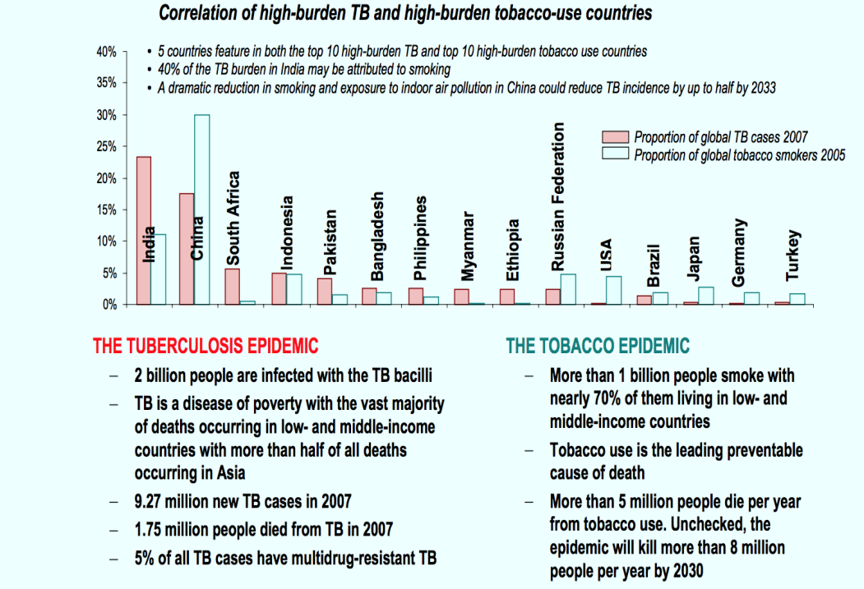
Why is it a concern for Saudi Arabia?¹
THE DUAL EPIDEMIC OF TB AND DIABETES - A deadly linkage
People with a weak immune system, as a result of chronic diseases such as diabetes, are at a higher risk of progressing from latent to active tuberculosis.
Diabetes triples a person's risk of developing TB. About 15% of TB cases globally may be linked to diabetes
TB can temporarily cause impaired glucose tolerance which is a risk factor for developing diabetes
The likelihood that a person with TB will die or relapse is significantly higher if the person also has diabetes.
A large proportion of people with diabetes as well as TB are not diagnosed, or are diagnosed too late.
THE DUAL EPIDEMIC OF TB AND DIABETES - Key actions
Early detection can help improve care and treatment outcomes of both diseases. AM people with TB should be systematically screened for diabetes, Systematic screening for TB in people with diabetes should be considered in settings with high TB prevalence.
WHO-recommended treatments should be rigorously implemented for people with TB/diabetes.
It is important that proper care for diabetes is provided to minimize the risk of TB
Diabetes prevention on population level also helps prevent TB
A joint response is needed to ensure coordinated clinical management and address common health system bottlenecks and social determinants
A strong association
1
2
3
Smoking substantially increases the risk of tuberculosis (TB) and death from TB
More than 20% of global TB incidence may be attributable to smoking
Controlling the tobacco epidemic will help control the TB epidemic
Smoking is a risk factor for TB, independent of alcohol use and other socioeconomic risk factors
Smoking increases the risk of TB disease by more than two and a half times
The WHO monograph on TB and tobacco describes other linkages and evidence
1: It’s a concern due to the high number of immigrants coming from countries with high TB prevalence.
The highest prevalence of TB in Saudi Arabia is in Jazan, Jeddah, Medina. Due to the low socioeconomic status, crowding and lots of immigrants.

Slide 12
Quiz
MCQ
1- Which one of the following can transmit Tuberculosis to another person?
A-person with a latent Tuberculosis infection B. Patient with infectious Tuberculosis
C. A and B D. None of them
2- Which of the following is an extrinsic risk factor for the occurrence of tuberculosis?
A. High altitude B. Overcrowding
C. Mycobacterium tuberculosis D. Poor hygiene
3- Which of the following diagnostics tests is intended for latent tuberculosis infection?
A-Sputum smear microscopy B. Polymerase chain reaction (PCR)
C.Interferon Gamma Release Assays ( IGRA) D.tuberculin skin test (TST).
4- The ideal clinical specimen for pulmonary TB diagnosis is:
A. Blood. B. Sputum. C. Urine. D. Tissue
5- The commonest radiologic finding in TB is:
A. Upper lobe consolidation with or without cavities B. Pleural effusion
C. Pericardial effusion D. Lung nodule
6- What is the best duration of treatment for a patient with bone and joint Tuberculosis?
A.Treat for 9 months B. Treat for 7 months
C. Treat for 3 months D.Treat for a minimum of 12 months
Answers
Q1 | Q2 | Q3 | Q4 | Q5 | Q6
B | B | D | B | A | D

Slide 13
Thank You and
Good Luck
Team Leaders:
Lama AlAssiri | Mohammed AlHuqbani | Ibrahim AlDakhil
Team Members:
Lama AlZamil
Leen AlMazroa
May Babaeer
Muneera AlKhorayef
Norah AlMazrou
Nouf Alhussaini
Rema AlMutawa
Sara AlAbdulkareem
Sedra Elsirawani
Wejdan Alnufaie
Abdulrahman Alhawas
Abdulrahman Shadid
Abdullah Aldawood
Abdullah Shadid
Alwaleed Alsaleh
Bader Alshehri
Bassam Alkhuwaiter
Faisal Alqifari
Hameed M. Humaid
Khalid Alkhani
Meshari Alzeer
Mohannad Makkawi
Nayef Alsaber
Omar Aldosari
Omar Alghadir
Zyad Aldosari

