Slide 1
Malaria
Objectives
Understand the epidemiology and global burden of malaria
Understand the epidemiology and risk factors related to Malaria in KSA
Understand the cycle of infection of malaria
Define modes of transmission, clinical features, risk factors, community diagnosis and treatment for malaria
Enlist the factors responsible for antimalarial drug resistance
Understand the role and measures taken by WHO to combat the burden of Malaria globally
Enlist the global measures of prevention and elimination for Malaria
OSCE
You can check the references at the end of the lecture if interested
Color Index
Main text
Males slides
Females slides
Doctor notes
Important
Textbook
Golden notes
Extra
Editing File

Slide 2
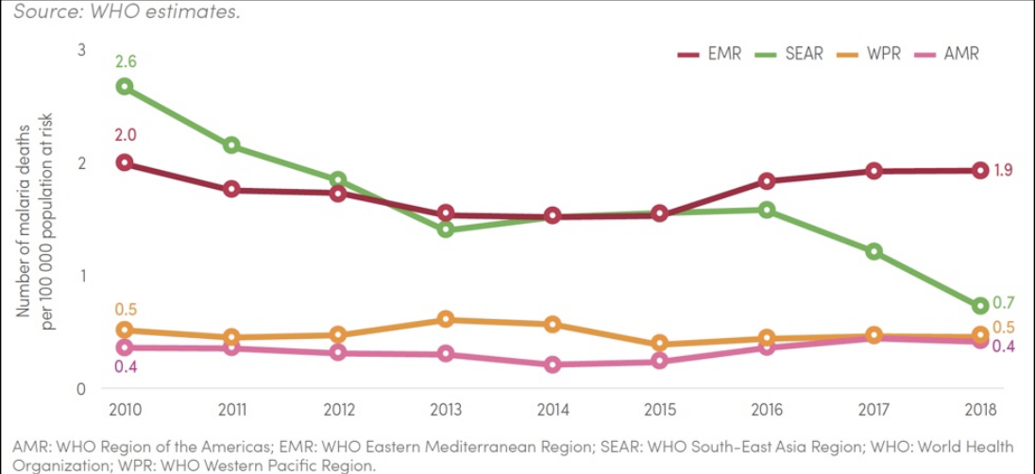
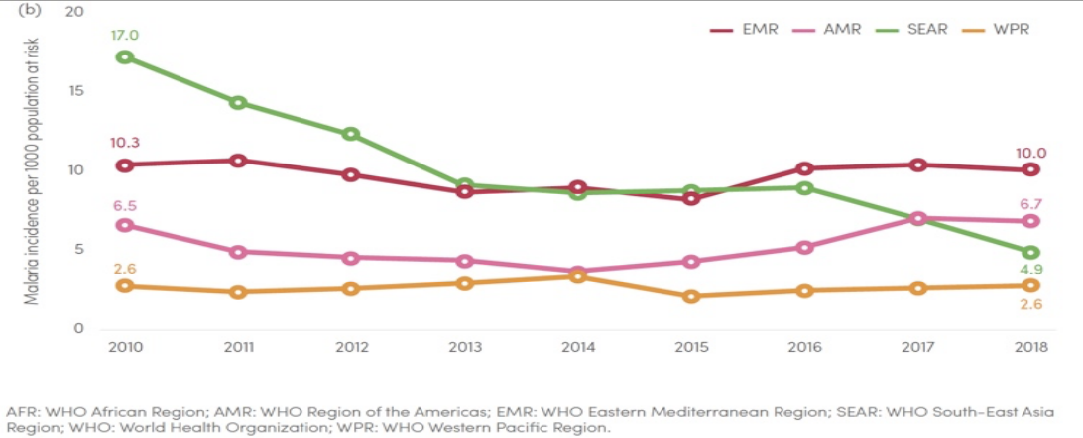
Malaria
“Malaria is a life threatening febrile illness caused by infection with the protozoan parasite, Plasmodium. It is transmitted to humans by the bite of the female Anopheles mosquito¹”
(Public Health England 2013).
A typical attack comprises three distinct stages: cold stage, hot stage and sweating stage
COLD STAGE: The onset is with lassitude, headache, nausea and chilly sensation followed in an hour or so by rigors. The temperature rises rapidly to 39-41°C. Headache is often severe and commonly there is vomiting. In early part of this stage, skin feels cold; later it becomes hot. Parasites are usually demonstrable in the blood. The pulse is rapid and may be weak. This stage lasts for 15 mins -1 hour.
HOT STAGE: The patient feels burning hot and casts off his clothes. The skin is hot and dry to touch. Headache is intense but nausea commonly diminishes. The pulse is full and respiration rapid. This stage lasts for 2 to 6 hours.
SWEATING STAGE: Fever comes down with profuse sweating. The temperature drops rapidly to normal and skin is cool and moist. The pulse rate becomes slower, patient feels relieved and often falls asleep. This stage lasts for 2-4 hours
Epidemiology
Malaria is globally one of the most important public health issues, predominantly affecting young children (Especially those who are less than 5 years) and pregnant women.
In 2019, there were 229 million cases and, 409,000 deaths caused by malaria worldwide (WHO 2020)
67% of deaths were in children aged less than five years.
94% of cases and deaths occurred in Africa².
Multidrug resistance is prevalent in many areas around the world³, particularly in South East Asia (Cambodia, Thailand, Brunei, Burma (Myanmar), Timor-Leste, Indonesia, Laos, Malaysia, Philippines, Singapore and Vietnam.)(Kirwan 2006)
Regional trends and comparisons⁴
Red line: Middle East
Green line: South East Asia
Pink line: Region of the Americas (middle & South)
Orange: Western Pacific Region
In the last 4-5 years, the incidence in the middle east is increasing causing an increase in the number of deaths.
1: Life threatening if not treated properly
2: There’s always a risk of reintroduction to other countries
3: Like Saudi is chloroquine resistant
4: Why are the cases increasing ? Usually it’s political reasons (like wars) more than health reasons. Poverty, war, etc can increase the chance of disease incidence and this will also cause the death percentages to increase

Slide 3
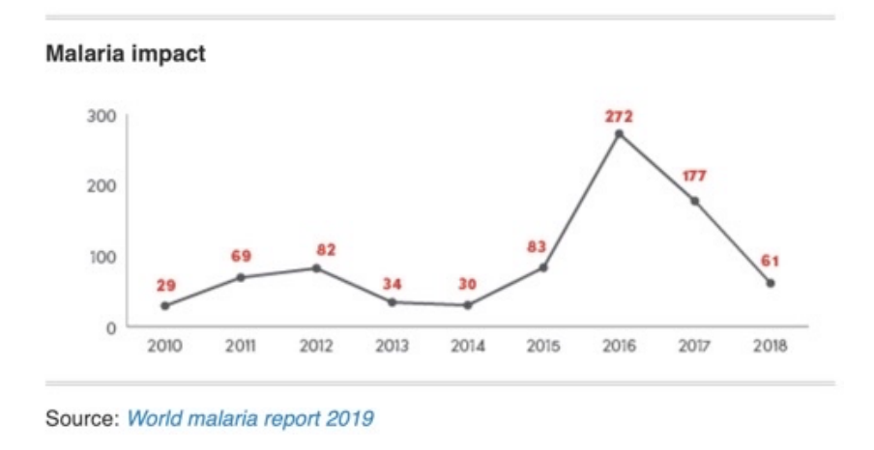
Malaria
Epidemiology in Saudi Arabia
Dominant species in indigenous cases: P. Falciparum (93%), mainly transmitted by Anopheles Arabiensis (MOH 2019; WHO 2019)
In 2018, number of confirmed cases was 2711, of which:
2650 (97.7%) were either imported or introduced.
only 61 cases were indigenous.
Zero indigenous deaths from 2010 to 2018.
How malaria shaped history? The Doctor said this isn’t from the objectives
African v Native American slaves.
In Africa, Europeans settlers preferred unfavourable environment to Anopheles.
The unconquerable Rome and noxious fume “mal’aria”.
Around 1630, in Peru, missionaries found natives ingesting powdered bark of cinchona tree.
Europeans learnt how to extract quinine, grow the cinchona and produce drugs.
High-risk populations in KSA
Imported cases which represent (97%) of all cases (WHO 2019):
Migrants¹ (e.g., undocumented workers from Yemen and its neighbouring countries).
Pilgrims from endemic countries.
Indigenous cases:
Southern and South-Western populations (Jazan and Aseer²) in coastal areas, lowlands and mountains due to seasonal anomalies (i.e., unusual high annual rainfall)
Southern and South-
Western populations
Immigrants
Pilgrims
1: Most common cause especially illegal undocumented workers
2: They are the cause of indigenous cases especially during winter even though its only a minor percentage

Slide 4
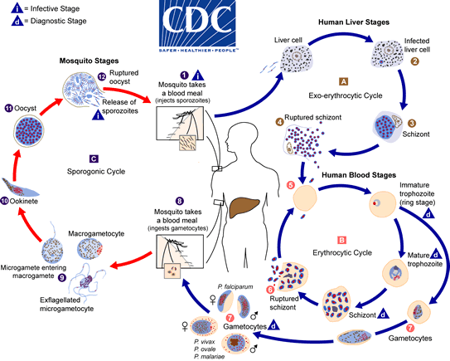
Plasmodium Parasites
Five protozoan parasites that are known to affect humans:
Plasmodium falciparum
P. vivax¹
P. ovale
P. malariae
P. knowlesi²
Mode of transmission and lifecycle:
MAINLY Vector (female Anopheles mosquitoes)
Blood (injection/transfusion of contaminated blood)
Congenital (rare)
Recall from Microbiology
Explanation for the picture:
1. Malaria is mainly carried by female anopheles mosquito.
2. The infected mosquito will bite and inject sporozoites from it salivary gland into the bloodstream of human
3. Which then will travel through blood until it reaches the liver and enter the hepatocytes where it will multiply
asexually to form merozoites inside the schizont (Exoerythrocytic schizont).
4. When the hepatic schizont rupture (clinical symptoms appear) the merozoites will be released into blood, then it will enter the erythrocytes forming immature trophozoites (ring stage) which will have 2 pathways:
a. First pathway: It goes through the erythrocytic cycle starting from ring stage then into Mature trophozoites,
then the merozoites will multiply inside the RBCs forming schizont (Erythrocytic schizont), which will rupture (hemolysis) and release the merozoites into the bloodstream (Clinical attack of malaria is due to this stage) and the cycle will repeat over and over again.
b. Second pathway: Some immature trophozoites will become gametocytes (male and female) those gametocytes will be ingested by another mosquito; in the mosquito:
i. There are Micro(Male) and Macro(Female) gametocytes, the microgametocytes will enter into the macrogametocytes in which they will form Ookinete then it will develop into Oocyst which will rupture releasing sporozoites in mosquito, then the cycle will go over and over again.
1- India, Afghanistan
2- Documented in South east Asia.

Slide 5
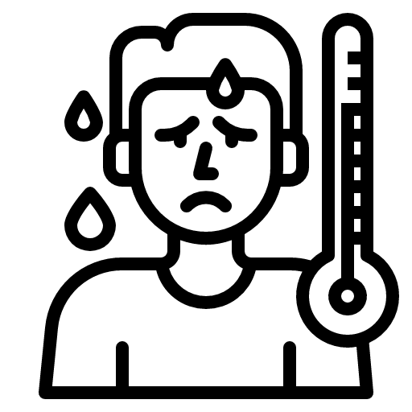
History and Clinical features
OSCE
Symptoms are not specific
- Paroxysms of:
Chills/rigors followed by fever, sweats
- A pattern might develop (i.e., fever occur every 2-3 days)
- Headache, weakness, muscle and joint pain.
Common
Anorexia
Nausea, vomiting
Diarrhoea
Abdominal pain
Less common
↑ suspicion index (e.g., travel history); the presentation within 3 months of exposure (P. falciparum) or up to 1 year (P. vivax & ovale).
In children → influenza-like respiratory symptoms. (Atypical presentation)
History and Risk Factors
Travel history is key in patients presenting in non-endemic countries. If positive, history of prophylaxis must be obtained. Must ask because some patients maybe asymptomatic
Settled migrants.
Low host immunity.
Pregnancy.
Children aged less than five years.
Elderly.
Physical examination
Bedside examination might reveal the following signs:
Hepatosplenomegaly due to 1- liver stage + Human blood stage 2-Hemolysis-> anemia -> pale
Anaemia signs (e.g., pallor)
It is important to pick up the complications of severe malaria such as: because treatment differs in severe cases
Confusion/altered level of consciousness
Seizures
Hypotension
Oliguria/anuria
Jaundice
Respiratory distress

Slide 6
Investigations
OSCE
Laboratory
1
Rapid diagnostic test (RDT)¹
2
Light Microscopy:²
Giemsa-stained blood smear; Thin film, thick film.
3
Polymerase Chain Reaction (PCR) large hospitals
3
Loop-mediated Isothermal Amplification (LAMP)³
An emerging test
Other baseline tests
Full blood count (FBC) for anemia or hemolysis people with sickle cell anemia tend to be immune to Malaria
Clotting profile
Serum electrolytes
Urea and creatinine (U&E)
Liver function tests (LFTs)
Blood glucose Hypoglycemia due to chloroquine- resistance
Urinalysis
Arterial blood gas (ABG) you might see Lactic acidosis
Community diagnosis
Pre-elimination⁴
Eliminated
Epidemic-prone areas
Areas with advanced malaria control
- Universal access to diagnostic tests/ capabilities.
- Surveillance/mapping.
- Focused screening (e.g., those who present with danger signs) and treatment (e.g., active case strategy in Oman).
Areas where malaria has been eliminated
- Prevent re-introduction.
- Considerable resources are still needed.
- Different strategies (e.g., border control, active case management).
- Maintain high-quality diagnosis
Areas where malaria has been eliminated
- Vigilance (e.g., investigations of unusual increase in cases with fever)
- Field surveys with RDTs
Which of the following preventive measures is included in the malaria control program ? Case Management
1: Anyone can do it, but not specific and you can’t tell the type of Protozoa. It is used in community diagnosis (because it is rapid) where you scan a lot of people.
2: It’s specific. It tells you the type of Protozoa but someone has to be very skilled in order to count on it as diagnostic (picture it as an Ultrasound where it’s operator dependent)
3: New diagnostic tool it’s still under development but promising because it’s cheap and specific
4: Saudi is in this stage

Slide 7
Management
Treatment will depend on:
Geographical area (sensitivity V resistance)
The infecting species (falciparum V the rest)
Blood smear appearance (parasite load; stage)
Clinical status (acute v ongoing; uncomplicated v severe; pregnancy)
Treatment algorithm: an example
Acute P. falciparum
Sever
Uncomplicated
Pregnant
Non-pregnant
Chloroquine-resistant region an non pregnant
Chloroquine- sensitive region and non-pregnant
Pregnant
1st line: Artesunate and Sulfadoxine- Pyrimethamine (ACT)
2nd line: Artemether and Lumefantrine
Chloroquine phosphate/hydroxychloroquine
1st line: quinine sulphate and clindamycin
PLUS Primaquine
Saudi Arabia is considered as a chloroquine-resistant area as the first case of resistance was reported in the late 1980s, therefore, Artemisinin Combination Therapy (ACT) is recommended (MOH 2019).
Treatment of malaria in pregnancy must be discussed with an infectious diseases specialist.
Primaquine is contraindicated in:
G6PG deficiency¹
Infants <6m
Pregnancy
Hypersensitivity
lactating mothers for babies <6m
1- The evidence is still uncertain if patients with P. Falciparum infection and glucose-6-phosphate dehydrogenase deficiency (G6PD) should not be given primaquine (BMJ 2020).

Slide 8
Management
Treatment failure → Antimalarial drug resistance
behaviour
Health workers / patients’
behaviour
(incorrect dose; poor compliance)
National policy
Poor national policy
(drug quality; distribution)
Parasite
Parasite resistance
Three species known for resistance: P. falciparum, vivax and malariae.
Resistance to one drug confers resistance to others (cross-resistance) which leads to multidrug resistance
Resistance (gene mutations):
Complete:
Survival / multiplication of malaria despite adequate treatment.
Partial:
Delayed clearance or incomplete recovery.
The main cause of resistance is gene mutations
Incubation period for each organism
 | Prepatent period | Incubation period
 | Time between infective bite and detection of the parasite in a blood smear | Time between infective bite and onset of clinical symptoms
P. falciparum | 6-12 days | 9-14 days
P. vivax¹ | 8-12 days | 12-18 days
P. ovale | 8-12 days | 12-18 days
P. malariae | 12-16 days | 18-40 days
Period of communicability:
Humans may infect mosquitoes as long as infective gametocytes are present in the blood.
Anopheles mosquitoes remains infective for life.
1- Some strains of P. vivax, may have an IP of 8-10 months or longer
Transfusion associated malaria has a shorter example IP.

Slide 9
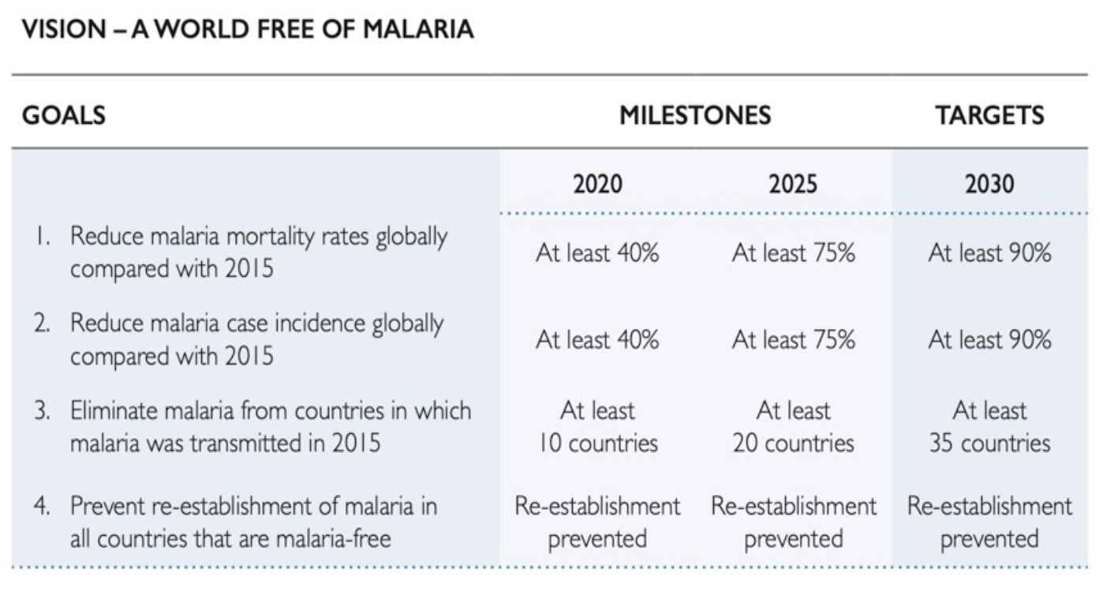
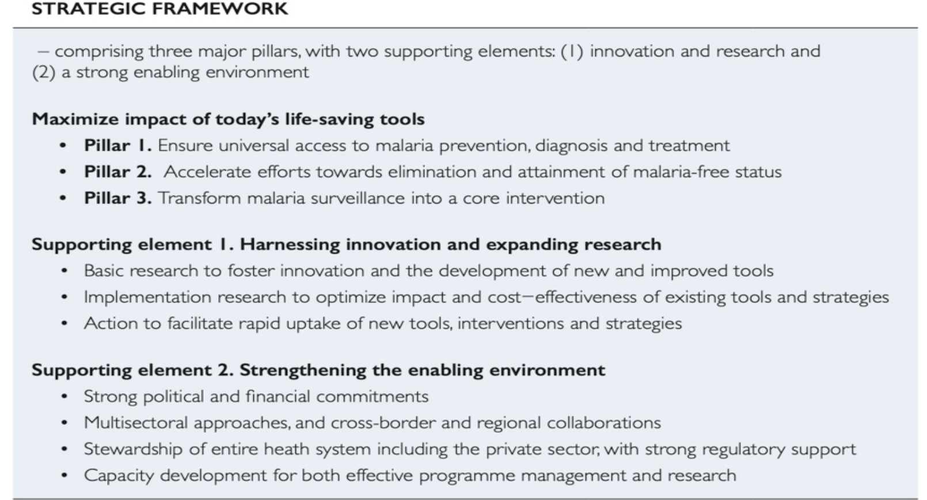
Malaria Control
WHO efforts in malaria control (vision 2030)
Global technical strategy “GTS” (2016-2030)

Slide 10
Malaria Control
Global measures to combat malaria: Pillar 1
Pilar 1: Ensure universal access to malaria prevention, diagnosis and treatment
1- Vector control
Maximise the impact of vector control Maintain adequate entomological surveillance and monitoring Manage insecticide resistance and residual transmission Strengthen capacity for evidence- driven vector control Implement malaria vector control in the context of integrated vector management
2- Chemo-prevention subtherapeutic doses of malaria treatment for prophylaxis
Expand preventive treatment to prevent disease in the most vulnerable groups. Protect all non-immune travellers and migrants. Example: Someone plans on traveling to an endemic chloroquine- resistant country? Doxycycline (before/during/after travel)
3- Diagnostic testing and treatment
Ensure universal diagnostic testing of all suspected malaria cases. Provide quality assured treatment to all patients. Monitor safety and efficacy of antimalarial medicines and manage antimalarial drug resistance. Contain antimalarial drug resistance. Eliminate falciparum malaria from the Greater Mekong subregion. Remove all inappropriate antimalarial medicines from market. All countries should aim to eliminate malaria. Scale up community based diagnostic testing and treatment. - All suspected cases must be confirmed first before given treatment. If treatment failure is > 10% , first line therapy is reviewed (every 2 years, countries review their malaria health policies) - Use multiple drugs (combination) to avoid resistance

Slide 11
Malaria Control
Global measures to combat malaria: Pillar 2 & 3
Pillar 2: accelerate efforts towards elimination and attainment of malaria-free status
Refocus programmes Enact legislation Renew political commitment and deepen regional collaboration Reduce the number of undetected infections Implement targeted malaria vector control Prevent re-establishment of local malaria transmission Implement transmission-blocking chemotherapy in high transmission/resistance cases Detect all infections to attain elimination and prevent reestablishment Use of medicines to reduce the parasite pool Devise P. vivax-specific strategies the problem is that it can live in multi environments so it’s very resistant Use surveillance as an intervention in elimination programs
Pillar 3: transform malaria surveillance into a core intervention
Surveillance in areas of high (focus on no. of deaths and cases) and low (focus on high risk groups) transmission. Surveillance in areas targeted for elimination of malaria Invest in routine information systems Collect necessary data for understanding disease trends and overall programme performance Develop national strategic plans that take into account the epidemiology and heterogeneity of malaria in a country Monitor the implementation of national malaria strategic plans at regular intervals Ensure the surveillance system is monitored
Supporting element 1: harnessing innovation and expanding research | Supporting element 2: strengthening the enabling environment
Vector control Diagnostic testing and treatment Malaria vaccines Surveillance Elimination | Increase international and domestic financing Ensure robust health sector response Strengthen health workforce and malaria expert base Ensure the sustainability of malaria responses Improve government stewardship Strengthen multisectoral collaboration Encourage private sector participation Empower communities and engage with non-governmental organisation

Slide 12
Cases
Case 1
A child aged 3 years is brought in for fever over the past 24 h. The father reports no cough or diarrhoea.
Physical examination shows a temperature of 38.6 °C but no other major sign.
RDT is negative.
(1) What is your diagnosis?
(2) What advice do you give to the father, and what treatment do you prescribe?
Non-specific fever (without danger signs)
1) Diagnosis: non-specific fever or non-malaria fever or flu-like syndrome
2) Reassure the father that his child does not have malaria. Tell him to bring the child again if the fever persists or if a new problem appears. Treat the child with an antipyretic only.
Take home message: RDT is negative → No malaria → No antimalarial treatment
Case 2
An infant aged 11 months is brought to a dispensary for fever over the past 48 h. The mother reports difficulty in breastfeeding since the previous day and one episode of convulsion.
Physical examination shows a temperature of 38.6 °C and slight drowsiness but no other major sign.
Explain the actions you would take, one by one.
- Difficulty to suck, convulsion, drowsiness = Danger signs
- Do not lose time by asking for malaria tests; they will be done at the hospital.
- Immediately prescribe an antimalarial and an antibiotic treatment (and antipyretic)
- Refer the infant urgently to hospital
Take home message: Danger signs antimalarial+antibiotic + immediate referral
Exercise:
Identify key factors and common clinical Features
A 42-year-old Nigerian woman presents to her primary care physician with a 2-day history of fever, chills, and sweats with associated headache and myalgia. She is febrile (38.6C [101.4 F]) and tachycardic, but examination is otherwise unremarkable. A presumptive diagnosis of influenza is made, and she is advised to return if she does not improve. Two days later she presents to the emergency department with similar symptoms and frequent vomiting. On examination she appears ill, with a temperature of 38.8°C (101.8'F), pulse rate 120 beats per minute, blood pressure 105/60 mmHg, and mild jaundice. Further history reveals that she recently visited family in Nigeria for 2 months, returning 1 week before presentation. She did not take malaria prophylaxis.

Slide 13
Quiz
MCQ
1- Sporozoites when injected into the human skin it migrates to?
A- Hepatocytes. B- Intestinal wall. C- Macrophages. D- Lymphocytes.
2- What is the main organ affected in malaria infection?
A- Liver. B- kidney. C- RBCs. D- intestine.
3- which one of the following has immunity against malaria:
A- sickle cell trait B- microcytic anemia C- G6PG deficiency D- children less than 6
4- the main way to reduce malaria transmission at a community is
A- human control B- vector control C- environmental control
5- You work in prevention of malaria in west Africa, what is the best prevention?
A- Mass vaccination B- Use insecticides in beds and crops C- use spray nets D- Drinking a lot of orange juice
6- What is the main mode of transmission in malaria?
A- Blood Transfusion B- Animal bite C- TransPlacental D- Vector borne
Answers
Q1 | Q2 | Q3 | Q4 | Q5 | Q6
A | C | A | B | C | D

Slide 14
Thank You and
Good Luck
Team Leaders:
Lama AlAssiri | Mohammed AlHuqbani | Ibrahim AlDakhil
Team Members:
Lama AlZamil
Leen AlMazroa
Muneera AlKhorayef
Norah AlMazrou
Nouf Alhussaini
Rema AlMutawa
Sara AlAbdulkareem
Sedra Elsirawani
Wejdan Alnufaie
Abdulrahman Alhawas
Abdulrahman Shadid
Abdullah Aldawood
Abdullah Shadid
Alwaleed Alsaleh
Bader Alshehri
Bassam Alkhuwaiter
Faisal Alqifari
Hameed M. Humaid
Khalid Alkhani
Meshari Alzeer
Mohannad Makkawi
Nayef Alsaber
Omar Aldosari
Omar Alghadir
Zyad Aldosari

