Slide 1
Emerging Infectious
Disease
Objectives
Understand the viral antigenic variations of influenza virus .
List the different hosts for influenza (according to influenza type), MERS-Cov and SARS .
Be familiar with the famous pandemics for each of these viral infections, and measures used to contain spread .
Identify the different elements in the infection cycle for these viral infections .
Provide appropriate prevention and control measures for each of these viral infections .
Outline how to take history of risk factors, and how to give preventive advise.
Be familiar with all 3 diseases
Important lecture!
Color Index
Main text
Males slides
Females slides
Doctor notes
Important
Textbook
Golden notes
Extra
Editing File

Slide 2
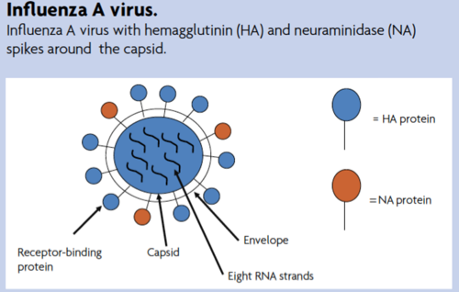
What is an emerging infectious diseases?
Emerging infectious diseases are those that: 1.Occur among humans for the first time 2.Occurred previously in a small number and suddenly increased in number 3.Have been occurring throughout history but only recently recognized as distinct diseases
1
Influenza virus
Orthomyxoviridae
Virus subtypes are antigenically distinct (no cross-immunity)
Frequently subject to antigenic variation Antigenic changes occur in types A or Type B, with type C being stable
Influenza Virus: types and variation
Antigen type | Who does it infect? | What does it cause?
A | Human | Seasonal epidemic,pandemic
B | Human | Seasonal Epidemic
C | Human | Mild respiratory illness
D | Cattle | ---
Influenza A subtypes
Influenza Type B
Subtypes are based on the two surface proteins;
Hemagglutinin (H); antigen initiates infection
Neuraminidase (N); antigen releases virus into cell
There are:
18 hemagglutinin subtypes (H1 to H18)
11 neuraminidase subtypes (N1 to N11)
Influenza A subtypes infective to humans:
Currently circulating viruses type A are:
H1N1 responsible for pandemics (this is the doctor’s note and a golden note)
H3N2
Type B influenza does not have subtypes,It can be divided into two lineages:
B/Yagamata
B/Victoria

Slide 3
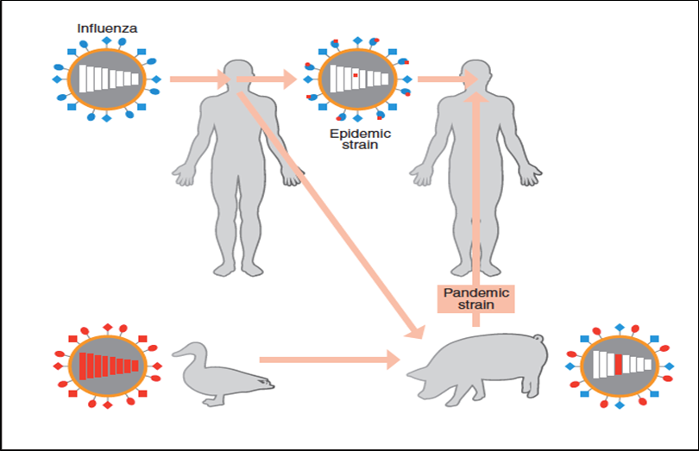
Antigenic variations
What does this mean?
Antigenic drift
Happens continually over time.
Results from point mutation of the gene -> changes in surface proteins¹.
Antigenic drifts produce viruses with similar antigenic properties -> Coss-Pretection^{3,4}
Antigenic shifts happen less frequently than antigenic drifts
Type A viruses undergo both antigenic drift and shift.
Type B viruses undergo antigenic drift only
Antigenic Shift
Complete sudden change
Results from genetic recombination of human virus with animal or avian virus Responsible for pandemic strains².
Three different methods for antigenic shift:
1- virus from human and avian reassort in the swine.
2- virus jumps from avian to human.
3- virus jumps from avian to swine to human without Reassortment
Naming of influenza viruses:
These are named in the following order: The antigenic type (e.g., A, B, C) The host of origin (e.g., swine. For human-origin viruses, no host of origin designation is given.) Geographical origin Strain number (التسلسل الجيني) Year of isolation For influenza A viruses, the hemagglutinin and neuraminidase antigen description in parentheses Example of naming: ̈What does this mean? A/Perth/16/2009 (H3N2) No host origin because from human
A/duck/Alberta/35/76 (H1N1)
Geographic origin
Year
Hemagglutinin and neuraminidase subtypes
Antigen
Host of origin
Strain number
1: The result is a mutated virus.
2: The result is a new virus.
3: Cross-protection is the inability of a new virus strain to cause infection in a host that is already infected with another similar strain of that same virus.
4: Why do some people get the flu more than 1 time, although they are vaccinated? This is due to antigenic drift. The small changes that occur from antigenic drift produce viruses that are closely related to one another, however these small changes can accumulate over time and result in viruses that are antigenically different.

Slide 4
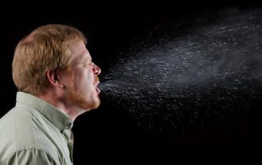
Reservoir, Mode of Transmission, Symptoms, and Diagnosis
Differentiate between them in Influenza virus, MERS-CoV and SARS-CoV
1
Reservoir of influenza:
Animals (swine, horses, dogs, cats)
Birds (poultry, wild birds)
human
2
Characteristics of influenza infection:
Source of infection is an infected host (a case or subclinical)
Secretions of respiratory tract are infective
Period of infectivity: 1-2 days prior to symptoms, and 5-7 days after symptom onset
Portal of entry: respiratory tract
Incubation period: 18 – 72 hrs
3
Symptoms:
Fever, chills, aches, coughing, generalized malaise
Fever lasts for 1-5 days (average 3 days)
4
Complications:
Secondary bacterial infection¹
Pneumonia
Raye syndrome²
Sinusitis
Otitis media
Bronchitis
5
Diagnosis:
Testing should not be done for all
Useful in order to verify if the influenza is a cause of an outbreak
Specimen collected within 3-4 days of illness:
Nasopharyngeal swab; nasal swab; nasal wash or aspirate; lower respiratory tract
6
Lab tests:
Viral culture
Serology
rRT-PCR³
7
Mode of transmission:
person-to-person by droplet or droplet nuclei
Touching surface contaminated with influenza virus
8
Risk factors for infection:
Season: Winter or rainy season
Age: More severe disease in older age and children younger than 18 m
Overcrowding
Contact with infected individual
Immunity
Antibody against H antigen vs. antibody against N antigen
High risk for severe disease:
Chronic diseases; pregnant; elderly; DM; CHD; CLD; Imm
1: Whether it’s upper or lower respiratory tract infection.
2: Reye syndrome is characterized by hepatic failure and encephalopathy. It occurs after a viral infection in children who use aspirin during the infection.
3: Confirmatory test.

Slide 5
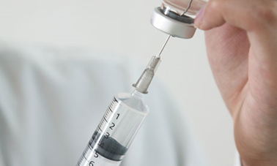
Historical Pandemics
Date of Pandemic | Influenza subtype | Death Toll
1918-1919 | Spanish influenza H1N1 | 50 million
1957-1958 | Asian influenza H2N2 | 2 million
1968-1969 | Hong kong influenza H3N2 | 1 million
2009-2010 | H1N1 (swine flu) - novel subtype | 18.2 thousand +
Signs of an outbreak :
01
02
03
04
05
06
Starts with few cases
Sudden outburst of disease
Increased febrile illness in children followed by adults
Increased hospitalization due to illness
Attack rates are high: 5-10% in adults; 20-30% children
Epidemic peaks within 3-4 weeks then declines
Control of Infection and Prevention
Prevention of influenza :
Follow cough etiquette ( cover mouth and nose while sneezing)
Wash hands
Vaccination to prevent severe disease
Influenza vaccine:
Provides 90% protection in healthy adults
Reduce severity of disease by 60%; death by 80%
Usually takes two weeks after vaccination for body to produce immunity
One vaccine for northern hemisphere and one for southern hemisphere
Immunity against two type A (H1N1; H3N2) , and B (trivalent)
Immunity against two type A and two B
Flu vaccines available in KSA:
Injection vaccine:
Inactivated virus
Ages 6 months and above
Safe for pregnant women
Targets H antigen
Nasal spray vaccine:
Live weakened virus
Ages 2y to 49 y
NOT safe for pregnant women
Targets both H and A antigens

Slide 6
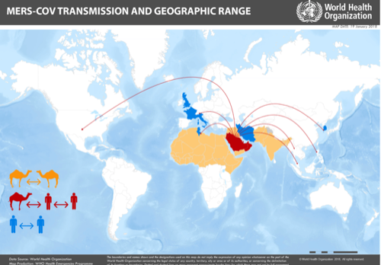
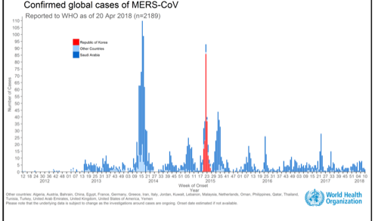
According to the MOH the following are recommended for flu vaccination:
All Diabetics
Individuals with asthma; COPD
Patients with chronic cardiac diseases; chronic renal diseases; chronic liver diseases
Neurological Disorders
Immune deficiency patients
Morbidly obese individuals
Pregnant women
6 m - 18 y on long term Aspirin therapy
Children aged 6m – 5y; adults 50+ y¹
All healthcare workers
Vaccine complications and contraindications: symptoms that appear in the first 48 hours:
Mild redness or swelling at the injection site
Slight rise in temperature
Minor body aches
Sore throat
Contraindications (the Doctor might ask a question)
Those who have severe egg allergy Previous history of severe allergy to influenza vaccine Yes there are vaccine modifications where egg allergies aren’t contradicted but we don’t know of KSA has them so we make sure they don’t have egg allergies
History of Guillain Barre Syndrome after taking the vaccine
Children under 6 months
People suffering from very high or moderate temperature
2
Middle East Respiratory Syndrome (MERS-CoV)
Caused by the coronavirus
First discovered in Saudi in 2012 due to socioeconomics (camel owners)
It was a novel virus
Majority of cases were due to unprotected healthcare provision
Reported in the following countries (80% of cases were in KSA):
Algeria, Austria, Bahrain, China, Egypt, France, Germany, Greece, Islamic Republic of Iran, Italy, Jordan, Kuwait, Lebanon, Malaysia, the Netherlands, Oman, Philippines, Qatar, Republic of Korea, Saudi Arabia, Thailand, Tunisia, Turkey, United Arab Emirates, United Kingdom, United States, and Yemen.
Reservoir, Mode of Transmission, Symptoms, and Diagnosis
1
Source of MERS-CoV:
Animals in the Arabian peninsula
Dromedary camels
May have been in bats and transmitted to camels sometime in the past
2
Incubation period & transmission:
Incubation: 2-14 days
Mode of transmission:
Person-to-person(patient- to-HCW)
Camels-to-humans (unknown route or infection cycle)
1: Because the age group itself is a risk factor.

Slide 7
3
Symptoms:
Fever
Cough
Shortness of breath
asymptomatic or mild symptoms
GI symptoms
4
Complications:
Pneumonia: respiratory failure (require ventilator)
Death (30-40% of infected))
Why do we worry about MERS-COV more than COVID-19? Due to the high case fatality rate
5
Risk factors for infection:
People in close contact with a confirmed MERS case
Healthcare personnel who do not use recommended infection-control precautions
People who have been in contact with camels; visiting farms
Consumption of raw animal products
Elderly, immunocompromised, chronic disease
6
Diagnosis:
Nasopharyngeal swab -> rRT-PCR
If negative -> retest lower respiratory specimen¹
Cases should be reported within 24 hrs (category 1 reportable disease)
7
Treatment:
No treatment is available
Only treatment to relieve symptoms
Support vital organ functions in severe cases
No vaccine is available
8
Prevention:
Handwashing
Cough etiquette
Avoid touching your eyes, nose and mouth with unwashed hands
Avoid personal contact, or sharing cups or eating utensils, with sick people
Clean and disinfect frequently touched surfaces and objects, such as doorknobs
Healthcare workers practice infection control precautions; negative pressure room, masks…etc
3
Severe Acute Respiratory Syndrome (SARS-CoV)
Also an infection caused by coronavirus
First reported in Asia in 2003
Spread to more than 24 countries around the world
8,098 cases -> 774 deaths
No cases have been reported after 2004
Reservoir: Horseshoe bats
1
Symptoms:
High fever
Headache
Overall feeling of discomfort
Generalized body aches
Mild respiratory symptoms
Dry cough
Diarrhea
Complications: Pneumonia; pulmonary decompensation; ARDS
1: Due to high false negative.

Slide 8
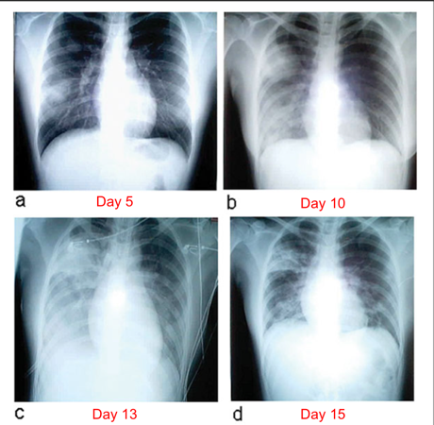
2
transmission:
Direct: Person-to-person; respiratory
Droplets Indirect: Contacting surface contaminated with respiratory droplets
May be airborne ? it spreads very quickly they think it may be airborne In healthcare setting: Aerosol-generating procedures
Virus shed in stool – not clear feco-oral transmission
Incubation period: 2 – 7 days
3
Diagnosis::
Usually based on history
If history suggest SARS and X-ray normal; thin cut CT
Laboratory: rRT-PCR¹
4
Signs of chest x-ray:
Unilateral patchy shadowing
After 1-2 days: bilateral interstitial infiltration
Later: Air-space opacities
5
Treatment²:
No clear scientifically proven treatment available
Severe cases require intensive care
Antiviral treatment is questionable; some studies suggest poorer outcomes for those receiving antiviral agents.
6
Prevention & control:
No vaccine available
Handwashing and infection control precautions
In case of reported cases, early identification and efficient reporting of cases³
Isolation of patients with infection
Exit screening for international travelers⁴
Appropriate protection of medical staff caring for patients⁵
1: Confirmatory test.
2: Supportive treatment.
3: Helped in decreasing the number of infection in those 2 years.
4: الجواز الصحي
5: Providing PPE, training medical staff, develop an infection control program, etc..

Slide 9
Quiz
MCQ
1- Which type of influenza virus causes pandemics?
A. Type A B. Type B C. Type C D. All of them
2- What does X denotes in this nomenclature, A/duck/X/Y/Z (H1N1) influenza virus?
A. Antigen B. Year C. Strain number D. Origin
3- What is the main reservoir for influenza A?
A. Animals B. Soil C. Human carriers D. Water pools
4- Which of the following requires 2nd level prevention?
A. Leprosy B. Ebola C. MERS-CoV D. Malaria
5- Which of the following is the most common symptom of MERS-CoV?
A. Muscle aches B. Bloody diarrhea C. Fever D. Abdominal pain
6- What is the main reservoir for SARS Co-V?
A. Camel B. Horseshoe bat C. Wild birds D. Dogs
Answers
Q1 | Q2 | Q3 | Q4 | Q5 | Q6
A | D | A | C | C | B

Slide 10
Thank You and
Good Luck
Team Leaders:
Lama AlAssiri | Mohammed AlHuqbani | Ibrahim AlDakhil
Deema AlMaziad
Lama AlZamil
Leen AlMazroa
Lina AlOsaimi
Muneera AlKhorayef
Norah AlHarbi
Norah AlMazrou
Nouf Alhussaini
Razan AlRabah
Renad Alhaqbani
Rema AlMutawa
Team Members:
Hameed M. Humaid
Khalid Alkhani
Meshari Alzeer
Mohannad Makkawi
Nayef Alsaber
Omar Aldosari
Omar Alghadir
Zyad Aldosari
Sara AlAbdulkareem
Sedra Elsirawani
Wejdan Alnufaie
Abdulrahman Alhawas
Abdulrahman Shadid
Abdullah Aldawood
Abdullah Shadid
Alwaleed Alsaleh
Bader Alshehri
Bassam Alkhuwaiter
Faisal Alqifari

