Slide 1
COVID-19 Pandemic
ALL PICTURES AND NOTES ARE IMPORTANT!!
Objectives
Global and local epidemiology of COVID 19
Risk factors, and preventive measures in COVID
Practices required to effectively prevent infection in the University and hospital setting
Outline
What is COVID?
Why has it been called a pandemic?
How can it spread?
Signs and symptoms of COVID
Who are at risk?
How to protect yourself and your loved ones
Precautions to take while in the University and clinical rotations/work
How take care of your physical and mental
Color Index
Main text
Males slides
Females slides
Doctor notes
Important
Textbook
Golden notes
Extra
Editing File

Slide 2
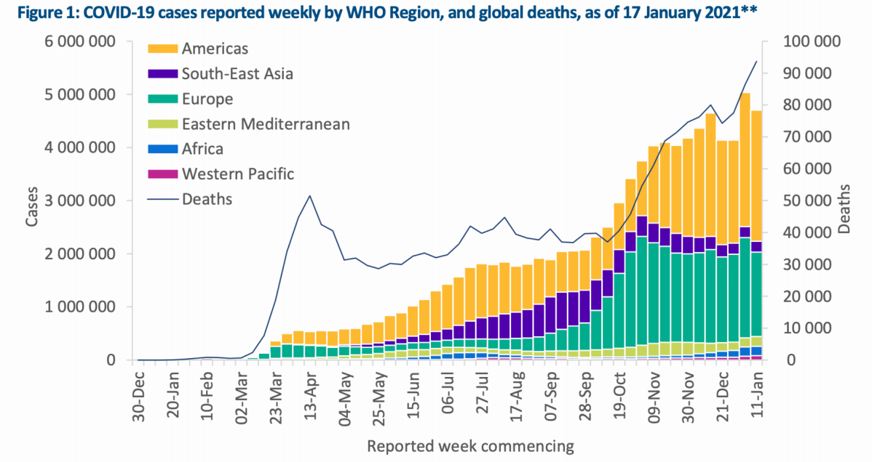
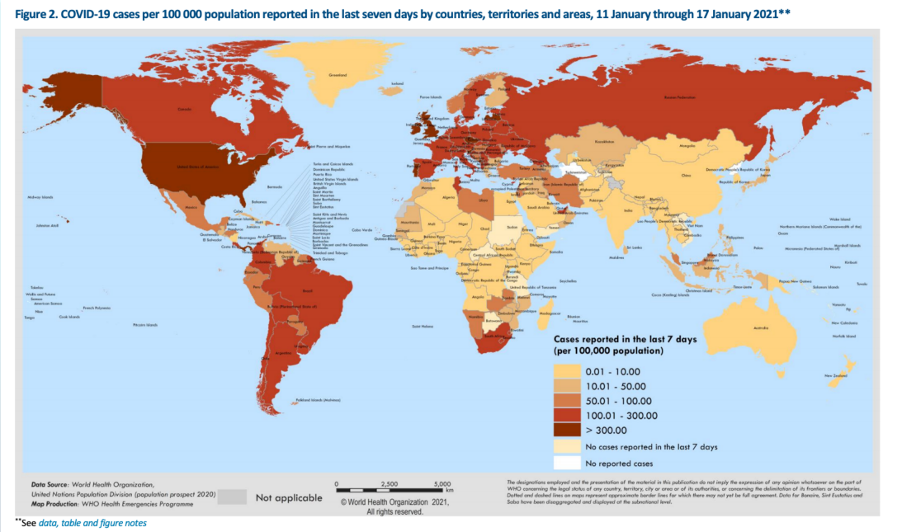
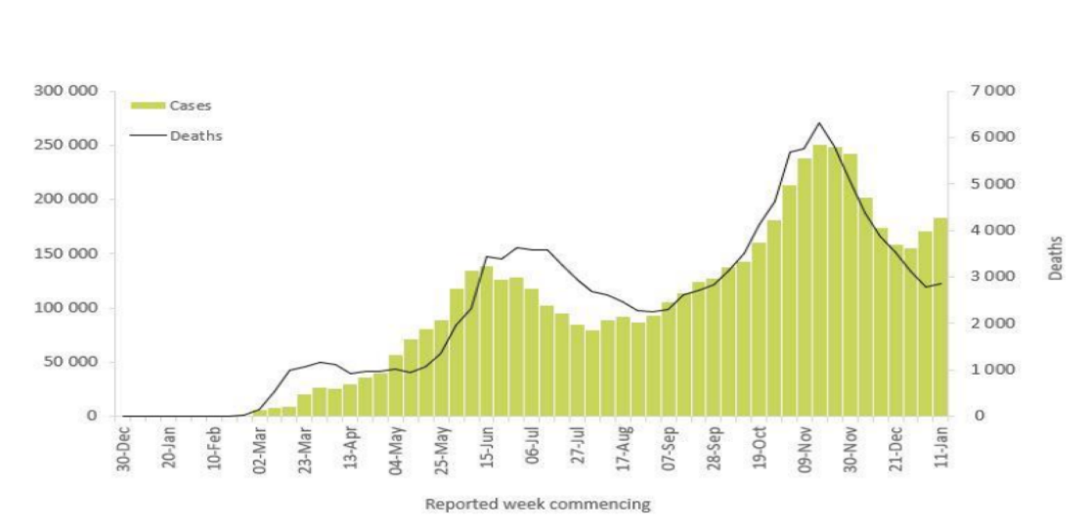
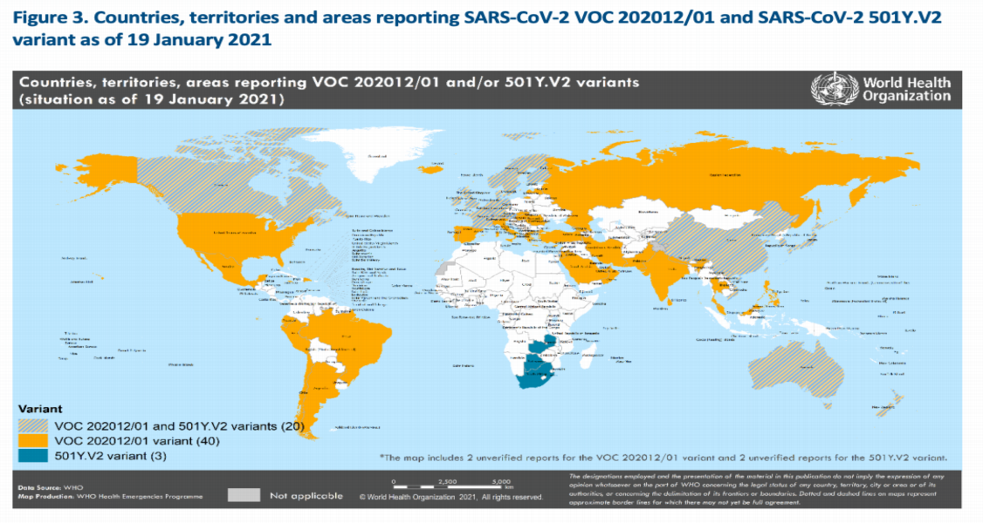
Coronavirus
These are a large family of viruses that cause illness ranging from the common cold to more severe diseases such as Middle East Respiratory Syndrome (MERS-CoV) and Severe Acute Respiratory Syndrome (SARS-CoV)
A novel coronavirus (nCoV) is a new strain that has not been previously identified in humans; COVID 19. It was publicly identified first in Wuhan city, China on December, 31, 2019.
It entered a global level on March, 2020. The graph shows two major peaks (Mar & Nov) with smaller peaks in between
Americas region is where most of the cases are
Also, this graph shows the cases reported across all countries. Highest rates are in US and some countries in europe (ex: UK).
Eastern Mediterenean regions
There are two peaks. First was in May-June and the other peak was in November.
The graph also predicts that there might be a rise in the cases if necessary precautions weren’t implemented.
The graph shows the different variants of COVID-19.
The first variant was the one first discovered.
Different variants should arise a concern. Vaccines made mainly covers the first variant, limited studies are there on their efficacy on other variants and future variants.

Slide 3
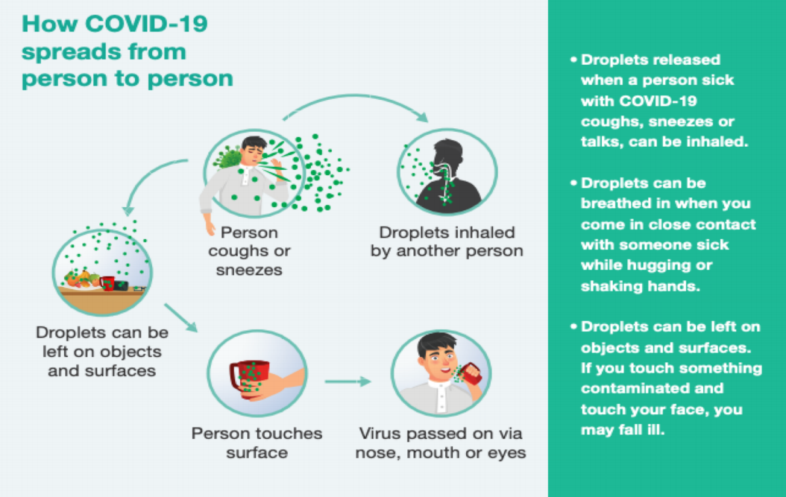
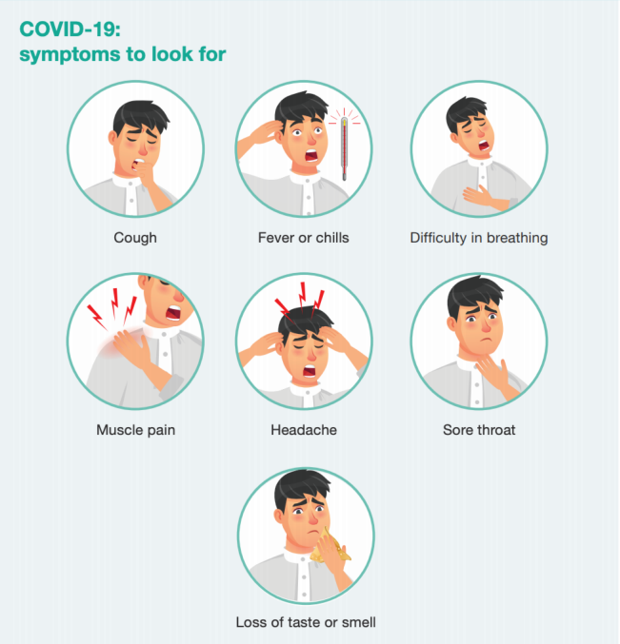
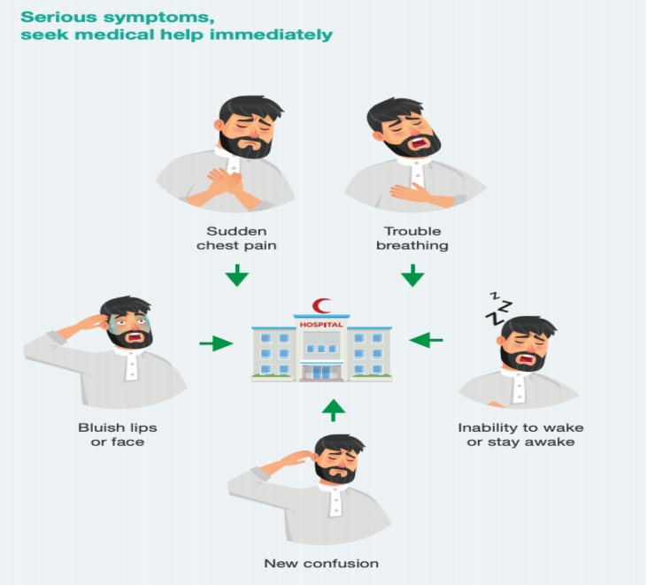
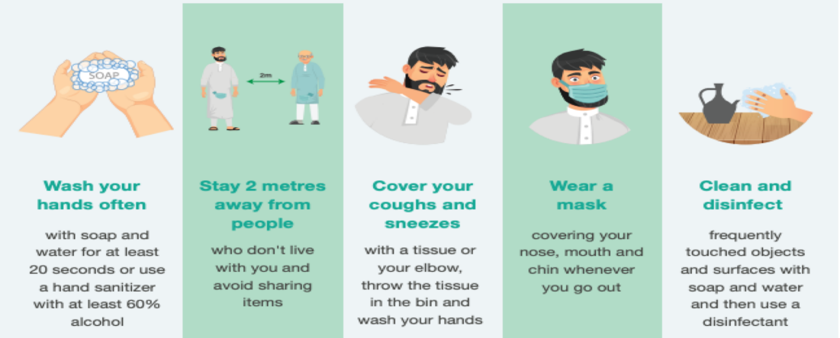
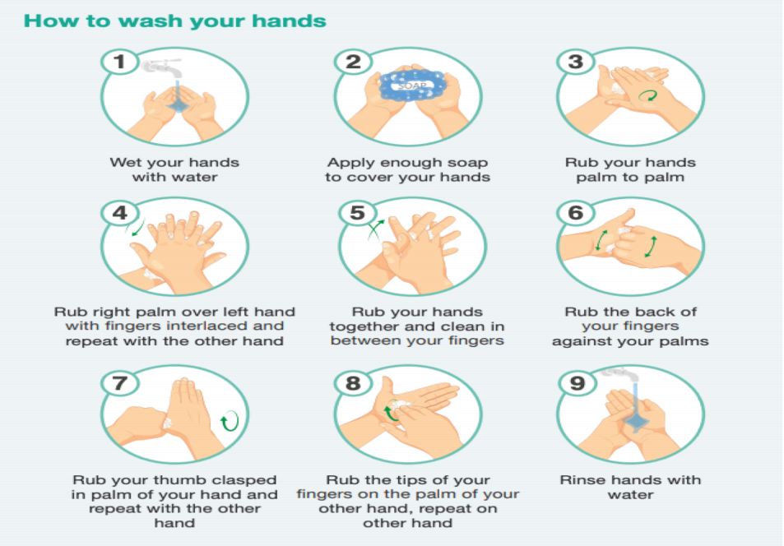
Clinical Picture of COVID-19
Mode of Transmission:
COVID-19 is mainly transmitted through droplet infection.
Whenever an infected person speaks or coughs, droplets are released and can be inhaled by a different person within 2 m
Moreover, droplets can be left on surfaces ¹ for sometime before getting inactivated
Signs and Symptoms:
Common symptoms | Serious/Severe Symptoms
The symptoms differ from the flu in their intensity. Loss of taste or smell is particularly pathognomic and should rise high index of suspicion. | Any patient with any of the symptoms above should immediately seek healthcare and MUST be admitted to the hospital.
How to protect yourself and others? ^{2,3}
Video is very important!!
2 meters = 2 arm's length
Handwashing should be for 2 minutes
Recent research evaluated the survival of the COVID-19 virus on different surfaces and reported that the virus can remain viable for up to 72 hours on plastic and stainless steel, up to four hours on copper, and up to 24 hours on cardboard.
Does a person, who had the infection, required to wear a mask? YES, all people should wear masks even if they got the infection since they’re still susceptible for reinfection.
Medical masks (surgical) should be worn by healthcare workers, COVID-19 infected people, people who takes care of infected people, people above the age of 60 and people with underlying conditions. Other than that, a fabric mask is enough.

Slide 4
Surveillance and Case Definitions
Suspicion of COVID-19 case is defined as:
Clinical Presentation | Epidemiological Link
1- Patient with acute respiratory illness* (sudden onset of at least one of the following: fever (measured or by history), cough, or shortness of breath). AND in the 14 days prior to the symptom onset, met at least one of the following epidemiological criteria * Some patients might present with GI symptoms prior to developing LRTI | Had a history of travelling abroad Or Has visited or being a resident of high-risk area for COVID-19 in the kingdom Or A close physical contact prior to symptom onset with a confirmed COVID-19 case Or Working in healthcare facility
2- Any admitted adult patient with unexplained SARI (Severe acute respiratory illness), whether its community acquired (CAP) or hospital acquired pneumonia (HAP). | NOT REQUIRED
What Should I do if I Feel Sick?
REPORT IMMEDIATELY!
Flu-like symptoms:
Report to the flu clinic
Opens 24 hrs
Come in Close Contact:
Report to the occupational health clinics
Fill in the link for contact tracing
Who & Where

Slide 5
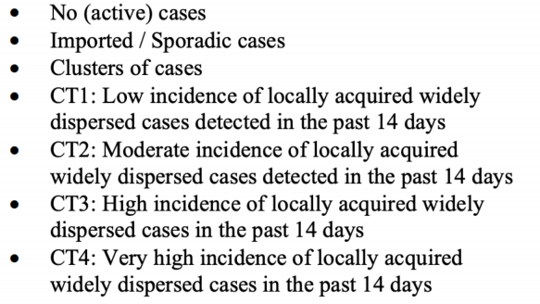
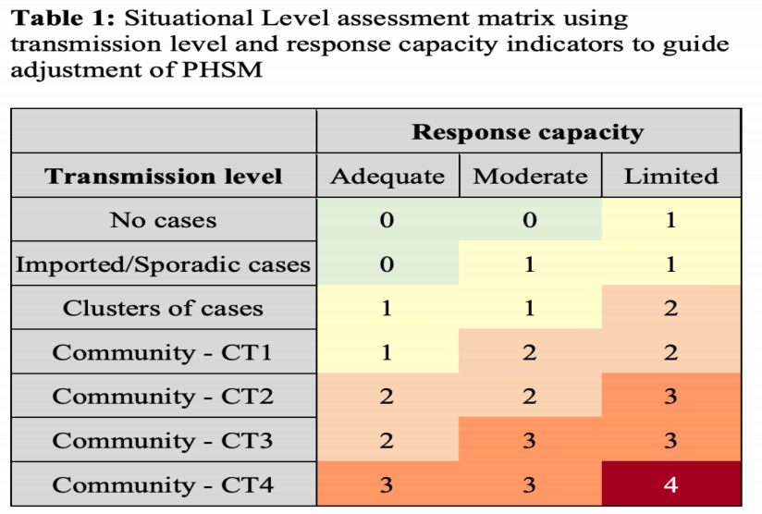
Public Health and Social Measurements
Community Transmission
Situational level | Description
0 | Corresponds to a situation with no known transmission of SARS-CoV-2 in the preceding 28 days. The health system and public health authorities are ready to respond, but there should be no restrictions on daily activities.
1 | Situation where basic measures are in place to prevent transmission; or if cases are already present, the epidemic is being controlled through effective measures around the cases or clusters of cases, with limited and transient localized disruption to social and economic life.
2 | Represents a situation with low community incidence or a risk of community transmission beyond clusters. Additional measures may be required to control transmission; however, disruptions to social and economic activities can still be limited.
3 | Situation of community transmission with limited additional capacity to respond and a risk of health services becoming overwhelmed. A larger combination of measures may need to be put in place to limit transmission, manage cases, and ensure epidemic control.
4 | Corresponds to an uncontrolled epidemic with limited or no additional health system response capacity available, thus requiring extensive measures to avoid overwhelming of health services and substantial excess morbidity and mortality.
1
Public health and social measures (PHSM) have proven critical to limiting transmission of COVID19 and reducing deaths.
2
The decision to introduce, adapt or lift PHSM should be based primarily on a situational assessment of the intensity of transmission and the capacity of the health system to respond, but must also be considered in light of the effects these measures may have on the general welfare of society and individuals
3
Indicators and suggested thresholds are provided to gauge both the intensity of transmission and the capacity of the health system to respond; taken together, these provide a basis for guiding the adjustment of PHSM. Measures are indicative and need to be tailored to local contexts.
4
PHSM must be continuously adjusted to the intensity of transmission and capacity of the health system in a country and at sub-national levels . When PHSM are adjusted, communities should be fully consulted and engaged before changes are made

Slide 6
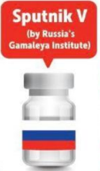
This pic was skipped by the doctor →
Vaccines
Vaccine | Item | Description
 | Technology | Viral vector (genetically modified virus). When injected, the vaccine instructs the immune system to target SARS-CoV-2 spike proteins.
 | Efficacy | 62-90% | Dose | 2 doses required ($4/dose)
 | Process | Passed all three phases of clinical trial
 | Technology | mRNA. When injected, the vaccine tricks the body into making the viral proteins which will trigger the immune system.
 | Efficacy | 95% | Dose | 2 doses required ($20/dose)
 | Process | Passed all three phases of clinical trial
 | Technology | Inactivated vaccine. When injected, the vaccine uses the dead COVID-19 to trigger an immune response.
 | Efficacy | 50-70% | Dose | 2 doses required ($5/dose)
 | Process | Phase 3 trials
 | Technology | Adenoviral vector-based platform. When injected, the vaccine delivers SARS-CoV-2 antigens to the patient triggering an immune response.
 | Efficacy | 91.4% | Dose | 2 doses required ($10/dose)
 | Process | Phase 3 trials
 | Technology | mRNA. When injected, the vaccine tricks the body into making the viral proteins which will trigger the immune system.
 | Efficacy | 95% | Dose | 2 doses required ($33/dose)
 | Process | Passed all three trials
 | Technology | Cold virus vector. When injected, the vaccine uses the virus to deliver genetic material from COVID-19 to trigger an immune response.
 | Efficacy | Not yet released | Dose | 1 dose required ($10/dose)
 | Process | Phase 3 trials
Vaccines administration should be prioritized for: healthcare workers, elderly (>60), people with comorbidities and immunocompromised people.
For healthcare workers, first line health workers should be prioritized before physicians with minimal contact to patients.

Slide 7
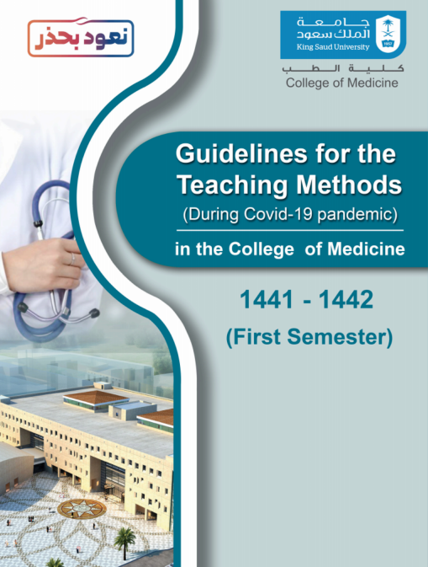
COVID-19 in University Settings
Risk transmission can be categorized as the following:
Lowest risk: virtual learning, activities, and events.
More risk: small in-person classes, activities, and events. (eg. hybrid virtual and in-person class structures or staggered / rotated scheduling to accommodate smaller class sizes)
Individuals are spaced at least 1.5-2 m apart and DO NOT share objects
Highest risk: Full-sized in-person classes, activities, and events.
Individuals are not spaced apart and they share objects, materials and supplies
Promoting Behaviors that Reduces Spread:
1
Checking temperature of students at the entrance of building/hospital
2
Staying home or Self isolating when appropriate
3
Hand Hygiene and Respiratory Etiquette:
Hand wash with soap and water for at least 20 sec (preferably 2 mins).
Hand wash immediately after arriving at college, entering classroom, finishing lunch, touching shared objects, using the bathroom, coughing, sneezing, blowing one’s nose and arriving at home.
4
Shared Objects: avoid sharing electronic devices, books, pens and other objects.
5
Masks/Cloth Face covering
6
Healthy Classrooms: space seating/desks at least 2 meters (= 2 seats) when feasible
7
Cafeteria and Restaurants: Grab and Go
8
Gathering between classes: STRICTLY not permissible
9
Use of elevators: avoid as much as possible and try to use the stairs 😂
How do you protect yourself in the hospital?
REMEMBER: PPE, surgical masks, face shield & gloves
Always follow the guidelines in the OR, ICU, ER
Always report any signs of illness, any one is deviating from the policies laid down
Reduce congestion in the health clinic
Distance inside clinics has to be 1.5 meters
Compensate the clinical training by enforcing CBD, or online courses

Slide 8
Protecting Our Mental Health
Pandemics can be really stressful
Stress can lead to decrease in the learning curve
Stress during pandemics can be related to:
- COVID-19 itself - Coping with it - Returning to back to our normal lives - Studying and keeping pace - Being in the medical field (protecting loved ones)
Healthy Ways to Cope with Stress
Know what to do if you are sick and are concerned about COVID-19
Know where and how to get treatment and other support services and resources, including counselling or therapy (in person or through telehealth services)
Take care of your emotional health (help you think clearly and react to the urgent needs to protect yourself and your family)
Take breaks from watching, reading, or listening to news stories, including those on social media
Keep informed and listen to advice and recommendations from your national and local authorities.
Take care of your body:
Take deep breaths (breathing exercises) , stretch, or meditation
Eat healthy, well-balanced meals
Exercise regularly
Get plenty of sleep
Avoid smoking and drug use
Have a routine (keep up with daily routines as far as possible, or make new ones).
Make time to unwind: Try to do some other activities you enjoy other than studies.
Connect with others: Talk with people you trust about your concerns and how you are feeling. Family, mentors, peers...
Socialisation can be done through social media, phone or mail.
Mindfulness and Types of Mindful Practice:
Mindfulness is an evidence based science that sparks innovation. It is not obscure or exotic nor a special added thing we do. You don't need to change. Mindfulness has the potential to become a transformative social phenomenon that anyone can do. It’s a way of living that brings awareness and caring into everything we do and cuts down our needless stress. Even a little makes our lives better.
While mindfulness is innate, it can be cultivated through proven techniques. Some of which are:
1
Seated, walking, standing and moving meditation (also possible by lying down but often leads to sleep)
2
Short pause we insert into everyday life
3
Merging meditation with other activities
Such as: yoga and sports
4
Applications for mindfulness

Slide 9
Quiz
MCQ
1- She is 70 years old with hypertension, type 2 diabetes mellitus, and obesity admitted to the hospital for difficulty in breathing a chest pain. She complains of a recent lack of smell, malaise, a feverish feeling, and a persistent nonproductive cough. Your community currently has a surge in COVID-19 cases, and test positivity rates are 15%. Her general examination is normal and CXR showed 60% lung infiltration. How will you classify this case?
A- Pre-disease case B- Mild case C- Moderate case D- Severe case
2- Which of the following community level transmission is described by the following statement: “high incidence and widely dispersed cases”?
A- CT1 B- CT2 C- CT3 D- CT4
3- Which of the following vaccines is correctly matched with its technology?
A- Pfizer/BioNtech → IAV B- AstraZeneca → mRNA C- Sinovac → Viral Vector D- Moderna → mRNA
4- Following the correct respiratory etiquette and advice provided by our national authorities and MOH, where should you sneeze at?
A- Hands B- Away from people C- Elbows D- Clothes
5- During the pandemic it’s advisable to wash your hands with water and soap. What is the minimum amount of time you should clean your hand with a sanitizer?
A- 120 seconds B- 90 seconds C- 60 seconds D- 20 seconds
Answers
Q1 | Q2 | Q3 | Q4 | Q5
D | C | D | C | D

Slide 10
Thank You and
Good Luck
Team Leaders:
Lama AlAssiri | Mohammed AlHuqbani | Ibrahim AlDakhil
Deema AlMaziad
Lama AlZamil
Leen AlMazroa
Lina AlOsaimi
Muneera AlKhorayef
Norah AlHarbi
Norah AlMazrou
Nouf Alhussaini
Razan AlRabah
Renad Alhaqbani
Rema AlMutawa
Team Members:
Hameed M. Humaid
Khalid Alkhani
Meshari Alzeer
Mohannad Makkawi
Nayef Alsaber
Omar Aldosari
Omar Alghadir
Zyad Aldosari
Sara AlAbdulkareem
Sedra Elsirawani
Wejdan Alnufaie
Abdulrahman Alhawas
Abdulrahman Shadid
Abdullah Aldawood
Abdullah Shadid
Alwaleed Alsaleh
Bader Alshehri
Bassam Alkhuwaiter
Faisal Alqifari

