Slide 1
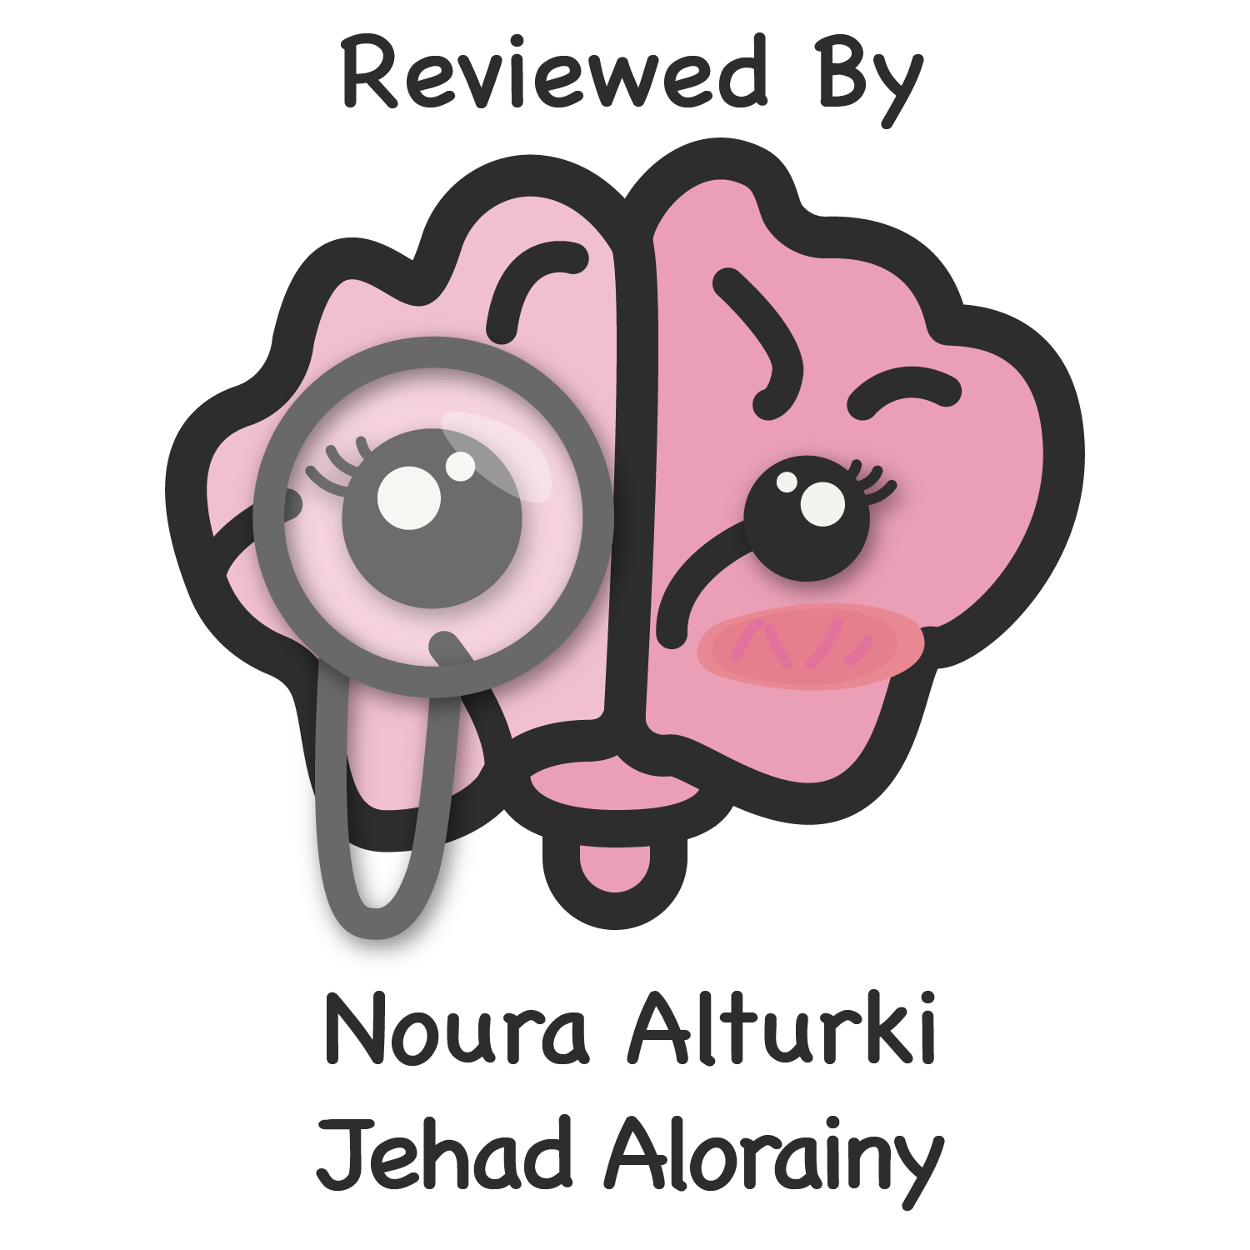
Determinants
of Health
Objectives
Understand the spectrum of health in relation to health and sickness
Define; health, disease, illness and wellbeing
Define and understand the determinants’ of health; biological, behavioral, socio and cultural, environmental, socioeconomic, health services, and aging and gender
Understand the concepts of “right to health “ and “health for all”
Color Index
Main text
Males slides
Females slides
Doctor notes
Important
Golden notes
Extra
Editing File

Slide 2
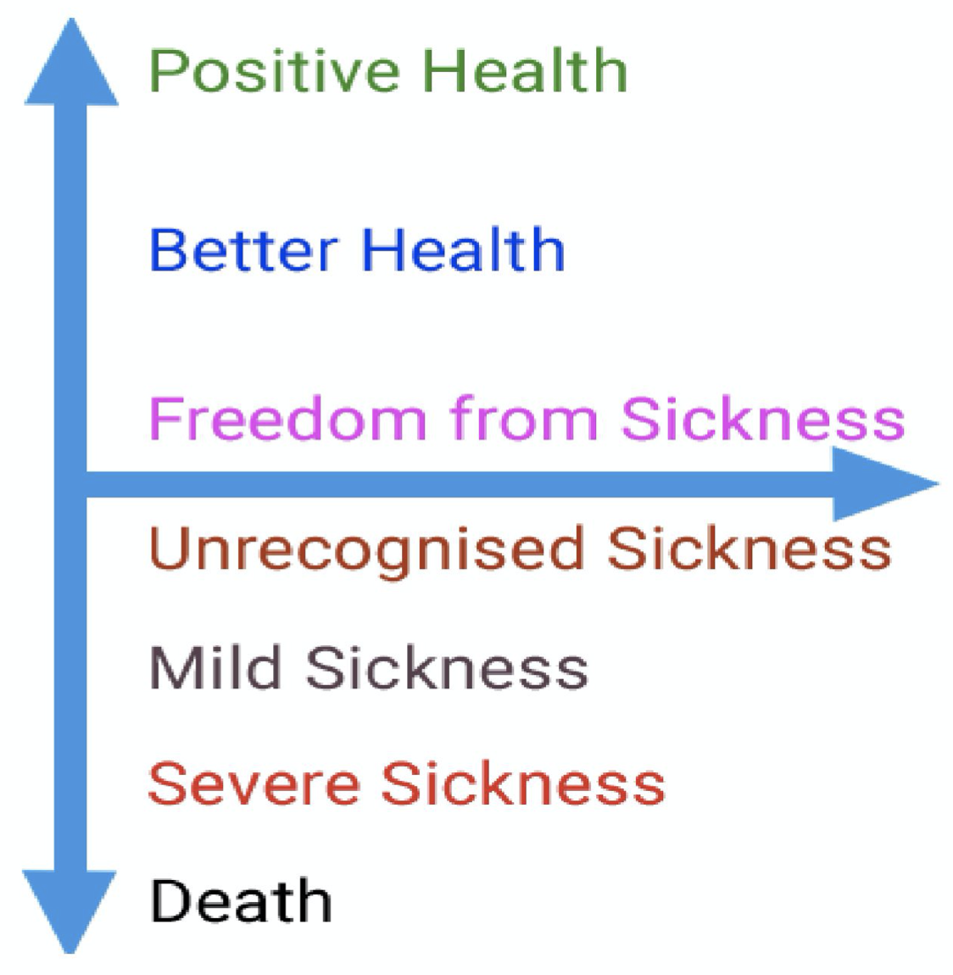
Spectrum of Health
Health and disease lie along a continuum, and there is no single cut-off point
The lowest point on the health-disease spectrum is death and the highest point corresponds to the WHO definition of positive health.
The health of an individual is not static; it is a dynamic phenomenon and a process of continuous change.
There are degrees or "levels of health" as there are degrees or severity of illness. As long as we are alive there is some degree of health in us.
Definitions of:
1
Health
Health is a relative concept; It is relative to
Where on the spectrum of health the person is
The health dimensions (physical, mental, social, spiritual, emotional, vocational dimensions)
Local conditions and health standards¹
Definitions of Health
The oldest definition is that health is the "absence of disease."
World Health Organization (1948):
"Health is a state of complete physical, mental and social well-being and not merely an absence of disease or infirmity"
In recent years, this statement has been amplified to include the ability to lead a "socially and economically productive life"²
2
Disease, illness and sickness
Disease
Illness
Sickness
- A condition that is diagnosed by a physician or other medical expert.
- Used by the physicians
- Example: Flu diagnosed by a physician³
- Ill health that the person identifies themselves with, often based on self reported mental or physical symptoms.
- It can be Acute or Chronic
- Used by the Patient
- Example: Flu reported by a patient⁴
- Social & cultural conception of a person’s condition.
- Used by the Society
- Example: Missed class or work due to Flu⁴
1-Health standards varies from person to person might be too low or too high, so you should be careful how to interpret the answer
2- it’s added because poor social and economic life can worsens the person’s mental health
3-Not self diagnosed even physicians themselves should be diagnosed by a physician
4- in illness symptoms are not a social barrier unlike sickness

Slide 3
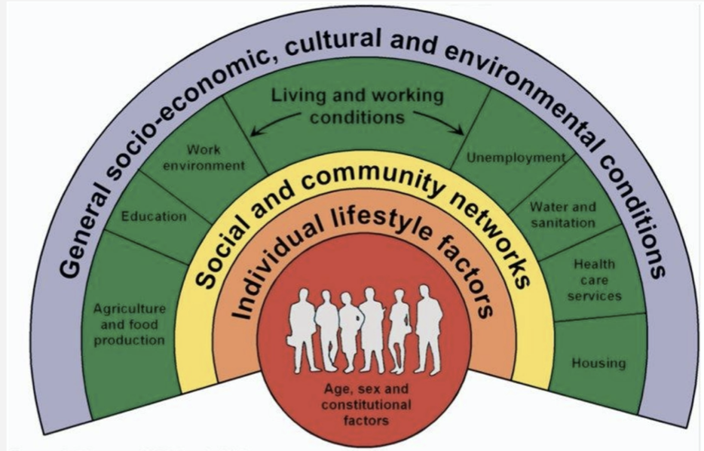
3
Well-being
There is no satisfactory definition of the term well-being!
Objective Components
Standard of living
Well-Being
Level of living
Subjective components
PQLI
Quality of life
HDI
 | Physical Quality of Life Index (PQLI) | Human Development Index (HDI)
Indicators used in calculating this index | Infant mortality Life expectancy at age one literacy | Life expectancy at birth (longevity) Mean years of schooling (knowledge) Expected years of schooling (knowledge) GNI, gross national income, per capita (income/ decent standard of living)
Scale | From 0-100 (0 is worst performance and 100 is best performance) | Values from 0 to 1
It measures | The results of social, economic, and political policies. Does NOT measure economic growth | It reflects achievements in the most basic human capabilities
Both allow for National and International Comparison
Determinants of Health: Definition, Types, and Levels
Many factors combine together to affect the health of individuals and communities
1
Biological: Genetic predisposition
Analysis: Genetic predisposition and obese parents.
Behavioral and socio-cultural: Cultural and behavior patterns, life long habits developed from socialization (eg: smoking, staying up late)
Analysis: High TV, computer, electronic entertainment use | Sedentary lifestyle | Car-only mode of transportation
2
3
Environment: Internal – internal medicine / external (macro-environment: things you’re exposed to after conception)
Analysis:
Internal: Hypothyroidism, Syndromic
External: High consumption of fatty takeaway foods / Low consumption of fruits, vegetables and fiber rich foods / Poor walkable environment / Easy access to convenience stores / Extensive unhealthy food marketing
Notes on the picture: as seen healthcare is a small portion in the determinants of health, so even if they received the best healthcare but he comes from an abusive family (for example) it can affect the recovery. So it’s important to know the environment the patient comes from they might not be discharged if known that the family is abusive for the patient’s own sake.

Slide 4
4
Socio-economic: Economic status; Education, Employment, Housing.
Analysis: Unemployment / Low disposable income / Rural area
5
Health services: Services for treatment of disease, prevention, and promotion of health.
Analysis: Limited preventive services / Delayed access to treatment
6
Aging population: Increased burden of chronic diseases.
7
Gender: Women's health covering nutrition, reproductive health, the health consequences of violence, ageing, lifestyle related conditions and the occupational environment.
Analysis: Male obesity is more prevalent than females in Saudi Arabia
8
Other: Information technology, health related systems like agriculture and food.
Analysis: Weak food policy & pricing | High Cost of organized physical activity programs/sport
“Right to Health” & “Health for All”
Right to Health
Health for All
- Historically, the right to health was one of the last to be proclaimed in the Constitutions of most countries.
- Universal Declaration of Human Rights (1948): "Everyone has the right to a standard of living adequate for the health and well-being of himself and his family".⁵
- WHO Constitution introduction affirms that it is one of the fundamental rights of every human being to enjoy "the highest attainable standard of health".
- Decided by the 30th World Health Assembly in year 1977.
- They decided that the main social target of governments and WHO in the coming decades should be "the attainment by all citizens of the world by the year 2000 of a level of health that will permit them to lead a socially and economically productive life"
5-everyone agrees on the Health right but Health care right is still debatable

Slide 5
Summary
Spectrum of Health:
Health and disease lie along a continuum, and there is no single cut-off point
Health is a dynamic phenomenon and a process of continuous change and there are levels of health.
Definitions:
Health: “Is a state of complete physical, mental and social well-being and not merely an absence of disease or infirmity”. Then they added the ability to lead a "socially and economically productive life".
Disease: condition that is diagnosed by a physician .
Illness: When the patient self reported mental or physical symptoms.
Sickness: Social & cultural conception of a person’s condition.
Determinants of Health:
Biological | Genetic predisposition
Behavioral and socio-cultural | Cultural and behavior patterns and life long habits
Environment | internal medicine and external environment
Socio-economic | Education, Employment and housing
Health services | Treatment of disease, prevention, and promotion of health
Aging population | Increased burden of chronic diseases
Gender | Being a woman makes you more susceptible
Other | Information technology, health related systems like agriculture and food

Slide 6
Quiz
MCQ
1-social & cultural conception of a person’s condition definition of :
A- illness. B- sickness. C- disease. D- health
2- Which of the following it reflects achievements in the most basic human capabilities ?
A-level of living . B- standard of living . C- human development index D-physical quality of life index .
3- Which of the following health determinants has the highest impact on women?
A-genetic predisposition B- Education C- Race D-information technology .
4- “he attainment by all citizens of the world by the year 2000 of a level of health that will permit them to lead a socially and economically productive life” definition of ?
A- determinants of health B- health for all C- right to health D-quality of life
5- At which level of spectrum can we apply health promotion?
A- Susceptible person B- Asymptomatic C-Discernible disease D-Positive health
Answers
Q1 | Q2 | Q3 | Q4 | Q5
B | C | B | B | D

Slide 7
Thank You and
Good Luck
Team Leaders:
Lama AlAssiri | Mohammed AlHuqbani | Ibrahim AlDakhil
Team Members:
Lama AlZamil
Leen AlMazroa
May Babaeer
Muneera AlKhaorayef
Norah AlMazrou
Nouf Alhussaini
Rema AlMutawa
Sara AlAbdulkareem
Sedra Elsirawani
Wejdan Alnufaie
Abdulrahman Alhawas
Abdulrahman Shadid
Abdullah Aldawood
Abdullah Shadid
Alwaleed Alsaleh
Bader Alshehri
Bassam Alkhuwaiter
Faisal Alqifari
Hameed M. Humaid
Khalid Alkhani
Meshari Alzeer
Mohannad Makkawi
Nayef Alsaber
Omar Aldosari
Omar Alghadir
Zyad Aldosari

