Slide 1
Reporting & Surveillance
Understand this lecture rather than memorizing 🥳💔
Objectives
Define surveillance.
Know aims and uses of surveillance system.
Understand the different types of surveillance systems.
Recognize the elements of surveillance system.
Be able to assist in establishing and evaluation a surveillance system.
Color Index
Main text
Males slides
Females slides
Doctor notes
Important
Textbook
Golden notes
Extra
Editing File

Slide 2
What is Surveillance?
The Centres for Disease Control and Prevention (CDC) defined Public Health Surveillance as: “Ongoing systematic collection, analysis, interpretation and dissemination of data regarding a health related event for use in public health action to reduce morbidity and mortality and to improve health”.
In other words, it means “information for action”.
It is the eyes and ears of public health.
It a very important tool for public health
It is a network of people and activities to keep this process.
Functions at local to international levels and is available in regular reports routinely.
Describing Surveillance:
Surveillance systems provide descriptive information regarding when and where health problems are occurring and who is affected (the basic epidemiologic parameters of time, place, and person).
Surveillance and Monitoring:
Surveillance and Monitoring are often used interchangeably but they are distinct.
Monitoring ¹ | Surveillance
Refers to the ongoing measurements of health services or a health programme with a view to ‘evaluate’ the particular programme / service or intervention, with constant adjustment of performance in relation to the results. | Surveillance is a broader term
Is concerned with a specific target Example: vaccinated infants | Is concerned with the general population
Objectives of Public Health Surveillance ^{2, 3}
Main aim:
Disease control and prevention
1
To study the trends of disease
6
To develop epidemiologic research questions
2
Early warning of epidemics
7
To test epidemiologic hypothesis
3
To provide quantitative estimates of magnitude of health problem
8
Evaluation of control and preventive measures Breast cancer screening
4
To study the natural history of disease
9
Monitoring of change in infectious agent like changes in malaria species
5
Demonstrating the spread of a disease in time and Place
10
Detecting changes in health practices
More specific, to evaluate a program and is considered a specific term under the broader term of surveillance.
It is essential to set the objectives when you establish a surveillance system. It is not necessary to have them all you can have only one objective but you should have them at least.
A surveillance system can meet one objective while another one can meet multiple objectives.

Slide 3
Surveillance
Criteria for Identifying High Priority Areas for Establishing Surveillance Activities: ¹
1
Frequency of the disease
→ Incidence of mortality, and incidence/prevalence of morbidity due to the disease
2
Severity
→ Case fatality ratio, proportionate mortality ratio, hospitalization rates due to the disease, disability rates
3
Economic impact
→ Direct costs that add due to medical treatment for the disease and indirect costs due to reduction in productivity
4
Preventability
5
Public interest
→ Community and political attitudes towards the disease
Features of a Surveillance System:
Practical, clear case definitions for each disease
Workable, uniform and continuous data collection methods
Rapidity of collection, analysis, interpretation and dissemination of data.
Types of Surveillance
Types | Item | Description
Passive | Definition | Regular reporting of disease ² data by all institutions that see patients (or test specimens) and are part of a reporting network. There is no active search for cases. Relies on the cooperation of health-care providers — laboratories, hospitals, health facilities and private practitioners. This is the most common type of surveillance. Example: Reported cases of COVID-19 by hospitals.
 | Uses | In this type of surveillance criteria are established for reporting diseases, risk factors or health-related events then health practitioners are notified of the requirements and they report events as they come to their attention. The data recipient has to wait for the data providers to report. In most countries with a passive surveillance system, every health facility is required to send a monthly (sometimes weekly/daily) report of all cases on a standard form.
 | Advantage | Simple to conduct Inexpensive Covers wide areas (whole countries or provinces)
 | Disadvantage | It can be difficult to ensure completeness and timeliness of data. Because it relies on an extensive network of health workers. Usually underestimate the true illness burden.
Recall that surveillance is a network and aims for the general public so definitely it comes with a high cost. So not everything should be surveilled. Based on these criteria we should prioritize certain programs.
Not necessarily a disease. Any health related event can be surveilled.

Slide 4
Types of Surveillance
Types | Item | Description
Active | Definition | In active surveillance the organization conducting the surveillance actively seeks the relevant information (healthcare providers are contacted and asked to provide details of any cases they have seen). Data must be obtained by searching for cases, and also by periodically contacting those who may know of cases. Example: Health workers go into the community, search for cases of fever and take their blood slide for malarial parasite Screening for people arriving from a certain country. Actively visiting and screening individuals in high risk areas.
 | Uses ¹ | Active surveillance is used when there is an indication that something unusual is occurring: Rare disease Disease on way to eradication e.g. polio During outbreaks (very good indication) Regular outreach to potential reporters, to stimulate the reporting of specific diseases or injuries.
 | Advantage | Produce complete data of a good quality
 | Disadvantage | Expensive high use of resources For this reason, when it is used, it is for a limited time period.
Sentinel ² | Definition | Reporting of cases of specific diseases ³ or risk factors that may indicate that a particular preventive or therapeutic activity is not working as planned. Example: a measles outbreak in kids who were supposedly vaccinated.
 | Uses | It is used when high-quality data are needed about a particular disease that cannot be obtained through a passive system. It involves only a limited network of carefully selected reporting sites Data is obtained from selected hospitals who agree to report all cases of the disease. Data collected in a well-designed sentinel system can be used to: Signal trends. Identify outbreaks. Monitor the burden of disease in a community.
 | Advantage | Rapid Economical alternative to other surveillance methods. Because it is conducted only in selected locations.
 | Disadvantage | May not be as effective for detecting rare diseases or diseases that occur outside the catchment areas.
This type of surveillance is not effective in all types of diseases.
Similar to passive but more detailed and is not considered a main type of surveillance.
E.g. Myocardial Infarction

Slide 5
Organization and Structure of a Surveillance System
Components of a Surveillance System:
1
An overall organization:
Consisting of personnel, finances, logistics and administrative back up.
2
The originators of data:
This would include the sources of data, data collectors and data collecting mechanisms.
3
The transmission of data to the surveillance centre
With specification of the mode of transmission and frequency of such transmission.
4
Data management and analysis:
This includes manual/ computerized data files, and statistical analysis procedures.
5
The sensible interpretation or results:
Including their consolidation and preparation of reports.
6
A system of feedback of results:
To the originators of data and to those who are in a position to enforce preventive steps.
7
A system to periodically evaluate the surveillance system itself.
Steps in Establishing a Surveillance System
Step 1
Is it Justifiable to Establish a Surveillance System?
Confirming if the disease is of public health importance and whether prevention/ control measures are available.
Step 2
Spell out the objectives of surveillance system
The following issues should be addressed :
Clearly specify the disease (s) proposed to be brought under surveillance.
Specify : Who needs what information, for what purpose?
The target population
The health problem: e.g. whether only Acute MI or entire spectrum of IHD is to be put to surveillance?
Nature of control programmes: e.g. if it is a rare disease or a disease moving towards eradication, a fine surveillance will be needed; on the other hand if it is a common disease, a crude surveillance would suffice.

Slide 6
Steps in Establishing a Surveillance System
Step 3
Specify the organization and structure of the surveillance ?
At the planning stage, clear specifications should be made as to “who will do what, how, and will be responsible to whom”.
Step 4
Clearly define the disease(s) being considered for surveillance ?
Case definitions should be accurately worked out after detailed consultation with experts.
All those involved in the collection of data should be well trained in the use of these case definitions/ diagnostic methods.
Case definitions/ diagnostic procedures should be simple enough so as to be understood and used by all those on which the system depends for reporting.
Case Definition:
A set of uniform criteria used to define a disease for public health surveillance (possible, probable, confirmed).
Enable public health officials to classify and count cases consistently across reporting areas.
It is not intended to be used by healthcare providers for making a clinical diagnosis or determining how to meet an individual patient's health needs.
Refer to standard definitions stated by WHO and CDC.
Every year, case definitions are updated.
Low specificity
Suspected
Probable
Confirmed
High specificity
Example | Item | Description
Beginning of COVID-19 (2019-nCoV) | Suspected case | A person with acute respiratory illness (fever with cough and/or shortness of breath) AND and of the following: 1. A history of travel to China in the 14 days prior to the symptom onset. 2. A close physical contact in the past 14 days with a confirmed case of COVID
 | Confirmed case | Suspected case with laboratory confirmation of 2019-nCoV infection
Smallpox | Probable case | A case that meets the clinical case definition that is not laboratory confirmed but has an epidemiological link to another confirmed or probable case.
 | Confirmed case | case of smallpox that is laboratory confirmed.

Slide 7
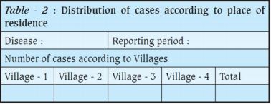
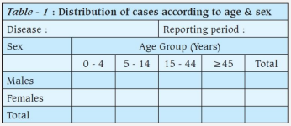
Steps in Establishing a Surveillance System
Smallpox
Clinical description:
An illness with acute onset of fever >101 °F followed by a rash characterized by vesicles or firm pustules in the same stage of development without other apparent cause.
Laboratory criteria for confirmation:
Isolation of smallpox (variola) virus from a clinical specimen
Polymerase chain reaction (PCR) identification of variola DNA in a clinical specimen
Negative stain electron microscopy (EM) identification of variola virus in a clinical specimen (Level D laboratory or approved Level C laboratory)
Working Case Definition: Smallpox Outbreak
Anyone who meets original case definition
Anyone with fever (>101 °F ) or rash who was in a confirmed exposed area during the Bioterrorism (BT) event or came in contact with a confirmed or probable case should be considered a case.
Until confirmed; if not confirmed; will be under observation and could be classified as “case”; and others as “confirmed cases”.
Step 5
Specify the Details of Collection of Information
Select the proper sources of data
Specify the method of data collection
The forms that will be used
What time/place of diagnosis will be entered
What will be the frequency of reporting?
Decide the method of transmission of reports
Central Collection of Data
Step 6
The Organization and procedures of data Analysis
Simple display of data: Data can be displayed through histograms/ bar diagrams/ line diagrams describing the data according to various characteristics of person, place and time.
Descriptive statistics: Give the “Summary statistics” (Incidence rates / prevalence / proportions /Mean / Median) along with the measures of dispersion (SD) and the 95% confidence intervals.

Slide 8
Steps in Establishing a Surveillance System
Step 7
Making Scientific interpretations out of the results
Consider whether the apparent, statistically significant, increases or decreases in the disease incidence at a given place and time represent true changes.
False increase or decrease may be due to:
Improvement in diagnostic procedures
Duplicate reporting
Enhanced reporting
Increase in population size
Step 8
Ensure proper feedback to all concerned
Provide regular (usually monthly) feedback reports to all those who are in a position to take action on the surveillance data (as, secretaries and directors of health department as well as other department concerned with human development).
Step 9
Periodically evaluate / review the surveillance system
Periodic evaluation is important to identify defects and reorient the methodology.
→ See whether the case definitions need a change?
→ Are there some problems in the timely and accurate reporting
→ How can it be improved?
© Faisal alqifari

Slide 9
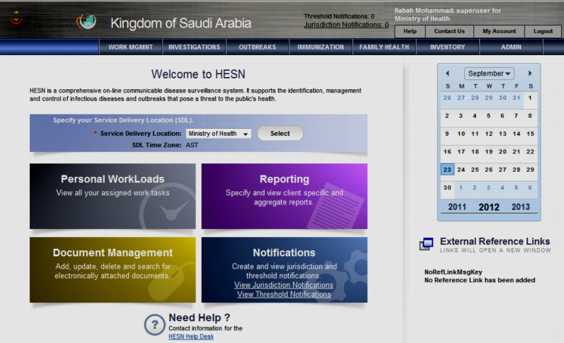
Evaluation of Surveillance System
Skipped by the doctor
1
Is the system detecting what it is supposed to detect?
The surveillance system data need to be compared with data produced by another
detection mechanism.
2
Is the system producing data in time for appropriate responses?
3
Can the system cope with changes?
The disease or our knowledge may be changing quickly. A surveillance system should adopt to such changes (flexibility).
4
Is the system as simple and cheap as possible?
5
Are the public health responses timely and appropriate?
Any system that does not lead to appropriate responses is flawed.
Examples of National Surveillance Systems
HESN
Health Electronic Surveillance Network (HESN) is used to control and manage infectious diseases and epidemics online.
1
7 Modules →

Slide 10
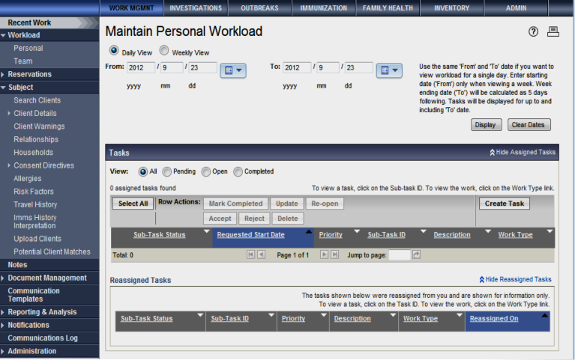
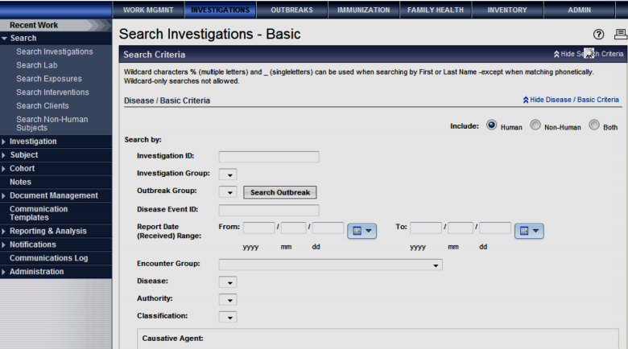
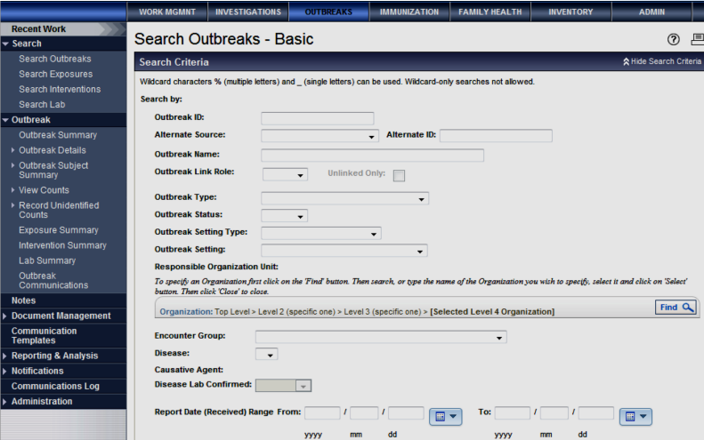
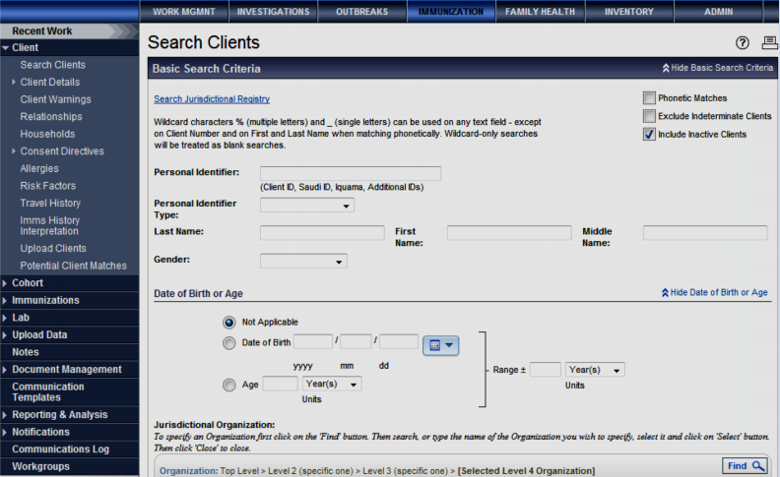
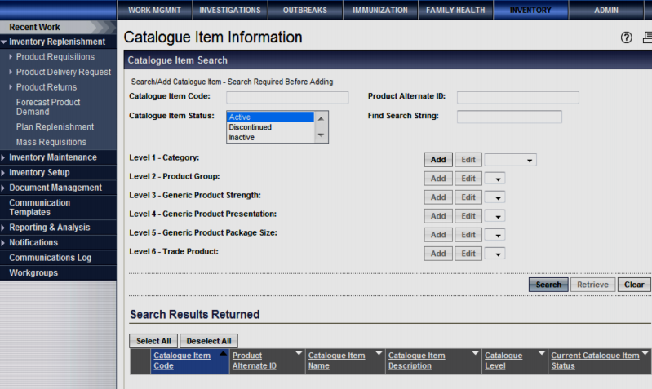
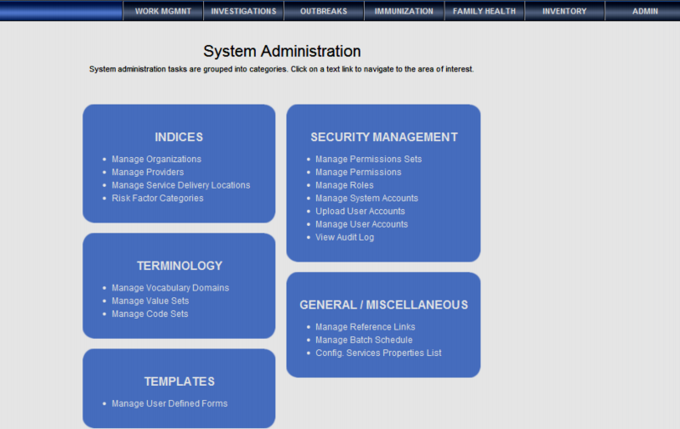
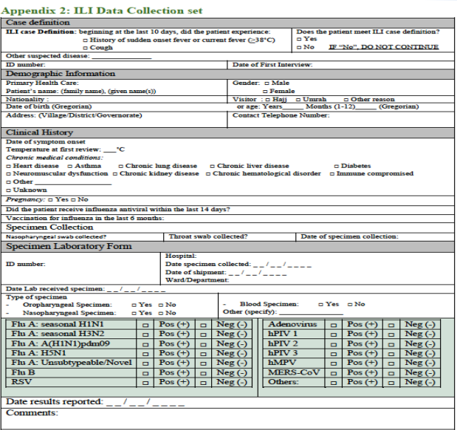
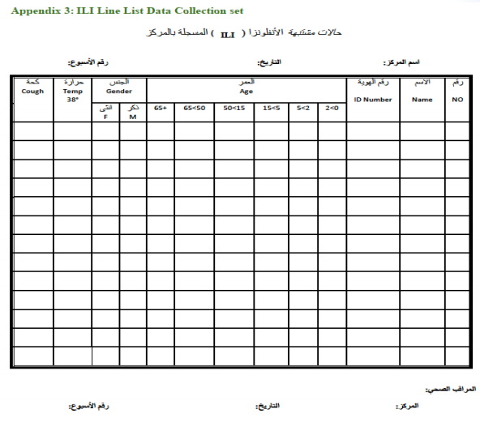
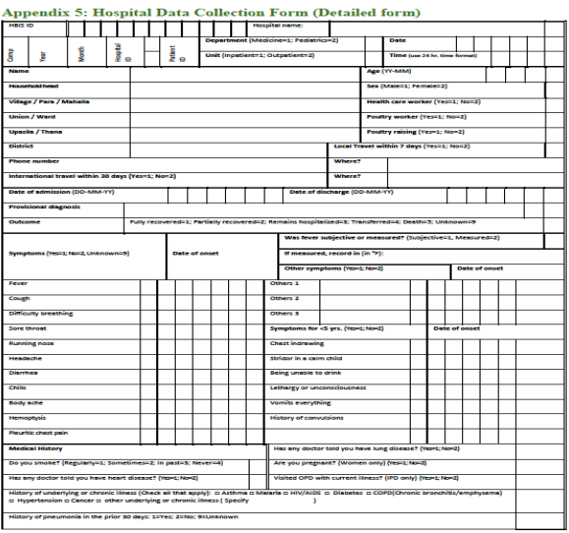
Examples of National Surveillance Systems
HESN
1
Work management
Investigations
Outbreaks
Immunization
Inventory
Administration
ISSA
Influenza Surveillance In Saudi Arabia (ISSA)
Objectives:
Objectives of influenza surveillance The goal of influenza surveillance is to minimize the impact of the disease by providing useful information to public health authorities, which will help in planning appropriate control and intervention measures, allocate health resources, and make case management recommendations.
2

Slide 11
Quiz
MCQ
1- You want to conduct a surveillance program system on “Nocardiosis”. You know that Nocardia infections are very rare in your country. Which type of surveillance system would you use?
A- Passive surveillance
B- Active surveillance
C- Semi active surveillance
D- Sentinel surveillance
2- “Measurements used to evaluate a certain program with constant adjustments done based on the results”. Which of the following terms best describe the statement?
A- Reporting
B- Surveillance
C- Monitoring
D- Adjusting
3- You decided to create a surveillance program that tests people for certain highly deadly genetic illness. Your supervisor told you that testing people born with a genetic illness is not a priority. Which of the following criterias DOESN’T apply to your proposed program?
A- Severity
B- Preventability
C- Disability
D- Fatality
4- Which of the following statements is true regarding case definition?
A- Probable and suspected cases are distinct and can never overlap
B- It is intended to be used by healthcare providers for making a clinical diagnosis or determining how to meet an individual patient's health needs
C- A case of a patient who meets the clinical criteria is said to be a susceptible case. If the patient had contacted a confirmed case it is said to be probable.
D- a case of a patient who meets the clinical criteria is said to be susceptible case. If the patients shows radiographic images suggestive of the case it is said to be confirmed
5- Which of the following describes a difference between survey and surveillance?
A-Survey monitors long term trends whereas surveillance informs about patterns of disease
occurrence
B- Survey provides data for new cases of diseases whereas surveillance provides history of old and
new cases of disease
C- Survey is time consuming while surveillance is relatively quick
D- Survey is a one time activity and surveillance is an ongoing collection of data
6-Which one of the following is an obstacle for obtaining high quality surveillance data?
A- On time responsiveness
B- Under reporting
C- Use of active surveillance system
D- Well-trained staff
Answers
Q1 | Q2 | Q3 | Q4 | Q5 | Q6
B | C | B | C | D | B

Slide 12
Thank You and
Good Luck
Team Leaders:
Lama AlAssiri | Mohammed AlHuqbani | Ibrahim AlDakhil
Deema AlMaziad
Lama AlZamil
Leen AlMazroa
Lina AlOsaimi
Muneera AlKhorayef
Norah AlHarbi
Norah AlMazrou
Nouf Alhussaini
Razan AlRabah
Renad Alhaqbani
Rema AlMutawa
Team Members:
Hameed M. Humaid
Khalid Alkhani
Meshari Alzeer
Mohannad Makkawi
Nayef Alsaber
Omar Aldosari
Omar Alghadir
Zyad Aldosari
Sara AlAbdulkareem
Sedra Elsirawani
Wejdan Alnufaie
Abdulrahman Alhawas
Abdulrahman Shadid
Abdullah Aldawood
Abdullah Shadid
Alwaleed Alsaleh
Bader Alshehri
Bassam Alkhuwaiter
Faisal Alqifari

