Slide 1
Introduction to Non-Communicable Diseases
Objectives
The epidemiology of non-communicable diseases
Risk factors for non-communicable diseases
Overall framework and common preventive strategies against non communicable diseases
Color Index
Main text
Males slides
Females slides
Doctor notes
Important
Textbook
Golden notes
Extra
Editing File

Slide 2
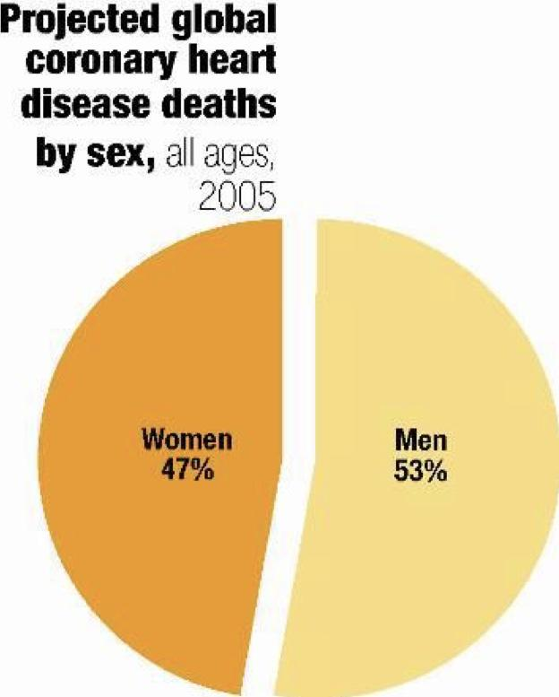
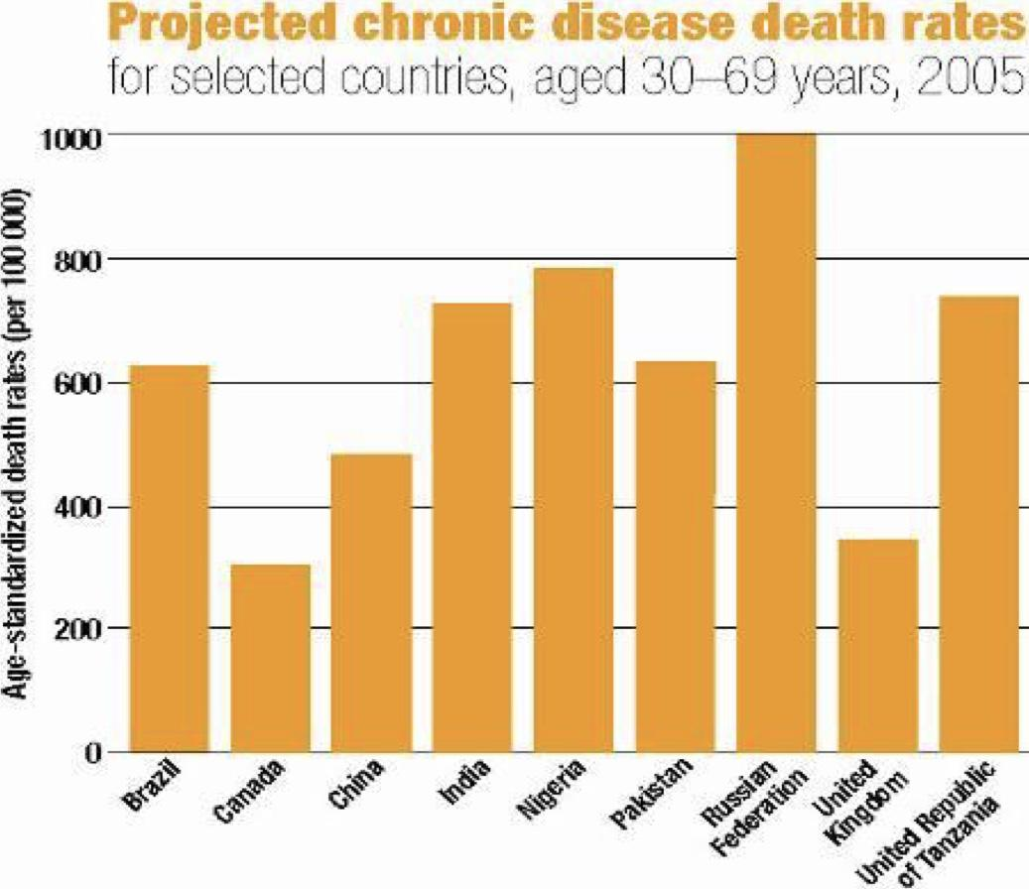
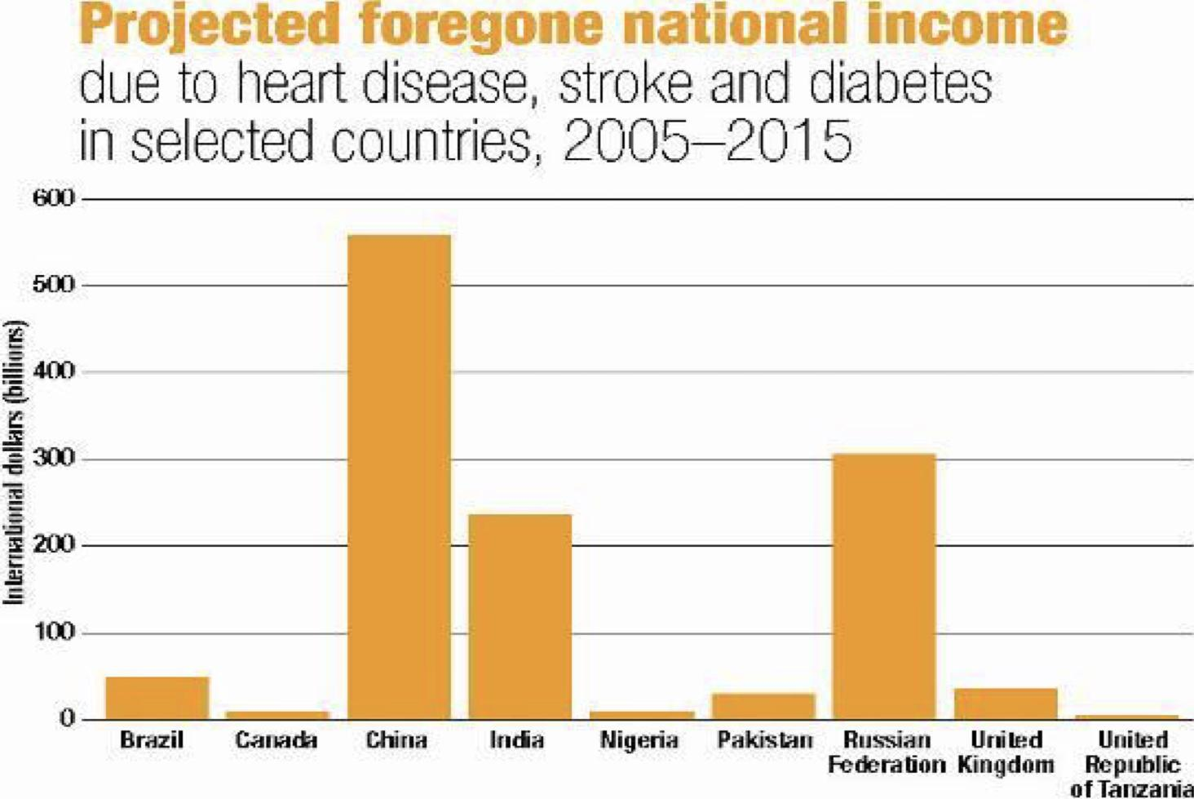
Definition of NCDs
● Non-communicable diseases are all impairments or deviations from the normal, which have one or more of the following characteristics;
Are permanent
Caused by non-reversible pathological alterations¹
Leave residual disability
Require special training of the patient for rehabilitation²
May be expected to require a long term supervision
Epidemiology of NCDs
1
Noncommunicable diseases (NCDs) kill 41 million people each year, equivalent to 71% of all deaths globally.
2
Each year, 15 million people die from a NCD between the ages of 30 and 69 years; over 85% of these "premature" deaths occur in low- and middle-income countries.
3
Cardiovascular diseases account for most NCD deaths, or 17.9 million people annually, followed by cancers (9million), respiratory diseases (3.9million), and diabetes (1.6million).
4
These 4 groups of diseases account for over 80% of all premature NCD deaths.
5
Tobacco use³, physical inactivity, the harmful use of alcohol and unhealthy diets all increase the risk of dying from a NCD. If you can control these 4, you control the NCDs.
Detection, screening and treatment of NCDs, as well as palliative care, are key components of the response to NCDs.
6
Risks are increasing
chronic diseases are concentrated among the poor⁴
chronic diseases mainly affect rich people
80% of premature heart disease, stroke and type 2 diabetes is preventable, 40% of cancer is preventable
misunderstanding
chronic diseases can’t be prevented
inexpensive and cost-effective interventions exist
chronic diseases prevention and control is too expensive
chronic diseases affect men and women almost equally
Reality
chronic diseases
affect primarily men
almost half in people under age 70 years⁵
chronic diseases
mainly affect
Old people
The economic impact: billions
1: For ex: cancer
2: Most patients enter the 3rd phase of rehabilitation.
3: It plays a major risk factor for all NCDs.
4: Due to the lack of health facilities and education which leads to late diagnosis.
5: For ex: DM type 1 affects children and young people.

Slide 3
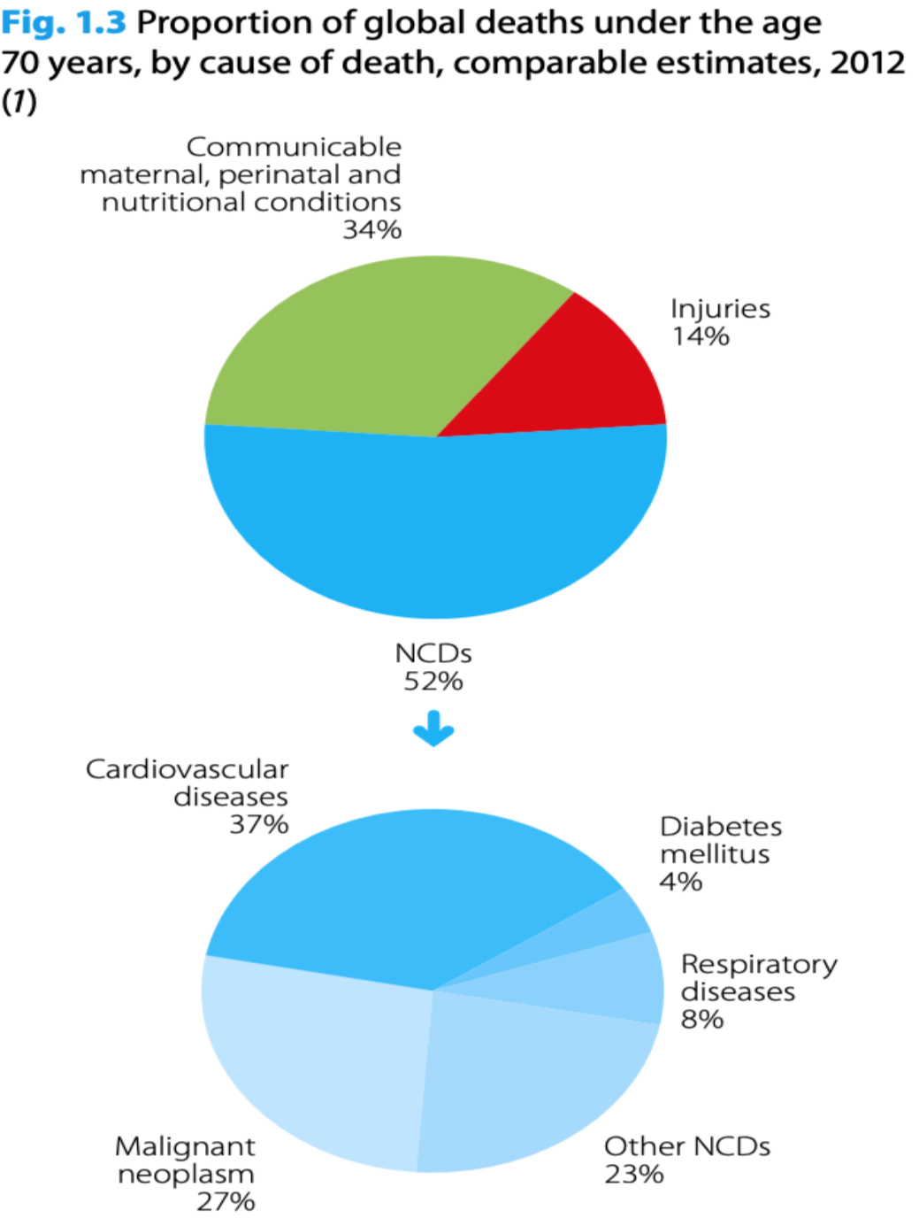
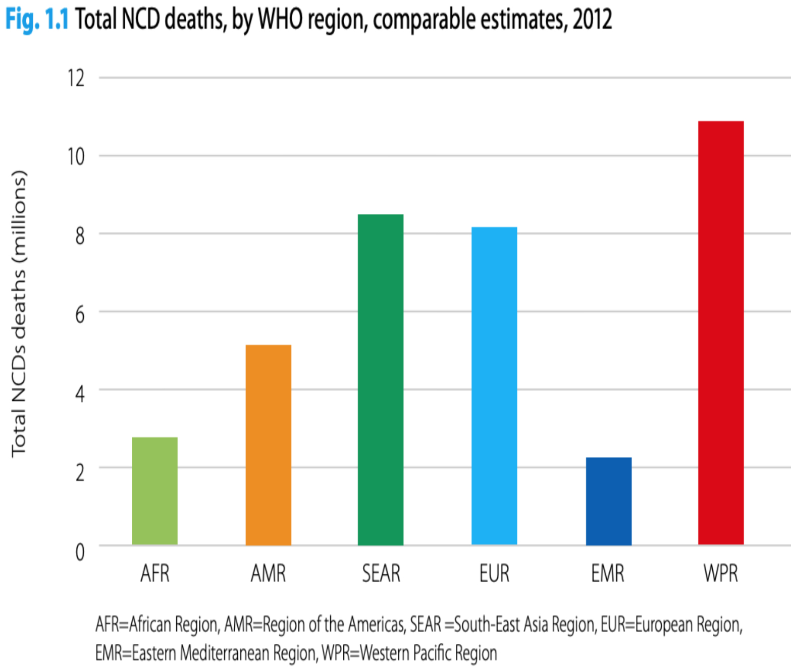
80% of chronic disease deaths occur in low & middle income countries¹
Non-Communicable Diseases²
Coronary Heart Diseases
Mental Retardation
Mental disorders: Schizophrenia, anxiety and depression
Hypertensive Heart Diseases
Chronic Obstructive diseases
4
5
1
2
3
Diabetes
Cancer
Stroke
Arthritis
11
Peptic Ulcer
Blindness
8
9
10
6
7
Causes of non-communicable diseases
1
Underlying socioeconomic, cultural, political and environmental determinants:
● Globalization³ ● Urbanization⁴ ● Population ageing
2
Common modifiable risk factors:
● Unhealthy diet ● Physical inactivity ● Tobacco use
3
Non-modifiable risk factors:
● Age ● Heredity ● Gender
4
Intermediate risk factors:
● Raised blood pressure ● Raised blood glucose ● Abnormal blood lipids ● Overweight/obesity
5
Main Chronic Diseases:
● Heart Disease ● Stroke ● Cancer ● Chronic Respiratory Disease ● Diabetes
Modifiable behavioral risk factors
Metabolic risk factors
Modifiable behaviours, such as tobacco use, physical inactivity, unhealthy diet and the harmful use of alcohol, all increase the risk of NCDs.
● Tobacco accounts for over 7.2 million
deaths every year (including from the
effects of exposure to second-hand
smoke).
● 4.1 million annual deaths have been
attributed to excess salt/sodium intake⁵.
● More than half of the 3.3 million
annual deaths attributable to alcohol
use are from NCDs, including cancer.
● 1.6 million deaths annually can be attributed to insufficient physical
activity.
Metabolic risk factors contribute to four key metabolic changes that increase the risk of NCDs:
● Raised blood pressure
● Overweight/obesity
● Hyperglycaemia (high blood glucose
levels)
● Hyperlipidaemia (high levels of fat in
the blood)
● In terms of attributable deaths:
1. Elevated blood pressure (Attributable risk is 19% )
2. Overweight and obesity
3. Raised blood glucose.
1: Every region contributes to these deaths including high income countries like KSA due to increased risk in the past years. ( check the right diagram )
2: NCDs are attributable for almost 52% of deaths among those who are younger than 70 y/o and 37% of these NCDs are due to cardiovascular diseases ( check the left diagram )
3: Due to the elimination of borders and boundaries between countries (migration, sharing cultures and diet).
4: Living in cities, where there are less outdoor and physical activities.
5: Leads to HTN which in return leads to coronary disease and stroke.

Slide 4
Modifiable risk factors
VS
Non Modifiable risk factors
Cigarette smoking
High Blood pressure
Elevated serum Cholesterol
Diabetes
Lifestyle changes (dietary patterns,physical activity)
Stress factors
Alcohol abuse
Age
Sex
Family Hx
Genetic factors
Personality
Race
The objectives of Integrated Chronic Disease Prevention and Control Programme are:
1
To strengthen prevention and control of chronic non- communicable diseases by tackling the major risk factors, focusing on WHO’s four priority non-communicable diseases - cardiovascular diseases, cancer, diabetes, and chronic respiratory diseases, and underlying determinants of health.
2
To reduce premature mortality and morbidity.
3
To improve quality of life, with particular focus on developing countries.
Framework for NCD prevention
2
Secondary prevention²
03
Primary prevention
Population Strategy¹
High Risk strategy¹
1
Prevention
3
01
01
Tertiary prevention³
Population Strategy⁴
High risk approach⁵
Secondary approach
Dietary Changes
Blood pressure control
Physical activity
(weight reduction)- specially children
Behavioral change reduction of stress & Smoking cessation
Self care
Health education
Identify Risk: Identify high risk people and families eg those who smoke, and have high serum cholesterol.
Specific Advice: helping them to stop smoking and exercise and diet control ect
Continuation of primary care.
Early case detection
and treatment.
Eg: CHD
Cessation of smoking
Reduction of serum cholesterol level
Compliance
1: The difference between them is to distinguish which disease needs a broader strategy.
2: For ex: drug compliance.
3: Rehabilitation.
4: Towards prevalent diseases in the community such as DM, stroke, breast / colon cancer and tobacco smokers (due to its wide spread).
5: Towards specific groups (high risk groups) like alcoholics, tobacco smokers (if you want to make your efforts very concentrated).
.

Slide 5
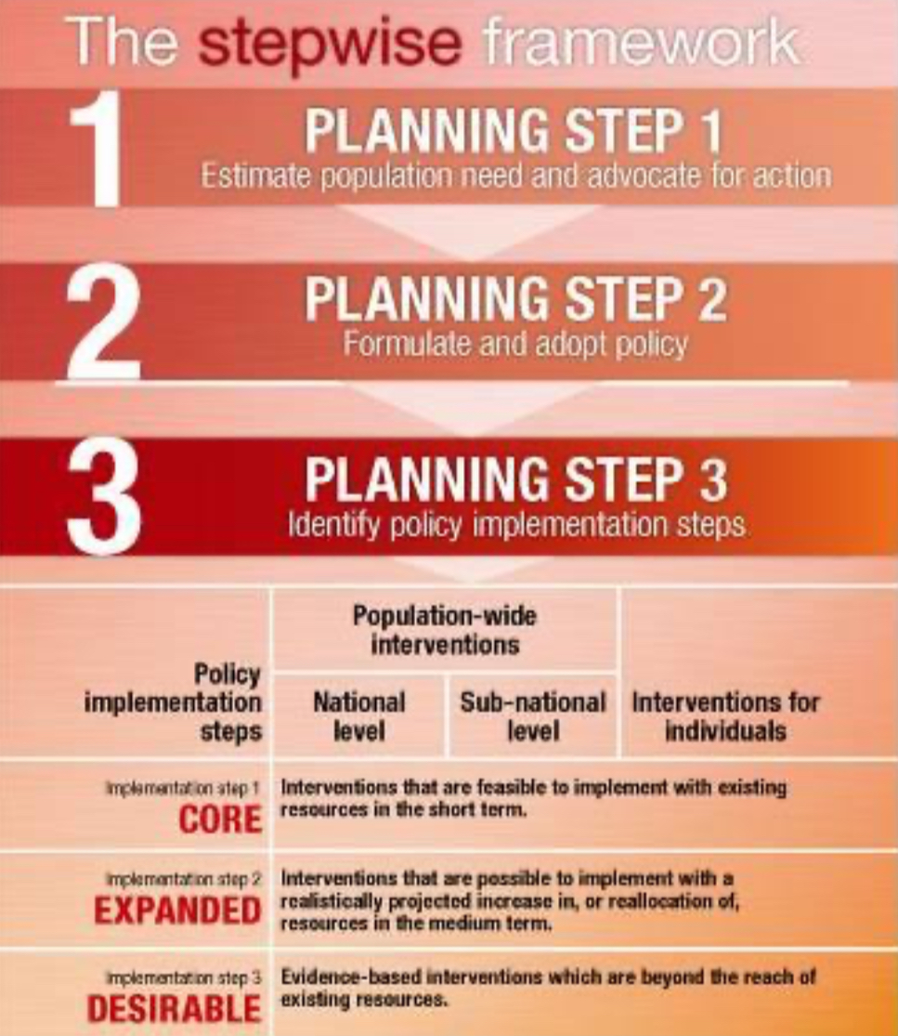
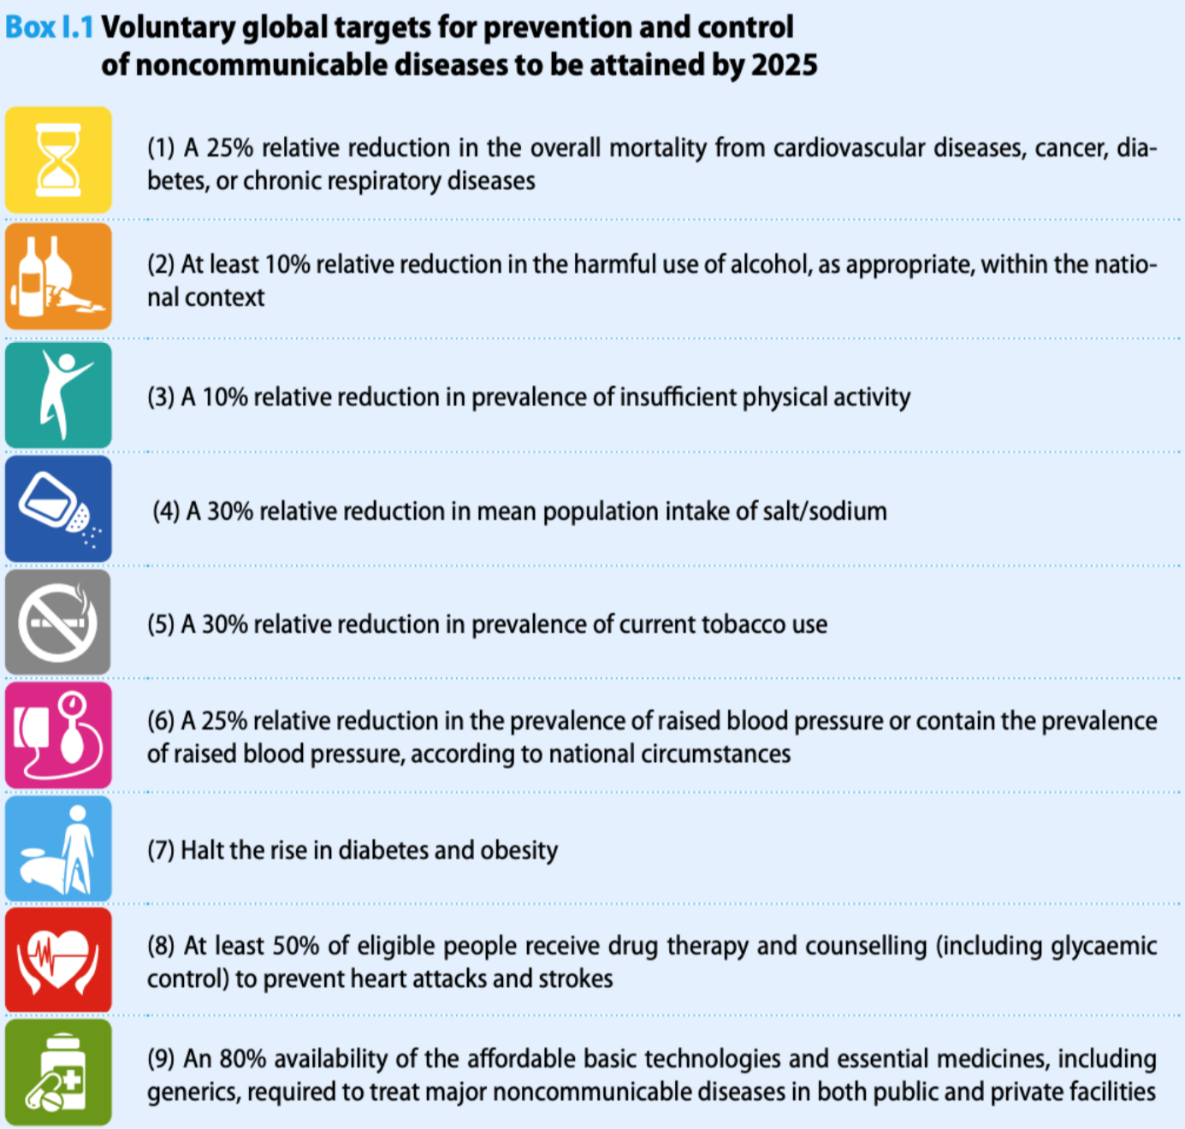
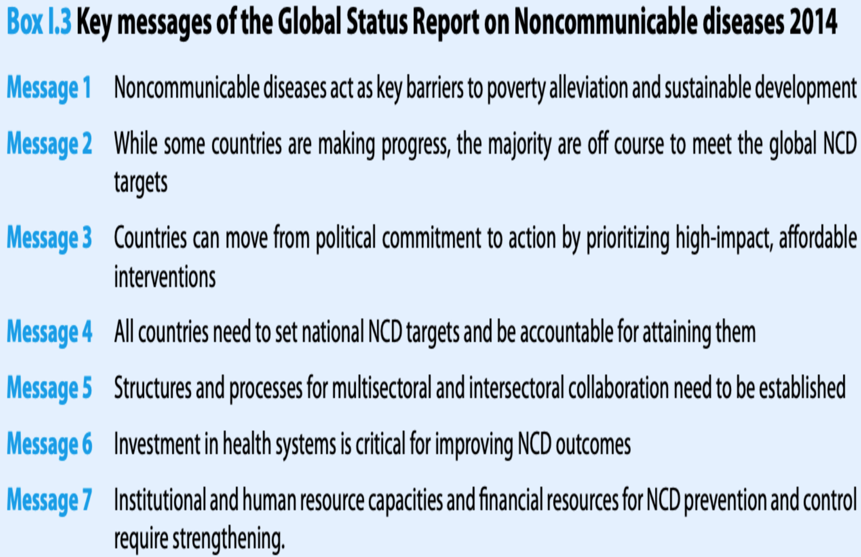
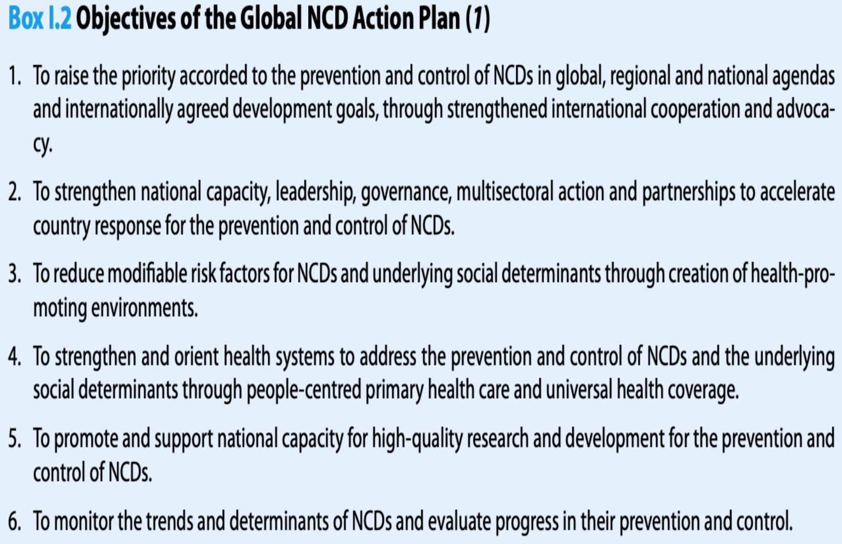
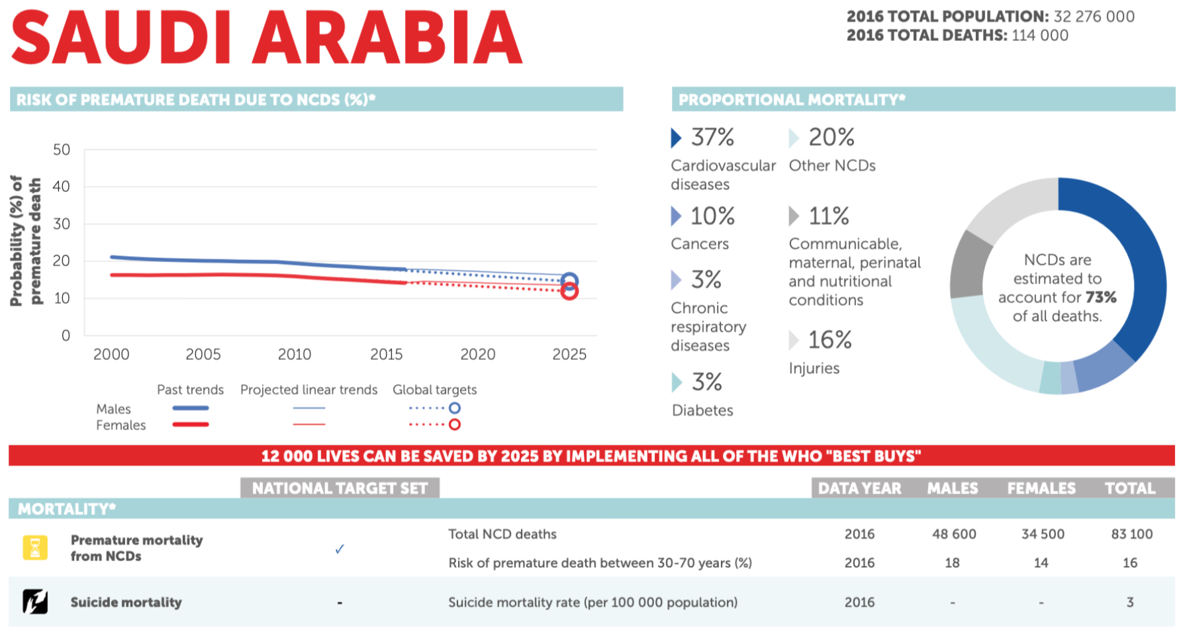
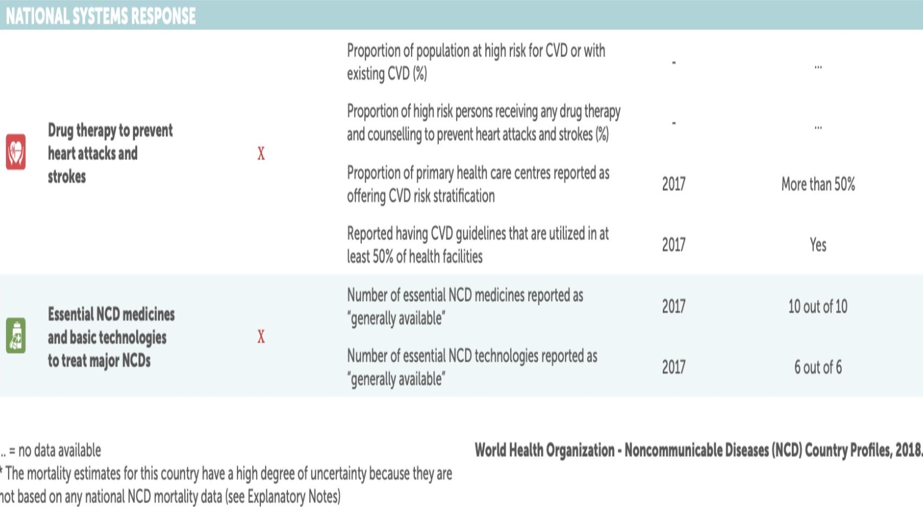
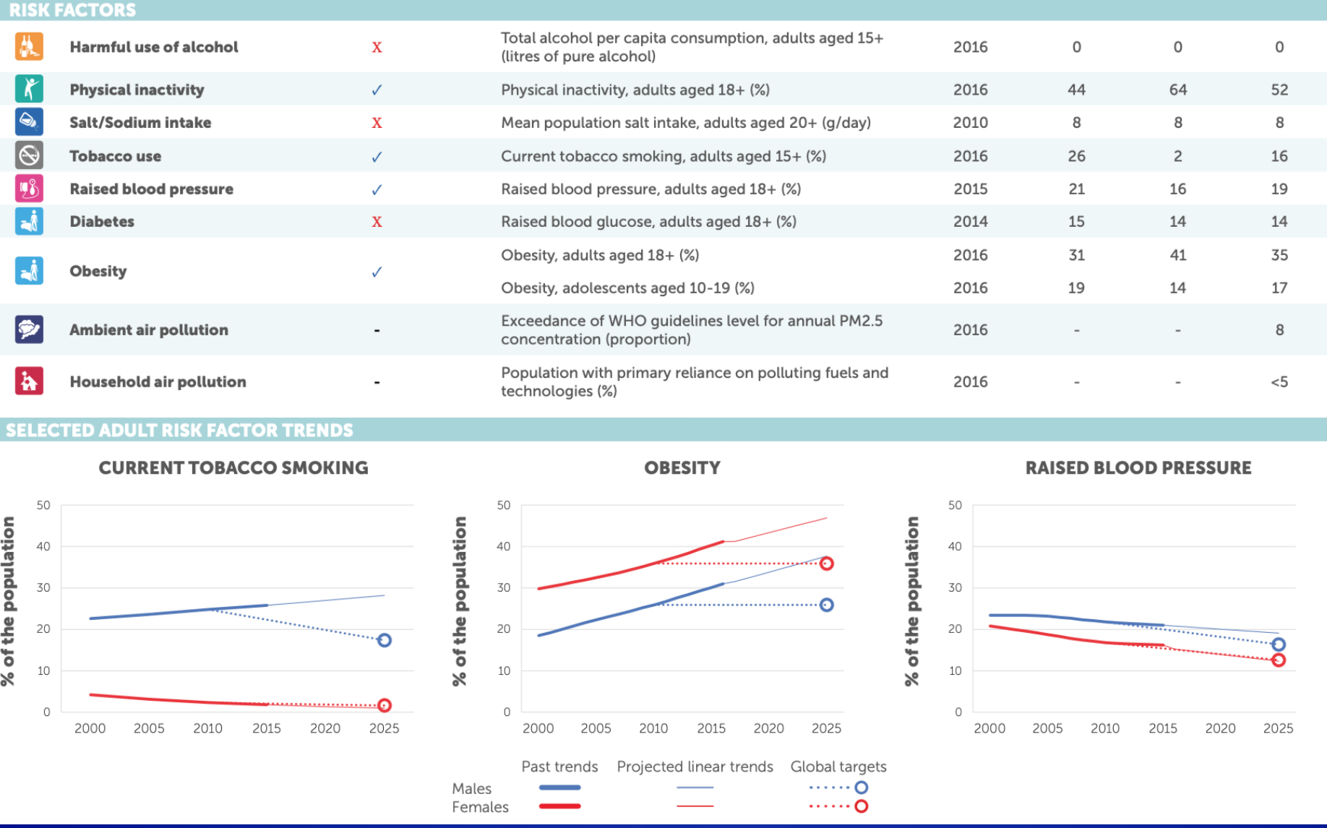
What works?
1
Comprehensive and integrated action is the means to prevent and control chronic diseases.
Global Actions
Situation in Saudi Arabia
1: Step 1→Data, data will give us how many male and female diabetics we have, how many people died of stroke and how many people need secondary or tertiary prevention due to stroke.
Step 2→Policy, for ex. adaptation of tobacco free areas and taxation of tobacco products.
Step 3→Implementation:
A.National level: not selling tobacco products to anyone under 18.
B.Sub-national level: labeling zones and neighborhoods that are smoke free.
C.Individuals level: fines/penalties for anyone who smokes in a smoke free area.

Slide 6
Quiz
MCQ
1-All of the followings are features of non-communicable diseases EXCEPT:
A- Permanent
B- Causes disability
C- Reversible causes
D- Non-reversible causes
2-Most of the chronic diseases are preventable:
A-True
B-False
3-Lack of physical activity and unhealthy diet both on long term can lead to all of the following except:
A- Hypotension
B-Hyperglycemia
C- Elevated HDL
D- A and C
4-WHO four priority NCDs are:
A- Diabetes, Cardiovascular, cancer and chronic respiratory diseases
B-Hypertension, Diabetes, cancer and chronic respiratory diseases
C-Hyperlipidemia, diabetes, cardiovascular and hypertension
D-Any chronic disease causes disability and needs prolonged treatment is a priority
Answers
Q1 | Q2 | Q3 | Q4
C | A | D | A

Slide 7
Thank You and
Good Luck
Team Leaders:
Lama AlAssiri | Mohammed AlHuqbani | Ibrahim AlDakhil
Deema AlMaziad
Lama AlZamil
Leen AlMazroa
Lina AlOsaimi
Muneera AlKhorayef
Norah AlHarbi
Norah AlMazrou
Nouf Alhussaini
Razan AlRabah
Renad Alhaqbani
Rema AlMutawa
Team Members:
Hameed M. Humaid
Khalid Alkhani
Meshari Alzeer
Mohannad Makkawi
Nayef Alsaber
Omar Aldosari
Omar Alghadir
Zyad Aldosari
Sara AlAbdulkareem
Sedra Elsirawani
Wejdan Alnufaie
Abdulrahman Alhawas
Abdulrahman Shadid
Abdullah Aldawood
Abdullah Shadid
Alwaleed Alsaleh
Bader Alshehri
Bassam Alkhuwaiter
Faisal Alqifari

