Slide 1
Risk factors for NCDs
Important lecture
Objectives
Definition of risk factors and metabolic risk factors.
Common risk factors for NCDs.
More in-depth discussion on 4 leading NCDs, 4 behavioral/lifestyle risk factors, and 4 metabolic risk factors:
Definition
Global burden
Health effects
OSCE
Color Index
Main text
Males slides
Females slides
Doctor notes
Important
Textbook
Golden notes
Extra
Editing File

Slide 2
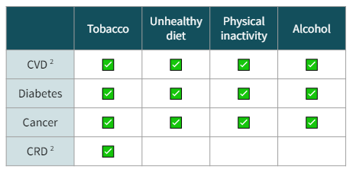
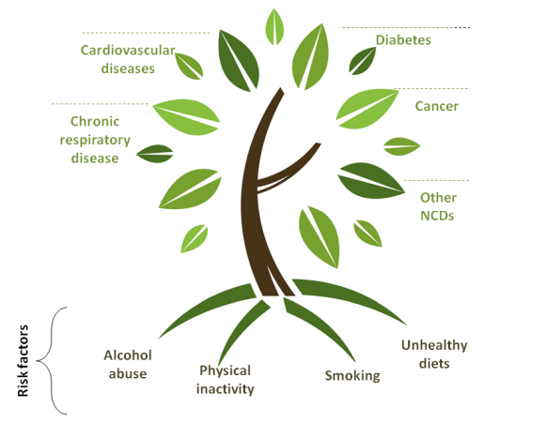
Types of NCDs
Cardiovascular disease (e.g. coronary heart disease, stroke) (considered a major killer)
Cancer
Chronic respiratory disease
Diabetes
Chronic neurologic disorders (e.g.,Alzheimer’s, dementias)
Arthritis/Musculoskeletal diseases especially back pain.
Unintentional injuries (e.g., from traffic crashes)
Risk Factors
“An aspect of personal behavior or lifestyle, an environmental exposure, or a hereditary characteristic that is associated with an increase in the occurrence of a particular disease, injury, or other health condition”.
Modifiable Risk Factors | Non-Modifiable Risk Factors
A behavioral risk factor that can be reduced or controlled by intervention, thereby reducing the probability of disease. | A risk factor that cannot be reduced or controlled by intervention
WHO has prioritized the following four: - Physical inactivity Tobacco use Alcohol use ¹ Unhealthy diets Increased fat and sodium, with low fruit and vegetable intake | for example: Age Gender Race Family history Genetics
Metabolic Risk Factors :
“Metabolic" refers to the biochemical processes involved in the body's normal functioning.
Behaviors (modifiable risk factors) can lead to metabolic/physiologic changes.
WHO has prioritized the following four metabolic risk factors:
1. Raised blood pressure.
2. Raised total cholesterol.
3. Elevated glucose.
4. Overweight and obesity ³
 | Tobacco | Unhealthy diet | Physical inactivity | Alcohol
CVD ² | ✅ | ✅ | ✅ | ✅
Diabetes | ✅ | ✅ | ✅ | ✅
Cancer | ✅ | ✅ | ✅ | ✅
CRD ² | ✅
Harm depends on the amount and frequency of use
CVD = Cardiovascular Disease; CRD = Chronic Respiratory Disease
It leads to inflammation.

Slide 3
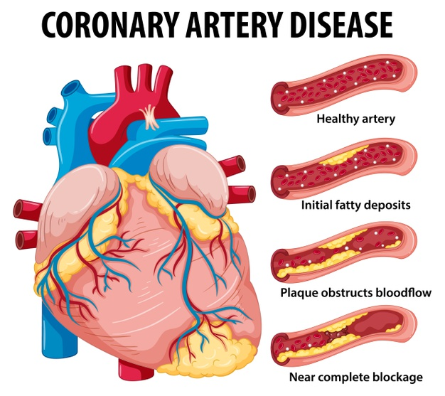
Cardiovascular Disease
Definition:
Cardiovascular disease (CVD) is a group of disorders of the heart and blood vessels, and may include:
Coronary heart disease
Cerebro- vascular disease
Peripheral arterial disease
Congenital heart disease
Disease of the blood vessels supplying the heart muscle.
Disease of the blood vessels supplying the brain.
(Stroke)
Disease of blood vessels supplying the arms and legs.
Malformations of heart structure existing at birth
not of main focus.
Global Burden:
CVDs are the #1 cause of death globally.
- An estimated 17.3 million people died from CVDs in 2016. (31% of all global deaths)
→ 85% are due to heart attacks and strokes
- Over 80% CVD deaths occur in low- and middle- income countries (less knowledge).
- By 2030, almost 25 million people will die from CVDs.
Risk Factors:
Major Modifiable Risk Factor | Other Modifiable Risk Factor
Unhealthy diets Physical Inactivity Obesity or Overweight High Blood Pressure Tobacco use Diabetes | Low socioeconomic status Heavy alcohol use Psychosocial stress Mental ill health ( depression ) Use of certain medication Lipoprotein
Non-Modifiable Risk Factor | ‘Novel’ Risk Factor
Increased age Family history/genetics Race African Americans Gender Male | Excess homocysteine in blood Inflammatory markers (CRP) Abnormal blood coagulation (increased fibrinogen)

Slide 4
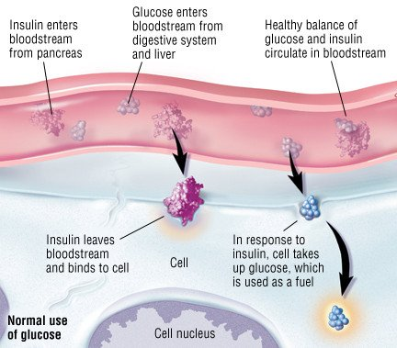
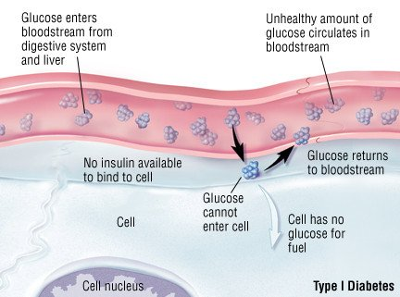
Diabetes
Definition:
Diabetes is a disorder of metabolism — the way the body uses digested food for growth and energy.
There are 4 types:
1- Type 1 an autoimmune attack against insulin secreting cells in the pancreas
2- Type 2 insulin resistance combined with decreased insulin secretion
3- Gestational diabetes first diagnosed during pregnancy that usually resolves after labor.
4- Prediabetes elevated blood sugar but doesn’t meet the clinical definition of diabetes.
Type 2 is mainly caused by modifiable risk factors and is the most
common world wide.
>90% of all adult diabetes cases are type 2.
Healthy diet, regular physical activity, normal body weight and avoiding tobacco use can prevent or delay the onset of type 2 diabetes.
Global Burden:
422 million people worldwide have diabetes in 2014
1
In 2014, an estimated 3.8 million people died from consequences of high blood sugar.
2
4
WHO projects that diabetes deaths will increase by two thirds between 2008 and 2030.
3
More than 80% of diabetes deaths occur in low- and middle-income countries.
Risk Factors:
Major Modifiable | Other Modifiable
Unhealthy diets Physical Inactivity Obesity or Overweight High Blood Pressure High Cholesterol | Low socioeconomic status Heavy alcohol use Psychological stress High consumption of sugar sweetened beverages Low consumption of fiber
Non-Modifiable | Other
Increased age Family history/genetics Race Distribution of fat | Low birth weight Presence of autoantibodies

Slide 5
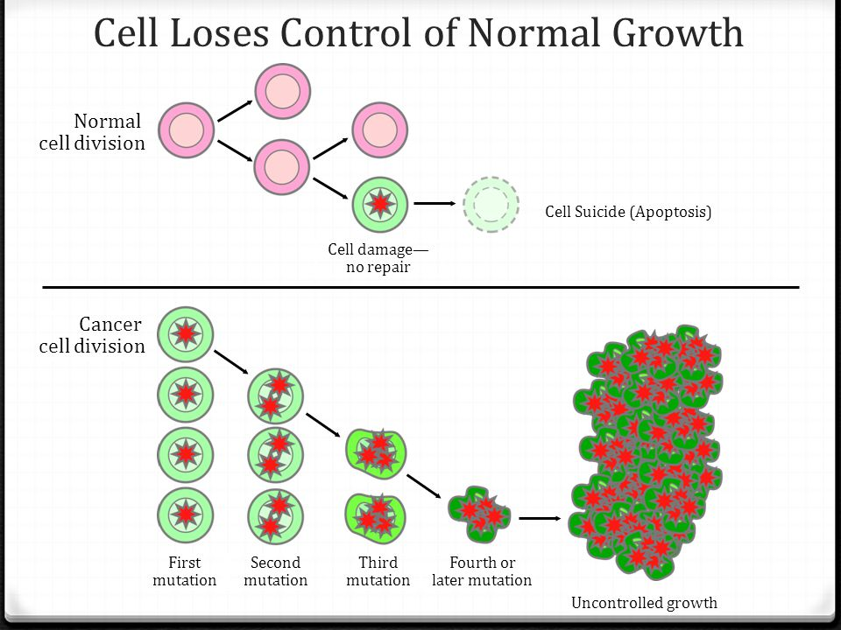
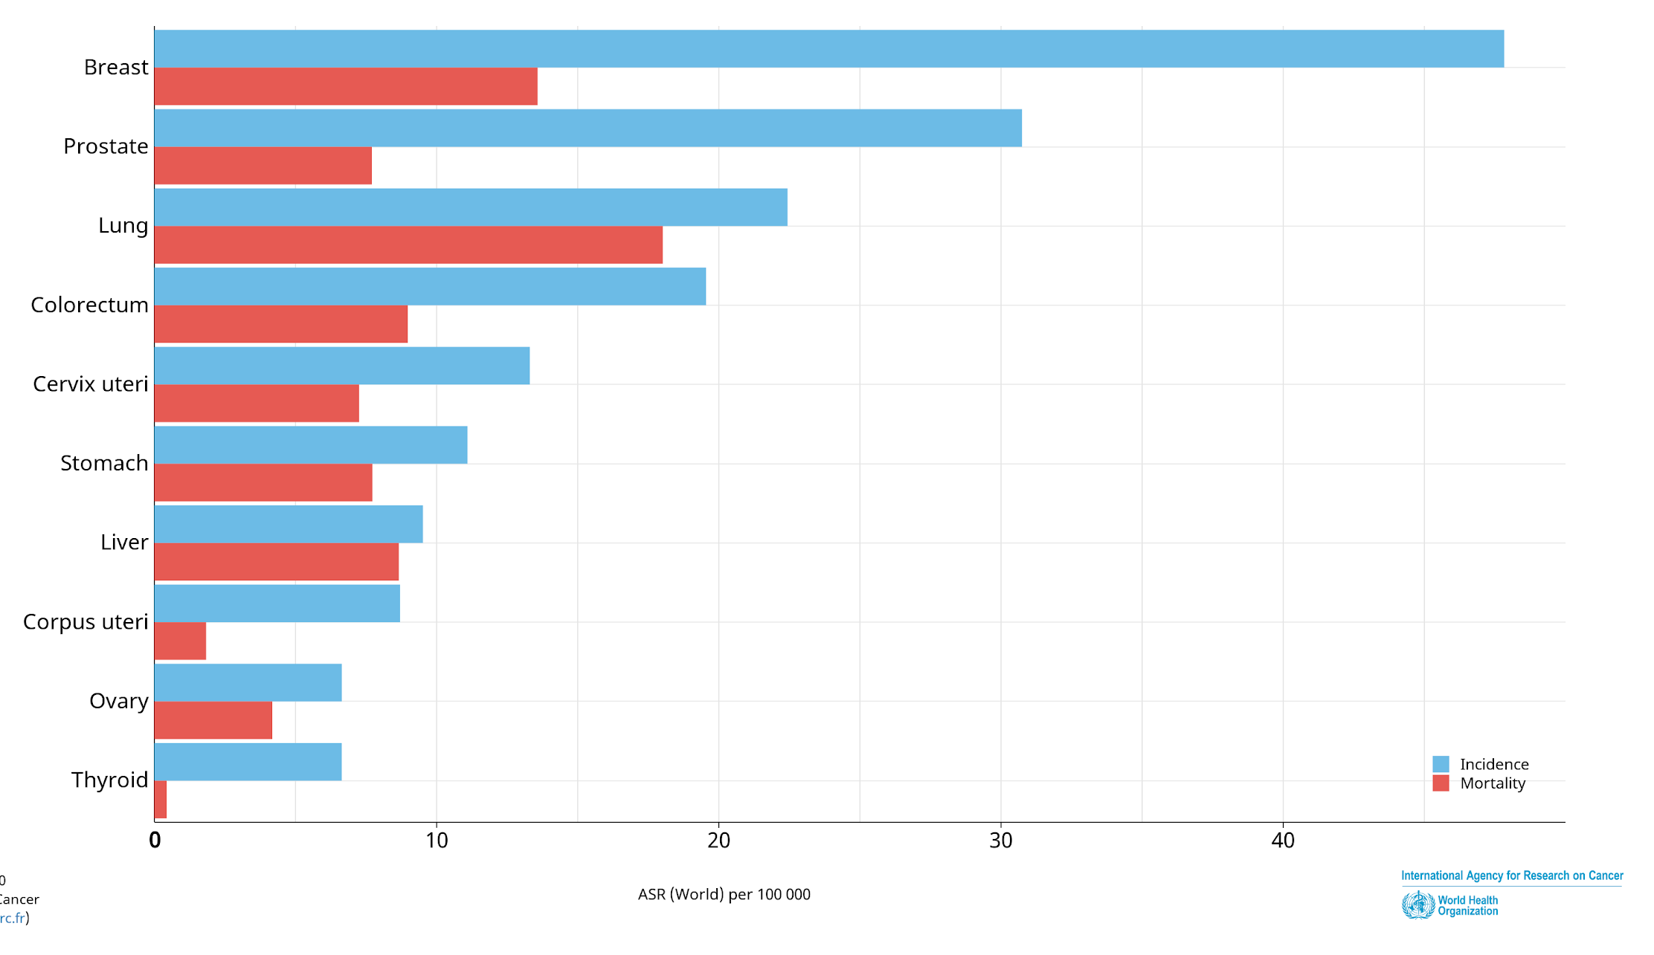
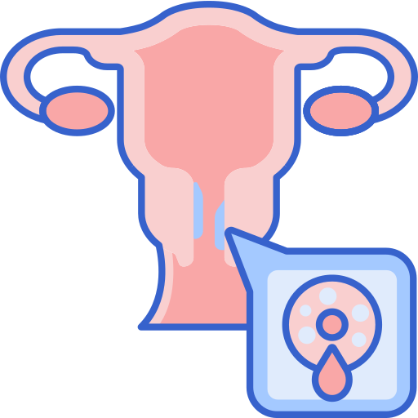
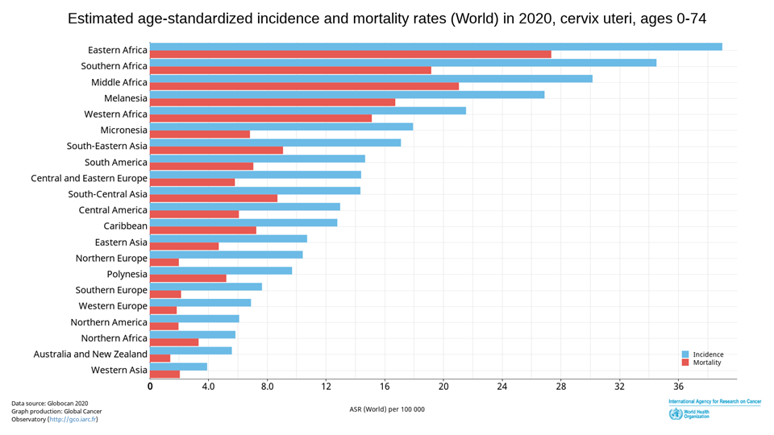
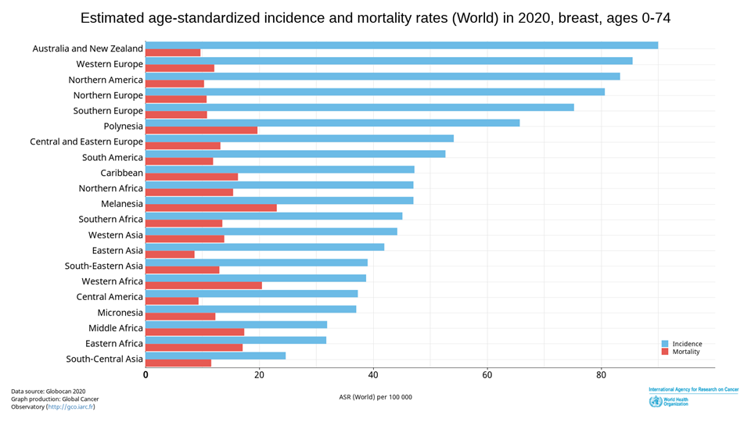
Cancer
Definition:
Generic term for a large group of diseases that can affect any part of the body.
“Rapid creation of abnormal cells that grow beyond their usual boundaries, and which can then invade adjoining parts of the body and spread to other organs.” (WHO, 2012)
Types of Tumors:
Benign tumors
Malignant tumors
Estimated age-standardised incidence and mortality rates: total population
Global Burden:
9.6 million people died from cancer in 2018.
70% of all cancer deaths occur in low- and middle- income countries.
The total annual economic cost of cancer in 2010 was estimated at approximately US$ 1.16 trillion
About 30% of cancers are attributable to behavior risk factors.
1
Cervical Cancer
Cancer of the female reproductive system.
The cervix is made up of two cell types (squamous and glandular).
Cervical cancer tends to occur where the two cell types meet.
99% of cases linked to genital infection with (HPV).
Risk Factors:
1. Human Papillomavirus (HPV) ¹
2. Smoking
3. Immunodeficiency Disorders (e.g. HIV)
4. Poverty
5. No access to PAP screening
6. Family history of cervical cancer
2
Breast Cancer ²
Cancer that forms in the tissues of the breast.
Usually affects the ducts or the lobules.
Occurs commonly in women, rarely occurs in men.
1 of 8 women will be diagnosed with breast cancer in her lifetime.
Risk Factors:
1. Hormonal therapy
2. Weight and physical activity ³
3. Race
4. Age is the most reliable risk factor
Screening should start after 45 ⁴.
5. Genetics (e.g. BRCA1, BRCA2)
There’s a vaccine for this virus that decreased the incidence of cervical cancer
Incidence higher in European countries however the mortality is considerably lower compared to African countries
Estrogen is formed in the ovaries and in adipose tissue. Obesity can increase the aromatization of androgens and increase the levels of estrogen leading to an increased risk for breast cancer
Women with positive family history should start screening prior to this age

Slide 6
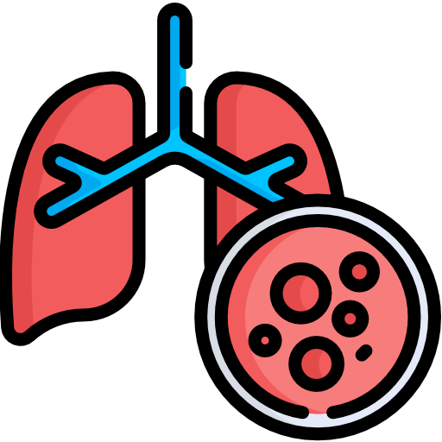
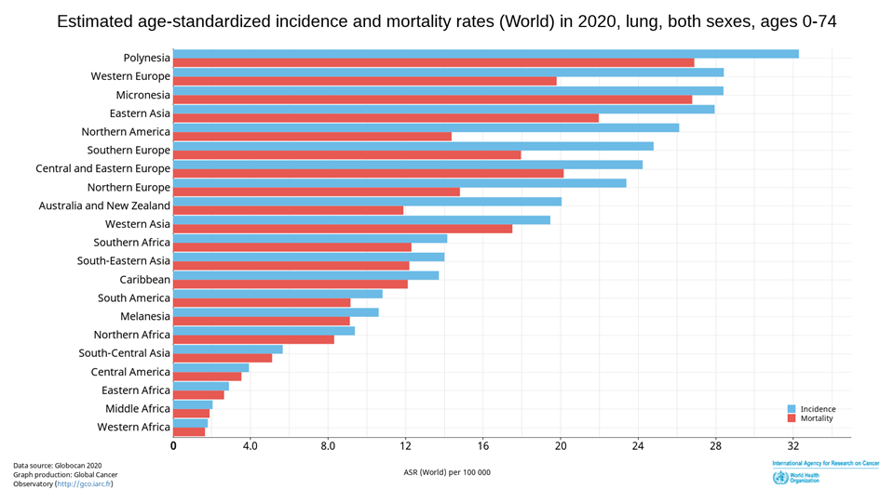
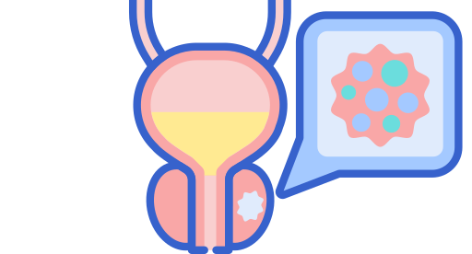
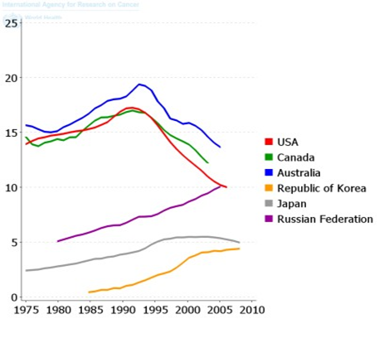
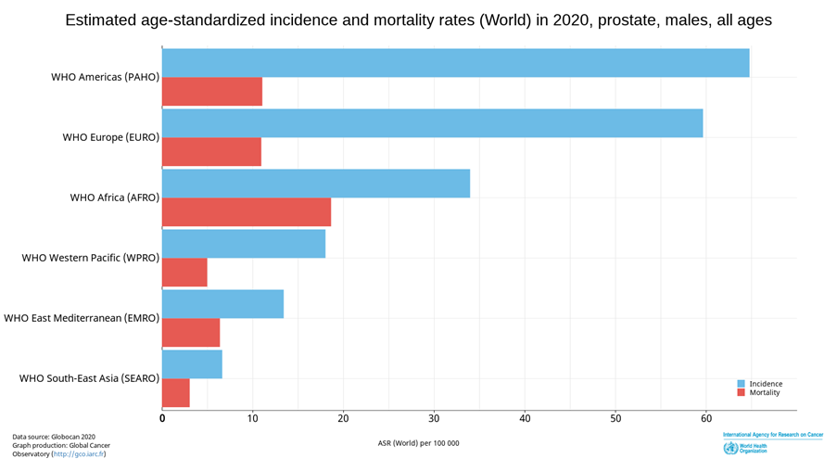
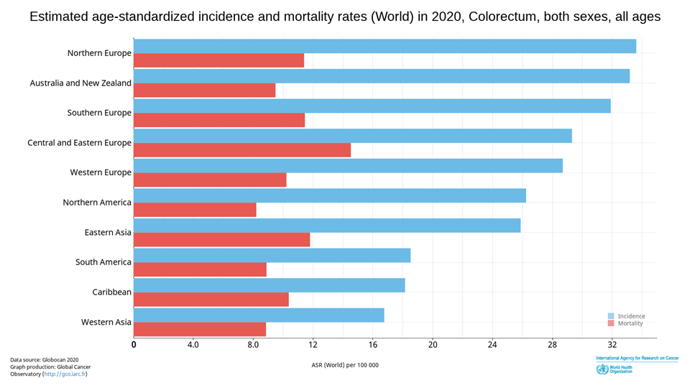
Cancer
3
Lung Cancer
Cancer forms in tissues of the lung, usually in the cells lining air passages.
Leading cause of cancer death globally, 1.37 million deaths in 2008.
Affects more men than women.
Two main types: ¹ 1- small cell cancer ‘more aggressive’ 2- non-small cell cancer. I
Risk Factors:
Smoking cigarettes, pipes, or cigars now or in the past.
Being exposed to secondhand smoke
Being exposed to asbestos, radon, chromium, nickel, arsenic, soot, or tar.
4. Being treated with radiation therapy
To the breast or chest
5. Living where there is air pollution.
4
Prostate Cancer
2nd most common cancer among men
The cancer develops inside of the prostate. No shit
Risk Factors:
Age
Weight gain
Obesity
Race
5
Colorectal Cancer
3rd most common type of cancer (most common in men in KSA)
Forms in the lower part of the digestive system (large intestine)
Most preventable cancer among men in KSA
Most common death cause of cancer among men in KSA
Risk Factors:
1. Age
2. Unhealthy diet and low exercise
3. Black Race
4. Diabetes
5. Family history of colorectal cancer
It is important to differentiate between the 2 types because the two have different management options; SCC can not be treated by surgery.

Slide 7
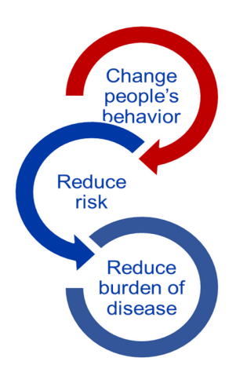
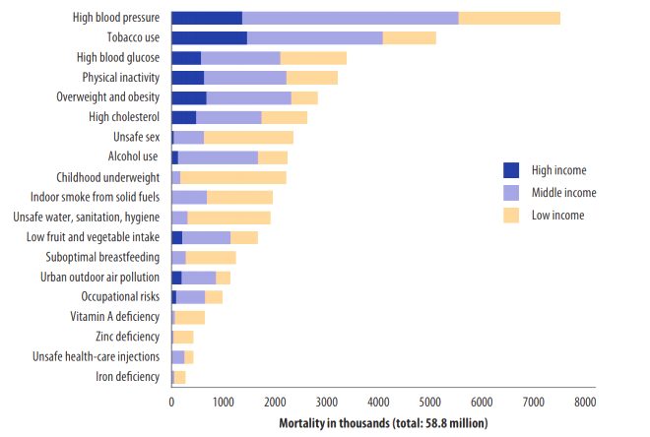
Chronic Respiratory Disease
Definition:
Chronic respiratory diseases (CRDs) are diseases of the airways and other structures of the lung. Some of the most common are chronic obstructive pulmonary disease (COPD), asthma, occupational lung diseases and pulmonary hypertension.
Global Burden:
A leading cause of death
High underdiagnoses rates
90% of deaths occur in low-income countries
Risk Factors
1. Cigarette smoke
2. Occupational dust and chemicals
3. Environmental Tobacco Smoke (ETS)
4. Indoor and outdoor air pollution
5. Genes
6. Infections (frequent respiratory infections)
7. Socio-economic status
8. Aging populations
Why Risk Factors?
Surveillance for non-communicable disease can be difficult because of:
Lag time between exposure and health condition (e.g. smoking and COPD)
More than one exposure for a health condition
Exposure linked to more than one health condition
Interventions that target risk factors are needed to prevent disease.
19 Leading Risk Factors Causing Death:

Slide 8
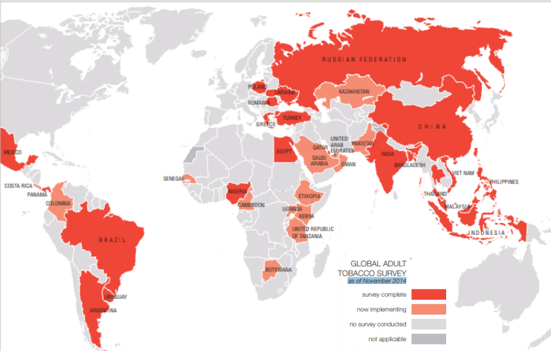
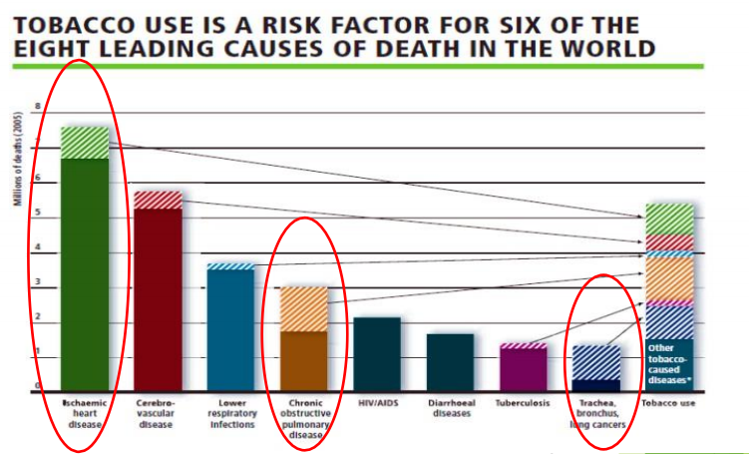
Leading Risk Factors Causing Death
Tobacco Use
Global Tobacco Survey
Tobacco kills up to half of its users.
Tobacco kills nearly 8 million people each year.
More than 7 million deaths are the result of direct tobacco use
Around 1.2 million are the result of non-smokers being exposed to secondhand smoke.
Nearly 80% of the world’s 1.3 billion smokers live in low- and middle-income countrie
Health Effects:
Among Smokers:
Cancer
Coronary heart disease
Diseases of the lungs
Peripheral vascular disease
Stroke
Fetal complications and stillbirth
Among Second-hand Smokers:
Heart disease
E.g. Heart attack
Lung cancer
Unhealthy Diet
Most countries have increased overall daily consumption of:
Daily calories
Fat and meats
Energy dense and nutrient-poor foods such as: starches, refined sugars, trans-fats.
Health Effects:
Coronary Heart Disease (CHD)
Stroke
Cancer
Type 2 diabetes (T2D)
Hypertension
Diseases of the liver and gallbladder
Obesity

Slide 9
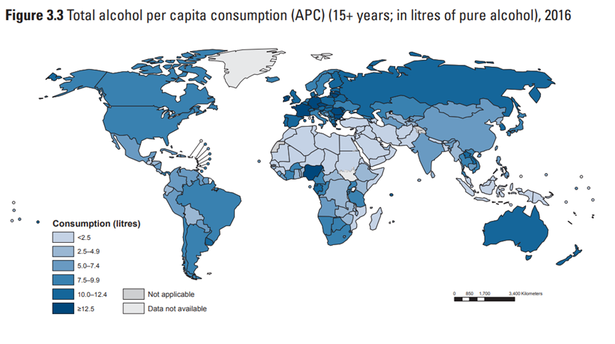
Leading Risk Factors Causing Death
Physical Inactivity
6%
CHD
31% of the world’s population does not get enough physical activity.
Many social and economic changes contribute to this trend. ¹
Example: Aging populations, transportation, and Communication technology.
6-10% of major NCDs worldwide is attributable to physical inactivity.
7%
T2D
Health Effects:
10%
Breast cancer
Reduces:
High blood pressure
Improves lipid profile
Arthritis pain
Psychiatric issues
Reduces risk of:
T2D
Certain cancers
Heart attacks and strokes
Early death and falls
10%
Colon cancer
Alcohol Use
9%
Premature Mortality
11.5% of all global drinkers are episodic, heavy users.
2.5 million people die from alcohol consumption per year
The majority of adults consume at low-risk levels.
Estimated worldwide consumption of alcohol has remained relatively stable.
Excessive Drinking: ²
Heavy Drinking on average:
Binge drinking (single occasion):
Health Effects:
Immediate effects
Diminished brain function
Loss of body heat
Fetal damage
Risk of unintentional injuries and violence
Coma and death
Long term effects
Liver disease
Cancers
Hypertension
GI disorders
Neurological and psychiatric issues
Cars, TVs, mobile phones and many other new technologies contributed to the decrease in physical activity
Women have generally less body surface area and have a lower enzymatic activity responsible in detoxifying alcohol, thus they can get intoxicated by less amount when compared to men.

Slide 10
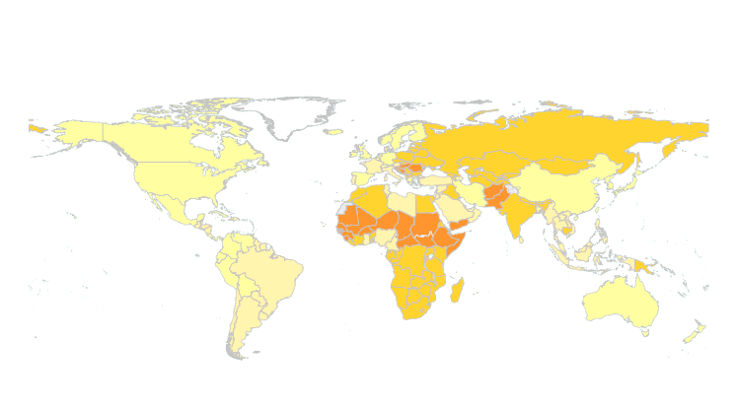
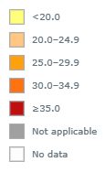
Metabolic Risk Factors
01
02
03
04
Raised blood pressure
Raised cholesterol
Raised blood glucose
Overweight and Obesity
1
Raised Blood Pressure:
Blood Pressure is measured as systolic/diastolic and expressed in mmHg
Systolic = amount of force your arteries use when the heart pumps
Diastolic = amount of force your arteries use when the heart relaxes
Measurement | Normal | Prehypertensive | Hypertensive
Systolic (mmHg) | <120 | 120-139 | 140+
Diastolic (mmHg) | <80 | 80-89 | 90+
Health Effects:
Leading risk factor for stroke and coronary heart disease (CHD).
In some age groups, the risk of CVD doubles for each increment of 20/10 mmHg of blood pressure.
Other complications of raised blood pressure:
Heart failure
Peripheral vascular disease
Renal impairment
Retinal hemorrhage
Visual impairment
Hypertension and Excessive Sodium Intake:
Sodium (through HTN) is a major cause of CVD deaths and disability.
About 10% of CVD is caused by excessive sodium intake.
8.5 million deaths could be prevented over 10 years if sodium intake were reduced by 15%.
People are unaware of how much dietary sodium they are eating.
In the U.S. 75% of sodium consumed comes from processed and restaurant foods.
In China and Japan, 75% of sodium consumed comes from cooking with high sodium products.
Recommendations and Actual Intakes WHO/PAHO:
A population salt intake of less than 5 grams or approximately 2,000 milligrams of sodium, per person per day is recommended to reach national targets or in their absence. This level was recommended for the prevention of cardiovascular diseases.
Actual intake: Latest global estimates show that average sodium intake varies from 2,000 to 7,200 milligrams of sodium per person per day

Slide 11
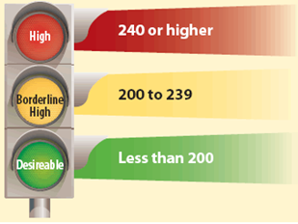
Metabolic Risk Factors
2
Raised Blood Cholesterol:
Raised total cholesterol
HDL: High density lipoproteins; often called
“Good cholesterol”
LDL: Low density
Lipoproteins; often called
“Bad cholesterol”
VLDL: Very low density
Lipoproteins; has highest amount of triglycerides.
Triglycerides: Type of fat found in your blood (stored in fat cells)
Global Burden
In 2008, global prevalence of raised total cholesterol among adults (≥ 5.0 mmol/l) was 39% (37% for males and 40% for females).
Estimated to cause 2.6 million deaths.
Health Effects
Increases risks of heart disease and stroke
Globally, ⅓ of ischaemic heart disease is attributable to high cholesterol.
A 10% reduction in serum cholesterol in men aged 40 has been reported to result in a 50% reduction in heart disease within 5 years.
A 10% reduction in serum cholesterol in men aged 70 years can result in an average 20% reduction in heart disease occurrence in the next 5 years
3
Raised Blood Glucose:
Sugar produces fuel and energy for our cells
Insulin helps control the amount of glucose in our bodies
Global Burden:
In 2012, it was estimated that elevated glucose resulted in 3.7 million deaths.
Globally, approximately 8.3% of adults aged 18 and over had elevated blood glucose in 2013.
Health Effects
Elevated glucose levels can lead to type 2 diabetes.
Diabetes is the leading cause of renal failure.
Lower limb amputations are at least 10 times more common in people with diabetes
Raised glucose is a major cause of heart disease and renal disease.
Retinal damage

Slide 12
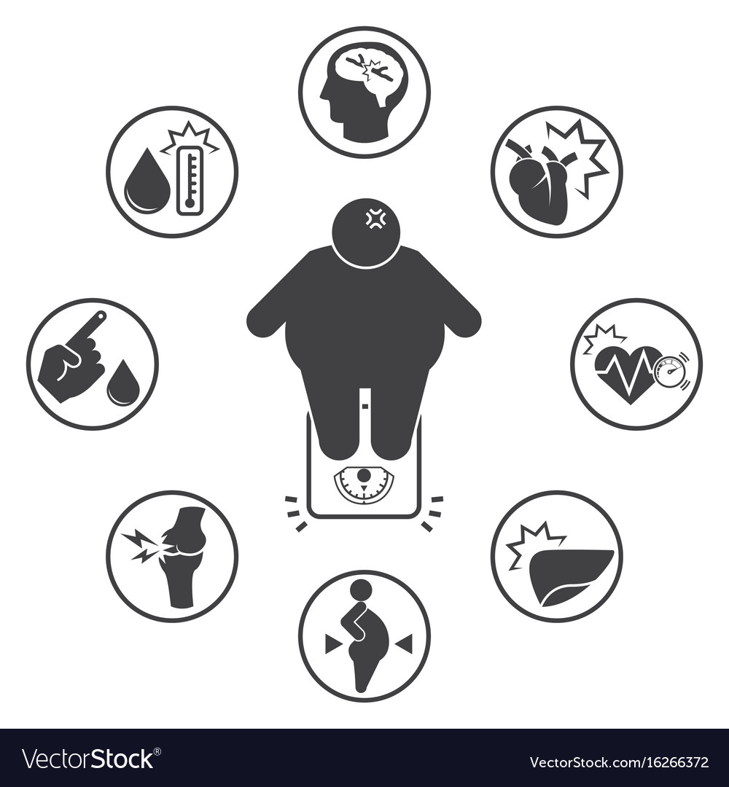
Metabolic Risk Factors
4
Overweight and Obesity:
Overweight and obesity are defined as
''abnormal or excessive fat accumulation that presents a risk to health.”
Body Mass Index
BMI (Body Mass Index) = Weight (kg) / Height² (m)
Underweight | <18.5
Normal | 18.5-24.9
Overweight | 25-29.9
Obese | >30
Skinfold Thickness Test
Waist-to-Hip Circumference Ratio
Men | > 102 cm are considered high risk
Women | > 88 cm are considered high risk
WHO Website
Global Health Observatory (GHO):
Provides data and analyses on global health priorities
Noncommunicable diseases
Mortality/morbidity
Risk Factors
Country statistics: health data and statistics for countries
Media Centre Fact Sheets:
Key facts
Symptoms, risk factors and burden of disease
© Faisal alqifari

Slide 13
Quiz
MCQ
1- Which of the following modifiable risk factors is considered a shared risk factor between Cardiovascular Disease (CVD) and Chronic Respiratory Disease (CRD)?
A- Physical Inactivity
B- Genetic predisposition
C- Unhealthy diet
D- Tobacco use
2- Which of the following cancer sites is considered the most common one in Saudi Arabia?
A- Males: Colorectal cancer ; Females: Breast cancer
B- Males: Prostate cancer ; Females: Breast cancer
C- Males: Prostate cancer ; Females: Thyroid cancer
D- Males: Thyroid cancer ; Females: Colorectal cancer
3- A patient was asked you about the relation between sodium and blood pressure. After explaining to him the relationship between them. He asked you about the recommended intake of sodium:
A- 5 g of sodium
B- 3 g of sodium
C- 2 g of sodium
D- 4 g of sodium
4- Which of the following is considered a preventative measure for NCDs?
A- Performing a bypass graft for a patient with coronary stenosis
B- Genetic testing
C- Vaccinating against HPV.
D- Promoting physical inactivity
4- According to latest guidelines on Obesity, which of the following waist-to hip ratios are associated with increased risk in women.
A- > 108 cm
B- > 102 cm
C- > 92 cm
D- > 88 cm
Answers
Q1 | Q2 | Q3 | Q4 | Q5
D | A | C | C | D

Slide 14
Thank You and
Good Luck
Team Leaders:
Lama AlAssiri | Mohammed AlHuqbani | Ibrahim AlDakhil
Deema AlMaziad
Lama AlZamil
Leen AlMazroa
Lina AlOsaimi
Muneera AlKhorayef
Norah AlHarbi
Norah AlMazrou
Nouf Alhussaini
Razan AlRabah
Renad Alhaqbani
Rema AlMutawa
Team Members:
Hameed M. Humaid
Khalid Alkhani
Meshari Alzeer
Mohannad Makkawi
Nayef Alsaber
Omar Aldosari
Omar Alghadir
Zyad Aldosari
Sara AlAbdulkareem
Sedra Elsirawani
Wejdan Alnufaie
Abdulrahman Alhawas
Abdulrahman Shadid
Abdullah Aldawood
Abdullah Shadid
Alwaleed Alsaleh
Bader Alshehri
Bassam Alkhuwaiter
Faisal Alqifari

