Slide 1
Diabetes
Objectives
List the risk factors of diabetes
List complications of diabetes
Discuss preventive measures within the framework of NCDs
Screening of Diabetes
Prevention programs in KSA
OSCE
Color Index
Main text
Males slides
Females slides
Doctor notes
Important
Textbook
Golden notes
Extra
Editing File

Slide 2
Epidemiology
The studies demonstrated varying prevalence rates in different geographical regions in the country, ranging from 18.2% (in 2004± 2005) in the study conducted in the Eastern province to 31.6% in 2011 in the study conducted in Riyadh.
Type 1 diabetes:
due to autoimmune β-cell destruction, usually leading to absolute insulin deficiency
Gestational diabetes mellitus (GDM): diabetes diagnosed in the second or third trimester of pregnancy that was not present prior to gestation
Classification of diabetes
Type 2 diabetes¹:
due to a progressive loss of β-cell insulin secretion frequently on the background of insulin resistance²
Specific types of diabetes due to other causes, e.g. maturity-onset diabetes of the young [MODY], and drug induced diabetes (such as with glucocorticoid use,)
Criteria for the diagnosis
No reference values will be given during the OSCE
FPG: 126 mg/dL (7.0 mmol/L)³. Fasting for at least 8 h.
OR 2-h PP: 200 mg/dL (11.1 mmol/L).
OR A1C: 6.5%.
OR In a patient with classic symptoms of hyperglycemia and a random plasma glucose 200 mg/dL (11.1 mmol/L)⁴.
In the absence of unequivocal hyperglycemia, diagnosis requires two abnormal test results from the same sample or in two separate test samples. (2 FPG / 2 A1C / FPG and A1C/ FPG and 2hpp)
Normal Fasting Plasma Glucose: 5.5 mmol/L (99 mg/dL)
Normal 2-h PP: < 140 mg/dl (7.8 mmol/L)
Prediabetes; Fasting Plasma Glucose: 5.6 – 6.9 mmol/L (100 - 125 mg/dL)
Prediabetes 2-h PP: 140- 199 mg/dl (7.8-11 mmol/L)
Prediabetes; A1C: 5.7 – 6.4%
The person is at risk to develop diabetes mellitus
Prediabetes
Diabetes
More common in the clinic
Especially among obese patient
To get in mmol/L divide by 18 and vice versa.
In symptomatic patients one random plasma glucose reading is sufficient to diagnose diabetes.

Slide 3
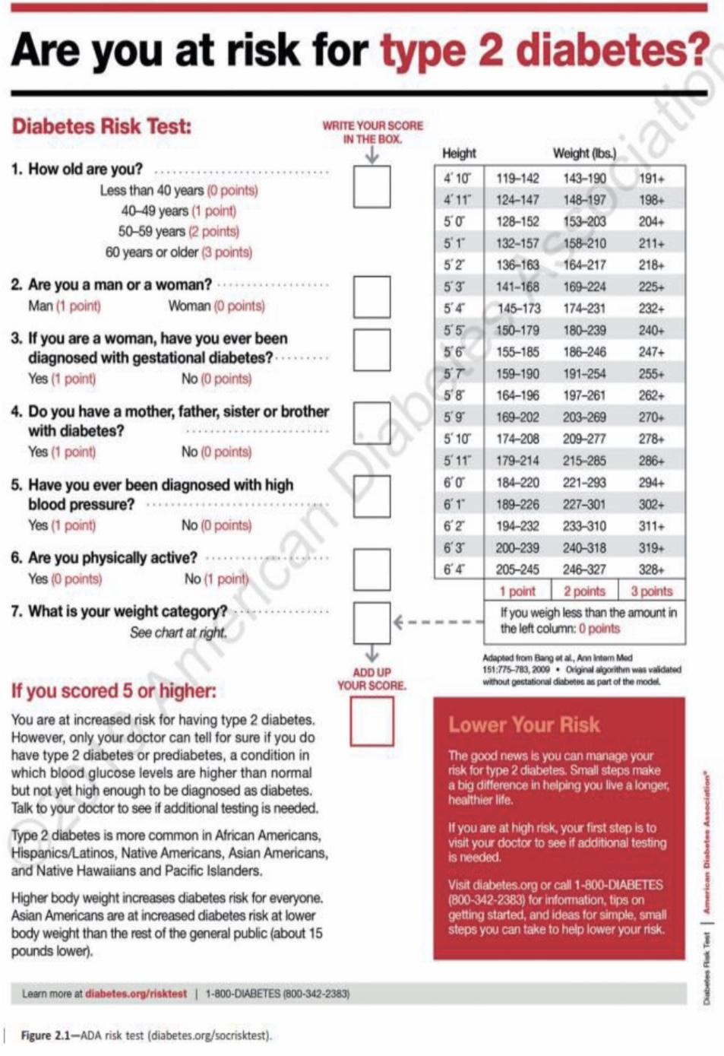
Criteria for testing for diabetes in asymptomatic adults
Testing should be considered in overweight or obese adults who have one or more of the following risk factors:
a. First-degree relative with diabetes
b. History of CVD or Hypertension
c. Women with polycystic ovary syndrome
d. Physical inactivity
e. Conditions associated with insulin resistance (e.g., severe obesity, acanthosis nigricans)
1
Patients with prediabetes should be tested yearly.
2
Women who were diagnosed with GDM even after delivery.
3
For all other patients, testing should begin at age 45 years.
4
If results are normal, testing should be repeated at a minimum of 3-year intervals
Can be distributed on the world’s diabetes day for awareness and educational purposes.
5
Prevention or delay development of diabetes
The Diabetes Prevention Program Several major randomized controlled trials, including:
Diabetes Prevention Program (DPP)
Finnish Diabetes Prevention Study (DPS)
Da Qing Diabetes Prevention Study (Da Qing study)
All demonstrated that lifestyle/ behavioral therapy featuring an individualized reduced calorie meal plan is highly effective in preventing type 2 diabetes and improving other cardiometabolic markers (such as blood pressure, lipids, and inflammation).
The strongest evidence for diabetes prevention comes from the DPP trial (1). The
DPP demonstrated that an intensive lifestyle intervention could reduce the incidence of type 2 diabetes by 58% over 3 year
LIFESTYLE INTERVENTIONS
Refer patients with prediabetes to an intensive behavioral lifestyle intervention program.
Based on the Diabetes Prevention Program (DPP) to achieve PREVENTION OR DELAY OF TYPE 2 DIABETES and maintain 7 - 10% loss of initial body weight and increase moderate-intensity physical activity (such as brisk walking) to at least 150 min/week¹. (Evidence: A)
i.e. at least 30 min, 5 day a week.

Slide 4
Healthy nutrition
OSCE
Encourage:
Whole grains, legumes, nuts, fruits, vegetables, and meat with no fat
Minimize; refined and processed foods, like rice, white bread, sugary drinks,
The use of nonnutritive sweeteners may have the potential to reduce overall calorie and carbohydrate intake if substituted for caloric (sugar) sweeteners.
A referral to dietitian (even when you give them diet advice) is essential to assess the overall nutrition status of, and to work collaboratively with, the patient to create a personalized meal plan that considers the individual's health status, skills, resources, food preferences, and health goals to coordinate and align with the overall treatment plan including physical activity and medication.
Physical activity and tobacco cessation
OSCE
Just as 150 min/week of moderate intensity physical activity, such as brisk walking, showed beneficial effects in those with prediabetes.
Moderate intensity physical activity has been shown to improve insulin sensitivity and reduce abdominal fat.
Tobacco Smoking may increase the risk of type 2 diabetes; therefore, evaluation for tobacco use and referral for tobacco cessation, if indicated, should be part of routine care for those at risk for diabetes. We don't expect you to counsel unless it's a separate osce station but always give a brief advice
Pharmacologic Interventions
Metformin therapy for prevention of type 2 diabetes should be considered in those with prediabetes, especially for those who are obese and hypertensive.
Metformin and intensive lifestyle modification led to an equivalent 50% reduction in diabetes risk.

Slide 5
Complications of DM
Cardiovascular Disease (CVD) | After 10 years of observational follow-up of the UKPDS, those originally randomized to intensive glycemic control had significant long-term reductions in MI (15% with sulfonylurea or insulin as initial pharmacotherapy, 33% with metformin as initial pharmacotherapy) and in all-cause mortality (13% and 27%,respectively). DM increase risk of CVD
Chronic kidney disease (CKD) | Optimize glucose control to reduce the risk or slow the progression of chronic kidney disease. A Optimize blood pressure control to reduce the risk or slow the progression of chronic kidney disease. A Screening by: Albumin/Creatinine Ratio to detect Microalbuminuria beside Renal function tests. Normal levels → once a year Abnormal levels → more than once a year, depending on the patient status.
Diabetic Retinopathy | Optimize glycemic control to reduce the risk or slow the progression of diabetic retinopathy. A Optimize blood pressure and serum lipid control to reduce the risk or slow the progression of diabetic retinopathy. A Screening by referring them to the ophthalmology clinic: Adults with type 1 diabetes should be referred to an ophthalmologist within 5 years¹ after the onset of diabetes. B Patients with type 2 diabetes should be referred to an ophthalmologist at the time² of the diabetes diagnosis. B
Neuropathy | Screening by the GP no need for referral to neurology: All patients should be assessed for diabetic peripheral neuropathy starting at diagnosis of type 2 diabetes and 5 years after the diagnosis of type 1 diabetes and at least annually thereafter. B
Foot care & Diabetic foot | Perform a comprehensive foot evaluation at least annually³ to identify risk factors for ulcers and amputations. B The examination should include inspection of the skin,assessment of foot deformities, neurological assessment (monofilament testing with pinprick, temperature, vibration), and vascular assessment including pulses in the legs and feet. B
Because the symptoms presents shortly after the onset of insulin deficiency
Because the pathological process (hyperglycemia) started years ago
However, in each visit ask about the feet and maybe do a general inspection.

Slide 6
The National Executive Plan Includes Seven Objectives:
1
the primary prevention from the second type of diabetes, and diminishing incidence rates of the disease through addressing the risk factors causing the disease.
2
Secondary prevention from the second type of diabetes through the early detection of the disease and its complications.
3
Advancing quality of the health services delivered to the patients suffering from diabetes and its complications.
Developing ways of detecting and following up, and assessing patients through Diabetics' Registration Program, extent of adherence to the work quality levels, annual follow-up registers, patients' interviews, and healthcare registers of patients.
4
5
Improving on the research tools and studies related to the disease.
6
Enabling diabetics and their families to contribute to controlling diabetes and its complications.
7
Community participation in controlling diabetes.

Slide 7
Referral of diabetic patients to:
Eye Clinic
Diabetic Educator
Dietitian
Specialty Clinics
DM type 2 “first visit” and DM type 1 after 5 years of diagnosis
For all and especially when start insulin or shift to Penfill injections.
For all.
like nephrology when indicated
All diabetic patients especially on insulin will be offered a Glucometer for home monitoring.¹
Multidisciplinary approach for DIABETIC PATIENTS (Physician, clinical pharmacist, health educator and nutritionist)
Prevention / Health Services in Saudi Arabia
Specialized Centers:
The Ministry of Health (MOH) adopted implementing an objective method in all the fields of health services providing: prevention, treatment, and rehabilitation, through a network of integrated facilities.
Thus, it established 20 specialized centers for treating diabetics, and eight new more centers are underway across the Saudi Arabia's regions.
Further, the MOH is working on enhancing the health awareness of each diabetic or anyone vulnerable to develop the disease, and providing the best health and education services.
World Diabetes Day
The Ministry of Health (MOH) is interested annually in marking the World Diabetes Day, falling on the fourteenth of November of each year.
This is with the aim of achieving the general goals in terms of boosting up and carrying out the prevention policies and controlling diabetes and its complications.
Supporting the national initiatives for diabetes control and its complications, and highlighting the importance of evidence- based education with regard to treating diabetes and preventing from its complications.
National Preventive Programs
The cornerstone of a national preventive program would be the PHCCs.
However, quality of care at the PHCCs is unsatisfactory.
A comprehensive review of primary healthcare in Saudi Arabia found that access to health education was limited and referrals to specialist hospitals were low.
Patients’ follow-up system was ineffective.
Multiple problems with poor quality and time for health education, poor counseling, lack of trust in health-care providers, and difficulty in understanding instructions from health providers due to poor communication.
Target levels::
Post-prandial s180 mg/dl (if above, increase the bolus insulin by 2 unit for 3 day and check again)
Fasting s 130 mg/dl (if above, increase the basal insulin by 2 unit for 3 day and check again).

Slide 8
Quiz
MCQ
1- According to new World Health Organization diabetes management guidelines, what is the best diagnostic criterion of diabetes?
A. Oral glucose tolerance test
B. Random blood sugar
C. Urine analysis
D. Glycosylated hemoglobin
2- 25 y.o woman comes in for an antenatal care appointment, she is 7 months pregnant with twins. Her urine dipstick is showing proteinuria. What is the possible cause?
A.gestational hypertension
B. Type 1 Diabetes
C. Type 2 Diabetes
D.maturity-onset diabetes of the young [MODY]
3- Which of the following confirmed values meet the diagnostic threshold for diabetes?
A- Random glucose > 160 mg/dl
B- 2 hour post prandial glucose ≥ to 126 mg/dl
C- Fasting blood glucose ≥ 126 mg/dl
D- Fasting blood glucose equal to or greater than 140mg/dl
4- Keeping your diabetes under control early on will help you prevent more health problems later. People with diabetes are at higher risk for which of these?
A- Heart disease
B- Cancer
C- Nerve damage
D- A and C
5- Prediabetes is the term used for individuals that do not meet the criteria for diabetes but are too high to be considered normal. Which of the following statement accurately characterize prediabetes?
A- Fasting blood glucose from 120-180 mg/dL
B- Fasting blood glucose from 126-140 mg/dL
C- Fasting blood glucose from 110-125 mg/dL
D- All of the above
Answers
Q1 | Q2 | Q3 | Q4 | Q5
A | A | C | D | C

Slide 9
Thank You and
Good Luck
Team Leaders:
Lama AlAssiri | Mohammed AlHuqbani | Ibrahim AlDakhil
Deema AlMaziad
Lama AlZamil
Leen AlMazroa
Lina AlOsaimi
Muneera AlKhorayef
Norah AlHarbi
Norah AlMazrou
Nouf Alhussaini
Razan AlRabah
Renad Alhaqbani
Rema AlMutawa
Team Members:
Hameed M. Humaid
Khalid Alkhani
Meshari Alzeer
Mohannad Makkawi
Nayef Alsaber
Omar Aldosari
Omar Alghadir
Zyad Aldosari
Sara AlAbdulkareem
Sedra Elsirawani
Wejdan Alnufaie
Abdulrahman Alhawas
Abdulrahman Shadid
Abdullah Aldawood
Abdullah Shadid
Alwaleed Alsaleh
Bader Alshehri
Bassam Alkhuwaiter
Faisal Alqifari

