Slide 1
Travel Medicine
Important lecture
Objectives
Define travel medicine and its importance
Levels of travel medicine (pre, during, post)
Pre-travel consultation (risk assessment, risk management, immunization, prophylaxis, self-medications)
Immunization (required, recommended, routine)
Other infections (malaria, zika, traveler’s diarrhea)
Prevention (food, water and personal precautions, environmental precautions, vector and animal precautions, injury precautions)
Travel emergency kit
Post-travel care
Color Index
Main text
Males slides
Females slides
Doctor notes
Important
Textbook
Golden notes
Extra
Editing File

Slide 2
Travel medicine
What is travel medicine?¹
An interdisciplinary specialty concerned with prevention, early detection, and research of health problems associated with travel.
What does travel medicine do?
Seeks to prevent illnesses and injuries occurring to travelers going abroad.
Manages problems arising in travelers coming back or coming from abroad.
Impact of tourism on health and to improve health and safety services to tourists
Refugee and migrant health
1
2
Why travel medicine?
4
WORLDWIDE
1950 - 25 million international tourist arrivals
2000 - 664 million international tourist arrivals
2010 - 940 million international tourist arrivals (growth rate 7% from 2009)
2030 – forecast 1.8 billion
World Tourism Organisation
3
Importance of travel medicine
Of 100,000 travellers to the developing world for 1 month
50.000 will develop some sort of health problem during their trip
8000 will see a physician
5000 will have to stay in bed
300 will have to be admitted to hospital either during their trip or on return
50 will need to be air evacuated
1 will die
Ref. Spira AM Lancet. Vol 361. April 19, 2003
Concerns:
1
International travel carries a risk for travelers, community of origin and community of destination.
2
The risk for travelers includes diseases, injuries and death.
1: Because the numbers of travellers are usually increasing every year, keep in mind that it got affected by the pandemic so the numbers are gonna decrease with the latest updates

Slide 3
Travel medicine
Types of travelers
Tourists
Students
VFRs (visiting friends and relations)
Gap year travel
Business travellers
Asylum seekers
Migrant workers
Refugees
Military
Pilgrims
Aid and Development workers
List the group of travelers who are at a special risk
Special population
Elderly travelers | Travelers with chronic diseases
Infants and children | Travelers with disabilities
Pregnant women | Immunocompromised travelers
Special journeys “Risk depends on distentation”
Cruise ship travel | Extreme travel
Diving | Mass gathering (eg. The Hajj)
Extended stay | Wilderness/remote region trave
Components of Travel medicine
Pre-travel
During Travel
Post travel
1
2
3

Slide 4
Pre-travel consultation (4-6 weeks before departure)
Risk assessment (potential hazard)
Risk management (advice to reduce exposure to health risks)
Service delivery: immunization, prophylaxis or self-medications.
Empower traveler to manage his health
1
2
Risk assessment (potential hazards)
4
3
Information about travelers:
Age & sex
Medical history
Medications
Allergies
Immunization history
Special health needs
Information about trip:
Destination
Length of stay
Mode of travel
Purpose of trip
Purpose of planned activities
Financial budget, accommodation, insurance
Healthcare in destination
Risk factors and health problems facing international travelers:
Risk
Health problems
Overcrowding
Aggravation of existing problem
(Eg. Cardiac pts going for hiking)
Food and water borne infections
Air borne infections
Unintentional & intentional Injuries
Vector borne diseases
Zoonotic diseases
Stray animals
Low sanitation
Unsafe roads
Climate change
Security problems
Vector of diseases

Slide 5
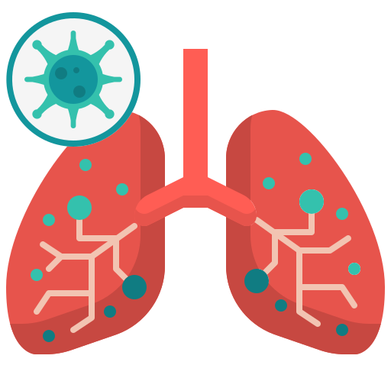
Common diseases associated with international travel:
Traveler’s diarrhea
Typhoid fever
Hepatitis A
Cholera
Poliomyelitis
Influenza
Meningitis
MERS-Cov
COVID19
Tuberculosis
Yellow fever
Malaria
Dengue fever
Leishmaniasis
Japanese encephalitis
Gastrointestinal
Pulmonary Disease
Vector borne diseases
Sexually transmitted diseases
Rabies
Hepatitis B
Tetanus
Behavior related
Zoonotic diseases
Blood borne
Soil borne
Unintentional and intentional injuries:
- Road traffic injuries -Interpersonal violence
-Injury in recreational water -Animal bites (domestic and wild animals)
Risk management (give advise):
Food and water safety and hand hygiene
Insect bite prevention
Immunization
Malaria prevention
Personal safety (RTA, fall, drowning, fire, robbery, STD)
Environmental risks (sun exposure, heat, high altitude, motion sickness, DVT)
Travelers with special needs (chronic disease, children, pregnant, immunocompromised patients)
Traveler's medical insurance
Preventive measures for common diseases among international travelers
Immunization or/and prophylaxis
general measures for prevention of infectious diseases.

Slide 6
Preventive Measures for International Travelers
Immunization:
Routine:
Childhood immunizations.
Recommended:
According to risk of infection.
Required:
yellow fever vaccine
meningococcal vaccine
COVID-19 vaccine?
Routine immunizations:
Hepatitis A
Hepatitis B
BCG
DPT
MMR
Polio
Pneumococcal
Meningococcal
Rota virus
Varicella
Hemophilus influenzae
Human papilloma virus
Tick borne encephalitis
Influenza
Others in other countries
In KSA
Required immunizations
Yellow fever (international health regulation)
Meningococcal meningitis: by Saudi Arabia for Hajj and Umrah and seasonal workers.
Polio

Slide 7
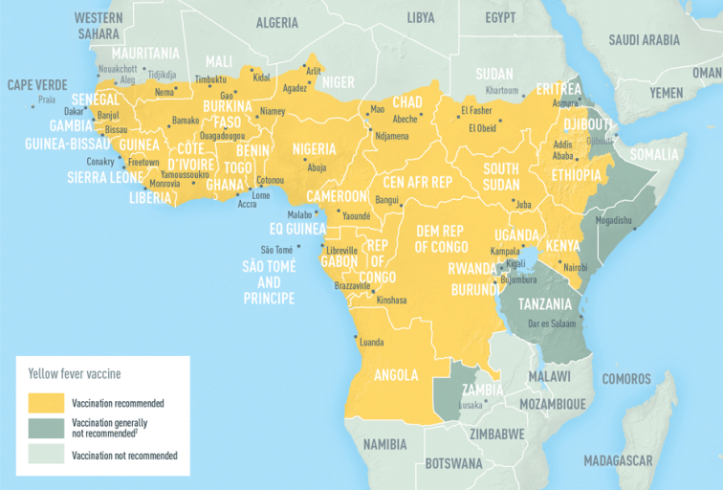
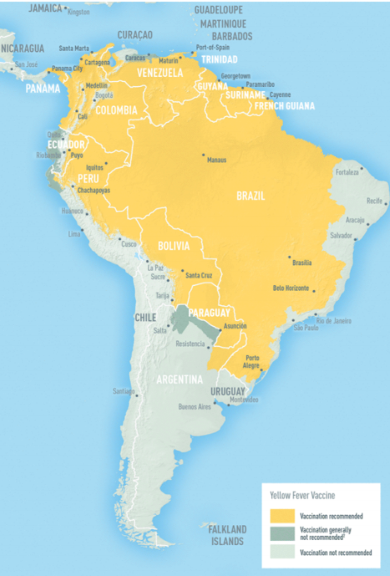
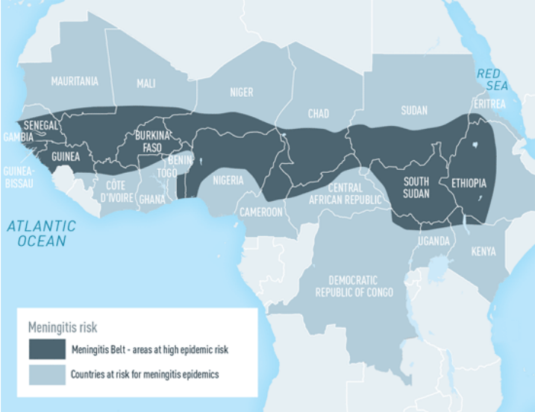
Preventive Measures for International Travelers
1-Yellow Fever : vector borne disease associated with international travel and addressed by the international health regulation (IHR)
Required for travelers to a country under the International health regulations.
Recommended: for travelers to endemic area. Ex: Brazil
Vaccination:
Type: Live attenuated virus vaccine
Dose: Single subcutaneous injection
Immunity: starts after 10 days
Protection: Valid for 10 years
Vaccine Not recommended for:
Infants < 9 months
Immunocompromised patients
Pregnant women
Egg allergies
HIV-positive individuals
2- Meningococcal Meningitis:
Required: by Saudi government for Hajj or Umrah.
Recommended: for travelers to endemic area.
Risk:
Sub-Saharan Africa (seasonal)
Saudi Arabia (Hajj)¹
Crowded student dormitory situations
Vaccination:
Dose: Single dose (injection)
Protection: for 3–5 years in adults and older children¹
Not effective: for children below 2 years
Meningitis belt
1: Individuals who had received the vaccine > 3-5 years ago and want to go to Hajj or Umrah, should take the vaccine again (as well as Saudis).

Slide 8
Preventive Measures for International Travelers
Recommended immunizations (according to risk):
Hepatitis A, B
Typhoid
Cholera
Poliomyelitis
Meningococcal meningitis
Japanese encephalitis
Rabies
Tick-borne encephalitis
Covid-19
1- Hepatitis A:
Endemic in many developing countries & High mortality in elderly & pregnant women
Prevention: Food, water, personal hygiene & immunization
Vaccination:
Type: Inactivated vaccines
Dose (2 doses) (HAVRIX® or VAQTA®) (can combine immunoglobulins with the vaccine if needed)
Protection:
14 – 20 years in children
25 years among adults
Recommended for:
Travelers to the developing countries
2 years and older
2- Hepatitis B:
Transmission: Blood- borne, sexual contact
Prevention: Avoid risk factors & immunization
Vaccination:
Type: Recombinant vaccine, IM injection
Monovalent or combined with hepatitis A (for those ≥ 18 years)
Recommended for: travelers to endemic areas and travelers with special risk
Recommended immunizations hepatitis A (for those >= 18 years).
3- Cholera “Rare in travelers”
Transmission: Contaminated food or water
Prevention:
Food, water & personal hygiene
Vaccination (oral)
Vaccination
Type: Oral vaccine (Live attenuated)
Result in 60–80% protection for 6 to 12 months
Not effective against new serotype O139 (spread through Asia in mid 90s)

Slide 9
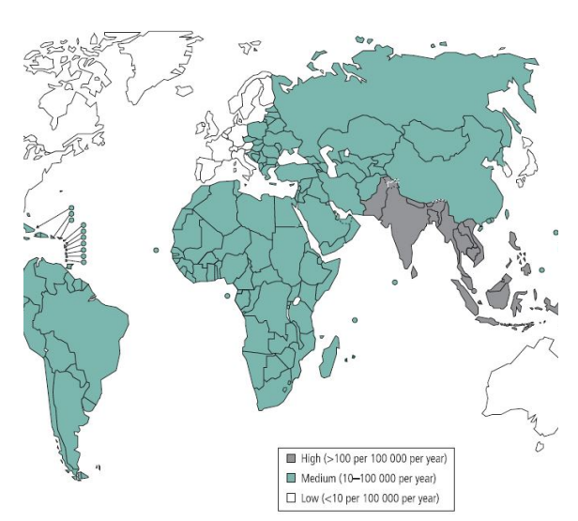
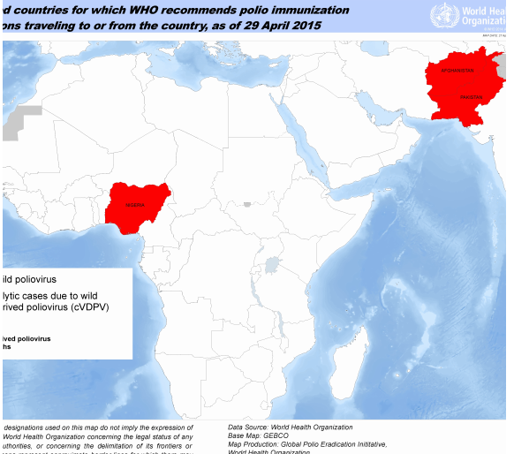
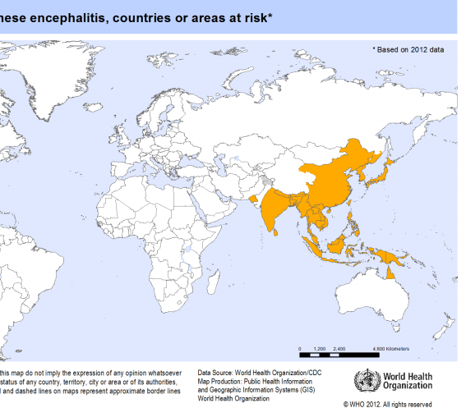
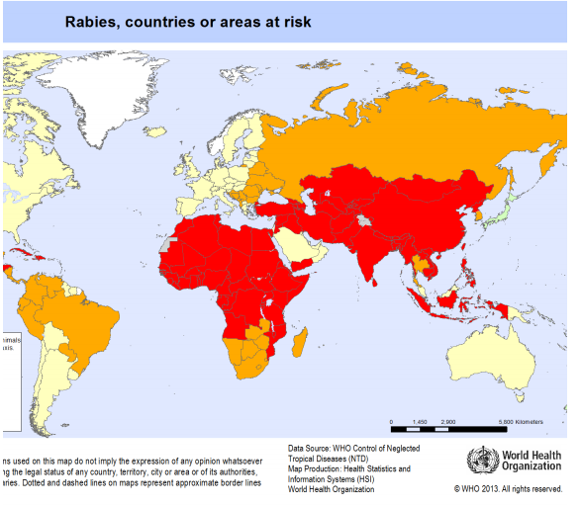
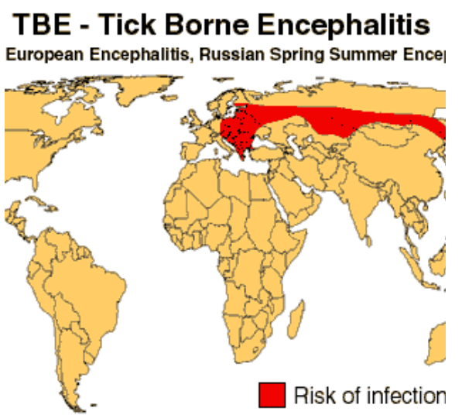
Preventive Measures for International Travelers
Recommended immunizations:
4- Typhoid
Transmission: contaminated food and water
Prevention: Food, water, personal hygiene & vaccination
5- polio “Rare in travelers”
Transmission: contaminated food and water.
Prevention:
Food, water, personal hygiene
Vaccination: (injectable, oral)
Polio in Saudi Arabia:
In Saudi Arabia, proof of receipt of polio vaccine is required from travelers from endemic countries or countries vulnerable to infection or re-infection.
(within the previous 12 months and at least 4 weeks prior to departure).
All travelers from these countries will also receive 1 dose of OPV at border points on arrival in Saudi Arabia.
6- Japanese encephalitis
Transmission: By mosquito bite same as malaria
Prevention: vector control & vaccination
Risk: increases in travelers to rural Asia or long stay travelers
7- Rabies
Transmission: Animal bite or scratch
Prevention: Immunization (Preexposure • Post exposure • Immunoglobulin)
Risk: occupational , travel to rabies risk countries
8- Tick-borne encephalitis:
Transmission: 1. Ixodes sp. Ticks. 2. Ingestion of unpasteurized dairy products.
Rural forested areas of east and Central Europe, Russia and part of Asia.
Prevention:
Tick prevention.
Avoidance of unpasteurized dairy products.
Vaccination.
Self check and removal ASAP (tweezers).

Slide 10
Preventive Measures for International Travelers
Other vaccines
Influenza
Tuberculosis
Recommended to: to travelers to Southern Hemisphere from April through
September & tropic and subtropic at risk of serious related complications
Recommended to: long stay in developing countries
Risk: Exposure to the virus is throughout the year in tropical & subtropical areas.
Attack rate: is 1.2–2.8% in travelers of all age groups
Vaccination Type
Inactivated parenteral vaccine
live attenuated vaccine, administered by:
Nasal spray (for healthy persons 5–49 years)
Inactivated parenteral vaccine as injection.
The vaccine:
BCG
Live attenuated
Single intradermal injection
Baseline tuberculin before travel with a follow up every 1 year

Slide 11
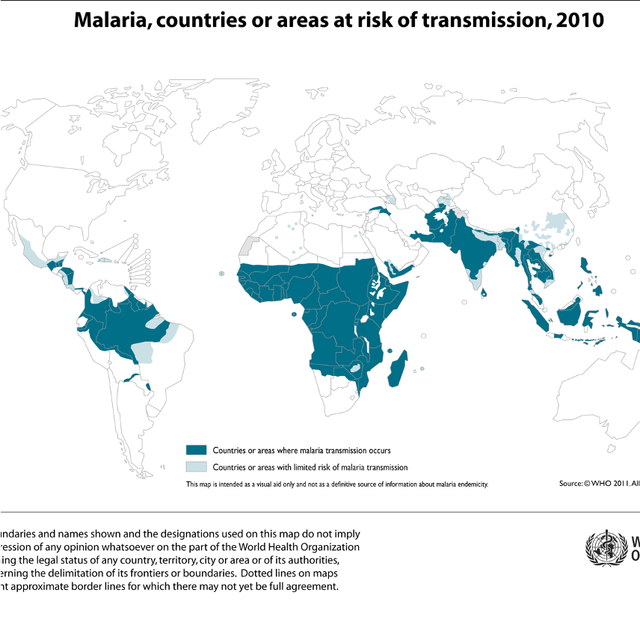
Preventive Measures for International Travelers
Chemoprophylaxis
Malaria
Transmission: Mosquito bite Malaria
Prevention:
Awareness
Bite avoidance
Chemoprophylaxis before and after traveling
Diagnosis of febrile illness
Fever in returned traveler is a medical emergency considered malaria until proven otherwise
Drug | Area | Instructions of use
Proguanil | all areas | 1 – 2 days before departure, daily during the journey and 7 days after return
Doxycycline 100 mg | all areas | 1 – 2 days before departure, daily during the journey and 4 weeks after return
Chloroquine 300 mg | chloroquine sensitive areas | 1 – 2 weeks before departure, weekly during the journey and 4 weeks after return
Primaquine 30mg | predominant vivax areas & ovale | 1 – 2 days before departure, daily during the journey and 7 days after return
Mefloquine 228mg | mefloquine sensitive areas | 2 weeks before departure, weekly during the journey and 4 weeks after return

Slide 12
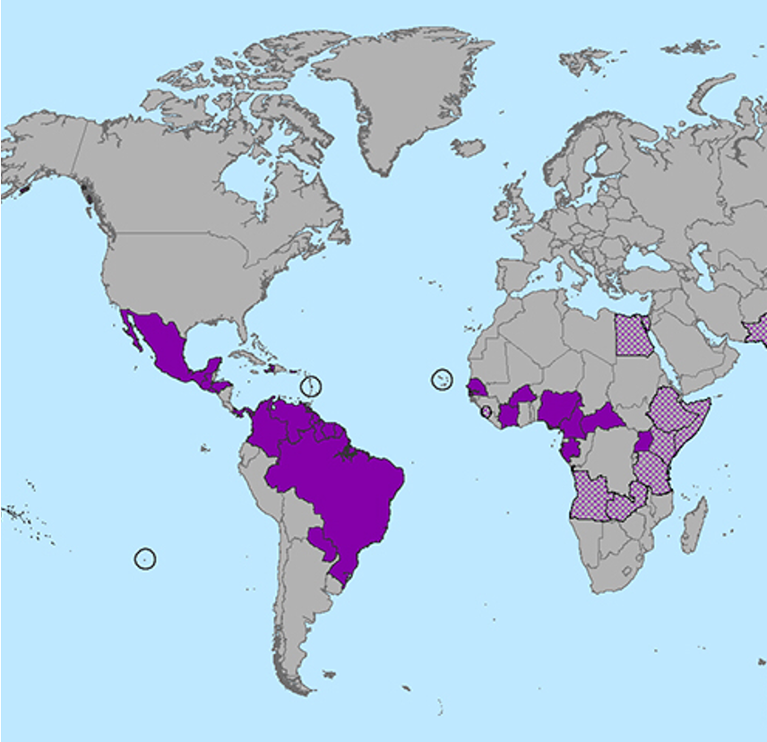
Other infections
Zika virus
Transmission: mosquito bite
Prevention: preventing mosquito bite
Risk? To pregnant women —> microcephaly and other brain abnormalities.
Traveler’s diarrhea¹
Cause:
Bacterial (60-80%)
Viral (10-20%)
Parasitic (5-10%)
Prevention:
Wash It, Peel It, Cook It, or Forget It
Only Drink Bottled Water
Wash hands frequently
Post-Travel care
Post-travel checkup
Long term travelers
Adventure travelers
Travelers in developing world
Post-travel care
Fever, chills, sweats
Persistent diarrhea
Weight loss
1: One of the most common traveler’s incidence.

Slide 13
Responsibilities of Travelers to Prevent Ill-health
Responsibilities of traveler:
Decide on the travel destination and timing
Recognize and accept risk
Visit the general practitioner prior to traveling
Obtain travel insurance
Adhere to the preventive precautions
Carry medical kits and understand its use
Assume the responsibility of the health and safety of children
Respect people and culture in country of destination
Visit the general practitioner upon return
Check status of destination:
Warning level 1
Warning level 2
Warning level 3
Practice usual precautions
- Presence of usual risk for infectious diseases as diarrheal diseases and malaria
Practice enhanced precautions
- Presence of MERS-CoV in Arabian Peninsula
Avoid non-essential travel
- Presence of outbreak (Ebola, COVID-19) and adverse security situation if returned from and infectious diseased country then the person should quarantine

Slide 14
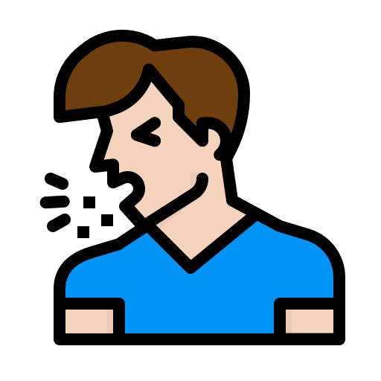
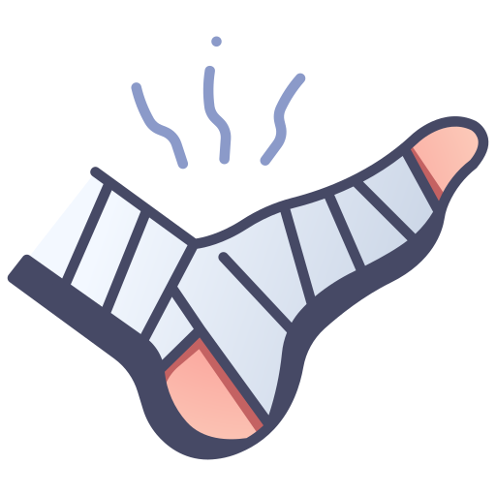
Responsibilities of Travelers to Prevent Ill-health
Consulate general practitioner:
Before departure:
Timing: 4 to 6 weeks
Purpose:
1- medical evaluation.
2- receive preventive intervention .
3- travel advice.
4- Risk of assessment
After arrival:
1- have chronic diseases.
2- spent > 3 months in a developing country.
3- received treatment for malaria while traveling.
4- exposed to a serious infectious disease while traveling.
5- experienced illness in the weeks following return (fever, persistent diarrhea, vomiting, jaundice, urinary disorders, skin disease or genital infection).
Carry emergency medical kits:
Usual prescription medications in sufficient quantities
Essential over the counter medicines to meet common illnesses
Analgesics.
Decongestant, cold medicine, cough suppressant.
Antibiotic/antifungal/hydrocortisone
Creams antacid
First aid kits
○ Band-Aids, gauze bandages, tape, Ace wraps. ○ Tweezers, scissors, thermometer.
Special items according to destination
○ Insect repellant, sunscreen, lip balm
Issue travel insurance:
Required in case of:
Covers:
● Changes to the itinerary.
● Emergency repatriation for health reasons.
● Medical care (illness and accidents).
● Hospitalization.
● Repatriation of the body in case of death.
llness
Accident
Death

Slide 15
Precautions
Food & water
Bottled water | Selection of foods (well-cooked and hot)
Avoidance of:
Slads, raw vegetables & Street vendors
Unpasteurized dairy products & Ice
Environmental
Jet Lag | Sun protection | Altitude
Extreme Heat & Cold (Dehydration, heat stroke, hypothermia & frostbite)
Water recreation:
Drowning, boating & diving accidents
Biological and chemical contamination
Injury and crime
Vehicles:
Risk of road and pedestrian accidents
Night travel
Seat belts and car seats
Avoid the use of drugs and alcohol
Understanding local crime risks:
Scam awareness
Situational awareness
Location avoidance

Slide 16
Quiz
MCQ
1- Which of the following is the main focus of travel medicine?
A. Control of the growing volume of travelers
B. Provision of treatment after return
C. Pre-travel preventive care
D. Legislation concerning international travel
2- Who is of the following travellers considered as a high risk population?
A-A 35 years male with absent limb
B- A 25 years female known to have SLE and she is on medications
C- An 18 years male with past medical history of mononucleosis
D- A and B
3- Which of the following vaccines is recommended for someone who is travelling to sub-Saharan Africa?
A. Meningococcal vaccine
B. Pneumococcal vaccine
C. Yellow fever
D. Rocky mountain fever
4- A man is planning to travel to Brazil for a conference. He visits his family physician to which he advised him to take a vaccine. Which of the following vaccines he's recommended to take? :
A. Hepatitis B
B. Yellow fever
C. Malaria
D. Meningococcal
5- I35 year-old man is traveling to India and staying around 15 days. What would you advise him to avoid getting "traveler's diarrhea" prior to his departure?
A. Take prophylactic antibiotic
B. Avoid using public toilets
C. Eat peeled fruits and vegetables
D. Take a vaccine
Answers
Q1 | Q2 | Q3 | Q4 | Q5
C | D | A | B | C

Slide 17
Thank You and
Good Luck
Team Leaders:
Lama AlAssiri | Mohammed AlHuqbani | Ibrahim AlDakhil
Deema AlMaziad
Lama AlZamil
Leen AlMazroa
Lina AlOsaimi
Muneera AlKhorayef
Norah AlHarbi
Norah AlMazrou
Nouf Alhussaini
Razan AlRabah
Renad Alhaqbani
Rema AlMutawa
Team Members:
Hameed M. Humaid
Khalid Alkhani
Meshari Alzeer
Mohannad Makkawi
Nayef Alsaber
Omar Aldosari
Omar Alghadir
Zyad Aldosari
Sara AlAbdulkareem
Sedra Elsirawani
Wejdan Alnufaie
Abdulrahman Alhawas
Abdulrahman Shadid
Abdullah Aldawood
Abdullah Shadid
Alwaleed Alsaleh
Bader Alshehri
Bassam Alkhuwaiter
Faisal Alqifari

