Slide 1
Introduction to Occupational Health
Objectives
Define Occupational Health.
Enlist major diseases related to occupational hazards.
Physical hazards such as heat, light, pressure, noise, radiation, electricity, and mechanical factors.
Chemical hazards such as gases, fumes, dust, metals and solvents.
Others including biological agents, occupational cancers and dermatosis.
Understand signs and symptoms and diagnosis of occupational diseases of public health importance.
Discuss the scope of occupational health and safety.
Color Index
Main text
Males slides
Females slides
Doctor notes
Important
Textbook
Golden notes
Extra
Editing File

Slide 2
Occupational Health Definitions
Occupational Health
It is the promotion and maintenance of the highest degree of physical, mental, and social Well-being of workers in all occupations by preventing departures from health, controlling risks and the adaptation of work, and people to their jobs.
Industrial Hygiene
Activities directed to identifying, assessing, preventing, and managing hazards to the worker. In the working environment, falls in the domain of Occupational Safety and Health (OSH).¹
These activities should be systematic and scientific.
Ergonomics
Stress evaluation occurring in a work environment and the ability of people to cope with these stresses. ²
Designing suitability, the facilities, furniture, equipment, tools, and job demands to make them compatible with the work-force capabilities and limitations.
Example: having a rest support under the wrist can prevent carpal tunnel syndrome
Aims of Occupational Health and Safety:
Ensure the highest degree of Physical, mental, and social well-being of workers in their occupations
1
Preventing adverse effects on health due to workplace hazards
2
Preventing and controlling hazards of occupations
3
Matching health and safety needs with suitable occupational environment
4
Continued adaptation of workers to work and vise-versa
5
OSH is a new domain that his its full set of protocols, policies, procedures and assessment criterias to ensure the protection of workers.
Ergonomics (or ‘human factors’ as it is referred to in North America) is a branch of science that aims to learn about human abilities and limitations, and then apply this learning to improve people’s interaction with products, systems and environments. It is the process of designing or arranging workplaces, products and systems so that they fit the people who use them.

Slide 3
Occupational Diseases
Definition
Occupational diseases are adverse health conditions in the human being, the occurrence or severity of which is related to exposure to factors on the job or in the work environment.
Physical
Chemical
Heat, noise, radiation
Solvents, pesticide, heavy metals and dust
Biological ¹
Ergonomics
TB, HBV and HIV
Types of Hazards
improperly designed tools or work areas, repetitive motions
Psychosocial
Mechanical
lack of control over work, inadequate personal support
these mainly cause work accidents and injuries rather than occupational diseases.
Characteristics of Occupational Diseases:
1
The clinical and pathological presentation are identical to that of non-occupational diseases; Example: asthma
2
Occupational disease may occur after the termination of exposure.
Example: asbestos-related mesothelioma (a cancer affecting the lung and abdomen) which can occur 30 or 40 years after the exposure.
3
The clinical manifestations of occupational disease are related to the dose and timing of exposure ²
Example: at very high airborne concentrations, elemental mercury is acutely toxic to the lungs and can cause pulmonary failure, while at lower levels of exposure, elemental mercury has no pathologic effect on the lungs but can have chronic adverse effects on the central and peripheral nervous systems.
4
Occupational factors can act in combination with non-occupational factors to produce disease
Example: exposure to asbestos (five-fold increase in lung cancer ); and the long-term smoking of cigarettes (increases the risk by 50 and 70 fold.
Health care providers are at a greater risk against biological hazards
COVID-19 is a time dependant. For someone to have an increased risk of getting COVID-19, 20 mins of direct exposure is required to get the infection.

Slide 4
Types of Hazards
Physical Agents
Factor | Description
Heat ¹ | Heat hyperpyrexia, exhaustion, syncope, cramps, burns
Cold | Trench foot, frostbite
Light | Occupational cataracts, miner’s nystagmus
Pressure | Caisson disease ², air embolism, blast (explosion)
Noise | Occupational deafness
Radiation | Cancers, leukemias, aplastic anemia, pancytopenia
Mechanical Factors | Injuries, accidents
Electricity | Burns
Chemical Agents
Gases | CO2, CO, HCN, N2,NH3,HCL
Dusts (pneumoconiosis) | Coal dust (anthracosis), silica (silicosis), asbestos (asbestosis, Ca lung), iron (siderosis) Cane fiber (bagassosis), cotton dust (byssinosis), tobacco (tobacossosis), hay or grain dust (farmer's lung)
Metals and their compounds | Toxicity from Lead, mercury, cadmium, mercury, arsenic
Chemicals | Acids, alkalis, pesticides
Other Agents
Biological agents | Brucellosis, leptospirosis, anthrax, tetanus, encephalitis, fungal infections
Occupational cancers | Skin, lung, bladder
Occupational dermatosis | Dermatitis and eczema
Psychological origin | Industrial neurosis, hypertension, peptic ulcer
Construction workers, chefs and other workers have a greater risk of hyperpyrexia and heat strokes especially here in KSA
Decompression sickness (also known as divers' disease) describes a condition arising from dissolved gases coming out of solution into bubbles inside the body on depressurisation (as someone goes back up after deep dives)

Slide 5
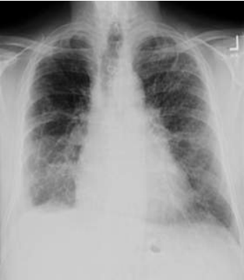
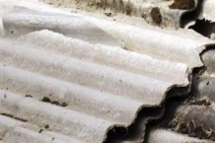
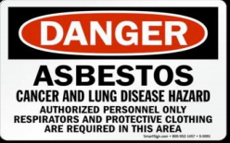
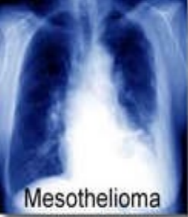
Pulmonary Dust Disease
Pneumoconiosis
Pneumoconiosis is a disabling pulmonary fibrosis that results from the inhalation of various types of inorganic dust, such as silica, asbestos, coal, talc and china clay.
Example: silicosis and asbestosis (the two most important causes of pneumoconiosis)
Types of Pneumoconiosis:
Asbestosis
1
Description | Inhalation of asbestos fibres
Occupations | Mining and extraction Exposure to asbestos (insulation) making of asbestos cloth (soldiers clothes) manufacture of asbestos cement pipes and other products, Such as vinyl floor tiles, in brake and cloth lining
Presentation | Interstitial fibrosis of the lungs, pleural thickening, calcification. Bronchogenic carcinoma, pleural and peritoneal mesothelioma Progressive dyspnoea on exertion frequently out of proportion to the clinical signs in the lungs, cough, expectoration, chest pain, cyanosis and clubbing of the fingers
Diagnosis | Asbestos bodies in sputum (asbestos fibres coated with fibrin) X-ray shows ground-glass appearance in the lower 2/3 of the lung →
Progression | Progressive disease
Prevention | Prevention and periodic examinations
Long time ago, insulators were made of asbestos. Asbestos is an important risk factor for mesothelioma which can present with chest pain (pleuritic) and SOB with unexplained weight loss.
Asbestos is of two types - serpentine or chrysolite variety (90%) and the amphibole type. Asbestos is used in the manufacture of asbestos cement, fireproof textiles, roof tiling, brake lining , gaskets and several other items. Asbestos enters the body by inhalation, and fine dust may be deposited in the alveoli. The fibres are insoluble. The dust deposited in the lungs causes pulmonary fibrosis (due to mechanical irritation), leading to respiratory insufficiency and death; carcinoma of the bronchus; mesothelioma of the pleura or peritoneum; and cancer of the gastrointestinal tract.

Slide 6
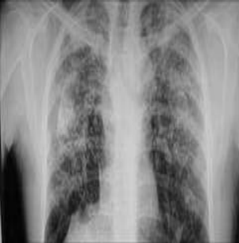
Pulmonary Dust Disease
Silicosis
2
Description | Absorption of high amount of crystalline silica (SiO₂)
Occupations | Mining Coal, mica, gold, silver, lead, zinc Stone cutting and shaping, sandblasting Building and construction areas Glass manufacture Iron and steel industry Ceramic workers and manufacturers
Time | 7–10 years, sometimes less. Prolonged exposure to higher concentrations of dust
Presentation | Dyspnoea on exertion, irritant cough and chest pain Pulmonary tuberculosis (silicosis can activate latent TB) Cardiac or respiratory failure Impaired TLC (total lung capacity) in advanced disease
Diagnosis | X-ray shows snow storm appearance (Scattered micro-opacities and might also present with cavitation in upper lobe of the lung because of TB activation)
Progression | Progressive (irreversible) disease and converts to TB "silico-tuberculosis”
Prevention | Prevention and regular physical examinations Education about the importance of protection →
Lead Poisoning (Plumbism)
Definition:
Defined as lead level of 70 µg/ 100 ml with clinical signs and symptoms
Occupational usage (Industrial):
Storage batteries, glass, ship building, printing and potteries, rubber
Non-occupational :
Gasoline, drinking water via lead pipes, paints (shine in paints), toys
Modes of absorption:
Inhalation of fumes and dust
Ingestion through food or drink
Skin absorption “tetraethyl lead”
Clinical features:
(only organic lead)
Organic Lead
Insomnia, headache, mental confusion and delirium
Inorganic Lead
Plumbism (lead poisoning), abdominal colic, obstinate constipation (very severe), loss of appetite, blue lines on the gum, anemia and wrist and foot drop

Slide 7
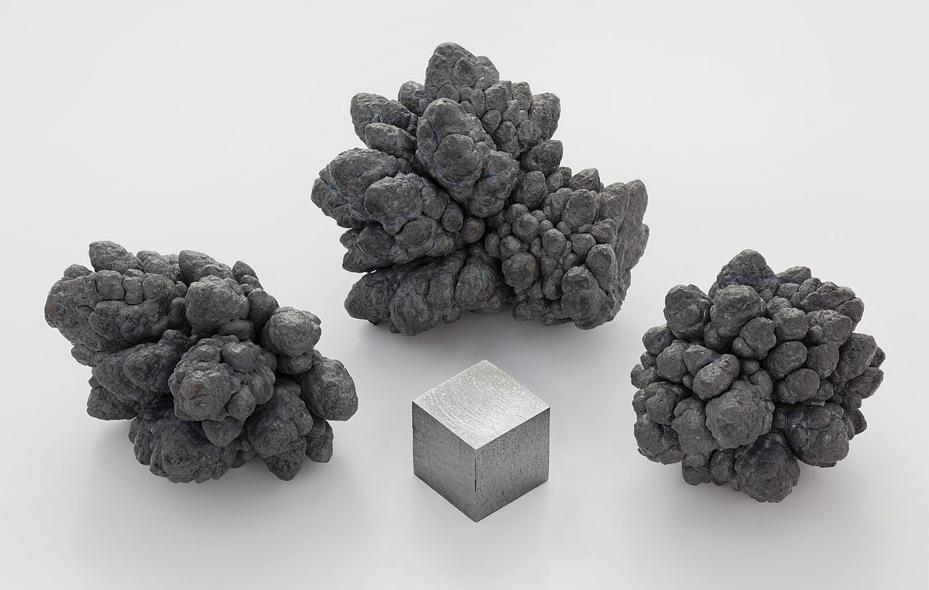
Lead Poisoning
Lab diagnosis:
Coproporphyrin in urine (screening test)
Amino levulinic acid in urine
Lead levels in blood and urine
Basophilic stipling of RBCs (very sensitive)
Methods of prevention:
1
Substitution (with other materials)
Personal protection (should be disposed of after finishing)
4
2
Isolation
(segregate procedures with risk)
5
Periodic examinations (through coproporphyrin in urine)
3
Local exhaust ventilation
Health education and personal hygiene (handwashing)
6
Occupational Cancers
Carcinogenic agent | Organ affected
Arsenic | Skin and lung
Chromium compounds, hexavalents | Lung
Nickel | Lung and nasal sinus
Polycyclic aromatic hydrocarbons | Skin
Coal tars | Skin, scrotum, lung and bladder
Benzol | Blood (leukaemia)
B-naphthylamine | Bladder
Ionizing radiation | Skin, bone, lung and blood (leukaemia)
Asbestos | Lung, pleura, peritoneum

Slide 8
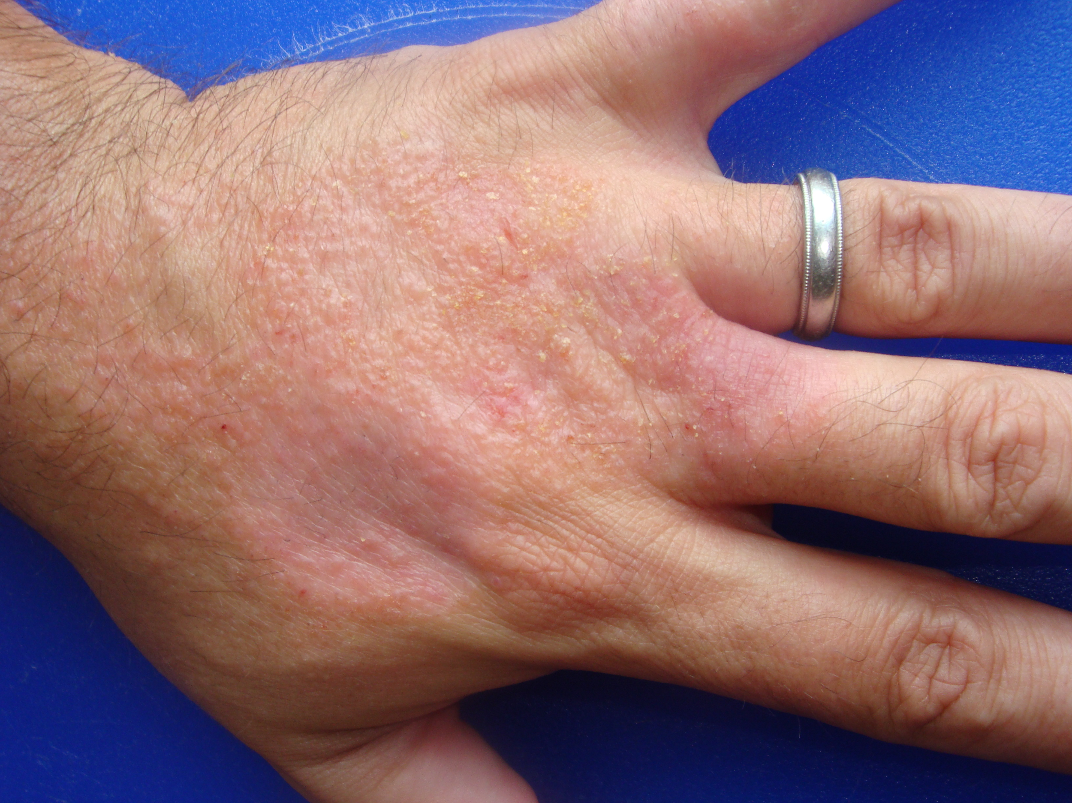
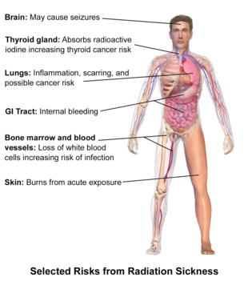
Occupational Dermatitis
Causes:
Heat, cold and moisture
Friction and pressure
X-rays
Acids, alkalis, solvents, grease, tar and pitch
Bacteria and fungi
Leaves, vegetables and fruits
Classification
Primary Irritants
Sensitizing Substances
Prevention:
1
Pre-selection (pre-employment check)
Personal hygiene
3
2
Protection (protective equipment)
Periodic assessment (usually every 6 months)
4
Extra!!
Radiation Hazards
Industrial Exposures:
Manufacture of radioactive paints
Painting of luminous dials for watches
Mining of radioactive ores and sand workers
X-rays rooms
Effects of Radiation:
Acute
Acute burns, dermatitis and blood dyscrasias
Chronic
Malignancies (carcinogenic effect) and genetic effects
Prevention:
1
Shielding in x-ray areas, monitoring 6 monthly, for their film badge or pocket electronic device, adequate workplace ventilation, replacement and periodic exams. (badges are available)
2
Pregnant ladies should not be allowed to work in the area.
Primary irritants (e.g. acids, alkalies, dyes, solvents, etc.) cause dermatitis in workers exposed in sufficient concentration and for a long enough period of time.
Sensitizing or allergic dermatitis occurs only in small percentage of cases, due to sensitization of the skin to certain materials

Slide 9
Prevention of Occupational Disease
Prevention of occupational diseases should be addressed by different measures including: medical measures, engineering measures and legislations.
Field | Measurements
Medical | Pre-placement exams Periodic examinations Medical and health care services Notifications, employees should notify the employer with all diseases he has Supervision of working environment Maintenance and analysis of records Health education and counseling
Engineering | Designing of the buildings build good exhaust systems Good housekeeping General ventilation ACs, windows, ...etc. Substitution any harmful substance used should be replaced Dusts Enclose Isolate Local exhausts ventilations Protective devices based on the occupation Environmental monitoring Research
Legislations | Policies and regulations for factories, work places, health of the workers Example: insurance, sickness policies and disability benefits
Dr. Hafsa recommended reading about the measurements from the book. Link here

Slide 10
Quiz
MCQ
1- A lead miner was admitted to the hospital complaining of irritant cough and shortness of breath particularly whenever he exerts some effort. X-ray showed patchy areas of nodular opacities. History showed the that the patient never performed an periodic occupational examination. What is your diagnosis?
A- Anthracosis
B- Lead poisoning
C- Silicosis
D- Asbestosis
2- Which of the following cancers is most likely to occur in workers dealing with hydrocarbon containing gasoline?
A- Skin and lung cancers
B- Skin, scrotum, lung and bladder cancers
C- Blood cancer (leukemia) only
D- Skin cancer only
3- All of the following are characteristics of occupational diseases EXCEPT
A- Identical to non-exposed disease
B- Can be prevented if the person quits his job
C- Related to the dose of exposure
D- Related to the length of exposure
4- Which of the following terms best defined the following statement: “It is the promotion and maintenance of the highest degree of physical, mental, and social well-being of workers in all occupations”?
A- Occupational Health
B- Occupational Safety and Health (OSH)
C- Industrial hygiene.
D- Ergonomics
5- Which of the following tests is the best screening test for occupational workers in lead industries?
A- Blood smear to check for basophilic stipling
B- Amino levulinic acid levels in urine
C- Direct lead levels in blood
D- Coproporphyrin in urine
Answers
Q1 | Q2 | Q3 | Q4 | Q5
C | D | B | A | D

Slide 11
Thank You and
Good Luck
Team Leaders:
Lama AlAssiri | Mohammed AlHuqbani | Ibrahim AlDakhil
Deema AlMaziad
Lama AlZamil
Leen AlMazroa
Lina AlOsaimi
Muneera AlKhorayef
Norah AlHarbi
Norah AlMazrou
Nouf Alhussaini
Razan AlRabah
Renad Alhaqbani
Rema AlMutawa
Team Members:
Hameed M. Humaid
Khalid Alkhani
Meshari Alzeer
Mohannad Makkawi
Nayef Alsaber
Omar Aldosari
Omar Alghadir
Zyad Aldosari
Sara AlAbdulkareem
Sedra Elsirawani
Wejdan Alnufaie
Abdulrahman Alhawas
Abdulrahman Shadid
Abdullah Aldawood
Abdullah Shadid
Alwaleed Alsaleh
Bader Alshehri
Bassam Alkhuwaiter
Faisal Alqifari

