Slide 1
Introduction
& diseases related to environmental health
& hazard
Objectives
To understand the definition of environmental health.
To identify the components of the environment.
To describe the interaction between different factors with the environment to produce disease.
To enumerate different environmental hazard concerns.
To describe sources of water hazards.
To describe sources of air hazards.
To be able to decide on appropriate method for water treatment.
To list the steps for environmental risk assessment.
Color Index
Main text
Males slides
Females slides
Doctor notes
Important
Textbook
Golden notes
Extra
Editing File

Slide 2
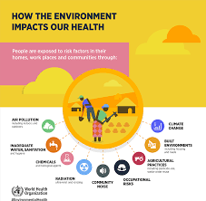
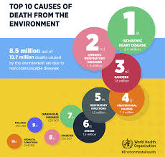
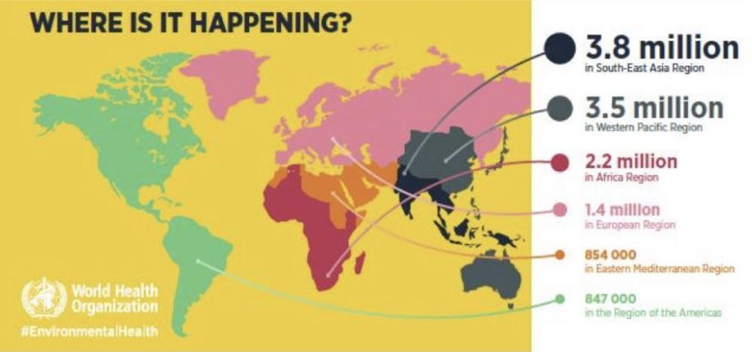
Environment
All external factors, living and nonliving, surrounding man
Physical environment:
Noise and radiation
Chemical:
Air, toxic waste, pesticides and water
Components of the environment:
Biological environment:
Disease organisms, allergens and insects
Social environment:
Culture, habits and access to healthcare
Environmental Health
Environmental health is the science and practice of preventing vvvvv human injury and illness and promoting well- being by:
Identifying and evaluating environmental sources and hazardous agents and
limiting exposures to hazardous physical, chemical, and biological agents in air, water, soil, food, and other environmental media or settings that may adversely affect human health
World Health Organization Estimates
23% of global deaths are related to environment
Low and middle income countries bare the greatest share of the environmental hazards¹
2
1: because the population from those countries are mainly outdoor worker thus higher risk
2: stroke and IHD are the most common causes because they are related to the lifestyle of the population

Slide 3
Environmental Health Concerns
Water quality
Human industrialization
Disasters
Hazard
Chemical substances
Biological substances
Climate change
Occupational hazard
Air quality
Disposal of waste
How do humans damage the environment?
Air Water Soil Biota
E.g. smoke
E.g. dumping waste in the sea
Environmental Chemicals of Concern
Lead¹
Phthalates
Sulfur Dioxide
Nitrogen Oxides
Carbon Monoxide
Radon
Ozone
Mercury
Benzene
Toluene
Particulate Matter
Chromium
Asbestos
Volatile Organic Compounds
Pesticides
Arsenic
Lead is found in jewelry, toys, paint.
Primary prevention of lead poisoning: ban the use of lead in such products
Secondary prevention of lead poisoning: early investigation through blood test and monitoring the levels.
Prevention is the same to the all the previous chemicals

Slide 4
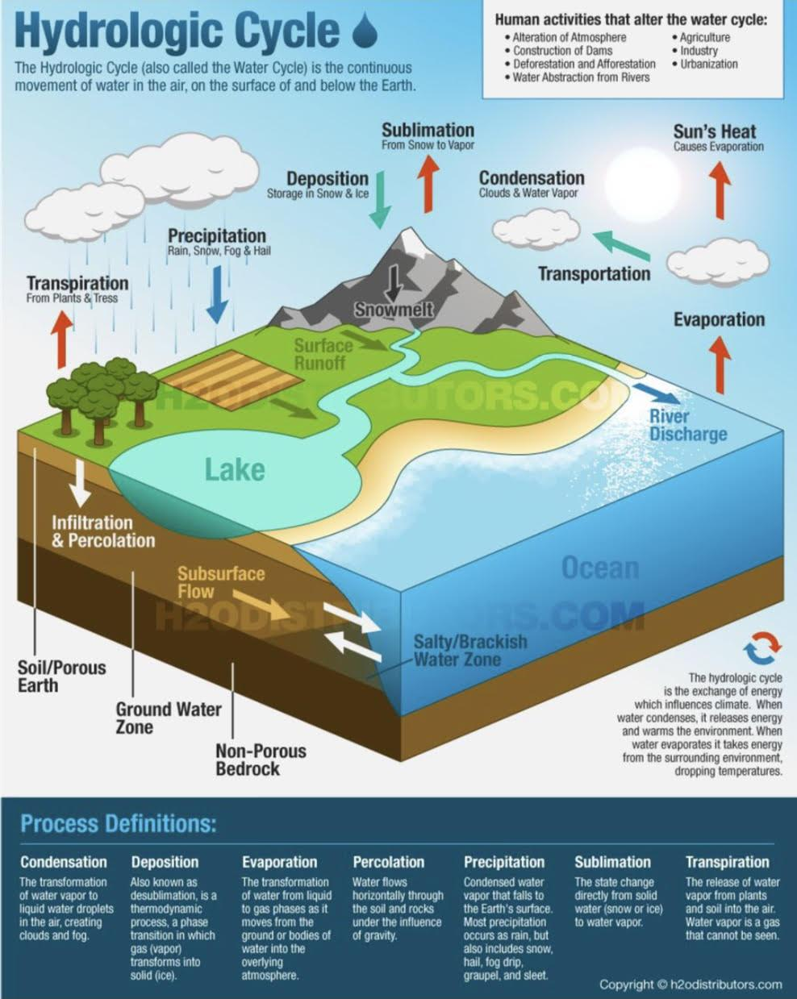
Air Quality
Air pollution
Air pollution is the introduction of chemicals, particulate matter, or biological materials that cause harm or discomfort to humans or other living organisms, or cause damage to the natural environment or built environment, into the atmosphere.
Pollutants
An air pollutant is known as a substance in the air that can cause harm to humans and the environment. Pollutants can be in the form of solid particles, liquid droplets¹, or gases. In addition, they may be natural or man-made.
Primary (directly emitted)
- Sulphur oxide, Nitrogen oxides, carbon monoxide (CO), CO 2, volatile organic compounds, particulate matter, persistent free radicals, chlorofluorocarbons, ammonia, odors, radioactive material.
Secondary (form in air when primary pollutants interact with a third agent)
- Ozone², smog, peroxyacetyl nitrate, Acid rain is formed in the presence of water, with sulfur dioxide or nitrogen oxide.
What are the biological consequences of ozone depletion? Increased skin cancer, cortical cataracts, reduction of plankton populations
Water Sanitation and Availability
Issues with water:
Humans need 2 litres of water per day³
Water should be available
Should be sanitary
In order for water to be safe for human consumption:
Free of pathogenic agents
Free of harmful chemical substances
Pleasant to taste
Usable for domestic purposes
Volume of water on earth depends on hydrologic cycle:
COVID-19 is an example of biological air pollutant
Formed by the combination hydrocarbon and nitrogen oxide in the presence of sunlight
Variable based on the physical activity, climate change, gender, and age

Slide 5
Sources of water:
Rain.
Surface water: river, stream and lake.
Ground water: wells and springs.
Water pollution:
Water appears naturally with impurities
(not hazardous)
- Dissolved gasses:
(CO2 , N, H2 S)
- Dissolved minerals:
(Ca, Mg, Na)
- Suspended impurities:
(Clay, sand, mud)
Pollution of water due to industrialization (hazardous)
- Sewage
- Toxic waste
- Agricultural pollutants
(insecticide, fertilizers)
- Heat and radioactive
materials
Water related diseases:
Biomedical causes
● Viral, bacterial, protozoal, helminthic, snail and cyclopes
Chemical causes
● Cyanides, dyes, heavy metals, bleaching agents and ammonia
● Directly cause disease or indirectly (fish life)
Water purification:
Depends on source:
Wells and springs -> only disinfection Surface water -> needs more treatment
1- Filtration.
2- Storage:
● To preserve water from further contamination and pollution
● Provides a small amount of purification
Number of bacteria die out
Suspended impurities fall by gravity
Chemical composition changes (↓free ammonia, ↑nitrates)
● Must be stored within a certain period
Prolonged periods cause vegetable growth (algae)
3- Disinfection:
Methods for disinfection:
1. Heat¹ (boiling for 10-20 min kills most organisms and sterilizes water)
2. Chlorination² (kills bacteria but not spores and viruses)
3. Ozonation³
4. Bleaching powder (chlorinated lime)
5. Bromination
Challenges with disinfection:
● Sterilization is impractical at a large scale
(only feasible at homes)
● Chlorination⁴ is the most widely method used
● Organisms resistant to chlorination (E coli, salmonella, polio, HAV)
● Decision for disinfection method depends on:
○ Costs; availability of technology and method Like in developing countries
○ Target organism to get rid of
○ Ability to produce residual to provide post-treatment disinfection
1- the most common method and the cheapest (the most used in developing countries)
2- common method
3- Ozonation: is a chemical water treatment technique based on the infusion of ozone into water.is a type of advanced oxidation process, involving the production of very reactive oxygen species able to attack a wide range of organic compounds and all microorganisms. The treatment of water with ozone has a wide range of applications, as it is efficient for disinfection BUT IT’S EXPENSIVE AND RARELY USED
4- used in larger scales

Slide 6
Risk Assessment¹
“Risk assessment in the process of estimating the potential impact of a chemical, physical, microbiological or psychosocial hazard on a specified human population or ecological system under a specific Set of condition and for a certain time frame.”
In other words, we try to estimate the risk for exposure to a specific hazard in the environment, based on the several assumptions.
Environmental risk assessment involves assessing impacts of :
Chemical pollutants and contaminants in air, water, soil and food
1
Radiation sources
2
Pathogenic microbiological contaminants in food and water
3
Electromagnetic fields (EMFs)
4
Climate and climate change
5
Things to keep in mind when attempting risk assessment:
Heavily relies on assumptions (not what really happens)
Does not take into account the different interaction of environment with other factors
Exposures and outcomes on which the risk assessment is based are poorly defined
Types of environmental risk assessment:
Individual and population-based (more common)
Quantitative and qualitative
Categories of risk vs. numeric estimation
1: The main reason of risk assessment is prevention and report the recommendation to decision makers.

Slide 7
The five stages of environmental hazard risk assessment¹:
Issue Identification
1
➢ What is the problem in question?
➢ Can the problem be addressed by the proposed risk assessment?
➢ Do we have the technology and capabilities to apply the assessment process?
➢ Are there any factors that contribute to persistence of that risk?
➢ Did the risk come about as a breach in public health measures?
Hazard Identification
2
➢ How severe are the health effects? And are they reversible?
➢ Is there interaction between this hazard and other agents in the environment?
➢ Is the onset of the effect immediate or delayed after exposure to hazard?
➢ Is there a critical window for exposure?
Dose-response Relationship²
3
➢ Does the exposure to the hazard exhibit a dose response relationship for the effect to appear?
➢ Is there a critical threshold for exposure? (cut-off point over which the effects will take place)
Exposure Assessment
4
➢ What is the nature of exposure?
➢ Is there a specific frequency of exposure?
➢ Is there a latency period for exposure?
➢ Can the critical time of exposure be determined?
(In order to be targeted for prevention and control measures)
➢ Has the route for exposure been identified? Is there more than one route?
➢ Is exposure one time, continuous or intermittent?
Risk Characterization
5
➢ Is there genetic variability in exposure to the hazard?
➢ Do personal characteristics play a role in exposure to hazard?
➢ Or do they play a role in the development of the health outcome following exposure to hazard?
➢ Should we consider any population characteristics or dynamics?
Prevention and control
Monitoring water
Biological surveillance of water:
● Sanitary surveys
● Inspection of manufacturing of water bottles and ice
● inspection of reservoirs and wells Establishing policies and procedures for extracting water from wells, and maintaining water safety and storing water
Monitoring air pollution
By monitoring the concentration of:
● Sulphur dioxide
● Smoke
● Suspended particles
1: Example: a. Dusty weather and asthmatic/COPD patients b. How severe are the exacerbations c.Dose= duration of exposure (For how long) the more the dust the more the exacerbations d. Exposure can be confined to a location for example riyadh more than jeddah thus more cases in riyadh e. Can staying home or wearing masks minimize the risk?
2: for example: the cut-off point for Na+ in the water that if exceeded would lead to intoxication, the more the dose the more the risk

Slide 8
Risk Assessment
Issue identification
Identification of key issues amenable of risk assessment
Hazard assessment
Collection and analysis of relevant data
1- Hazard identification
Identify chemicals of potential concern (COPC)
2- Dose - response assessment
Identify relevant toxicity data
Uncertainty analysis for both hazard identification and dose-response assessment
Exposure assessment
Conceptual site model
Analysis of hazard locations
Identification of exposed populations
Identification of potential exposure pathways
Estimation of exposure concentration and intakes of each pathway
Uncertainty analysis for exposure assessment step
Review and reality check
Risk characterization
Characterize potential for adverse health effects to occur
Evaluate uncertainty
Summarize risk information
Review and reality check
Risk Management
Define the options and evaluate the environmental health, economic, social, and political aspects of the options
Make informed decisions
Take actions to implement the directions
Monitor and evaluate the effectiveness of the action taken

Slide 9
Quiz
MCQ
1- What is the most serious environmental effect posed by hazardous wastes?
A. Air pollution
B. Contamination of groundwater
C. Increased use of land for landfills
D. Destruction of habitat
2- A company would do an outdoor concert in June, they brought a contractor to build a temporary stage, and the concert was informal. Which of the following hazards could happen?
A) Hypothermia, trauma injury, food poisoning
B) Hyperthermia, trauma injury, food-borne diseases
C) Hypothermia, poor airway circulation, air pollution
D) Heat stroke, poor airway circulation, food-borne diseases
3- Exposure to which of the following hazardous materials results in instantaneous reactions?
A. Aerosolized zinc
B. Ammonia gas
C. Asbestos
D. Lead
4- What is the first stage of risk assessment?
A. Exposure assessment
B. Issue identification
C. Toxicity study
D. Risk characterization
5- What is the main objective of risk characterisation?
A. Estimation of the potential for adverse health or ecological effects to occur from exposure to a stressor
B. Determination of pathways
C. Estimation of exposure
D. Collection of data
Answers
Q1 | Q2 | Q3 | Q4 | Q5
A | B | B | B | A

Slide 10
Thank You and
Good Luck
Team Leaders:
Lama AlAssiri | Mohammed AlHuqbani | Ibrahim AlDakhil
Deema AlMaziad
Lama AlZamil
Leen AlMazroa
Lina AlOsaimi
Muneera AlKhorayef
Norah AlHarbi
Norah AlMazrou
Nouf Alhussaini
Razan AlRabah
Renad Alhaqbani
Rema AlMutawa
Team Members:
Hameed M. Humaid
Khalid Alkhani
Meshari Alzeer
Mohannad Makkawi
Nayef Alsaber
Omar Aldosari
Omar Alghadir
Zyad Aldosari
Sara AlAbdulkareem
Sedra Elsirawani
Wejdan Alnufaie
Abdulrahman Alhawas
Abdulrahman Shadid
Abdullah Aldawood
Abdullah Shadid
Alwaleed Alsaleh
Bader Alshehri
Bassam Alkhuwaiter
Faisal Alqifari

