Slide 1
Mass-Gathering & Related Hazards
Objectives
Define mass gathering.
List mass gathering characteristics that represent public health risk.
List and understand the steps of mass gathering risk assessment.
Identify risk based on event assessment.
Understand the components of risk identification and characterization.
Understand the components of risk management: surveillance and response.
Understand incident response system.
Understand the role of WHO in mass gathering.
Color Index
Main text
Males slides
Females slides
Doctor notes
Important
Textbook
Golden notes
Extra
Editing File

Slide 2
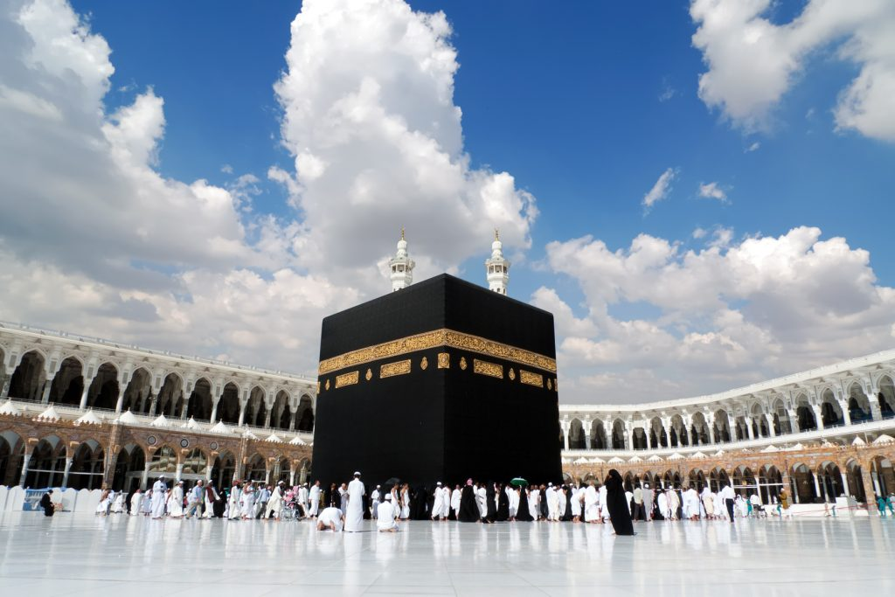
Mass-gathering and related hazards
Definitions
Mass gatherings (MGs)
Are events attended by large numbers of individuals, concentrated in a specific area for a specific purpose andover a limited period of time ¹
Are events attended by a sufficient number of people to strain the planning and response resources of the host community, state/province/, nation, or region where it is being held.
The World Health Organization (WHO) definition also takes a broader view of mass gatherings to include the public health dimensions and defines mass gatherings as events attended by a sufficient number of people to potentially strain the public health resources of the community, city, or nation hosting the event.
Number of participants: >1000 persons, although most literature suggests >25000 persons
Mass gatherings medicine
is an area of medicine that deals with health aspects during mass gatherings including the health effects and risks of mass gatherings and strategies for effective health services delivery during these events.
The formal discipline of mass gatherings medicine was launched at the World Health Assembly of Ministers of Health in Geneva in May 2014.
Examples of mass gatherings
Hajj ²
The London Olympics 2012
10,250 Olympic athletes \4,000 Paralympic athletes\ 20,000 press and media \ 180,000 spectators/day
17,000 people living in the Olympic Village
Estimates of 4.5 million visitors to London
26 Olympic sports in 30 venues
20 Paralympic sports in 21 venues
In other words, mass gathering is a lot of people in a confined space
During Hajj, the country hosts millions of people. This confined area creates a risk for hazards that threatens public health to spread and injure those people. Such mass gatherings require huge planning and preparation and identifying potential risks and figuring ways to overcome them.

Slide 3
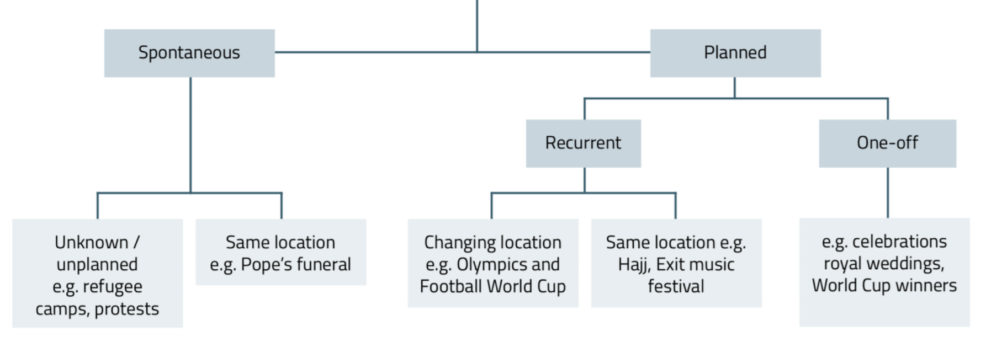
Mass-gathering and related hazards
Types of Mass-gathering
Fairs, exhibitions (World Expo Shanghai)
Concerts, festivals (Riyadh season, Glastonbury, UK)
Sports (Olympics)
Religious (Hajj)
Political (G20)
Categories of Mass-gathering
Where is the risk in MG?
Mass gatherings can pose several significant public health challenges to the health and security authorities both within the host country and abroad.
They place additional pressures on health systems, which must operate for the duration of the mass gatherings stretched to surge capacity. ¹
Require intersectoral approaches to risk mitigation and coordination and
cooperation across multiple disciplines, agencies, sectors, and ministries
MG characteristics that represent public
health risk
Higher population concentration Diversity of population characteristics ² Different communities/ parts of the world/ regions Imported diseases Epidemic prone diseases Different health-related behavior | Pressure on infrastructure Hotels Food sales Healthcare system aviors
Environmental conditions Heat/ cold Vectors of diseases | Political attention Terrorism/ bioterrorism
For example Iran facing the coronavirus their healthcare system collapsed
Age, gender, disabilities, comorbidities...etc

Slide 4
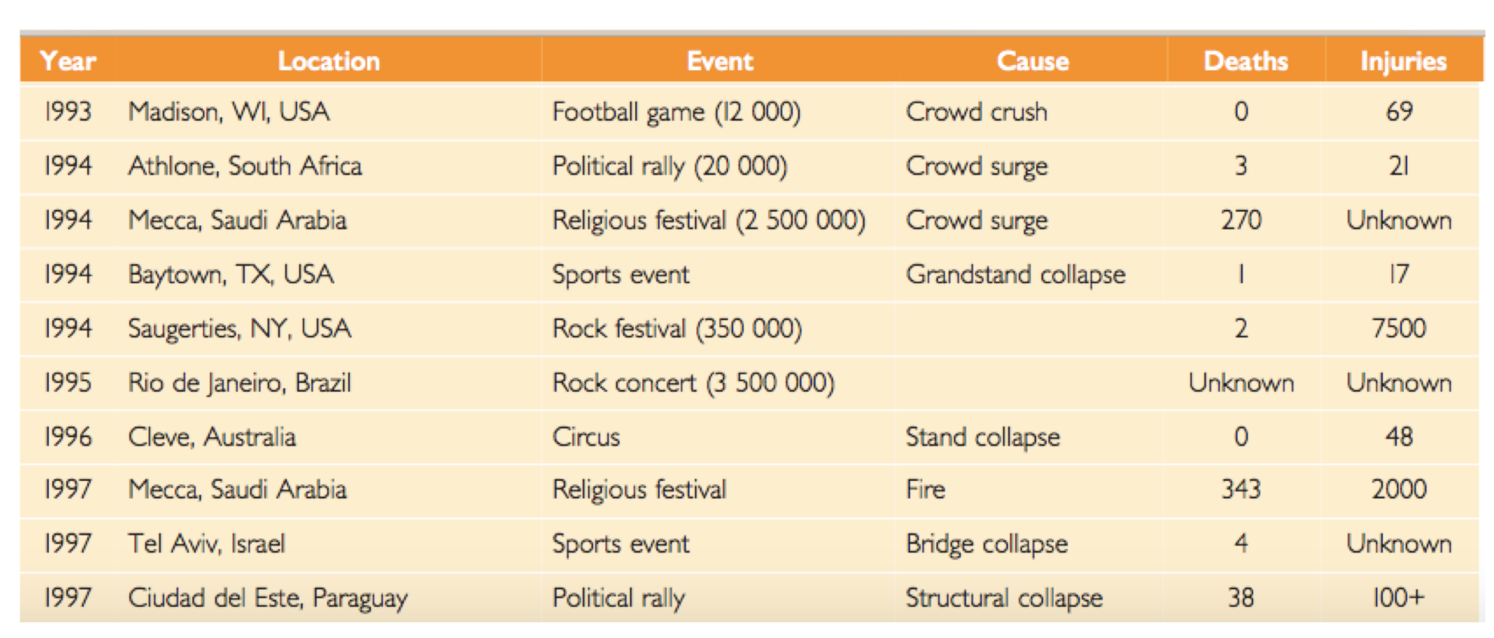
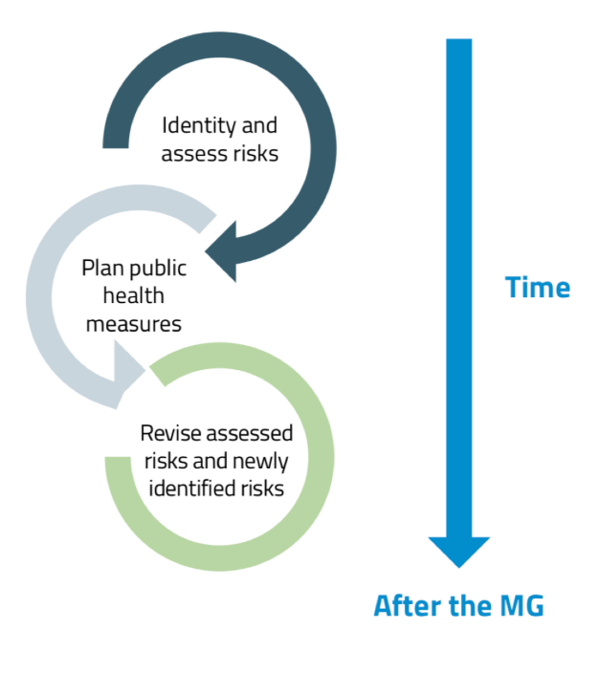
Mass-gathering and related hazards
Risk of Outbreak
The importation of infectious diseases during a mass gathering may result in outbreaks.
Mass gatherings health deals with the diverse health risks associated with mass gatherings including transmission of infectious disease, non-communicable disease, trauma and injuries (occupational or otherwise), environmental effects (such as, heat-related illnesses, dehydration, hypothermia), illnesses related to the use of drugs and alcohol and deliberate acts, such as terrorist attacks
Examples of outbreaks
Risk assessment ¹
Risk identification
1
(depending on event assessment)
(impact, likelihood)
(surveillance and response)
Risk characterization
2
Risk management
3
The aim of risk assessment is to:
Know the risk by risk assessment, identification
Know when it happens by surveillance
Know what to do when it happens to prepare a response
Risk assessment starts with risk identification through assessing the type of event. For example, if the event was religious (ex. Hajj) you need to expect elderly and people with comorbidities to gather. After identifying the risk we need to characterize it whether it’s major or minor risk. Depending on the risk characterization, a plan must be developed to manage it.

Slide 5
Risk assessment
Risk identification
1
Host country context assessment
Systems: need for enhancement in surveillance, testing, reporting, response and command, control and communication
Training: responsibilities
Population factors: immunity (hosts, visitors)
Baseline status for CD
Examples of MG event assessment characteristics
For understanding !
Mass Gathering Features
Type | Sporting event | Energetic, potentially emotionally aggressive mood. Risks of injuries and violence. Risk of cardiovascular events
 | Religious event | Higher risk of participants with existing medical conditions which may increase the need for on-site medical care
 | Cultural event | Risk of alcohol and drug use Risk of sexually transmitted infections Risk of dehydration, hyperthermia, hypothermia
 | Political event | Energetic and potentially aggressive moods Risk of demonstrations or riots, injuries
Activity level | Seated | Risk of collapse if infrastructure inadequate to support attendees
 | Standing | Risk of injuries, fatigue
 | Mobile | Risk of injuries, crushes
duration | ≤ 24 hours | Lack or decrease of perceived vulnerability by participants Lack of preparations by participants, health systems due to shorter duration
 | 1 day – week | Lack or decrease of perceived vulnerability by participants Lack of preparations by participants, health systems due to shorter duration
 | 1 month | Higher risk of communicable disease Increased duration of strain on public health system
 | > 1 month | Higher risk of communicable disease Extended strain on public health systems due to need to function at surge capacity for the whole period
Occurrence | Recurrent | Excessive reliance on previously used systems Inflexible health systems
 | Single | Inadequate health systems Lack of planning
Environmental Factors
Season | Summer | Risk of dehydration, heat stroke/hyperthermia
 | Winter | Risk of hypothermia Risk of injuries with snow or ice Potential for damage to infrastructure
 | Wet | Drowning, flood−related injuries Waterborne disease Potential increase in vector-borne and waterborne diseases Loss of property, damage to infrastructure
 | Dry | Risk of dehydration, waterborne disease Risk of allergies Risk of fires, decreased air quality

Slide 6
Risk assessment
Risk identification: cont
1
Participant Characteristics
Participant origins | National | Complacency/low perceived vulnerability with health risks Potentially low immunity for imported infectious diseases
 | International | Risk of importation/exportation of disease Risk of delayed access to healthcare due to unfamiliarity with healthcare system Risk of delayed detection of pathogens by inexperienced healthcare system Risk of environmental risks for those not acclimatized such as heat or cold, altitude, pollution Communicable disease for unvaccinated or vulnerable travellers to endemic pathogens and parasites Unknown immunity of participants
Density of participants | High density | Risk of communicable disease Risk of mass casualty event
Participants health status | Elderly or chronically ill | Risk of non-communicable disease May require higher levels of health services
 | Disabled | Local infrastructure may not be adequate Will need special care Emergency preparedness requires planning
Venue Characteristics
Venue | Indoor | Poor air circulation
 | Outdoor | Potential for inadequate sanitation, food and water preparations
 | Contained venue (fenced) | Overcrowding Spread of infectious diseases
 | Uncontained venue | Difficulty locating services near attendees due to geographic spread
 | Rural | Increased distance to health services, particularly advanced level care Increased potential for contact with animals and insects
 | Temporary | May lack infrastructure for safe food and water delivery May lack infrastructure for emergency medical services May lack financial capacity to create infrastructure necessary for a safe and successful MG
 | Permanent | Infrastructure may be aged or failing Infrastructure may need upgrading in order to comply with current standards (e.g. accessibility or fire codes)
Alcohol sold | Yes | Risk of injuries, including alcohol poisoning Risk of drunk driving, property damage Risk of violence
likely drug use | Yes | Risk of injuries Risk of overdose Risk of poisoning due to consumption of unknown, counterfeit or low-quality drugs
level of medical services at the venues | First aid stations | May provide some basic medical care Triage services Potential contact point for higher level medical support services
 | On-site Medical posts | May provide some basic medical care Triage services Potential contact point for higher level medical support services
 | On-site hospitals for participants | Easy proximity to higher level medical support services Increased number of healthcare providers
Catering | Professional catering | Lower risk of food-borne illness Improved food security
 | Informal | Increased risk of food-borne illness
 | Self-catering | Increased risk of food-borne illness
Hygiene / Sanitation services | None | Increased risk of infectious disease, including respiratory and diarrhoeal diseases Lack of hand washing facilities Lack of toilets Increased risk of open defecation
 | Hand washing stations | Decreased risk of infectious disease May include alcohol-based disinfectants
 | Latrines: temporary | Improved sanitation and waste disposal
 | Latrines: permanent | Preferable to temporary latrines Requires more infrastructure than temporary latrines for construction and maintenance

Slide 7
Risk assessment
Risk identification: cont
1
After we finished assessing the event we need to identify the risks based on event assessment
Event assessment
Risk identification
Type: Religious event
Older population with NCD, in-site medical care
Season: summer
Risk of dehydration, heat stroke
International
Imported diseases
Venue: indoor
Poor air circulation
Venue: temporary
Poor infrastructure
Catering: informal
Risk of food-born illnesses
Hygiene: hand washing stations
Decreased risk of infections
Risk characterization
2
After identifying the risk we need to characterize its impact on the mass gathering and public health (minimal-severe) .
In other words, what is the risk likelihood?
 | Potential impact on the mg | Potential impact on public health
Minimal | Little or no consequence or disruption to the MG | Little or no consequences
Minor | Small impact on MG can be managed with little impact on the event | Few illness or injuries which public health and medical services can manage
Moderate | Some controlled impact on the Games and reputation for host | Death and or injuries or illness occur. Public and medical services are strained
Major | Event is disruptive to MG and reputation of host | Many deaths, injuries or illness. Disrupts public health and medical services
Severe | Event causes cancellation of some or all of MG. Significant adverse impact on MGs and host reputation. | Substantial loss of life and serious injuries or illness. Widespread disruption of local services and infrastructure
Why risk characterization?
If the risk estimate that a particular event will occur is highly uncertain, risk management decisions might be more conservative than in the case of an event deemed to be highly likely ¹
Then what?
Once the risks have been mapped on the risk matrix, the objective of public health planning for the MG will be to reduce the likelihood of a threat occurring and to reduce the consequences of each threat: risk management
We always need to prioritize the risks we identified after we assessed the mass gathering. Because we can never deal with all risks.

Slide 8
Risk assessment
Risk management
3
What mitigation measures can be put into place to manage the risk and reduce either the probability or impact?
Management can include:
Initiating new surveillance programmes
Implementing a range of special prevention (risk of food-borne, waterborne, airborne and person-to-person spread of diseases)
Developing plans for immediate acquisition of additional human and material resources should a crisis occur
Surveillance in MG
When planning surveillance for the MG, the questions that public health authorities are likely to ask are:
What diseases or syndromes should surveillance be conducted for and what is the risk of these?
What is the best type of public health surveillance system(s) to use? (timeliness and sensitivity)
What are the special considerations for outbreak or public health response?
Diseases with the following characteristics should be considered for surveillance:
Have an outbreak potential (modes of transmission enhanced in the MG e.g. respiratory spread)
Are known to be of particular potential use as bioterrorism agents
May cause severe illness and require investigation and / or the application of control measures even for a single case
Imported diseases not usually seen in the host country (especially drug-resistant organisms and unusual serotypes)
Endemic diseases for which event attendees may have no immunity.
Highly infectious diseases (e.g., norovirus or measles).
Diseases or events that need to be reported under the IHR (2005).
Surveillance Problems posed by MGs
Preparing a surveillance plan
Short time – problem for collecting information – systems sensitive and responsive
Large, diffuse and highly varied population Include diseases not normally surveyed?
People arrive from/return to many locations
Multiple opportunities for exposure: air travel – food – water – physical contact
Varying health surveillance capabilities of – host nation– originating nation(s)
Tracking (time/location) and notification – not just in location, but after returning
Identify monitoring resources at all levels
Define conditions to look for
Establish priorities
Set threshold / alert levels
Identify mechanism for prompt investigation and feedback
Link notification and response plan

Slide 9
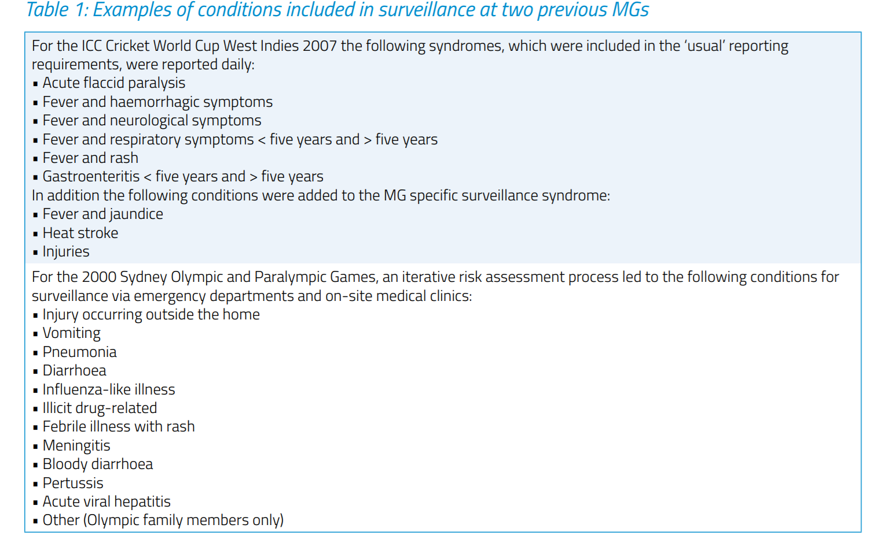
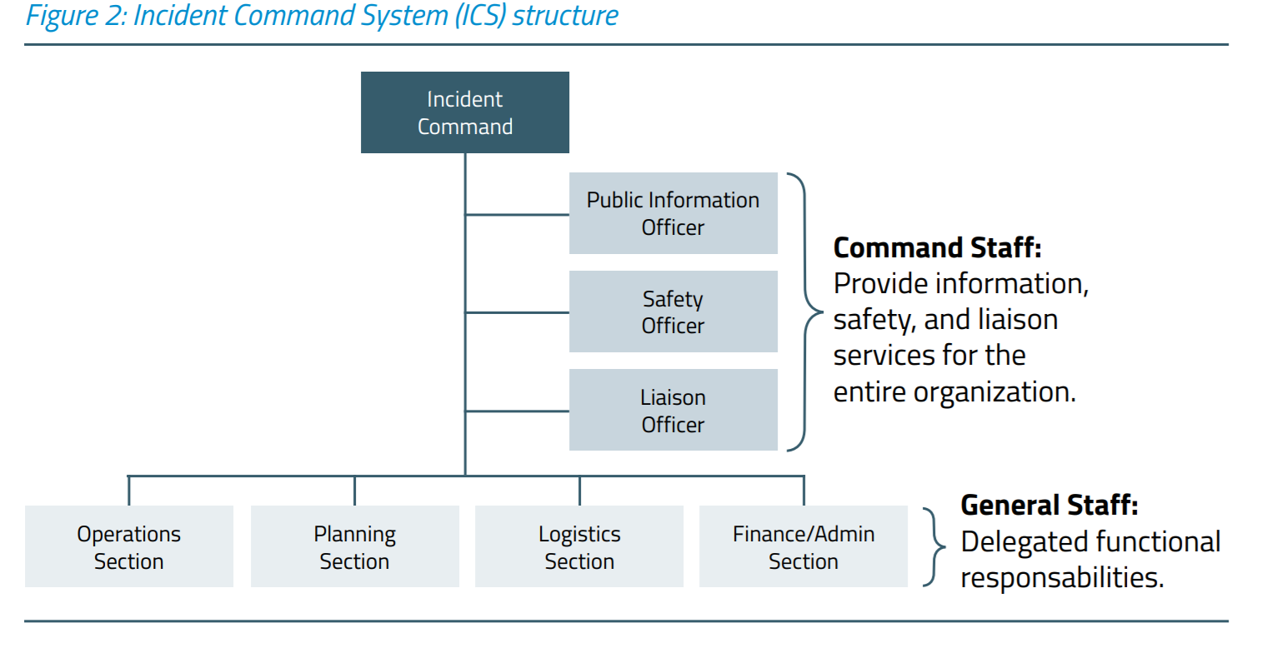
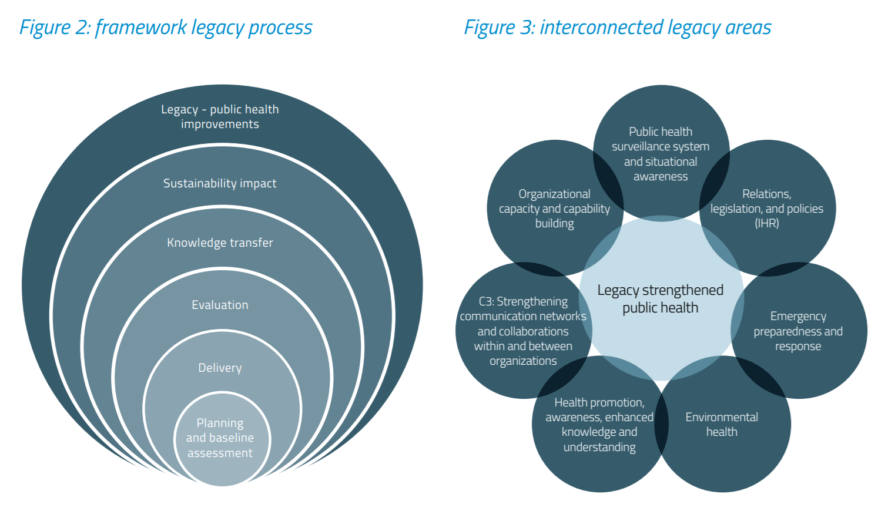
Risk assessment
MG Planning
A safe and healthy MG requires
Early multi-sectoral preparation involving:
event organizers
health emergency managers
public health authority representatives
local hospital emergency departments
first-aid personnel
other sectoral partners (e.g. police, emergency services, security services)
Depends on risk assessment and risk identification
Medical care needs to be offered at the mass gathering but local care needs to be maintained as usual
Response
Establish a major incident response system
Well rehearsed multi-agency and cross government response systems.
Effective liaison across health sector.
Public health engagement with: – Police & other emergency services (threat assessment, incident response) – Central government (threat assessment, preparedness, response) – Intelligence services (threat assessment).
Agency Operation Center (AOC)
Legacy and Evaluation
The wealth of knowledge and expertise generated from mass gatherings can drive best health promotion, education, and risk mitigation strategies and optimize the planning and delivery of effective health services during future mass gathering events.
The general staff are divided into sections to plan for the event. In case of any issue they face they immediately report to the agency operation center which in its place report to the commanding staff to decide for an action.

Slide 10
WHO’s role in mass gatherings
WHO provides advice and technical support to host governments preparing for mass gathering events.
How does WHO provide support to Member States for mass gatherings?
To provide advice and technical support to Member States that are hosting mass gatherings, WHO draws on 5 WHO Collaborating Centres for Mass Gatherings and a Virtual Interdisciplinary Advisory Group (VIAG). VIAG is an informal network of mass gathering experts. Their role is to share expertise on public health requirements and best practices with any organization considering hosting a mass gathering event.
Activities to support host governments of mass gatherings often include:
Prior to the event: all-hazard risk assessment, travel medicine and activities to encourage increased physical activity, cessation of tobacco use and avoidance of excess alcohol.
During the event: international monitoring of potential disease spread and risk assessment, emergency medical services and hospitals and plans to manage fan zones.
After the event: capture lessons learnt and share expertise with future mass gathering hosts
What governs WHO’s work on mass gatherings?
The decision states that the WHO "Director-General should, where appropriate, work closely with Member States that are planning and conducting mass gatherings to support cooperation and communication between the concerned health authorities in each country, and help Member States strengthen capacities to better utilize the International Health Regulations (2005)".
Does WHO have the power to cancel or move mass gatherings?
WHO may provide advice and technical guidance to host countries on public health risks, but has no decision power to uphold, cancel or postpone mass gatherings hosted by Member States.

Slide 11
Quiz
MCQ
1- What is the required number of participants in an event to consider the event as mass gathering ?
A- >1000 persons
B- <1000 persons
C- >100 persons
D- >20000 persons
2- You were asked to do a risk identification for a sport event which will be held outdoors in summer as part of Riyadh season event. what are the risks that the event may face?
A- Risk of waterborne diseases , drowning and flood related injuries.
B- Risk of STDs, hypothermia and non-communicable diseases . poor air circulation, unknown immunity of participants.
C- Risks of injuries and violence, Risk of cardiovascular events, Risk of dehydration, heat stroke/hyperthermia, Potential for inadequate sanitation, food and water preparation
D- Risk of communicable disease, risk of food-borne illness, Risk of injuries, Risk of alcohol poisoning
3- What is the definition of " Mass gatherings" ?
A- Aspect of health and disease related to travel
B- Health issues that call for actions on the global forces that determine the health of people
C- Involvement of cities in the work of international organizations
D- Temporary collection of large numbers of people at one site or location for a common purpose
4- A planned combination of educational, political, regulatory, and organizational supports for actions and conditions of living conducive to the health of individuals, groups, or communities is the definition of ?
A- Health promotion .
B- Health education .
C- Community health.
D- Mass gathering
3- Which of the following mass gathering category has the greatest threat to public health
A- Hajj
B- Pope’s funeral
C- Olympics
D- Wedding celebration
Answers
Q1 | Q2 | Q3 | Q4 | Q5
A | C | D | A | B

Slide 12
Thank You and
Good Luck
Team Leaders:
Lama Alassiri | Mohammed Alحuقbani | Ibrahim AlDaخil
Deema AlMaziad
Lama AlZamil
Leen AlMazroa
Lina AlOsaimi
Muneera AlKhorayef
Norah AlHarbi
Norah AlMazrou
Nouf Alhussaini
Razan AlRabah
Renad Alhaqbani
Rema AlMutawa
Team Members:
Hameed M. Humaid
Khalid Alkhani
Meshari Alzeer
Mohannad Makkawi
Nayef Alsaber
Omar Aldosari
Omar Alghadir
Zyad Aldosari
Sara AlAbdulkareem
Sedra Elsirawani
Wejdan Alnufaie
Abdulrahman Alhawas
Abdulrahman Shadid
Abdullah Aldawood
Abdullah Shadid
Alwaleed Alsaleh
Bader Alshehri
Bassam Alkhuwaiter
Faisal Alqifari

