Slide 1
Global Demography
Concept &
Population Pyramids
Handbook from the Doctor
Objectives
Key Concepts on Demography and Population Dynamics
Describe the concept of demographic equation
Describe and understand the theory of demographic transition
Define, compute and interpret the rates of population increase and population doubling time
Describe major sources of population data
Describe features of population pyramid and compare the pyramids of developed and developing countries
Describe the effect of population momentum on growth of population
Explain the phenomenon of migration and its effect on population size
Apply demographic concepts in health system
We advise you to study “Health Indicators” before studying this lecture
Color Index
Main text
Males slides
Females slides
Doctor notes
Important
Golden notes
Extra
Editing File

Slide 2
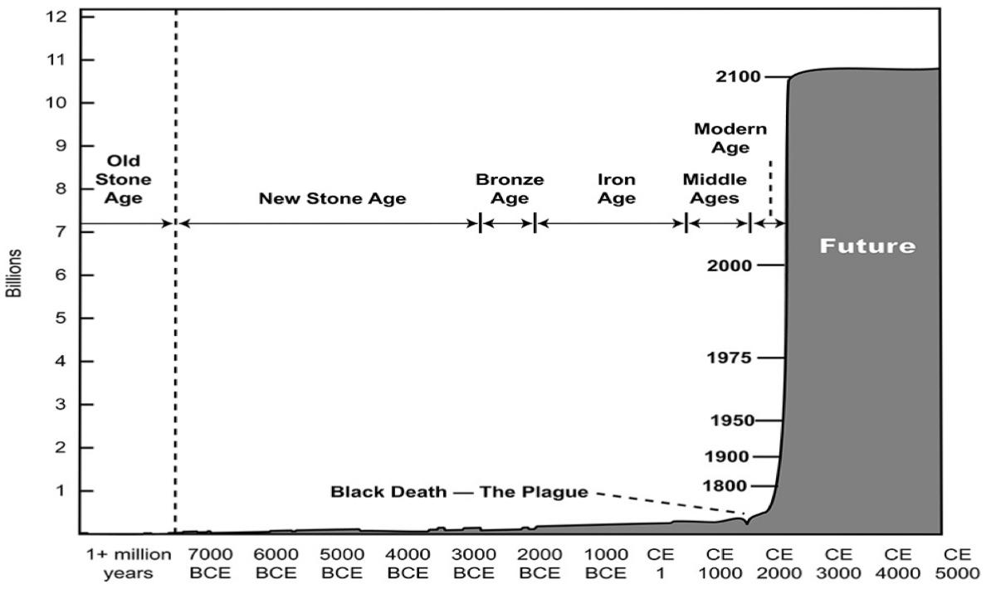
Demography
What is demography?
World population growth through history ¹
It is the study of the size, territorial distribution, and composition of population, changes therein, and the components of such changes, which may be identified as natality, mortality, territorial movement (migration), and social mobility (change of status).
Components of Population Growth²
Population at time
Population at current time
Natural increase (births - deaths)
Net migration (immigration - emigration)
Population growth happens when:
Natural increase is positive: Births > Deaths ⇒ Birth increases or Death declines
and/or
Net migration is positive: Immigration > Emigration ⇒ Immigration increases or Emigration declines
Law of 70
If a population is growing at a constant rate of 1% per year, it can be expected to double approximately every 70 years.
if the rate of growth is 2%, then the expected doubling time is 70/2 or 35 years.
The unprecedented population growth of modern times heightens interest in the notion of doubling time. Calculation of population doubling time is facilitated by the Law of 70 ³.
1: At year 1800 the world reached 1 billion people, today there are 7.5 billion people. What were the reasons for this population explosion? Increase life expectancy (reduced mortality rate), increase quality of life, public health improvement.
2: Also called Balancing equation
3: 70/growth rate= the number of years estimated for a population to double.
For ex.: The growth rate in KSA is around 1.2-1.5, the doubling time is 60-70 years.

Slide 3
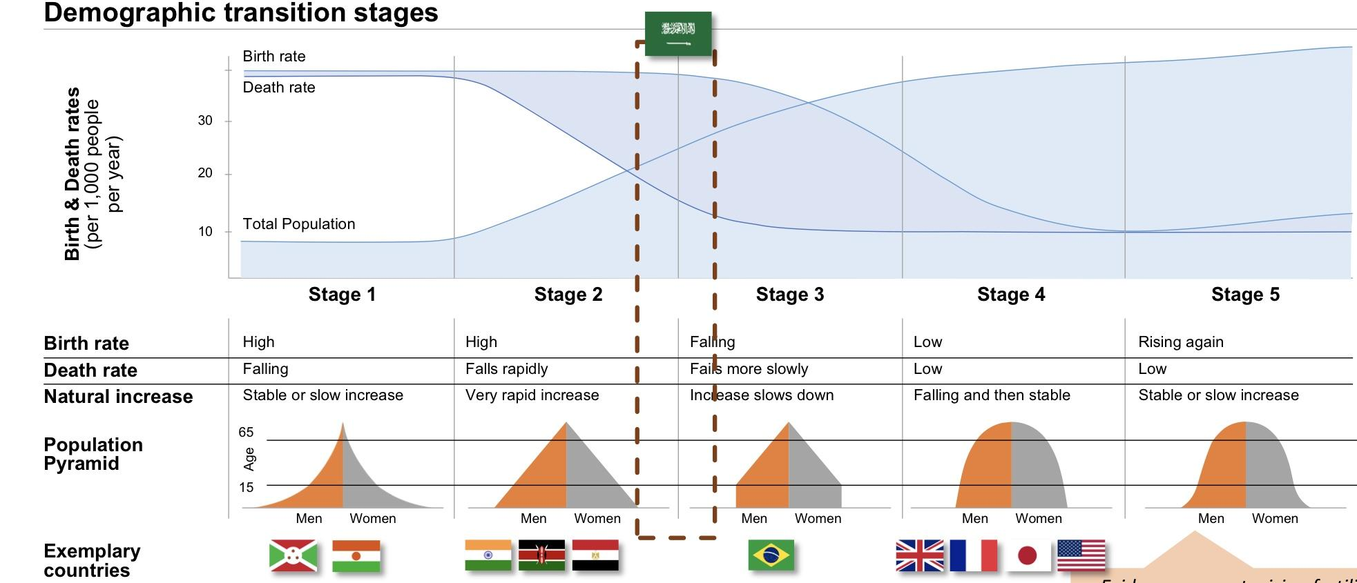
Demographic Transition ^{1,2}
It is the Movement of death and birth rates in a society, from a situation where both are high (in the pre-transition stage) to one where both are low (in the post-transition stage).
Transition is the interval between these two stages during which the population increases oftentimes rapidly, as births exceed deaths.
Evidence suggests rising fertility at very high development levels - however no country fully reached level yet
2: Each stage has its own policy:
Stage 1: To fight malaria, reduce death rates and birth rates.
Egypt: How is Egypt going to provide/afford good education and jobs for the people coming in? It’s a question of contraceptive policies and family planning services within the healthcare system.
Population Dynamics
It studies the size and age composition of populations and the biological and environmental processes driving them.
Three factors contribute to population dynamics
Population Drivers
Fertility is the number of babies women have
Fertility
Total population growth and population composition
Birth rates & Immigration
Death rates & Emigration
Migration
Mortality
Migration looks at the number of people who are moving in/out of countries
Key questions
What is the link between population growth and healthcare system utilization ? ³
Is population growth in the Saudi context a real problem and why?
Mortality is the rate of deaths in a given period
1: Stage 1: The majority of the population is﹤15 years old (↑birth rates) and very low population of ﹥65 years old (↑death rates). These are countries in Africa, that aren’t managing infectious diseases (Malaria, HIV, etc..).
Stage 2: ↑birth rates and the majority of the population are between 15-64 (↑working age population). There’s improvement in the healthcare system and the quality of life which lead to decreased death rate but birth rate is very high.
Stage 3: When birth rate starts to decreased fall, the working age population (15-64) starts to have less dependence.
Stage 4: Birth rate starts matching the death rate (as if it’s replacing it. This is a very aging population.)
3: Increase demand of healthcare services.

Slide 4
Fertility
It is the child-bearing capacity of the population represented by women between the ages of 15 and 49 years.
Indicators for fertility
1
General fertility rate
2
Age-specific fertility rate
3
total fertility rate
General Fertility Rate (GFR)¹:
Number of live births per 1000 women between the ages of 15 and 49 year ².
Example: - Number of live births in 2019= 90,254. - Mid-year female population aged 15-49 = 2,374,912
1
GFR =
N of live births
X 1000
GFR =
90254
X 1000 = 38
Mid - year female population aged 15-49
2374912
Age-speciﬁc Fertility Rate:
number of births to women of a particular age (a year or age group). E.g. females in the age group 20-24 y.
2
N of live births of mothers aged 20 - 24
Age - specific FR=
Mid - year female population aged 20 - 24
X 1000
3
Total Fertility Rate (TFR):
average number of children a woman would bear during her reproductive lifetime (15-49 years), assuming her childbearing conforms to her age-specific fertility rate every year of her childbearing years. Internationally used measure of fertility. What is the best measure for comparison? TFR
TFR > 2 means growing population
TFR < 2 means decreasing number of the population
TFR = 2 or 2.1→ replacement fertility ³
Total fertility rate, 1950-2015 ⁴
Total Fertility rate by country, 2010-15 ⁵
• Fertility replacement rate for total population is about 2.1; thus current fertility rate is slightly above replacement.
• Replacement fertility rate results in zero population growth in the long run; in short term, demographic inertia may result in continued growth.
• If fertility is kept constant at levels by 2050 there will be an increase in population size of more than 6 million.
• Very few countries have registered such a steep decline of fertility in such a short time, and the trend is likely to continue.
• Fertility projected to decrease to the point of replacement level (2.1 children per women) by 2030, in only 12 years.
• Fertility higher among Saudis than among non-Saudis. Since the non Saudis may not stay in the country in the long run, the demographic dividend in the KSA is less advanced than shown previously.
1: Not used as an accurate measure of fertility.
2:It’s the reproductive life span of a woman.
3:Replacement fertility: when a generation replaces itself (in other words: for every born child, that child replaces death).
4:Why did fertility rates and birth rates decrease from 7 to 2.5-3? Due to cost, availability of contraceptives, woman lifestyle (having a job), family planning and awareness.
5: Saudi Arabia is still growing. UAE is 1.8, due to the large number of expatriates.

Slide 5
Fertility
Crude birth rate^{1,2}: the number of live births in a year per 1000 of the population.
Example: • Number of live births in country A = 85000 • Mid-year population = 10,000,000
Birth Rate =
N of live births
X 1000
Crude Birth Rate =
85000
X 1000 = 8.5 live births per 1000 population
Mid - year population
10000000
Mortality
● Mortality is a relationship of death cases to the whole population. Two basic types of mortality:
General (crude) mortality rate or death rate
Specific mortality rates:
1
Age and sex related (special rates: infant mortality and fetal losses)
2
Cause related (diseases, injuries, suicide, homicide)
3
Life expectancy (sex and age related)
1
Crude death rate (or mortality rate) is the number of death cases in a year per 1000 of the population.
Example: • number of death cases = 135000 • the mid-year population = 10000000.
Crude mortality rate (CMR) =
N of death cases
X 1000
CMR =
135000
X 1000 = 13.5
Mid - year population
10000000
2
Age and sex related mortality rate: CMRs can be computed for both genders and age groups. The age group under 1 year is separately treated (the infant mortality).
Example: General population between 40-49 years:
CMR 40-49 years =
N of death cases of the cohort
X 1000
Mid - year population of the cohort
3
Infant mortality rate³: is the number of deaths of infants under one year (365 days) old in a given year per 1,000 live births occurred in the same year.
Infant mortality rate =
N of infants died in the first 365 days
X 1000
N of infants born in a given year
1: Not used as an accurate measure of fertility.
2: Crude birth rate isn’t used to compare between countries. Because some populations have large numbers of elderly (↑deaths,↓births) such as Japan, compared to a population that has large numbers of younger people.
3: Infant mortality rate is considered a good indicator of the health status of a population.

Slide 6
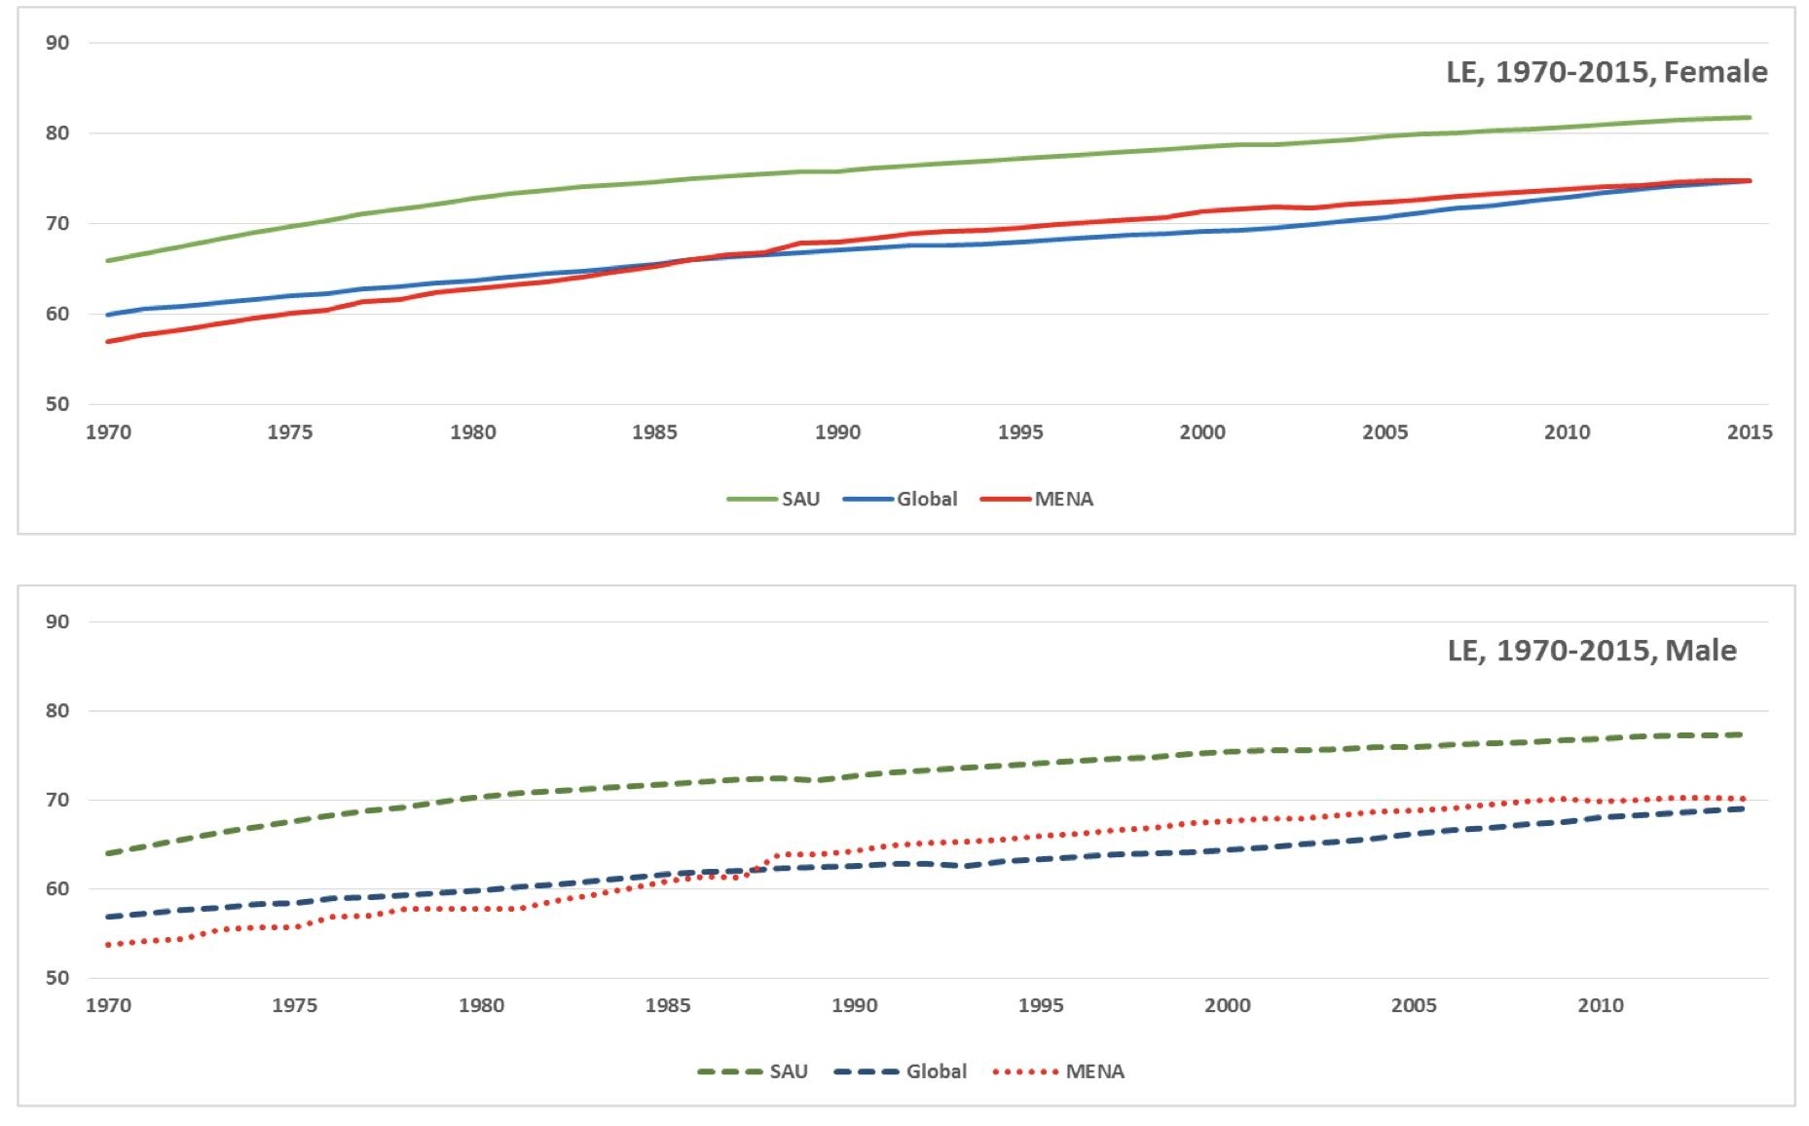
Maternal mortality¹ :
• Special case of sex-related mortality.
• Represents death cases of women who die during pregnancy and childbirth inclusive of the first 42 days after the delivery (WHO definition).
• The number per year is relatively small (developed countries), thus maternal mortality rate is computed per 100,000 live births.
• ~ 11/100,000 in the developed countries.
4
Maternal mortality rate =
N of maternal deaths
X 100000
N of infants born in a given year
5
Life expectancy: the average number of years an individual of a given age is expected to live if current age-specific mortality rates continue to apply. Every cohort had different experiences in its earlier life that might have influenced its mortality rate in a given year.
6
Life expectancy at birth: Average number of years a newborn is expected to live if current
mortality structure persists throughout its life.
Example: Life Expectancy in Saudi Arabia ²
Example: Life Expectancy in Saudi Arabia
Saudi Arabia vs. the world and MENA region, 1975-2015
Index | Male |  | Female
 | 1990 | 2015 | 1990 | 2015
Life expectancy at birth (years) | 72.3 | 77.4 | 75.9 | 81.3
Maternal mortality ratio (per 100000 live births) | - | - | 21.4 | 14.2
Infant mortality rate (per 100000 live births) | 39.3 | 9.9 | 35.4 | 8.8
Sources of demographic data:
• Population Census (Usually executed every 10 years)
• Household surveys (Demographic Health Survey; Every 5 years)
• Calculations and Projections
• Registration of births and deaths (civil registration)
• Location of residence registry (National Address Registry)³
• Causes of death – death certificate (ICD)
• Marriage and Divorce Registries
• Contraception practices and prevalence⁴
1: Its usually due to the lack of spacing between pregnancies
1: What should the ideal maternal mortality rate be? Zero.
2: We’re expecting larger numbers of aging population (>65) some will be having diseases (HTN, diabetes, etc..). Rather than waiting for the disease to develop in the elders, we should intervene and prevent them. The key factor is to have a younger healthy population.
3: To understand how many people are living in the same household, and what’s their relationship to one another (siblings?, children?,etc..).
4: Do you they use contraception? Do they have access to contraception?

Slide 7
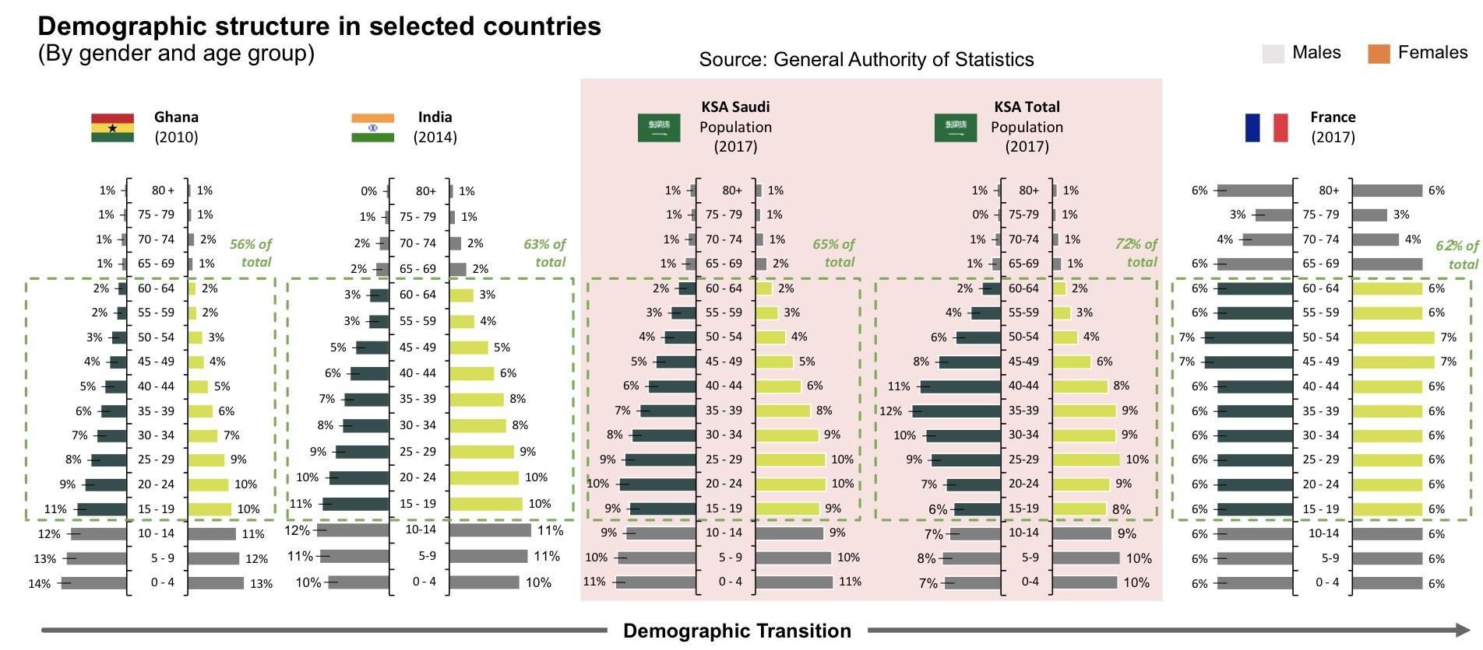
They are presented as:
• sex distribution (females and males) and sex ratio
• population by main age-groups (0-14, 15-39, 40-59, 60-X) and mean age
• female population by main age-groups (0-14, 15-39, 40-59, 60-X) and mean age
• male population by main age-groups (0-14, 15-39, 40-59, 60-X) and mean age
• age structure of population by life-years or five-year age-groups
• age structure of female population by life-years or five-year age-groups
• age structure of male population by life-years or five-year age-groups
• age composition, dependency ratio, ageing index
• Distribution by nationality, socioeconomic status, education level etc..
Population Pyramids
1
Population studies consider three key elements: population dynamics, policy areas and outcome indicators
Framework for analyzing population dynamics
1. population dynamics
2. population development policy areas
Policy Area. Key questions for governments
3. Selected population outcome indicators
Aggregate Indicator. Sample sub-indicators
Fertility
How can countries improve the access to and quality of its education systems to improve educational outcomes?
• Expected years of school
• Harmonized test scores
• Probability to survive to age 5
• Survival rate (age 15- 60)
• Fraction of children under 5 not stunted
Education
HCI
Mortality
Population growth & composition
Labor
How can countries increase employment levels, enhance labor skillsets and ensure adequate labor supply-demand balance?
• Household income levels
• Household consumption levels
Poverty
How can countries improve the access to and quality Mortality
Growth & of its healthcare systems to assure high-quality Composition
health care access and outcomes for all Saudis in the future?
• Mean years of schooling
• Expected years of schooling
• Gross national income per capita
• Life expectancy at birth
Migration
Health
HDI
Gov’t & social services
How can countries improve the access to and quality of its gov’t and social services for its citizens, including infrastructure, security, social protection, etc.?
Inequality (GINI)
• Household income levels
Social norms & attitudes
How can countries preserve and promote a sense of community and identity in light of its expanding population?
Happiness
index
• GDP/capita
• Household income levels
• Life expectancy
• Democratic quality
• Generosity
• Social support
• Freedom to make
life choices
Social progress Index
• School enrolment rates
• Undernourishment
• Access to utilities
• Inclusiveness
• Gender parity
1: Ghana→ ↑birth rate, ↑death rate.
In KSA Total population (2017)→ notice how the independent population (15-64) increased to 72%, this is due to the large number of single working men (non Saudi).
France→ stationary pyramid.

Slide 8
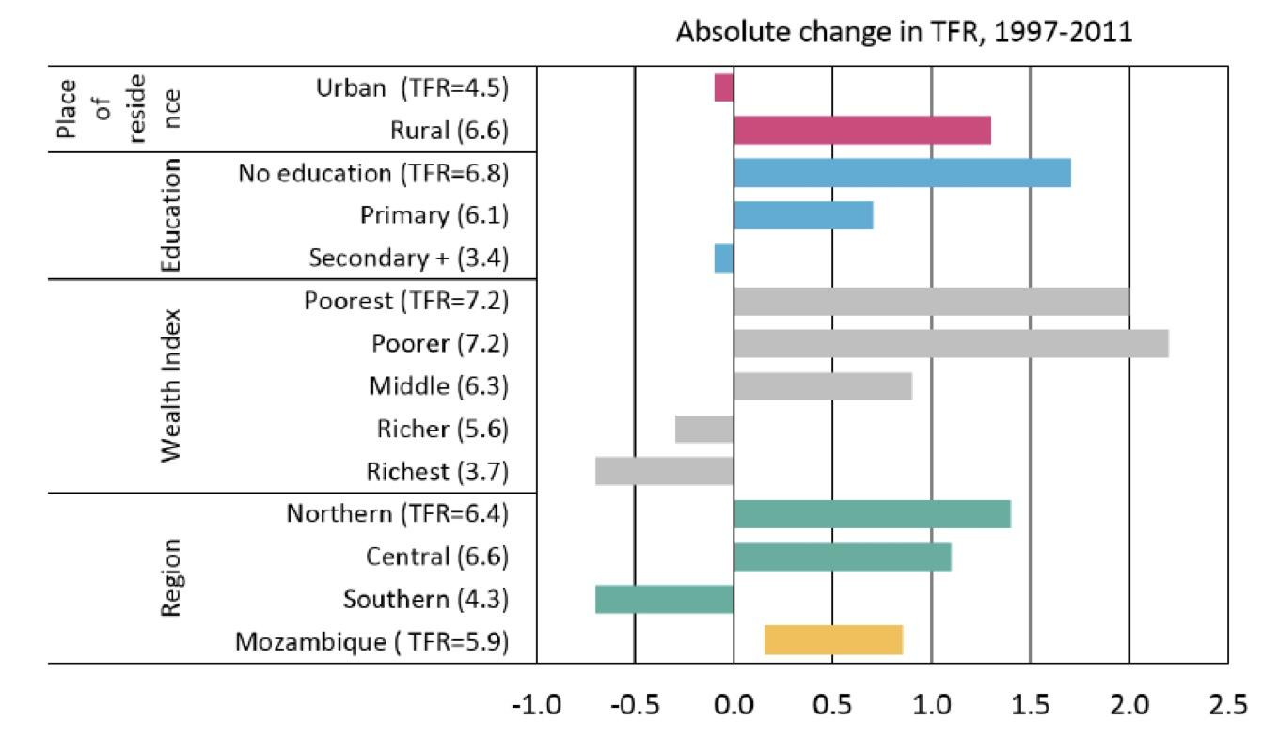
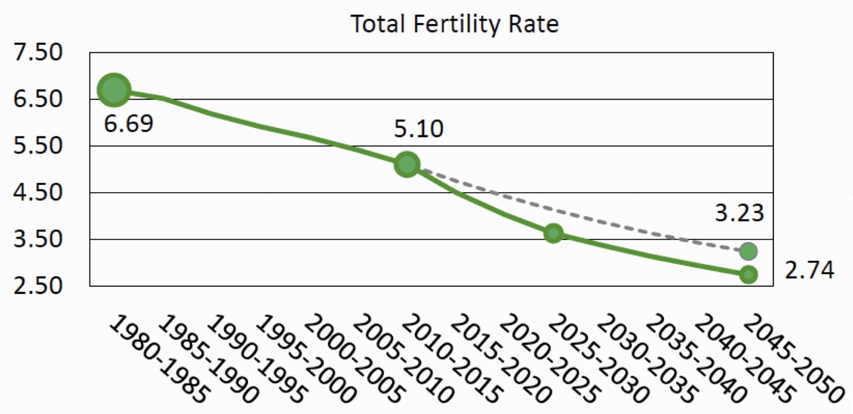
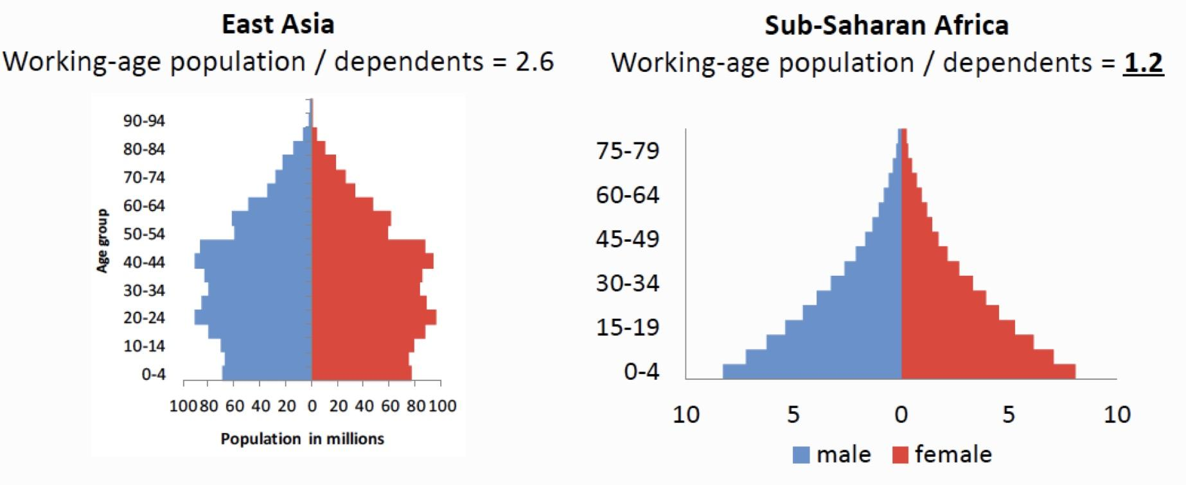
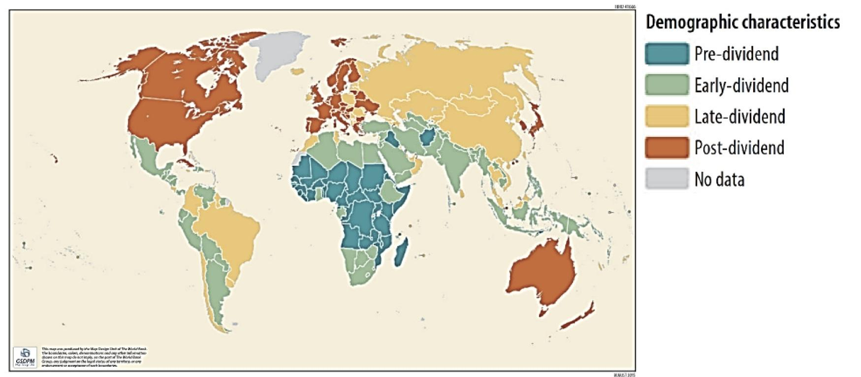
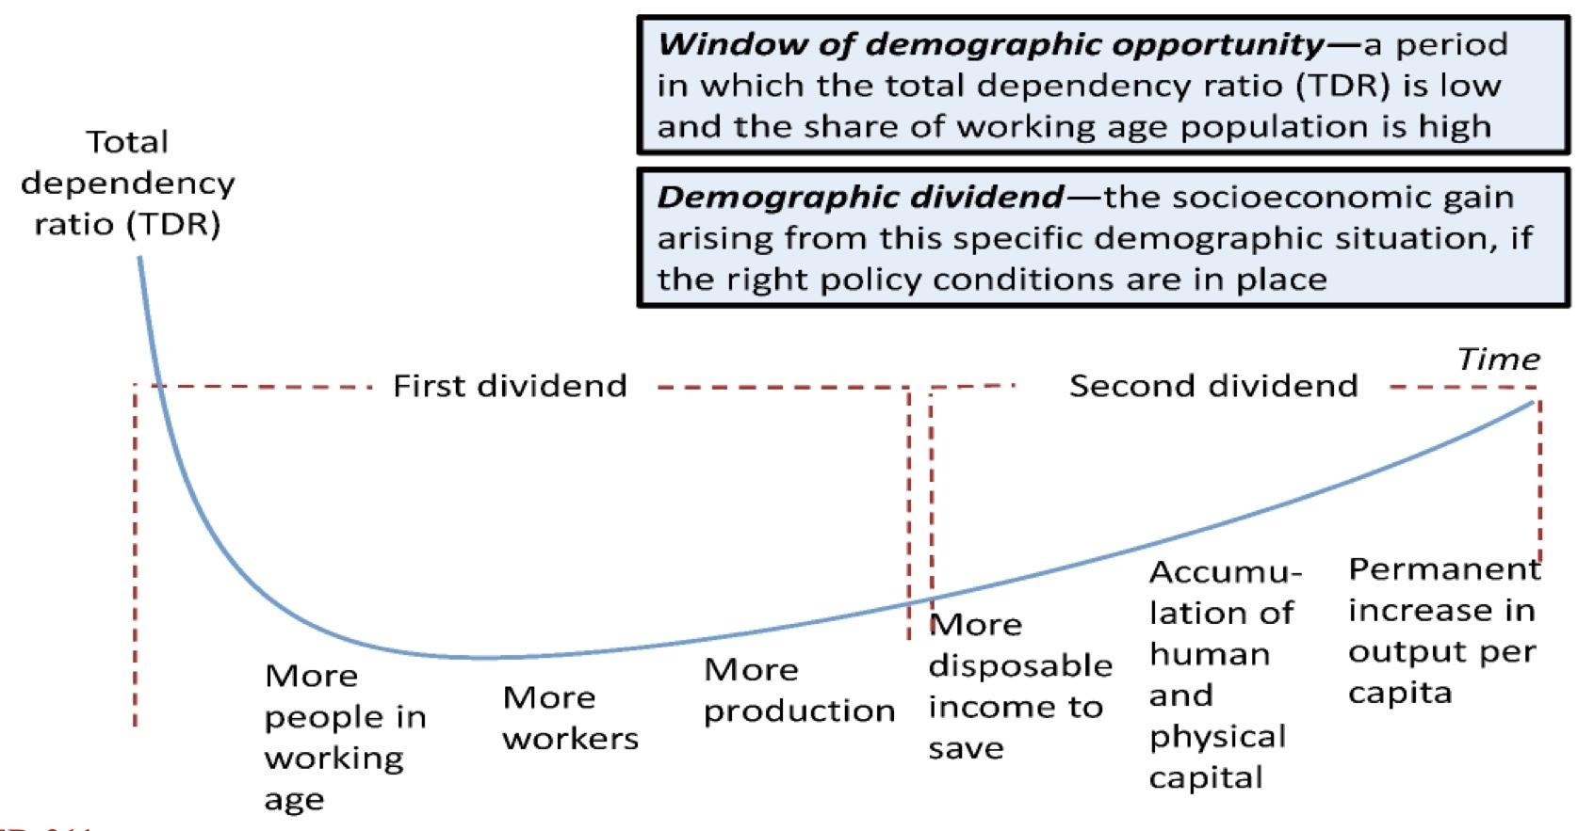
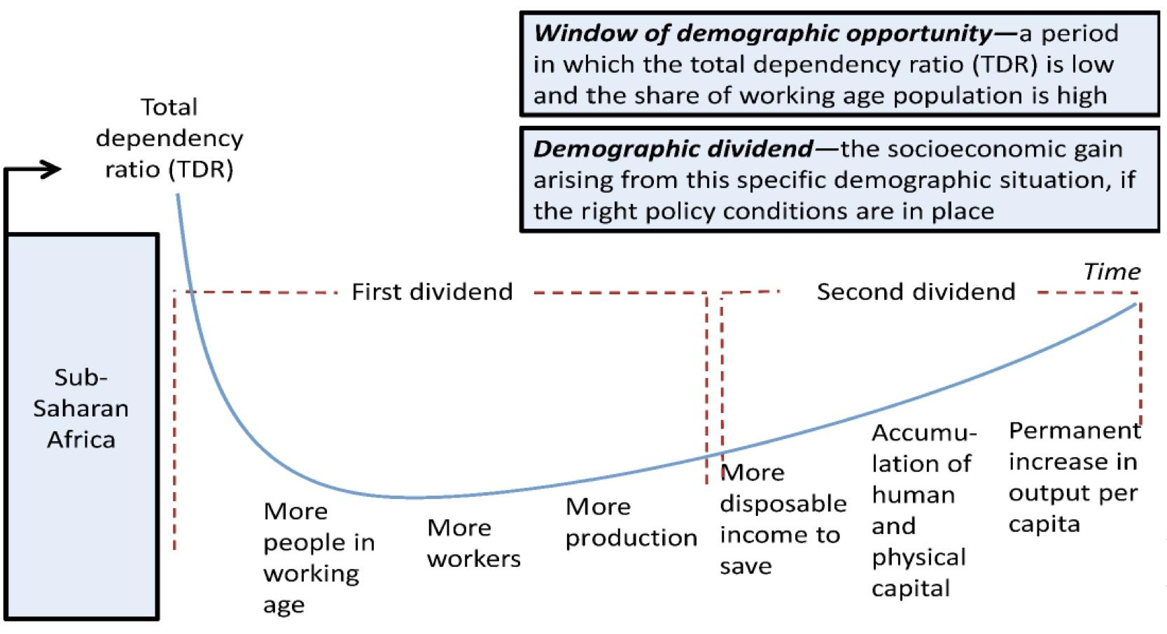
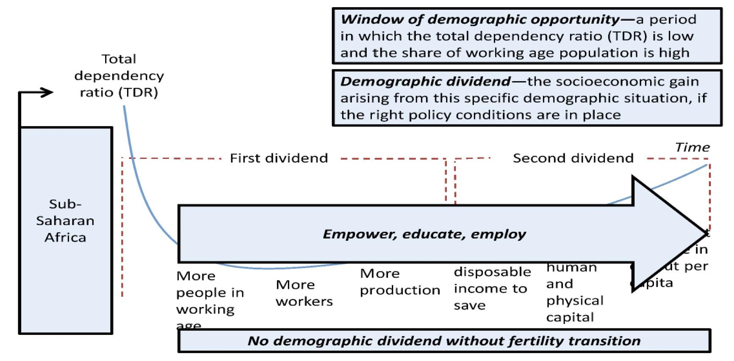
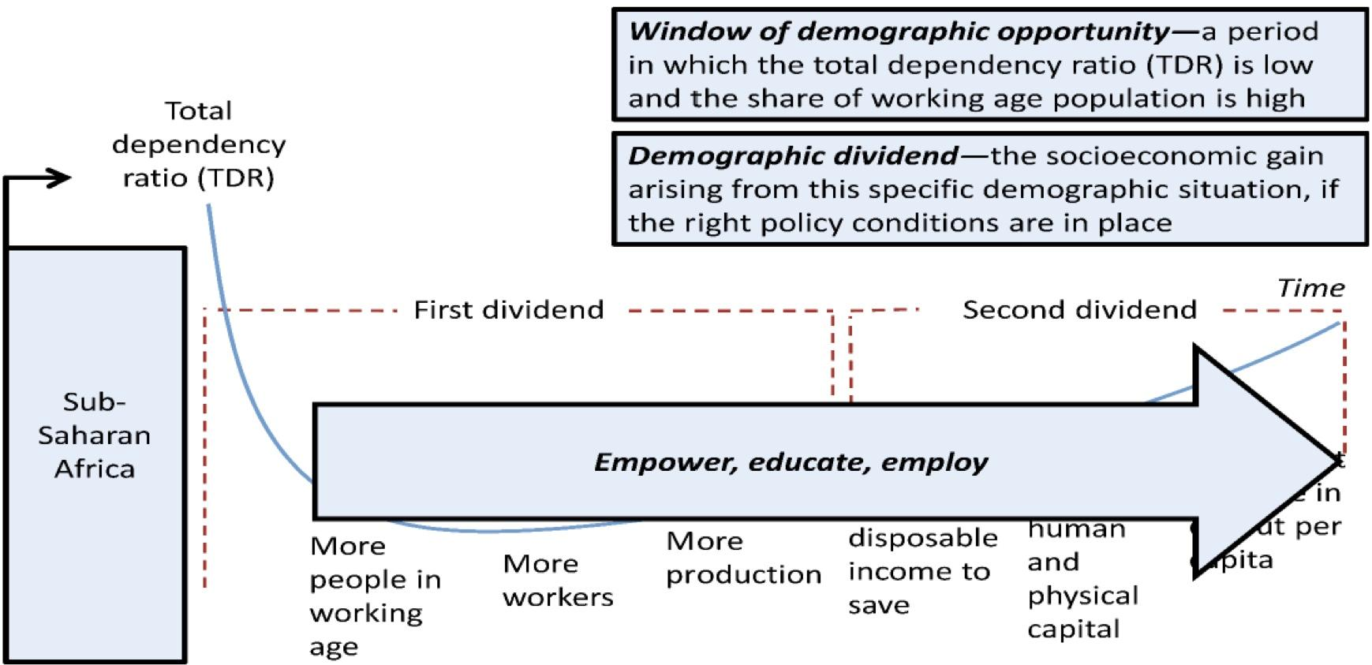
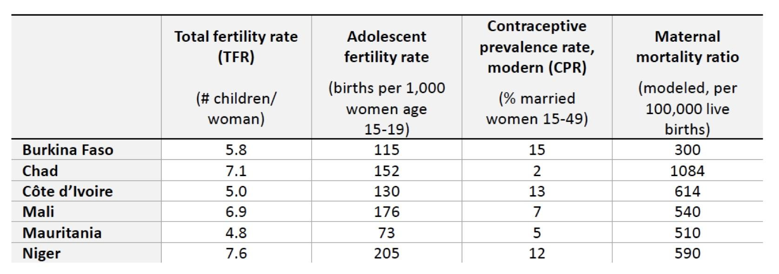
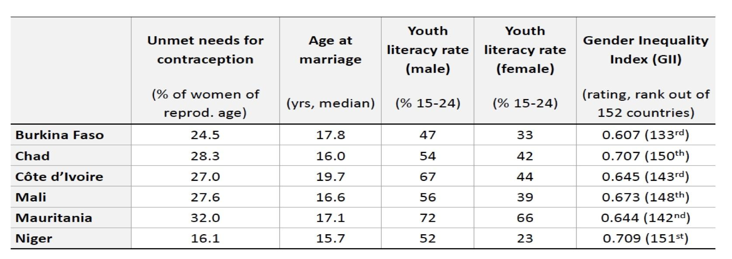
Fertility Is Increasingly Unequal Across Socioeconomic Groups
The Opportunity: Potential Impact of Demographic Change on Poverty Reduction in Sub-Saharan Africa
100-150 million fewer poor people by 2050
Additional benefits with reduced infant and maternal mortality, reduced malnutrition and improved early childhood development, and higher education for girls
Few Adults to Sustain Dependents¹
Most Countries in Sub-Saharan Africa Still Have Very High Fertility ²
Demographic Dividend
Most Countries in Sub-Saharan Africa Still Have Very High Fertility
Most Countries in Sub-Saharan Africa Still Have Very High Fertility
1: left pic = Stage 4 , right pic = Stage 1
2: Pre-dividend→ Stage 1, Early-dividend→ Stage 2, Late-dividend→ Stage 3, Post-dividend→ stage 4.

Slide 9
Summary
From the Doctor
 | Total Fertility Rate (TFR) | General Fertility Rate (GFR) | Crude Birth Rate (CBR)
Definition | Number of children a woman would have if she lived from 15 to 50 and experienced the same age-specific fertility as currently observed | Mean number of births per woman in fertile age (15-49) | Mean number of births per person within given period
Assessment | ✔ Independent of the effect of the age structure as each age group is given equal weighting. ✔ Widely used measure enabling compatibility across the countries. | ✔ Low data requirements making it an often used measure in cases of limited\poor data availability
 | ✖ More complex data requirements, which is often obtained through survey and thus are affected by survey quality. | ✖ Strongly affected by age structure as fertility is concentrated within certain age structures (i.e GFR and CBR may be different across countries, simply due to different age structure)
Uses | - Assessment\Comparison of demographic development. - Internationally used measure of fertility | - Population growth\demographic development, if insufficient data for TFR available. - Not used as an accurate measure of fertility

Slide 10
Quiz
MCQ
1-Population doubling time is
A- Growth rate(GR %)/ 70 B- 70/GR % C- 60/GR% D- GR%/60
2- Three of the followings factors contribute to Population dynamics except:
A- Birth. B- Death. C-Migration. D- Morbidity.
3- For every 1,000 babies born in Burundi in 2008, an estimated 120 of them will have died before
reaching their first birthday. The rate of 120 deaths per 1,000 births is known as the
A- total fertility rate. B- crude death rate. C- life expectancy. D- infant mortality rate.
4- A country has 7 per 1000 deaths and 7 per 1000 births, at which stage of the demographic transition is it?
A- Stage 2 B- Stage 3 C- Stage 4 D- Stage 5
5- In what stage in the demographic transition theory do death rates fall Rapidly while birth rates remain high leading to rapid population growth?
A-Stage 1. B- Stage 2. C- Stage 3. D- Stage 4.
6- Number of deaths in a given population in a specific period of time over the mid-year population of that same time period is ?
A-Crude death rate. B- life expectancy. C- fertility. D- Crude birth rate.
7- What is the most commonly used and reliable measure of fertility ?
A-Total fertility rate. B- General fertility rate. C- Crude birth rate.
Answers
Q1 | Q2 | Q3 | Q4 | Q5 | Q6 | Q7
B | D | D | C | B | A | A

Slide 11
Thank You and
Good Luck
Team Leaders:
Lama AlAssiri | Mohammed AlHuqbani | Ibrahim AlDakhil
Team Members:
Lama AlZamil
Leen AlMazroa
May Babaeer
Muneera AlKhorayef
Norah AlMazrou
Nouf Alhussaini
Rema AlMutawa
Sara AlAbdulkareem
Sedra Elsirawani
Wejdan Alnufaie
Abdulrahman Alhawas
Abdulrahman Shadid
Abdullah Aldawood
Abdullah Shadid
Alwaleed Alsaleh
Bader Alshehri
Bassam Alkhuwaiter
Faisal Alqifari
Hameed M. Humaid
Khalid Alkhani
Meshari Alzeer
Mohannad Makkawi
Nayef Alsaber
Omar Aldosari
Omar Alghadir
Zyad Aldosari

