Slide 1
Screening
Objectives
Define the term “screening”
Explain the concept of screening and the lead time
Explain the difference between “screening”, “case finding”, “periodic examination” and “diagnosis”
State the uses of screening programs
State the criteria of health problems amenable for screening
Outline the differences between screening and diagnostic test
Distinguish between “mass screening” and “high risk screening”
State the criteria of an ideal screening test
Color Index
Main text
Males slides
Females slides
Doctor notes
Important
Golden notes
Extra
Editing File

Slide 2
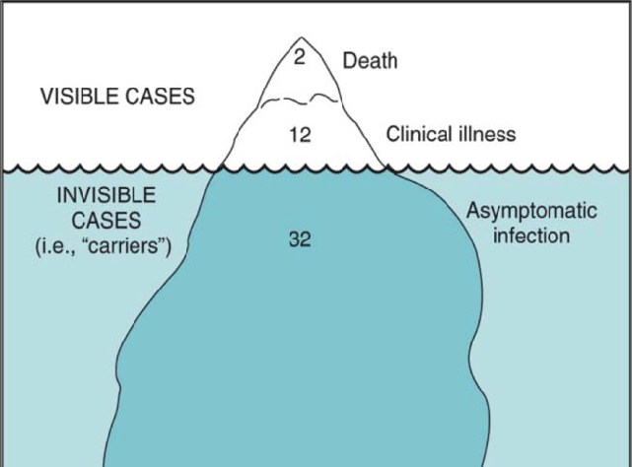
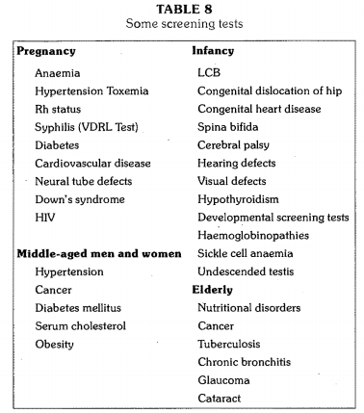
Iceberg Phenomenon of Disease ¹
Screening ²
This concept helps in giving us a better idea of the progress of disease to its overt or apparent form.
The submerged portion of the iceberg represents the hidden mass of the disease (carriers)
The floating tip represents what physicians see in practice (symptomatic cases)
This concept is very challenging in preventive medicine, because if we can’t detect the disease we can’t prevent it
Definition
The search for unrecognized disease or defect by means of rapidly applied tests, examinations or other procedures in apparently healthy individuals.
Examples
Epidemiologist and others who study disease find that the pattern of disease in hospitals is quite different from that in a community. That is, a far larger proportion of disease (e.g., diabetes, hypertension) is hidden from view in the community than is evident to physicians or to the general public. The analogy of an iceberg, only the tip of which is seen, is widely used to describe disease in the community.
They are based primarily on conserving the physician-time for diagnosis and treatment and having technicians to administer simple, inexpensive laboratory tests.

Slide 3
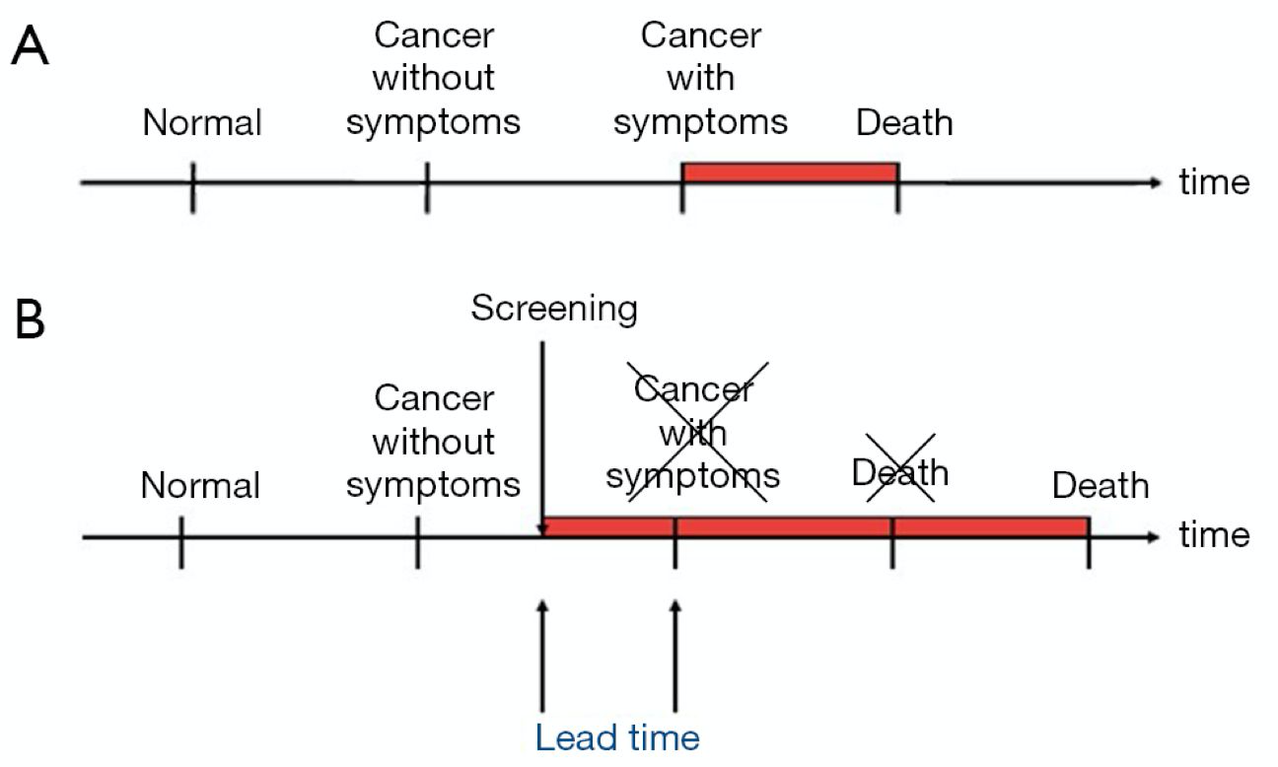
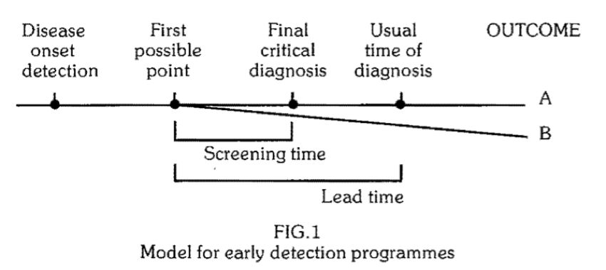
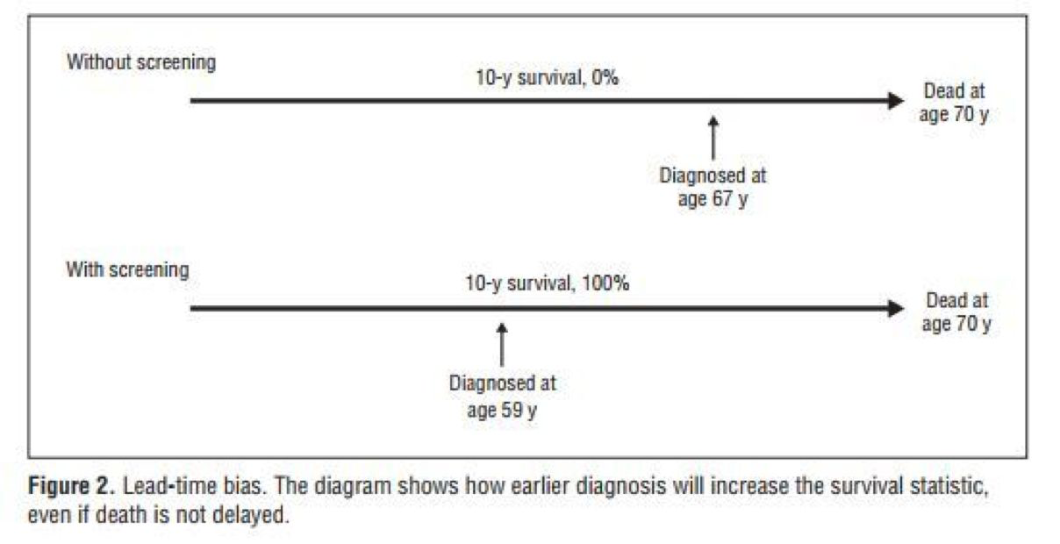
Lead Time
A
B
B-A
is the outcome of the disease.
Is the outcome to be detected when the disease is detected at the earliest possible moment
is the benefit of the screening program.
1
Lead time ¹ is the advantage gained by screening presented by alteration in the outcome.
2
It is defined as the period between diagnosis by early detection (screening) and diagnosis by other means ².
3
The benefit of the program must be seen in terms of its outcome, so if there’s no benefit in early detection the lead time is considered a bias and doesn’t provide critical info.
Lead Time Bias ³
Think of lead time as the time that could’ve been wasted before an actual diagnosis is made (after the symptoms appeared). Early detection can help treat many diseases and prevent their complications.
Detection programmes should, therefore, concentrate on those conditions where the time lag between the disease onset and its final critical point is sufficiently long to be suitable for population screening
Lead time bias is an increase in the perceived survival time (what you see) without affecting the outcome. For example, if there’s an untreatable cancer and its survival time was 10 years, even if you diagnose the case early the outcome is the same.

Slide 4
Concepts Related to Screening
We need to differentiate between screening and other terms, which are:
Case-finding
Diagnosis and diagnostic tests
Periodic examination
Is testing for infection or disease in populations or in individuals who are not seeking health care.
For example: serological testing for AIDS virus in blood donors, neonatal screening and premarital screening for syphilis.
Screening tests ¹
Use of clinical and/or laboratory procedures to confirm or refute the existence of disease or true abnormality in patients with signs and symptoms presumed to be caused by the disease.
For example: VDRL testing of patients with lesions suggestive of secondary syphilis; endocervical culture for N. gonorrhoeae.
Diagnostic tests
text
Screening vs Diagnostic tests ²
Difference | Screening test | Diagnostic Test
Target | Apparently healthy | People with indications or sick
Application | Applied to groups | Applied to single patients all diseases are considered
Evidence | Test results are arbitrary and final | Diagnosis is not final but modified in light of new evidence, diagnosis is the sum of all evidences
Criteria | Based on one criterion/cut-off point | Based on evaluation of sign(e.g diabetes), symptoms and laboratory findings
Accuracy | Less accurate | More accurate
Cost | Less expensive | More expensive
Treatment | Not a basis for treatment | Basis for a treatment
Initiative | From the investigator or care-providing agencies | From the patient with a complaint
A screening test is not intended to be a diagnostic test. It is only an initial examination. Those who are found to have positive test results are referred to a physician for further diagnostic work-up and treatment
However, the criteria in the table are not hard and fast. There are some tests which are used both for screening and diagnosis, e.g., test for anaemia and glucose tolerance test. Screening and diagnosis are not competing, and different criteria apply to each.

Slide 5
Concepts Related to Screening
Uses of Screening
The use of clinical and/or laboratory tests to detect disease in individuals seeking health care for other reasons
For example: the use of VDRL test to detect syphilis in pregnant women. Other diseases include pulmonary tuberculosis in chest symptomatics, hypertension, cervical cancer, breast cancer, diabetes mellitus.
Case finding ¹
text
It is a common and important part of office practice. Its purpose is the detection of asymptomatic illness and the prevention of disease before irreversible pathological changes occur using a number of standard procedures such as counseling, examination, and lab tests..
Periodic Health Examination
text
Screening vs Periodic Health Examination ²
Difference | Screening | Periodic Health Examination
Application | Wide application | Individual application
Cost | Inexpensive | Consumes money
Time | Requires less time from the physician | Consumes physician time
1
Case detection ²: people screened for their own benefit.
For example: Screening for breast cancer, PKU, deafness in children
2
Control of disease ³: people are screened for the benefit of others
For example: TB to protect population
3
Research purposes such as measuring the prevalence and incidence.
4
Educational opportunity: creating public awareness and educating health professionals.
Case finding is a strategy for targeting individuals or groups who are suspected to be at high risk
This is also known as "prescriptive screening". It is defined as the presumptive identification of unrecognized disease, which does not arise from a patient's request, e.g., neonatal screening.
This is also known as "prospective screening". People are examined for the benefit of others, e.g., screening of immigrants from infectious diseases such as tuberculosis and syphilis to protect the home population; and screening for streptococcal infection to prevent rheumatic fever.

Slide 6
Uses of Screening
Case detection
Is the presumption identification of unrecognized disease, which does not arise from a patient request.
For example, in neonatal screening.
The people are screened primarily for their own benefit.
1
Control of disease
People are examined for the benefit of others.
Screening of immigrants from infectious diseases like Ebola, TB and syphilis to protect the home population.
Another example is the screening for HIV and other STDs
It also leads to early diagnosis to permit more effective treatment and reduce the spread of infectious disease and mortality.
2
Research purposes
To know the history of many chronic diseases like cancer, HTN etc.
Screening may aid in obtaining more basic knowledge about the natural history of such diseases.
Initial screening provides a prevalence estimate and subsequent screening provides and incidence
3
Educational opportunities
Acquisition of information of public health relevance.
Providing opportunities for creating public awareness.
4
Types of Screening ¹
Mass screening
VS
High risk / Selective screening
Mass screening simply means the screening of a whole population or a sub-group, as for example, all adults.
It is offered to all, irrespective of the particular risk individual may run of contracting the disease in question (e.g., Tuberculosis)
Not useful for preventive measures ²
Screening will be most productive if applied selectively to high-risk groups, the groups defined on the basis of epidemiological research
For example: screening for diabetes, hypertension, breast cancer in patients with positive family history
Screening for risk factors.
There’s a third type of screening called multiphasic screening which is defined as defined as the application of two or more screening tests in combination to a large number of people at one time than to carry out separate screening tests for single diseases. The procedure may also include a health questionnaire, clinical examination and a range of measurements and investigations (e.g., chemical and haematological tests on blood and urine specimens, lung function assessment, audiometry and measurement of visual acuity)
Unless it is backed up by suitable treatment that will reduce the duration of illness or alter its final outcome.

Slide 7
Criteria for Screening Diseases
Criteria for Screening Tests
important health problem ¹
Has an effective treatment
Recognizable latent ² or early symptomatic and it’s natural history of the condition should be understood ³
There should be an agreed-on policy concerning whom to treat as patients
Criterias for Screening Diseases
There is a test that can detect the disease
Good Evidence (i.e. the number of lives saved) that early detection and treatment reduces morbidity and mortality
Facilities should be available to confirm the diagnosis
Expected benefits ⁴ of early detection exceeding risks and costs
1
Acceptability:
A screening test should be acceptable to people at whom it is aimed.
Painful (bone marrow biopsy), discomforting or embarrassing (rectal/vaginal exam) tests are not acceptable to the population in mass campaigns
2
Repeatability:
A screening test must give consistent results when repeated more the once on the same individual under the same conditions
3
Validity:
Refers to what extent the test accurately measures which it claims to measure
For example: Glycosuria vs Glucose tolerance test (GTT) to diagnose diabetes (glycosuria is a useful screening test however GTT is more valid)
In other words, the prevalence should be high. If the disease wasn’t an important health issue the costs will exceed the benefits making the screening program not cost effective.
We can’t screen for rapidly fatal diseases or diseases with short preclinical stage because there’ll be no time between screening and diagnosing and this will make the screening program not efficient
So that we can know at what stage the process ceases to be reversible
For example the number of lives saved

Slide 8
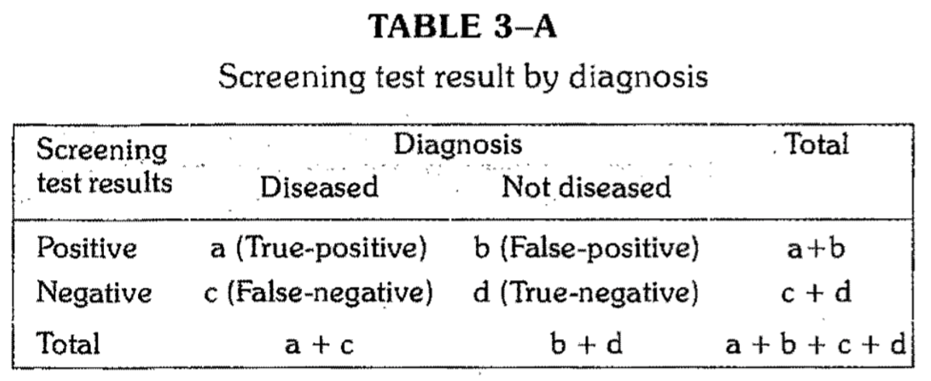
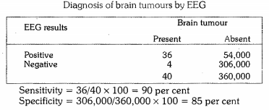
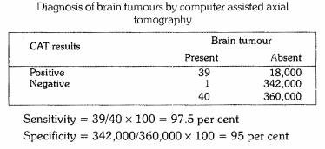
Components of Validity
1
Sensitivity
2
Specificity
3
Predictive value of a positive test
4
Predictive value of a negative test
5
Percentage of false-negative
6
Percentage of False-positive
Sensitivity and Specificity
1
 | Sensitivity | Specificity
Definition | The ability of the test to identify correctly all those who have the disease, that is true positive Percentage of true positives | The ability of a test to identify correctly those who do not have the disease, that is true negatives Percentage of true negative
Example | 90% sensitivity means that 90% of diseased people screened by the test will give a “true-positive” result and the remaining 10% a “false negative results” | 90% specificity means 90% of non-diseased people will give “true-negative” result, 10% of non diseased people screened by the test will be wrongly classified as “diseased” when they are not
Formula
Example

Slide 9
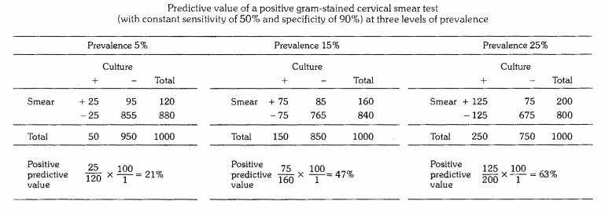
Predictive Accuracy
2
Definition | Reflects the diagnostic power of a test Depends upon the sensitivity, specificity and disease prevalence It is the probability that a patient with a positive test result has in fact the disease in question The more prevalent is a disease in a given population, the more accurate will be the predictive value of a positive screening test
Predictive Value | Predictive Value of a Positive Test | Predictive Value of a Negative Test
Formula
Example
Percentage of False +/-
3
Definition | Opposite to sensitivity and specificity and is more important to clinicians
Percentage | Percentage of False-Negative ¹ | Percentage of False-Positive ²
Formula
False-negatives: The term "false-negative" means that patients who actually have the disease are told that they do not have the disease. It amounts to giving them a "false reassurance". The patient with a "false-negative" test result might ignore the·. development of signs and symptoms and may postpone the treatment.
False-positives: The term "false-positive" means that patients who do not have the disease are told that they have the disease. In this case, normal healthy people may be subjected to further diagnostic tests, at some inconvenience, discomfort, anxiety and expense - until their freedom from disease is established.

Slide 10
Quiz
MCQ
1. Which of the following is the most effective method for prevention of sexual transmission in the Mediterranean region?
A. Mutual fidelity and condom use B. Adherence to religious teachings and education C. Screening measures in blood banks D. Genetic and premarital counseling and services
2. Which one of the following diseases is suitable for screening programs?
A. A disease with high mortality B. A disease with high prevalence of asymptomatic cases C. Diseases with no effective treatment D. A disease with rapid development of signs
300 known diabetics (positive on the glucose tolerance test) and 250 normal volunteers (negative on the glucose tolerance test) are given finger prick tests, the results are:
3. What is the sensitivity of the test?
A. 20% B. 90%
C. 94% D. 98%
4. What is the specificity of the test?
A. 90% B. 92%
C. 94% D. 98%
5. What is the percentage of false-positive?
A.8% B. 6%
C. 8.7% D. 6.4%
6. PSA screen test for prostate cancer is tested against prostate biopsy, The PSA test was able to detect 22 cases among 45 subjects who were confirmed positive by the biopsy. And 64 subjects were identified as free of prostate cancer by the biopsy, 4 of which were reported by using PSA to be affected with prostate cancer. What is the sensitivity of the PSA test?
A. 49% B. 51% C. 85% D. 72%
7. The capacity of a test or procedure to screen as “negative” in those NOT having a disease is called?
A. Sensitivity B. Specificity C. (+) predictive value D. (-) predictive value
8. Screening neonates for potential infections is considered in which of the following uses of screening?
A. Control of disease B. Case detection C. Case finding D. Mass screening
Tests |  | GTT |  | Total
 |  | + | -
Finger prick test | + | 282 | 20 | 302
 | - | 18 | 230 | 248
Total |  | 300 | 250 | 550
Answers
Q1 | Q2 | Q3 | Q4 | Q5 | Q6 | Q7 | Q8
C | B | C | B | A | A | B | B

Slide 11
Thank You and
Good Luck
Team Leaders:
Lama AlAssiri | Mohammed AlHuqbani | Ibrahim AlDakhil
Team Members:
Lama AlZamil
Leen AlMazroa
May Babaeer
Muneera AlKhaorayef
Norah AlMazrou
Nouf Alhussaini
Rema AlMutawa
Sara AlAbdulkareem
Sedra Elsirawani
Wejdan Alnufaie
Abdulrahman Alhawas
Abdulrahman Shadid
Abdullah Aldawood
Abdullah Shadid
Alwaleed Alsaleh
Bader Alshehri
Bassam Alkhuwaiter
Faisal Alqifari
Hameed M. Humaid
Khalid Alkhani
Meshari Alzeer
Mohannad Makkawi
Nayef Alsaber
Omar Aldosari
Omar Alghadir
Zyad Aldosari

