Slide 1
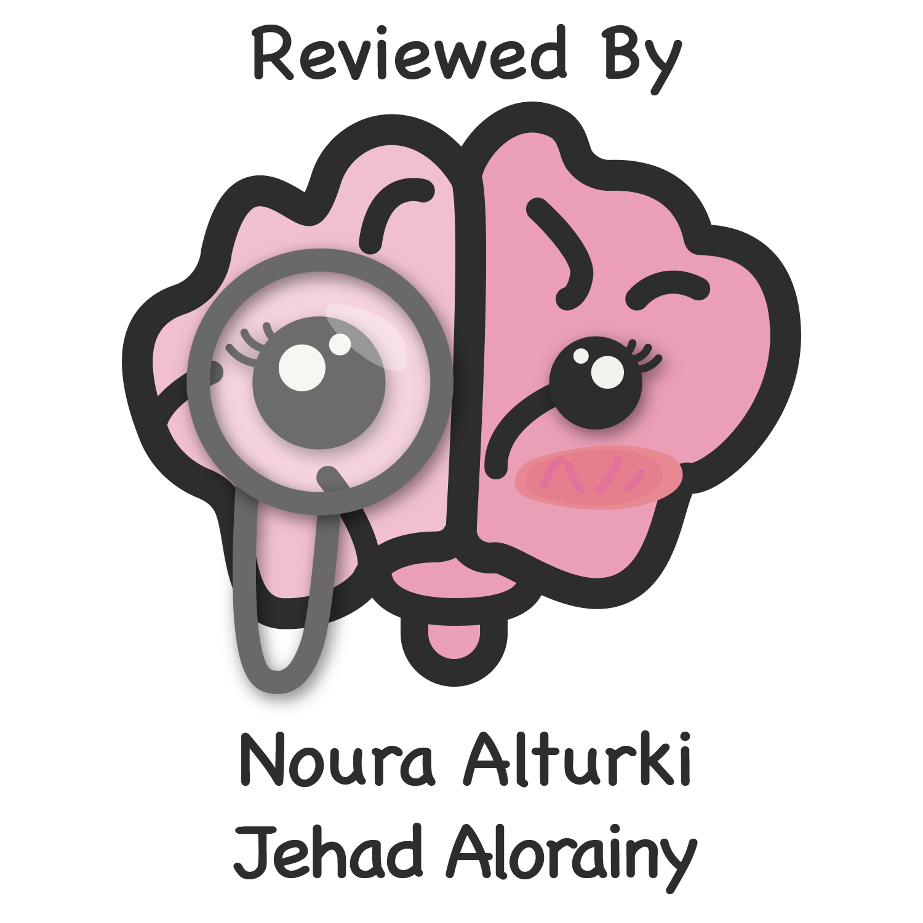
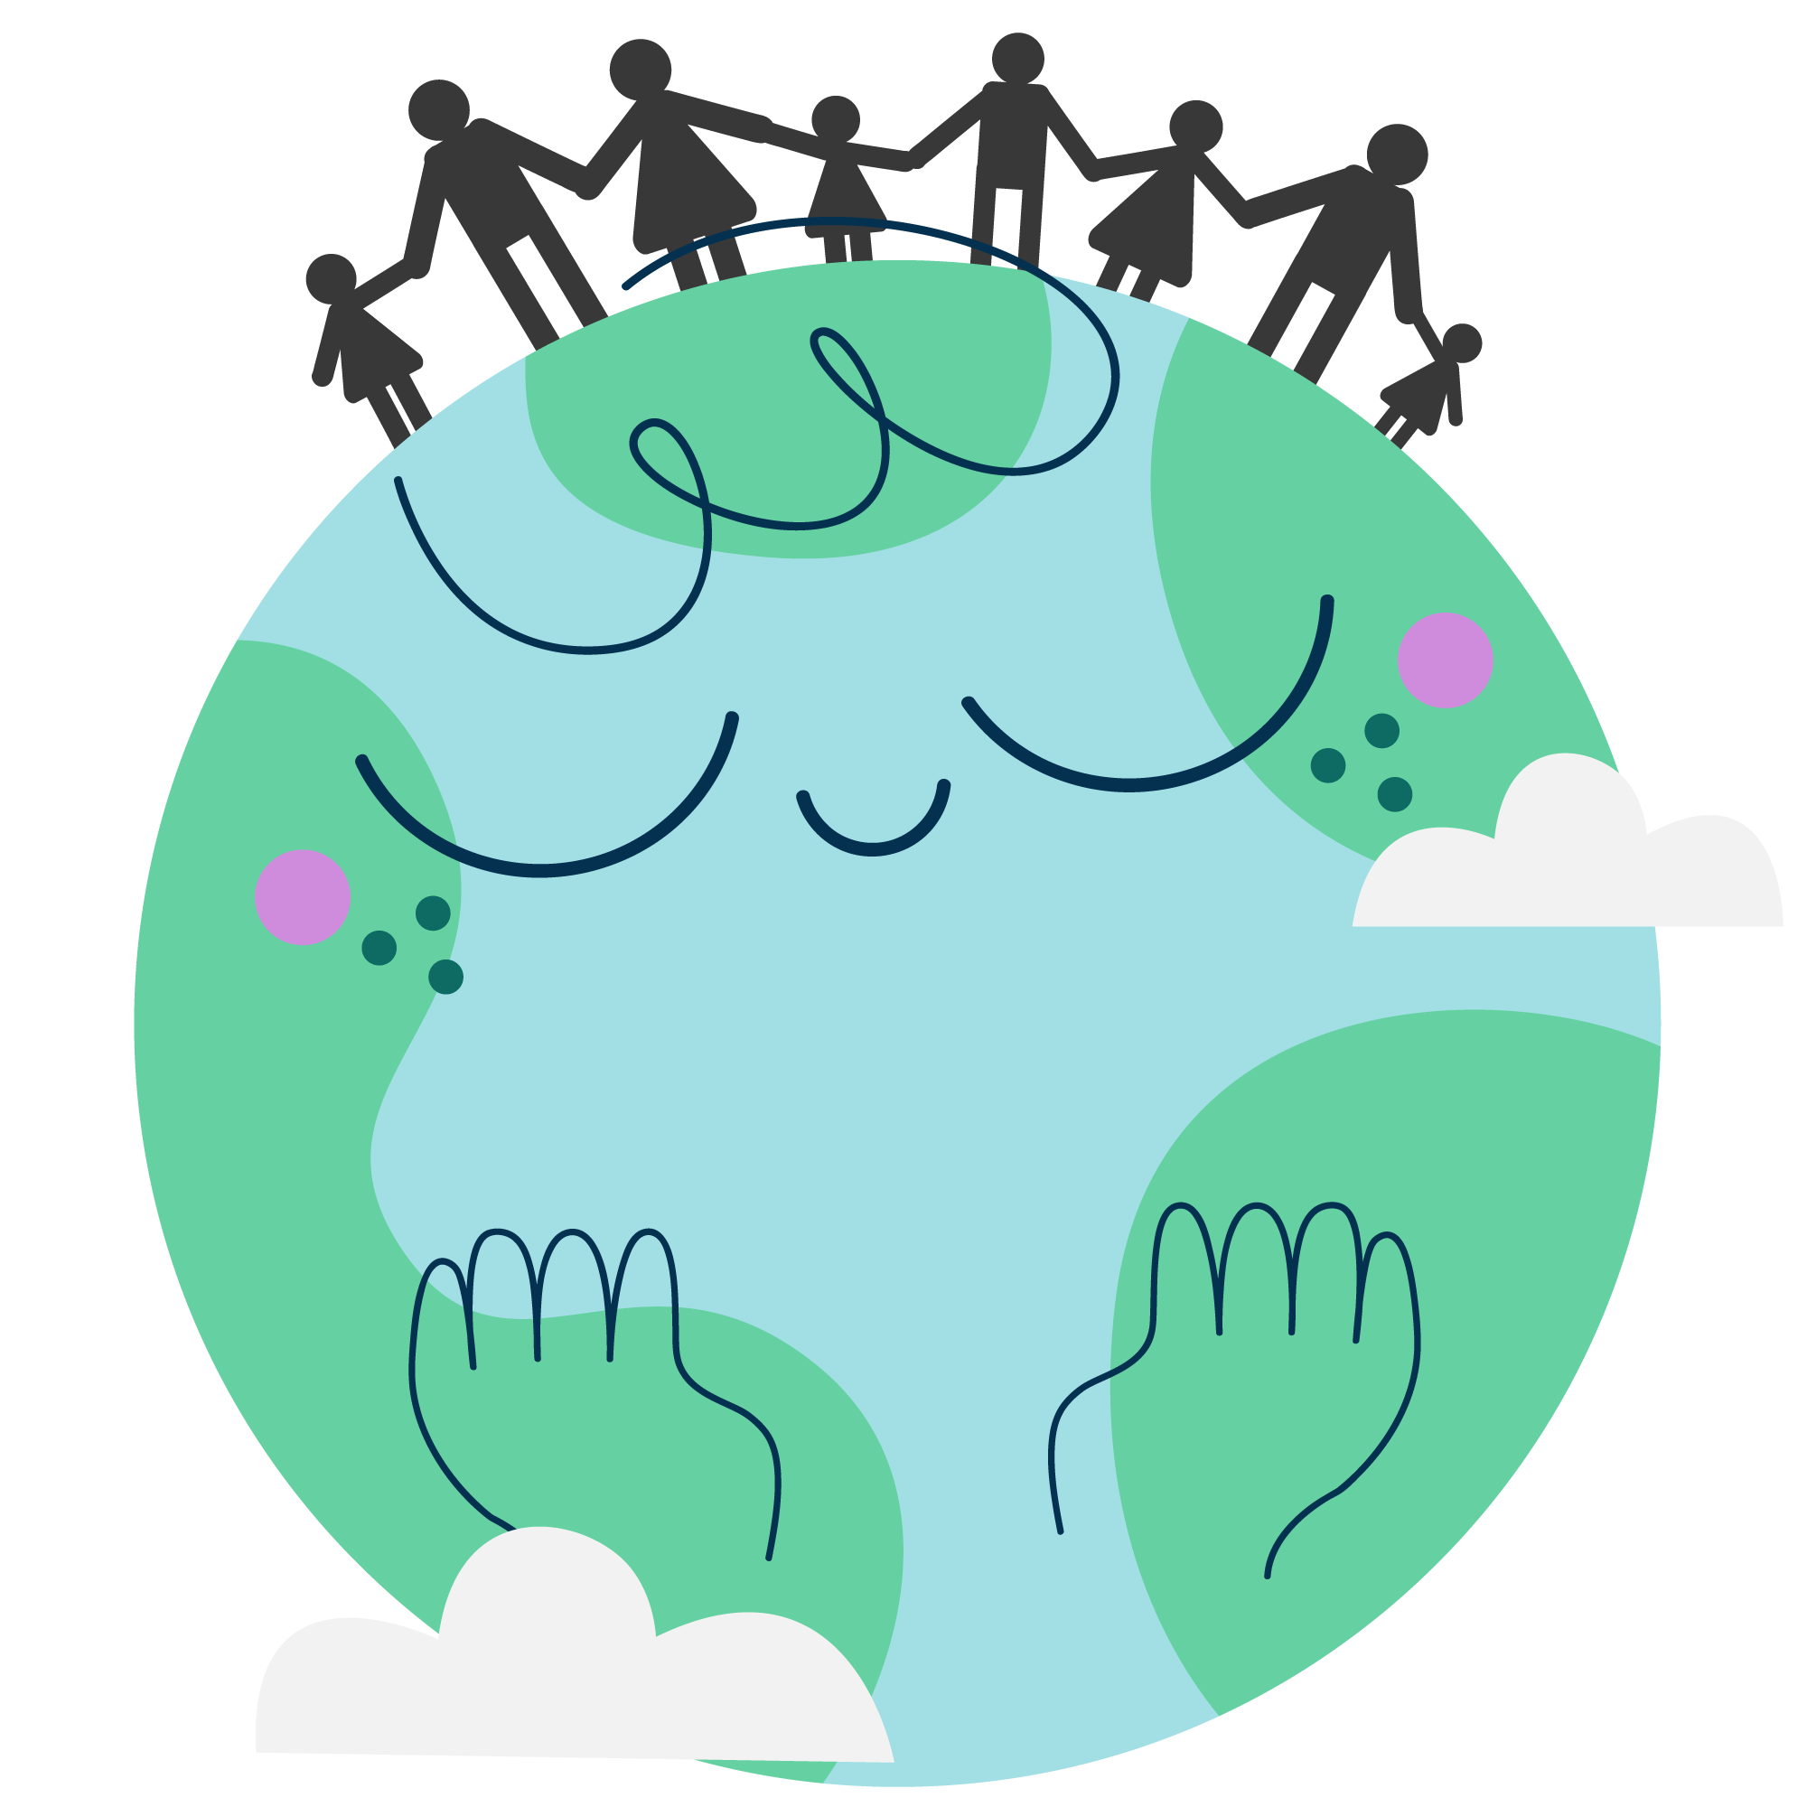
Global Health Programs & Policies
Objectives
Define “Policy” , “Health Policy”, “Global Health ” & “Global Health Governance”.
Identify the goals of health policy.
Describe the policy process.
Differentiate between health policies (Macro vs. Micro policy).
Discuss Global Health major players and challenges.
Discuss Sustainable Development Goals (SDGs).
Color Index
Main text
Males slides
Females slides
Doctor notes
Important
Golden notes
Extra
Editing File

Slide 2
Definitions
Policy
Policy is a law, regulation, procedure, administrative action, incentive, or voluntary practice of governments and other institutions.
Policy decisions are frequently reflected in resource allocations.
Health can be influenced by policies in many different sectors, for example:-
Transportation policies can encourage physical activity (pedestrian and bicycle friendly community design).
Policies in schools can improve nutritional content of school meals. ¹
1
2
Health Policy
Health policy refers to decisions, plans, and actions that are undertaken to achieve specific health care goals ² within a society.
3
Global Health ³
An area of study, research and practice that places a priority on improving health and achieving equity in health for all people worldwide.
Emphasizes transnational ⁴ health issues, determinants and solutions.
Inter and multi disciplinary collaboration within and beyond health sciences.
A synthesis of population based prevention and individual level clinical care.
4
Global Health Governance ⁵ (GHG)
The formal ⁶ and informal ⁷ institutions, norms and processes which govern or directly influence global health policy and outcomes.
1-Ministry of Education is responsible for such policies regarding nutrient content of school meals.
2- All policies must be attached to a goal.
3- Global health is a subspecialty of public health.
4- Transnational issues are issues that face many countries such as: COVID-19, poverty, environmental health.
5- حوكمة
6- Formal agencies are governmentally approved such as MOH, red crescents even the private sectors and non-profit agencies.
7- Non-formal agencies such as lobbies (Tobacco industries)

Slide 3
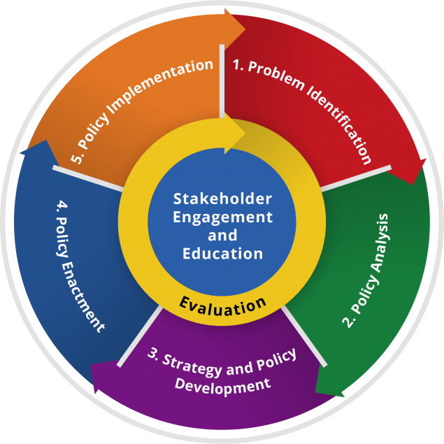
Goals of Health Policy
Why health policies are needed?
A health policy can achieve several things
It defines a vision for the future which in turn helps to establish targets and points of reference for the short and medium term.
It outlines priorities and the expected roles of different groups.
It builds consensus ¹ and informs people.
The Policy Process
Step 2
Step 1
Step 3
Step 4
Step 5
Identify the problem or the issue
through health indicators and trends
Policy Analysis:
2.1: identify and describe the policy options.
2.2: assess them.
2.3: prioritize them.
Develop a strategy
for furthering adoption of policy solution
Policy enactment ²
Policy implementation ³
Overarching activities: ⁴
1- Stakeholder engagement and education
2- Evaluation
Factors that affect policy decision making:
Economic factors. (limited resources)
Cultural/Religious factors. ⁵
Behavioral factors. (smoking, not wearing mask)
Physical environment. (walking area)
Availability of medical services.
Political situation. (Yemen cholera outbreak)
Technology advances. (distance learning)
Epidemiological structure
Disease distribution and disease prevention priorities.
Public health evidence.
1- اجماع
2- Policy enactment means passing laws and legislations.
3- Policy implementation means applying measures to implement the law.
4- Overarching activities are activities that must be initiated from the beginning and throughout the process.
For example: you should initiate a dialogue with stakeholders and policy makers from the beginning and tell them how’s the process going.
5- Religious factors such as what happened during COVID pandemic and the closing of Mosques. Another example is what happened during the eradication of polio, some countries (Pakistan) refused to take the vaccine believing its a fight against their religion.

Slide 4
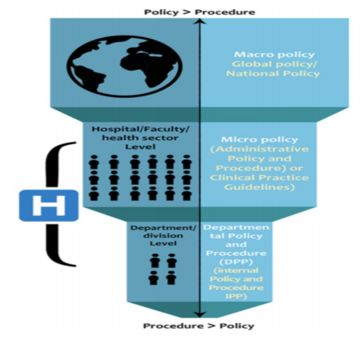
Macro- vs. Micro- Health Policy
Macro Policies ¹
VS
Micro Policies
Broad and expensive national policies that are developed at the national level.
Developed based on population-health needs.
Affects a large portion of the population (region or country).
Define the country's vision priorities, budgetary decisions, course of action to sustain health.
For example:
Ministry of health policies.
2030’s vision’s health transformation initiatives.
More specific to the level of organizations or individuals.
Based on the operational needs of the facility; which differ by organization (from hospital to another).
These policies affects:
Employees. - Operations.
Ethics. - Safety.
Research.
For example:
Hospital administrative policy and procedures.
Department/internal policy and procedures.
Clinical practice guidelines.
Inter relationship between micro- and macro- policies:
Micro- policies at organizations are developed in line with macro- policies put in place by the MOH.
The development and implementation of such policies require a multi disciplinary approach.
For example:-
Many ministries work together on development of some macro policies; MOH + MOMRA + MOE etc (HiAP).²
Different departments of the hospital collaborate for putting in place micro policies.
Ministry of Health
Hospital e.g. KKUH
Department
1- السياسات الصحية الكلية
2- Ministry of Health “MOH”, Ministry of Municipal and Rural Affairs “MOMRA”, Ministry of Education “MOE”, Health in All Policies “HiAP”.

Slide 5
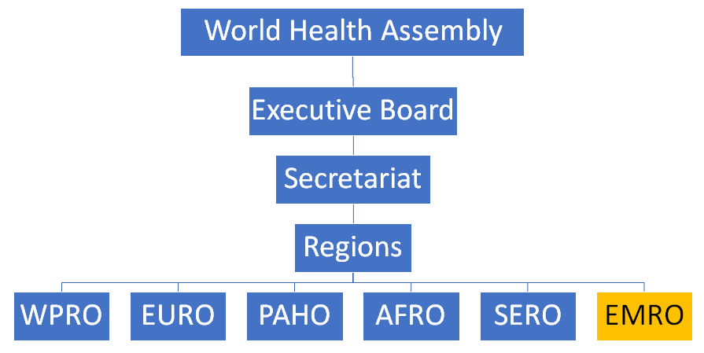
Global Health Players and Challenges
Global Health Major Players:
1
International Organizations
E.g. WHO, UNICEF ¹, World Bank
5
Philanthropies
E.g. Gates Foundation
2
Multilateral Entities
E.g. G8, G20
6
Global Public-Private Partnership
3
Multilateral Initiatives
E.g. GAVI (Global Alliance for Vaccines and Immunizations)
7
Private Sector Industries
E.g. Tobacco and oil industries
4
Bilateral Initiatives
E.g. PEPFAR (President's Emergency Plan for AIDS Relief)
8
Civil Society
World Health Organization:
WHO is a specialized non-political health agency of the United Nations with headquarters in Geneva
It is a unique institution since it has its own:
Constitution
Governing bodies
Membership
Budget
Its constitution came into force on the 7th of April, 1948 which day is celebrated every year as the “World Health Day” with a different theme every year focusing in a different public health issue.
There are two major policy developments that influenced WHO:
The Alma-Ata declaration of 1978 which identified primary health care as the key to the attainment of the goal of health for all
Global strategy for health for all in 2000, followed by MDGs ² and recently SDGs ³ 2030.
WHO scope of work ⁴:
Prevention and control of disease
Development of comprehensive health services
Family health
Environmental health
Health statistics ⁵
Health research (Biomedical)
Health literature and information
Coordination with other agencies
6
1- the UNICEF services roam around child health, child nutrition, family and child welfare and formal/non-formal eduction
2- MDG stands for “Millenium Development Goals” which focused on poverty, HIV/AIDS and providing universal primary education by the target date of 2015
3- SDG stands for “Sustainable Development Goals” with a target date of 2030
4- If you want to further read about the work of WHO from the book, click this link: shorturl.at/mqEWX
5- WHO is concerned with the dissemination of a wide variety of morbidity and mortality statistics relating to health problems.
6- EMRO stands for Eastern Mideterranian Regional Office

Slide 6
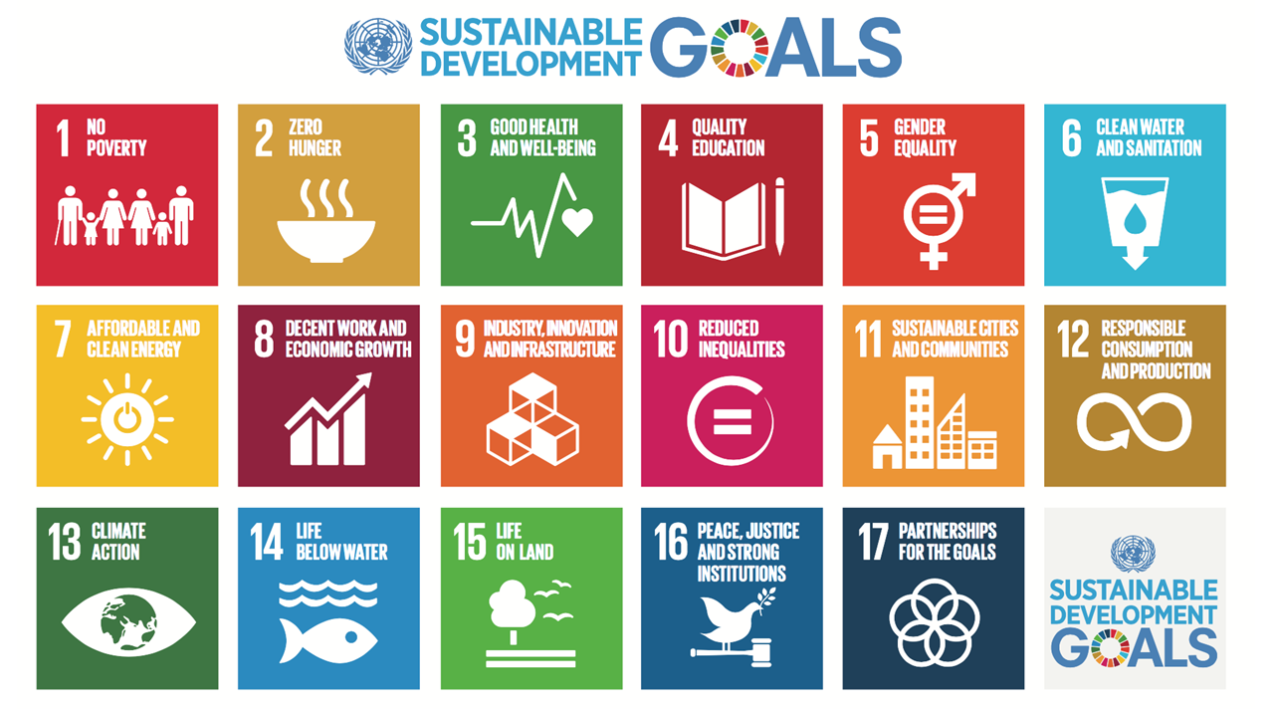
Global Health Players and Challenges
Impact of financial crisis and globalization ¹
Global Health Challenges
Multiple, diverse, emerging health threats
Failure in delivery & access to both existing and needed interventions
Disparities and inequities continue
Fragile health system unable to achieve SDG targets
Sustainable Development Goals^{2,3} (SDGs)
What is sustainable development?
Sustainable development has been defined as: development that meets the needs of the present without compromising the ability of future generations to meet their own needs.
1- The main challenge is that every country has its own health issues that differs from other countries and wants to prioritize them
2- أهداف التنمية المستدامة
3- The goals are highly related to all health indicators thus related to public health

Slide 7
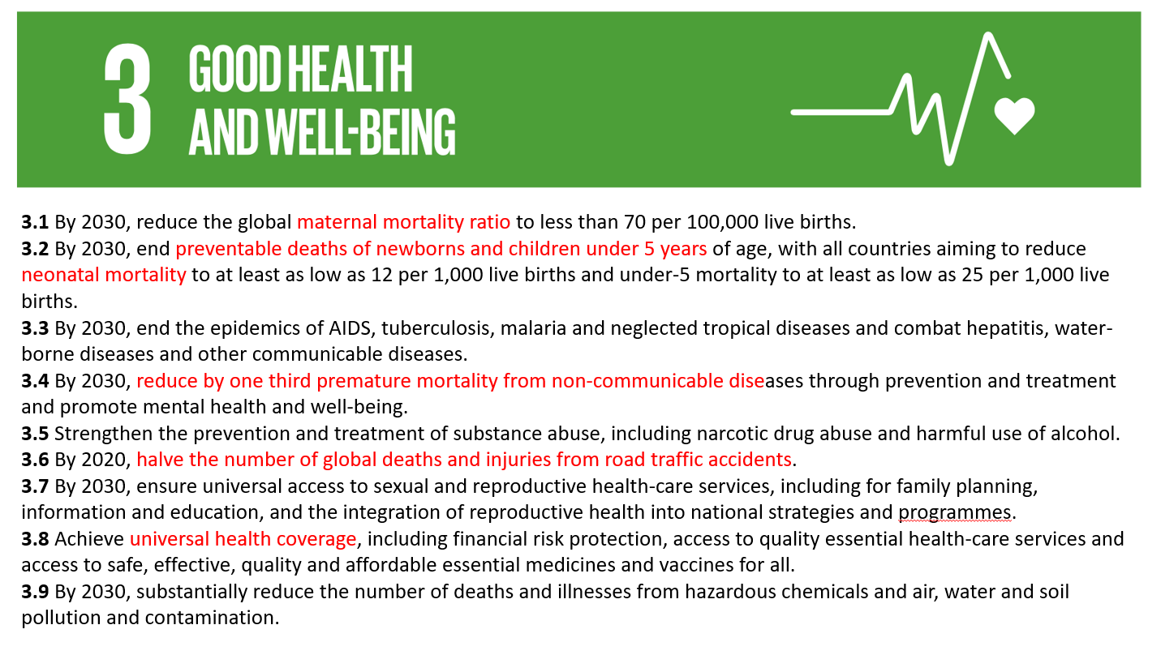
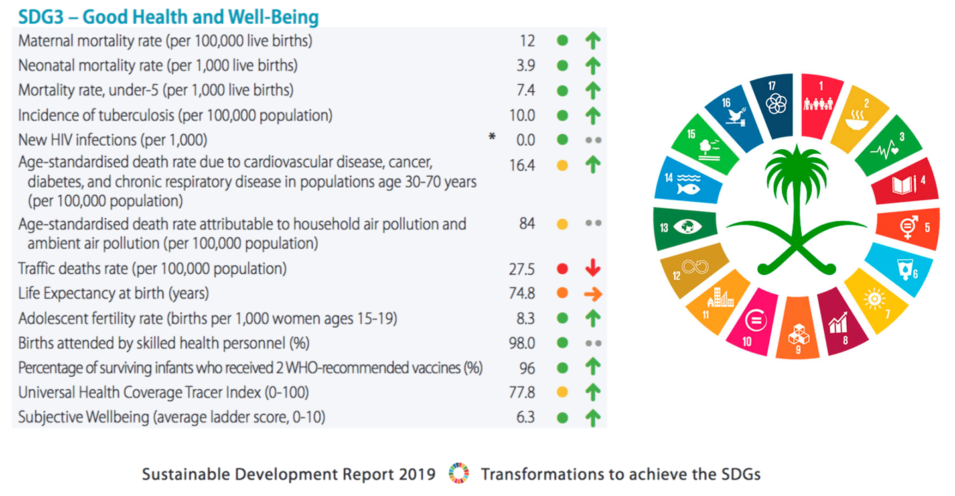
Sustainable Development Goals (SDGs)
What are the sustainable development goals?
193 countries of the United Nations agreed on a new document about a new sustainable development agenda called “Transforming Our World: The 2030 Agenda for Sustainable Development”.
It contained 17 goals and 169 targets.
This agenda focuses on the Millennium Development Goals (MDG), which were adopted in 2000 and helped guide development actions for the last 15 years. The MDGs proved that global goals can lift millions out of poverty
The UN summit for the adoption of SDGs was held from 25th → 27th of september 2015 in New York.
How are the SDGs different from the MDGs?
SDGs are broader in scope and will dig deeper by addressing the root causes of poverty and the universal need for development that work for all people.
These goals will cover the three dimensions of sustainable development:
Economic growth
Social inclusion
Environmental protection
SDGs are universal and apply to all countries, unlike MDGs which only apply to developing countries.
A core feature of the SDGs has been the means of implementation: the mobilization of financial resources, as well as capacity building and the transfer of environmentally sound technologies.
How will it be assessed?
It will be assessed by using a set of global indicators, complemented by indicators at the regional and national levels, which will be developed by Member States.
When are the SDGs expected to start and end?
It started on 1 January 2016 and is expected to finish by 31 December 2030.
Check footnote 1
Check footnote 2
1- These are the sub goals for goal number 3. Notice the words in red are the health indicators
2-This the report submitted by KSA to the WHO in 2019 regarding the SDGs. HIV and air pollution data are outdated although the kingdom has its own registries about them

Slide 8
Quiz
MCQ
1. It is a “decision, plan, or action that is undertaken to achieve a specific health care goals 2 within a society”. This definition defines which of the following terms
Policy
Health Policy
Global Health
Global Health Governance (GHG)
2. Which of the following in policy process making is applied during all steps of policy making?
Describing policy options
Assessing policy needs
Strategizing an adoption solution
Evaluating the process
3. Which of the following is a difference between SDGs and MDGs?
SDGs targets halving extreme poverty rates
MDGs targets universal application of decent work and economic development
SDGs cover multidimension disciplines and is applied universally
MDGs provided countries with the means of implementation
4. Which of the following SDGs targets health care development and various health indicators?
Clean water sanitation
No poverty
Climate action
Good health and wellbeing
5. What of the following types of policies is based on the operational needs of an organization?
Macro policy
Meso policy
Micro policy
Meta policy
Answers
Q1 | Q2 | Q3 | Q4 | Q5
B | D | C | D | C

Slide 9
Thank You and
Good Luck
Team Leaders:
Lama AlAssiri | Mohammed AlHuqbani | Ibrahim AlDakhil
Team Members:
Lama AlZamil
Leen AlMazroa
May Babaeer
Muneera AlKhorayef
Norah AlMazrou
Nouf Alhussaini
Rema AlMutawa
Sara AlAbdulkareem
Sedra Elsirawani
Wejdan Alnufaie
Abdulrahman Alhawas
Abdulrahman Shadid
Abdullah Aldawood
Abdullah Shadid
Alwaleed Alsaleh
Bader Alshehri
Bassam Alkhuwaiter
Faisal Alqifari
Hameed M. Humaid
Khalid Alkhani
Meshari Alzeer
Mohannad Makkawi
Nayef Alsaber
Omar Aldosari
Omar Alghadir
Zyad Aldosari

