Slide 1
National Health
Policies & Programs
Objectives
Describe the national health transformation under vision 2030
Discuss the National Health Sector Transformation, including needs, goals, and themes.
Discuss the New Models of Care Program including systems, levels of care, and enablers.
Define Health in All Policies (HiAP)
State an example of integrating HiAP into national health policy
Color Index
Main text
Males slides
Females slides
Doctor notes
Important
Golden notes
Extra
Editing File

Slide 2
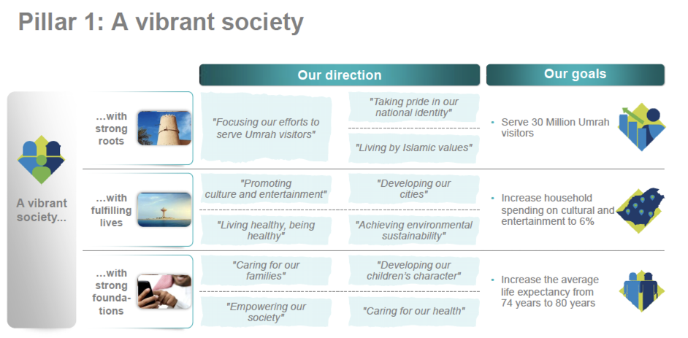
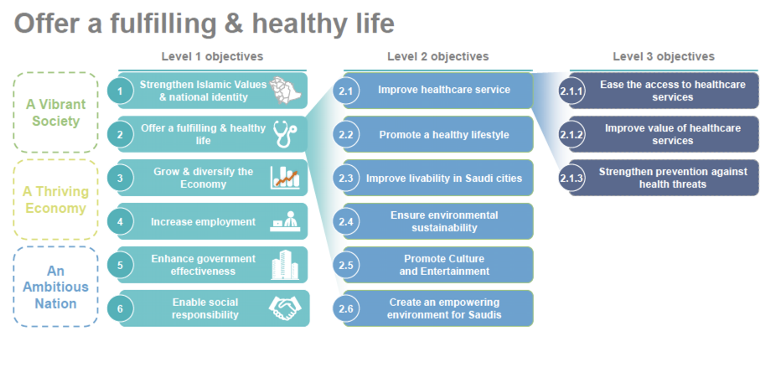
Health under vision 2030
The Kingdom will achieve its “Vision 2030” objectives through three main pillars:
1
2,3
4
1-Life expectancy is an indicator of how well is the population
2-how do we achieve fulfilling healthy life? By Level 2 objectives
3-Improving healthcare services is very important and we achieve it by Level 3 objectives, The rest of level 2 are determinants of health.
4-Why do we have different objectives to offer a fulfilling healthy life? To give it a specific meaning from different aspects for the IMPLEMENTATION.

Slide 3
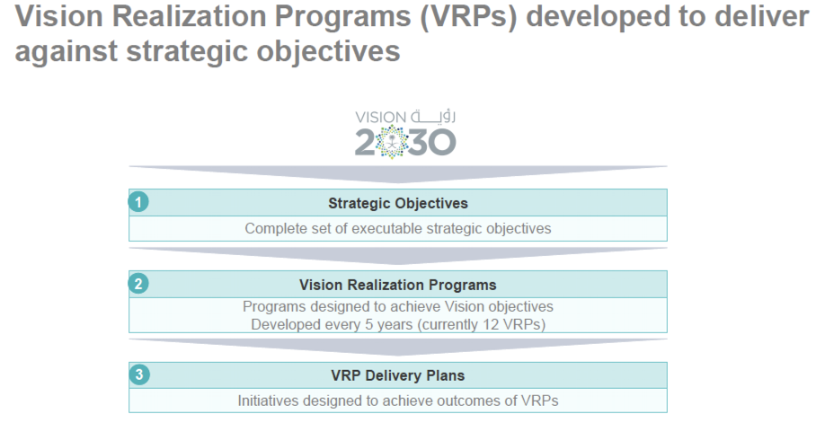
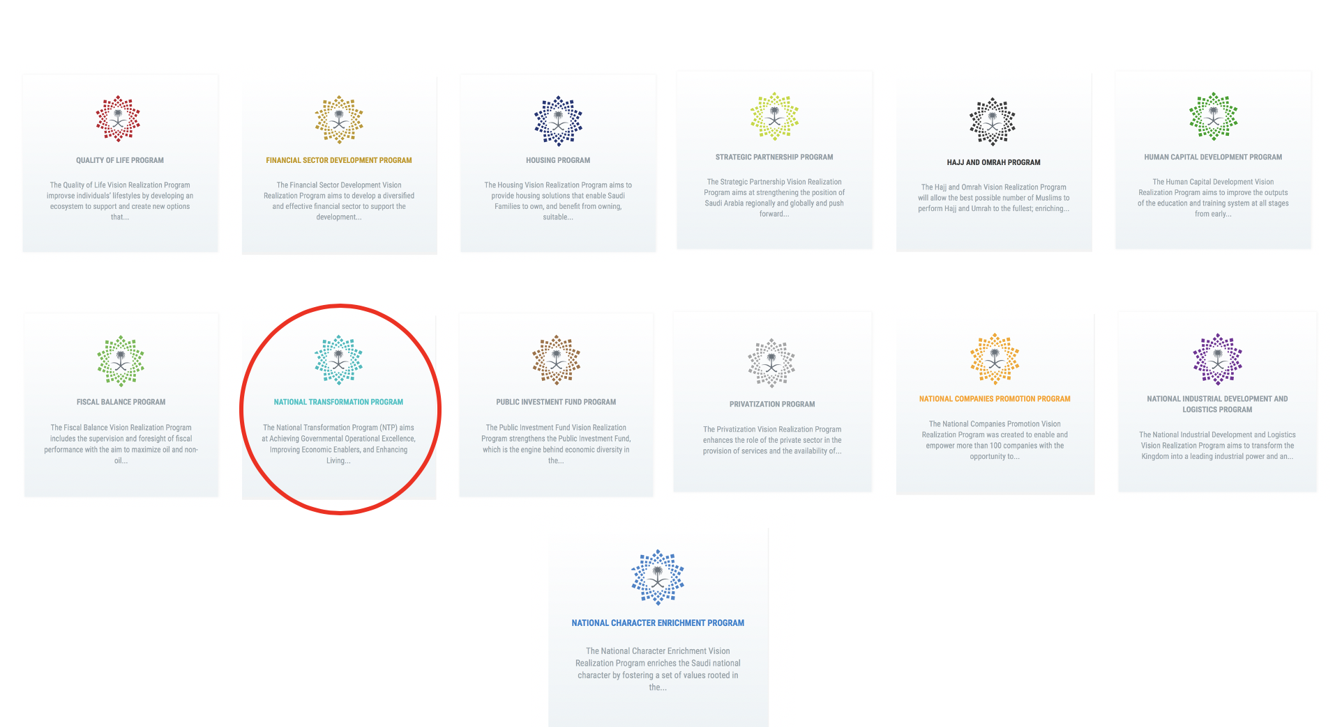
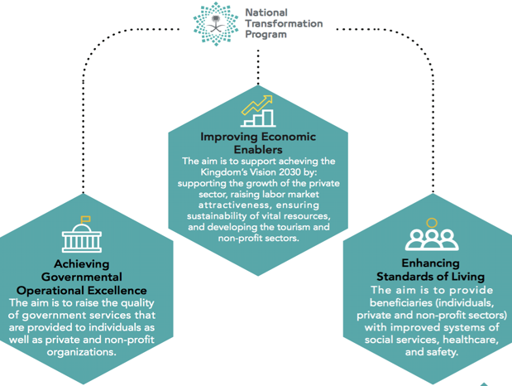
Health under vision 2030
1
2
Click to go to the vision 2030 website
Aims of the National Transformation program
1-These programs are the vehicle to achieve and implement the objectives not only by the ministry of health but as an entity of different sectors.
2-Quality of life program is more related to life determinants other than healthcare

Slide 4
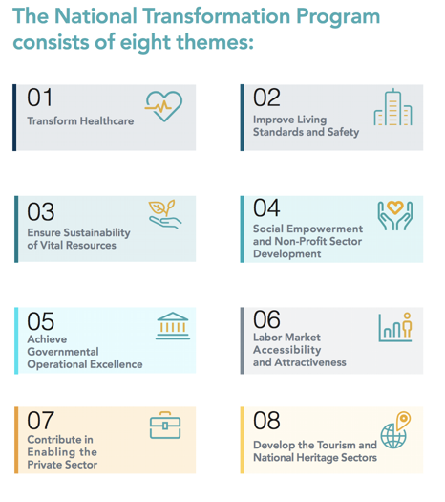
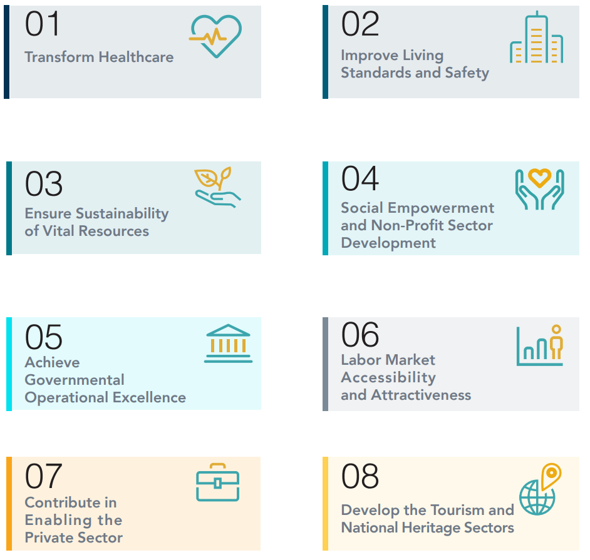
Health under vision 2030
The First Theme (Transform Healthcare) in the NTP seeks to achieve a vibrant society by restructuring the health sector to become a comprehensive and effective system.
1
Limited quality and inefficient health services
Difficult access to health services
3 Major Challenges
01
3
2
Limited preventive healthcare

Slide 5
Health under vision 2030
Main entities involved in Transforming Healthcare
1
Ministry of Health
2
Saudi Council Health
3
Saudi Food and Drug Authority
4
The Saudi Red Crescent Authority
5
Ministry of Education¹
6
King Faisal Specialist Hospital and Research Center
Three strategic objectives to transform healthcare under Vision 2030:
1
Ease Access to Health Services
3
Promote Prevention Against Health Risks
expansion of total capacity (number of beds and medical staff)
adequate geographical distribution (distance from healthcare provider)
timely and affordable access to related healthcare services
promoting public health and preventive healthcare (such as awareness and vaccination) to minimize the risks associated with health crises and diseases of communicable diseases, non-communicable diseases, and injuries
2
Improve Quality and Efficiency of Healthcare Services:
improvement of the quality and efficiency of the healthcare services
Improvement of the safety of the healthcare facilities
ensuring adequate healthcare coverage with financial sustainability
1-Ministry of Education is responsible for the Human Capital that is needed in the healthcare sector, (Human Factor is very important)

Slide 6
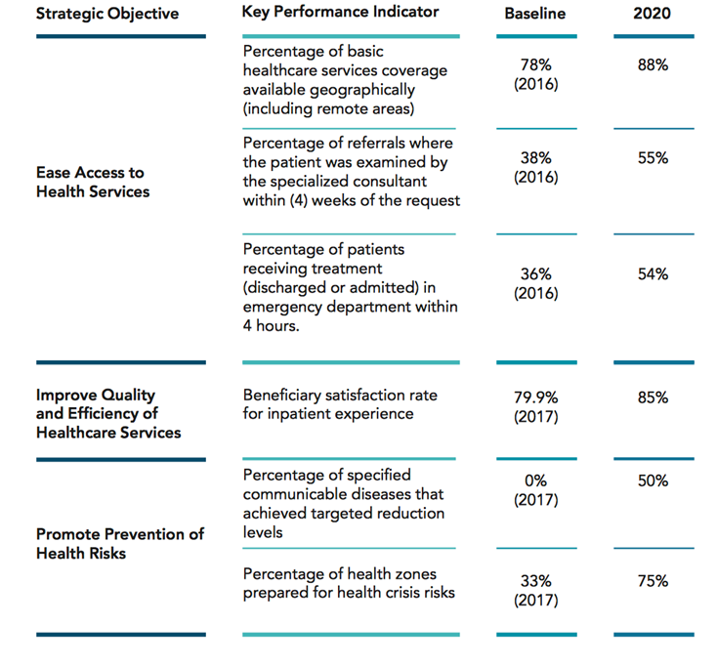
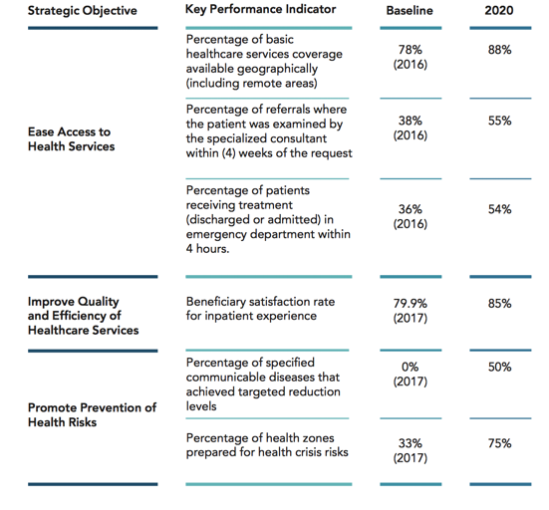
Health under vision 2030
National Health Sector Transformation
التحول في القطاع الصحي
Health Transformation (First Theme of NTP) Major Indicators
The Need for Transformation: Why do we want to change?
The population of the Kingdom continues to grow and age.
Rates of avoidable injury and non-communicable disease remain high by regional and international standards.
Primary care remains inadequate and inconsistent. Secondary and tertiary hospitals, and associated resources, are poorly distributed across the Kingdom.
There are significant gaps in the quality of services provided to patients
There is unwarranted variation in provision, access and investment when assessed using the population served rather than the patients treated
The system is currently resource and staff centric rather than patient or person centric in its orientation
There are significant gaps in workforce capacity and capability, specifically in relation to Saudi employees.
The health system also needs to support the containment of public expenditure, and the diversification of the Saudi economy.

Slide 7
National Health Sector Transformation
التحول في القطاع الصحي
Defining the Transformation Goals and Methods: What do we want to change?
All three transformation goals conform with, and are enablers of, the Vision 2030 strategic objectives for health: access, quality and public health
Transformation Goals
1
Improve health
2
Improve healthcare
Improve value
3
by containing costs, improving outcomes, controlling public healthcare expenditure and guiding new investment
Increase the length, wellbeing and quality of life of Saudi citizens, which includes the Vision 2030 goal of increasing the life expectancy of citizens to 80 years by 2030
By improving the quality and consistency of services and the performance and accountability of healthcare organizations and staff to deliver care that is safe, effective, patient-centered, timely and equitable
4
To achieve the previous transformation goals, The Vision Realization Office (VRO) at MOH has organized its work into seven themes (seven programs)
The New Models of Care التحول المؤسسي ونموذج الرعاية الصحية
Governance development الحوكمة
eHealth development الصحة الالكترونية
Provider reforms التجمعات الصحية
Workforce development القوى العاملة
Financing reforms برنامج الضمان الصحي وشراء الخدمات الصحية
Private and third sector participation مشاركة القطاع الخاص والقطاع الثالث

Slide 8
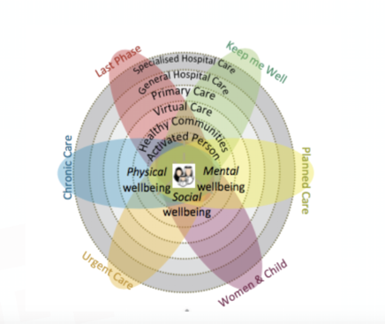
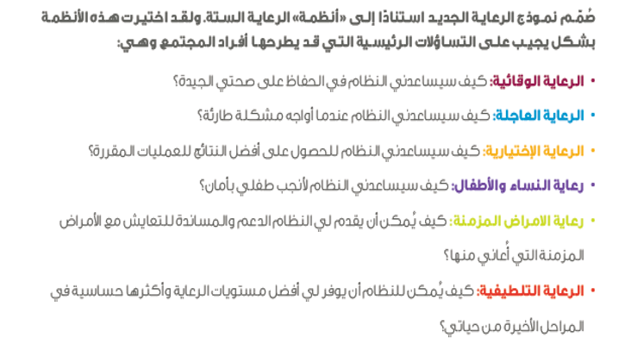
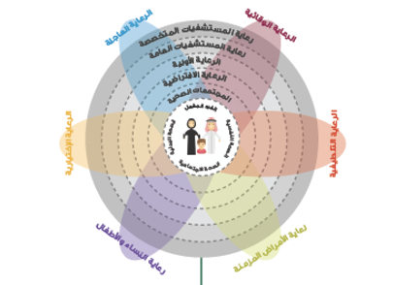
New Models of Care Program
التحول المؤسسي ونموذج الرعایة الصحیة
Challenges with the Existing Models of Care:
Growing hazards within healthcare facilities due to inadequate medical quality and low safety standards
Waiting times are prolonged and they vary considerably across healthcare facilities, causing inevitable dissatisfaction
Shortage of medications and available medicines are dispensed inconsistently
Lack of standardized clinical guidelines and variations in the quality and delivery of care
Poor pathway management (مسار الرعاية), with inappropriate referrals, and inappropriate presentation by ill-informed patients disrupting patient flow
Lack of out-of-hospital services for diagnostic, preventative, proactive or follow-up care
Poorly coordinated care, particularly between MoH providers and non-governmental organization
Poor communication between providers, and between clinicians and patients
To address these challenges, MoH has developed a program to design, pilot, and implement a patient centric New Models of Care Program
Systems of Care
The program has been designed to answer six key questions:
1. How will the system help to keep me well? (preventive care)
2. How will the system support me when I have an urgent problem? (urgent care)
3. How will the system support me to have a great outcome for my planned procedure? (planned care)
4. How will the system support me to safely deliver a healthy baby? (women & child)
5. How will the system support me with my chronic conditions? (chronic care)
6. How will the system support me with compassionate care during the last phase of
my life? (palliative care; last phase)

Slide 9
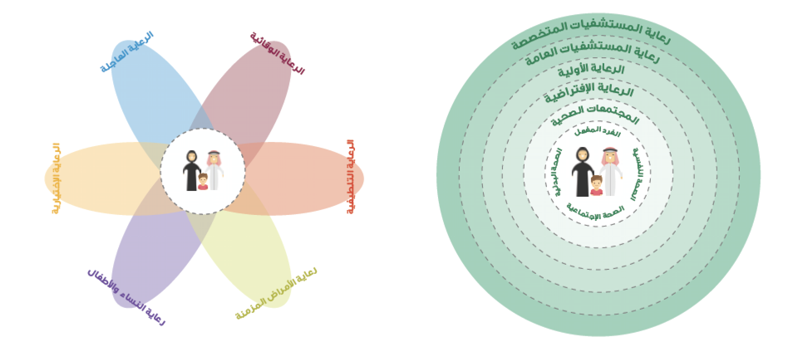
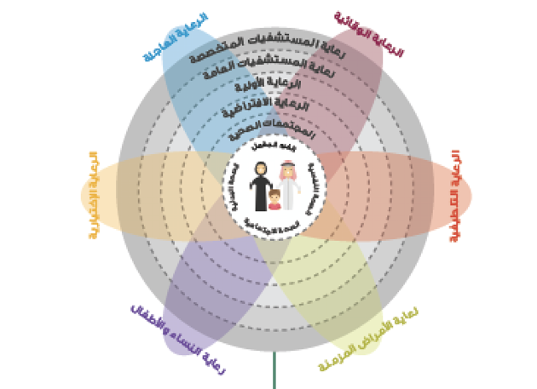
New Models of Care Program
التحول المؤسسي ونموذج الرعایة الصحیة
The New Models of Care program is designed to support people with their health and wellness needs: physical wellbeing, mental wellbeing and social well being.
This aligns with the principles set out in the Constitution of the World Health Organization: “health is a state of complete physical, mental and social well being and not merely the absence of disease or infirmity”.
Levels of Care in the New Models of Care Program:
1- Activated Person
2- Healthy Communities:
Active individuals are at the heart of the model by enabling them and their families to maintain their health, through self-care services, and health education.
The second level emphasizes the role of healthy communities in supporting active individuals By encouraging them to adopt a healthy lifestyle, providing them with appropriate information, and empowering them to access to community health facilities.
3- Virtual Care
Virtual care will be a powerful source of health advice. Virtual care in most instances will serve as people’s first point of contact with medical care providers, improving people’s access to medical advice and guiding them to navigate the healthcare system and seek appropriate care.
4- .Primary Care
5- Secondary Care (general hospital care).
6- Tertiary Care (specialized hospital care).

Slide 10
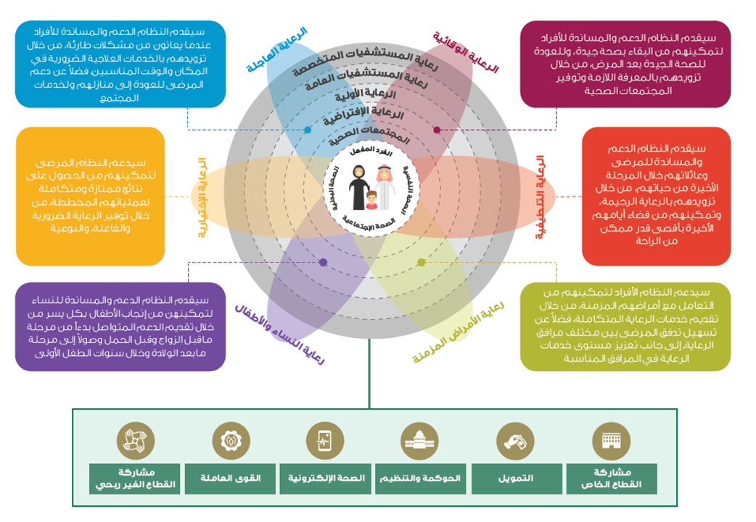
New Models of Care Program
التحول المؤسسي ونموذج الرعایة الصحیة
The New Models of Care program has been designed based on the following FIVE principles:
1
Empowering people and their families to take control of their health
2
Providing knowledge to people as part of their treatment, and enabling them to be well-informed and in control of their health
3
4
Keeping people healthy and focusing on the whole population through a preventive approach, rather than a solely curative approach to health provision
Fully integrating the health system from the people’s perspective
5
Providing treatment in a patient-friendly and outcome-focused way, without overtreating or under-treating patients.
The New Models of Care Program will deliver 42 coordinated interventions (i.e. initiatives), across six ‘systems’ of care by the end of 2020.
The 42 initiatives will include defined patient pathways and key performance indicators (KPIs) including measurement of: safety and quality process metrics, clinical and patient reported outcomes, and financial performance.
The Enablers of New Model of Care program
Private Sector Participation
eHealth
Financing
Workforce
Governance & Regulations
Non-profit Sector Participation

Slide 11
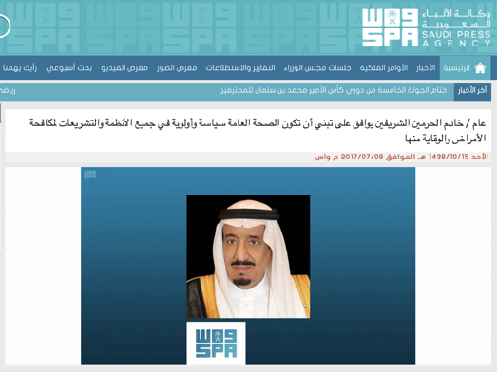
Health in all policies (HiAP) in national health policy
Health in All Policies (HiAP)
HiAP is an approach to public policies across sectors that systematically takes into account the health implications of decisions, seeks synergies, and avoids harmful health impacts in order to improve population health and health equity.
As a concept, it reflects the principles of: legitimacy, accountability, transparency and access to information, participation, sustainability, and collaboration across sectors and levels of government.
Announced at the 8th Global Conference on Health Promotion, Helsinki, Finland, 10-14 June 2013
1
2
3
“We call on governments:
Commit to health and health equity as a political priority by adopting the principles of Health in All Policies and taking action on the social determinants of health.
Ensure effective structures, processes and resources that enable implementation of the Health in All Policies approach across governments at all levels and between governments.
Strengthen the capacity of Ministries of Health to engage other sectors of government through leadership, partnership, advocacy and mediation to achieve improved health outcomes.
Build institutional capacity and skills that enable the implementation of Health in All Policies and provide evidence on the determinants of health and inequity and on effective responses.
Adopt transparent audit and accountability mechanisms for health and equity impacts that build trust across government and between governments and their people.
Establish conflict of interest measures that include effective safeguards to protect policies from distortion by commercial and vested interests and influence.
Include communities, social movements and civil society in the development, implementation and monitoring of Health in All Policies, building health literacy in the population”
In 2017, An approval was granted by Custodian of the Two Holy Mosques King Salman for Public health to be adopted as a policy and priority in all regulations and legislations for preventing diseases.
A ministerial committee was formed for Health in All Policies in Saudi Arabia with ministerial membership (Health, Education, Commerce, MOMRA, and others)

Slide 12
Summary
Health under vision 2030:
Limited quality and inefficient health services
Ease Access to Health Services
Major Challenges
Limited preventive healthcare
The objectives
Promote Prevention Against Health Risks
Limited preventive Difficult access to health services
Improve Quality and Efficiency of Healthcare Services
Improve health
Transformation goals
Improve healthcare
Improve value
The New Model of Health:
System of Care:
Preventive care
Urgent care
Planned care
Women & Child care
Chronic care
Palliative care
Levels of Care:
Activated Person
Healthy Communities
Virtual Care
Primary Care
Secondary Care (general hospital care)
Tertiary Care (specialized hospital care)
The Five Principles:
Empowering people and their families to take control of their health
Providing knowledge to people as part of their treatment, and enabling them to be well-informed and in control of their health
Fully integrating the health system
Keeping people healthy and focusing on the whole population through a preventive approach, rather than a solely curative
Providing treatment in a patient-friendly and outcome-focused way
Health in all policies (HiAP):
Is an approach to public policies across sectors that systematically takes into account the health implications of decisions, seeks synergies, and avoids harmful health impacts in order to improve population health and health equity.

Slide 13
Quiz
MCQ
1-The new model of care program has been designed to answer Six key questions. Which of the following answer “How will the system help to keep me well”?
A-preventive care. B-chronic care. C-planned care D- Urgent care
2-main entities involved in Transforming Healthcare:
A- Ministry of Health B-Saudi Health Council.
C-Saudi Food and Drug Authority. D-all of above
3-Which of the following Levels of Care active individuals are at the heart of the model by enabling them and their families to maintain their health, through self-care services, and health education?:
A- Healthy community. B-Virtual care
C-Primary care. D-Activated Person
4-containing costs,improving outcomes, controlling public healthcare expenditure and guiding new investment is?
A-Improve value. B-Improve health care. C-Improve health.
5- Which of the following health pillars are under Vision 2030?
A-Strengthen islamic values. B-Vibrant society.
C-Offering a fulfilling and healthy life. D- Promote a healthy lifestyle
Answers
Q1 | Q2 | Q3 | Q4 | Q5
A | D | D | A | B

Slide 14
Thank You and
Good Luck
Team Leaders:
Lama AlAssiri | Mohammed AlHuqbani | Ibrahim AlDakhil
Team Members:
Lama AlZamil
Leen AlMazroa
May Babaeer
Muneera AlKhorayef
Norah AlMazrou
Nouf Alhussaini
Rema AlMutawa
Sara AlAbdulkareem
Sedra Elsirawani
Wejdan Alnufaie
Abdulrahman Alhawas
Abdulrahman Shadid
Abdullah Aldawood
Abdullah Shadid
Alwaleed Alsaleh
Bader Alshehri
Bassam Alkhuwaiter
Faisal Alqifari
Hameed M. Humaid
Khalid Alkhani
Meshari Alzeer
Mohannad Makkawi
Nayef Alsaber
Omar Aldosari
Omar Alghadir
Zyad Aldosari

