Slide 1
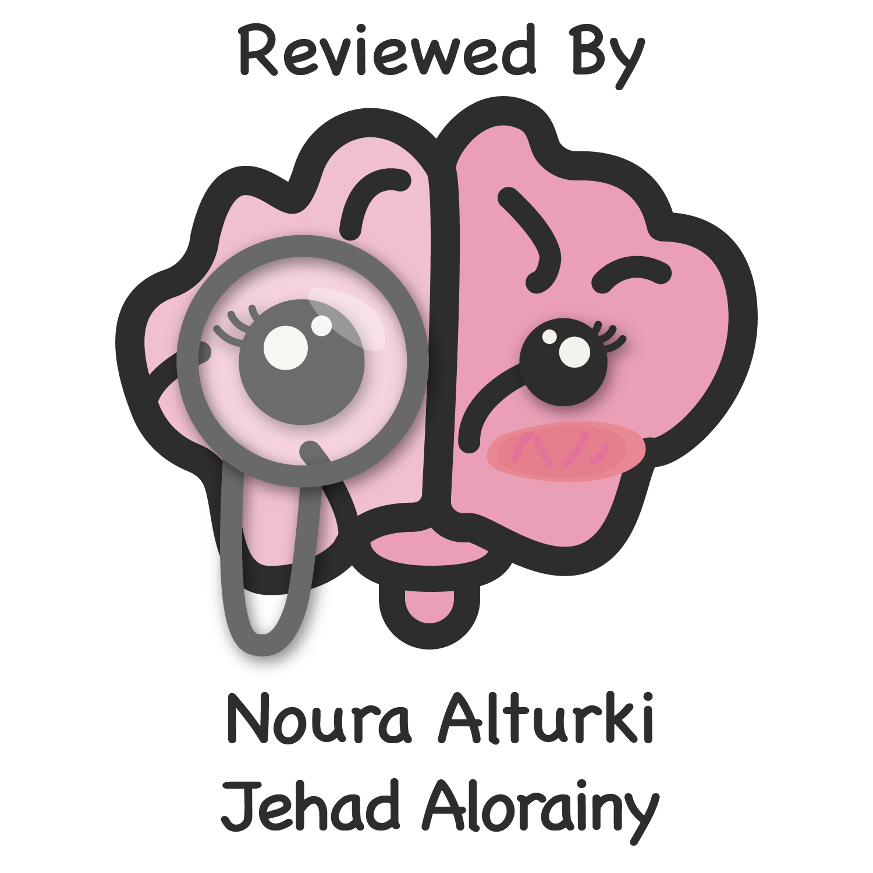
Health Education
and Promotion
Objectives
Define "health education" and state its aims.
Explain the role of health education in relation to the stage of disease prevention.
Identify the factors that influence human behavior.
Discuss the factors that contribute to behavior change.
Define learning and identify the domains of learning.
Outline the Health Belief Model of behavior change Describe the trans-theoretical model of stages of motivation.
List the direct and indirect methods of communicating health messages.
State the strength and limitation of each method of communicating health messages.
State the types and values of audiovisual aids in facilitating the transfer of health message.
Color Index
Main text
Males slides
Females slides
Doctor notes
Important
Golden notes
Extra
Editing File

Slide 2
Health Education
Health Education is defined as:
"designed combination of learning methods to facilitate voluntary adaptation of behavior conductive to health".
Aims of Health Education:
Make people value their own health
Understand and practice healthy habits
Take the initiative to attain and keep positive health ¹
Interrupt a behavioral pattern that heightened the risk of disease, injury, disability or death ²
Utilize the available health services
Health Education & Prevention:
LEVEL OF PREVENTION | GOAL OF HEALTH EDUCATION
Primordial prevention ³ | Promote health by reinforcing healthy practices ⁴
Primary prevention ⁵ | Prevent ill-health, maintain the highest level of health & improve the quality of life
Secondary prevention ⁶ | Understand health behavior underlying the ailments and means of behavioral changes to prevent further deterioration of health or restoration of health
Tertiary prevention ⁷ | Make the most of the remaining potential for healthy living
1: Make them have the desire to maintain positive health.
2: Replacing bad behavior to good behavior.
3: Preventing the development of risk factors in healthy individuals.
4: Exercising, sleeping and eating well.
5: Preventing the development of disease in individuals with risk factors.
6: In individuals who already have the disease and preventing it from getting worse.
7: In individuals who are already affected by the disease and improving their quality of life.

Slide 3
Behavior & Health Problem
Underlying Cause of a Health Problem
NON BEHAVIOR
HEALTH EDUCATION
BEHAVIOR ^{1,2,3}
HEALTH EDUCATION ⁴
Genetic susceptibility, family history, etc..
Factors Influencing Human Behaviour
CULTURE ⁵
RESOURCES ⁶
THOUGHTS & FEELINGS
INFLUENCE OF OTHER PEOPLE ⁷
^{For ex.: In a kidney disease}
Sum of beliefs and values shaping the behaviour of
a community
• Availability of dialysis
• Accessibility of transportation
• Affordability to pay
• Acceptability
• Knowledge
• Beliefs
• Attitudes
• Values
• Leaders
• Elders
• Friends
LEGISLATION ⁸
EDUCATION
(Empowering people)
RESOURCES
(Utilization)
Changing Human Behavior
1: Behavior is crucial in managing health problems.
2: Aspects of behavioral change are always needed regardless of the disease.
3: 75% of all global burden of disease is a combination of metabolic and behavior. Behavior is 40% of that.
4: To change and adopt better behaviors in life.
5: It’s hard to convince some people in consuming less dates or honey, because it’s part of their culture.
6: It’s called bottleneck analysis (BNA).
7: Peer pressure is very important and crucial in changing people’s behavior.
8: For ex. violation fines of preventive measures and curfew during the Covid-19 pandemic.

Slide 4
Learning
Learning
Know
Feel
Do
"Change of behavior brought about by experience ¹, insight, perception or a combination of the three, which causes the individual to approach future situation differently"
Knowledge
Cognitive domain ²
Psychomotor domain
Skills
Attitudes Belief
Affective domain
1
Learning is an active process
2
Learning is
stimulated by
a need
3
Learning is
demonstrated
by a change in
behavior
1: Happened to them once or to any of their relatives.
2: Cognitive domain is connected to the cortical function (higher function).

Slide 5
Teaching
Giving information
Teaching enable learning
1
Clarify thinking
TEACHING ACTIVITIES
2
Identifying options
INFORMAL ¹
VS
FORMAL ²
3
NOT PLANNED
PLANNED
4
Develop new skills
1
Knowledge: An intellectual acquaintance with facts, truth, or principles gained by sight, experience, or report.
2
Value: Ideas, ideals, customs that arouse an emotional response for or against a thing or a behavior.
3
Beliefs: Acceptance of or confidence in an alleged fact or body of facts as true or right without positive knowledge or proof; perceived truth.
4
Attitudes: Manner, disposition, feeling, or position toward a person or thing.
VARIABLES IN THE BEHAVIOR CHANGE
5
Perceptions: Ascribing meanings to sensory or cortical activity in such a way that the activity comes to acquire symbolic function
6
Skills: The ability to do something well, arising from talent, training, or practice.
7
Self-efficacy: The internal condition of experiencing competence to perform desired tasks which will influence the eventual outcome.
1: For example teaching your sibling.
2: Teaching in a planned formal way, in a lecture hall with a time slot for an audience.

Slide 6
The Health Belief Model for Behavior Change
The model postulates
Health behavior of all kind is related to a general health belief that one is susceptible to a health problem (Perceived susceptibility ¹)
Health problems have undesirable consequences (Perceived seriousness or severity ²)
Health problems and their consequences are preventable.³
If health problems are to be overcome, barriers have to be overcome
Phases of the health belief model
perceptions
Modifying factors
Likelihood of action
Demographic variables (age, level of education) & Socio-psychological variables (personality, self-esteem, peer pressure) & Structural variable (knowledge, or experience of a health problem)
Perceptions of susceptibility
Perception of severity or seriousness ⁴
Perceived benefits Minus Perceived barriers ⁵
Perceived threat of the disease
Likelihood of taking recommended preventive action
Cues to action (mass media campaign, reminder from a physician, illness of a friend)
1: A prediabetic has their own perception of developing diabetes.
2: An individual’s own perception of how serious the disease is and how it will change their life (its consequences).
3: The cost of preventing it is less than treating it “درهم وقاية خير من قنطار علاج”.
4: The combination of these two is the perceived threat of any disease.
5: Perceived benefits should be higher than the barriers.

Slide 7
The Health Belief Model for Behavior Change
Predisposing, enabling and reinforcing factors in the education process
1
Predisposing Factors
Characteristics of a person or population that motivate a behavior change
Predisposing factors are knowledge, beliefs, values and attitudes
2
Enabling Factors
Characteristics of the environment and individuals that facilitate action to attain a specific behavior
Enabling factors are health services (available, accessible, affordable), skills and legislations
3
Reinforcing Factors
It determines the continuity (maintenance) of the new behavior
Reinforcing factors are rewards (experienced or anticipated) of the new behavior
Maintaining a health-risky behavior
03
1
03
Lack of knowledge of the health risk
Modified perception of risk
2
3
01
REASONS
2
3
01
01
Low self efficacy to change

Slide 8
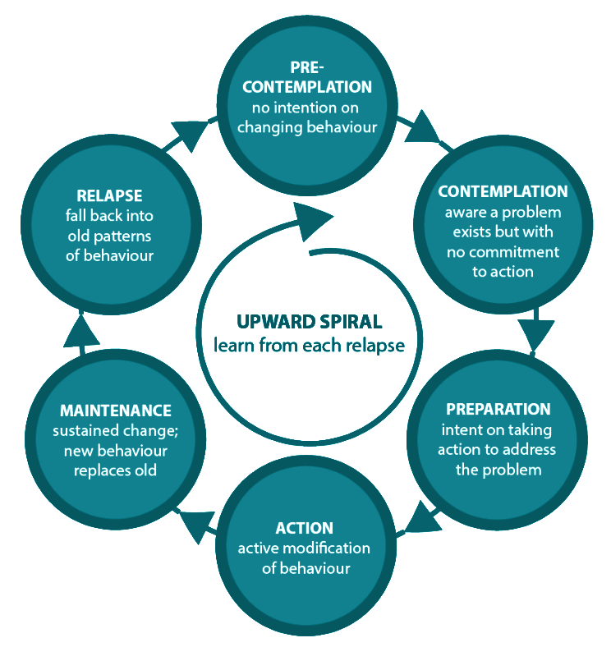
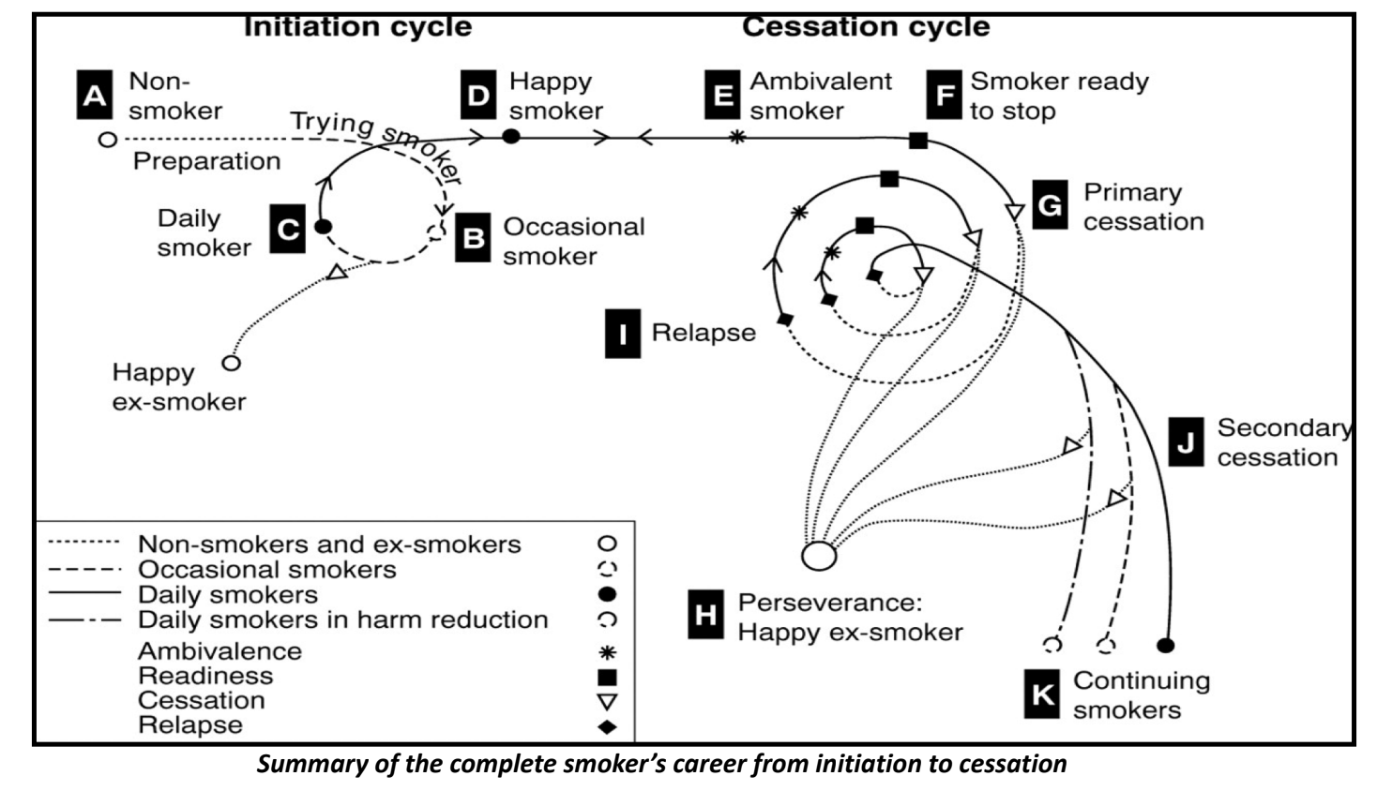
Transtheoretical Model: Stages of Motivation
Stages related to individual's motivation
(The Transtheoretical Model should be viewed as cyclic rather than a straight line)
Pre-contemplation
No interest or consideration for behavior change (denial, ignorance, demoralization)
Contemplation
Thinking about making a change
Preparation
Person's imagining himself with different behavior
Action
Making specific changes
Maintenance
New behavior becomes a life-long pattern.

Slide 9
Methods of Health Education
1
Direct Methods (Face to Face)
Individual ¹
Group
communities
2
Indirect Methods (Mass Media)
Direct Method in Community
(COMMUNITY ORGANIZATION)
Problem addressed:
Affect almost all members
Emergencies/ disease outbreak
Needs pooling of resources
Community organization:
Method of health education, which depends on the leaders’ involvement in solving health problems.
Opinion leaders:
People respected by community ²
Their opinion and ideas are valued
They are influential
Direct Group Method
• Select a place which is comfortable and allows privacy
• Size from 5 to 20 persons having same problem
• Time allotted consider time available for members
• Respect and encourage members to express their views
• Educator don’t dominate the group
• Group should finally put their own plan of action and goal to be achieved and procedures to achieve this goal
• Learning domain → Affective
• Group discussion → Attitudes
Educational domain
Psychomotor
Real life demonstration
Skills
It is a near realism situation
Educational domain
(ALL)
Roll play
(ALL)
Organizing a Group Discussion
Real Life Demonstration
Role Play ³
1: Counseling.
2: For ex.: religious leaders.
3: Usually with children.

Slide 10
Methods of Health Education
Direct Individual Method
Lectures
Check the level of knowledge of learners and build on it
Always check understanding by looking at learner’s expression
Touch a need “what people need to know” otherwise it will be useless.
Learning domain Cognitive
Lecture knowledge
Counselling
Principles of counseling
1
Active participation in understanding the problems and selecting a solution
1. Greet the person
2
2. Gain trust
Choices are made based on perception of the situation
3
3. Ask about the problem
Feel that he is in control of his life ¹
4. Listen carefully
4
5. Provide background information
Assume more responsibilities
6. Answer raised questions
Learning domains addressed by counselling
7. Check understanding ²
Cognitive domain
8. Assist in reaching a decision
Psychomotor domain
9. Clear doubts
Affective domain
10. Give appointment for follow up
1: They make their own decisions.
2: Asking the diabetic patient to show you how they’ll use the insulin pen.

Slide 11
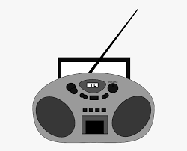
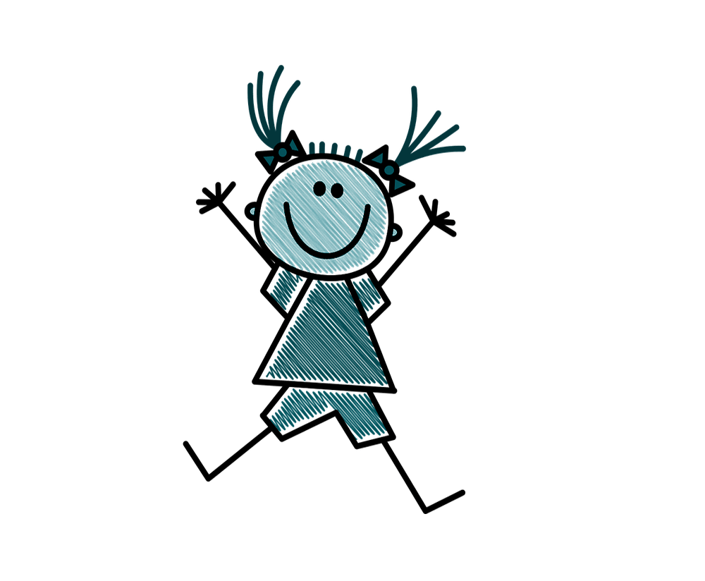
Methods of Health Education
Indirect Methods (Mass Media)
Television
Radio
Pamphlets
Newspapers
Posters
There are posters and pamphlets designed specially for children
Fact: lectures, talks or pamphlets
Nature of the content
Concepts ¹: Group discussion or problem solving
Skills: Demonstration and hand on practice ²
CHOICE OF THE METHOD depends on:
Available materials and program budget
Level of literacy:
Avoid written materials and scientific terms for illiterate
Characteristics of the learners
Children: Use attractive methods
1: Tutorials, seminars.
2: Showing diabetics how to use their medications (Glucometer, insulin pen).

Slide 12
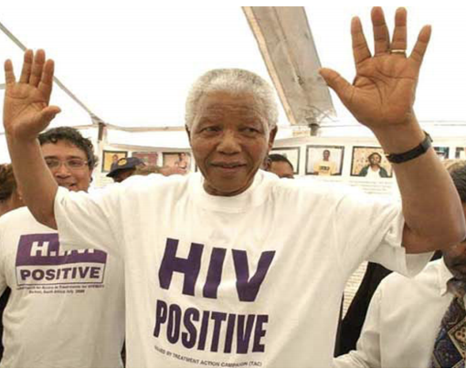
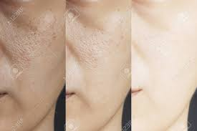
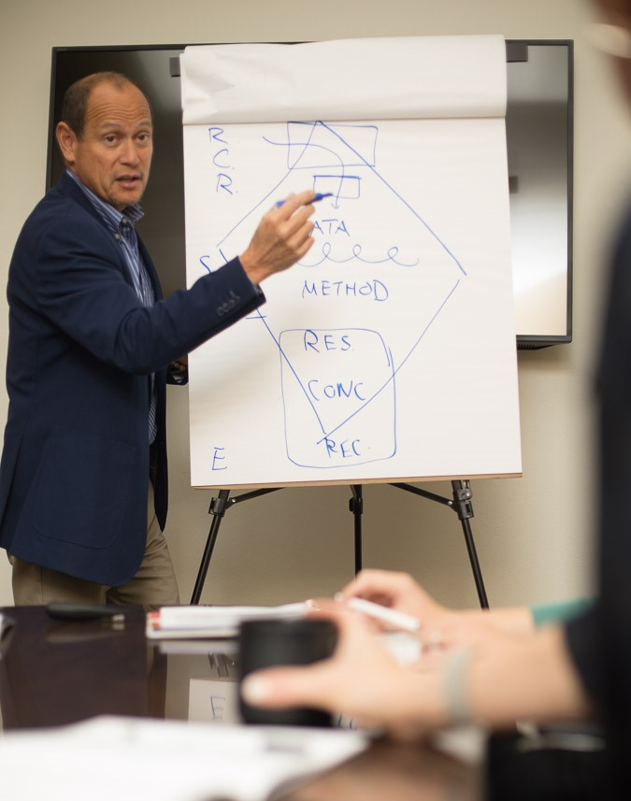
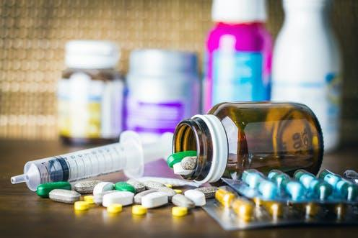
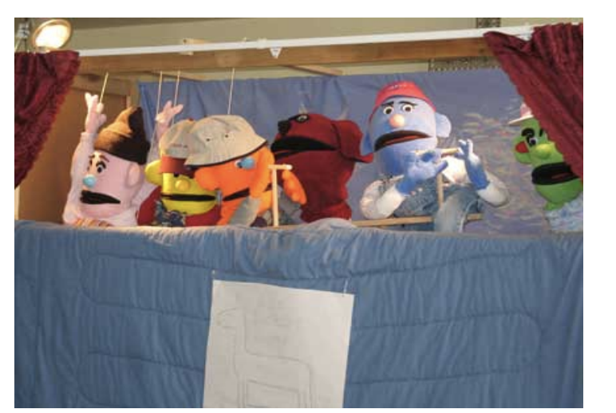
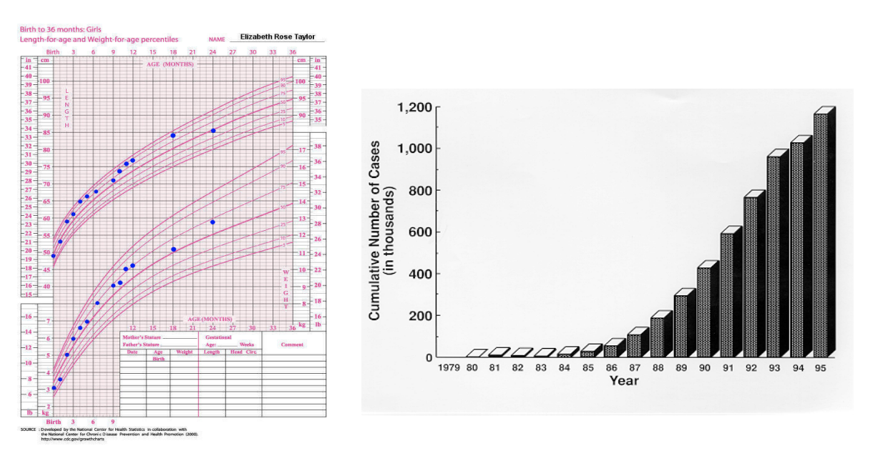
Health Education Aids
Still pictures
Before and after treatment
Flip charts ¹
MOTION PICTURE
EXHIBITION OR DISPLAY ²
PROJECTED MATERIALS
PUPPET SHOW
Charts ³
1: Usually used in communities.
2: Teaching them how to use it.
3: Used in convincing organizations.

Slide 13
The Health Belief Model for Behavior Change
Summary
Definitions
Health education: Is a designed combination of learning methods to facilitate voluntary adaptation of behavior conductive to health.
Learning: Change of behavior brought about by experience, insight, perception or a combination of the three, which causes the individual to approach future situation differently.
Levels of prevention and the goal of health education
Primordial prevention
Secondary prevention
Promote health by reinforcing healthy practices
Prevent further deterioration of health or restoration of health
1
3
Primary prevention
Tertiary prevention
Prevent the development of the disease
Make the most of the remaining potential for healthy living
2
4
Factors Influencing Human Behaviour: Culture, resources, Thoughts and feelings, and influence of other people
Postulates
Factors
Health behavior of all kind is related to a general health belief that one is susceptible to a health problem
Health problems have undesirable consequences
Health problems and their consequences are preventable
If health problems are to be overcome, barriers have to be overcome
Predisposing Factors
Characteristics of a person or population that motivate a behavior change
Enabling Factors
Characteristics of the environment and individuals that facilitate action to attain a specific behavior
Reinforcing Factors
It determines the continuity (maintenance) of the new behavior
Phases
Reasons of maintaining health-risky behaviour
Perceptions
Modifying factors
Likelihood of action
Modified perception of risk
Lack of knowledge of the health risk
Low self efficacy to change

Slide 14
Quiz
MCQ
1- Which level of prevention apply for the setting of policies to address behaviours of the population and environment?
A-Primary prevention B. Tertiary prevention C. Primordial prevention D. Secondary prevention
2- What is the main objective of prevention of primary prevention level?
A. Prevention of complications B. Limit progression of disease C. Reduce incidence rate D. Early recovery
3- Autism is irreversible disease with unknown cause, which of the following is the suitable intervention for such disease?
A-Primary prevention B. Tertiary prevention C. Primordial prevention D. Secondary prevention
4- The Health Belief Model assumes that decision-making occurs when the following three elements take place:
A. Assumed susceptibility, assumed threat, and assumed reward
B. Assumed susceptibility, assumed threat, and assumed benefit vs. barriers
C. Perceived susceptibility, perceived threat, and perceived reward
D. Perceived susceptibility, perceived threat, and perceived benefit vs. barriers
5- Match Each Construct with the best example of it:
1) Perceived Susceptibility a) My chances of having a diabetes-related complication is high.
2) Perceived Severity b) I am sure that I can monitor my blood sugar on a daily basis.
3) Perceived Benefits c) It is serious to have high blood sugar.
4) Perceived Barriers d) It takes too much time to monitor my blood sugar every morning.
5) Cues to Action e) Monitoring my blood sugar makes diabetes easier to live with.
6) Self-Efficacy f) Hearing about diabetes though the media reminds me to take care of myself
6- Which of these is an element of the Health Belief Model?
A-Threat B. Expectations C. Socio-demographic factors D. All of the above
Answers
Q1 | Q2 | Q3 | Q4 | Q5 | Q6
A | C | B | D | 1) a 2) c 3) e 4) d 5) f 6) b | D

Slide 15
Thank You and
Good Luck
Team Leaders:
Lama AlAssiri | Mohammed AlHuqbani | Ibrahim AlDakhil
Team Members:
Lama AlZamil
Leen AlMazroa
May Babaeer
Muneera AlKhorayef
Norah AlMazrou
Nouf Alhussaini
Rema AlMutawa
Sara AlAbdulkareem
Sedra Elsirawani
Wejdan Alnufaie
Abdulrahman Alhawas
Abdulrahman Shadid
Abdullah Aldawood
Abdullah Shadid
Alwaleed Alsaleh
Bader Alshehri
Bassam Alkhuwaiter
Faisal Alqifari
Hameed M. Humaid
Khalid Alkhani
Meshari Alzeer
Mohannad Makkawi
Nayef Alsaber
Omar Aldosari
Omar Alghadir
Zyad Aldosari

