Slide 1
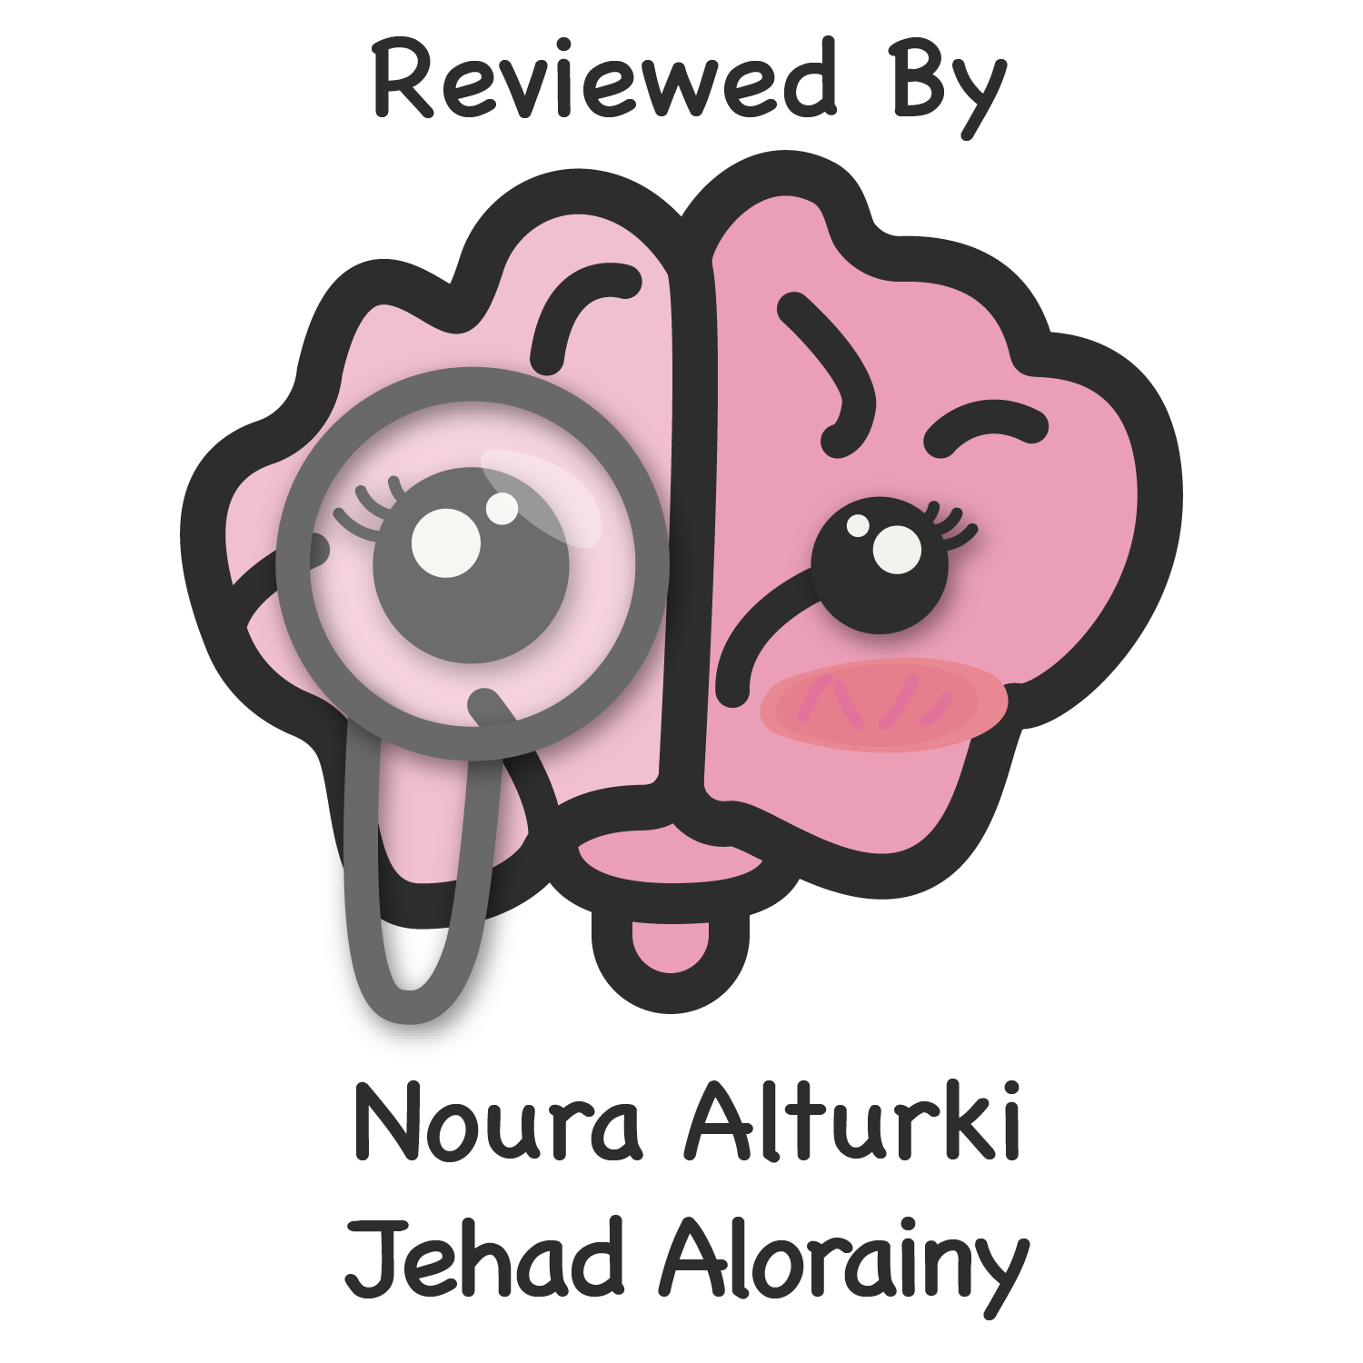
Health of People
With Disabilities
Objectives
Distinguish between health and quality of life.
Portray the spectrum of health.
Develop an understanding to the concept of disability.
Compare between the medical model and social model of disability.
Distinguish between capacity and performance.
State the main health conditions associated with disability.
List the disabling barriers.
Outline the interventions for prevention of disabilities and rehabilitation.
Understand the burden ( morbidity , mortality, cost) of disabilities in KSA
Reflect on the policies in KSA addressing limitation of disabled people in KSA.
Enlist and understand community services available for disabled people in KSA.
Color Index
Main text
Males slides
Females slides
Doctor notes
Important
Golden notes
Extra
Editing File

Slide 2
Definitions
Health
“State of complete physical, mental, and social well- being, not merely the absence of disease or infirmity"(WHO, 1948).
In recent years, this statement has been amplified to include the ability to lead a "socially ¹ and economically productive life”
Quality of Life ²
“Individual's perception of their position in life in the context of the culture and value systems in which they live and in relation to their goals, expectations, standards and concerns.” (WHO)
Disability
A long-term physical, mental, intellectual, or sensory impairment, which in interaction with various barriers may hinder their full and effective participation in society on an equal basis with others. Always we focus on Barriers.
Dimensions of Disability:
Impairment is a problem in body function or structure
Activity limitation is a difficulty encountered by an individual in executing a task or action.
Participation restriction is a problem experienced by an individual in involvement in life situations.
Spectrum of health ³
4
3
2
1
1
2
3
Negative
Positive
Unrecognised sickness
01
01
Freedom from sickness
Mild sickness
02
02
Better Health
Severe sickness
03
03
Positive health
Death
04
1- Social wellbeing deals with work and recreation centers.
2- The term quality of life is much broader than the term health and it can be measured through tools and questionnaires to estimate a person’s quality of life
3- When a person doesn’t have a disease, it doesn’t mean that he has a positive health.

Slide 3
Development of Disability ¹
Medical Model:
The impairment is the barrier
Disease
Impairment
Disability
Handicap
Departure from health
Damage to a body part or aberration of physiological function
Inability to carry out function/activity
Limitation of person’s role
The medical model of disability says people are disabled by their impairments or differences.
Under the medical model, these impairments or differences should be ‘fixed’ or changed by medical and other treatments.
The medical model looks at what is ‘wrong’ with the person and not what the person needs. It creates low expectations and leads to people losing independence, choice and control in their own lives.
Social Model
The society is the barrier
The social model of disability says that disability is caused by the way society is organised, rather than by a person’s impairment or difference. It looks at ways of removing barriers that restrict life choices for disabled people. When barriers are removed, disabled people can be independent and equal in society, with choice and control over their own lives.
It can be subdivided into: community attitudes, environmental barriers and institutional barriers
Medical Model | Social Model
You cannot make decisions about your life You are the problem You are the sufferer You can never be equal to a non-disabled person | Everyone is equal Society put the barriers in place Society prevents and restricts equal opportunities
1- An example here is blindness. Looking at it through the medical model. Blind people are the problem and we cannot make them equal to normal people. However, if we look at it through the social model. The society is to be blamed for putting the barriers to those people. For example, instead of putting a sign we should put a voice recording.

Slide 4
ICF Classification
International Classification Of Functioning, Disability & Health (ICF)
It was developed by the WHO, and aims to:
To provide a scientific basis for consequences of health conditions.
To establish a common language to improve communications.
To permit comparison of data across: countries, disciplines, services and time.
To provide a systematic coding scheme for health information systems
Health Condition (Disorder/ Diseases) ¹
Body function & Structure (Impairment)
Activities (Limitation)
Participation (Restriction)
Contextual Factors
Environmental Factors ²
Personal Factors ³
ICF- Estimation of Disability: Response and Scoring
To quantify the disability of a person, the ICF developed a scoring system which divides disability into 6 domains and score each one of them out of 4.
ICF allows to shift our gaze from the cause (impairment) → impact (function)
Core Domains:
- Seeing Hearing - Mobility - Cognition - Self care - Communication
Response:
No difficulties=0 Mild difficulties=1 Moderate difficulties=2 Severe difficulties=3 Extreme difficulties=4
Score:
Score range from 0 to 100
Score of 40 = significant difficulty
Score of 50 = very significant difficulty
1- If we take a person who’s paralyzed and apply this structure we’ll see that:
Impairment: Spinal transection Limitation: can’t move Restriction: can’t go to the market Environment: Special parking Personal: Rehab
2- Environmental factors include profession, education, employment
3- Personal factors include sex, age, BMI, smoking, alcohol, positive attitude

Slide 5
ICF Classification
Environmental factors: Capacity vs. Performance
Capacity | Performance
Indicates what a person can do in a standardized environment, often a clinical setting, without the barriers or facilitators of the person’s usual environment The highest probable level of functioning of a person in a given domain at a given moment. | Indicates what a person does in the current or usual environment, with all barriers and facilitators in place. Not always capacity will be better than performance and not always performance is better than capacity.
Health Conditions associated with Disability
1
Children
Hearing problems
Vision disorders
Speech problems
Dyslexia
Cerebral palsy
Learning disabilities (associated with autism, attention deficit)
2
Non-communicable Diseases
Diabetes ¹
Cardiovascular disease
Mental disorders
Cancer
Respiratory illnesses
3
Infectious Diseases
HIV
Malaria
Poliomyelitis
Leprosy
Trachoma
4
5
Injuries: RTA (Road Traffic Injuries)
Arthritis and Back Pain
Disabling Barriers
WHO defines barriers as: “Factors in a person’s environment that, through their absence or presence, limit functioning and create disability”.
These factors include different aspects such as:
Attitudinal
Communication
Physical
Policy
Social
Transportation
1- Diabetics requires more preparations and special consideration in many activities

Slide 6
Types of Disabling Barriers
Barrier | Description
Attitudinal | Negative attitudes leading to rejection and marginalization.
Communication | Are experienced by people who have disabilities that affect hearing, speaking, reading, writing, and or understanding. Examples: Lack of accessibility to transport and information system (sign language) Specialized services: availability, accessibility and quality
Physical | Structural obstacles in natural or manmade environments that prevent or block mobility or access Examples: Steps and curbs that block a person with mobility impairment from entering a building or using a sidewalk
Policy | Inadequate policies and standards which does not consider the needs of people with disabilities, or existing policies and standards are not enforced. Examples: Insufficient funding for implementation of policies and plans.
Social | Lack of consultation and involvement of persons with disability.
Transportation | Lack of adequate transportation that interferes with a person’s ability to be independent and to function in society.

Slide 7
Prevention of Disabilities and Rehabilitation
Type | Description
Primary Prevention | Premarital genetic counseling Maternal and neonatal care Screening of neonates for hypothyroidism Expanded program on immunization School services
Secondary Prevention & Tertiary Prevention | In 2ry prevention we try to prevent complications from happening, while in 3ry prevention we try to limit the disability that resulted from the complication by the means of rehabilitation.
 |  | Intervention | Prevention
 | Health condition | Medical treatment or care | Health promotion, Nutrition, Immunization
 | Impairment | - Medical treatment or care - Surgery | Prevention of the development of further activity limitations
 | Activity limitation | - Assistive devices - Personal assistance - Rehabilitation therapy | Preventive rehabilitation, Prevention of the development of participation restrictions
 | Participation restriction | - Accomodations - Public education - Anti-discrimination law - Universal design | Environmental change, Employment strategies, Accessible services, Universal design, Lobbying for change
 | After the person gets a complication from the disability he has or even before he gets one, we can start rehabilitation. Outcome of Rehabilitation includes: Prevention of the loss of function Slowing the rate of loss of function Improvement or restoration of function Compensation for lost function Maintenance of current function

Slide 8
Burden of Disabilities in KSA
It is estimated that 3.73% of the population has functional disabilities limiting their independence.
Data from national census indicates that nearly 0.8% of the total Saudi population has disability.
The main causes of disability are cerebral palsy and developmental delays followed by road traffic accidents (RTAs).
The main care gaps are low access to poor families, low service coverage and low quality of services in public agencies.
Rights of Disabled People in KSA
A royal decree was passed numbered (M/37) in 23/09/1421 H. that approved a legislation made by the council of ministers (no. 224) in 14/9/1421 H. that supports disabled people and promote their rehabilitation.
المادة الثانية:
تكفل الدولة حق المُعوق في خدمات الوقاية والرعاية والتأهيل، وتشجع المؤسسات والأفراد على الإسهام في الأعمال الخيرية في مجال الإعاقة، وتُقدَّم هذه الخدمات لهذه الفئة عن طريق الجِهات المُختصة في المجالات الآتية:
1 - المجالات الصحية :
وتشمل:
أ - تقديم الخدمات الوقائية والعلاجية والتأهيلية، بما فيها الإرشاد الوراثي الوقائي ،وإجراء الفحوصات والتحليلات المخبرية المُختلِفة للكشف المُبكِر عن الأمراض، واتِخاذ التحصينات اللازِمة.
ب - تسجيل الأطفال الذين يولدون وهُم أكثر عُرضة للإصابة بالإعاقة، ومُتابعة حالاتِهم، وإبلاغ ذلك للجهات المُختصة.
ج - العمل على الارتِقاء بالرعاية الصحية للمُعوقين واتِخاذ ما يلزم لتحقيق ذلك.
د - تدريب العامِلين الصحيين، وكذلك الذين يُباشِرون الحوادِث على كيفية التعامُل مع المُصابين وإسعافِهم عند نقلِهم مِن مكان الحادِث.
هـ - تدريب أُسر المُعوقين على كيفية العناية بِهم ورعايتِهم.
2 - المجالات التعليمية والتربوية :
وتشمل تقديم الخدمات التعليمية والتربوية في جميع المراحِل (ما قبل المدرسة، والتعليم العام، والتعليم الفني، والتعليم العالي) بما يتناسب مع قُدُرات المُعوقين واحتياجاتِهم، وتسهيل التِحاقِهم بها، مع التقويم المُستمر للمناهِج والخدمات المُقدمة في هذا المجال.
3 - المجالات التدريبية والتأهيلية :
وتشمل تقديم الخدمات التدريبية والتأهيلية بما يتفق ونوع الإعاقة ودرجتِها ومُتطلبات سوق العمل، بما في ذلك توفير مراكِز التأهيل المِهني والاجتِماعي، وتأمين الوسائل التدريبية المُلائمة.
4 - مجالات العمل :
وتشمل التوظيف في الأعمال التي تُناسِب قُدُرات المُعوق ومُؤهلاتِه لإعطائِه الفُرصة للكشف عن قُدُراتِه الذاتية، و لتمكينه من الحصول على دخل كباقي أفراد المُجتمع، والسعي لرفع مُستوى أدائه أثناء العمل عن طريق التدريب.
5 - المجالات الاجتِماعية :
وتشمل البرامِج التي تُسهِم في تنمية قُدُرات المُعوق، لتحقيق اندماجِه بشكل طبيعي في مُختلف نواحي الحياة العامة، وتقليل الآثار السلبية للإعاقة.
6 - المجالات الثقافية والرياضية :
وتشمل الاستِفادة مِن الأنشِطة والمرافِق الثقافية والرياضية وتهيئتِها، ليتمكن المُعوق مِن المُشاركة في مناشِطِها داخلياً وخارجياً بما يتناسب مع قُدُراتِه.
7 - المجلات الإعلامية :
وتشمل قيام وسائل الإعلام - المرئية والمسموعة والمقروءة - بالتوعية في المجالات الآتية:
أ - التعريف بالإعاقة وأنواعِها وأسبابِها، وكيفية اكتِشافِها والوقاية مِنها.
ب - تعزيز مكان المُعوقين في المُجتمع، والتعريف بحقوقِهم واحتياجاتِهم، وقُدُراتِهم وإسهاماتِهم، بالخدمات المُتاحةٌ لهُم، وتوعيتِهم بواجباتِهم اتجاه أنفُسِهم، وبدورِهم في المُجتمع.
ج - تخصيص برامِج موجهة للمُعوقين تكفل لهُم التعايُش مع المُجتمع.
د - حث الأفراد والمؤسسات على تقديم الدعم المادي والمعنوي للمُعوقين، وتشجيع العمل التطوعي لخدمتِهم.
8 - مجالات الخدمات التكميلية :
وتشمل:
أ - تهيئة وسائل المواصلات العامة لتحقيق تنقُل المُعوقين بأمن وسلامة، بأجور مُخفضة للمُعوق ومُرافِقه، حسب ظروف الإعاقة.
ب - تقديم الرعاية النهارية والعناية المنزلية.
ج - توفير أجهزة التقنية المُساعِدة.

Slide 9
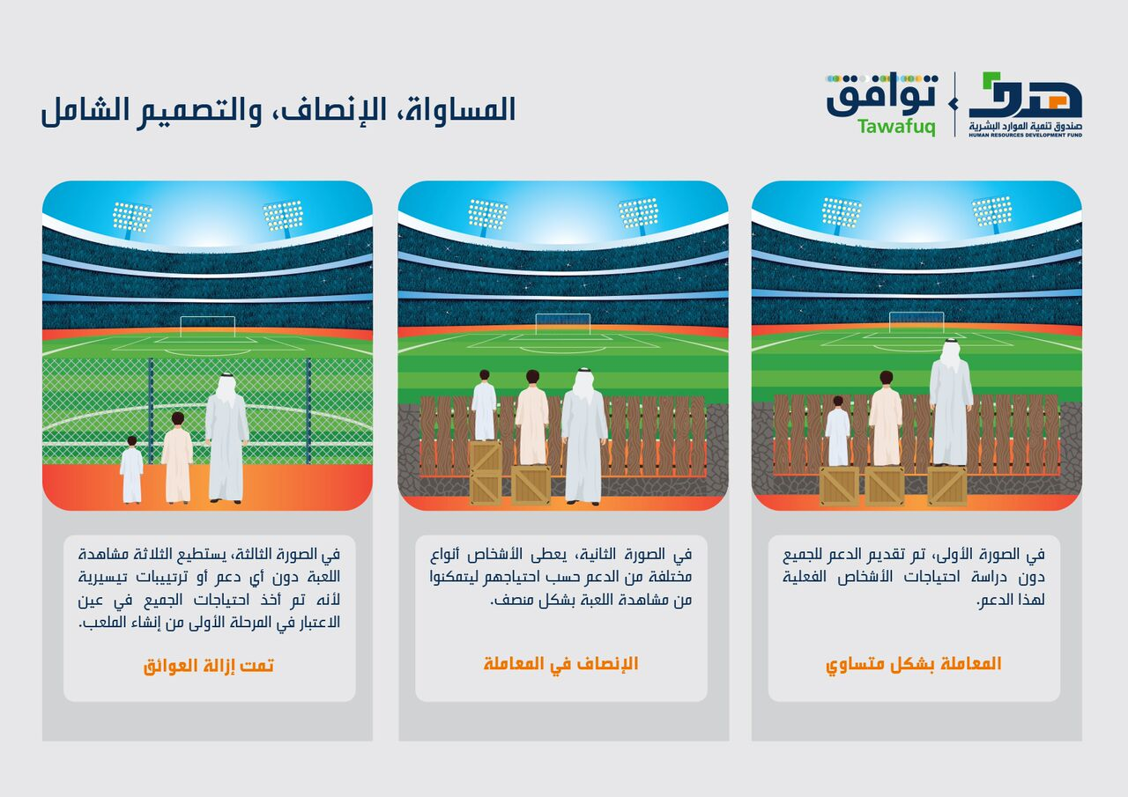
Community Services Available in KSA

Slide 10
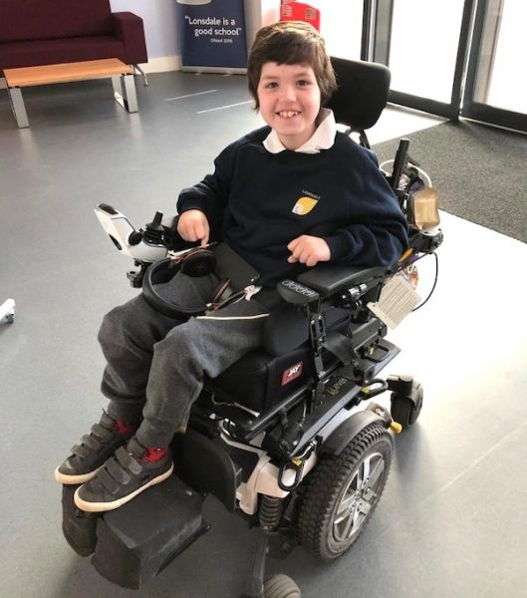
Quiz
MCQ
1. Which of the following terms best describes this statement “perception of an individual person about his/her position in life”?
Health
Positive health
Quality of life
Human development
2. Which of the following is the lowest point along the spectrum of health
Severe sickness
Freedom from disease
Disability
Death
3. Which of the following terms best describe the image?
Capacity - environmental factors
Performance - environmental factors
Capacity - personal factors
Performance - personal factors
4. You entered a governmental building and you noticed that there were stairs with no ramp. Which of the following disabling barriers is present
Transportation barrier
Physical barrier
Policy barrier
Social barrier
5. A friend of yours was recently diagnosed with autoimmune arthritis and was advised to take steroid injection to prevent further damage to the joint. At which level of prevention does your friend lie?
Primary
Secondary
Tertiary
Rehabilitation
6. Which of the following is considered the most leading cause of disability in Saudi Arabia?
Road Traffic Injuries
Cerebral Palsy
Diabetes Mellitus
Cardiovascular Disease
Answers
Q1 | Q2 | Q3 | Q4 | Q5 | Q6
C | D | B | B | B | B

Slide 11
Thank You and
Good Luck
Team Leaders:
Lama AlAssiri | Mohammed AlHuqbani | Ibrahim AlDakhil
Team Members:
Lama AlZamil
Leen AlMazroa
May Babaeer
Muneera AlKhorayef
Norah AlMazrou
Nouf Alhussaini
Rema AlMutawa
Sara AlAbdulkareem
Sedra Elsirawani
Wejdan Alnufaie
Abdulrahman Alhawas
Abdulrahman Shadid
Abdullah Aldawood
Abdullah Shadid
Alwaleed Alsaleh
Bader Alshehri
Bassam Alkhuwaiter
Faisal Alqifari
Hameed M. Humaid
Khalid Alkhani
Meshari Alzeer
Mohannad Makkawi
Nayef Alsaber
Omar Aldosari
Omar Alghadir
Zyad Aldosari

