Slide 1
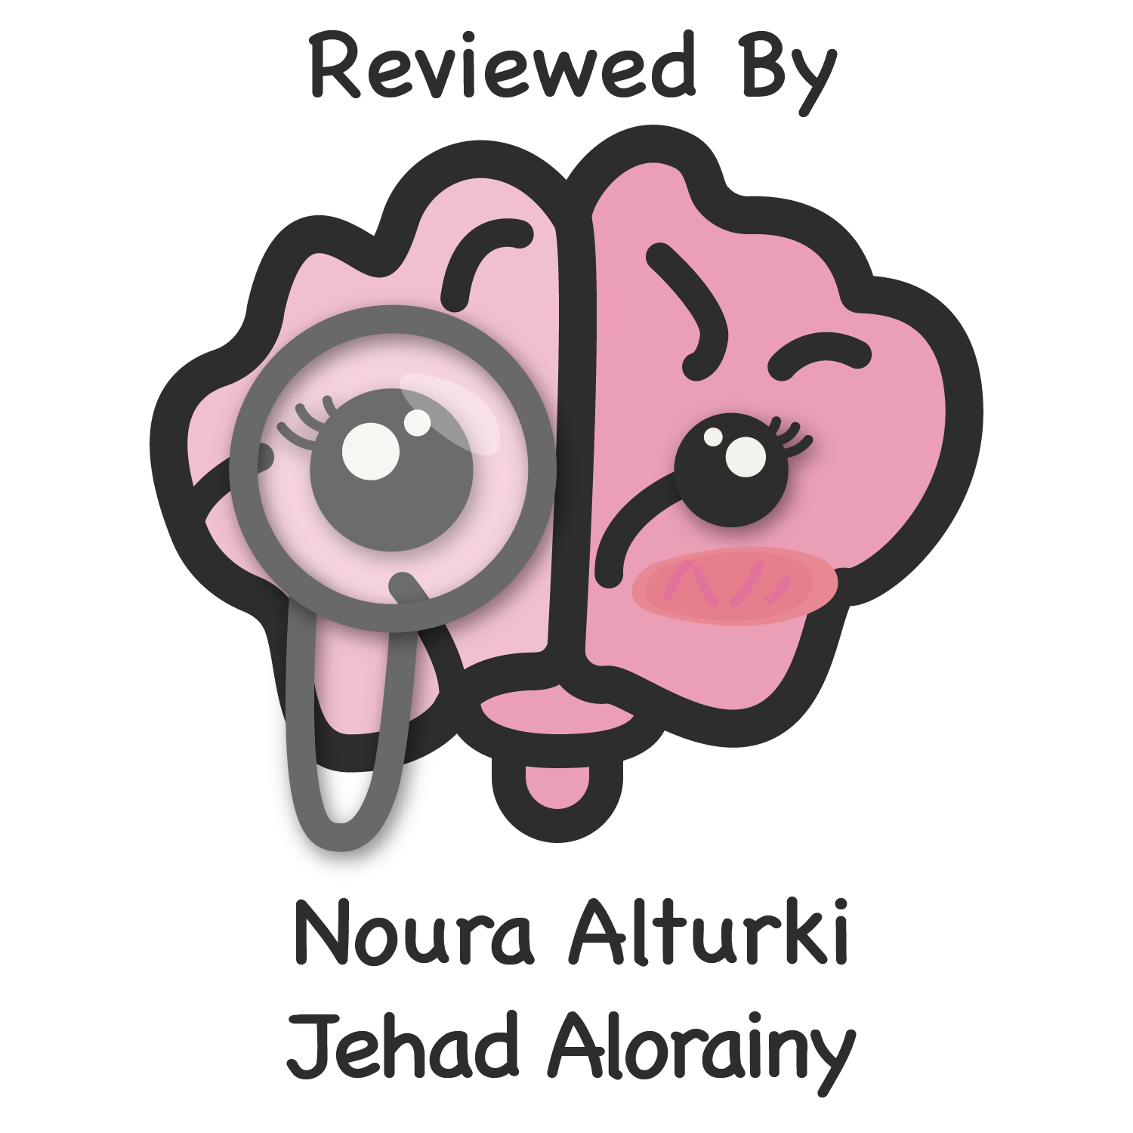
Summary
Nouf AlShammari
Leen AlMazroa
Wejdan AlNufaie
Lama AlAssiri
Noura AlTurki
Color Index
Main text
Males slides
Females slides
Doctor notes
Important
Golden notes
Extra
Editing File

Slide 2
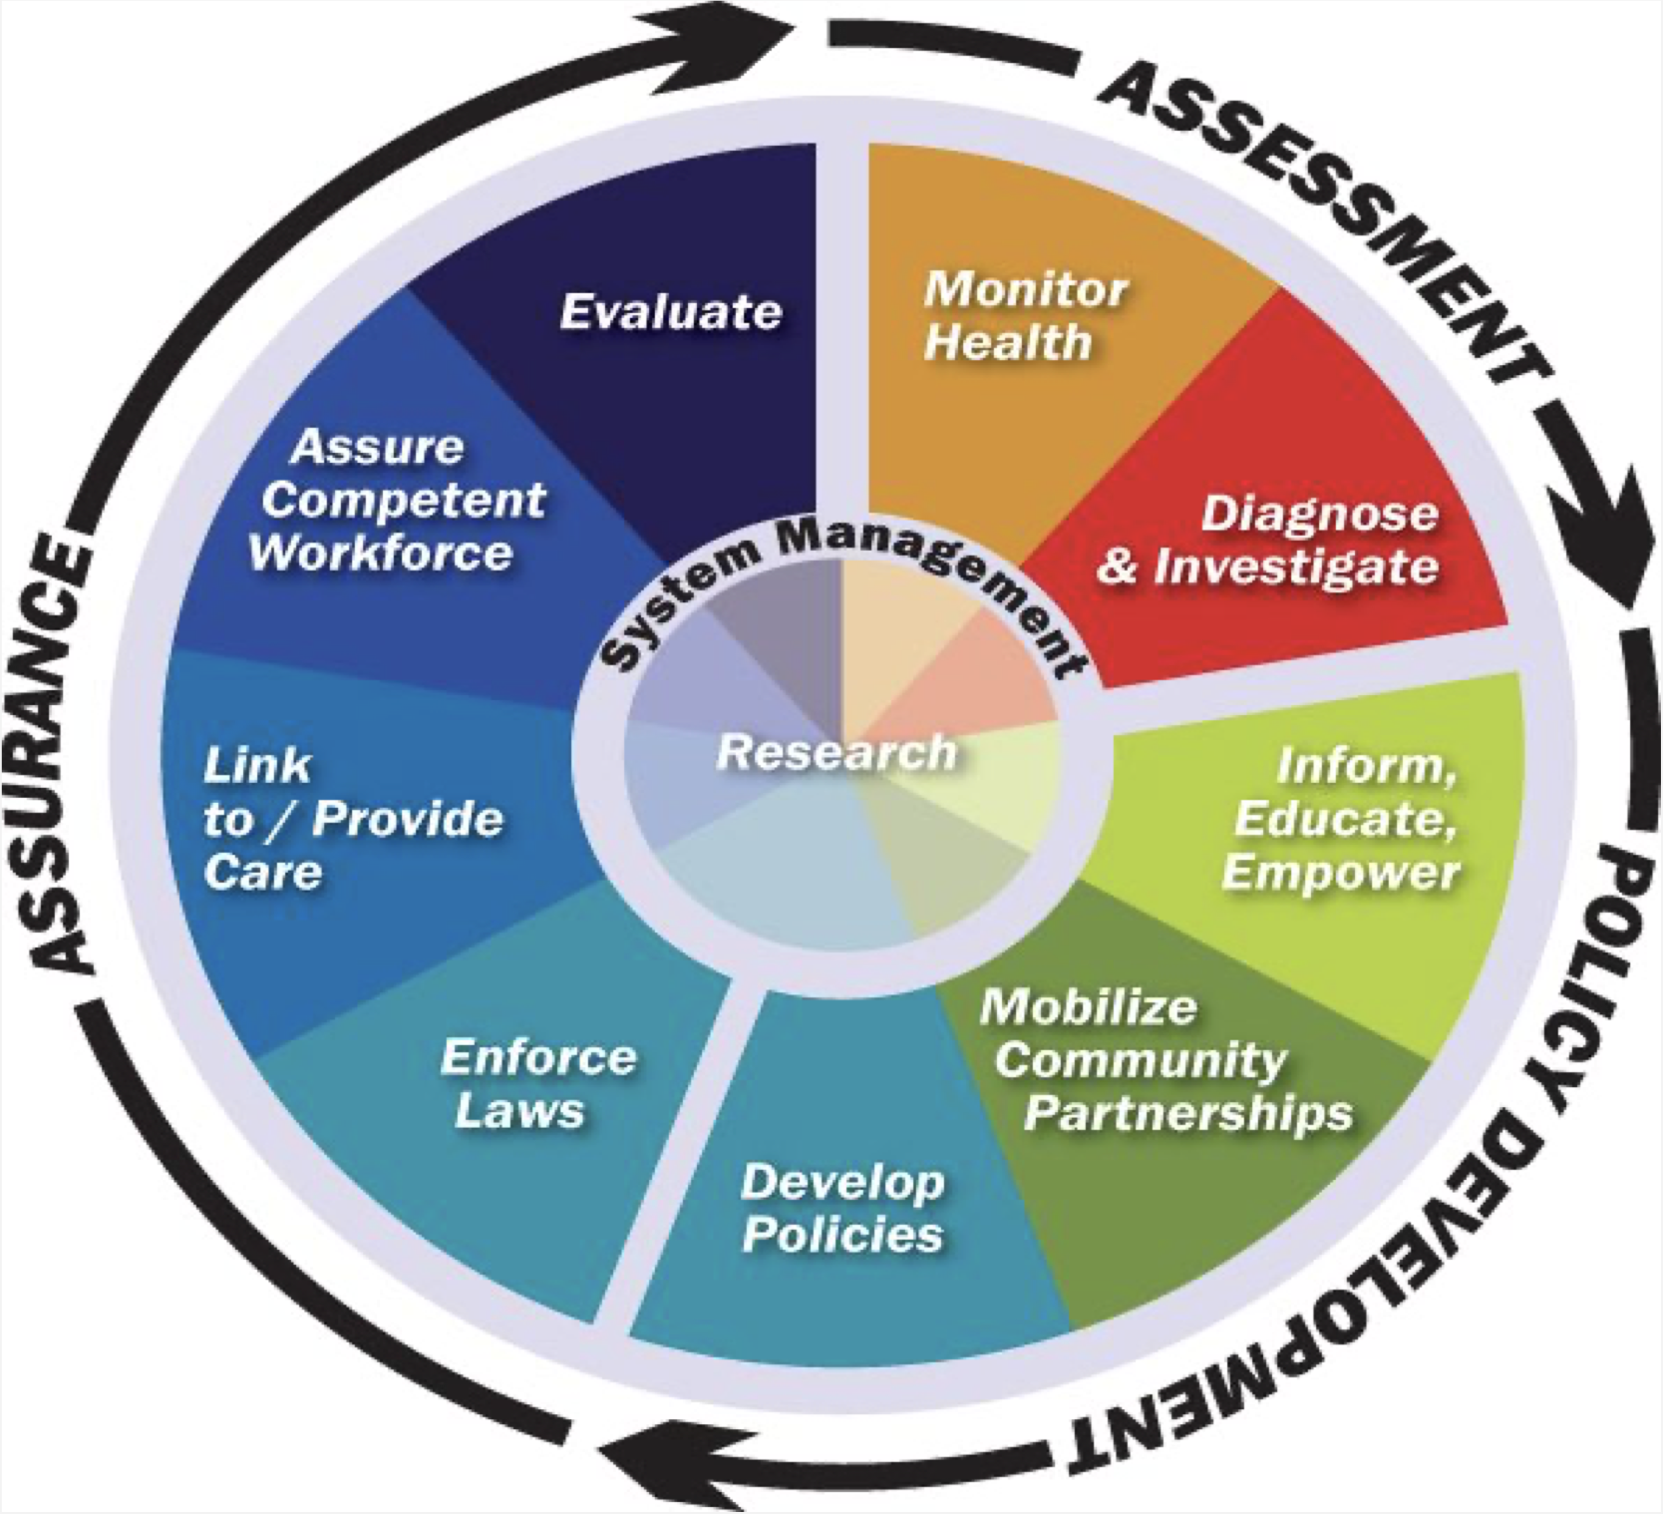
Introduction
Who is responsible for conducting Community health services?
Definitions:
Community Medicine: Specialized field of medical practice focusing on health of a defined population in order to promote and maintain health and wellbeing, prevent disease, disability, and premature death.
Preventive Medicine: Measures taken to prevent diseases, rather than curing them.
Public Health Medicine: It’s the sub-speciality of Community Medicine which aims to advance the health of population.
Community medicine specialist
Community Medicine university departments & Ministry of Health
Other governmental and non-governmental agencies (Non-governmental agencies help the government in carrying out essential services in the community (since the government can’t reach and cover every neighborhood). Examples of non-governmental agencies: diabetic association, heart association.)
Community personal (leaders & residents)
Preventive intervention classification:
Universal prevention: addresses the entire population
Selective prevention: Focuses on groups whose on risk
Indicated Prevention:
screening
Environmental prevention: ranges from ultimate restrictions to drug testing and legislative measures
Public Health
Organized measures (whether public or private) to prevent disease, promote health, and prolong life among the population as a whole, through organised community efforts for the sanitation of the environment, the control of communicable infections, the education of the individual in personal hygiene, the organization of medical and nursing services for the early diagnosis and preventive treatment of disease.
It is a combination of:
Scientific discipline (e.g., epidemiology, biostatistics, laboratory science, social science, demography)
Skills and strategies (e.g., epidemiological investigations, planning and management, intervention, evaluation) that are directed to the maintenance and improvement of the health of people
Three Core Public Health Functions
Assessment
Assessment & monitoring of the health of communities and populations
Policy Development
Development of policies to solve local and national health problems
Assurance
To assure access to appropriate and cost-effective care
The 10 Essential Public Health Services
Monitor health status to identify community health problems
Enforce laws and regulations that protect health and ensure safety
Diagnose and investigate health problems and health hazards in the community
Link people to needed personal health services and assure the provision of health care when otherwise unavailable
Inform, educate, and empower people about health issues.
Assure a competent public health and personal health care workforce
Mobilize community partnerships to identify and solve health problems
Evaluate effectiveness, accessibility, and quality of personal and population-based health services
Develop policies and plans that support individual and community health efforts
Research for new insights and innovative solutions to health problems

Slide 3
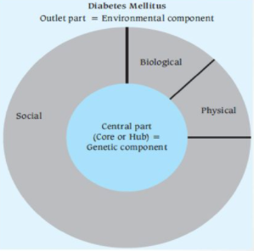
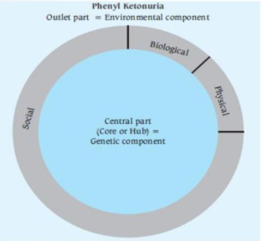
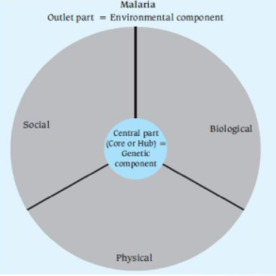
L1- Natural History of Disease & Concept of Prevention & Control
What is Health?
“Health is a state of complete physical, mental and social well-being and not merely the absence of disease or infirmity”
Theories of Disease Causation
1- Germ Theory:
Germ theory states that: Every human disease is caused by a microbe or germ, which is specific for that disease and one must be able to isolate the microbe from the diseased human being.
Germ theory showed a one to one relationship between causal agent and disease
2- Epidemiological Triad:
Not everyone exposed to tubercle bacteria develops tuberculosis but the same exposure in an undernourished or immunocompromised person may result in clinical disease and exposure occurs more in overcrowding.
The second theory for disease causation is the epidemiological triad.
Unlike the germ theory which takes the agent as a sole factor, the epidemiological triad considers the host and environmental factors
3- “Web of Causation”
It considers all predisposing factors of any type and their complex interrelationship with each other.
Each factor has its own relative importance in causing the final departure from the state of health, as well as interacts with others, modifying the effect of each other.
ideally suite chronic diseases (no agent is there) and disease is the outcome of interaction of multiple factors
One example is AMI (Acute Myocardial Infarction)
4- Wheel Theory
As medical knowledge advanced, an additional aspect of interest that came to play is the comparative role between genetics (host) and the environmental (i.e. extrinsic factors outside the host) factors in causation of disease
Both the triad and web theory don’t cover this aspect thoroughly
To explain such a relative contribution of genetic and environmental factors, the “wheel theory” has been postulated

Slide 4
Definition of Natural History of Diseases:
Natural history of disease refers to the progress of a disease process in an individual over time, in the absence of intervention.
The process begins with exposure to or accumulation of factors capable of causing disease.
Results: - Recovery - Disability (ex. Diabetic foot resulting in amputation) - Death
Stages: 1..Pre-disease stage 2. Latent (asymptomatic) stage 3. Symptomatic stage
Pre-disease Stage: Before a disease process begins in an individual.
Social environment
Immunological capability
Nutritional history
Genetics
makeup
Environment exposure
Demographic
characteristics
(age)
Behavioral
patterns
Latent Stage (asymptomatic):
Patient was exposed and the disease-producing process is underway (no symptoms)
Screening may be feasible
Symptomatic Stage: When the disease is advanced enough to produce clinical manifestations
Disease Prevention: Prevention is the process of intercepting or opposing the “cause” of a disease and thereby the disease process.
Leavell’s Levels of Prevention
Stage of Disease and Care |  | Level of Prevention | Response
Predisease Stage | No known risk factors | Primary Prevention | Health promotion (lifestyle, nutrition & environment)
 | Disease Susceptibility |  | Specific Protection (immunization, safety measures)
Latent Disease | Hidden Stage (Asymptomatic) | Secondary Prevention | Screening (for population) & case finding (for individual)
Symptomatic Disease | Initial Care | Tertiary Prevention | Disability limitation
 | Subsequent Care |  | Rehabilitation

Slide 5
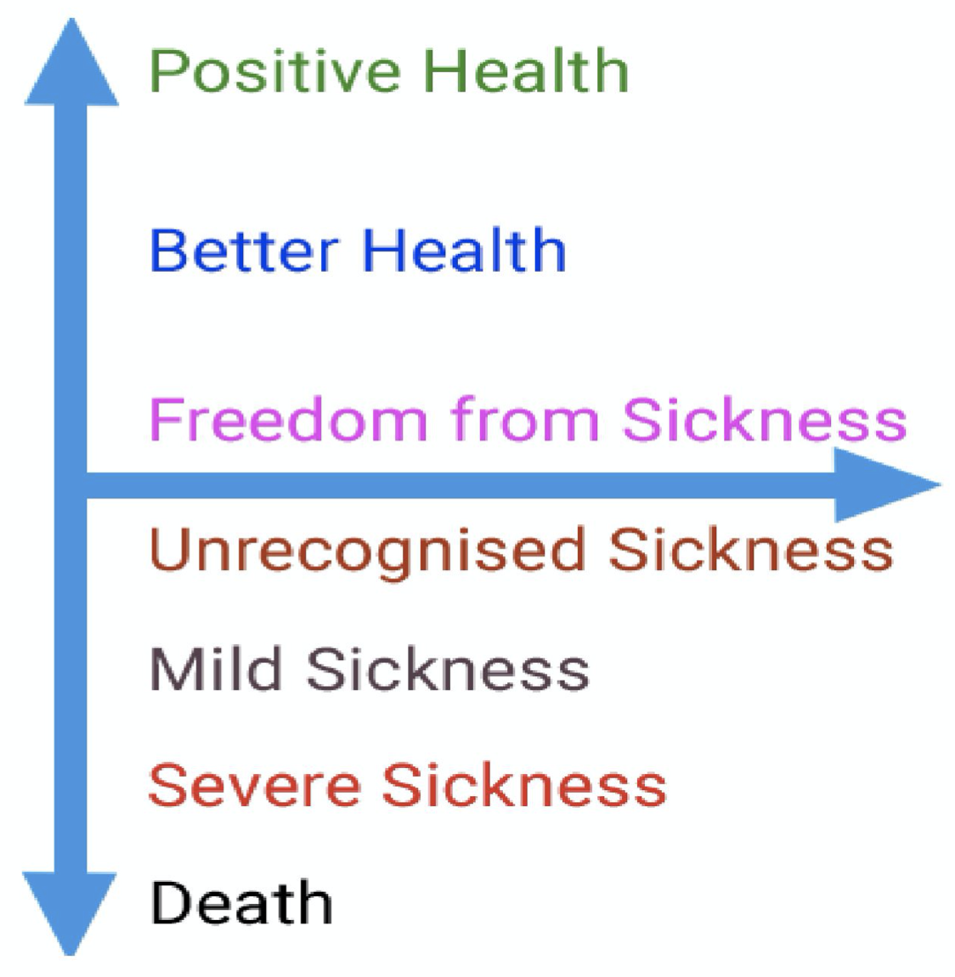
L2- Determinants of Health
Spectrum of Health:
Health and disease lie along a continuum, and there is no single cut-off point
Health is a dynamic phenomenon and a process of continuous change and there are levels of health.
Definitions:
Health: “Is a state of complete physical, mental and social well-being and not merely an absence of disease or infirmity”. Then they added the ability to lead a "socially and economically productive life".
Disease: condition that is diagnosed by a physician .
Illness: When the patient self reported mental or physical symptoms.
Sickness: Social & cultural conception of a person’s condition.
Right to health : WHO Constitution introduction affirms that it is one of the fundamental rights of every human being to enjoy "the highest attainable standard of health".
Health for all: "the attainment by all citizens of the world by the year 2000 of a level of health that will permit them to lead a socially and economically productive life"
Well being:
There is no satisfactory definition of the term well-being!
Objective Components
Standard of living
Well-Being
Level of living
Subjective components
PQLI
Quality of life
HDI
 | Physical Quality of Life Index (PQLI) | Human Development Index (HDI)
Indicators used in calculating this index | Infant mortality Life expectancy at age one literacy | Life expectancy at birth (longevity) Mean years of schooling (knowledge) Expected years of schooling (knowledge) GNI, gross national income, per capita (income/ decent standard of living)
Scale | From 0-100 (0 is worst performance and 100 is best performance) | Values from 0 to 1
It measures | The results of social, economic, and political policies. Does NOT measure economic growth | It reflects achievements in the most basic human capabilities
Both allow for National and International Comparison

Slide 6
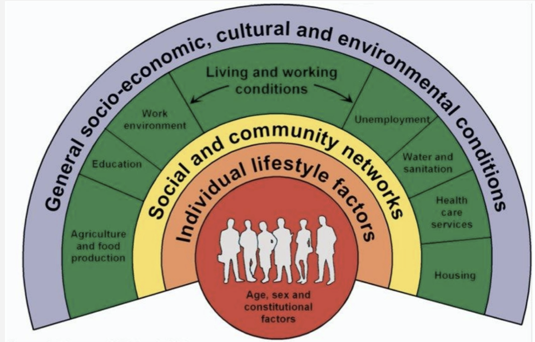
Determinants of Health:
Many factors combine together to affect the health of individuals and communities
1
Biological: Genetic predisposition
Analysis: Genetic predisposition and obese parents.
Behavioral and socio-cultural: Cultural and behavior patterns, life long habits developed from socialization (eg: smoking, staying up late)
Analysis: High TV, computer, electronic entertainment use | Sedentary lifestyle | Car-only mode of transportation
2
3
Environment: Internal – internal medicine / external (macro-environment: things you’re exposed to after conception)
Analysis:
Internal: Hypothyroidism, Syndromic
External: High consumption of fatty takeaway foods / Low consumption of fruits, vegetables and fiber rich foods / Poor walkable environment / Easy access to convenience stores / Extensive unhealthy food marketing
4
Socio-economic: Economic status; Education, Employment, Housing.
Analysis: Unemployment / Low disposable income / Rural area
5
Health services: Services for treatment of disease, prevention, and promotion of health.
Analysis: Limited preventive services / Delayed access to treatment
6
Aging population: Increased burden of chronic diseases.
7
Gender: Women's health covering nutrition, reproductive health, the health consequences of violence, ageing, lifestyle related conditions and the occupational environment.
Analysis: Male obesity is more prevalent than females in Saudi Arabia
8
Other: Information technology, health related systems like agriculture and food.
Analysis: Weak food policy & pricing | High Cost of organized physical activity programs/sport
Notes on the picture: as seen healthcare is a small portion in the determinants of health, so even if they received the best healthcare but he comes from an abusive family (for example) it can affect the recovery. So it’s important to know the environment the patient comes from they might not be discharged if known that the family is abusive for the patient’s own sake.

Slide 7
L3- Health Indicators
Tool of Measurement | Ratio (simple ratio) | Proportion | Rate
Definition | the relationship in size of one measure/variable to another | A specific type of ratio that relates a part to a whole | A special type of proportion that measures the occurrence of an event in a population during a given time.
Use | size of two different variables or quantities | magnitude of the part of a whole | to allow comparisons
Differentiating element | The numerator is NOT a component of the denominator. | The numerator is ALWAYS a component of / INCLUDED in the denominator. | There must be a time dimension and a multiplier (per 1000, per 100,000)
Health Indicators: Morbidity Indicators:
Incidence
1
Definition | Number of NEW cases occurring in a DEFINED POPULATION during a SPECIFIED PERIOD OF TIME.
Tool of Measurement | Rate
Numerator | Number of NEW cases of specific disease during a given time period
Denominator | Population at risk during that given time period at the start of the period
10n | per 1000
Time frame | per year (usually a year unless otherwise specified)
Uses | Taking action (outbreak) Control disease (outbreak) Research for etiology and pathogenesis Efficacy of therapeutic and preventive measures
Formula

Slide 8
Prevalence
Disease Prevalence refers to all cases (NEW & OLD) existing at a given POINT in time OR over a PERIOD of time in a given POPULATION.
2
Type | Point-Prevalence | Period-Prevalence (less common)
Definition | Number of all current cases NEW & OLD occurring in a DEFINED POPULATION at ONE POINT OF TIME (a day, days, or few weeks) | Number of all current cases NEW & OLD occurring in a DEFINED POPULATION at a DEFINED PERIOD of TIME (over months or annual)
Tool of Measurement | Proportion (BE CAREFUL! It is a proportion even when it is called rate)
Numerator | Number of all current cases NEW & OLD at a given POINT of TIME | Number of all current cases NEW & OLD at a a DEFINED PERIOD of TIME
Denominator | Estimated population at the same given POINT of TIME | Estimated population at the same a DEFINED PERIOD of TIME
10n | per 100 (always expressed as percentage)
Time frame | Given point of time
Uses | 1) Estimate the magnitude of health, disease and high risk populations, 2) Administrative and planning e.g. hospital beds | Estimate the magnitude of health, disease and high risk populations
Formula
Keep Going

Slide 9
Health Indicators – Mortality: Crude Death Rate
Crude Death Rate (CDR)
A Major Disadvantage of CDR is Lack of comparability for communities with populations that differ by age, gender, race, etc.
1
Definition | Number of deaths from ALL CAUSES occurring in ESTIMATED MID-YEAR POPULATION during ONE YEAR in a GIVEN PLACE.
Tool of Measurement | Rate
Numerator | Number of deaths from ALL CAUSES during the YEAR
Denominator | Mid-year population
10n | per 1000
Time frame | One year
Uses | Gives an impression of mortality in a single figure!
Formula
2
Specific Mortality Rates (SMR)
Definition | Number of deaths from/in SPECIFIC (CAUSE, GROUP, SOCIAL DETERMINANT) occurring in ESTIMATED MID-YEAR POPULATION during a ONE YEAR in a GIVEN PLACE.
Tool of Measurement | Rate
Numerator | Number of deaths from specific (cause, group, social determinant) during the year
Denominator ¹ | Cause-specific: mid-year population / group, social determinant: mid-year population of specific group, social determinant
10n | per 1000 or per 100,000
Time frame | One year
Uses | Identify at risk groups for preventive action, They allow comparison between different causes within the same population
Formula

Slide 10
Proportionate Mortality
3
Definition | Number of deaths due to a particular cause (or in a specific age group) per 100 total deaths
Tool of Measurement | Proportion
Numerator | Number of deaths from SPECIFIC CAUSE OR AGE GROUP during the YEAR
Denominator | TOTAL deaths from ALL CAUSES (not the POPULATION in which the deaths occurred)
10n | per 100 (percentage %)
Time frame | One year
Uses | Used in broad disease groups (e.g. communicable, non-communicable, injuries) Specific diseases of public health importance (e.g Cancer)
Formula
Case Fatality Rate
4
Definition | Number of deaths due to a PARTICULAR CAUSE (DISEASE) per 100 TOTAL CASES
Tool of Measurement | Proportion (although it is called rate!, called also: Deaths to Cases Ratio)
Numerator | Number of deaths due to a PARTICULAR CAUSE (DISEASE)
Denominator | TOTAL number of number of CASES (not the POPULATION in which the cases occurred)
10n | per 100 (percentage %)
Time frame | Not specified
Uses | Reflects the killing power of a disease. Used mainly in acute infectious diseases.
Formula

Slide 11
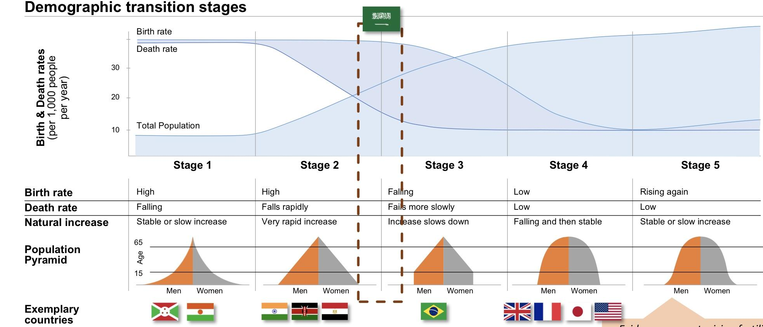
L4- Global Demography Concept & Population Pyramids
Population growth happens when:
Natural increase is positive: Births > Deaths ⇒ Birth increases or Death declines
and/or
Net migration is positive: Immigration > Emigration ⇒ Immigration increases or Emigration declines
Law of 70
If a population is growing at a constant rate of 1% per year, it can be expected to double approximately every 70 years.
if the rate of growth is 2%, then the expected doubling time is 70/2 or 35 years.
The unprecedented population growth of modern times heightens interest in the notion of doubling time. Calculation of population doubling time is facilitated by the Law of 70.
70/growth rate= the number of years estimated for a population to double. For ex.: The growth rate in KSA is around 1.2-1.5, the doubling time is 60-70 years
Demographic Transition ^{1,2}
It is the Movement of death and birth rates in a society, from a situation where both are high (in the pre-transition stage) to one where both are low (in the post-transition stage).
Transition is the interval between these two stages during which the population increases oftentimes rapidly, as births exceed deaths.
Evidence suggests rising fertility at very high development levels - however no country fully reached level yet
1: Stage 1: The majority of the population is﹤15 years old (↑birth rates) and very low population of ﹥65 years old (↑death rates). These are countries in Africa, that aren’t managing infectious diseases (Malaria, HIV, etc..).
Stage 2: ↑birth rates and the majority of the population are between 15-64 (↑working age population). There’s improvement in the healthcare system and the quality of life which lead to decreased death rate but birth rate is very high.
Stage 3: When birth rate starts to decreased fall, the working age population (15-64) starts to have less dependence.
Stage 4: Birth rate starts matching the death rate (as if it’s replacing it. This is a very aging population.)
2: Each stage has its own policy:
Stage 1: To fight malaria, reduce death rates and birth rates.
Egypt: How is Egypt going to provide/afford good education and jobs for the people coming in? It’s a question of contraceptive policies and family planning services within the healthcare system.

Slide 12
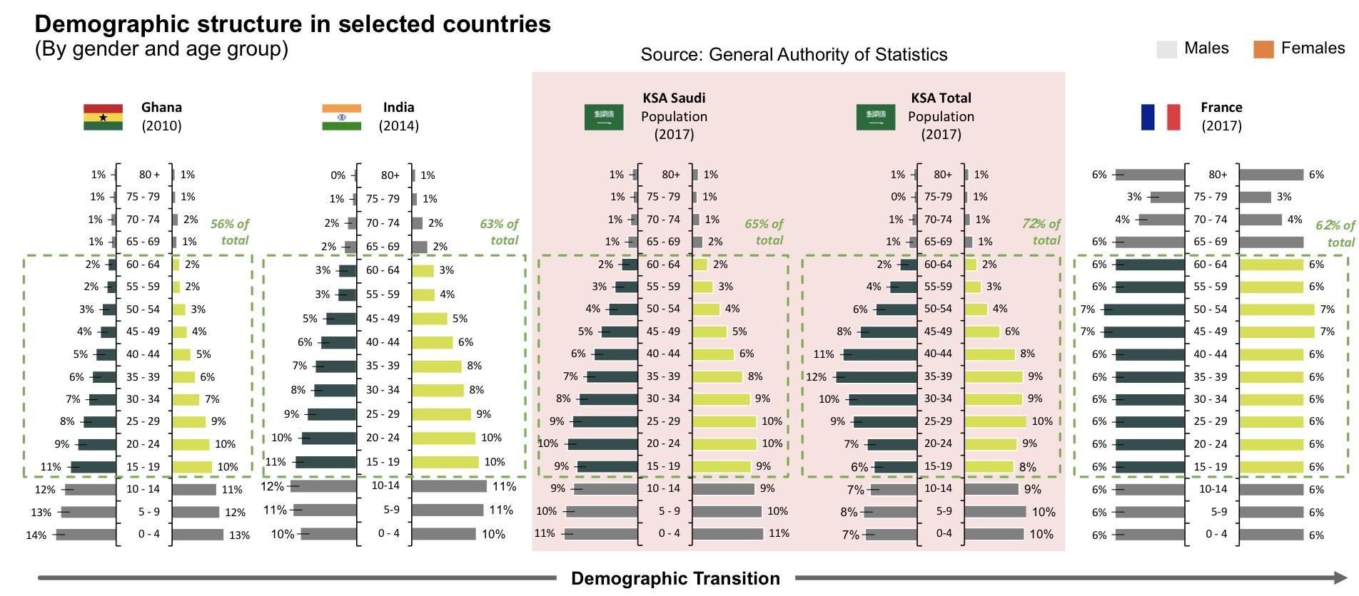
Indicators for fertility
General Fertility Rate (GFR):
Number of live births per 1000 women between the ages of 15 and 49 year childbearing age
Example: - Number of live births in 2019= 90,254. - Mid-year female population aged 15-49 = 2,374,912
1
GFR =
N of live births
X 1000
GFR =
90254
X 1000 = 38
Mid - year female population aged 15-49
2374912
Age-speciﬁc Fertility Rate:
number of births to women of a particular age (a year or age group). E.g. females in the age group 20-24 y.
2
N of live births of mothers aged 20 - 24
Age - specific FR=
Mid - year female population aged 20 - 24
X 1000
3
Total Fertility Rate (TFR):
average number of children a woman would bear during her reproductive lifetime (15-49 years), assuming her childbearing conforms to her age-specific fertility rate every year of her childbearing years. Internationally used measure of fertility. What is the best measure for comparison? TFR
TFR > 2 means growing population
TFR < 2 means decreasing number of the population
TFR = 2 or 2.1→ replacement fertility
Replacement fertility: when a generation replaces itself (in other words: for every born child, that child replaces death).
Why did fertility rates and birth rates decrease from 7 to 2.5-3? Due to cost, availability of contraceptives, woman lifestyle (having a job), family planning and awareness.
Fertility
Crude birth rate^{1,2}: the number of live births in a year per 1000 of the population.
Example: • Number of live births in country A = 85000 • Mid-year population = 10,000,000
Birth Rate =
N of live births
X 1000
Crude Birth Rate =
85000
X 1000 = 8.5 live births per 1000 population
Mid - year population
10000000
1: Not used as an accurate measure of fertility.
2: Crude birth rate isn’t used to compare between countries. Because some populations have large numbers of elderly (↑deaths,↓births) such as Japan, compared to a population that has large numbers of younger people.
Population Pyramids
1
Population studies consider three key elements: population dynamics, policy areas and outcome indicators
Framework for analyzing population dynamics
1: Ghana→ ↑birth rate, ↑death rate.
In KSA Total population (2017)→ notice how the independent population (15-64) increased to 72%, this is due to the large number of single working men (non Saudi).
France→ stationary pyramid

Slide 13
Mortality
1
Crude death rate (or mortality rate) is the number of death cases in a year per 1000 of the population.
Example: • number of death cases = 135000 • the mid-year population = 10000000.
Crude mortality rate (CMR) =
N of death cases
X 1000
CMR =
135000
X 1000 = 13.5
Mid - year population
10000000
2
Age and sex related mortality rate: CMRs can be computed for both genders and age groups. The age group under 1 year is separately treated (the infant mortality).
Example: General population between 40-49 years:
CMR 40-49 years =
N of death cases of the cohort
X 1000
Mid - year population of the cohort
3
Infant mortality rate¹: is the number of deaths of infants under one year (365 days) old in a given year per 1,000 live births occurred in the same year.
Infant mortality rate =
N of infants died in the first 365 days
X 1000
N of infants born in a given year
Maternal mortality² :
• Special case of sex-related mortality.
• Represents death cases of women who die during pregnancy and childbirth inclusive of the first 42 days after the delivery (WHO definition).
• The number per year is relatively small (developed countries), thus maternal mortality rate is computed per 100,000 live births.
• ~ 11/100,000 in the developed countries.
4
Maternal mortality rate =
N of maternal deaths
X 100000
N of infants born in a given year
5
Life expectancy: the average number of years an individual of a given age is expected to live if current age-specific mortality rates continue to apply. Every cohort had different experiences in its earlier life that might have influenced its mortality rate in a given year.
6
Life expectancy at birth: Average number of years a newborn is expected to live if current
mortality structure persists throughout its life.
1: Infant mortality rate is considered a good indicator of the health status of a population.
2: It's usually due to the lack of spacing between pregnancies
2: What should the ideal maternal mortality rate be? Zero.

Slide 14
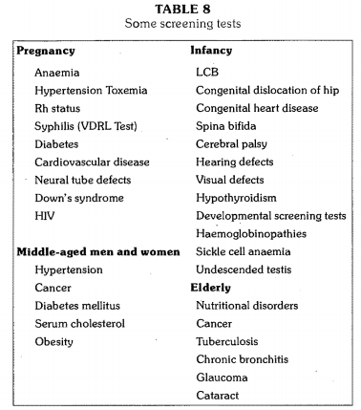
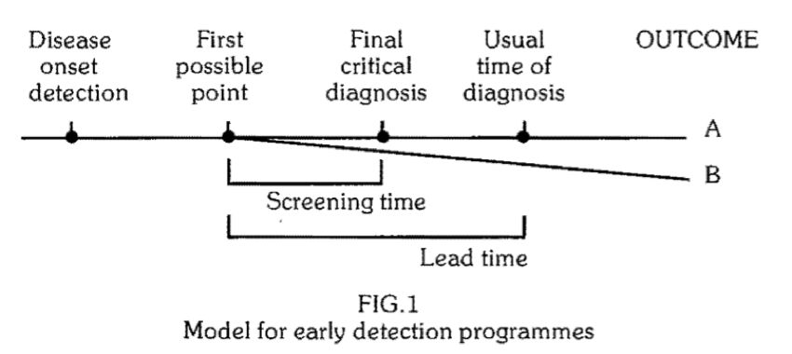
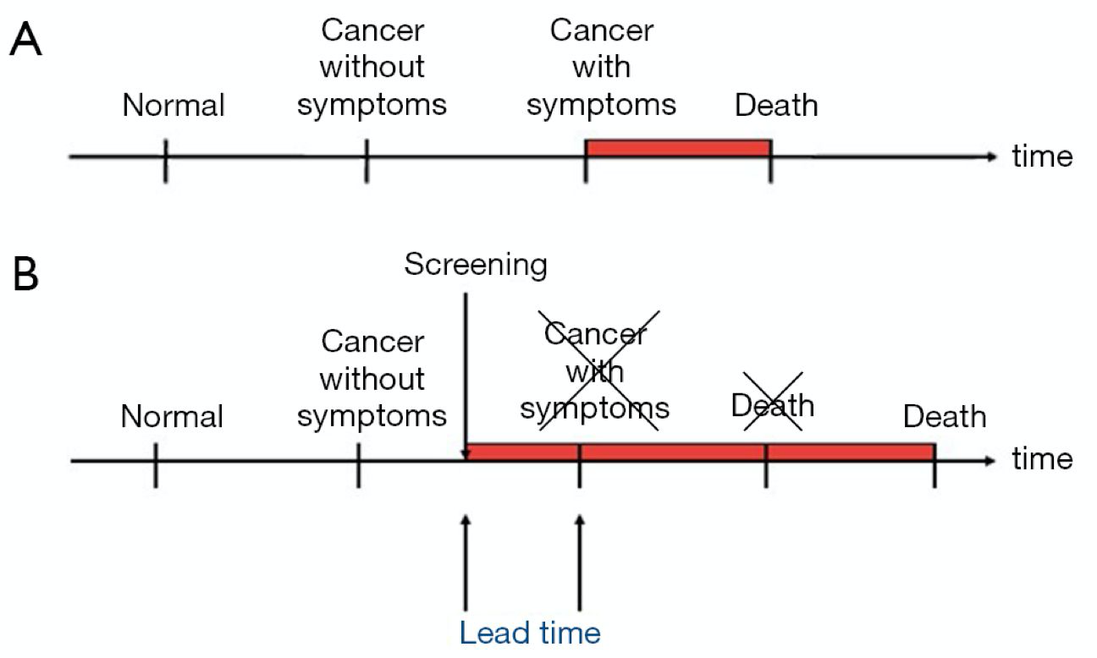
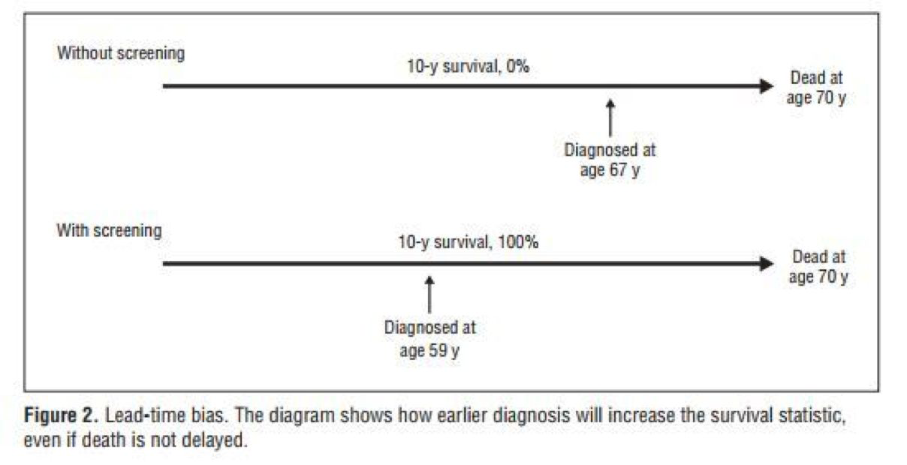
Lead Time
L5- Screening
Definition
The search for unrecognized disease or defect by means of rapidly applied tests, examinations or other procedures in apparently healthy individuals.
Uses of Screening
1
Case detection ²: people screened for their own benefit.
For example: Screening for breast cancer, PKU, deafness in children
2
Control of disease ³: people are screened for the benefit of others
For example: TB to protect population
3
Research purposes such as measuring the prevalence and incidence.
4
Educational opportunity: creating public awareness and educating health professionals.
is the outcome of the disease.
Is the outcome to be detected when the disease is detected at the earliest possible moment
B-A= is the benefit of the screening program.
1
Lead time is the advantage gained by screening presented by alteration in the outcome.
2
It is defined as the period between diagnosis by early detection (screening) and diagnosis by other means
3
The benefit of the program must be seen in terms of its outcome, so if there’s no benefit in early detection the lead time is considered a bias and doesn’t provide critical info.
Lead Time Bias
Lead time bias is an increase in the perceived survival time (what you see) without affecting the outcome. For example, if there’s an untreatable cancer and its survival time was 10 years, even if you diagnose the case early the outcome is the same.

Slide 15
Concepts Related to Screening
L5- Screening cont’
We need to differentiate between screening and other terms, which are:
Case-finding
Diagnosis and diagnostic tests
Periodic examination
Is testing for infection or disease in populations or in individuals who are not seeking health care.
For example: serological testing for AIDS virus in blood donors, neonatal screening and premarital screening for syphilis.
Screening tests ¹
Use of clinical and/or laboratory procedures to confirm or refute the existence of disease or true abnormality in patients with signs and symptoms presumed to be caused by the disease.
For example: VDRL testing of patients with lesions suggestive of secondary syphilis; endocervical culture for N. gonorrhoeae.
Diagnostic tests
text
Screening vs Diagnostic tests ²
Difference | Screening test | Diagnostic Test
Target | Apparently healthy | People with indications or sick
Application | Applied to groups | Applied to single patients all diseases are considered
Evidence | Test results are arbitrary and final | Diagnosis is not final but modified in light of new evidence, diagnosis is the sum of all evidences
Criteria | Based on one criterion/cut-off point | Based on evaluation of sign(e.g diabetes), symptoms and laboratory findings
Accuracy | Less accurate | More accurate
Cost | Less expensive | More expensive
Treatment | Not a basis for treatment | Basis for a treatment
Initiative | From the investigator or care-providing agencies | From the patient with a complaint
A screening test is not intended to be a diagnostic test. It is only an initial examination. Those who are found to have positive test results are referred to a physician for further diagnostic work-up and treatment
However, the criteria in the table are not hard and fast. There are some tests which are used both for screening and diagnosis, e.g., test for anaemia and glucose tolerance test. Screening and diagnosis are not competing, and different criteria apply to each.

Slide 16
Concepts Related to Screening
L5- Screening cont’
The use of clinical and/or laboratory tests to detect disease in individuals seeking health care for other reasons
For example: the use of VDRL test to detect syphilis in pregnant women. Other diseases include pulmonary tuberculosis in chest symptomatics, hypertension, cervical cancer, breast cancer, diabetes mellitus.
Case finding
It is a common and important part of office practice. Its purpose is the detection of asymptomatic illness and the prevention of disease before irreversible pathological changes occur using a number of standard procedures such as counseling, examination, and lab tests..
Periodic Health Examination
Screening vs Periodic Health Examination ²
Difference | Screening | Periodic Health Examination
Application | Wide application | Individual application
Cost | Inexpensive | Consumes money
Time | Requires less time from the physician | Consumes physician time
Types of Screening
Mass screening
VS
High risk / Selective screening
Mass screening simply means the screening of a whole population or a sub-group, as for example, all adults.
It is offered to all, irrespective of the particular risk individual may run of contracting the disease in question (e.g., Tuberculosis)
Not useful for preventive measures
Screening will be most productive if applied selectively to high-risk groups, the groups defined on the basis of epidemiological research
For example: screening for diabetes, hypertension, breast cancer in patients with positive family history
Screening for risk factors.

Slide 17
Criteria for Screening Diseases
Criteria for Screening Tests
important health problem ¹
Has an effective treatment
Recognizable latent ² or early symptomatic and it’s natural history of the condition should be understood ³
There should be an agreed-on policy concerning whom to treat as patients
Criterias for Screening Diseases
There is a test that can detect the disease
Good Evidence (i.e. the number of lives saved) that early detection and treatment reduces morbidity and mortality
Facilities should be available to confirm the diagnosis
Expected benefits ⁴ of early detection exceeding risks and costs
1
Acceptability:
A screening test should be acceptable to people at whom it is aimed.
Painful (bone marrow biopsy), discomforting or embarrassing (rectal/vaginal exam) tests are not acceptable to the population in mass campaigns
2
Repeatability:
A screening test must give consistent results when repeated more the once on the same individual under the same conditions
3
Validity:
Refers to what extent the test accurately measures which it claims to measure
For example: Glycosuria vs Glucose tolerance test (GTT) to diagnose diabetes (glycosuria is a useful screening test however GTT is more valid)
In other words, the prevalence should be high. If the disease wasn’t an important health issue the costs will exceed the benefits making the screening program not cost effective.
We can’t screen for rapidly fatal diseases or diseases with short preclinical stage because there’ll be no time between screening and diagnosing and this will make the screening program not efficient
So that we can know at what stage the process ceases to be reversible
For example the number of lives saved

Slide 18
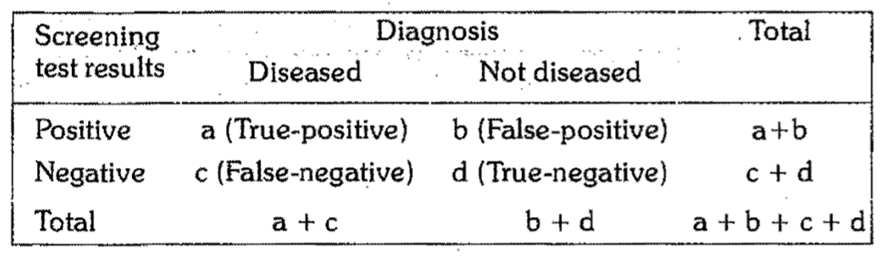
Components of Validity
Sensitivity and Specificity
 | Sensitivity | Specificity
Definition | The ability of the test to identify correctly all those who have the disease, that is true positive Percentage of true positives | The ability of a test to identify correctly those who do not have the disease, that is true negatives Percentage of true negative
Example | 90% sensitivity means that 90% of diseased people screened by the test will give a “true-positive” result and the remaining 10% a “false negative results” | 90% specificity means 90% of non-diseased people will give “true-negative” result, 10% of non diseased people screened by the test will be wrongly classified as “diseased” when they are not
Formula
Predictive Accuracy
Definition | Reflects the diagnostic power of a test Depends upon the sensitivity, specificity and disease prevalence It is the probability that a patient with a positive test result has in fact the disease in question The more prevalent is a disease in a given population, the more accurate will be the predictive value of a positive screening test
Predictive Value | Predictive Value of a Positive Test | Predictive Value of a Negative Test
Formula
Percentage of False +/-
Definition | Opposite to sensitivity and specificity and is more important to clinicians
Percentage | Percentage of False-Negative | Percentage of False-Positive
Formula

Slide 19
L6 - Global health program & policies
Definitions
Policy
Policy is a law, regulation, procedure, administrative action, incentive, or voluntary practice of governments and other institutions.
Health Policy
Health policy refers to decisions, plans, and actions that are undertaken to achieve specific health care goals within a society.
Global Health
An area of study, research and practice that places a priority on improving health and achieving equity in health for all people worldwide.
Emphasizes transnational health issues, determinants and solutions.
Inter and multi disciplinary collaboration within and beyond health sciences.
A synthesis of population based prevention and individual level clinical care.
Global Health Governance (GHG)
The formal and informal institutions, norms and processes which govern or directly influence global health policy and outcomes.
Goals of Health Policy
Why health policies are needed?
A health policy can achieve several things
It defines a vision for the future which in turn helps to establish targets and points of reference for the short and medium term.
It outlines priorities and the expected roles of different groups.
It builds consensus and informs people.
The Policy Process
Step 2
Step 1
Step 3
Step 4
Step 5
Identify the problem or the issue
through health indicators and trends
Policy Analysis:
2.1: identify and describe the policy options.
2.2: assess them.
2.3: prioritize them.
Develop a strategy
for furthering adoption of policy solution
Policy enactment
Policy implementation

Slide 20
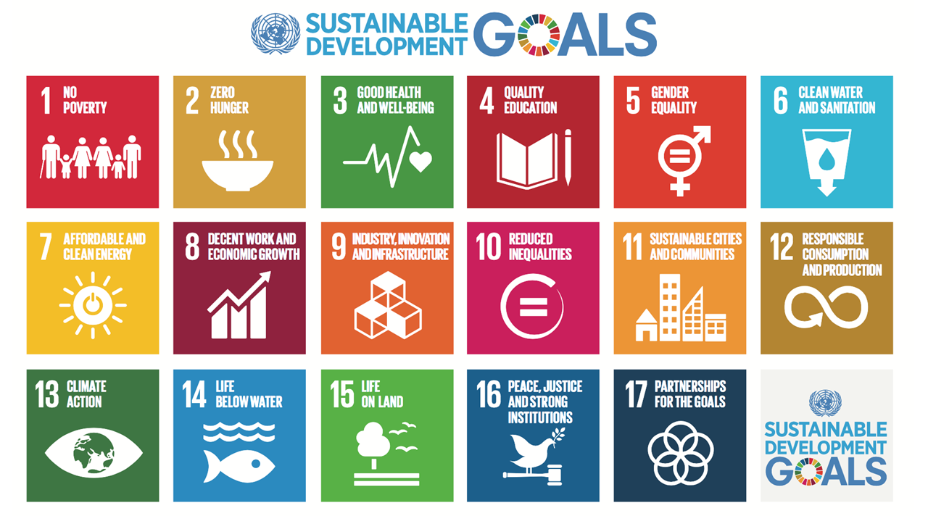
L6 - Global health program & policies cont’
Macro- vs. Micro- Health Policy
Macro Policies
VS
Micro Policies
Broad and expensive national policies that are developed at the national level.
Developed based on population-health needs.
Affects a large portion of the population (region or country).
Define the country's vision priorities, budgetary decisions, course of action to sustain health.
More specific to the level of organizations or individuals.
Based on the operational needs of the facility; which differ by organization (from hospital to another).
These policies affects:
Employees. - Operations.
Ethics. - Safety.
Research.
Global Health Players and Challenges
Global Health Major Players:
1
International Organizations
E.g. WHO, UNICEF , World Bank
5
Philanthropies
E.g. Gates Foundation
2
Multilateral Entities
E.g. G8, G20
6
Global Public-Private Partnership
3
Multilateral Initiatives
E.g. GAVI (Global Alliance for Vaccines and Immunizations)
7
Private Sector Industries
E.g. Tobacco and oil industries
4
Bilateral Initiatives
E.g. PEPFAR (President's Emergency Plan for AIDS Relief)
8
Civil Society
Impact of financial crisis and globalization
Global Health Challenges:
Multiple, diverse, emerging health threats
Failure in delivery & access to both existing and needed interventions
Disparities and inequities continue
Fragile health system unable to achieve SDG targets

Slide 21
L7 - National Health Policies & Programs
Health under vision 2030
Aims of the National Transformation program
The Kingdom will achieve its “Vision 2030” objectives through three main pillars:
The First Theme (Transform Healthcare) in the NTP seeks to achieve a vibrant society by restructuring the health sector to become a comprehensive and effective system.
Limited quality and inefficient health services
Difficult access to health services
3 Major Challenges
01
Limited preventive healthcare
Main entities involved in Transforming Healthcare
1
Ministry of Health
2
Saudi Council Health
3
Saudi Food and Drug Authority
4
The Saudi Red Crescent Authority
5
Ministry of Education¹
6
King Faisal Specialist Hospital and Research Center
1-Ministry of Education is responsible for the Human Capital that is needed in the healthcare sector, (Human Factor is very important)

Slide 22
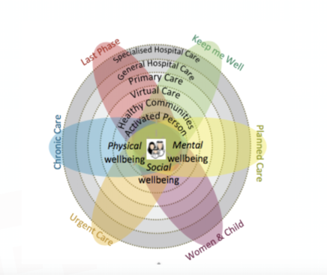
Three strategic objectives to transform healthcare under Vision 2030:
1
Ease Access to Health Services
2
Improve Quality and Efficiency of Healthcare Services:
3
Promote Prevention Against Health Risks
expansion of total capacity (number of beds and medical staff)
adequate geographical distribution (distance from healthcare provider)
timely and affordable access to related healthcare services
improvement of the quality and efficiency of the healthcare services
Improvement of the safety of the healthcare facilities
ensuring adequate healthcare coverage with financial sustainability
promoting public health and preventive healthcare (such as awareness and vaccination) to minimize the risks associated with health crises and diseases of communicable diseases, non-communicable diseases, and injuries
New Models of Care Program
التحول المؤسسي ونموذج الرعایة الصحیة
Systems of Care
The program has been designed to answer six key questions:
1. How will the system help to keep me well? (preventive care)
2. How will the system support me when I have an urgent problem? (urgent care)
3. How will the system support me to have a great outcome for my planned procedure? (planned care)
4. How will the system support me to safely deliver a healthy baby? (women & child)
5. How will the system support me with my chronic conditions? (chronic care)
6. How will the system support me with compassionate care during the last phase of my life? (palliative care; last phase)
Levels of Care in the New Models of Care Program:
1- Activated Person
2- Healthy Communities:
Active individuals are at the heart of the model by enabling them and their families to maintain their health, through self-care services, and health education.
The second level emphasizes the role of healthy communities in supporting active individuals By encouraging them to adopt a healthy lifestyle, providing them with appropriate information, and empowering them to access to community health facilities.
3- Virtual Care
4- .Primary Care
Virtual care will be a powerful source of health advice. Virtual care in most instances will serve as people’s first point of contact with medical care providers, improving people’s access to medical advice and guiding them to navigate the healthcare system and seek appropriate care.
5- Secondary Care (general hospital care).
6- Tertiary Care (specialized hospital care).

Slide 23
Health in all policies (HiAP) in national health policy
The New Models of Care program has been designed based on the following FIVE principles:
1
Empowering people and their families to take control of their health
2
Providing knowledge to people as part of their treatment, and enabling them to be well-informed and in control of their health
3
Fully integrating the health system from the people’s perspective
4
Keeping people healthy and focusing on the whole population through a preventive approach, rather than a solely curative approach to health provision
5
Providing treatment in a patient-friendly and outcome-focused way, without overtreating or under-treating patients.
The Enablers of New Model of Care program
Private Sector Participation
eHealth
Financing
Workforce
Governance & Regulations
Non-profit Sector Participation
Health in All Policies (HiAP)
HiAP is an approach to public policies across sectors that systematically takes into account the health implications of decisions, seeks synergies, and avoids harmful health impacts in order to improve population health and health equity.
As a concept, it reflects the principles of: legitimacy, accountability, transparency and access to information, participation, sustainability, and collaboration across sectors and levels of government.
Announced at the 8th Global Conference on Health Promotion, Helsinki, Finland, 10-14 June 2013
1
2
3

Slide 24
Teaching
L8 - Health Education and Promotion
Health Education & Prevention:
LEVEL OF PREVENTION | GOAL OF HEALTH EDUCATION
Primordial prevention ¹ | Promote health by reinforcing healthy practices ²
Primary prevention ³ | Prevent ill-health, maintain the highest level of health & improve the quality of life
Secondary prevention ⁴ | Understand health behavior underlying the ailments and means of behavioral changes to prevent further deterioration of health or restoration of health
Tertiary prevention ⁵ | Make the most of the remaining potential for healthy living
Factors Influencing Human Behaviour
CULTURE ⁶
RESOURCES ⁷
THOUGHTS & FEELINGS
INFLUENCE OF OTHER PEOPLE ⁸
^{For ex.: In a kidney disease}
Sum of beliefs and values shaping the behaviour of
a community
• Availability of dialysis
• Accessibility of transportation
• Affordability to pay
• Acceptability
• Knowledge
• Beliefs
• Attitudes
• Values
• Leaders
• Elders
• Friends
Learning
"Change of behavior brought about by experience ⁹, insight, perception or a combination of the three, which causes the individual to approach future situation differently"
Knowledge
Cognitive domain ¹⁰
Psychomotor domain
Skills
Affective domain
Teaching enable learning
Attitudes Belief
1: Preventing the development of risk factors in healthy individuals.
2: Exercising, sleeping and eating well.
3: Preventing the development of disease in individuals with risk factors.
4: In individuals who already have the disease and preventing it from getting worse.
5: In individuals who are already affected by the disease and improving their quality of life.
6: It’s hard to convince some people in consuming less dates or honey, because it’s part of their culture.
7: It’s called bottleneck analysis (BNA).
8: Peer pressure is very important and crucial in changing people’s behavior.
9:Happened to them once or to any of their relatives.
10:Cognitive domain is connected to the cortical function (higher function).

Slide 25
The Health Belief Model for Behavior Change
1
Knowledge: An intellectual acquaintance with facts, truth, or principles gained by sight, experience, or report.
2
Value: Ideas, ideals, customs that arouse an emotional response for or against a thing or a behavior.
3
Beliefs: Acceptance of or confidence in an alleged fact or body of facts as true or right without positive knowledge or proof; perceived truth.
VARIABLES IN THE BEHAVIOR CHANGE
4
Attitudes: Manner, disposition, feeling, or position toward a person or thing.
5
Perceptions: Ascribing meanings to sensory or cortical activity in such a way that the activity comes to acquire symbolic function
6
Skills: The ability to do something well, arising from talent, training, or practice.
7
Self-efficacy: The internal condition of experiencing competence to perform desired tasks which will influence the eventual outcome.
The model postulates
Health behavior of all kind is related to a general health belief that one is susceptible to a health problem (Perceived susceptibility)
Health problems have undesirable consequences (Perceived seriousness or severity)
Health problems and their consequences are preventable.
If health problems are to be overcome, barriers have to be overcome
Phases of the health belief model
perceptions
Modifying factors
Likelihood of action
Perceptions of susceptibility
Perception of severity or seriousness
Demographic variables (age, level of education) & Socio-psychological variables (personality, self-esteem, peer pressure) & Structural variable (knowledge, or experience of a health problem)
Perceived benefits Minus Perceived barriers
Perceived threat of the disease
Likelihood of taking recommended preventive action
Cues to action (mass media campaign, reminder from a physician, illness of a friend)

Slide 26
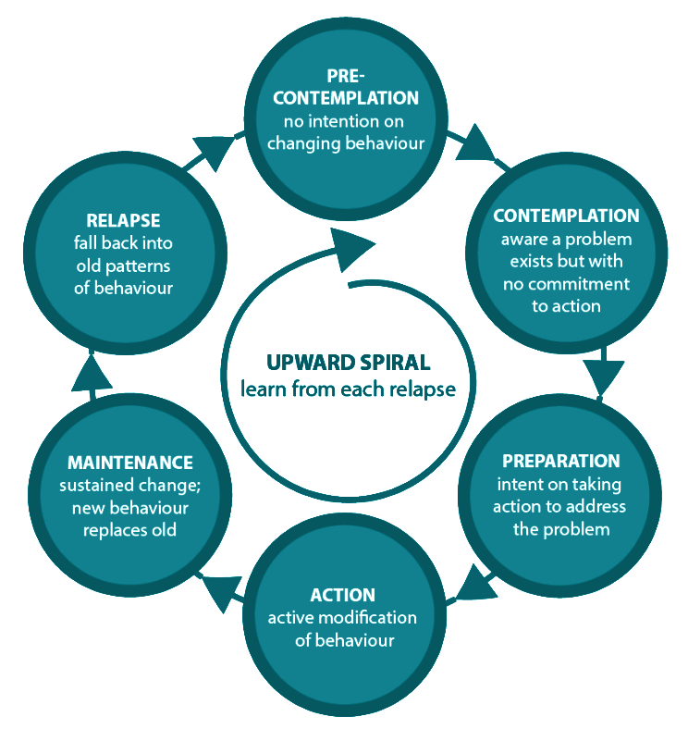
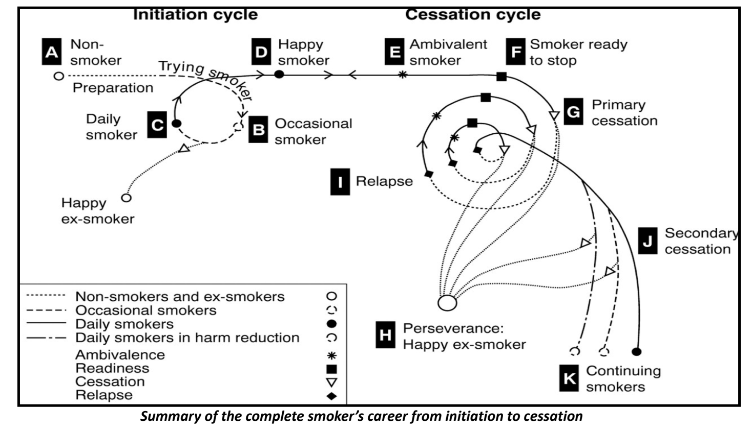
Transtheoretical Model: Stages of Motivation
Methods of Health Education
Maintaining a health-risky behavior
1
Lack of knowledge of the health risk
Modified perception of risk
REASONS
2
3
01
Low self efficacy to change
Stages related to individual's motivation
(The Transtheoretical Model should be viewed as cyclic rather than a straight line)
Pre-contemplation
No interest or consideration for behavior change (denial, ignorance, demoralization)
Contemplation
Thinking about making a change
Preparation
Person's imagining himself with different behavior
Action
Making specific changes
Maintenance
New behavior becomes a life-long pattern.
1
Direct Methods (Face to Face)
Individual
Group
communities
2
Indirect Methods (Mass Media)

Slide 27
L9 - Health of People with Disabilities
Definitions
Health
“State of complete physical, mental, and social well- being, not merely the absence of disease or infirmity"(WHO, 1948).
In recent years, this statement has been amplified to include the ability to lead a "socially ¹ and economically productive life”
Quality of Life¹
“Individual's perception of their position in life in the context of the culture and value systems in which they live and in relation to their goals, expectations, standards and concerns.” (WHO)
Disability
A long-term physical, mental, intellectual, or sensory impairment, which in interaction with various barriers may hinder their full and effective participation in society on an equal basis with others. Always we focus on Barriers.
Dimensions of Disability:
Impairment is a problem in body function or structure
Activity limitation is a difficulty encountered by an individual in executing a task or action.
Participation restriction is a problem experienced by an individual in involvement in life situations.
Development of Disability ²
Medical Model:
The impairment is the barrier
Disease
Impairment
Disability
Handicap
Departure from health
Damage to a body part or aberration of physiological function
Inability to carry out function/activity
Limitation of person’s role
The medical model of disability says people are disabled by their impairments or differences.
Under the medical model, these impairments or differences should be ‘fixed’ or changed by medical and other treatments.
The medical model looks at what is ‘wrong’ with the person and not what the person needs. It creates low expectations and leads to people losing independence, choice and control in their own lives.
Social Model
The society is the barrier
The social model of disability says that disability is caused by the way society is organised, rather than by a person’s impairment or difference. It looks at ways of removing barriers that restrict life choices for disabled people. When barriers are removed, disabled people can be independent and equal in society, with choice and control over their own lives.
It can be subdivided into: community attitudes, environmental barriers and institutional barriers
1- The term quality of life is much broader than the term health and it can be measured through tools and questionnaires to estimate a person’s quality of life
2- An example here is blindness. Looking at it through the medical model. Blind people are the problem and we cannot make them equal to normal people. However, if we look
at it through the social model. The society is to be blamed for putting the barriers to those people. For example, instead of putting a sign we should put a voice recording.

Slide 28
Environmental factors: Capacity vs. Performance
Capacity | Performance
Indicates what a person can do in a standardized environment, often a clinical setting, without the barriers or facilitators of the person’s usual environment The highest probable level of functioning of a person in a given domain at a given moment. | Indicates what a person does in the current or usual environment, with all barriers and facilitators in place. Not always capacity will be better than performance and not always performance is better than capacity.
Health Conditions associated with Disability
1
Children
Hearing problems
Vision disorders
Speech problems
Dyslexia
Cerebral palsy
Learning disabilities (associated with autism, attention deficit)
2
Non-communicable Diseases
Diabetes
Cardiovascular disease
Mental disorders
Cancer
Respiratory illnesses
3
Infectious Diseases
HIV
Malaria
Poliomyelitis
Leprosy
Trachoma
4
5
Injuries: RTA (Road Traffic Injuries)
Arthritis and Back Pain
Types of Disabling Barriers
Barrier | Description
Attitudinal | Negative attitudes leading to rejection and marginalization.
Communication | Are experienced by people who have disabilities that affect hearing, speaking, reading, writing, and or understanding. Examples: Lack of accessibility to transport and information system (sign language) Specialized services: availability, accessibility and quality
Physical | Structural obstacles in natural or manmade environments that prevent or block mobility or access Examples: Steps and curbs that block a person with mobility impairment from entering a building or using a sidewalk
Policy | Inadequate policies and standards which does not consider the needs of people with disabilities, or existing policies and standards are not enforced. Examples: Insufficient funding for implementation of policies and plans.
Social | Lack of consultation and involvement of persons with disability.
Transportation | Lack of adequate transportation that interferes with a person’s ability to be independent and to function in society.

Slide 29
Prevention of Disabilities and Rehabilitation
Type | Description
Primary Prevention | Premarital genetic counseling Maternal and neonatal care Screening of neonates for hypothyroidism Expanded program on immunization School services
Secondary Prevention & Tertiary Prevention | In 2ry prevention we try to prevent complications from happening, while in 3ry prevention we try to limit the disability that resulted from the complication by the means of rehabilitation.
 |  | Intervention | Prevention
 | Health condition | Medical treatment or care | Health promotion, Nutrition, Immunization
 | Impairment | - Medical treatment or care - Surgery | Prevention of the development of further activity limitations
 | Activity limitation | - Assistive devices - Personal assistance - Rehabilitation therapy | Preventive rehabilitation, Prevention of the development of participation restrictions
 | Participation restriction | - Accomodations - Public education - Anti-discrimination law - Universal design | Environmental change, Employment strategies, Accessible services, Universal design, Lobbying for change
 | After the person gets a complication from the disability he has or even before he gets one, we can start rehabilitation. Outcome of Rehabilitation includes: Prevention of the loss of function Slowing the rate of loss of function Improvement or restoration of function Compensation for lost function Maintenance of current function

Slide 30
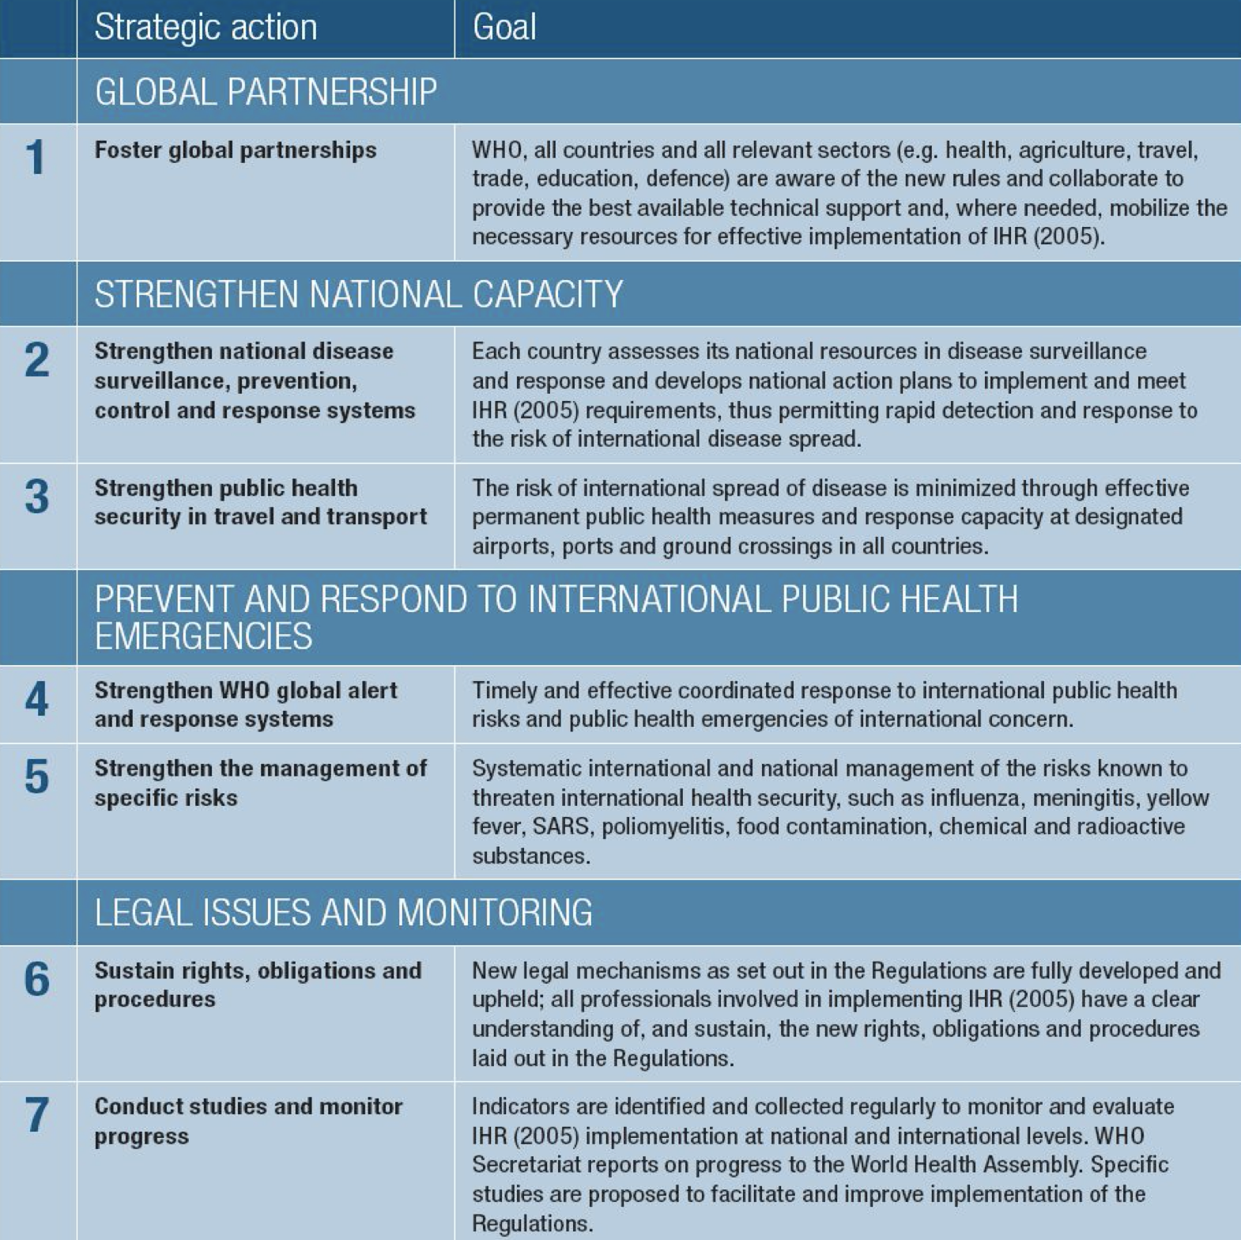
L10- International Health Regulation
What is IHR?
A legally-binding agreement.
It significantly contributes to global public health security.
Providing a new framework for the coordination of the management of events that may constitute a public health emergency of international concern.
improves the capacity of all countries to detect, assess, notify and respond to public health threats.
Why were the IHR revised?
Cross border travel and trade have increased
The challenge of emerging and reemerging infectious diseases
Only 3 diseases (cholera, plague and yellow fever) narrow scope
Dependence on affected country to notify and lack of mechanism for collaboration between WHO and affected countries
Lack of a formal internationally coordinated mechanism to contain international disease spread
IHR 2005
Purpose and Scope
Differences between IHR 1969 and 2005
To prevent, protect against, control and provide a public health response to the international spread of diseases.
From three diseases to all public health events not diseases
In a way commensurate with and restricted to public health risks.
From passive to pro-active using real time surveillance/ evidence
Which avoid unnecessary interference with international traffic and trade. Should be notified
From control of borders to detection and containment at source
Globally adopted strategies to control public health related diseases
Notifiable diseases under IHR 2005
1
Any case of the following 4 diseases:
Awareness
Smallpox, Poliomyelitis, SARS and Cases of
human influenza caused by a new subtype.
2
Any event of potential international public health concern, including:
Technical area
Those of unknown causes or sources
Even if not listed in points 1
Legal and monitoring framework

Slide 31
Major Obligations
1
Core capacity to detect, report and respond
Strengthen national capacity at 3 levels:
community, intermediate and national.
النظام الصحي بشكل عام Health system
وحدات الوبائیات Epidemiology
المختبرات Laboratory
الجاھزیة في جمیع القطاعات Preparedness
توفر الخدمات العلاجیة Case management
مكافحة العدوى Infection control
إدارة الأزمات Disaster management
التواصل السریع Communication
الموانئ Ports
المطارات Airports
المنافذ البریة Ground crossings
Intersectoral collaboration:
الطیران المدني Aviation sector
ھیئة الموانئ Shipping
ھیئة السكة الحدید Railways
الجمارك والجوازات والأمن Customs & Immigration security
"Event-based" surveillance and response at global level
البحث والتقصي Intelligence
التحقق من وجود خطر صحيVerification
تقییم الخطر Risk assessment
الاستجابة Response (GORAN)
الدعم اللوجستي Logistics
Collaboration with International organizations:
Influenza, Polio, SARS, Smallpox, Chemical Safety and EPI
Cholera→ GAVI
Cholera, Meningitis and Yellow fever → ICG Food Safety → INFOSAN
Radionuclear Safety →IAEA
TB, Malaria, HIV\AIDS →GFATM
HIV\AIDS →UNAIDS
2
Comply with routine provision
National Legislation should allow Compliance with IHR
تحدید نقاط الاتصال ومھامھا NFP Designation and Operations
Detection, reporting, verification and control of أعمال الترصد الوبائي والمكافحةevents
Implementation of IHR Documents استعمال وثائق اللوائح الصحية
Definition of implementing structures, organization,roles and responsibility تعريف الجهات المسؤولة وتحديد أدوارها
At 3 levels: Community/Peripheral, Intermediate and
National
تقییم القدرات الأساسیة في كل القطاعات المعنیة بتنفیذ اللوائح
8 Core capacities:
التشریعات Legislation and Policy
التنسیق بین القطاعات المعنیة Coordination
الترصد الوبائي Surveillance
الاستجابة Response
الجاھزیة Preparedness
إدارة المخاطر Risk Communications
الموارد البشریة Human Resources
المختبرات Laboratory

Slide 32
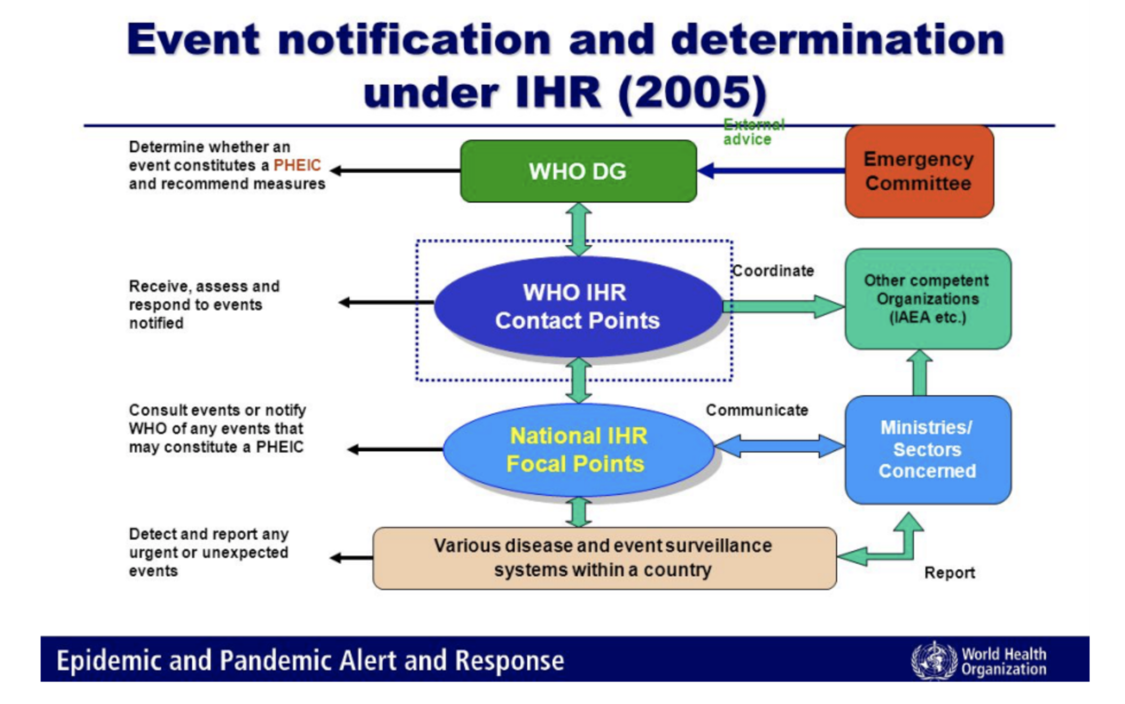
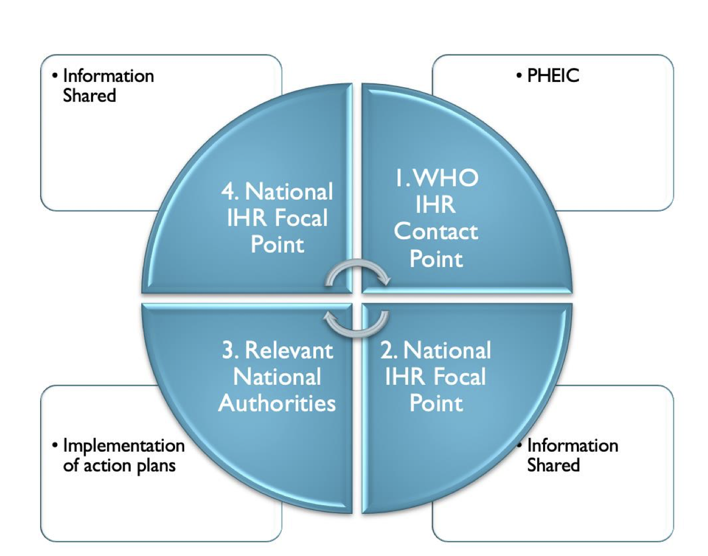
Major Obligations
3
Designation of a National Focal Point
Event notification and determination
Circle of Communications:
“The national center, designated by each State Party which shall be accessible at all times for communication with WHO Contact Points”.
WHO shall designate IHR Contact Points, which shall be accessible at all times for communications with National IHR Focal Points.
Responsible for notification to WHO but not necessarily responsible for carrying out the assessment.
Challenges faced by different countries while implementing IHR
Mobilize resources and develop national action plans
Strengthen national capacities in alert and response
Strengthen capacity at ports, airports, and ground crossings
Maintaining strong threat-specific readiness for known diseases/risks
Rapidly notify WHO of acute public health risks
Sustain international and intersectoral collaboration
Monitor progress of IHR implementation
IHR in Saudi Arabia: Case Study
During Hajj Season of 2014, the country was subjected to the risk of Ebola Virus Disease outbreak during the Hajj season.
What was the action plan conducted under the IHR?
Firstly: the disease was announced to be endemic in west African countries: Guinea, Liberia and Sierra Leone in West Africa. Additionally, a localised spread of the virus was announced in certain areas of Nigeria.
This announcement indicated a Public Health Emergency of International Concern (PHEIC).
Saudi Arabia, as a member state was informed about this PHEIC through the National IHR Focal Point.
The National IHR Focal Point in Saudi Arabia was a representative of the Saudi Ministry of Health.
How does The National IHR Focal Point in Saudi Arabia receive
information from the WHO?
Through the WHO IHR Contact Points.
i.e. (EMRO IHR contact point)

Slide 33
L11- Maternal Health
Definition:
Maternal health refers to the health of women during pregnancy, childbirth and the postpartum period.While motherhood is often a positive and fulfilling experience, for too many women it is associated with suffering, ill-health and even death.
Maternal death:
The death of a women while pregnant, (or within 42 days of termination of pregnancy).
Direct obstetric deaths
Indirect obstetric deaths
Accidental or incidental causes of death are not classified as maternal deaths.
Not Maternal
Death
Irrespective of the duration and site of the pregnancy
4 week
pregnant
Maternal
Death
Why women are dying?
Women die as a result of complications during and following pregnancy and childbirth.
The major complications that account for nearly 75% of all maternal deaths are:
severe bleeding (mostly after childbirth).
high blood pressure during pregnancy (pre-eclampsia and eclampsia).
complications from delivery. And unsafe abortion.
associated with diseases such as malaria, and AIDS during pregnancy.
infections (usually after childbirth). E.g. Tetanus (vaccination is recommended for pregnant women)
Why do women not get the care they need? (Why do these women die?)
1
Delay in reaching care
Delay in decision to seek care
Mountains, islands, rivers — poor organization
3 Delays
Model
-Lack of understanding of complications
-Acceptance of maternal death
-Low status of women
-Socio-cultural barriers to seeking care
2
3
Delay in receiving care
01
-Supplies, personnel
-Poorly trained personnel with punitive attitude
- Finances

Slide 34
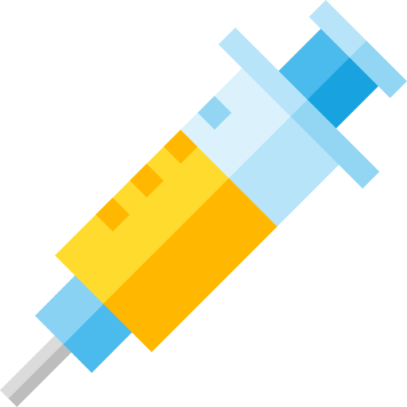
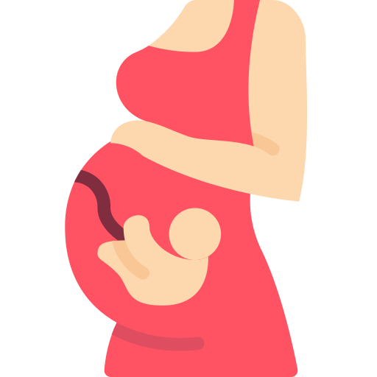
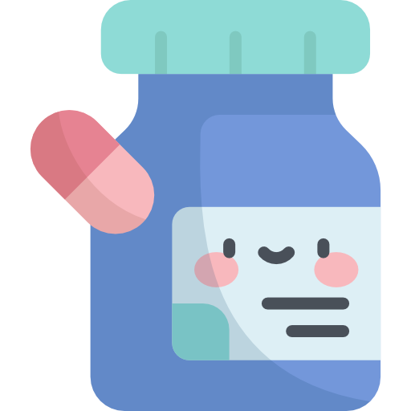
Maternal Mortality Indicators
Remember to multiply by 100 or 1000 to avoid small numbers with decimals
1
2
3
4
Maternal mortality ratio
Maternal mortality rate
Proportion maternal
Life-time risk of maternal morality
The number of maternal deaths per live births =
The number of maternal deaths in a given period per population of women who are of reproductive age =
proportion of all female deaths due to maternal causes =
N of maternal deaths in a period / Number of all female deaths in Same period *100
=
(N of maternal deaths over the reproductive life span) / (women entering the reproductive period)
Maternal deaths
Live births
Maternal deaths
Women of reproductive age
Successful Interventions for Maternal Care
Antenatal care:
Drugs; thalidomide (deformed hands), corticosteroids (impair fetal growth).
streptomycin (8th nerve damage).
Importance and management of lactation.
Advise on birth spacing.
Personal hygiene, dental care, rest (2 hrs) and sleep (8 hrs), regular bowel habits
Identifying high risk pregnancies, smoking and exposure to passive smoking.
Nutrition support
Immunization
Education on delivery and care of the newborn.
Emphasizing on ANC visits and maintenance of AN card.
Why is ANC critical?
Reduces complications from pregnancy and childbirth.
Reduces stillbirths and perinatal deaths.
Integrated care delivery throughout pregnancy.
Keep Going

Slide 35
ANC
History
Physical exam
Abdominal
exam
Confirm pregnancy.
Any previous complications.
Calculate LMP.
Record symptoms; signs of anemia: abnormal vaginal bleeding, palpitation, easy fatigability, breathlessness, generalized swelling.
Any concurrent illness.
Family history and history of drug allergies, or drugs.
General physical.
BP.
High BP; >= 2 readings 140/90
Urine +2 albumin
High BP + albuminuria = preeclampsia .
Weight.
Breast exam.
At 13-14 weeks: the top of the uterus is usually just above the mother’s pubic bone.
20-22 weeks: the top of the uterus is right at the mother's belly button.
36-40 weeks: the top of the uterus is up to the bottom of the mother's ribs.
Babies may drop lower in the weeks just before birth.
Assessment of gestational
age
Ultrasound
Antenatal care counseling
Antenatal
care
Routine US + LMP (history).
Lab investigations:
Pregnancy test, Hb estimation, Urine for albumin and sugar, blood grouping, Rh factor, VDRL, HIV testing, Blood sugar, HBsAg for Hep B.
Fetal assessment:
One ultrasound scan before 24 weeks of gestation (early ultrasound) is recommended for pregnant women to estimate gestational age.
Advantages; improve detection of fetal anomalies and multiple pregnancies, reduce induction of labour for post-term pregnancy, and improve a woman’s pregnancy experience.
Nutritional recommendations:
Daily oral iron and folic acid supplementation with 30 mg to 60 mg of elemental iron and 400 µg (0.4 mg) of folic acid.
A pregnant women should avoid smoked meat to protect herself against toxoplasmosis.
Maternal assessment:
Hyperglycaemia first detected at any time during pregnancy should be classified as either gestational diabetes mellitus (GDM) or diabetes mellitus in pregnancy.
Ask about tobacco use and exposure to second-hand smoke.
history of TB, HIV, and alcohol intake
Preventive services
A seven-day antibiotic regimen is recommended for all pregnant women with asymptomatic bacteriuria (ASB).
Tetanus toxoid vaccination is recommended for all pregnant women.
Common physiological symptoms
Relieves nausea: Ginger, chamomile, vitamin B6 and/or acupuncture.
Relieves low back and pelvic pain: Regular exercise, physiotherapy, support belts and acupuncture.
01
04
Relieves heartburn: Antacid preparations can be offered if symptoms that are not relieved by lifestyle modification first.
02
05
Relieves constipation: Wheat bran and other fibre.
Relieves leg cramps: Magnesium, calcium or non-pharmacological treatment.
03
06
Management of varicose veins and oedema: compression stockings, leg elevation and water immersion.
Click here
Women’s Health (Ministry of Health)

Slide 36
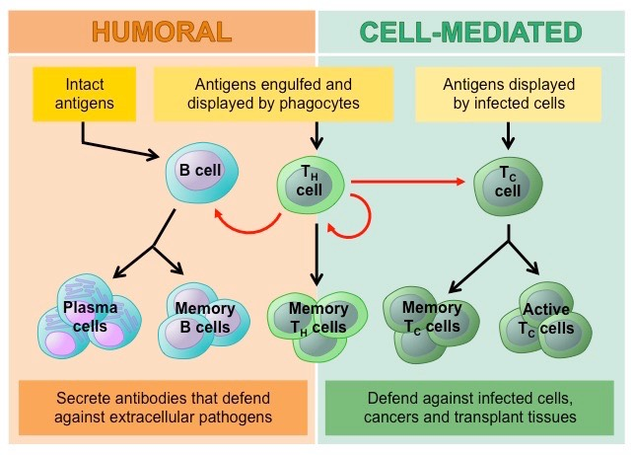
L12- Principles of Immunization
Types of Immunity
Immunity
Active Immunity
Passive Immunity
Natural:
Infection
Artificial:
Vaccination
Natural:
Maternal Antibodies
Artificial:
Monoclonal Antibodies
Types of Active Immunity
Advantages of active immunity compared to passive immunity
Long-lasting protection.
Severe reactions are rare.
Higher protective efficacy.
Less expensive.
Passive immunity is advantageous over active immunity in that the immunity provided is immediate; however, it is considerably shorter unlike active immunity which is long-lasting.
Herd immunity (Community immunity)
When vaccination of a portion of population (or herd) provides protection to unprotected individuals.
Provides an immunological barrier to the spread of disease in the human herd.
Vaccines and their Types
Live, attenuated vaccines | Inactivated vaccines | Polysaccharide vaccines | Recombinant vaccines
Contain a version of the living virus or bacteria that has been weakened (does not cause serious disease in people with healthy immune systems). Contraindication: immunocompromised patients. Example: Viral: Oral polio, Measles, mumps, rubella, Zoster, Varicella, Yellow fever, Rotavirus, Influenza. Bacterial: BCG, Oral typhoid vaccine. | Produced by growing the bacterium or virus in culture media, then inactivating it with heat and/ or chemicals. Not alive and cannot replicate. Always require multiple doses. Contraindication: reaction to a previous dose. Example: Polio (injectable NOT oral), Hepatitis A, Rabies, Pertussis, Typhoid, Cholera, Plague. | Type of inactivated subunit vaccine composed of long chains of sugar molecules. Pure polysaccharide: The immune response to a pure polysaccharide vaccine is typically T-cell independent, which means that these vaccines are able to stimulate B cells without the assistance of T-helper cells. Example: pneumococcal, meningococcal, and Salmonella Typhi. Conjugated polysaccharide: Which are polysaccharides chemically combined with a protein molecule. Example: Haemophilus influenzae type b (Hib). | produced by genetic engineering technology. Example: Hepatitis B human papillomavirus (HPV) Live typhoid vaccine (Ty21a) Live attenuated influenza
Combinations Vaccines
More than one kind of immunizing agent is included in the vaccine.
Doesn’t increase the risk of adverse reactions.
Example: DPT, MMR, DPTP, DPT-Hep B-Hib.

Slide 37
Routes of Vaccines Administration
Route of Administration
Oral administration | Intradermal injection | Subcutaneous injection | Intramuscular injection
• Oral administration of vaccine makes immunization easier by eliminating the need for a needle and syringe. Example: OPV, Rotavirus. | • Administers the vaccine in the topmost layer of the skin. • BCG is the only vaccine with this route of administration. • Intradermal injection of BCG vaccine reduces the risk of neurovascular injury | • Administers the vaccine into the subcutaneous layer above the muscle and below the skin. Example: Measles. | • Administers the vaccine into the muscle mass. • Vaccines containing adjuvants should be injected IM to reduce adverse local effects.
Immunity
Types of Vaccines Vials
Single-Dose Vials: contains one dose and should be used one time for one patient. Doesn’t contain preservatives.
Multidose Vials: contains more than one dose of vaccine. Contain a preservative → can be entered or punctured more than once. After the maximum number of doses have been withdrawn, the vial should be discarded.
Manufacturer-Filled Syringes: prepared and sealed under sterile conditions by the manufacturer. Activate an MFS (i.e., remove the syringe cap or attach the needle) only when ready to use. MFS don’t contain a preservative. Once the sterile seal has been broken, the vaccine should be used or discarded by the end of the workday.
You Got This!

Slide 38
Immunization Schedules
Disease | Vaccine | Dose/Route of administration | Timing | Side effects
Tuberculosis | Bacille Calmette-Guérin (BCG) | 0.05 ml Intradermal | At 6 months | Severe: generalized disease or infections such as osteomyelitis (bone infection); abscess; regional lymphadenitis (lymph node inflammation) Mild: injection site reactions & fever
Hepatitis B | Monovalent (HepB) Pentavalent: with Diphtheria, tetanus, pertussis, and Haemophilus influenzae type b Quadrivalent: DTP+HepB | 0.5 ml Intramuscularly | At birth 2, 4, 6 months | Severe: rare anaphylaxis Mild: injection site reactions (pain, redness, swelling); headache; fever
Diphtheria | (DT/ dT) with tetanus (DTP) with tetanus and pertussis Pentavalent: with tetanus, pertussis, hepatitis B and Haemophilus influenzae type b | 0.5 ml Intramuscularly | 2, 4, 6, 18 months and 4- 6 years | Severe adverse events due to diphtheria toxoid alone have not been reported Mild: injection site reactions, fever
Pertussis | Trivalent (DTP) with tetanus and diphtheria Pentavalent: with tetanus, diphtheria, hepatitis B and Haemophilus influenzae type b | 0.5 ml Intramuscularly | 2, 4, 6, 18 months and 4- 6 years | Severe: rare anaphylaxis, hypotonic– hyporesponsive episodes (loss of muscle tone & responsiveness/ consciousness); febrile seizures; prolonged crying. Mild: injection site reactions (pain, redness, swelling); fever and agitation
Tetanus Recommended during pregnancy | Monovalent (TT) Divalent (DT/ dT) with diphtheria Trivalent (DTP) Pentavalent: with diphtheria, pertussis, hepatitis B and Haemophilus influenzae type b | 0.5 ml Intramuscularly | 2, 4, 6, 18 months and 4- 6 years | Severe: rare anaphylaxis, brachial neuritis Mild: injection site reactions and fever
Haemophilus influenzae type b (Hib) | Monovalent Hib Pentavalent: with diphtheria, tetanus, pertussis and hepatitis B | 0.5 ml Intramuscularly | 2, 4, 6, 18 months | Severe: none reported to date Mild: injection site reactions, fever
Measles | Monovalent Measles only (M) Divalent with rubella (MR) Trivalent with mumps/ rubella (MM, MMR) Quadrivalent with varicella (MMRV) | 0.5 ml Subcutaneous | 9, 12, 18 months and 4-6 years | Severe: thrombocytopenia, anaphylaxis, encephalitis Mild: fever, rash 5–12 days following administration
Mumps Contradicted during pregnancy | (MMR) | 0.5 ml Subcutaneous | 12, 18 months and 4-6 years | Serious: aseptic meningitis (with some strains); orchitis (inflammation of the testicles); sensorineural deafness; acute myositis Mild: injection site reactions; parotid swelling

Slide 39
Immunization Schedules
Disease | Vaccine | Dose/Route of administration | Timing | Side effects
Rubella | (MR)→with Measles (MMR) →with mumps/measles | 0.5 ml Subcutaneous | 12, 18 months and 4-6 years | Mild: injection site reactions
Meningococcal disease | Quadrivalent Meningococcal conjugate (A,C,W135,Y-D) | 0.5 ml Subcutaneous | 9 and 12 Months | Severe: rare anaphylaxis Mild: injection site reaction, fever
Pneumococcal disease | PCVs | 0.5 ml Intramuscular | 2, 4, 6 and 12 months | Severe: none known Mild: injection site reactions and fever
Poliomyelitis | OPV/ IPV | OPV→2 drops orally IPV→ 0.5 ml intramuscularly | 2, 4, 6, 12,18 months and 4-6 years | OPV – Rare vaccine associated paralytic polio (VAPP) IPV – No known serious reactions; mild injection site reactions do occur
Rotavirus gastroenteritis | RV→Monovalent RV,Rotarix | 1.5 ml of liquid Oral | 2 and 4 months | Severe: intussusception Mild: irritability, runny nose, ear infection, diarrhoea, vomiting
Vaccine storage and handling
Proper storage and handling begin with an effective vaccine cold chain.
cold chain: temperature-controlled supply chain that includes all vaccine- related equipment and procedures.
Purpose of cold chain: to maintain product quality from the time of manufacture until the point of administration.
Vaccines are sensitive biological products. If not maintained, vaccine potency may be lost.
Potency is reduced every time a vaccine is exposed to an improper condition. (This includes overexposure to heat, cold, or light at any step in the cold chain). Once lost, potency cannot be restored.
Vaccines that are as sensitive to light as they are to heat include BCG, measles, measles-rubella, measles-mumps-rubella and rubella.
These vaccines are often supplied in dark glass vials.
Among the vaccines, polio is the most sensitive to heat, requiring storage at minus 20 degree C. Vaccines which must be stored in the freezer compartment are : polio and measles.
Vaccine Storage
Carefully select and use the proper vaccine storage units to store vaccines.
Rotate vaccine stock so the oldest vaccines are used first.
Store vaccines in their original packaging with lids closed until ready for administration.
Have a properly calibrated thermometer or temperature recording device inside each storage compartment. Every vaccine storage unit must have a Temperature monitoring devices (TMD).
Check and record storage unit minimum and maximum temperatures at the start of each workday.

Slide 40
Extra
Part of the objectives
Disease | Mode of Transmission | Vaccine
Tuberculosis | Tuberculosis is transmitted mainly by droplet infection and droplet nuclei generated by sputum-positive patients with pulmonary tuberculosis. | Live Attenuated Vaccine (LAV)
Pertussis (Whooping cough) | Whooping cough is spread mainly by droplet infection and direct contact. | Inactivated Vaccine
Rubella | The virus is transmitted directly from person to person by droplets from nose and throat, and droplet nuclei (aerosols) | Live Attenuated Vaccine (LAV)
Diphtheria | The disease is spread mainly by droplet infection. It can also be transmitted directly to susceptible persons from infected cutaneous lesions. | Inactivated Vaccine
Measles | Transmission occurs directly from person to person mainly by droplet infection and droplet nuclei | Live Attenuated Vaccine (LAV)
Tetanus | Infection is acquired by contamination of wounds with tetanus spores. | Tetanus Toxoid (TT)
Hepatitis | Hepatitis A can be transmitted through fecal oral route, parenteral route and sexual transmission. Hepatitis B can be transmitted through parenteral route, perinatal route and sexual transmission. | Hepatitis A - Inactivated Vaccine Hepatitis B - Recombinant Vaccine
Meningitis (Meningococcal) | The disease spreads mainly by droplet infection. The portal of entry is the nasopharynx. | Polysaccharide vaccine
Rabies | People are infected following a deep bite or scratch by an infected animal. Dogs are the main host and transmitter of rabies. | purified· cell-culture vaccine (CCV) embryonated egg-based vaccine (EEV)
Polio | Fecal oral route through contamination and poor hygiene. It can also be transmitted through droplets in its acute phase | OPV (oral) - Live Attenuated Vaccine (LAV) IPV (IM) - Inactivated vaccine

Slide 41
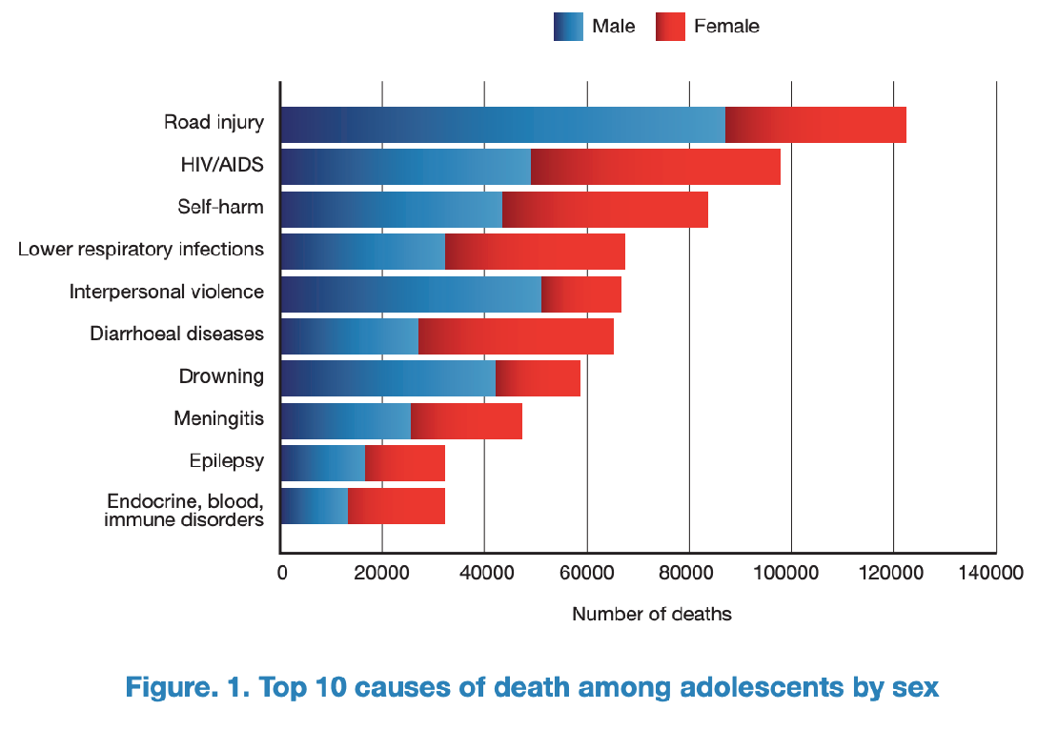
L13- Global Adolescent & Child Health
Adolescents
The second decade: No longer children, not yet adults
The definition vary from country to country and from law to law
WHO has three definitions. The first is adolescence from 10 - 19, 'Youth' from 15-24 , and 'Young People' covers the age range 10-24 years.
CDC immunization schedule: 7th till 19th birthday
Society of adolescent medicine: 10-25
Saudi Arabia, Middle East? unfortunately by law there is no segregation of this age group in saudi arabia nor in the middle east, so we rely on international classification
Adolescents are a diverse population group
Different needs
Changing needs
Why do we emphasize on this age group? because this age group is going in to a rapid change; physiological, psychological, mental and emotional changes.
We also have to appreciate that they need are different and keep change because there is a transition from childhood to adolescence and then from adolescence to adulthood
What makes it different from childhood & adulthood?
A time of rapid physical and psychological (cognitive and emotional) growth and development.
A time in which new capacities are developed.
A time of changing social relationships, expectations, roles and responsibilities.
This age group experience new challenges, develop new capacities and new habits they are semi exposed to the word and therefore it is very very critical the environment that is provided to this population is control environment otherwise they can end up developing risky behavior
Main health problems of adolescents ?
Studies suggests that depression and anxiety are one of the main problems in this age group
Technology use and sedentary lifestyles increase the risk for obesity
The most common cause of death is “Road Injury”
Third is self harm, self harm by poisoning, sharp instruments, medication overdose. This can be grouped with other causes into mental health issues leading to suicide.
Top causes of illness and disability:
Depression
Road traffic injuries
Anaemia
HIV/AIDS
Self-harm
Back and neck pain
Diarrhoea
Anxiety disorders
Asthma
Lower respiratory infections

Slide 42
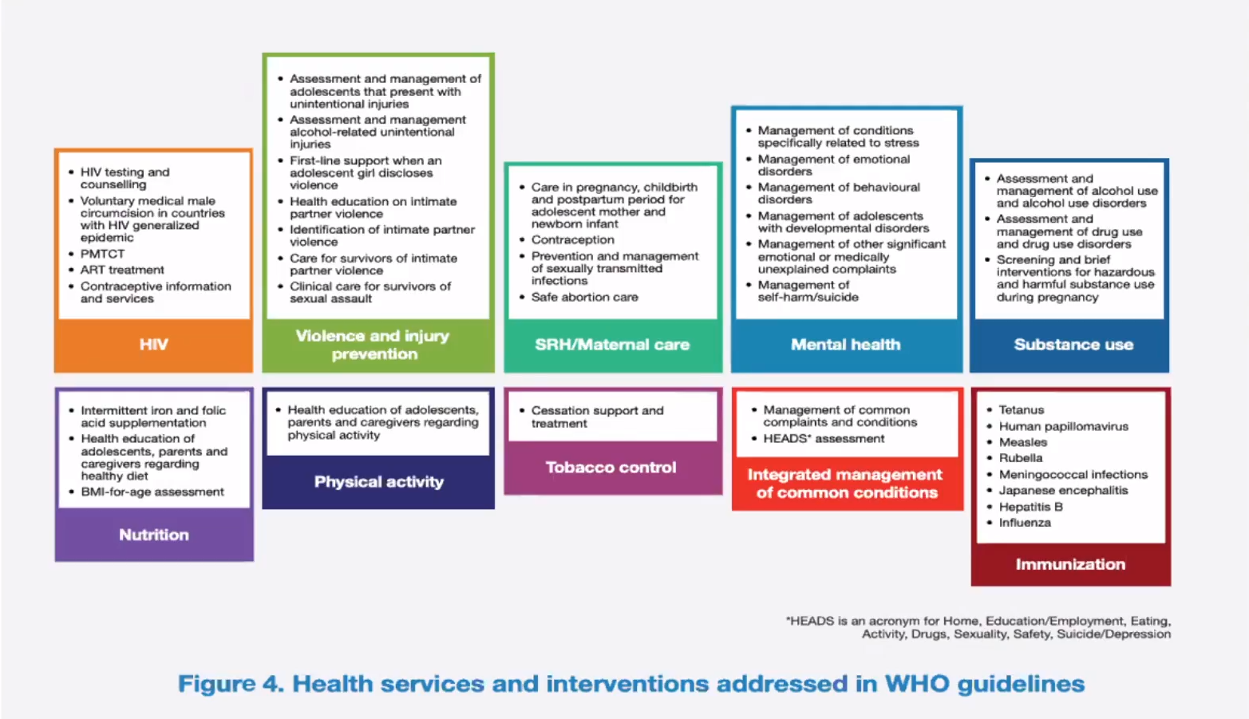
Key health problems in adolescence:
Sexual & Reproductive Health
pic
Other issues
Too early pregnancy
risks to mother
risks to baby
Health problems during pregnancy & childbirth (including unsafe abortion)
Sexually Transmitted Infections including HIV
Harmful traditional practices e.g. female genital mutilation
Sexual coercion
Injuries from accidents & intentional violence
Mental health problems
Substance use problems
Endemic diseases: malaria, schistosomiasis, tuberculosis
Under/over-nutrition
If a girl got pregnant at an early age her body may not be physically mature enough to tolerate the 9 months period of pregnancy, which might predispose the mother to various health issues including malnutrition which is linked to high infant mortality rate
Moreover unsafe deliveries and abortion done in facilities that aren’t qualified enough may cause the mother to get infected with tetanus, which can also kill the baby.
Health problems of adolescents in Saudi Arabia:
There are many studies investigating health problems in the youth of Saudi Arabia ¹.
It is well documented in the literature that young adults from the upper socioeconomic class undergo unlawful sex.
Sex education among females was found to be extremely deficit.
Many studies also documented the increasing use of energy drinks among the kingdom’s youths.
A study also documented that about 30% of this population smokes cigarettes.
Why invest in the health and development of adolescents?
Investment in their health should focus on:
Healthy diet
No Tobacco and Alcohol use
Physical activities
We should also focus on child marriage and try to prevent it at the government level.
What adolescents need & why and are we providing them?
Information & skills (they are still developing)
Safe & supportive environment (they live in an adult world)
Health & counselling services (they need a safety net)
Health services and interventions addressed in WHO guidelines
Saudi Arabia has a plan on adolescence services that was documented in papers in 2009. However, we don’t know really how it is implemented.
if we want to plan some adolescent health services in our country, there are many guidelines this is from WHO for example.

Slide 43
Child Health
56% of death are preventable.
Emerging Issues in Child Health:
Congenital Anomalies
Mostly are related to toxins, radiations or medications.
Injuries
Such as foreign object ingestion, drowning, & caustic injuries. The most frequent ER visit in child under 5 is foreign object ingestion
Non-communicable Diseases
Such as chronic respiratory diseases, acquired heart diseases, childhood cancers, diabetes, and obesity)
Global response:
Sustainable Development Goal (SDGs) 3.2 is the goal that reduce the neonatal death and under 5 mortality
By 2030, end preventable deaths of newborns and children under 5 years of age, with all countries aiming to reduce neonatal mortality to at least as low as 12 per 1000 live births and under-5 mortality to at least as low as 25 per 1000 live births
Indicators of Child Health
Prenatal mortality rate
Neonatal mortality rate
1
Infant mortality rate
2
Under 5 mortality rate
3
Prenatal deaths include both stillbirth and early neonatal deaths
REMEMBER stillbirth means they are born dead, if a neonate died immediately after delivery it’s not considered stillbirth.
We can divide neonatal deaths into early and late deaths.
ALWAYS multiply by 100,000
It is very important to know the
interval of each definition.
4
Global interventions:
1
2
3
Breastfeeding promotion
Growth monitoring
Immunization

Slide 44
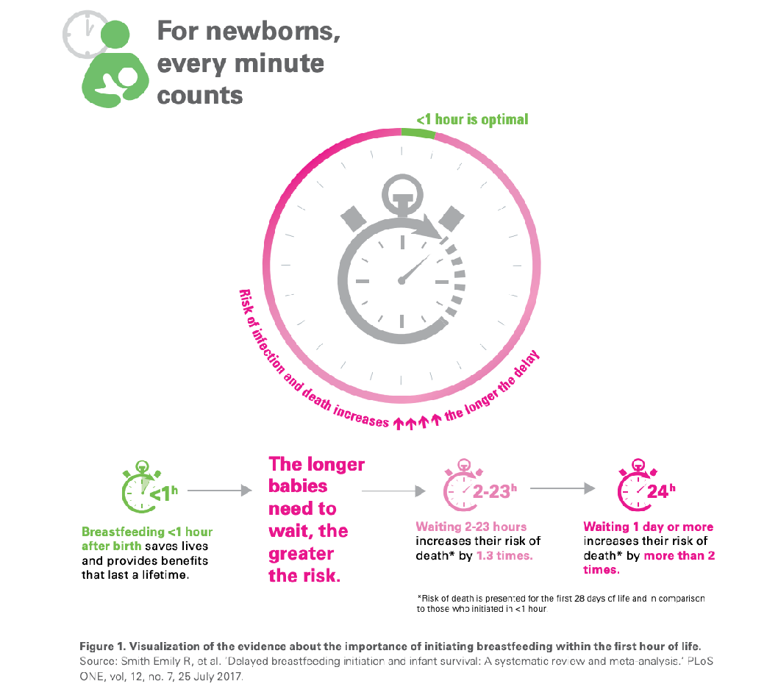
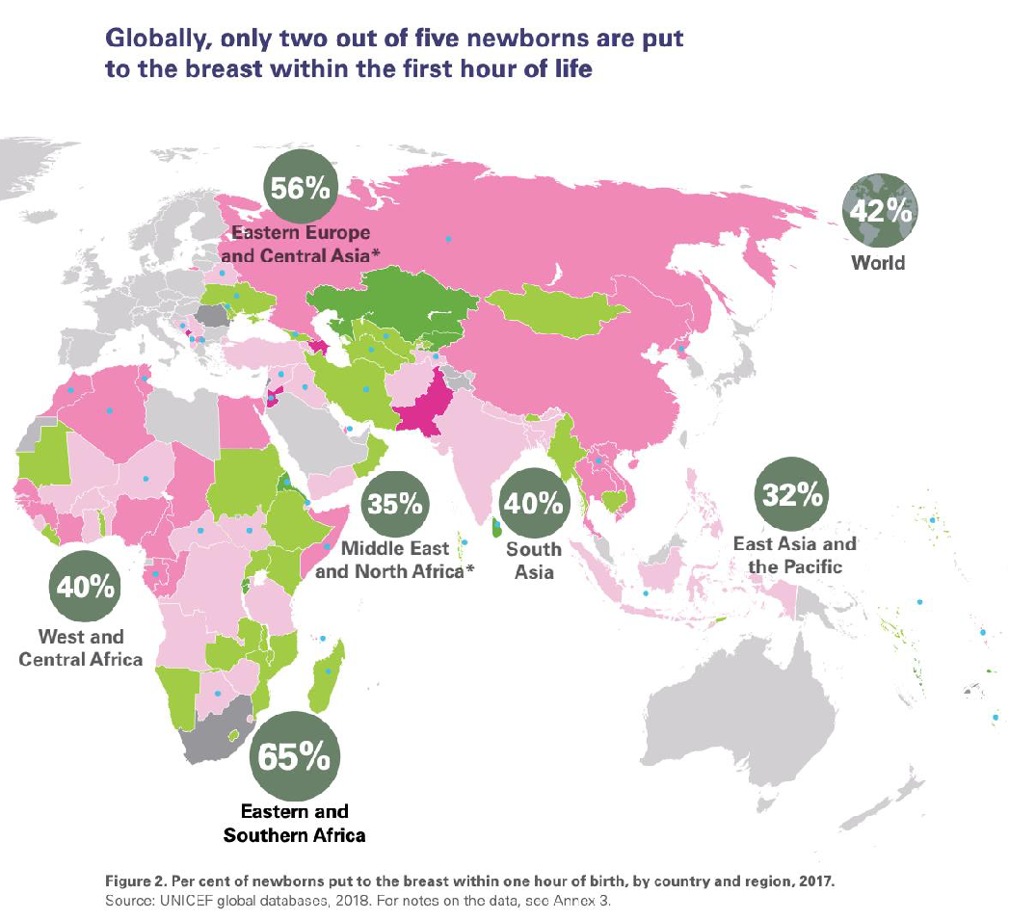
Breastfeeding
WHO Recommendations:
Early initiation of breastfeeding within 1 hour of birth and skin to skin contact
Exclusive breastfeeding for the first 6 months of life
Introduction of nutritionally-adequate and safe complementary (solid) foods at 6 months together with continued breastfeeding up to 2 years of age or beyond
Breastfeeding benefits:
Benefits to the infant
Benefits to the mother
bacteremia
diarrhea
respiratory tract infection
necrotizing enterocolitis
otitis media
urinary tract infection
late-onset sepsis in preterm infants
type 1 and type 2 diabetes
lymphoma, leukemia, and Hodgkin's disease
childhood overweight and obesity
decreased postpartum bleeding and more rapid uterine involution
decreased menstrual blood loss and increased child spacing (lactational amenorrhea)
earlier return to pre-pregnancy weight
decreased risk of breast and ovarian cancers
Growth monitoring
Very essential part in the physical and mental health of a child
The baby’s height and weight should increase during early childhood. If the child’s health remained the same (plateaued) it should rise some worry to the doctor and requires further investigations
“More details in breastfeeding tutorial”
Case: If you see that baby is not growing at normal rate what do you do?
first take history from mother: how often is she breastfeeding, for how long, and if the baby is suckling well. Also Ask about the vaccination & socioeconomic status. Also you should support and encourage mother if she is doing well.

Slide 45
L14- Introduction to Communicable Diseases
Definition
Communicable Diseases: An illness caused by an infectious agent or its toxic product which can be transmitted directly or indirectly or through vector from the reservoir to a susceptible host.
Six Prerequisites for the Transmission of Communicable Diseases
01
The presence of a reservoir of infection.
03
Mode of transmission
05
The presence of a susceptible host
The presence of a microbial agent
Portal of exit through which the microbiological agent leaves the reservoir
Portal of entry or an inlet through which the microbiological enters the host.
02
04
06
Relevant Terms
Control: Refers to the activities conducted to bring a disease or a health problem to a very low level till it becomes no longer a public health problem.
Elimination: Termination of all modes of transmission to a reduction of the incidence of the disease to the zero in a confined or specific geographic locality as a result of deliberate efforts yet, continued intervention methods are required.
Eradication: Termination of all modes of transmission of infection by extermination of the infectious agent.
The concept of eradication is a global one. (complete removal).
Smallpox is the only disease that has been eradicated to date is smallpox.
Types of Reservoir
Human Reservoir | Animal Reservoir | Non-Living Reservoir
Most viral and bacterial respiratory tract infections. Most infections caused by Staphylococci and Streptococci species. Sexually transmitted diseases (STDs). Human reservoir can be either: Case: possesses the infection and shows symptoms. Carrier: possesses the infection but doesn't show symptoms. Importance of Carriers: Number: Carriers may outnumber cases. Difficulty: Carriers don’t know that they are infected. Mobility: Carriers are mobile, cases are restricted. Chronicity: Carriers re-introduce infection and contribute to endemicity. | Animal ←→ Animal → Human Examples: The Plague caused by the bacterium Yersinia pestis was transmitted from rodents to fleas and eventually to humans. Other examples: Toxoplasmosis from cat feces, leptospirosis (rat urine), rabies. | From places like soil and water. Examples: Tetanus Botulism Fungi (ringworm and hookworm)

Slide 46
Agents Factors Related to Development of a Disease
Virulence:
Ability to produce severe pathological reaction. Measured by the ratio of clinical to subclinical disease and case fatality rate.
Spore Formation:
Maintain viability for a long period in unfavorable environmental conditions
Viability of Organism (resistance):
Ability of the organism to live outside the body.
Period of Communicability:
The length of time, from acquiring the infection, during which the infection can be transmitted to another uninfected organism.
01
03
05
07
Pathogenicity:
Ability of the organism to produce disease.
Dose of Infection (Inoculum):
The higher the dose of infection the higher probability of severe disease.
Antigenic Power of the Organism:
Ability to stimulate the immune system. Measured by the second attack frequency.
Ease of
Communicability:
measured by the secondary attack rate, which is the number of secondary cases, occurring within the range of incubation period following exposure to a primary case expressed as a percentage of susceptible.
02
04
06
08
Incubation Period
It is the period between the entry of the organism and the appearance of the first symptom of the disease.
Important for:
Surveillance and quarantine in some diseases.
Application of preventive measures to abort or modify the attack.
Identification of the source of infection.
Modes of Transmission
Direct Transmission |  | Indirect Transmission: agents are transmitted to new hosts through intermediates
Person to person | Transplacental transmission | Airborne Transmission | Vehicle-borne Transmission | Vector-borne Transmission
Touching, biting, kissing, sexual intercourse or direct projection of respiratory droplets. Examples: HIV transmission. | Examples: Mother to Child Transmission (MTCT) of HIV. | Agent is transmitted in dried secretions from the respiratory tract, which remains suspended in the air for some time. Examples: Droplet infection (direct spread): Whooping cough. Droplet nuclei (indirect air-borne): TB, histoplasmosis. Dust particles (indirect air-borne): Fungal spores. | A vehicle is any non-living substance (food and drinks) or object that can be contaminated by an infectious agent, which then transmits it to a new host. Examples: campylobacter, Salmonella and E. coli. Human hands or/and flies. | A vector is an organism, usually an arthropod, which transmits an infectious agent to a new host. Arthropods which act as vectors include houseflies, mosquitoes, lice and ticks. Examples: Dengue hemorrhagic fever: (P: Dengue, R: Monkeys & Humans, V: Mosquito) Encephalitis: (P: Japanese B Encephalitis, R: Wild birds & Pigs, V: Mosquito)
Prevention and control of communicable diseases
5
Measures applied to the reservoir:
Cases: case finding, reporting to the local health authority and isolation.
Carriers: treatment and exclusion from work till the organism is eliminated.
Animal reservoir: animal husbandry, immunization, treatment/killing of infected animals.
1
Measures applied to disease agent:
Sterilization and disinfection
3
Measures applied to the environment:
Sanitation (water/food/sewage)
Measures applied to contact:
Enlistment, surveillance, isolation, and increase resistance by immunization or chemoprophylaxis.
Measures applied to the host:
Health education, hygiene, nutrition, immunization and chemoprophylaxis
2
4

Slide 47
L15- Tuberculosis
Transmission of M. Tuberculosis
1
2
3
4
Spread by droplet nuclei expelled when person with infectious TB coughs,sneezes, or speaks.
Close contacts at highest risk of becoming infected and prolonged exposure usually needed to establish infection.
Risk of transmission outdoors is reduced because of dilution and bacilli are killed by ultraviolet light.
Transmission occurs from person with infectious TB disease (not latent TB infection).
Susceptible hosts:
Low standard of living, malnutrition, alcoholism, HIV/AIDS.
Latent Tuberculosis Infection (LTBI)
Defined as a state of persistent immune response to stimulation by Mycobacterium tuberculosis antigens with no evidence of clinically manifest active TB.
There is an increased chance of developing active TB disease from the infection.
Treatment: Isoniazid
Diagnosis of TB
Medical history & physical examination
Bacteriologic or histologic exam
Chest radiograph
Mantoux tuberculin skin test
Testing for TB Disease and Infection
Tuberculin skin test (Universal test): A tuberculin skin test reaction is considered positive if the transverse diameter of the indurated area reaches the size required for the specific group (If a person was in contact with TB we should do a skin test: if it’s negative (no reaction, 0mm) then we should repeat the test; if negative again we give the vaccine but if positive we give chemoprophylaxis.)
Induration size | Group
≥5mm | HIV-positive persons. Patients with organ transplants and other immunosuppressed patients.
≥10mm | Recent immigrants from countries with a high prevalence of TB. HIV-negative injection drug users. Laboratory personnel. Health care workers. Persons with increased risk of TB e.g. DM, silicosis, …
≥15mm | Persons with no risk factors for tuberculosis

Slide 48
Testing for TB Disease and Infection cont.
Chest Radiograph (it’s important to look at a number of TB x-rays, as you may find them in the exam.)
1
Abnormalities often seen in apical or posterior segments of upper lobe or superior segments of lower lobe.
2
May have unusual appearance in HIV-positive persons.
3
Cannot confirm diagnosis of TB
Arrow points to cavity in patient's right upper lobe
Sputum Specimen Collection
1
2
3
Obtain 3 sputum specimens for smear examination and culture.
Persons unable to cough up sputum, induce sputum, bronchoscopy or gastric aspiration
Follow infection control precautions during specimen collection
Smear Examination: Presumptive diagnosis of TB. Strongly consider TB in patients with smears containing alcohol acid-fast bacilli (AAFB).
Culture: Use to confirm diagnosis of TB. Culture all specimens, even if smear negative.
Blood Tests for TB Infection → Interferon Gamma Release Assays (IGRA): is a simple-blood test, a modern alternative to the tuberculin skin test that can aid in diagnosing M. tuberculosis infection. Highly specific and sensitive. Disadvantage: They do not help differentiate latent tuberculosis infection (LTBI) from tuberculosis disease.
Treatment of TB Infection
DIRECTLY OBSERVED TREATMENT, SHORT COURSE (DOTS) CHEMOTHERAPY: Treatment with the DOTS strategy is the current WHO recommended tuberculosis control strategy.
Include four drugs of initial regimen:
Isoniazid (INH)
Rifampicin (RIF)
Pyrazinamide (PZA)
Ethambutol (EMB) or Streptomycin
Adjust regimen when drug susceptibility result are known
TB for HIV-Negative persons
Extra-pulmonary TB
(Bone and Joint TB, Miliary TB,or TB Meningitis in Children)
In most cases, treat with same regimens used for pulmonary TB
Treat for a minimum of 12 months
Multidrug-Resistant TB (MDR TB)
Presents difficult treatment problems
Treatment must be individualized
Clinicians unfamiliar with treatment of MDR TB should seek expert consultation
Always use DOT to ensure adherence

Slide 49
Preventing and Controlling TB
Three priority strategies:
1
Identify and treat all persons with TB disease
2
Identify contacts to persons with infectious TB; evaluate and offer therapy
3
Test high-risk groups for latent TB infection (LTBI); offer therapy as appropriate
BCG Vaccination
the national policy is to administer BCG very early in infancy either:
At birth or at 6 weeks of age with other immunizing agents such as DPT and polio¹. In KSA, BCG vaccine is given at 6 months.
In countries where tuberculosis is prevalent and the risk of childhood infection is high.
You Did It!

