Slide 1
TBL1- Outbreak Investigations
Objectives
Understand what constitutes to an outbreak
Distinguish between endemic and epidemic
Learn the importance of investigating an outbreak
List the steps of an outbreak investigation
Describe types of studies used to investigate an outbreak
Read an epidemic curve and use it in estimating the incubation period
Calculate the attack rate from outbreak investigation data
Was Done by
Click here for outbreak investigations PDF
Mohmmed Alhumud
Nouf AlHumaidhi
Noura AlTurki
Razan AlRabah
Color Index
Main text
Males slides
Females slides
Doctor notes
Important
Textbook
Golden notes
Extra
Editing File

Slide 2
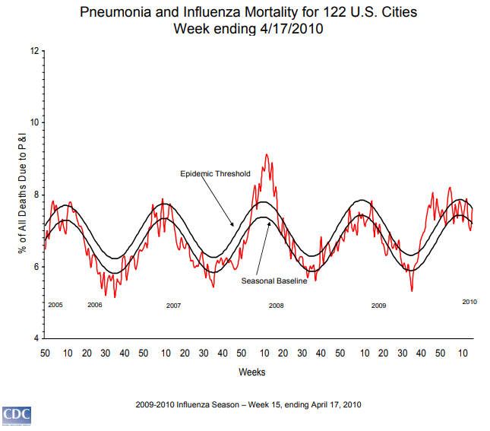
Introduction
Key Terms:
Sporadic | A disease that occurs infrequently and irregularly.
Endemic | The habitual presence of a disease within a given geographic area.
Hyperendemic | Persistent, high levels of disease occurrence.
Epidemic | The occurrence of more cases of disease than expected in a given area or among a specific group of people over a particular period of time. Usually, the cases are presumed to have a common cause or to be related to one another in some way.
Outbreak | Epidemic limited to localized increase in the incidence of disease.
Cluster | Aggregation of cases in a given area over a particular period without regard to whether the number of cases is more than expected.
Pandemic | An epidemic that has spread over several countries or continents, usually affecting a large number of people.
Outbreak settings
Most outbreaks are caused by exposure to contaminated food, water, or direct contact with others
Food-borne Outbreaks
(most common)
Water-borne Outbreaks
Community/Institution Acquired
(most widely varied)
Illness can be minor “self-limited” diseases, or major deadly diseases
Successful investigation of an outbreak can lead to positive advances in future protection of public health

Slide 3
Outbreak settings
Food-borne Outbreaks
(most common)
Water-borne Outbreaks
Community/Institution Acquired
(most widely varied)
Food-borne Outbreaks:
The most common outbreak is in a food borne setting.
A food-borne outbreak is generally considered to exist if there are more than two reports of a similar illness from the same food source, frequently in a restaurant or at a community dinner.
A food-borne outbreak may have a widely varied number of cases, and has no seasonal distribution.
While the food-borne outbreak is the most common, in only about 50% of the outbreaks is the food culprit identified, so a large number of these outbreaks go unsolved.
Outbreak settings
Food-borne Outbreaks
(most common)
Water-borne Outbreaks
Community/Institution Acquired
(most widely varied)
Water-borne Outbreaks:
Infection occurs by either ingesting contaminated water or swimming in contaminated water In disease that occurs from a water-borne outbreak, infection occurs by either ingesting water contaminated by pathogens or by swimming in water contaminated by pathogens.
Most often, these outbreaks are common source types.
The numbers of cases in these outbreaks can be variable and often unknown.
The most common agents responsible for water-borne outbreaks are norovirus, Shigella, Giardia, Crytosporidiosis, and E. coli.
Community/Institution Acquired
(most widely varied)
The most widely varied of the outbreak settings
Include most all types of infectious diseases, such as respiratory diseases and gastrointestinal diseases.
Transmitted most often by person-to-person transmission in schools, hospitals, daycare, nursing homes, prisons, and high density living areas such as military barracks, hotels, and even airplanes.
Some common agents that cause the diseases acquired in a community setting include norovirus, varicella, influenza, rhinovirus, parasites, and adenovirus.
Outbreak settings
Food-borne Outbreaks
(most common)
Water-borne Outbreaks
Community/Institution Acquired
(most widely varied)
Community/Institution Acquired:
The most widely varied of the outbreak settings
Include most all types of infectious diseases, such as respiratory diseases and gastrointestinal diseases.
Transmitted most often by person-to-person transmission in schools, hospitals, daycare, nursing homes, prisons, and high density living areas such as military barracks, hotels, and even airplanes.
Some common agents that cause the diseases acquired in a community setting include norovirus, varicella, influenza, rhinovirus, parasites, and adenovirus.

Slide 4
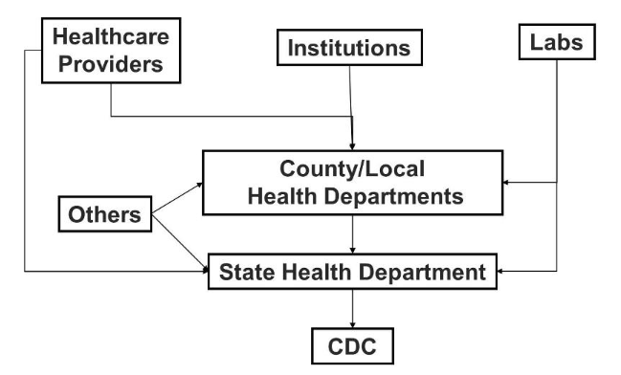
Exercise
1
22 cases of legionellosis occurred within 3 weeks among residents of a particular neighborhood (usually 0 or 1 per year).
Epidemic
2
Average annual incidence was 364 cases of pulmonary tuberculosis per 100,000 population in one area, compared with national average of 134 cases per 100,000 population.
Hyperendemic
3
Over 20 million people worldwide died from influenza in 1918–1919.
Pandemic
4
Single case of histoplasmosis was diagnosed in a community.
Sporadic
5
About 60 cases of gonorrhea are usually reported in this region per week, slightly less than the national average.
Endemic
Detecting Outbreaks
Regular, timely analysis of surveillance data
Reports of cases of notifiable diseases
Alert clinicians call the health department.
Patients or community members can report to
the health department
https://healthmap.org/en/
Community/Institution Acquired
(most widely varied)
The most widely varied of the outbreak settings
Include most all types of infectious diseases, such as respiratory diseases and gastrointestinal diseases.
Transmitted most often by person-to-person transmission in schools, hospitals, daycare, nursing homes, prisons, and high density living areas such as military barracks, hotels, and even airplanes.
Some common agents that cause the diseases acquired in a community setting include norovirus, varicella, influenza, rhinovirus, parasites, and adenovirus.
🤡

Slide 5
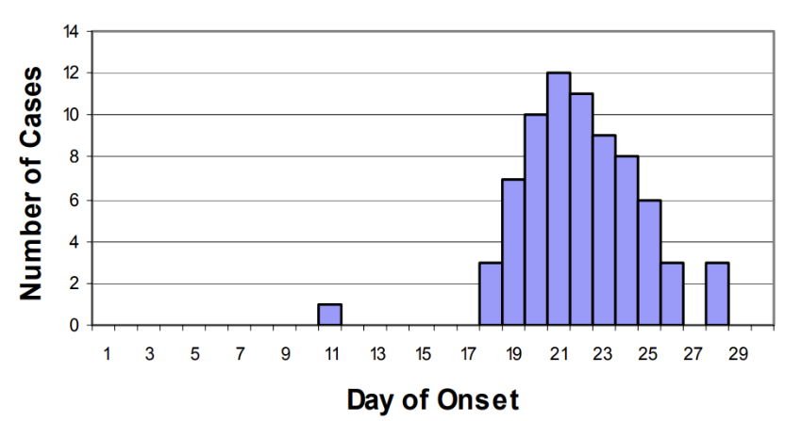
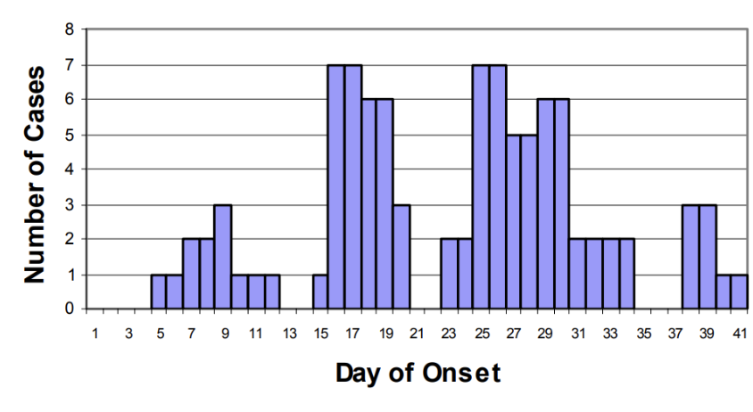
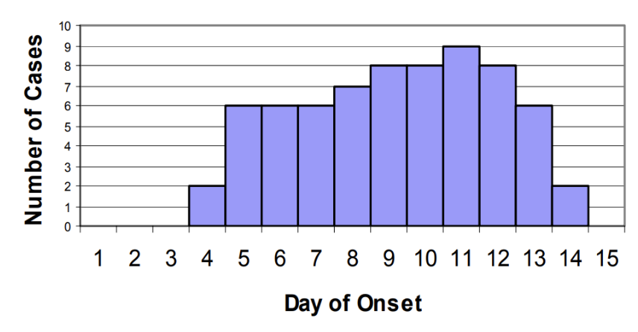
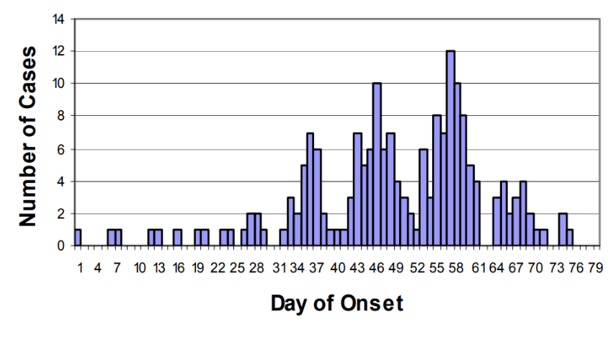
Epidemic Patterns
1
Common
Source
2
Propagated
3
Mixed
4
Others
Common Source
All cases of the infectious disease are acquired from the same source in a limited period of time and in a limited geographical location.
It is also characterized by very minimal (or zero) transmission from person to person.
Generally, a common source outbreak has a smaller number of cases than a propagated outbreak and is often caused by contaminated food or water.
A typical example of a common source epidemic is a foodborne illness caused by exposure to one specific food or restaurant.
Common source epidemics are usually characterized by a dramatic single “peak” of cases.
Many common source outbreaks go unreported since they are generally small in numbers and often don’t come to the attention of public health authorities.
Common Source “Point”: everyone becomes ill within one incubation period.
Common Source “Intermittent”: intermittent nature of the exposure
Common Source “Continuous”: exposed over a period of days, weeks, or longer
Propagated
Characterized by an outbreak that continues over an extended period of time.
This outbreak has individuals exposed to the original source, but then will also have secondary infections in individuals exposed to those initially ill people via person-to- person spread.
The propagated epidemic usually lasts for a longer period of time and has various numbers of “peaks” of cases over time.
The initial source often resolves, but the outbreak continues by affected persons infecting other persons.
Propagated outbreaks often result in larger numbers of cases than common source outbreaks.
Most outbreaks of respiratory diseases, such as influenza, are propagated outbreaks, as well as some food or water borne outbreaks such as those occurring from norovirus infections.

Slide 6
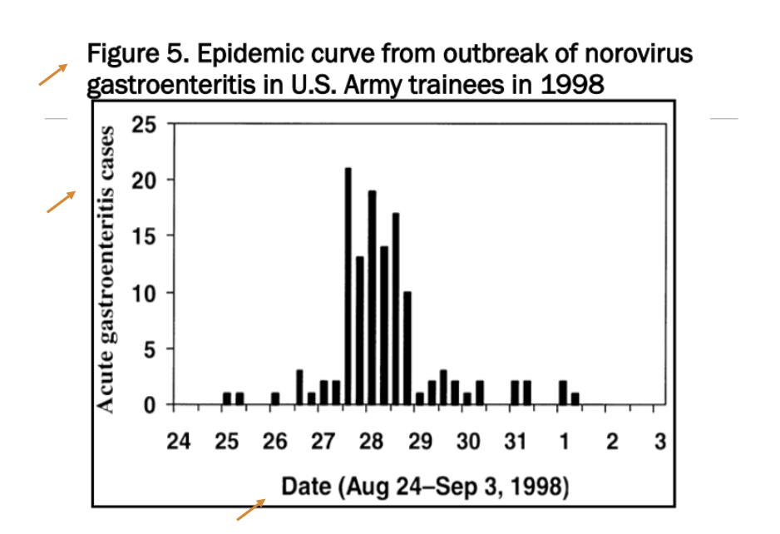
Epidemic Patterns (exercise)
1
21 cases of shigellosis among children and workers at a daycare center over a period of 6 weeks, no external source identified (incubation period for shigellosis is usually 1—3 days) → Propagated
2
36 cases of giardiasis over 6 weeks traced to occasional use of a supplementary reservoir (incubation period for giardiasis 3–25 days or more, usually 7–10 days) → Intermittent or continuous common source
3
43 cases of norovirus infection over 2 days traced to the ice machine on a cruise ship (incubation period for norovirus is usually 24–48 hours) → point source
Making Epidemic Curves
Plot the number of reported cases on the y-axis.
Plot the date/time of symptom onset on the x-axis.
Choose an appropriate time interval for the x-axis, or try several to see which best represents the data.
Include pre-outbreak time on the x-axis to show the “baseline” disease level and to show visually when the outbreak began.
Label the x and y-axes clearly.
Give the epi curve a descriptive, self-explanatory title.
Include more detailed information, such as cases by geographic location or by symptom, if helpful.
To be technically correct, make the bars touch each other (unless there are periods of time with no cases, in which case there will be space between the bars).

Slide 7
Steps of Outbreak Investigation
Each day, health departments learn about cases or outbreaks that require investigation.
Although the U.S. CDC receives over 1000 reported outbreaks per year, this is likely only the tip of the iceberg
Many times outbreaks are not seen in their entirety and never reported
75 million food-borne illnesses in the U.S. each year are estimated to be part of an outbreak that is not reported
Epidemiologists have an “outbreak cookbook”:
The 10 steps of an outbreak investigation assist epidemiologists in investigating an outbreak
Allows investigators to have the best success in determining the cause of the outbreak and preventing future cases of the same disease
Steps organized into categories that:
Identify that a problem exists
Measure the problem
Find the responsible agent
Prevent it from occurring further
Each step is dependent on the successful completion and information obtained in the previous step(s)
1
Confirm the Diagnosis
Identify that a problem exists
2
Confirm the Existence of an Outbreak/Epidemic
3
Define a Case and Count Cases
Orient Data in Terms of Person, Place and Time
Measure the problem
4
5
Determine Who Is at Risk
6
Develop a Hypothesis and Test It
7
Determine Control Measures
Find the responsible agent
8
Plan a More Systematic Study
9
Execute Disease Control and Prevention Measures
Prevent it from occurring further
10
Prepare a Written Report

Slide 8
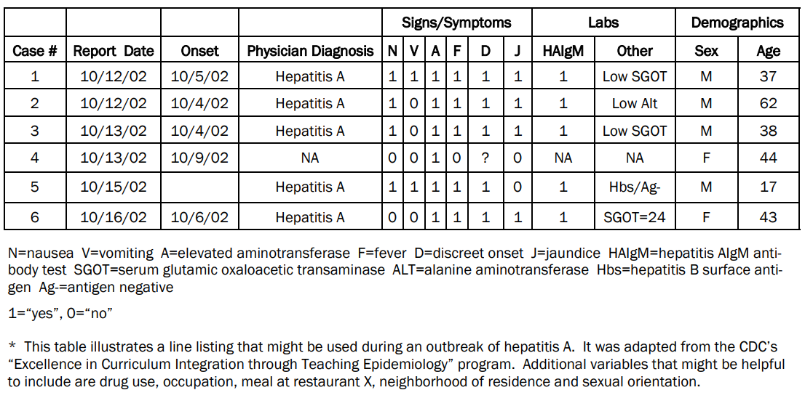
Steps in an outbreak investigation
Step 1: Confirm the Diagnosis
Symptoms need to be reviewed.
Disease must be properly diagnosed:
“Re-look” at records and visit existing cases
Ensure suspected illness is properly diagnosed
Confirm laboratory results/rule out errors
Visit/assess patients (cases)
Summarize clinical and laboratory findings
Step 2: Confirm the Existence of an Outbreak/Epidemic
Very important to establish that the disease being seen in the community is in fact an outbreak Investigations can be costly and time consuming
Normal rate of illness in the population must be known
Time is critical
What is expected number of disease?
Use Health Department Surveillance data
Use hospital discharge records
Use vital records
Use registries
May need to use neighboring rates
Last resort: conduct a survey
Step 3: Define a Case and Count Cases
Case classification (definition) should include:
Clinical symptoms (± 1 symptom can change accuracy)
Laboratory verification
Restrictions of person, place, and time
Do not include the exposure or risk factor you are interested in evaluating
Must classify if cases are “confirmed, suspected, or probable”
Count cases:
Important to find and count all cases that exist
Cast a wide net
Health clinics, hospitals
Advertise
Ask other cases
Meningococcal Disease —Case Definition
Clinical case definition
An illness with sudden onset of fever (>38.5°C rectal or >38.0°C axillary) and one or more of the following: neck stiffness, altered consciousness, other meningeal sign or petechial or puerperal rash.
Laboratory criteria for diagnosis
Positive cerebrospinal fluid (CSF) antigen detection or positive culture.
Case classification
Suspected: A case that meets the clinical case definition.
Probable: A suspected case as defined above and turbid CSF (with or without positive Gram stain) or ongoing epidemic and epidemiological link to a confirmed case.
Confirmed: A suspected or probable case with laboratory confirmation.
Line listing

Slide 9
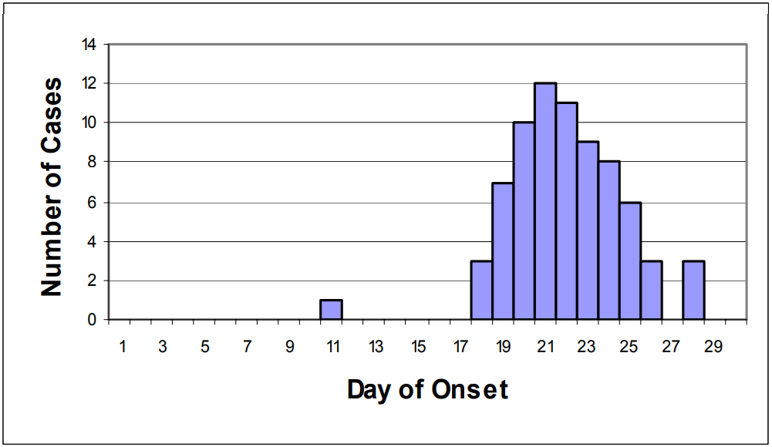
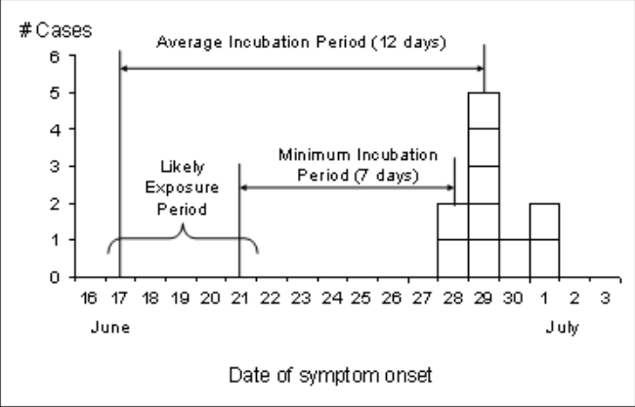
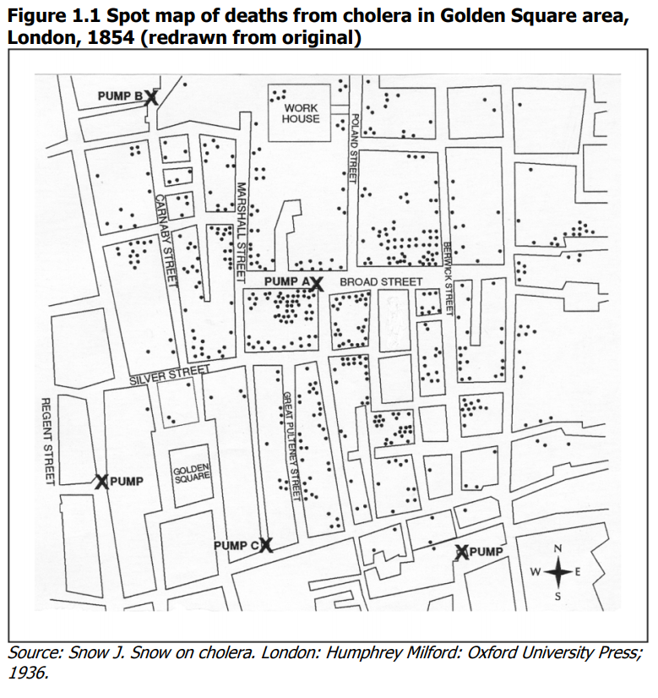
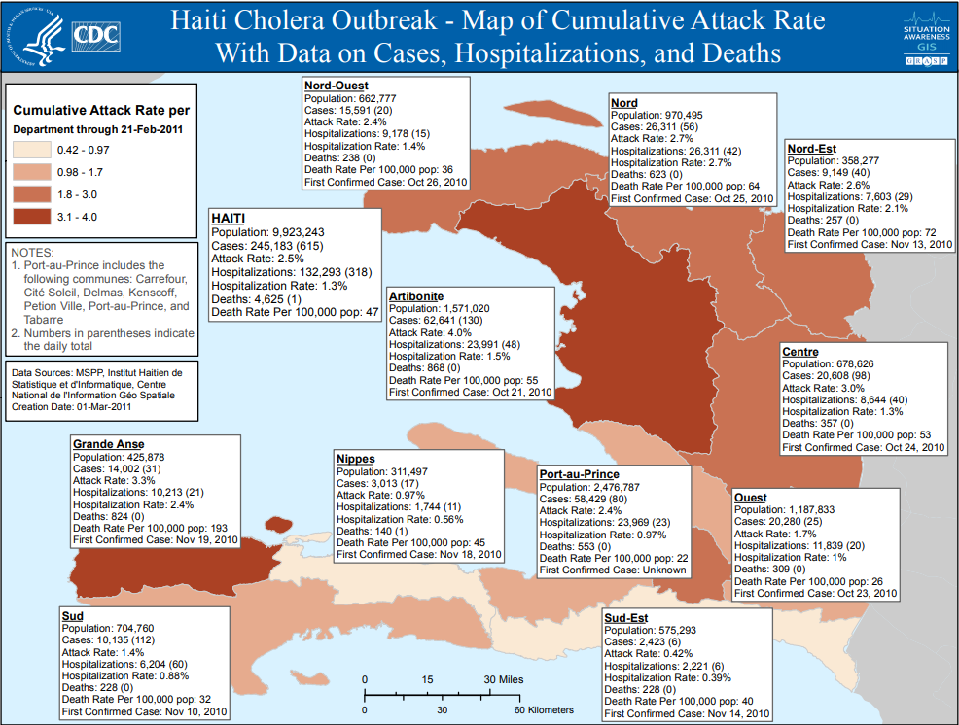
Steps in an outbreak investigation
Step 4: Orient Data in Terms of Person, Place, and Time
Get to know your data
Descriptive Epidemiology
Person: age, race, gender, medical status, exposures
Place: map cases (GIS)
Map attack rates, not numerators
Time: Epidemic curve
Orienting groups of cases by time provides more information about the outbreak and possible cause
Graphing number of cases over time provides an epidemic curve
Earliest set of cases to appear on graph can identify date of first exposure
Can help identify type of outbreak and secondary attack rate
Epidemic curve

Slide 10
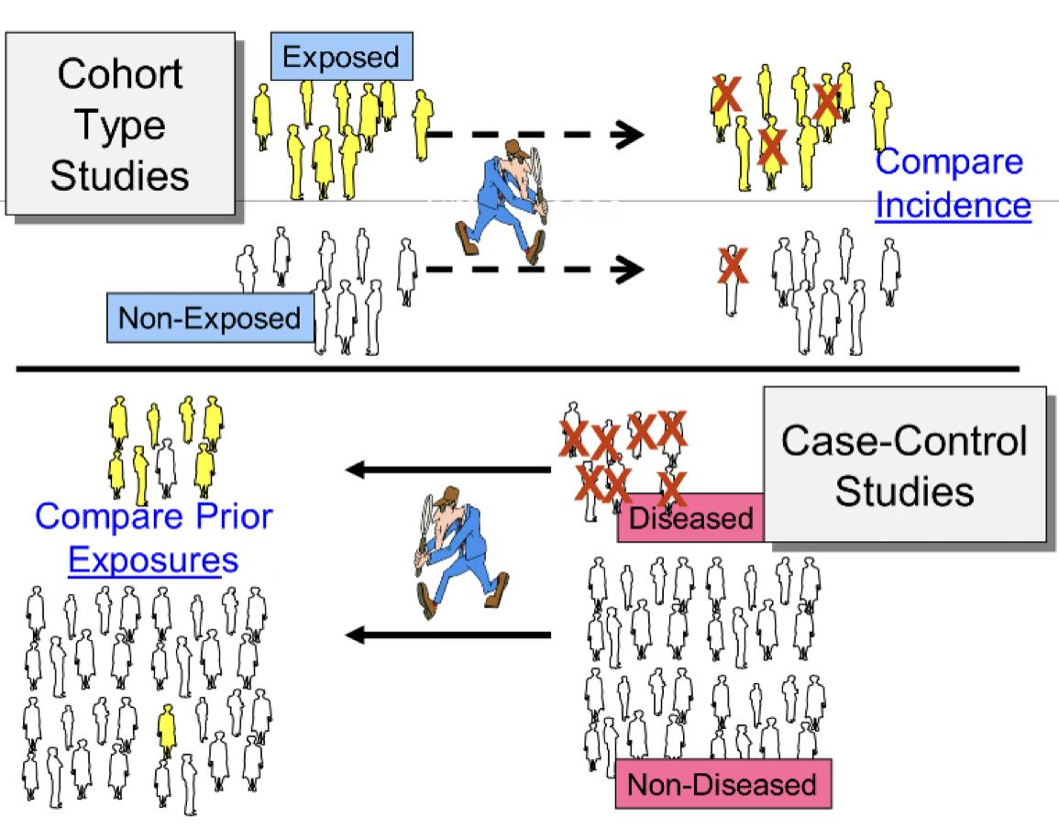
Steps in an outbreak investigation
Step 5: Determine Who is at Risk
Necessary to gather information from subjects who are not cases.
Population at risk is important because:
It will be the population used as controls.
Approach subjects for a study to test the hypothesis to find the cause of the outbreak.
It defines the population for whom prevention and control measures will be targeted
Where did the cases come from.
Using definition of cases, identify population with the same criteria:
Geographic location.
Time period.
Population characteristic.
Look for any remaining cases in population at risk.
This population will also be the target of prevention and control measures
Step 6: Develop a Hypothesis and Test It
Develop a hypothesis to confirm the cause of disease.
Include suspected etiologic agent.
Include mode of transmission.
Identifies expected exposures to transmit the disease.
Specifies population.
Test the hypothesis using a study design:
Case-control study if the population is not well defined and speed of investigation is important.
Cohort study if the population is small and well defined.

Slide 11
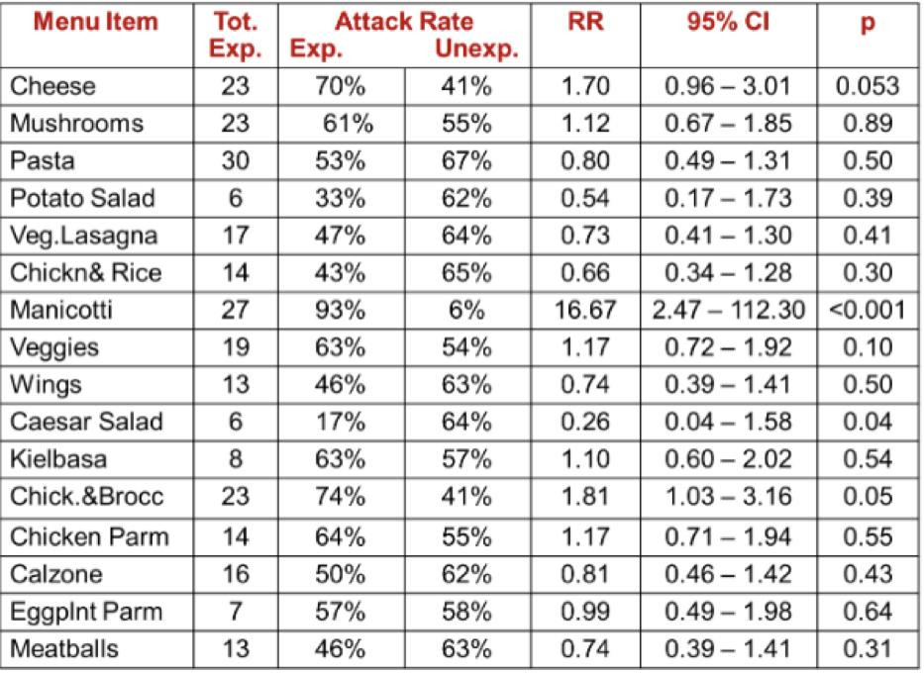
Steps in an outbreak investigation
Step 6: Develop a Hypothesis and Test It cont.
Example of a Cohort Study
A community in Massachusetts experienced an outbreak of Salmonellosis. Health officials noted that an unusually large number of cases had been reported during a span of several days. Descriptive epidemiology was conducted, and hypothesis-generating interviews indicated that all of the disease people had attended a parent-teacher luncheon at a local school. The descriptive epidemiology convincingly indicated that the outbreak originated at the luncheon, but which specific dish was responsible? The investigators needed to establish which dish was responsible in order to clearly establish the source and to ensure that appropriate control measures were undertaken.
Salmonellosis
 | Yes | No | Total | Incidence
Yes | 16 | 7 | 23 | 16/23 = 0.70
No | 9 | 13 | 22 | 9/22 = 0.41
Ate Cheese appetizer (exposed)
Risk Ratio = (Incidence in the exposed group) / (Incidence in the unexposed group).
Example of a Case-Control Study
Within a short period of time 20 cases of hepatitis A were identified in the Marshfield area. The epidemic curve suggested a point source epidemic, and the spot map showed the cases to be spread across the entire South Shore of Massachusetts. Hypothesis-generating interviews resulted in five food establishments that were candidate sources. The investigators identified as many cases as possible, and they selected a sample of non-diseased people as a comparison group (the controls). The "controls" were were matched to the cases with respect to age, gender, and neighborhood of residence. Investigators then ascertained the prior exposures of subjects in each group, focusing on food establishments and other possibly relevant exposures they had had during the past two months.
 | Cases | Controls
Ate at Papa Gino’s | 10 | 19
Did not ate at Papa Gino’s | 9 | 19
Total | 19 | 38
 | Cases | Controls
Ate at Ron’s Grill | 18 | 7
Did not ate at Ron’s Grill | 1 | 29
Total | 19 | 38
Odds Ratio = (10/19) / (9/19) = 1.1
Odds Ratio = (18/7) / (1/29) = 75
Exercise
You are called to help investigate a cluster of 17 persons who developed brain cancer in an area over the past couple of years. Most, perhaps all, used cell phones. Which study design would you choose to investigate a possible association between cell phone use and brain cancer?
A case-control study is the design of choice

Slide 12
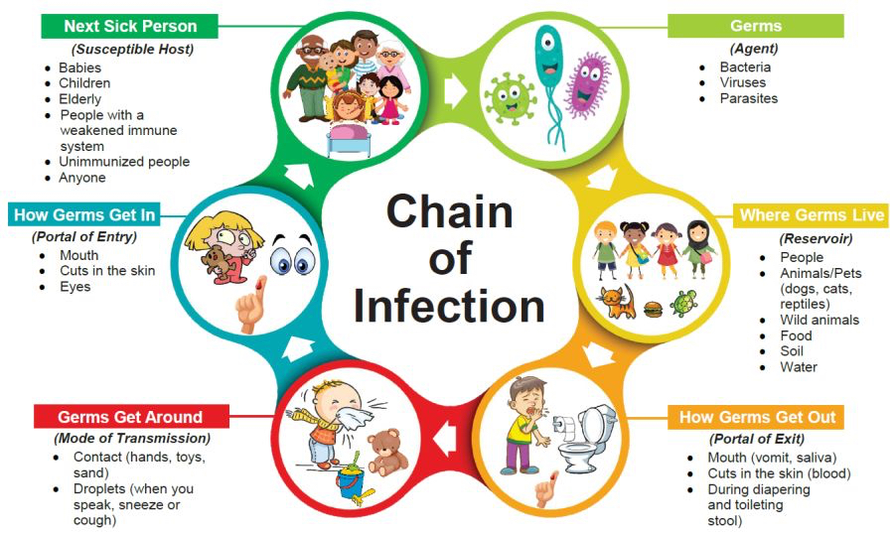
Steps in an outbreak investigation
Step 7: Determine Control Measures
Important to control current outbreak and prevent future outbreaks
Control measures completely dependent on the identified source of the outbreak.
May include treating carriers of infection and vaccinating population at risk
May include comprehensive training programs
May also include:
Destroy implicated food
Close water source or beaches
Treat carriers
Vaccinate susceptible population
Training, etc..
Step 8: Plan a More Systematic Study
It may be necessary to continue to study the outbreak with a more comprehensive design
Initial study may be inconclusive
Reconsider hypothesis
Revisit patients
Expand exposures
Utilize additional lab specimens
Additional or more refined control group
Utilize a more comprehensive design
Perform research to expand knowledge
Step 9: Execute Disease Control and Prevention Measures
As investigation wraps up, it is important to use all information available to prevent the spread or resurgence of outbreak
Activities include:
Implement the necessary control and prevention measures:
Treat carriers
Vaccinate susceptible population
Etc.
Surveillance for future disease occurrence
Regular communication with affected population and health care facilities

Slide 13
Steps in an outbreak investigation
Step 10: Prepare a Written Report
A written report should be prepared in a usual scientific format and should include information about:
The setting and the methods used
Results of any data collection and analysis
The identified causative agent and source
Recommendations for control and prevention
Report should be written for members of affected community
Summary from Dr’s slides
Disease outbreaks can be large or small
In order to determine source of outbreak, there are standard steps that should be taken to:
Identify there is a problem
Measure the outbreak
Find the responsible agent
Controlling the outbreak/prevention of further cases
🤡

Slide 14
Practical Exercise
DESCRIPTION OF THE OUTBREAK
On Friday, February 8th, a private physician telephoned the Baltimore City Health Department to report that on the day before and the morning of his call, he had seen several women with acute sore throat. Each of the women gave a history of attendance at a luncheon at a National Guard Armory on Wednesday, February 6 at 12:00 noon. The physician described the illnesses as characterized by acute onset with chills, fever, general malaise, and sore throat; physical examination revealed inflamed throat with some exudate, cervical adenitis, and temperature between 38.8 to 40.0 degrees Celsius.
In addition, he stated that one of the husbands, who had not attended the luncheon, had an acute sore throat. The physician further made the observation that the wife had brought home some leftover food and her husband had eaten this for supper on February 6.
An investigation was immediately undertaken, and the District Health Officer, who made the first home visits, verified the physician's original report and obtained additional information which indicated that this was an outbreak of major proportions.
The luncheon had been a fund‑raising effort to help fight cancer in children and had been an annual affair of an organization of 96 women for several years. Between 800‑900 people, mostly women, attended the luncheon. The procurement and preparation of the food served had been done largely by the women themselves. A commercial caterer and a restaurateur had voluntarily assisted in the preparation of the food. The complete menu, which was served cafeteria style, was as follows: egg salad, tuna fish salad, macaroni and cheese, cottage cheese with nuts and cherries, pickles and olives, ice cream, coffee and cookies.
A questionnaire was prepared by the Health Department and distributed one week after the luncheon to as many people who had attended as possible. The questionnaire requested the following information: clinical details of the illness, time of onset of the illness, name of the attending physician, history of foods consumed at the luncheon, and a statement whether any food had been taken home and if so, who had eaten it with what result. The accompanying table (see appendix) consists of a summary of the information obtained from the returned questionnaires. Listed in this table are all 96 members of the organization and the 67 guests who supplied information.
SUMMARY OF INFORMATION OBTAINED FROM QUESTIONNAIRES OF MEMBERS
Methods for Handling Data
The data are given in tabular form in the appendix. Information for all 96 members and 67 guests who responded to the questionnaire are available in the table. To extract data from the tables, one could use a highlighting marker to draw a band of transparent color across the line for each case or non‑case, based on your definition of which symptoms constitute illness. In this instance, there are fewer non‑cases than cases. Highlighting the non‑cases will be less work than highlighting the cases. This technique will increase the accuracy of data extraction. Sorting and counting of the data can be done simultaneously by more than one student in the group.

Slide 15
Practical Exercise
Case Definition: You have to consider the best way in which to define a case of illness. There are several possibilities and each definition you choose will yield a different number of cases. The goal is to include as many "true" cases and as few "false" cases as possible. Each definition will differ in its validity, i.e. its ability to properly classify those who are truly sick and those who are truly not sick. As a group, decide which symptom(s) will be your case definition. You will use this to determine the numerator of the attack rates that you will calculate later.
Population at risk: Your group must decide who to include in your study. The individuals you select to be in your study will constitute the denominator of the attack rate you calculate later. Ideally, they should be representative of all the people who ate at the luncheon and thus, all people at risk of becoming ill. To be representative they should be unbiased with respect to the foods eaten and to whether or not they became ill. Consider whether the data for both the members and the guests should be used in your analysis. Do both sets of data meet the requirements for representativeness mentioned above? Why or why not?
Attack rates: Using your case definition and definition of the population at risk of developing illness, calculate the estimated overall attack rate of the illness among those attending the luncheon?
Epidemic curve: Orient the outbreak as to time by tabulating the cases by day of onset, and where possible by time of day. Graph the distribution and find the median time (in hours) of onset. Note that only a date is given in some cases, whereas time of day (AM or PM) is given in other cases. Consider how to use this information while making maximum use of all of the data available. Make any possible inferences as to the type of outbreak and the probable time of exposure.
Food-specific attack rates: An important issue is whether a particular food can be implicated as the source of the agent causing the illness. In order to determine this, make appropriate tables of the rates needed to identify the probable source of the outbreak. Refer to the CDC form in the appendix. Compare the attack rates for eaters and non‑eaters of each food by calculating: (1) the difference between the two rates, and (2) the ratio of the two rates.
Conclusion. What is the responsible food for the outbreak?
Click here for the answers

Slide 16
Dr’s Quiz
MCQ
1- Infectious disease outbreak investigations include both an epidemiological and laboratory component
A- True. B- False
2-In the study of an outbreak of infectious diseases, plotting an epidemic curve is useful because
A- It helps determine the source of the outbreak
B- It shows whether herd community has occurred
C- It helps to determine the median incubation period
D- it helps calculate the attack rate
3- A case definition might include all of the following except:
A- Date of illness onset
B-suspected food
C- Laboratory test results
D- Symptoms of illness
4- You are called to help investigate on an outbreak among a wedding party attendees, which happened three days ago. They report fever, headache, vomiting, and diarrhea. Which study design would you choose to investigate the outbreak?
A- Case control
B- Experimental study
C- Prospective cohort study
D- Retrospective cohort study
5- A sensitive case discussion is one that:
A- Is considered “loose” and includes most cases
B- Is likely to include only (or mostly true cases)
C- Will include less than a specific case definition
D- Will not capture the most severe cases
Answers
Q1 | Q2 | Q3 | Q4 | Q5
A | C | B | D | A

Slide 17
Dr’s Quiz
MCQ
1- Which of the following steps of the outbreak investigation should be at the beginning of the investigation, before undertaking other steps in the following list?
A- Construct a working case definition .
B- Evaluate hypotheses epidemiologically
C- Perform descriptive epidemiology
D- Verify Diagnosis
2-What type of epidemic is depicted in the following diagrams
A- Continuous common-source epidemic
B- intermittent common-source epidemic
C- Point-source epidemic
D- Propagated epidemic
3- You are called to help investigate a cluster of 17 people who developed brain cancer in an area over the past couple years. Most, perhaps all used cell phones. Which study design would you choose to investigate a possible association between cell phone use and brain cancer?
A- Case control
B- Experimental study
C- Prospective cohort study
D- Retrospective cohort study
4- The most appropriate measure of association for case-control data is
A- Attack rate
B- Chi-square
C- Odds ratio
D- Relative risk
Answers
Q1 | Q2 | Q3 | Q4
D | B | A | C

