Slide 1
Tutorial 6: Breastfeeding
Objectives
Demonstrate counselling skills for promotion of breastfeeding feeding (focused on benefits of breastfeeding for the mother and child, and correct way of breastfeeding feeding, advise on prevention on breast engorgement and breast abscesses)
Demonstrate skills to plot growth charts of children
We will discuss Global target for breastfeeding ‘The Baby -Friendly Hospital Initiative As Part of The Global Strategy’
We will discuss Antenatal Infant Feeding Checklist
We will discuss Perceived insufficient milk issue.
History taking for assessment of breastfeeding.
How to assess a breastfeed (attachment, positioning, signs of effective suckling).
Demonstrate skills to plot growth charts of children to aid in breastfeeding counseling.
Student will be confidently support mothers with early and exclusive breastfeeding.
Student can help in movement towards achieving Baby-friendly hospitals and communities.
IMPORTANT FOR OSCE
Was done by
s
Noura AlTurki Wejdan Alnufaie
Rema AlKahtani
Editing File

Slide 2
What are the effects of poor infant feeding on:
1
Families
2
Communities
3
Health services
Global targets 2025: To improve maternal, infant and young child
Breastfeeding target: Increase the rate of exclusive breastfeeding¹ in the first 6 months up to at least 50%
The baby-friendly hospital initiative a part of the global strategy
The WHO International Code of Marketing of Breastmilk Substitutes
Usually abbreviated to the WHO Code was adopted in 1981 by the World Health Assembly (WHA) to promote safe and adequate nutrition for infants
by the protection and promotion of breastfeeding
And by ensuring the proper use of breast-milk substitutes (individual countries) implement the Code
Individual countries implement the Code but they may implement it in the way that they think is best for their countries
They can make their Code a law
1: Only Breast Milk for the first 6 months regardless how ( from the breast or pumping) for the first 6 months with no spplementaition.
Supplementation: Breast milk + milk formulas
The percentage of Exclusive breastfeeding in KSA is around 13%-20%

Slide 3
Perceived insufficient milk
The issue of perceived insufficient milk supply is a frequently occurring problem and is reported globally
Is often reported as the most common problem that women experience with breastfeeding
Frequently leads to early weaning or decreased exclusivity
Antenatal Infant checklist¹
²
³
1: Not nessecerally to cover all during the first visit.
IMPORTANT FOR OSCE
2: Premortes bonding, increase in infant’s respiratory rate, increase in O2 consumption, increase in uterine contractions which decreases the chances of postpartum hemorrhage
3: Mother and infant should sleep in the same room

Slide 4
Recommended Milk Intake and Stooling Patterns for Breastfed Infants¹
Age | Intake (mL per feeding) | Stooling patterns (stools per day) | Stool description
0 to 24 hours | 2 to 10 | 1 | Dark green to black, sticky
24 to 48 hours | 5 to 15 | 2 | Dark green to black, sticky
48 to 72 hours | 15 to 30 | 6 to 8 | Green
72 to 96 hours | 30 to 60 | 6 to 8 | Green
> 5 days | 60 to 120 | 6 to 8 | Light mustard-seed yellow
Look
Look
Look
Observe
Look at the mother herself
Look at how the mother holds her baby
Look at the baby’s condition
Crying? Jaundice? Any Herbs in the bottle?
Observe the baby responds to the breast
How to assess a breastfeed²
Observe how the mother holds her breast for the baby
Observe the baby’s attachment and suckling
Notice how the breastfeed finishes
Observe the condition of the mother’s breasts
Observe
Observe
Notice
Observe
How the mother holds her baby
Mother supports the baby’s whole body
Calm and relaxed? Nervous
The four signs of good positioning of the baby are:
The baby should be straight
Facing the breast
Close to the mother
The baby should be supported
It is easier for the baby to attach to the breast if the mother supports the baby’s whole body. Supporting only the baby’s head and shoulders makes it more difficult. However, supporting the whole body is less important after the first few months, when the baby has more control. If the mother is calm and relaxed, this helps milk flow. If she is nervous, and for example, she shakes or pokes her baby, this can interfere with suckling and breast milk flow.
1: The mother’s belief that she has “insufficient” milk is the main reason why mothers don't breastfeed
2: We don’t touch the mother. We just guide her she has to correct herself.

Slide 5
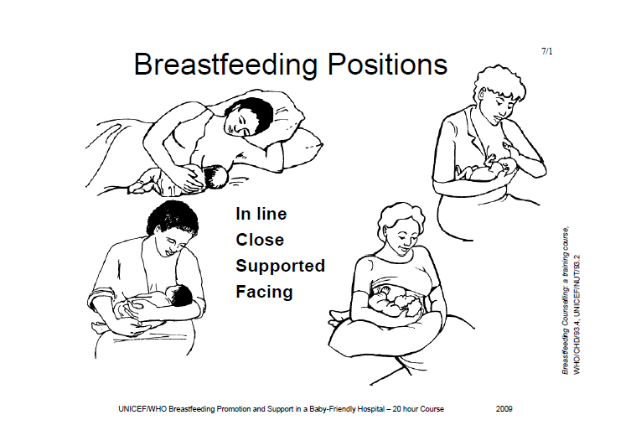
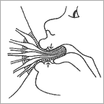
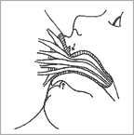
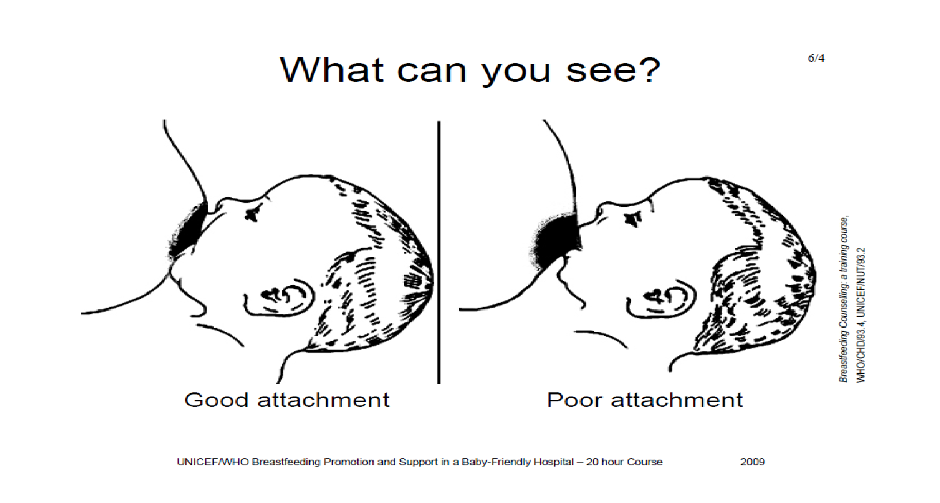
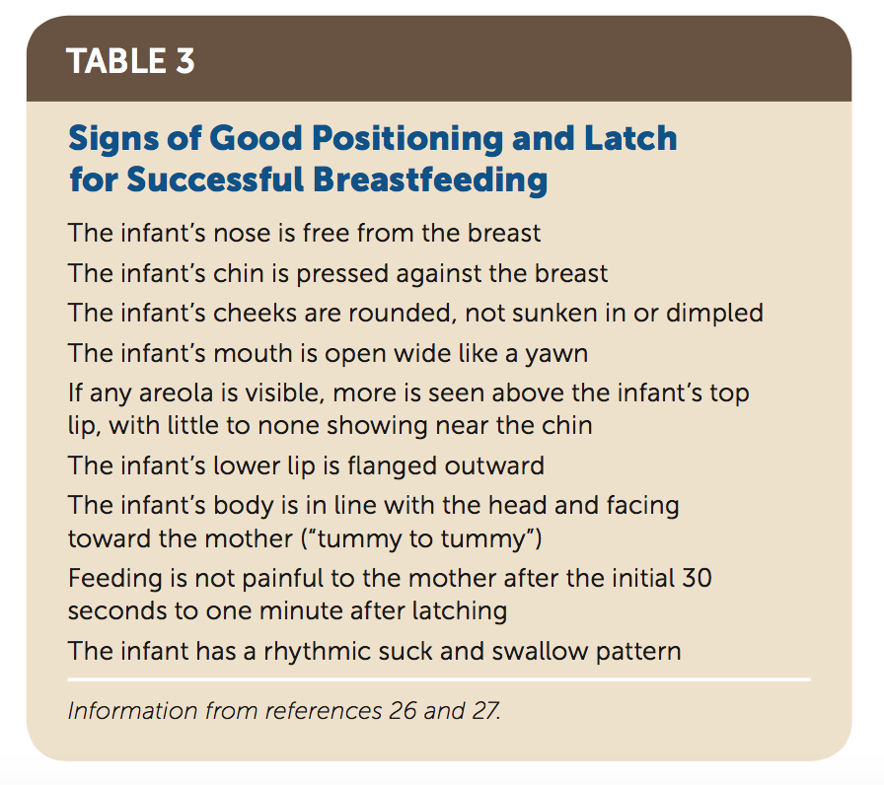
The baby’s position
¹
IN LINE-ear,shoulder,hip in a straight line; neck not twisted/bent forward or backward
1
FACING- the breast with baby’s nose to nipple
2
Remember 4 key points
4
SUPPORTED-at head,shoulders; newborn-support whole body
3
CLOSE to mum’s body- baby to breast
2
1
Observe the baby’s attachment and suckling ²
Good attachment
The baby’s mouth is wide open
The lower lip is turned out
The chin is touching the breast (or nearly so
More areola is visible above the baby’s mouth than below
Poor attachment
The mouth is not wide open
The lower lip is pointing forward (it may also be turned in)
The chin is away from the breast
More areola is below the baby’s mouth (you might see equal amounts of areola above and below the mouth)
How a baby latch
1: Whatever position the mother feels comfortable with is fine as long as the 4 key points are met.
2: While breastfeeding the mother should make sure that there’s “good attachment”. Also she should avoid the scissor way of holding the breast as it blocks the mammary ducts instead C- shaped is the most recommended.

Slide 6
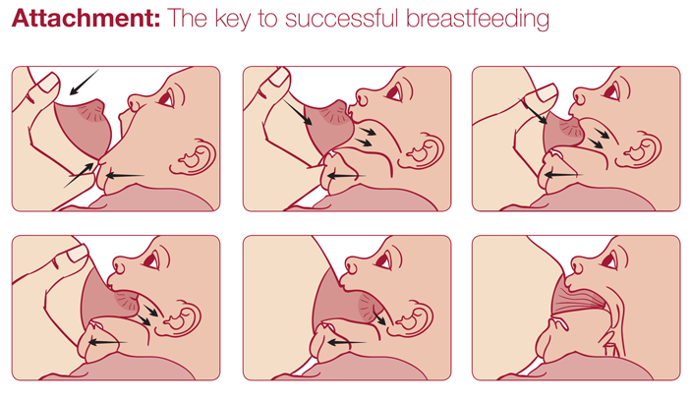
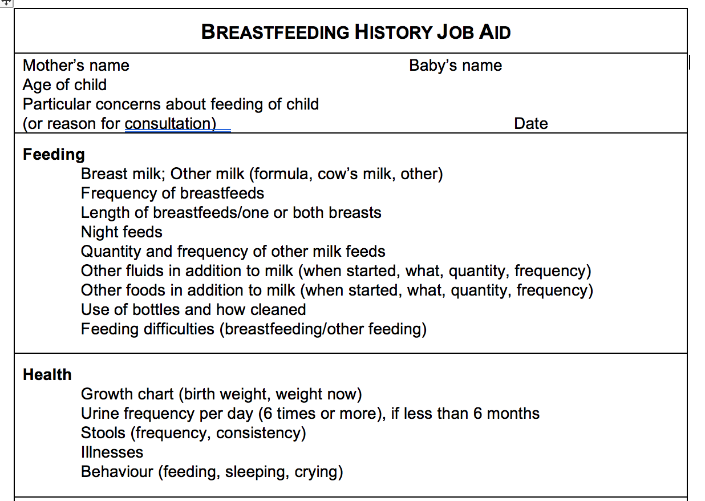
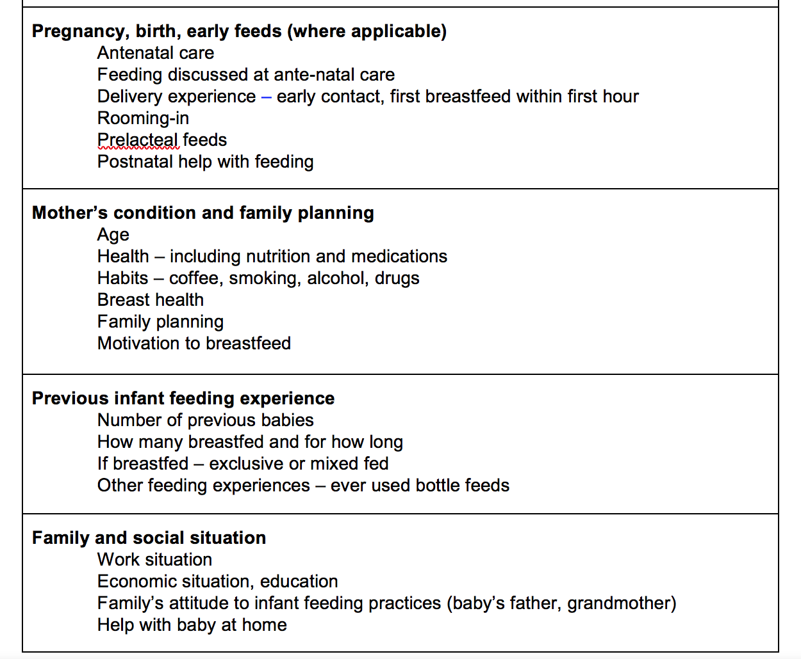
Sign of effective sucking
The baby takes slow deep sucks.
Then he pauses and waits for the ducts to fill up again.
Then he takes a few quick sucks to start the milk flow.
As the milk flows, his sucks become deeper and slower again.
You may see or hear swallowing.
The babies cheeks are round.
Output (full dipper)
Sign of ineffective sucking
The baby taking quick shallow sucks all the time.
The baby may make smacking sounds as he sucks.
The baby’s cheeks may be tense or pulled in as he sucks.
that mean the baby is not getting much breast milk.
To demonstrate effective suckling:
Suck on your fist, with your mouth open wide, your tongue forward, and your lower lip curled back. Give slow deep sucks, about 1 per second.
To demonstrate ineffective suckling:
Suck on your thumb, with your mouth almost closed, your lips pointing forwards, and letting your cheeks pull in. Give quick, small sucks
BREASTFEED HISTORY JOB AID¹
1: Frequency of breastfeeds should be every 2-3 hrs and the duration of one feed should be 10-15 mins. Night feeds are important
If the child isn't hungry after 2-3 hrs then the breast milk should be pumped

Slide 7
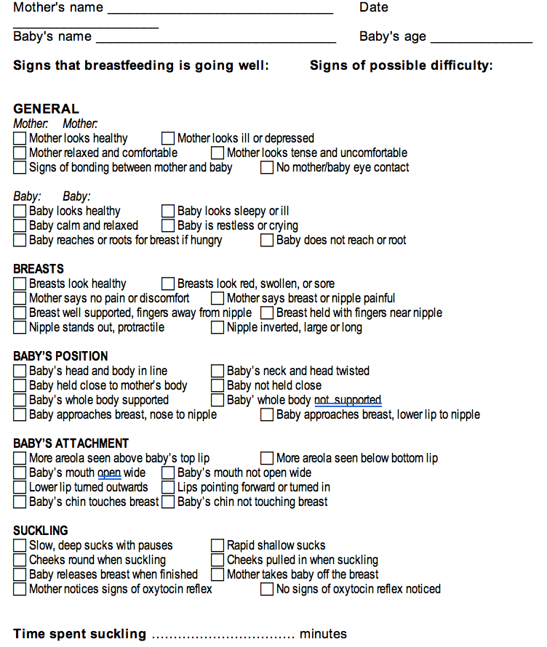
BREASTFEED OBSERVATION JOB AID
It summarizes the key points for assessing a breastfeed. You will use this form to practise observing breastfeeds with mothers and babies.
The signs are in 6 groups: General signs of the mother, and of the baby; Condition of the breasts; the baby’s position; the baby’s attachment; and suckling. There are 3 signs each for mother and baby, and four signs in each of the other groups.
Notice that the signs on the left all show that breastfeeding is going well. The signs on the right indicate a possible difficulty.
Beside each sign is a box to mark with a tick if you have seen the sign in the mother and baby that you are observing.
As you observe a breastfeed, mark a tick in the box for each sign that you observe. If you do not observe a sign, do not make a mark.
If all ticks are on the left hand side of the form, breastfeeding is probably going well.
If there are some ticks on the right hand side, then breastfeeding may not be going well. This mother may have a difficulty, and she may need your help.
The negative signs, such as "no signs of milk ejection", and "cannot see tongue", do not necessarily mean that there is a difficulty. However, the opposite positive signs are always helpful.
If a mother says that breastfeeding is going well, but you see signs that indicate a possible difficulty, you must decide what to do.
- In the days soon after delivery, while the mother is still learning, offer to help her. Even if she is not aware of any difficulty now, you may prevent one occurring later.
- If breastfeeding seems to be well established, you probably do not want to intervene immediately. It is usually more helpful to see her again soon, and follow the baby's growth, to make sure that breastfeeding continues to go well. Intervene only if a difficulty arises.

Slide 8
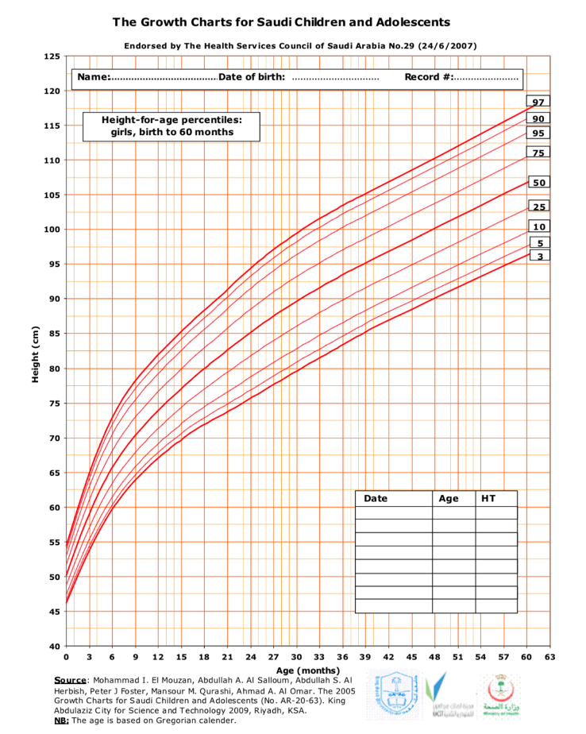
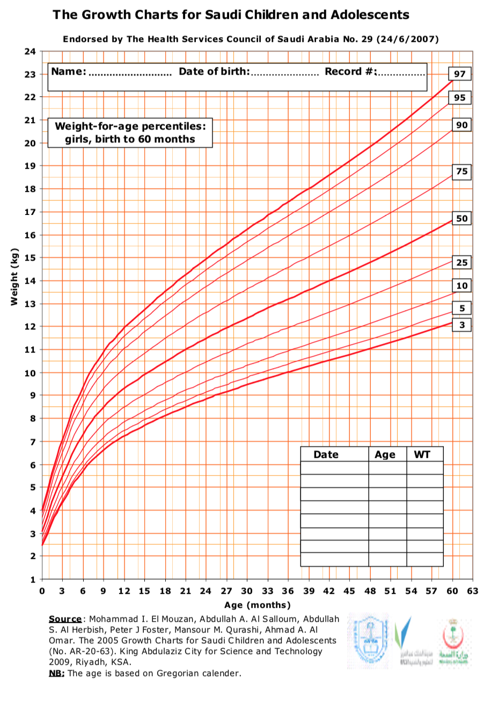
Case 1:
Fatima goes in to see her pregnancy care provider. He or she does not know if Fatima heard the group talk on breastfeeding and if she has any questions.
How can the pregnancy care provider find out if a pregnant woman knows about the importance of breastfeeding or has questions? Ask her open ended questions for example What do you know about breastfeeding ? This allows you to know about the mother’s background knowledge and from there you’ll know how and from where to start.
Slide 3
Case 2:
Mariam gave her previous baby regular supplements from birth. Now she is hearing that supplements are not good for babies and wants to know why because she want to give her daughter. Her baby now is 3 months ht 58 cm wt 6 kg
What can you say to Mariam? Assure her that she doesn't need supplements unless indicated
Indications for supplementation: Low infant weight. How do you know? From the growth chart (pictures seen on the right). Plot the height and weight and then show the mother (in this case it’s normal)
Red growth chart: Girls
Blue growth chart: Boys
Case 3:
Nora gave birth to a healthy boy in the hospital two weeks ago. Today she, the baby, and her mother-in-law are returning to the hospital because the baby is "sleeping all the time" and has passed only three stools this week. When the outpatient clinic nurse weighs the baby, she finds him 12% under birth weight.¹
Nora feels that her baby is refusing her breasts. Yesterday, the mother-in-law began offering tea with honey² in a bottle twice a day.
Upon observing the breastfeed; the baby is held loosely and that he must bend his neck to reach the breast. The baby has very little of the breast in his mouth and falls off the breast easily. When he falls off the breast, he gets upset, moves his head around, crying and has difficulty getting attached again.
How you can approach this case?
Tell the mother her efforts are appreciated
Before going to supplements try fixing the problem. Teach the mother about good attachment and latching.
Slide 6
Slide 7
1: Normally infants lose around 7% of their weight but after 2 weeks they regain it.
2: Honey is contraindicated for children less than 1 year

Slide 9
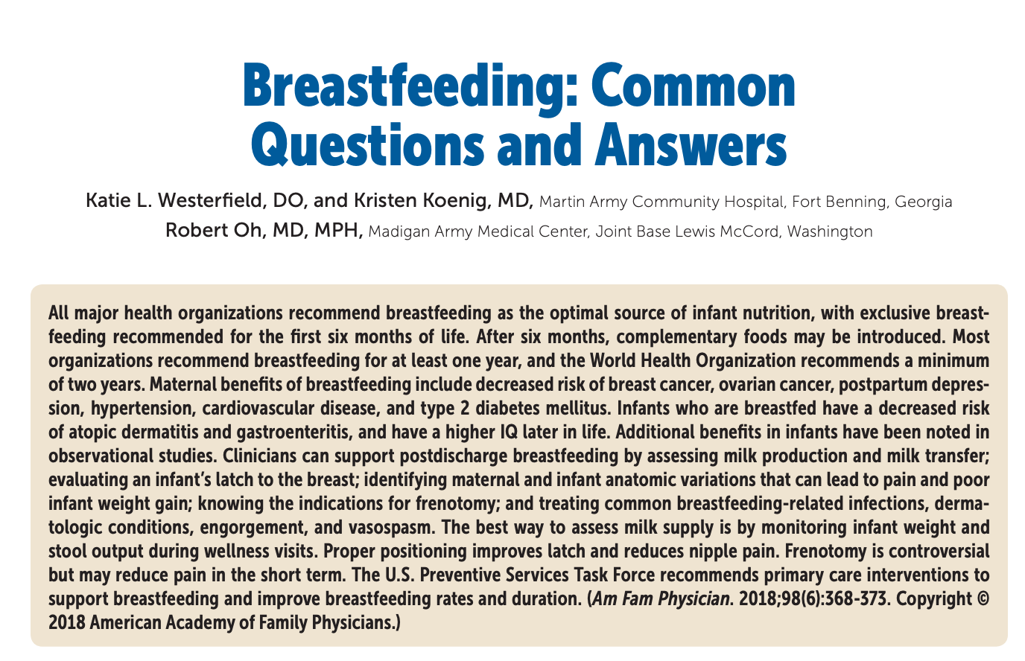
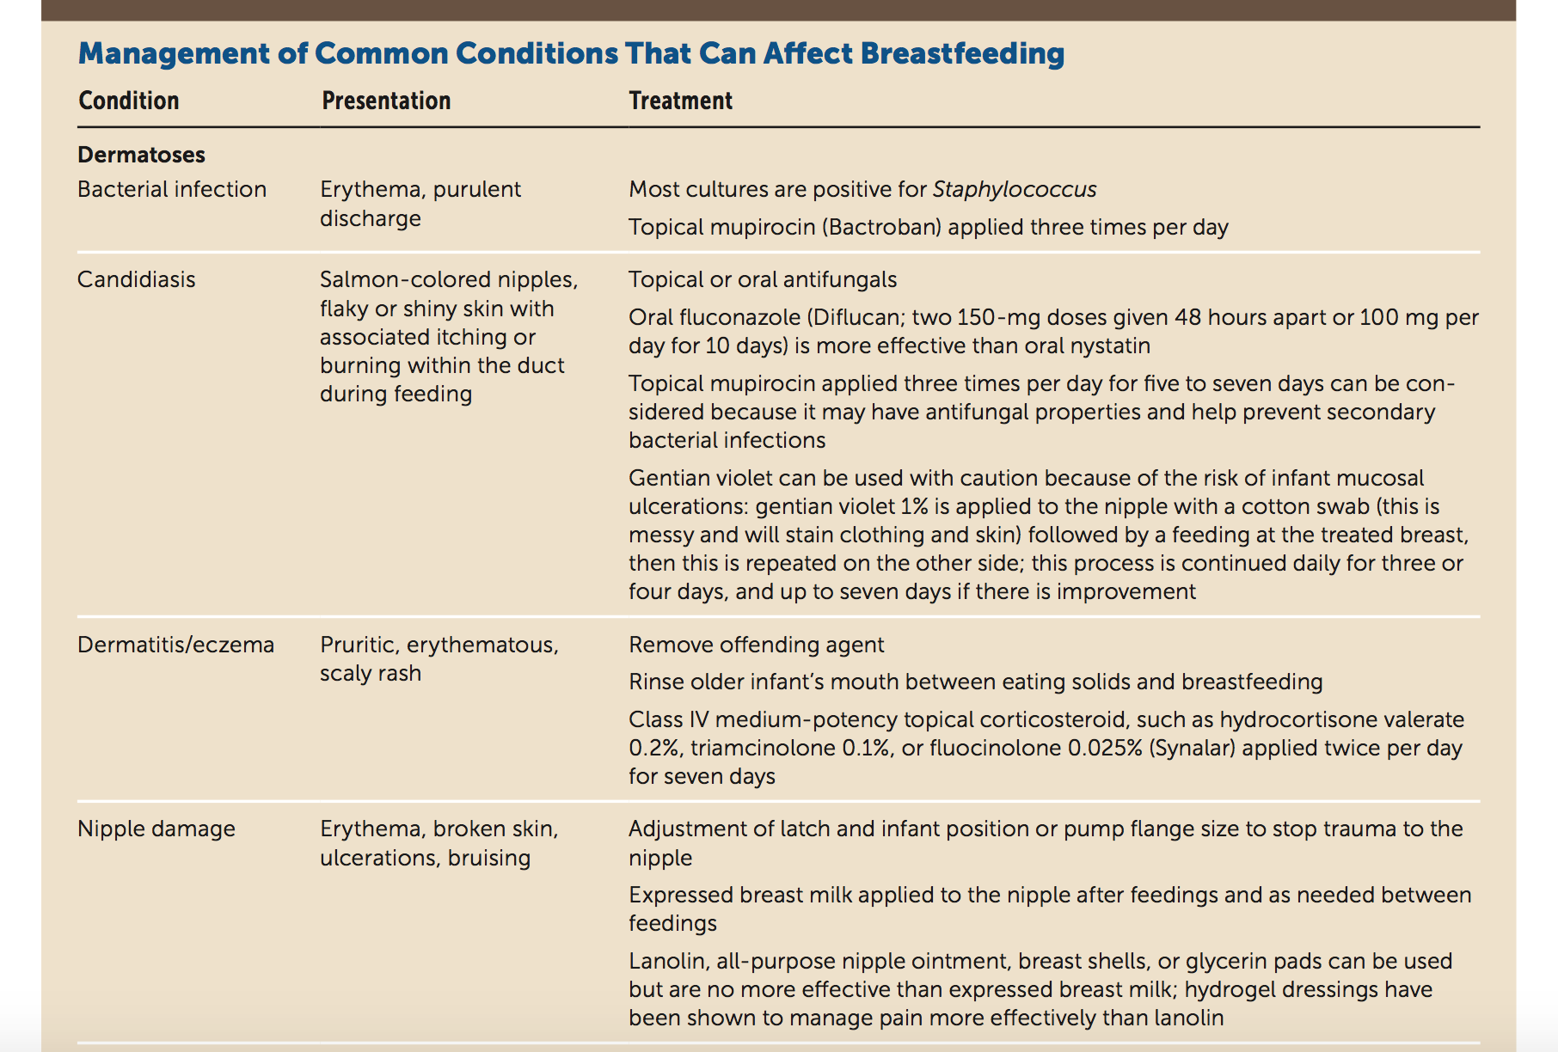
Additional Resources for practice Breastfeeding Counselling
Management of Common Problems that can Affect Breastfeeding
For additional reading

Slide 10
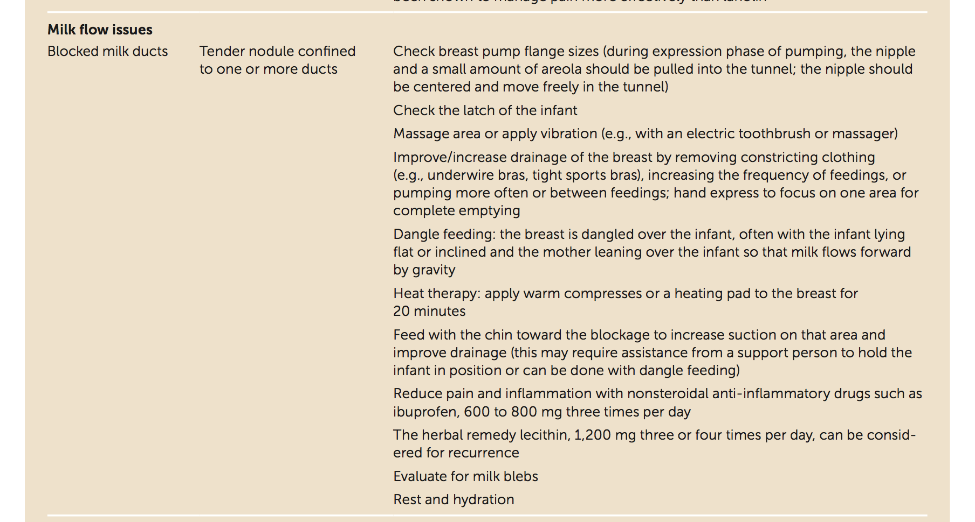
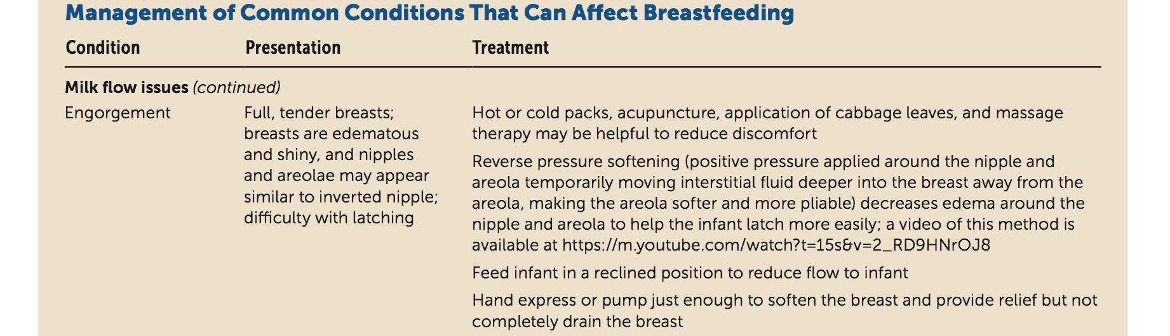
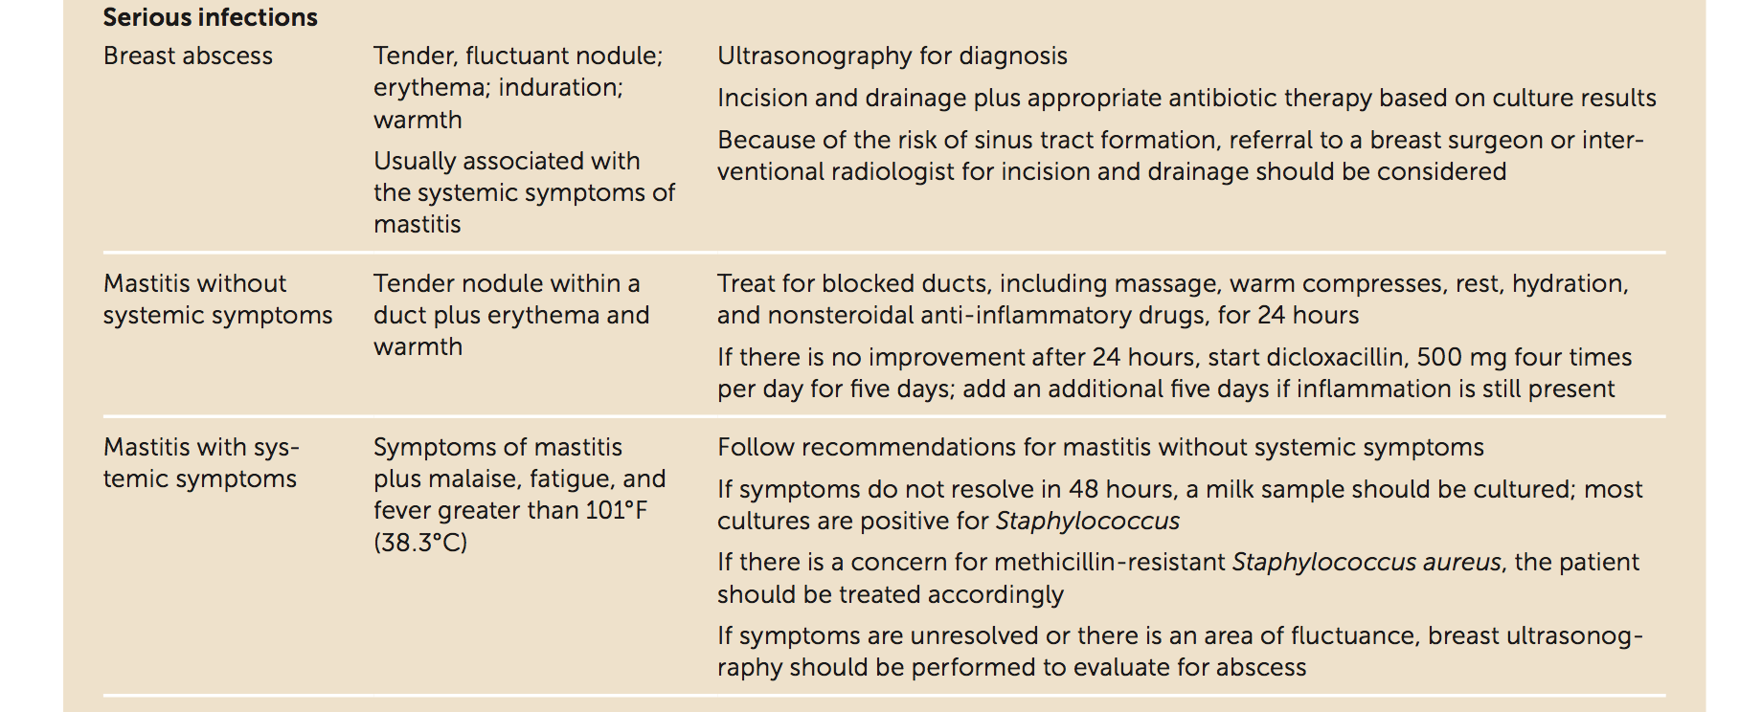
Additional Resources for practice Breastfeeding Counselling

Slide 11
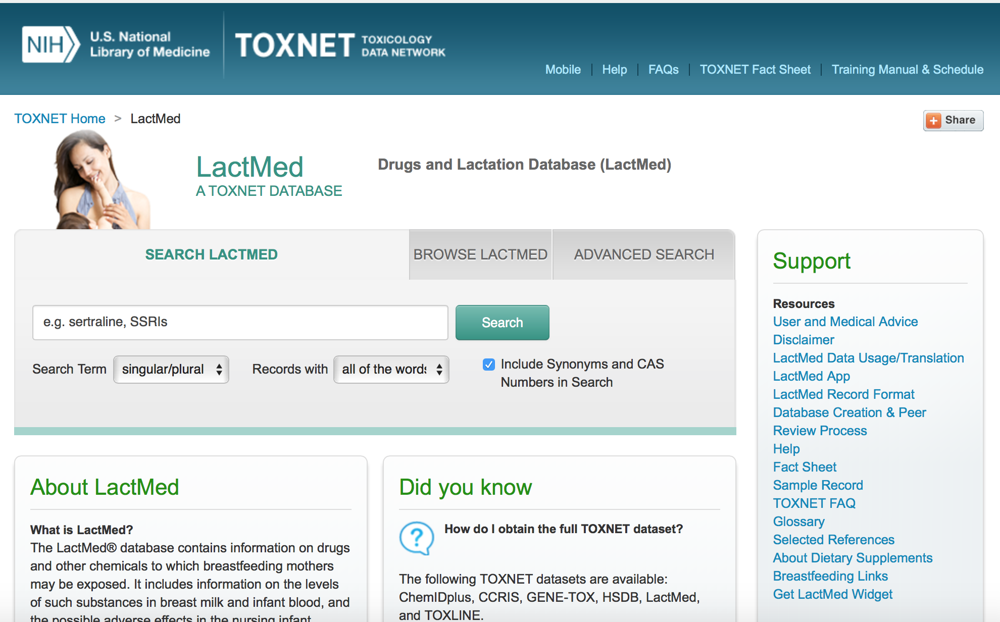
Additional Resources for practice Breastfeeding Counselling

