Slide 1
Tutorial 7: Notification/ Reporting Surveillance
Was Done by
Renad Alhaqbani
Color Index
Main text
Males slides
Females slides
Doctor notes
Important
Textbook
Golden notes
Extra
Editing File

Slide 2
Question 1:
Assume you work in a region in which none of the following conditions is on the list of notifiable diseases.
For each condition:
List at least one existing source of data that you need for conducting surveillance on the condition.
What factors make the selected source or data system more appropriate than another?
Listeriosis:
A serious infection can result from eating food contaminated with the bacterium Listeria
monocytogenes. The disease affects primarily pregnant women, newborns, and adults with weakened
immune systems. A person with listeriosis has fever, muscle aches, and sometimes gastrointestinal
symptoms (e.g., nausea or diarrhea). If infection spreads to the nervous system, such symptoms as
headache, stiff neck, confusion, loss of balance, or convulsions can occur. Infected pregnant women
might experience only a mild influenza-like illness; however, infections during pregnancy can lead to
miscarriage or stillbirth, premature delivery, or infection of the newborn. In the United States,
approximately 800 cases of listeriosis are reported each year. Of those with serious illness, 15% die;
newborns and immunocompromised persons are at greatest risk for serious illness and death.
1
Source of Data ¹:
Data from hospitals records (admission or discharge)
Data from the laboratories
Add it to notifiable disease to become a passive surveillance
The source of data should be based on morbidity more than mortality due to the low case fatality rate.
Spinal cord injury:
Approximately 11,000 persons sustain a spinal cord injury (SCI) each year in the
United States, and 200,000 persons in the United States live with a disability related to an SCI. More
than half of the persons who sustain SCIs are aged 15–29 years. The leading cause of SCI varies by
age. Motor vehicle crashes are the leading cause of SCIs among persons aged <65 years. Among
persons aged ≥65 years, falls cause the majority of spinal cord injuries. Sports and recreation activities
cause an estimated 18% of spinal cord injuries.
2
Source of Data:
Data from hospital record (admission or discharge)
Data from death certificate due to the high mortality rate
Data from trauma center if it's available
Data from the emergency medical center
Data from rehabilitation center (if we want only the survivors of the SCI, it's NOT complete data)
The source of data should be based on the mortality rate. It's serious condition almost all patients will be hospitalized
We can't take it from the registry because there's no registry for infectious disease. Usually it's for chronic disease.

Slide 3
Lung cancer among nonsmokers
A usually fatal cancer of the lung can occur in a person who has never smoked. An estimated 10%–15% of lung cancer cases occur among nonsmokers, and this type of cancer appears to be more common among women and persons of East Asian ancestry.
3
Source of Data:
Data from cancer registry (smoking information not shown)
Data from health surveillance (smoking information shown)
The best source of data for a type of cancer is the registry.
Question 2:
During the previous 6 years, 10 to 15 cases per year of tuberculosis had been reported to a region health department. During the past 3 months, 25 cases have been reported. All but 4 of these cases have been reported from one sector.
Describe the possible causes of the increase in reported cases.
True increase incidence due to TB exposure
False increase incidence because of many reasons:
improve the diagnostic methods
Enhance reporting processes
Change of surveillance system
Increase population size or increase immigrants
Change case definition
Increase awareness of physician of TB tests
Increase awareness of the population to seek medical attention
Untrained staff for testing TB

Slide 4
Question 3:
By 1993, E. coli O157:H7 (O157) has been recognized as an important foodborne pathogen that can cause serious illness. Numerous outbreaks across the country have been attributed to ground beef, roast beef, water, apple cider, and unpasteurized milk. Human infection occurs primarily through ingestion of food or water contaminated with bovine fecal material, but person to person transmission also occurs. The organism can survive for extended periods in water, meat
stored at subfreezing temperatures, soil, and acidic environments, but can be destroyed by thorough cooking or pasteurization.
Patients infected with O157 typically present with severe abdominal cramps, bloody diarrhea, and low grade fever. Children and the elderly are at greatest risk for complications such as hemorrhagic colitis, hemolytic uremic syndrome, and death.
In 1990, Region A added E. coli O157:H7 to its reportable disease list. The region requires reporting by health care providers, health care facilities, and laboratories. The Laboratories must also send isolates to the central Laboratory.
You are an epidemiologist assigned to the region A Health Division, and are responsible for reviewing surveillance data on a regular basis.
What basic descriptive epidemiology would you like to see to characterize the occurrence of E. coli O157:H7 in the region?
patient identifying information (name, address, phone no)
Demographic information (age, gender, race “if need it”)
Clinical information (lab results, sign and symptoms, date of infection, hospitalized or not)
Risk factors related to infection (occupation, travel, last meal, immune status, environmental factors ex: smoking)

Slide 5
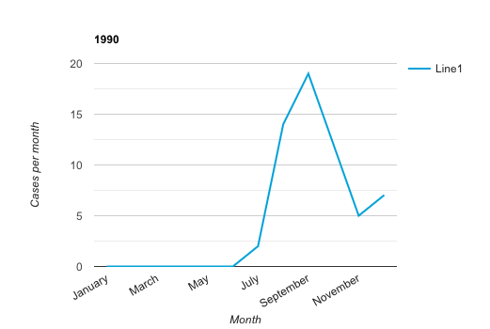
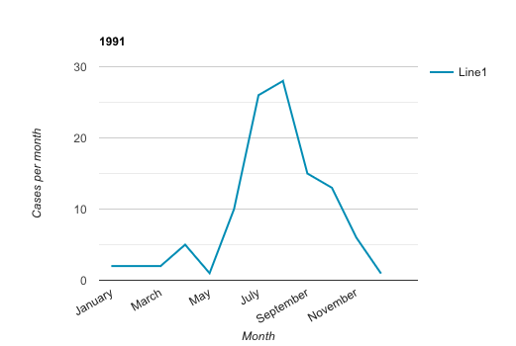
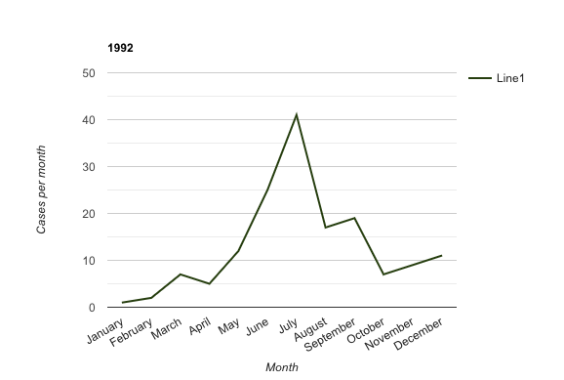
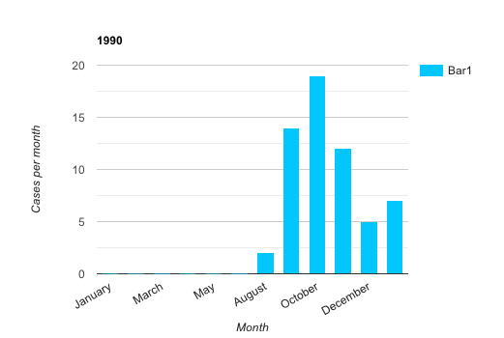
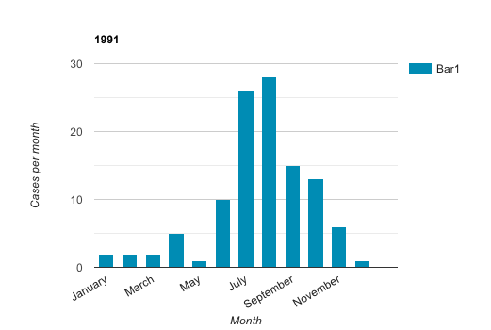
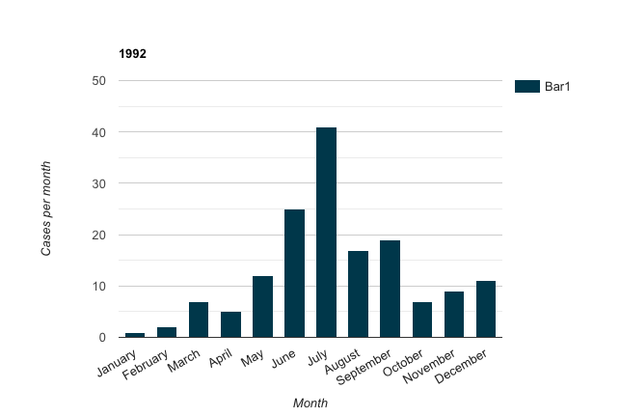
Question 3.2:
Following are several tables of E. coli O157:H7 August 1990 through December 1992.
Graph the data in Table A in two different formats (e.g., line graph, bar graph, or pie chart)
On the basis of the data graphed, what are two interpretations you can make? Was one type of graph easier to interpret? Why or why not?
Month | 1990 | 1991 | 1992 | Total
January | - | 2 | 1 | 3
February | - | 2 | 2 | 4
March | - | 2 | 7 | 9
April | - | 5 | 5 | 10
May | - | 1 | 12 | 13
June | - | 10 | 25 | 35
July | 2 | 26 | 41 | 69
August | 14 | 28 | 17 | 59
September | 19 | 15 | 19 | 53
October | 12 | 13 | 7 | 32
November | 5 | 6 | 9 | 20
December | 7 | 1 | 11 | 19
Total | 59 | 111 | 156 | 326
Best data graphs:
Bar graph
Line graph
Pie chart
Interpretation from data graphs:
The 2nd half of the year has higher cases than the 1st half.
The cases increase more in the summer.
The cases increase year after year.
The graphs are only for representation and for you it understand the idea. We tried our best but we can’t guarantee the accuracy
Pie chart
Line graph
Bar graph the best

Slide 6
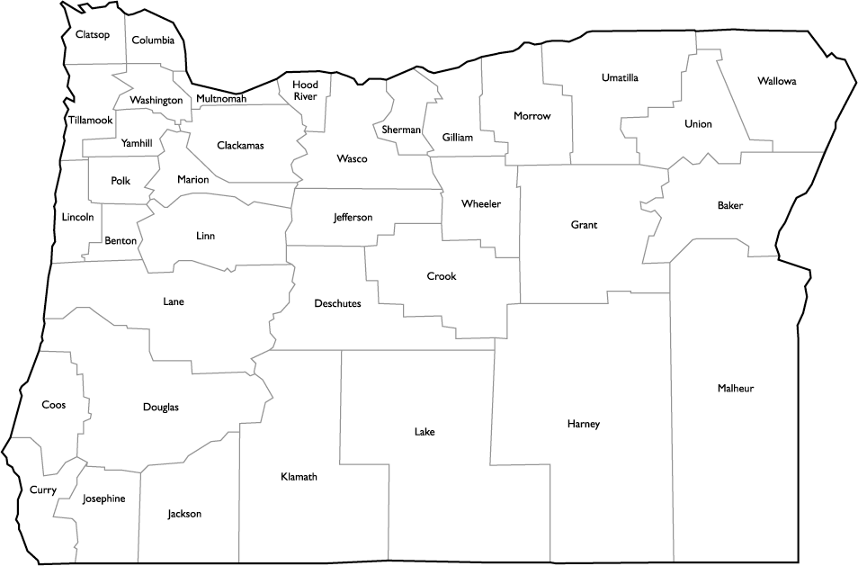
Question 3.3:
As a class, chart the previous information on E. coli O157:H7 outbreaks on a map.
Month | 1990 | 1991 | 1992 | Total
Baker | 0 | 1 | 0 | 1
Benton | 1 | 4 | 11 | 16
Clackamas | 7 | 11 | 21 | 39
Columbia | 1 | 2 | 5 | 8
Coos | 0 | 0 | 1 | 1
Deschutes | 2 | 0 | 0 | 2
Douglas | 2 | 4 | 4 | 10
Grants | 0 | 0 | 2 | 2
Jackson | 1 | 0 | 4 | 5
Jefferson | 0 | 0 | 2 | 2
Josephine | 0 | 0 | 1 | 1
Lane | 6 | 9 | 16 | 31
Lincoln | 2 | 1 | 1 | 4
Linn | 4 | 4 | 5 | 13
Malheur | 3 | 0 | 1 | 4
Marion | 9 | 8 | 10 | 27
Multnomah | 11 | 36 | 41 | 88
Polk | 1 | 1 | 3 | 5
Umatilla | 1 | 0 | 3 | 4
Wasco | 0 | 2 | 1 | 3
Washington | 7 | 26 | 19 | 52
Yamhill | 1 | 2 | 5 | 8
Total | 59 | 111 | 156 | 326
This question was skipped by both Dr.Shatha and Dr. Abdullah but the idea is to plot the number of total of cases on the map

Slide 7
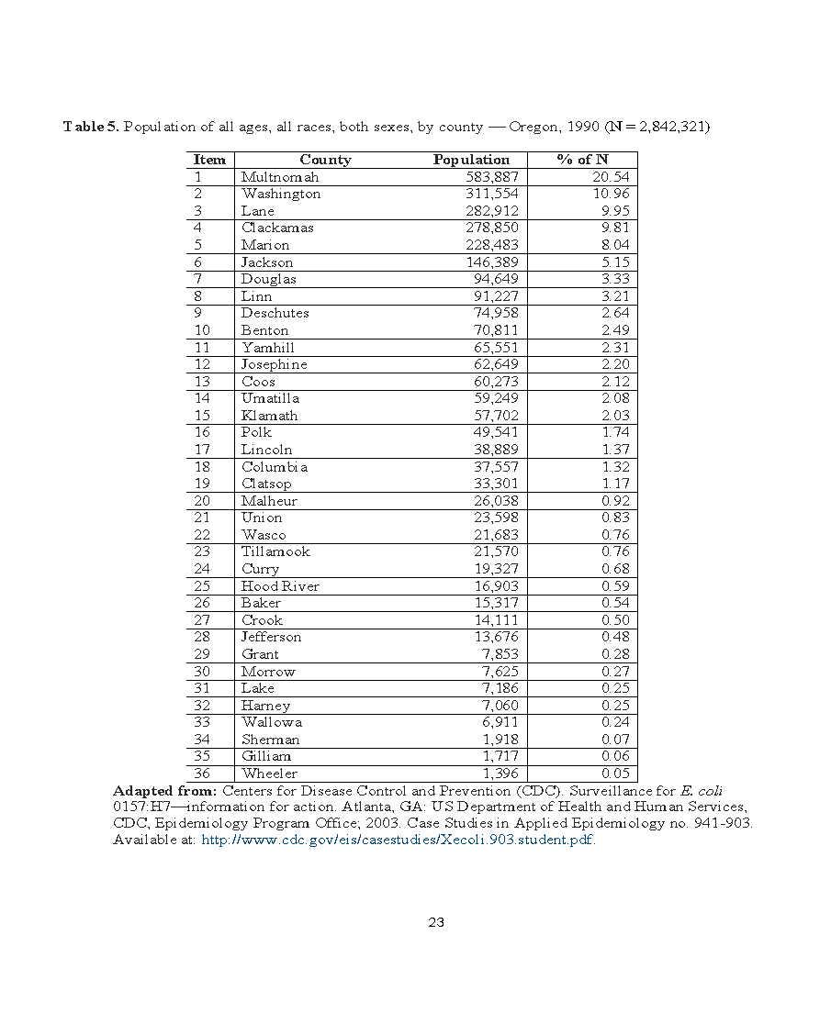
Question 3.3:

Slide 8
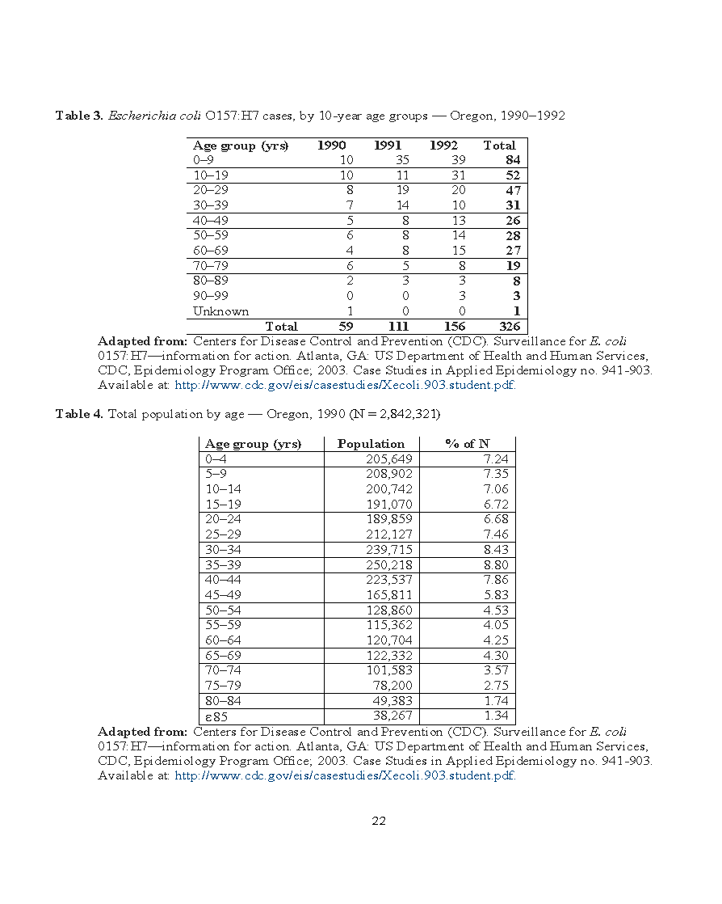
Question 3.3:

Slide 9
Question 3.4:
On the basis of this new population data, why do you think Multnomah County has the highest number of reported cases of E. coli O157:H7 infections?
They have a large population. Also, rural areas have a higher risk for foodborne transmission infections.
Question 3.5:
Which age groups reported the highest incidence of E. coli O157:H7?
Highest risk age group from 0-9 years old.
Based on the population data, can you make a hypothesis about which age group was most at risk for E. coli O157:H7 infections? Why do you think that age group is at higher risk of the infection?
Younger age is more vulnerable because their immunity is not yet developed, and their lifestyle makes foodborne transmission infections more easily.

