Slide 1
Tutorial 9: NCD Prevention
Was Done by
Renad Alhaqbani
Click here for tutorial 4 (imp especially stages of counseling and the 5 A’s)
Color Index
Main text
Males slides
Females slides
Doctor notes
Important
Textbook
Golden notes
Extra
Editing File

Slide 2
Abdullah a 44-year-old man came to you for help
as he is thinking to quit smoking. His BMI 27 and his BP 136/ 84
Take a history and how are you going to counsel him to quit smoking?
Cass 1
What areas are you going to discuss regarding smoking history?
1
2
Smoking history:
how many?
how long?
smokers around him at home or work?
History of previous attempts of quitting:
How many times?
Success or failure and why?
3
4
General health issues:
Chronic disease: CVD, HTN, chronic cough, depression, etc.
Explores ICE : (Have to be asked in history taking)
Idea: He wants to give up, will some medication help him , or there are other options to try
Concern: Mostly he is afraid to have lung cancer
Expecting: to get a advise on how to stop smoking Chance for opportunistic screening (only asked e.g. BP)
Motivation to quit
is he ready to quit smoking?
5
Important for OSCE
Family history: CVD, Stroke, Cancer, etc.
Recall from Tutorial 4
The 5 A’s: Ask, Advise, Assess, Assist, and Arrange.
ASK: Ensure that tobacco-use status is obtained and recorded at every patient visit, and ask an open-ended question
“Have you ever smoked?”
“How often do you smoke?”
“When is the last time you smoked?”
“How many cigarettes did you smoke yesterday/last week/last month?”
“Why do you think it would be a good idea to quit?”
“Do you dip or use snuff?”
ADVICE: Advise your patients to quit smoking. Use clear, strong, and personalized language to get your point across.
“Quitting is the single most important thing you can do to protect your health as well as your family.”
“quitting will help you to save money.”
ASSESS: Ask every patient if she is willing to quit at this time.
If she is willing to quit, offer praise and provide resources and assistance.
If they have tried to quit in the past, get more information.
“So you’ve tried to quit. What do you think triggered you to start smoking again?”
If unwilling to quit, help motivate the patient by using the “5 R’s”: Relevance, Risks, Rewards, Roadblocks, and Repetition.
ASSIST: Assist your patients with a quit plan.
ARRANGE: Schedule follow-up visits/phone calls to review patient progress toward quitting.
Important steps in all cases: 1) full history 2) focus history 3) maintain eye contact 4) break bad news by asking: what're your expectations?

Slide 3
How can you help him to quit smoking?
Discuss the benefits to quit smoking
Discuss the risks associated with smoking (cancer, COPD, ect)
Behavioral smoking counseling (Avoid places used for smoking, tell family and friends about quitting smoking, firm refusal of cigarette from others).
Discuss the different pharmacological treatments options and their efficacy.
Brief him about choices of Nicotine replacement therapy or varenicline (Champix)
Agree on a plan to proceed with his quitting
Define a date to stop smoking (e.g. write a contract between physician and smoker, put this contract in a place to be seen daily, remove ash tray, through any cigarette at home, anything reminding for smoking)
Respect his choice of advice on who to approach
Encourage him to attend the Primary care smoking cessation clinic.
Agree on discussing his success or failure attempts after two weeks

Slide 4
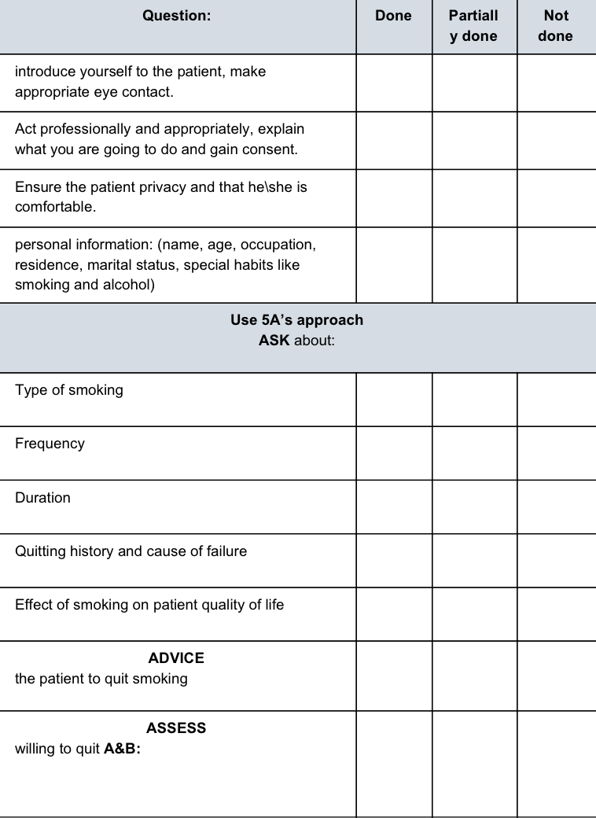
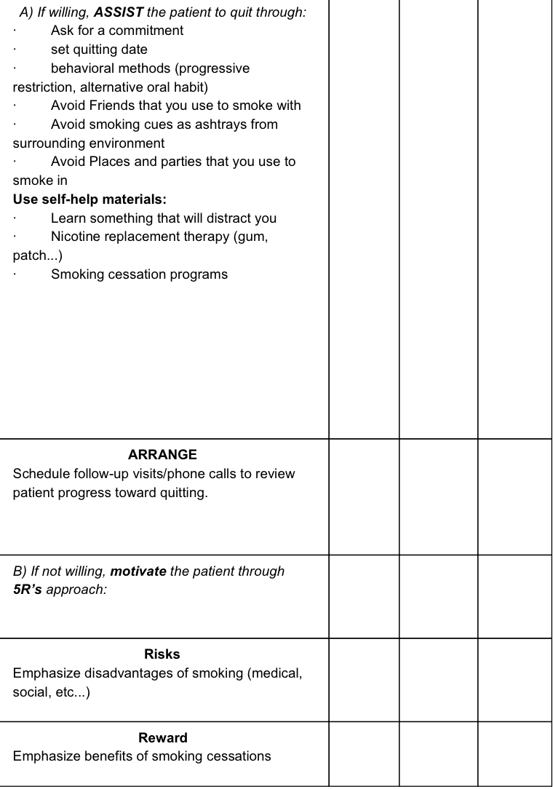
Practice with Checklist of smoking cessation
Extra
From 436 OSCE file

Slide 5
Cass 2
Mona a 46-year-old woman came to check some
results. She is totally asymptomatic. BMI 31, BP 124/75 Fasting plasma glucose: 8.4 mmol/L (151 mg/dl) 2 hours postprandial: 13.7 mmol/L (247 mg/dl) HbA1C:8.4%.
Take a history and how are you going to manage her?
Take a history based on her results
Personal and social history:
Job, marriage, children
1
She is newly discovered to be diabetic, start to take related history regarding diabetes:
2
3
4
Symptoms:
polyuria, polydipsia, nocturia, loss of weight, Duration of the symptoms.
Symptoms of complication:
burning / numbness of foot, visual disturbances
Risk factors:
Smoking, HTN, obesity, exercise, etc.
5
6
7
8
Family H. of DM (detail), HTN, CVD, etc.
Nutritional status, daily life activity
ICE
Alcohol, H/O drugs

Slide 6
How are you going to plan her management including education and prevention?
1
Appropriate education about life style modification
2
Exercise: Details, measures to decrease weight like walking (at least 150 minutes per week for at least 5 days and of brisk walking [Inform him to do such activity for at least 30 minutes daily) also to reduce risk and weight.
3
Dieting: Dietary advice, avoid excess sugar, reduce refined CHO, encourage vegetables, fruits and fibres, Low animal diet.
4
Advice for foot care inspection, shoes.
5
Offer referral to dietitian
6
Offer referral to ophthalmologist
7
Offer the patient Glucometer to do home monitoring blood glucose
8
The student may offer the start of Metformin
9
Offer requesting some investigations like: FBS, HbA1C, Renal functions, Lipid, Albumin/creatinine ratio
10
The student will plan for follow up for control of diabetes after 3 months.

Slide 7
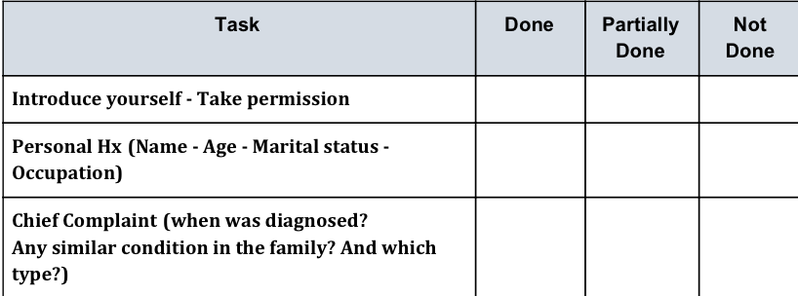
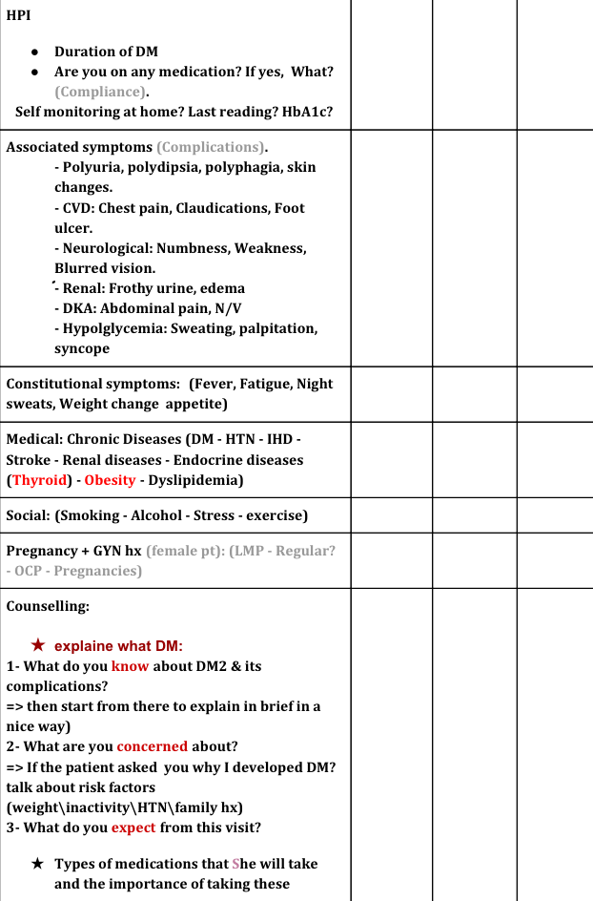
Practice with Checklist of Diabetes Type 2 Counseling
Extra
From 436 OSCE file

Slide 8
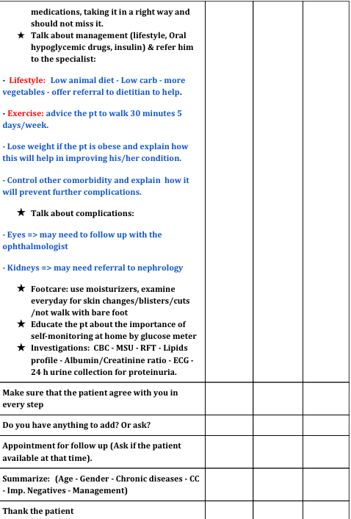
Practice with Checklist of Diabetes Type 2 Counseling
Extra

Slide 9
You are seeing Mrs. Bakar, a 56 year old woman, in your clinic today.
She is worried about a left breast mass, and would like you to tell her about screening availability.
Take a focused history of her complaint and educate her regarding the recommendations of breast screening.
Cass 3
Take a focused history of her complaint
Onset of awareness of mass
Size of the mass and any change in size
Mastalgia
Associated discharge, including pus and blood (none)
Size/tenderness association with menstrual cycle
Nipple changes Skin changes (on affected breast)
Systemic symptoms – weight loss, low energy, anorexia
Associated shortness of breath or chest pain
Changes in personality – suggestive of brain metastases
Bone pain – suggestive of bone metastases
Inquiries about date of menopause
Pregnancy history ¹
Breastfeeding history
History of chest radiation
Age of menarche
Alcohol history
Smoking history (quantity in pack-years)
Past and current use of hormone replacement and oral contraceptive pills
Past mammography results
Family history/risk factor history:
Family history of breast, ovarian, or colon cancer
Past history of breast masses
How are you going to plan her management and education?
Offer to examine breast mass.
Addresses patient’s concerns and educate her regarding screening guidelines
Recommended age of screening
Methods available for this patient you have to request Mammogram and US breast.
Date of menopause, breastfeeding, and pregnancy is important because of estrogens exposure, and some cancer is estrogen-dependent

