Slide 1
The Importance Of Learning Bioethics
By: Professor Eiad Alfaris

Slide 2
Teaching of bioethics is:
Very important
Little important
Not important at all
Not sure

Slide 3
story
Ahmed borrow sentences and paragraphs from someone else and put them in his assignment. Although he has not used quotation marks, he has provided correct citations (or footnotes): his colleague said to him that he plagiarized. He is not sure whether he has plagiarized or not?

Slide 4
The overall objective of learning ethics and professionalism among medical students is..
To be equipped with the principles and methods to enable them analyze and resolve practical clinical ethical problems that they encounter as students and as practitioners later in their life.

Slide 5



Slide 6
مقدمة
الخلق الحسن هو رسالة الإسلام وله مكانته وشرفه في التعامل القويم مع النفس بتزكيتها، و مع الآخرين بالعدل والإحسان.
لقد كان رسول الله صلى الله عليه وسلم قدوة عملية في تطبيق الأخلاق, واقعا ملموسا.

Slide 7
مقدمة
ومن هذه المنطلقات الإيمانية الراسخة كان جديرا بطلاب وطالبات كليات الطب والأطباء والطبيبات وجميع العاملين في المجال الصحي أن يلتمسوا هديه صلى الله عليه وسلم في الأخلاق والتعامل اليومي في مجال عملهم.
أن دراسة أخلاقيات التعامل و الخلق الحسن و محاولة تطبيقها في التعامل اليومي مع المرضى و الزملاء والأساتذة تزداد أهميتها لدى طلاب العلوم الصحية

Slide 8
مقدمة
ومن المعروف أن أخلاقيات المهن الصحية في المجتمع المسلم محكومة بالشرع الحكيم، ومنظمة بنصوص الوحيين وهي جزء من العبودية لله سبحانه وتعالى.

Slide 9
Definition
Ethics is the philosophy of morality.
Ethics is concerned with distinguishing the moral from the immoral and the right from the wrong.

Slide 10
Definition
Ethics as a discipline is not a corpus of knowledge or facts. It is principles and methodology used to analyze specific situations in order to make moral judgments.
Some matters are not subject to ethical analysis and moral judgment because.

Slide 11
Plagiarism Quiz
You borrow an essay written by another student and then submit it as your own work. Is this plagiarism?
- Yes, because it's not my own work.
- No, because the other student gave me permission.

Slide 12
Plagiarism Quiz
You find a great source for research on the internet. The site has no 'author', so you copy the information and use it in your assignment. Is this plagiarism?
- Yes, all sources of information must be cited.
- No, information on the net is up for grabs.

Slide 13
Ethics video
https://youtu.be/zPsoFhUDLuU

Slide 14

Let us see some examples

Slide 15
الصبر
و التواضع
روى الإمام مسلم عن أبي أيوب رضي الله عنه قال: ”إن أعرابياً عرض لرسول الله صلى الله عليه وسلم وهو في سفر، فأخذ بخطام ناقته أو زمامه، ثم قال: يا رسول الله أو يا محمد أخبرني بما يقربني من الجنة وما يباعدني من النار.
قال: فكفّ النبي صلى الله عليه وسلم، ثم نظر في أصحابه، ثم قال: لقد وُفّق أو لقد هُدِي، قال: كيف قلت ؟ قال: فأعاد.

Slide 16
الصبر
و التواضع
فقال النبي صلى الله عليه وسلم” تعبد الله لا تشرك به شيئاً، وتقيم الصلاة، وتؤتي الزكاة، وتصل الرحم, دع الناقة“
ومما نجده في الحديث أنه صلى الله عليه وسلم استحسن سؤال الأعرابي حيث قال: ” لقد وُفّق أو هُدِي“.

Slide 17
التواضع
عن أبي مسعود قال أتى النبي صلى الله عليه وسلم رجل فكلمه فجعل ترعد فرائصه فقال له هون عليك فإني لست بملك إنما أنا ابن امرأة تأكل القديد
قارن بين أخلاق الرسول و غيره من الأطباء؟
القديد: هو اللحم المملح المجفف في الشمس
صحيح سنن ابن ماجة باختصار السند

Slide 18
هل رأيت طبيبا يتعامل بشكل ممتاز؟
لماذا وصفته هكذا؟
هل رأيت طبيبا يتعامل بطريقة غير لائقة؟
لماذا وصفته هكذا؟

Slide 19
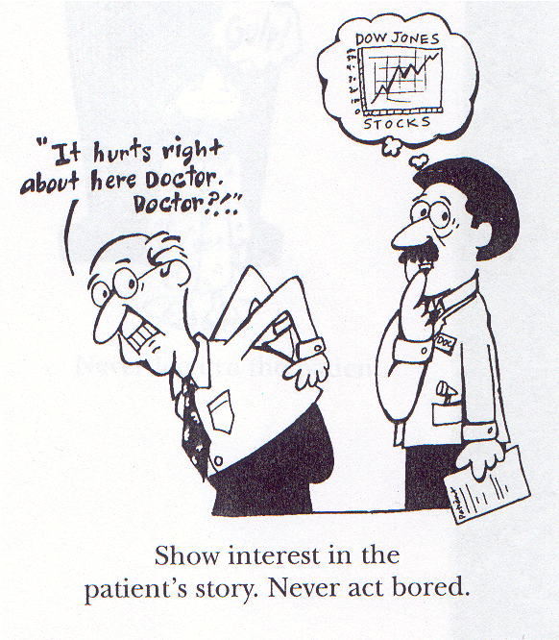

Slide 20
Case 1: Confidentiality
A patient with diastolic blood pressure of 120 mmHg failed to return to the Health Center for treatment. The nurse called the head of the village and asked him to convince the patient to come. In order to press on him the urgency of the matter, she had to explain all the details of the history & examination that had been carried out on the patient.
Your views on the ethical aspects of the response from the nurse ?

Slide 21
Case 2: Refusal of Treatment
A 42-year-old teacher pregnant for the first time refused an elective caesarean section. She continued to refuse the procedure when labor became obstructed and signs of fetal distress appeared. The obstetrician went ahead to operate on the basis of consent by the husband. The baby was delivered alive and well.
Your views on the ethical aspects of the Obstetrician’s action ?

Slide 22
Case 3: Life Support in Terminal Illness
A patient admitted to the ICU after a car accident was confirmed by three intensivists to be in a persistent vegetative state.
The doctors wanted to discontinue life support but the family refused because there were signs of life like reflex flexion of joints and blinking of the eyes.
The hospital decided to seek a court injunction after keeping the patient in the ICU for 6 months without any obvious improvement.

Slide 23
Are the requests of the doctors and hospital ethically justifiable?
Please explain the reasons for your answer

Slide 24
Once upon a time
Hassen attended his class lesson (lecture), having a slow day. The teacher was enthusiastic in his teaching. Sitting in the classroom, Hassen notices several text notifications on his phone from friends and spends his attention and time responding. The teacher is seeing you.

Slide 25
Please consider the following questions:
What type of message would personal use of your cell phone potentially send to his teacher, classmates or parents?
What are appropriate ways to spend “downtime”?
What are some inappropriate ways you can imagine spending “downtime”?

Slide 27
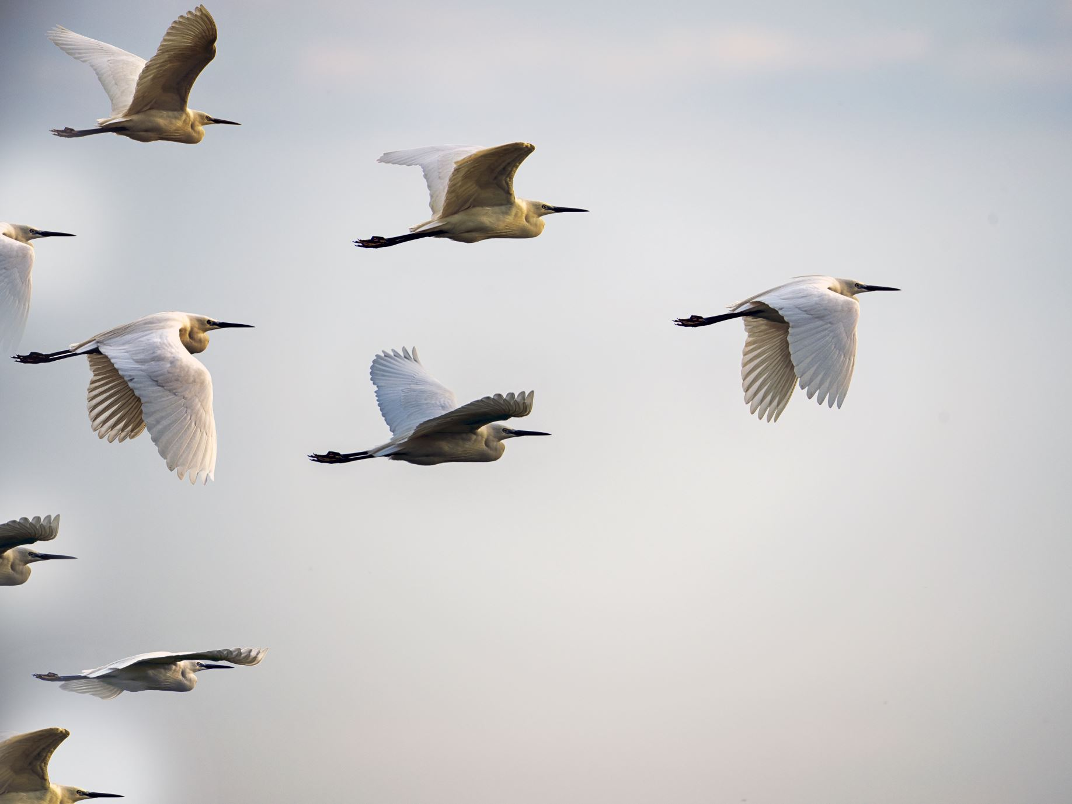
How can we improve our professionalism?

Slide 28
SUMMARY

Slide 29
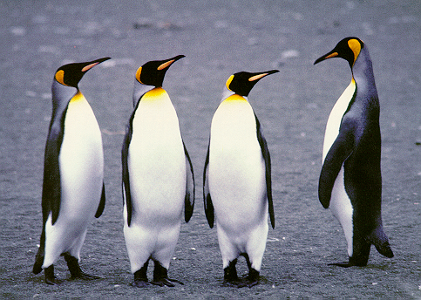

Slide 30
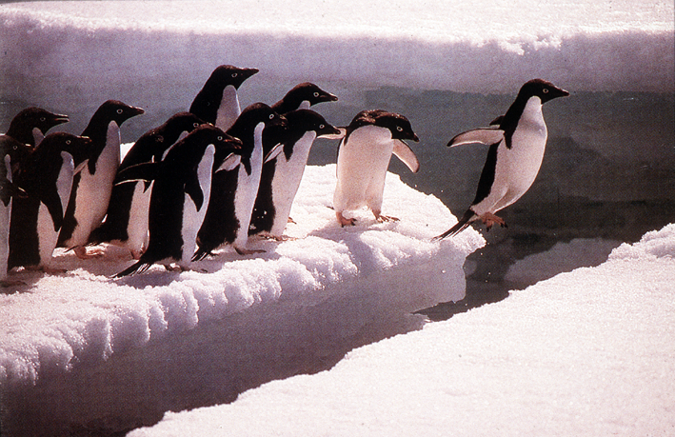

Slide 31
Teaching of bioethics is:
Very important
Little important
Not important at all
Not sure

Slide 32
شكــــــراً
THANKS

Slide 34
Where? When?
A- Classroom
B- Outside
A- Day
B- Night

Slide 36
Case 5
Dr. Alia has recently attended a meeting with the local health authority at which GP involvement in HiNi pandemic influenza prevention and containment was discussed. The authority has made it clear that, in the event of a pandemic, antiviral medication will be provided to GPs who are in contact with patients who may have influenza. The rationale for this is both to protect the GP and to reduce viral transmission in the community.
Dr. Alia has two young children and she is concerned about the risk that they may become infected if she is seeing patients with influenza

Slide 37
Case 5 (Continued)
At the meeting she asked about the availability of antiviral drugs for her family. She was told that there will not be sufficient supplies of antiviral drugs for GPs’ families, to be treated prophylactically.
Dr. Alia thinks that she would probably give the antiviral medication to her children before she would take it herself.
Your opinion on Dr Alia's views and concerns
from an ethical perspective?

Slide 38
Case 6
Mrs Jamila, a patient in her late sixties, is an infrequent attender at the Family practice clinic. One day, she presented to Dr. Jamal with abdominal distension and anorexia. On examination, Dr. Jamal found a large mass and ascites. He thought that the most likely diagnosis was ovarian cancer.

Slide 39
Case 6 (Continued)
He explained this to Mrs Jamila and advised that some investigations would help to confirm the diagnosis and then it would be possible to work out what, if any, treatment would be recommended.
Mrs Jamila refused to have any investigations or to see a specialist for further assessment. She eventually died several months later.
Your Views on Dr Jamal’s relative inaction from an ethical perspective?

Slide 40
Case 7
Once a month, Dr. Hameed hosts an HIV case conference in his practice. It is a breakfast meeting attended by staff in the practice and surrounding practices, who have an interest in the care of patients with HIV/AIDS. The breakfast is provided by Links – Howard, a pharmaceutical company that produces a range of drugs used in the treatment of HIV/AIDS. One of the Links-Howard pharmaceutical representatives also attends these meetings. The meetings usually begin informally as the participants eat breakfast together.

Slide 41
Case 7 (Contd)
They then spend about half an hour either discussing general treatment and management issues or one participant will bring a difficult case to the meeting. Dr. Hameed allows the Links – Howard representative to bring promotional literature and pens to the meeting, and there is also the opportunity to speak to individual doctors at the end of each meeting.
Are Dr Hameed’s actions in accepting help from a medical representative ethically acceptable in this scenario? Please justify your answer?

