Slide 1
COMPUTERIZED PHYSICIAN ORDER ENTRY
Color index:
Important
Golden notes
Doctors notes
Editing File

Slide 2
CPOE
Definitions:
The process where a medical professional entering orders or instructions electronically.
A process of electronic entry of medical practitioner instructions for the treatment of patients.
The process of capturing a physician's instructions for a patient's care electronically to improve the efficiency of care delivery.
A solution to a current human system problem that focuses on achieving improved quality and safety for all patients.¹
Often uses rule-based methods for checking appropriateness of care.³
CPOE is a computer application or a system that accepts physician orders such as : Meds, Laboratory Tests, Diagnostic Studies, Ancillary Support, Nursing Orders, Consults.
Ordering of tests, medications, and treatments for patients care using computers, and it involves electronic communication of the orders.²
CPOE has different terminologies which have the same function:
Computerized Physician Order Entry.
Computerized Provider Order Entry.
Computerized Provider Order Management (CPOM)
Information System:
Information system is an arrangement and integration of:
1. Data | 2. Processes | 3. People | 4. Technology
Which interacts to collect, process, store, and provide as output the information needed to support the organization.⁴
with documentation available.
This orders not only placed on computer but also electronically it’s been transmitted to the system.
Gives decision support (Examples: if you’re ordering a medication for a pregnancy, you can’t order it for a male because the system won’t accept. OR prescribe a medication to a patient has allergy to it “penicillin”, the system won’t accept this prescription.
The main purpose is to place orders in electronic format and a kind of support in different levels.

Slide 3
CPOE
What CPOE Does?
Provides Decision Support.¹
Warns of Drug Interactions: Drug-Drug, Drug-Allergy, Drug-Food. | Checks Dosing. | Reduces Transcription Error.
Reduces number of lost orders.² | Reduces duplicative diagnostic testing.³ | Recommends cost effective, therapeutic alternatives
Technical infrastructure:
EHR
Drug information database
DSS
Others: CPOE, EHR and DSS.
EHR | Documentation | DSS
 | Medication
 | Test reports (EKG, PFT)
 | Radiology, lab results
 | CPOE
Doctor’s explanation:
EHR is the main infrastructure and it is needed to place to have CPOE.
With EHR, we’ll be to do documentation, medication, test report radiology results and lab results, but all these won’t running if we don’t have CPOE.
DSS and CPOE need each other, we can’t do one of them alone.
The main concern and this support comes in different levels.
through the system
which is in turn will save time, effort and reduce the risk of the patient

Slide 4
CPOE
Example DSS in CPOE – medication prescription:¹
Allergy.²
Age (check drug name and dose).
Duplicate drugs on active orders, not one-time.
Severe drug interactions (Drug-drug, drug-food).
Dose maximum.³
Drugs with opposite actions.
Why Now?
November 1999: Report from the Institute of Medicine to Err is Human: Building a Safer Health System “44,000-98,000 patient deaths/year in U.S. hospitals due to medical errors” .
Increased focus on patient safety and on quality of care.
CPOE is viewed as an important tool to improve patient safety and quality of care delivered.
Institute of Medicine:
Report on medical errors released 1999.
Estimated that between 44,000 and 98,000 hospital deaths/year are due to medical errors.
Some question the accuracy of the estimates but has raised public awareness and concern.
Top 10 Causes of Death 1998
1. Heart Disease 724,269
2. Cancer 538,947
3. Stroke 158,060
4. Lung Disease 114,381
5. Medical Errors 98,000
6. Pneumonia 94,828
7. Diabetes 64,574
8. Motor Vehicle 41,826
9. Suicide 29,264
10. Kidney Disease 26,295
CPOE helps a lot with prescription, so there’s a function of DSS but it comes normally with CPOE.
Ex: while ordering antibiotic contain penicillin & the Pt have allergy to it & that’s recorded in the system, so the system will stop it or alert the physician
& minimum specially for children & infants.

Slide 5
IOM
institution of medicine
“The science and technologies involved in healthcare & increases in knowledge, data information, skills, care interventions, devices and drugs) have advanced more rapidly than our ability to deliver them safely, effectively, and efficiently” without considering tools like; CPOE, DSS & informatics tools
1
Actions
2
3
Endorsement of CPOE. To be implemented in healthcare setting.
Establish CPOE as an Institutional Commitment and Goal. It should be strategic goal for institution.
Identify CPOE as a Quality and Safety Improvement Initiative. In every healthcare sitting.
Definitions: (for your reference, according to doc)
EMR (Electronic Medical Record) :
The set of databases (lab, pharmacy, radiology, clinical notes, etc.) that contains the health data & information for patients within a given institution or organization.
CDS (Clinical Decision Support) component :
Software that makes relevant information available for clinical decision-making (clinical data, references, clinical guidelines, situation-specific advice) Working on the level of data, information & knowledge.
CPOE (Computerized Physician Order Entry) component
Enables clinicians to enter orders (tests, meds, dietary, etc.).
CCR (Computerized Clinical Reminder)
just-in-time (real time) reminders at the point of care that reflect evidence-based medicine guidelines.

Slide 6
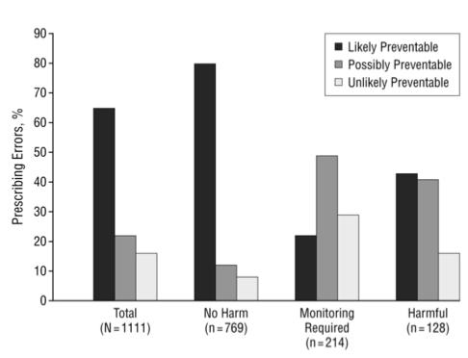
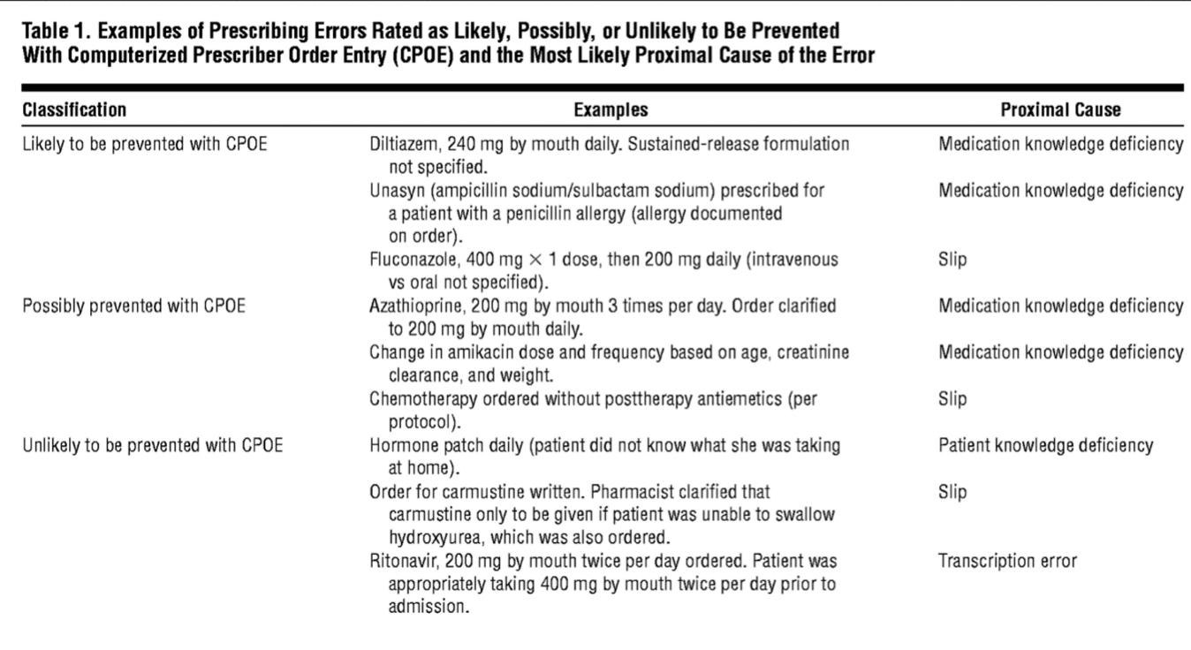
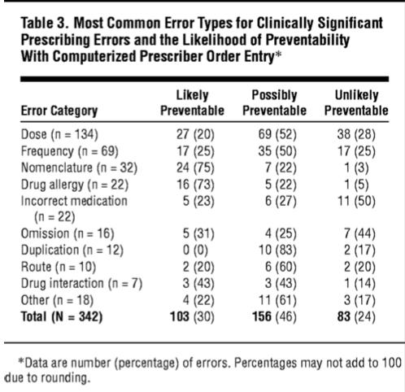
Medical Errors
Medication errors resulting in preventable ADEs most commonly occur at the prescribing stage.
Out of 1111 prescribing errors were identified (6.2% errors), most occurring on admission (64%). Of these, 30.8% were rated clinically significant and were most frequently related to;
anti-infective medication orders,
incorrect dose, and
medication knowledge deficiency.
64.4% were rated as likely to be prevented with CPOE.¹
13.2% unlikely to be prevented with CPOE.
22.4% possibly prevented with CPOE depending on specific CPOE system characteristics.
Severity of prescribing errors and rated preventability by use of a computerized prescriber order entry system.
Examples of Prescribing Errors Rated as Likely, Possibly, or Unlikely to Be Prevented With Computerized Prescriber Order Entry (CPOE) and the Most Likely Proximal Cause of the Error.
Two recent Harvard studies found that physician ordering errors accounted for 56%-78% of all preventable Adverse Drug Events.²
Physician drug ordering errors are most often due to one of two causes:
1. Lack of knowledge about the drug
Wrong dose.
Wrong frequency.
Drug-drug interaction.³
2. Incomplete patient information.⁴
Documented allergies.
Recent lab results.
Most Common Error Types for Clinically Significant Prescribing Errors and the Likelihood of Preventability With Computerized Prescriber Order Entry.
This is a good study outcome that showing a classification of errors & what can be managed & prevented by CPOE.
For Pt & main course among the health professionals who are committing these kinds of medical errors.
the physicians aren’t aware of it.
when they’re filling the form

Slide 7
ADEs
Adverse drug events (ADEs) are the most common cause of injury to hospitalized patients and are often preventable.
A CPOE with an advanced level of CDS is needed to prevent many of the prescribing errors with the greatest potential to lead to patient harm.
Basic = drug-allergy, drug-drug interaction & duplicate therapy checking, basic dosing guidance, formulary decision support.¹
Advanced = dosing for renal insufficiency and geriatric patients², guidance for medication-related lab testing, drug-pregnancy and drug- disease contraindication checking.³
Adverse Drug Reaction (ADR):
Several studies have found a serious medication error in 3.4%- 5.3% of inpatients.
The cost of a single preventable ADE is $4,685• $1.3 million annually for an average 300 bed hospital.
CPOE Can Help Reduce Errors:
Brigham and Women’s Hospital launched its first CPOE in 1993.
Since then, they have documented a 54% reduction in serious medication errors.
Resulted in 62% reduction in preventable ADE’s.
Improved Quality:
Improved Efficiency:
CPOE allows for physician reminders of best practice or evidence-based guidelines.
Indiana University study:
Pneumococcal vaccine in eligible patients
0.8% → 36%
Heparin prophylaxis
18.9% → 32%
Maimonides Medical Center (Bronx, NY), 700 bed teaching hospital.
After CPOE, found substantial reduction in order processing time:
Physician order to receipt by pharmacy:
3.4 hours →0.5 hours
Physician order to Delivery to Patient Care Area:
4.6 hours → 1.4 hours
Estimate 12% ↓ in LOS following CPOE.
Which is drug basic compare.
For old patients.
Giving high level of DSS.

Slide 8
Advantages of CPOE
1
Improve communication.¹
2
Make knowledge more readily accessible.²
3
Assist with calculations.³
4
Perform checks in real time.⁴
Assist with monitoring.⁵
5
6
Provide decision support.⁶
7
Require key pieces of information (dose, e.g.).⁷
CPOE
In 2005, only 4% of hospitals are in full compliance with CPOE; 17% have made good progress. Towards implementation of the CPOE
Government and larger teaching hospitals are more likely to have implemented CPOE. faster and better implementation
Effective in reducing the rate of serious medication errors.
Reduction in antibiotic-related ADEs after implementation of decision support for these drug.
Length of stay at Wishard Memorial Hospital in Indianapolis fell by 0.9 days, and hospital charges decreased by 13% after implementation of CPOE.
A study at Ohio State University also identified substantial reductions in pharmacy, radiology and laboratory turnaround times, and there was a reduction in length of stay in one of the two hospitals studied.
Research estimates that implementation of CPOE systems at all non-rural U.S. hospitals could prevent three million adverse drug events each year.
Reasons for CPOE:
Order Communication
Standardization of care⁹
Alerts and Reminders
Clarity of Orders.⁸
Ease of Identifying the Ordering Physician.
Clinically validated order sets for:
Clinical diagnoses
Procedures
Situations (post-op order sets)
(Real time decision support)
Drug Safety Database (Conflict Checking).¹⁰
Clinically validated rules.
6- could be basic or advanced levels.
7- for a request or an order to be placed.
8- because nothing is handwritten.
9- Kind of reinforcement for clinical guidelines & checking on spots
10- ex: drug-drug interaction.
1- between the clinician and another party.
2- and available for clinicians when ordering it.
3- for dosage.
4- like checking for allergies.
5- 0f the performance and adherence to the guidelines and efficiency of the system.

Slide 9
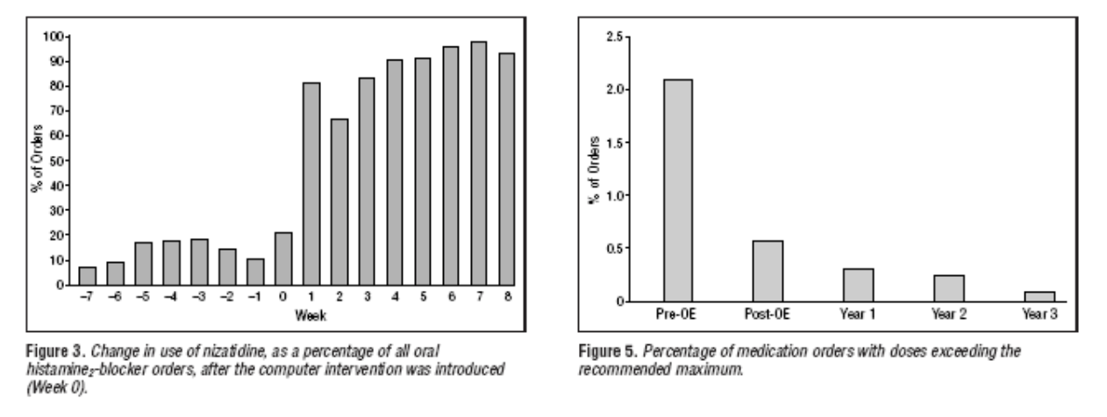
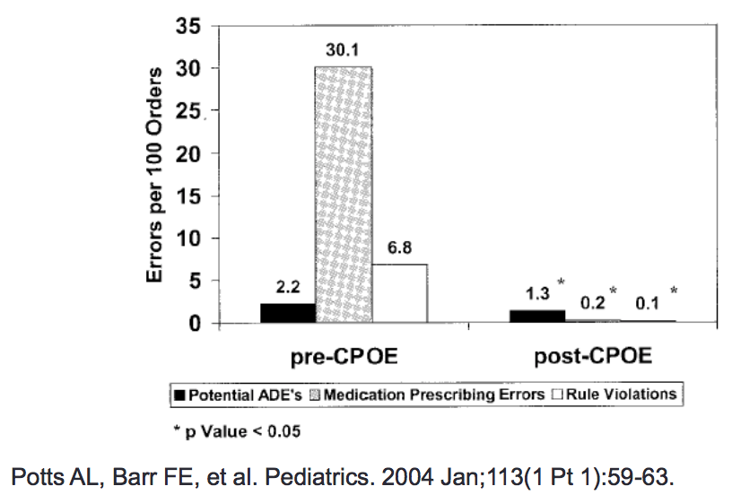
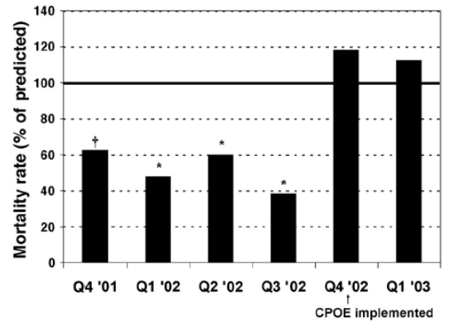
Examples
Examples of improved adherence to guidelines
Reduced to zero after implementation
Examples of Reduced Errors
studied ADE rates in 13,828 medication orders before/after CPOE implementation at Vanderbilt Children’s PICU.
This helped in reinforcing regulations & guidelines
Examples of Introducing Errors
Brigham and Women's Hospital, Boston introduced a CPOE:
 | Pre | Period1 | Period 2 | Period 3
Potential ADEs/1000 pt-days | 15.8 | 31.3 | 59.4 | 0.5
After implementation, the rate of intercepted Adverse Drug Events (ADE) doubled!
Reason: The system allowed to easily order much too large dosage of potassium chloride without clear indicating that it be given in divided doses. Bates et al The impact of computerized physician order entry on medication error prevention. JAMIA 1999, 6(4), 313-21.
Why ADE had decreased in period 3? Because of learning, training, customization, and modification to accommodate real time situations
Association with increased PICU mortality:
2.8% 14 months before CPOE
6.4% 5 months after CPOE

Slide 10
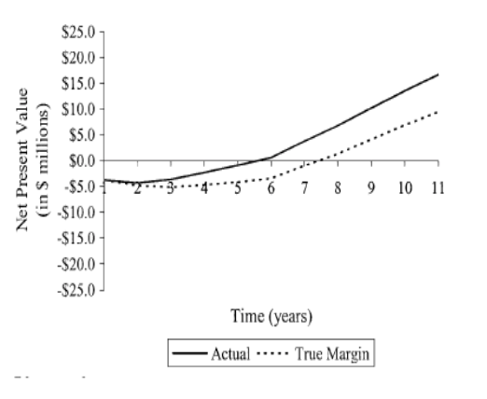
Examples
Examples of Reduced Costs
Brigham and Women’s Experience: Cost-Effective
$3.7 million implementation.
$ 600,000 to $1.1 million operational costs.
Results:
Decreased drug costs.
ADE cost is approximately $4,700.
The return on initial investment has been $5 to $10 million in annual savings.
Full implementation of computerized physician order entry and medication related quality outcomes: a study of 3364 hospitals in 2013 showed that only 8% of US hospitals have fully implemented CPOE systems.. While back in 2005 it was 4%
Challenges
The upfront cost of implementing CPOE is one major obstacle for hospitals. At Brigham and Women’s Hospital, the cost of developing and implementing CPOE was approximately $1.9 million, with $500,000 maintenance costs per year since.
Installation of even “off the shelf” ready made CPOE packages requires a significant amount of customization for each hospital and can be very expensive.
Integration with other systems, cost, time, technical.
Cultural obstacles to CPOE implementation. For example, some physicians resist utilizing computerized decision support tools, relying instead on practice experience. because they think it costs them more time, it is not flexible and the workflow is not smooth
CPOE lessons from other institutions
Leadership
Physicians need to lead the effort as the primary users.
However, CPOE is an interdisciplinary project that requires input and coordination with all clinical groups (nursing, PT/OT, Case Management, Pharmacy, Lab, Radiology, etc.) and I.T.
2. Commitment (needs management)
CPOE affects the workflow and process of all caregivers and ancillary departments.
Success requires commitment to change at all levels.
3. Support
Responsiveness and Flexibility are key especially at the first period
Must be ongoing, not just at rollout.

Slide 11
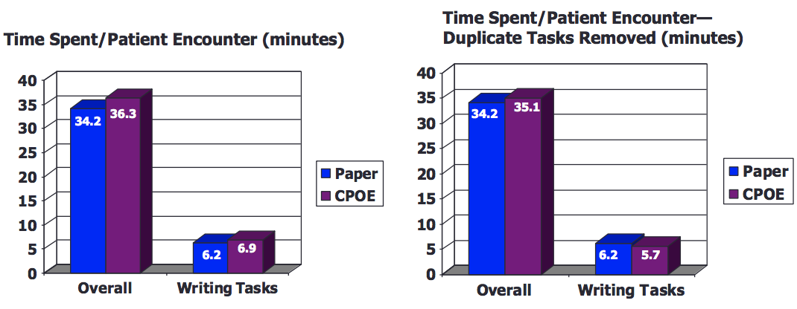
CPOE
The Need for CPOE
Improved patient safety | Improved quality | Improved efficiency | Reducing operating costs
Physicians are concerned that CPOE will take too much time.
Evidence shows that CPOE adds less than one minute to the time physicians spent writing orders and overall only added 1-2 minutes per patient encounter. As physicians gained experience with the system, the time for orders actually decreased.
The clinical benefits for improved patient care clearly outweigh the perceived concerns and limits
What is needed for success?
Clinicians :
End-users (clinicians) must be willing to champion the implementation of CPOE. not only to use it
Clinicians must be involved in design and implementation of the system. To the running of the system
Clinicians must be flexible and willing to change workflow processes.
2. Information Technology (I.T. Department) :
Ensure fast, reliable, and easily accessible system.
Provide ongoing support. at first period of implementation
Train, educate users
3. Institution :
Commitment to workflow changes. especially financial, budget, regulations

Slide 12
Summary
CPOE is a key component to improve Patient Safety and Quality of Care.
The focus needs to be on workflow and process of care changes that are necessary for optimal patient care, Not on implementing a new computer system. not only business
Commitment from clinicians (from all stakeholders) to help with process design and implementation is critical for success.
CPOE is a clinical based process development to improve patient care, not an I.T. project
Book summary
Computerized Physician Order Entry (CPOE)
CPOE has the potential to reduce medication errors through a variety of mechanisms.
It can be easily linked to drug-drug interaction warning, is more likely to identify the prescribing physician, is able to link to adverse drug event (ADE) reporting systems, can avoid medication errors like trailing zeroes, creates data that is available for analysis, can point out treatment and drugs of choice, can reduce under and over-prescribing, and allows prescriptions to reach the pharmacy quicker.
Reduce Medication Errors:
Inpatient CPOE:
CPOE can decrease serious inpatient medication errors by a relative risk reduction of 55%. However, this frequently cited article did not show reduction of potential adverse drug events (ADEs)
A more recent systematic review and meta-analysis suggested that transition from paper-based ordering to commercial CPOE systems in ICUs was associated with an 85% reduction in medication prescribing error rates, but that there was mixed evidence that CPOE reduced ICU mortality. The study concluded “there is also a critical need to understand the nature of errors arising post-CPOE and how the addition of advanced CDSSs can be used to provide even greater benefit to delivering safe and effective patient care.
Outpatient CPOE:
There is more of a chance for a medication error written for outpatients, because there are far more prescriptions written in the ambulatory setting than in acute care facilities.
Reduce Costs
Reduce Variation of Care
Patient safety
. Unfortunately, with implementation of most technologies new problems and issues arise that were not considered initially. EHRs are no exception to this observation and a variety of unintended (Adverse) consequences have been reported. Weiner coined the term e-iatrogenesis to mean “patient harm caused at least in part by the application of health information technology.” Several studies have shown increased errors after implementing CPOE.Campbell et al. outlined nine examples of unintended consequences related to CPOE implementation:
1. “More work for clinicians
2. Unfavorable workflow changes
3. Never ending demands for system changes
4. Conflicts between electronic and paper-based systems
5. Unfavorable changes in communication patterns and practices
6. Negative user emotions
7. Generation of new kinds of errors
8. Unexpected and unintended changes in institutional power structure
9. Overdependence on technology”
-Alert fatigue is another common unintended consequence related to CPOE
-In response to concerns AHRQ released the monograph Guide to Reducing Unintended Consequences of Electronic Health Records in 2011. This Guide discusses unanticipated and undesirable consequences of EHR implementation.

Slide 13
Questions
1- Which of the following falls under clinical aspect of informatics?
A. CME
B. CPOE
C. E-learning
2- Which of the following is advanced Computerized physician orders entry?
A. Dosing for renal insufficiency
B. Drug-drug interaction
C. Basic dosing guidance
D. Duplicate therapy checking
3- Which of the following is an example of basic type of CPOE?
A­. drug disease contraindications
B­. drug duplication check
C­. drug pregnancy contraindications
4- Which of the following is one of the main advantages of EHR?
A) Fast project implementation
B) Low implementation cost
C) One time training
D) Multiple users at a time
5- Which of the terms below is interchangeable with EMR?
A) Personal health record
B) Computerized physician order entry
C) Clinical decision support system
D) Computer-based patient record
6- An electronic prescription was entered in a wrong patient record. The prescribed patient was affected by the wrong prescribed medication. This is an example of what type of error?
A. Intercepted adverse drug event
B. Near miss / close call
C. Potentially Adverse drug event.
D. Preventable adverse drug effect
1)B
2)A
3)B
4)D
5)D
6)D

Slide 14
Good Luck!
DONE BY OUR AMAZING MEMBER:
Jude Alotaibi, Ahmad Alajlan, Omar Alotaibi
NOTE TAKEN BY OUR SHARP MEMBER:
Special thanks to Lama Alassiri who spaced out multiple times ;)
TEAM LEADER
JUDE ALOTAIBI
TEAM LEADER
KHALID ALKHANI

