Slide 1
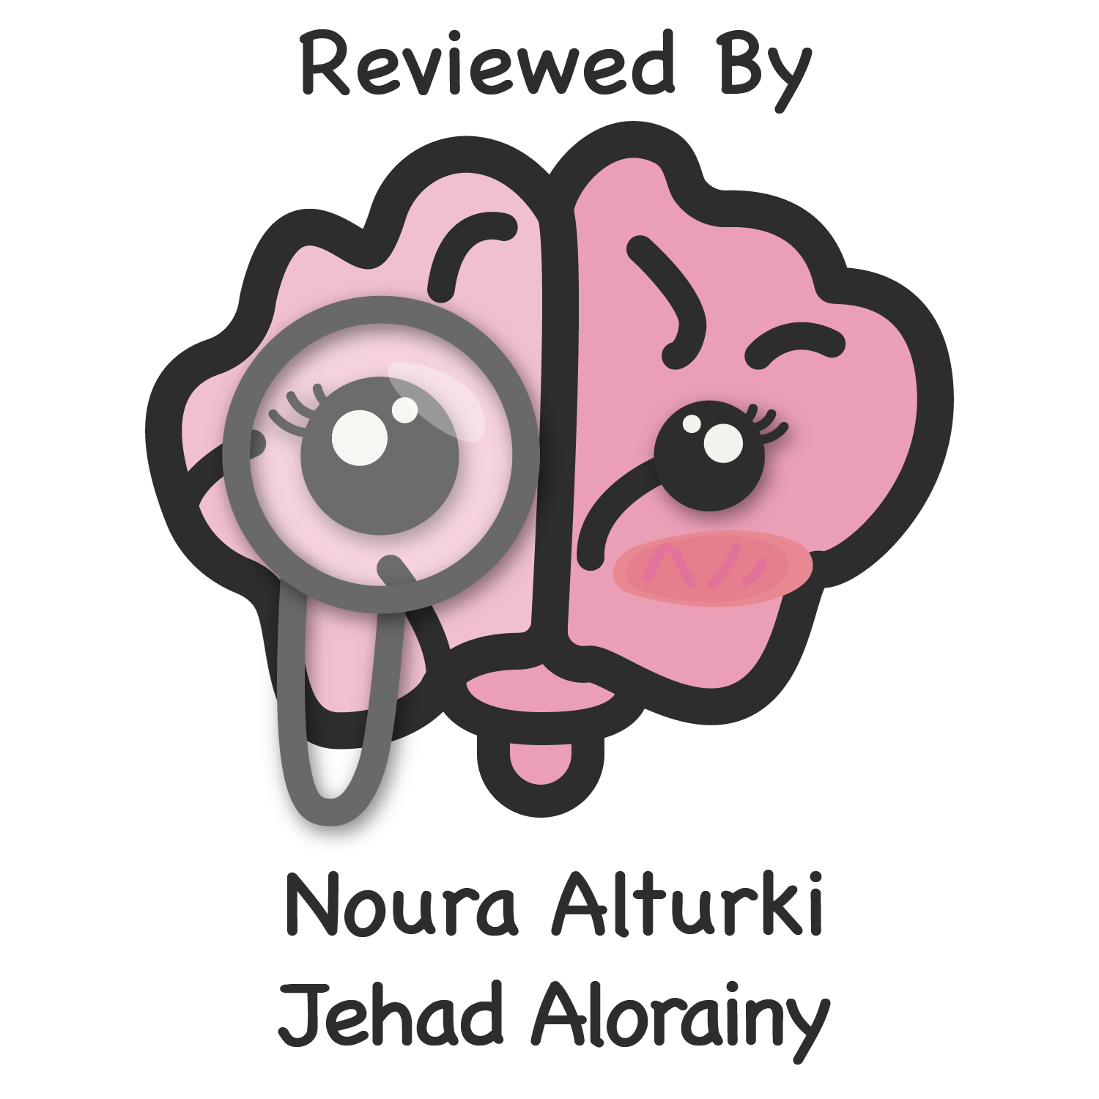
CLINICAL DECISION SUPPORT SYSTEM
Summary of the Book
Color index:
Important
Golden notes
Doctors notes
Editing File

Slide 2
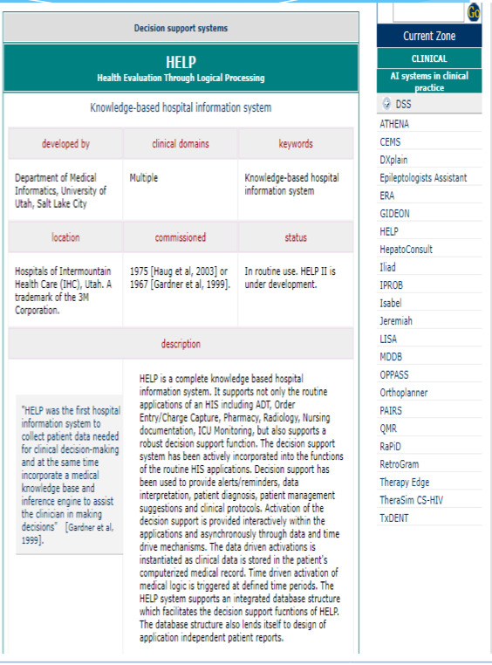
Intro to CDS & CDSS
Clinical decision support (CDS) provides clinicians, staff, patients or other individuals with knowledge and person-specific information, intelligently filtered or presented at appropriate times, to enhance health and health care.” (The Office of the National Coordinator for Health IT (ONC))
Clinical Decision Support System (CDSS)—Information technology systems that support electronic CDS.
Early on: CDS was thought of only in terms of reminders & alerts.
Now: CDS can include diagnostic help, cost data, calculators (drug-drug interactions), up-to-date, etc.
Vision: CDS data to be electronic, structured, and computable. Apply technology to it easily And help in moving data from system to another
Though,we can use the Internet's potent search engines to answer questions, many organizations promote CDS as a major strategy to improve patient care and safety.
The main goal: provide you the correct information at the right time.
Five Rights of CDS
For CDS to be effective
Right Time
Right Channel EHR, Email, message.
Right Intervention format Alert
Right People
Right Information high level of evidence
Historical prospective
As early as the 1950s scientists predicted computers would aid medical decision making.
CDS programs appeared in the 1970s and were standalone programs that eventually became inactive.
You can find all of the resources here.

Slide 3
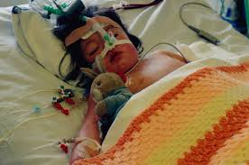
Examples of CDS tools
CDS Tool name | Approach used | Purpose
De Dombal’s system | Bayes theorem theoretical & statistical approach | Differential diagnoses for acute abdominal pain
Internist-1 | IF-THEN statements | Predict diagnoses
MYCIN | Rule-based system | Diagnosis and treatment of infections
SnapDx Positive (Apple iOS) | Positive and negative likelihood ratios from medical literature | Diagnosis (App covers about 50 common medical)
Isabel | Inference engine uses natural language processing and supported by 100,000 documents | Diagnosis tool
DxPlain | Based on clinical findings (signs,symptoms, laboratory data) the program generated a ranked list of diagnoses related to the clinical manifestations. | Justifies the diagnoses, suggests further steps and describes atypical manifestations
Isabel Story
Read it if you’re interested
Why the name Isabel?
Isabel is not an acronym but the name of the little girl whose illness inspired a medical tool diagnosed to help prevent misdiagnosis.
In 1999, 3 year old Isabel Maude nearly fetally misdiagnosed by her family doctor and hospital when her chickenpox developed, undetected, into Necrotizing fasciitis and Toxic Shock Syndrome. The result of this error was two months in hospital including a month in PICU struggling to survive from multiple organ failure and cardiac arrest. Against all odds, she survived her ordeal and, despite undergoing reconstructive surgery nearly two decades later, she is now an ambitious first class honors graduate pursuing a career in London. Surviving this life-threatening illness has given her a determination to live life to the full - conquering Mount kilimanjaro is just the beginning!
CDS Benefits & goals
Improvement in patient safety, patient care, & population health
Reduction in healthcare costs decrease duplicated cost.
Management of complex clinical issues
Monitoring clinical details
Management of administrative complexity Transfer patient, insurance billing.
Support clinical research clinical trial, Cohort.
Dissemination of expert knowledge

Slide 4
Supporting Organizations
Institute of Medicine (IOM) (now named as National Academy of Medicine (NAM)):
promoted “automated clinical information and CDS”
American Medical Informatics Association (AMIA): developed 3 pillars of CDS in 2006
Best available evidence.
High adoption and effective use.
Continuous improvement. Update according to user feedback
Office of the National Coordinator (ONC): has funded research to promote excellent CDS & sharing possibilities.
Agency for Healthcare Research and Quality (AHRQ) : also funded multiple CDS research projects & initiatives.
HL7: has a CDS working group and developed FHIR standards, discussed later
National Quality Forum (NQF):
developed a CDS taxonomy (triggers, input data, intervention, & action steps)
This helps evaluate CDS systems
Leapfrog:
promoted both CPOE and CDS
Developed educational and test tools
Healthcare Information Management System (HIMSS):
Their EMR Adoption Model rates EMRs from 1-7 (Adoption levels).
Full use of CDS qualifies as level 6

Slide 5
Types of CDS
1- Knowledge based CDS
Knowledge based CDS Two Phases
Knowledge Use
Knowledge Management: types
1-Trigger
2-Input data
Knowledge Acquisition (expert or data) guidelines & expert Drs
Knowledge Representation relevant to situation
4- Action
steps
Knowledge maintenance keeping data up to date
3- Intervention
2- Non-Knowledge based CDS
CDS Methodology
Data mining (machine learning) algorithms
The previous knowledge representation methods were based on known data so they would be labelled “knowledge based CDS”.
If CDS is based on data mining-related techniques it would be referred to as “non-knowledge based CDS”
Advantages of these approaches:
Analyze large amount of data
Discovering trends and patterns & discovering new information
Supervised learning | Unsupervised learning
Assumes that the user knows ahead of time what classes or categories exist. Regression (Size of tumor, age) Classification (Dead or alive) Logistic regression binary (cancer recurrence, no cancer recurrence) Decision Trees (could be in regression) Neural networks | Clustering Association rules (IF-THEN)

Slide 6
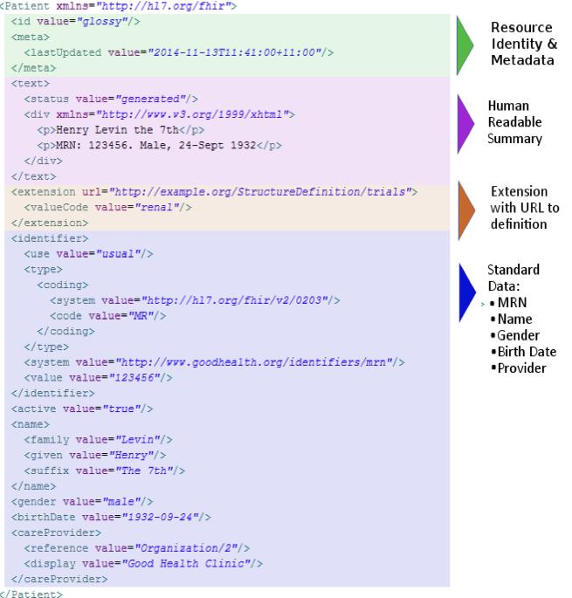
CDS Standards
CDS developers have struggled for a long time with how to share knowledge representation with others or how to modify rules locally.
It is important because it sets a standards that act as a common language for all systems to communicate
Standards were developed to try to overcome obstacles interoperability
Fast Healthcare Interoperability Resources (FHIR): Developed by HL7 there is great hope that this standard will solve many Interoperability issues
It is a restful API (like google uses) that uses either JSON or XML for data representation.
It is data and not document centric; so a clinician could place a http request on EHR A to retrieve just a lab value from EHR B.
Infobuttons: can be placed in workflow where decisions are made with recommendations
A button to redirect you yo up-to-date
Infobuttons
FHIR
CDS Sharing
Currently there is no single method for CDS knowledge can be universally shared. The approach has been to either use standards to share the knowledge or use CDS on a shared external server.
Socratic Grid and Open CDS are open source web services platforms that support CDS.
The FHIR standard appears to have the greatest chance for success, but it is still early in the CDS game to know.

Slide 7
CDS Functionality
CDSSs can be classified in multiple ways:
Knowledge
Relevance to EHR
Activation timing
Alert type
Knowledge based
non-Knowledge based
Internal to EHR
External to EHR up-to-date
1- during patient encounter
2- before
3- after
1- interruptive: physician cannot continue task ubtil alert is addressed
2- non-interruptive
Function | Example Taxonomy help in evaluation of CDS system
Patient safety | Medication alerts Critical lab alerts Ventilator support alerts Improved drug ordering for warfarin and glucose Infusion pump alerts Risk calculation Improved legibility Diagnostic aids
Cost | Reminders to use generic drugs or formulary recommendations Fewer duplications we don’t do more tests that we already do, so we reduce the cost Reminders about costs of drugs, lab tests, and imaging studies Reduce Medicare penalties for readmissions Reduce medication errors Reduce malpractice claims Better utilization of blood products
Patient Care | Embedded clinical practice guidelines, order sets, and clinical pathways Better chronic disease management Identify gaps in recommended care Immunization aids Diagnostic aids Sepsis alerts (see case study infobox) Antibiotic duration alerts Prognostic aids Patient reminders Pattern recognition for images, pulmonary function tests and EKGs, blood gases, pap smear interpretation
Disseminating Expert Knowledge | Use of infobuttons for clinician and patient education we provide the patient with resources to support him after leaving the clinic Provide evidence based medicine with embedded clinical practice guidelines and order sets
Managing complex clinical issues | Reminders for preventative care for chronic diseases Care management Predictive modeling based on demographics, costs, and clinical parameters
Managing complex administrative issues | Decision modeling Research recruitment

Slide 8
CDS Functionality
Ordering Facilitators
Order sets | Are EHR templated commercial or home grown orders that are modified to follow national practice guidelines . For example, a patient with a suspected heart attack has orders that automatically include aspirin, oxygen, EKG, etc.
Therapeutic support | include commercial products such as Theradoc and calculators for a variety of medical conditions.provide clinical surveillance like infection control assistantship to help in monitoring hospital acquired infections
Smart forms | Are templated forms, generally used for specific conditions such as diabetes. They can include simple check the boxes with evidence based recommendations.Template that provide structural questions to fill information but it will be report information because you just fill information according to the questionnaire
Alerts and reminders | Are the classic CDS output that usually reminds clinicians about drug allergies, drug to drug interactions and preventatives medicine reminders. This is discussed in more detail in the chapter on EHRs and the chapter on patient safety.
2. Relevant information display
Hyperlink, Infobuttons, mouse over
Common methods to connect to evidence based information
Shows up when it is relevant to case
Diagnostic support
Most diagnostic support is external and not integrated with the EHR; (e.g. Sim Consultant)
Isabel is an example automatically pull coded signs & symptoms
Dashboards
Can also be patient, and not population level, so they can summarize a patient’s status and thereby summarize and inform the clinician about multiple patient aspects

Slide 9
CDS Implementations
& lessons learned
Project initiation
CDS implementation
cannot be a mandate
SWOT analysis
Consider 5 rights
Provide educationally material
Project planning
One size does not fit all
Project Execution
User feedback is critical
Keep getting a feedback
Further improvements
Training for users and get a feedback through a training process
Project monitoring and control
Knowledge management & up to date content
CDS Challenges
General | Exploding medical information that is complicated and evolving. Tough to write rules we need methods more powerful to handle these large data beyond the rule system
Organizational support | CDS must be supported by leadership, IT and clinical staff. Currently, only large healthcare organizations can create robust CDSSs needs cooperation of all teams
Lack of a clear business case | Evidence shows CDS helps improve processes but it is unclear it affects behavior and patient outcomes. Therefore, there may not be a strong business case to invest in CDSSs we could use taxonomy here!
Unintended consequences | Alert fatigue The physician may ignore the alert either because it is wrong or appear in a wrong place or in a wrong way
medico-legal | Adhering to or defying alerts has legal implications confidentiality and privacy
Clinical | Must fit clinician workflow and fit the 5 rights We need to understand clinician workflow, for example: physician need a system to develop by a an IT. On the other hand, IT said the physicians don’t use it so we need more communication
Technical | Complex CDS requires an expert IT team
Lack of interoperability | Must be solved for CDS to succeed
Long term CDS benefits | Requires long term commitment and proof of benefit to be durable it is not just an implantation we need to follow up and evaluate for further improvement
Future Trends
If the FHIR standard makes interoperability easier we may see new CDS innovations and improved adoption enable liquidity of data

Slide 10
Quiz
Q1: “It provides the right information to the right person in the right format through the right channel at the right point in workflow to improve health care decisions and outcomes”
Which one of the following describes the above statement?
A)CDSS
B)PACS.C)ICD10.
D)RIS.
Q2: “Pop up alerts” is a feature of which of the following functional components of EHR?
A)integrated view of patient data.
B)CDSS.
C)Access to knowledge resources
D)communication and reporting tools.
Q3)Which of the following is a Drawback of CDSS?
A)flexibility
B)Legal implication
C)Faster use
D)changing relation between patient and the physician
Q4)Which one of the following is an example of CDSS?
A)MYCIN
B)PACS
C)HIPPA
D)CPOE
Q5)Why do we need expert system in CDSS?
A­)Preservation of knowledge
B­)Sharing of knowledge between clinician
C­)Aid in decision making
D)Collection of data.
Q6)Which of the following is a example of unsupervised learning?
A)Assumes that the user knows ahead of time what classes or categories exist.
B)Regression
C)Clustering
D)Classification
1:A 2:B. 3:B 4:A. 5:C. 6:C.

Slide 11
Good Luck!
DONE BY OUR AMAZING MEMBER:
Safana Alomar
NOTE TAKEN BY OUR SHARP MEMBER:
Khalid (sadly nothing rhymes with his name..)
TEAM LEADER
JUDE ALOTAIBI
TEAM LEADER
KHALID ALKHANI

