Slide 1
PATIENT SAFETY & REDUCING MEDICAL ERRORS
Summary of the Book
Color index:
Important
Golden notes
Doctors notes
Editing File

Slide 2
Medical Informatics
Medical informatics is a rapidly developing scientific field that deals with the storage, retrieval, and optimal use of biomedical information, data, and knowledge for problem solving and decision making." Blois, M.S., and E.H. Shortliffe. in Medical Informatics: Computer Applications in Health Care, 1990, p. 20.
Medical informatics is the application of computers, communications and information technology and systems to all fields of medicine - medical care, medical education and medical research.“ definition by MF Collen (MEDINFO '80, Tokyo, later extended).
This is a new definition, it is focusing more in computer application and communication. at the same time it defines the areas as medical services,education and research.
Safety in Healthcare
IOM,2000 | Freedom from accidental injury due to medical care, or medical errors.
Vincent,2011 | The avoidance, prevention and amelioration of adverse outcomes or injuries stemming from the process of healthcare.
WHO | Patient Safety defined as; The prevention of errors and adverse effects to patients associated with health care.
🌟 Errors vs. adverse effect 🌟
Errors: Prescribing Nonsteroidal anti- inflammatory drugs – NSAID without considering patient condition (age) which require co-prescription of proton pump inhibitors – PPIs.
A 67 year old patient is prescribed Nonsteroidal anti-inflammatory drugs – NSAID for osteoarthritis pain, and is admitted 4 weeks later with GI hemorrhage.
This is an adverse event, even though the prescribing decision was not erroneous. Recording it as a patient safety issue is honest, as the patient was harmed by medical care.
Being less tolerant of threats to patient safety such as this may lead to more recommendations to take precautionary action (such as guidance regarding co-prescription of proton pump inhibitors - PPIs for all older people given an NSAID).
Adverse Effects: GI hemorrhage.
Error: he is old and almost 70 and can not tolerate NSAIDS
Adverse effect: the result of an error
So not every error result in an adverse effect BUT sure we try to avoid errors as much as we can.

Slide 3
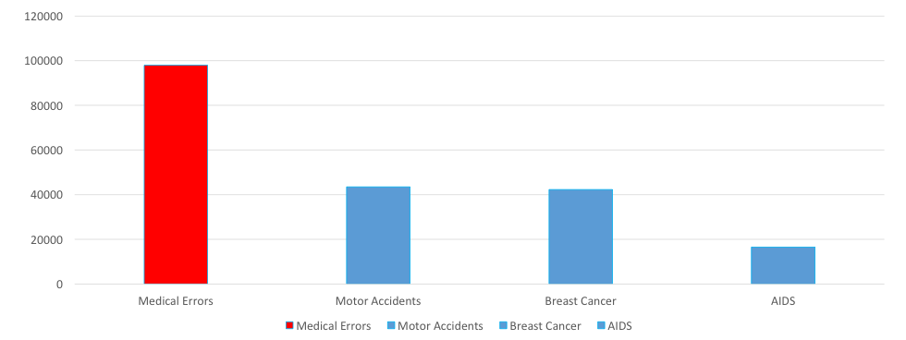
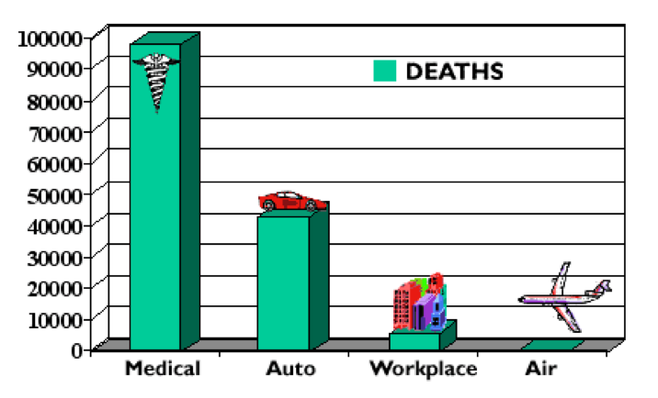
The Magnitude
98,000/365 = 268.49
Equal to one plane crashes every day! In 1998
Death Rate (US)
1 or 2 years later
Annual Accidental Deaths
Status quo
One in 5 patients discharged from hospitals end up sicker within 30 days and half are medication related
One of 10 inpatients suffers as a result of a mistake with medications cause significant injury or death
Over 7,000 deaths annually
Resulted by medication errors alone, occurring either in or out of the hospital.
Between $17B and $29B
Cost of errors estimated Per year
A study of two UK hospitals found that 11% of admitted patients experienced adverse events of which 48% of these events were most likely preventable if the right knowledge was applied. highlighting the underutilization of the available information and knowledge during healthcare delivery.
The under-utilization of healthcare data- Information- knowledge contributes to:
improper clinical decisions,
medical errors,
underutilization of resources
raise in healthcare delivery costs.
We are suppose to improve patient safety through proper clinical decision and proper utilization of information

Slide 4
Aircraft & ICU¹
Modern healthcare is the most complex human activity there is, due to interpersonal relationships between many different clinicians with different expertise and interests, and we haven’t figured out how to make that work well.
We have come to a full stop against a complex environment that resists accepting change on the scale clearly required.²
Lucian Leape, MD
Founder of the Modern Patient Safety Movement
Adjunct professor of health policy at Harvard University
"Error in Medicine," published in JAMA, 1994
ICU staff
Vasopressor agents
Beta blocking agents
Hypothermia
Vasodilators
Low tidal volume
Sedation
Diuretics
Analgesia
Fluid change
PEEP
Fever control
Feeding
Antibiotics
Dobutamine
Blood transfusions
Hemofiltration
Airline pilot
Altitude
Parameters
Speed
Route
This is a comparison between ICU staff and Pilots to show the complexity of healthcare, the ICU staff have many parameters that require control in comparison to Airplane pilot
Safety issues
Medication errors.³
Failure to rescue.
Readmissions.⁴
Falls.
Pressure ulcer.⁵
Sentinel events.
Hospital acquired infections.
Under reported incidents.
1- We have to move forward to change our way in runing healthcare system and try to workout the resistance we are facing.
2- All parameters and functions are well defined in aircraft while more complicated situations in ICU.
3- one of the most common
4- 1 out of 5 patient require readmissions in the next 30 days.
5- bad outcome for hospitalized patients

Slide 5
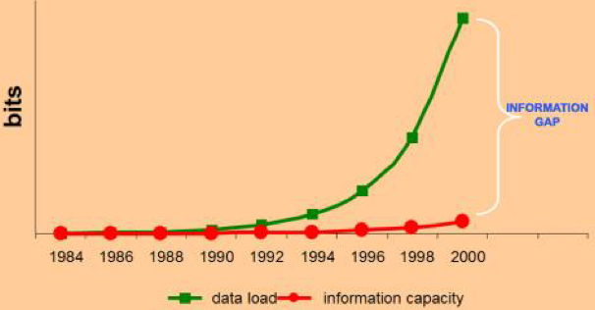
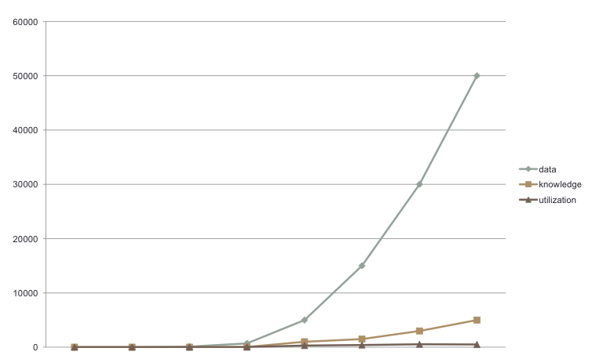
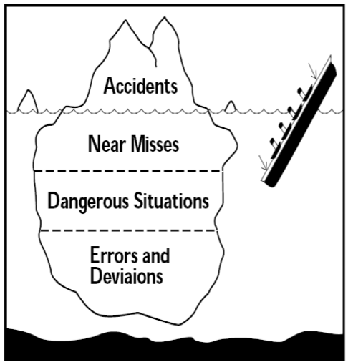
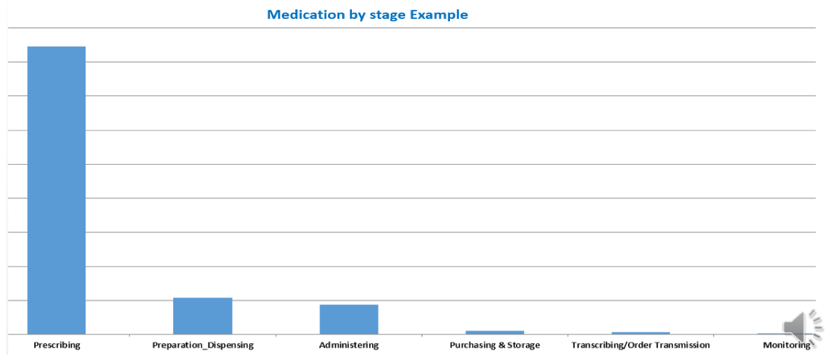
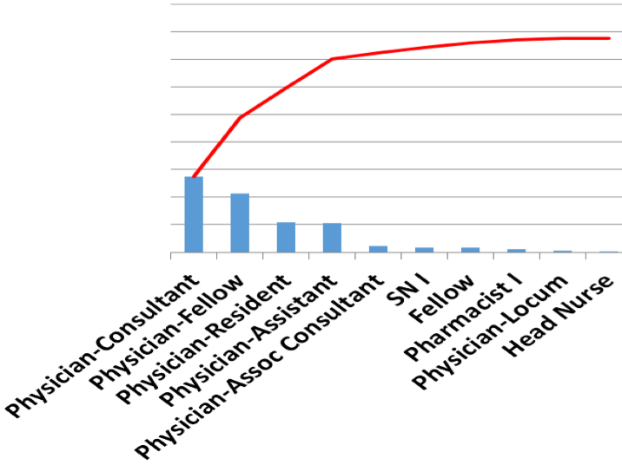
Flood of information
Huge gap in data acquisition and information → knowledge capacity
Explained before in Research Focus lecture
Data – knowledge - utilization
Many issues and complex situations underneath that need to be tackled and under spot.
We are not fully utilize and interprets the data we receive, medical informatics help us in that
I.e Medication Process
01
Prescribing (Prescribing is the most common phase to face medication errors)
02
Dispensing
03
Administration
04
Monitoring
Medication errors (MEs) are common and considered one of the highest risk factors that threaten patients in hospitals. The majority of these errors are considered common during prescribing medication stage (Shulman et al, 2005).
Where did it happened
Who did it ?
Prof. Lucian Leape MD
Incompetent people are, at most, 1% of the problem.
The other 99% are good people (more competent and have more knowledge) trying to do a good job who make very simple mistakes
It's the processes that set them up to make these mistakes.so it maybe the systems making these silly mistakes.

Slide 6
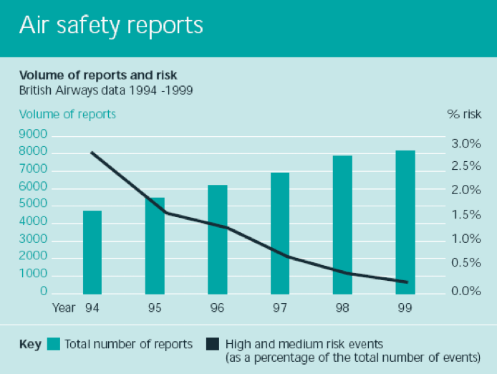
Error types
1
Prevention
Failure to provide prophylactic
2
Diagnostic
Delay in diagnosis
3
Treatment
Wrong medication administration
4
Others
Failure of communication
This graph shows you the experience of british by how they able to improve patient safety.
They have implement and conduct a strategy that they are asking everyone to report mistakes.
Reporting mistakes is one of the tool to improve patient safety.
🌟 Contributing Factors 🌟
Lack of communication.¹
Inadequate staffing.
IPP/standards not followed.
Insecure access of patient information.
Lack of knowledge.
Failure to follow up.
Lack of coordination.²
Lack of proper check.
Improper assessment/ reassessment.
no / inadequate resources or supplies
Look alike medications.³
Illegible handwriting.⁴
Informatics Benefits
Tracking System
Effective communication
Prompt alerts and notifications
Decision support system
Manage data and store information
Secured access and defined privileges
Protocol guided and standardized practices
Accessible documentations
Legible orders, requests, and reports
Integrated care delivery
Support lean processes toward more efficient workflows
Facilitate productivity measurements and monitoring
Reduce medication errors
Shortened length of patients’ hospitalisation due to effective enhancement of antimicrobial management
Reinforce clinicians compliance on evidence-based practices.
1- main aspect leading to many medical errors.
2- between teams and different department of healthcare services.
3- CPOE helps in differentiating look alike drugs.
4- COPE prevent this factor.

Slide 7
CPOE
CPOE benefits
CPOE impacts
>50% of none- intercepted serious MEs rate decreased significantly (Bates et al, 1998).
81% reduction of medication errors (Bates et al, 1999) .
Decreased patients LOS (Rothschild, 2004).
Improves medication reconciliation process (Vira et al, 2006).
Improves the prescribers’ compliance to standards and guidelines (Cunningham et al, 2008).
Decrease mortality rate by 20% per month (Longhurst et al, 2010).
Improves patients satisfaction (Splading et al, 2011). Many studies support the implementation of CPOE
Facilitates 22 new types of medication errors (Koppel et al, 2005).
Lack of information systems compatibility, configuration and usability with end users (Colpaert and decruyenaere, 2009: Rothschild, 2004).
A significant increase of mortality rates post CPOE ( Han et al,2005) .
Barriers to tech implementations
Cost (36%) sustain income to healthcare is not that easy.
Difficulties in proving quantifiable benefits and ROI (32%).
Vendors inability to provide satisfactory products or services (27%).
Lack of standardization with integration and interfaces (HL7,NAHIT.)
Level of system evolution needed to meet growing demand on technology advancements.
People resistance.

Slide 8
You can’t manage what you can’t measure!
Informatics help us much to quantify,measure and evaluate the process and efficacy and whatever we we are doing in healthcare.
What medical informatics tools can?
Improve communication
Make knowledge more readily accessible and utilized
Assist with calculations
Perform checks in real time and alerts
Assist with monitoring
Provide decision support
Require key pieces of information (dose, e.g)
The Accenture Study
The Accenture survey asked physicians about the extent to which they used 12 different “functions” of EMR and HIS— such as electronic entry of patient notes, electronic referrals, electronic ordering and prescribing and communicating with other physicians or patients via secure email.
The results showed that physicians who are routine users of a wider range of healthcare IT functions have a more positive attitude towards the these technologies. On average across all the countries, as physicians start to use more “functions” —the more positive they are about the benefits.
Majority of doctors surveyed believe that healthcare IT does provide some common top benefits, including:
better access, quality data for clinical research (70.9%)
improved coordination of care (69.1 %)
Reduction in medical errors 66%
Average score of 61%
In England, physicians perceived other healthcare IT benefits to include: increased speed of access to health services to patients (55.3 %), reduced number of unnecessary interventions and procedures (52 %).

Slide 9
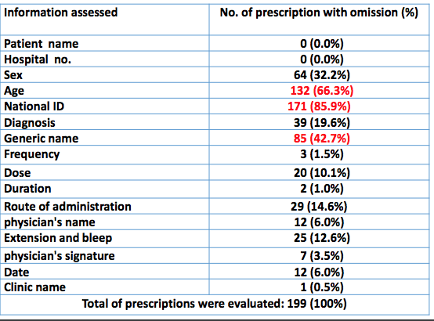
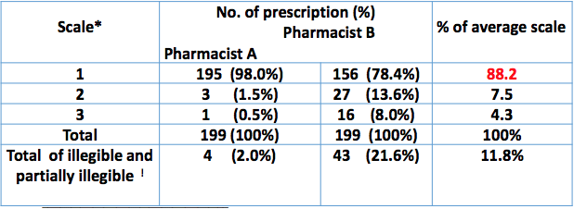
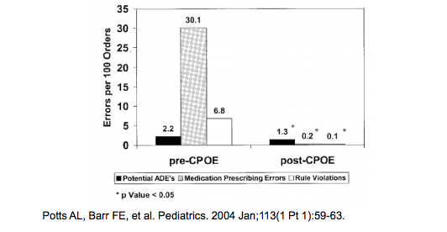
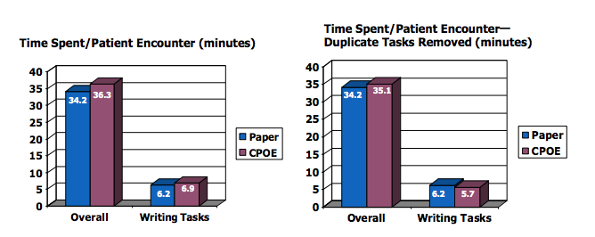
Assessment of Handwritten Prescriptions completeness In KKUH
Assessment of Handwritten Prescriptions Legibility
*1= Legible, 2= legible with effort, 3= illegible
^ pharmacist 1= expert
~ pharmacist 2= new
! scale of 2 and 3
Example CPOE reduce error:
Potts studied ADE rates in 13,828 medication orders before/after CPOE implementation at Vanderbilt Children’s PICU:
Does CPOE Take More Time?
Evidence shows that CPOE adds less than one minute to the time physicians spent writing orders and overall only added 1-2 minutes per patient encounter. As physicians gained experience with the system, the time for orders actually decreased.

Slide 10
Healthcare
The healthcare industry is different from, other industries. We are talking about healing and dealing with human, NOT a process based, and can’t just apply systems and global optimization techniques in the traditional, industrial engineering sense to the healthcare industry Health is something that is very difficult to measure nor to quantify “Modern healthcare is the most complex human activity there is, due to interpersonal relationships between many different clinicians with different expertise and interests, and we haven’t figured out how to make that work well. We have come to a full stop against a complex environment that resists accepting change on the scale clearly required” “The science and technologies involved in healthcare - the knowledge, skills, care interventions, devices and drugs – have advanced more rapidly than our ability to deliver them safely, effectively, and efficiently” they are continuous in improvement.
Informatics limitations
Limited funds.
Resistance to change.
Under developed IT infrastructure
Inadequate hardware logistics
Limited studies on the benefits of informatics on patient safety.
Lack of visionary leaders.
Could lead to a complete miss!
Facilitate errors due to inappropriate / poor designing of systems customisations and automations of processes.
Technology Adds New Concerns
Poor designed systems due to lack of proper planning and early involvement of clinicians.
Inflexible processes.
Changes in workflows.
Ease of use and interface with the various technologies.
Power outage + no backups.
Risk adjustment.
Overload data and system slowness.

Slide 11
Dr. watson’s IBS supercomputer
The computer can analyze about 200 million pages of data in less than three seconds, which could allow physician to more accurately diagnose and treat complex cases. Physicians could, for example, use Watson to consult medical records and the latest research findings for recommendations on treatment.
FDA Approved?
Just a culture principle
Values and expectations-what is important to the organization
System design and continual redesign of system and address processes and systems so it does not happen to someone else
Coaching and open environment better communication coaching with teams or organization trying to help others to overcome struggling
Peer to peer coaching where helping one another to stay safe and make sure things are being done correctly
Just culture algorithms can help
Patient safety needs to be viewed as a strategic priority
The entire hospital needs to be focused on patient safety if a culture of safety is to be established
Examples
Having a patient safety plan very important to have a plan - Doing an annual report card, use trigger tools summaries issues - Have a patient safety committee - Many also have separate medication management committee from safety
committee (more attention) - Education for staff to make sure they know near misses must be included
in definition of medical error what policy or purposes should follow - Doing patient safety walkabout rounds by senior leaders
look at readiness and preparedness for department in respect to safety in hospitals
Key success of a culture
Acknowledgment of the high-risk nature of an hospital’s activities and the determination to achieve consistently safe operations
A blame-free environment where individuals are able to report errors or near misses without fear of reprimand or punishment
Encouragement of collaboration across ranks and disciplines to seek solutions to patient safety problems
Organizational commitment and resources to address safety concerns should be number one priority

Slide 12
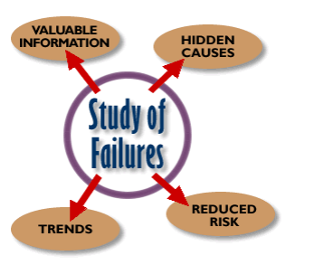
Event ‘management’
Prevent failure but if you can’t
Make failure visible and
Prevent adverse effects of failure or
Mitigate the adverse effects
Learn from all events most important
Errors provide useful information
We can learn more from our failures than from success
Our processes can be improved when studied
“Give me a fruitful error anytime, full of seeds, bursting
with its own corrections. You can keep your sterile truth
to yourself.” Vilfred Pareto.
Be able to understand trends and hidden causes and analyze valuable information available and then reduce errors in future.
Which Patients Are Most at Risk of Medication Error ?
patients on multiple medications
patients with another condition, e.g. renal impairment, pregnancy
patients who cannot communicate well
patients who have more than one doctor
patients who do not take an active role in their own medication use
children and babies (dose calculations required)

Slide 13
Systems process changes structure,environment and people
Simplification
Standardization should be everywhere is the same ex: same color code ue everywhere
Process design includes prompts
Elimination of sound/look-alikes eliminate confusion
Environment/product improvements
Training is the key success
Teamwork
Communication
Select resources for patient safety information:
Agency for Healthcare Research and Quality www.ahrq.gov
Institute of Medicine of the National Academies www.iom.edu
The Joint Commission www.jointcommission.org
Institute for Safe Medication Practices www.ismp.org
National Patient Safety Foundation http://npsf.org/
JCAHO “Speak Up” program http://www.jcaho.org/general+public/patient+safety/speak+up/index.htm
Take Home Messages
Safety is everyone's job!
Learn from previous errors
Report incidents to learn not to blame.
Errors are not only human related but the majority are system failure!
Technology has been designed by human factors!!

Slide 14
Questions
1- Which of the following is an example of preventable adverse event?
A-blurry CT scan
B-Cancellation of an appointment
C-Food allergy
D-Prescribing wrong dosage.
2- If a pregnant lady is prescribed a pregnancy-contraindicated medication but she did not have complications, which type of error did the physician make?
A-intercepted adverse event
B-Near miss event
C-Potentially adverse event
D-preventable adverse event
3- Which of the following patients at risk of medication error?
A. patients who have one doctor
B-patients who can communicate well
C-patients on multiple medications
D-patients who take an active role in their own medications use.
4-which of the following considered as Contributing factors.?
A-Failure to follow up
B-Standardization
C-Change in workflows
D-Tracking system
1-D. 2-C. 3-C. 4-A

Slide 15
Good Luck!
DONE BY OUR AMAZING MEMBER:
Reema Almasoud
NOTE TAKER BY OUR SHARP MEMBER:
TEAM LEADER
JUDE ALOTAIBI
TEAM LEADER
KHALID ALKHANI

